Slide 1
“Nature is a triumph of
kinetics over
equilibrium.”
-A.E.J. Engel
1916-1995
Scripps Institution of
Oceanography
Also, “We stand in the
foothills of the mountains
of ignorance.”

Slide 2
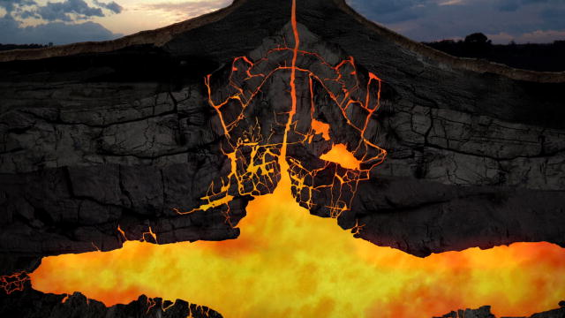
Artist’s conception of a magma chamber
Part of the gauntlet that must be run by any magma
ascending toward eruption.
Primitive magmas are not mainlined from upper-mantle
melt sources. They aggregate, crystallize, react with
surrounding rocks, and mix with shallow differentiates.

Slide 3
The message last time
1)Olivine-liquid geothermometry requires a closed-system,
olivine-only, fractionation pathway.
2)Occurrence of any other mineral on the liquidus of any fraction of
contributing melts (e.g., plag; cpx) violates this assumption.
3) “Closed-system” also means no mixing even between liquids
crystallizing olivine only.
4) Reaction between ascending melts and surrounding rock, whether
in the mantle or crust is precluded.
These conditions never occur in nature.
The gauntlet always has to be run.
Experimental petrology does not mimic nature.

Slide 4
The Al-in-olivine geothermometer
Is there a way
out of the box?
Short
Answer:
No
This is actually an olivine-spinel Al partitioning
geothermometer and depends on EQUILIBRIUM
between the two minerals.

Slide 5
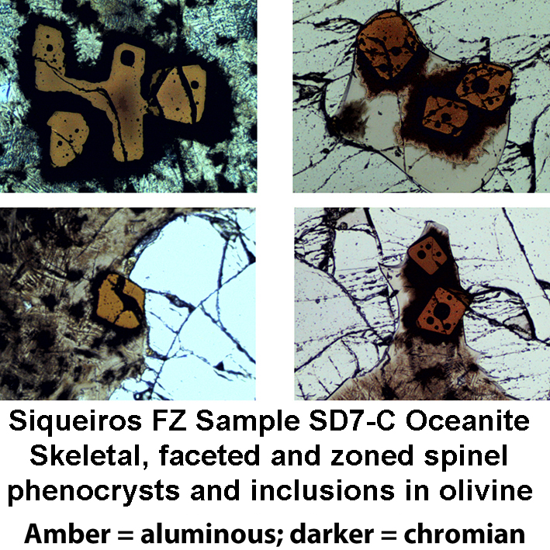
What does
spinel look like?
Spinel is
often skeletal
and occurs
in glass within
embayments
in olivine
phenocrysts.
It is often zoned.

Slide 6
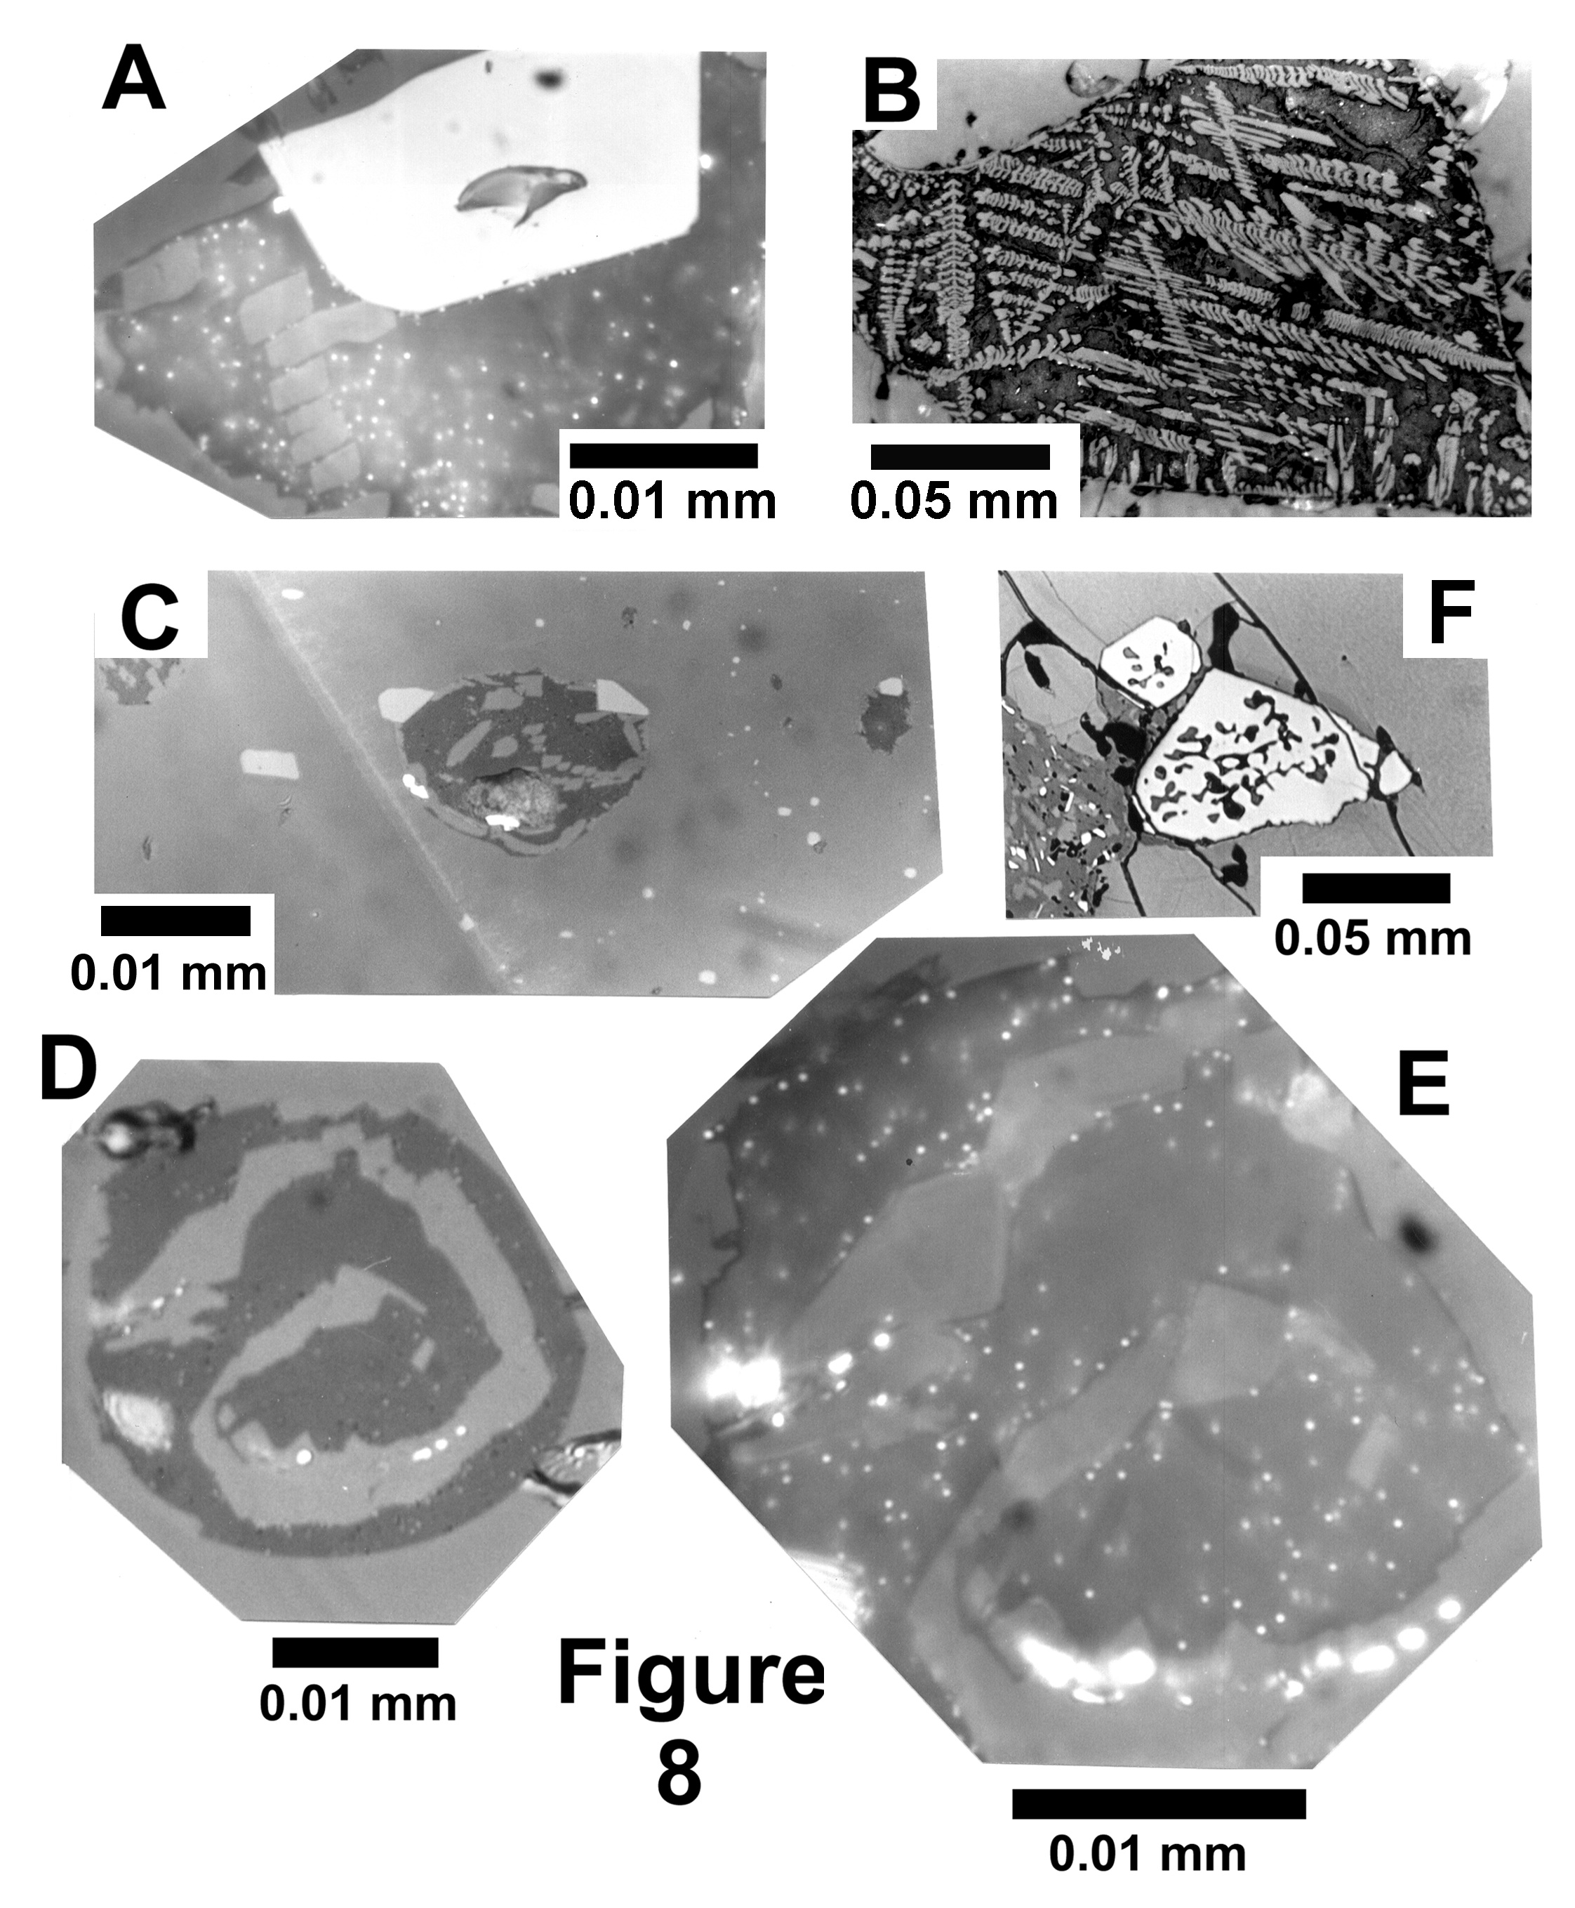
Natland
(2003)
reflected-
light
microscopy
The little
bright dots
are sulfides.
Skeletal spinel, glass, cpx dendrites,
sulfides and bubbles
in Juan Fernandez picrites

Slide 7
Natland
(2003)
Really tiny Cr-spinel in Juan Fernandez picrites
concentrated near annealed fractures;
Note: much olivine contains EXCESS Cr-spinel.

Slide 8
Boundary-layer sulfides adjacent to olivine
crystals in Siqueiros picrite sample SD7-C.
Oil-immersion reflected light (Natland, 2003).

Slide 9
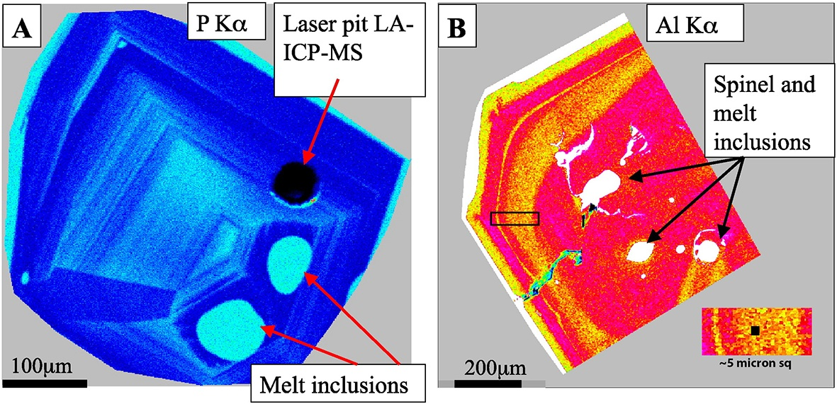
Electron probes these days have better vacuums, more stable
beam currents and higher sensitivity than when I was a boy. And
you can do more things with them, like make good elemental maps.
Oh, well!
Phosphorus and aluminum oscillatory zoning
in olivine phenocrysts (Welsch et al., 2014).
No one even thought about P in olivine until P-rich olivine
was discovered in meteorites.

Slide 10
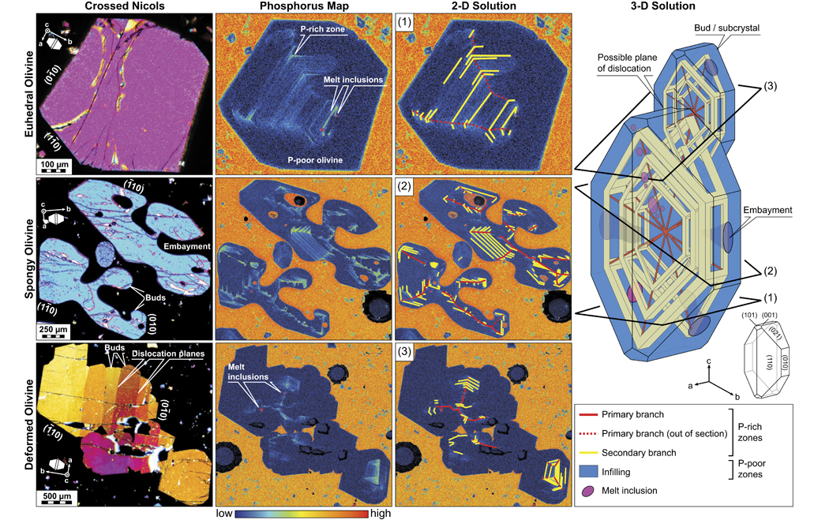
Three-dimensional derivation of dendritic
crystal growth of olivine phenocrysts based
on phosphorus zoning (Welsch et al., 2014).
Note: “spongy” = skeletal. Skeletal and
dendritic morphology imply undercooling.

Slide 11
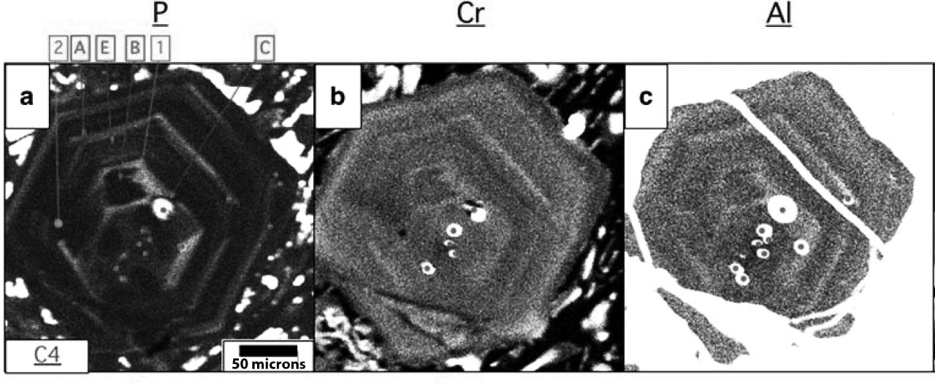
Millman-Barris et al (2008) Figure 4
Zoned olivine in Mauna Kea tholeiite
X-ray maps
Enriched zones for P, Cr and Al coincide.

Slide 12
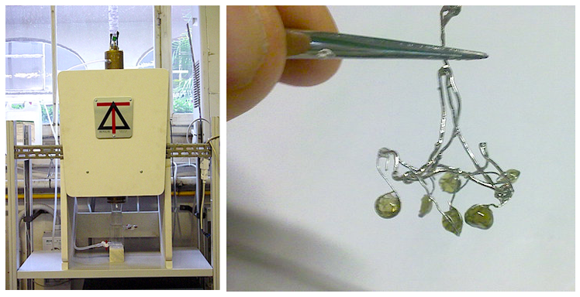
Platinum-loop experimental apparatus
Wan et al (2008) sintered a homogeneous powder
onto ends of loops, made glass, powdered the
glass, and then re-sintered the powdered glass
onto loops for their experiments, in order to
insure homogeneity and equilibrium.

Slide 13
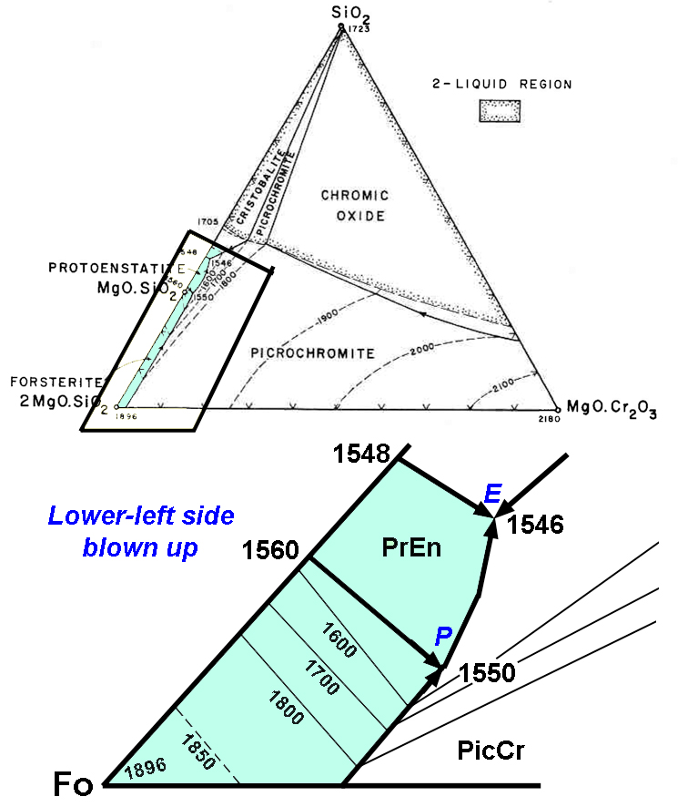
Wan et al (2008) added
aluminous spinel, olivine
and chromite to their
experimental charges.
What happens when you
SPIKE an experimental
charge with olivine
AND spinel?
Everything shifts to
higher temperature.
Just look at a phase
diagram.
Irvine (1965)

Slide 16
Matthews et al (2016) Iceland: 4-samples
plus Gorgona (gray).
Only four Iceland spinel (Borgarghraun) may
have crystallized at elevated temperature.

Slide 17
Two Baffin-West Greenland samples MAY have
spinel that crystallized at elevated temperature
(alternatively, more oxidized?)
Intraoceanic LIPs (Shatsky and OJP) have none.

