Slide 1
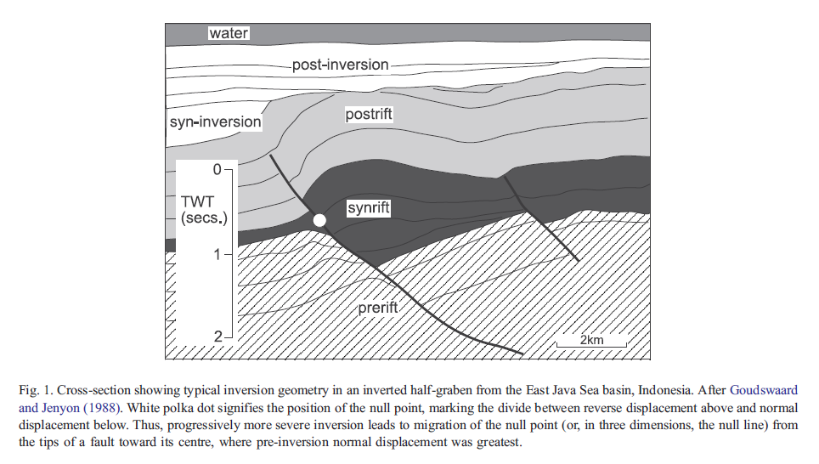
Basin inversion
Turner and Williams, 2004, Earth Science Reviews

Slide 2
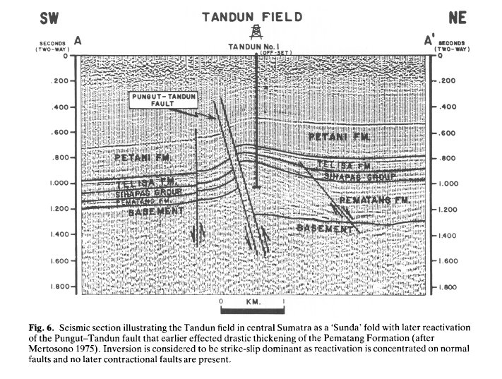
“Sunda fold” (Lowell, 1995)

Slide 3
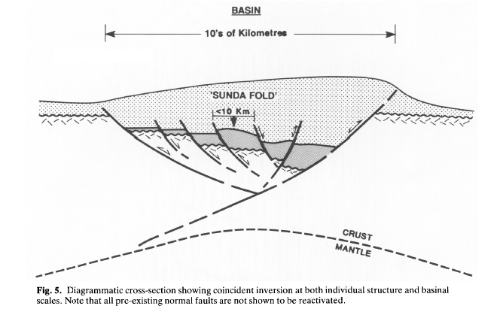
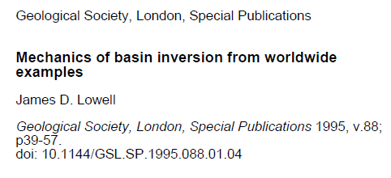
Basin inversion can be defined as “a basin controlled by a fault system that has been subsequently compressed-trans-pressed producing uplift and partial extrusion of the basin fill” (Cooper et al., 1989). Original normal faults are often, but not always, reactivated as reverse faults.
Basin inversion occurs at a crustal-lithosphere scale.

Slide 4
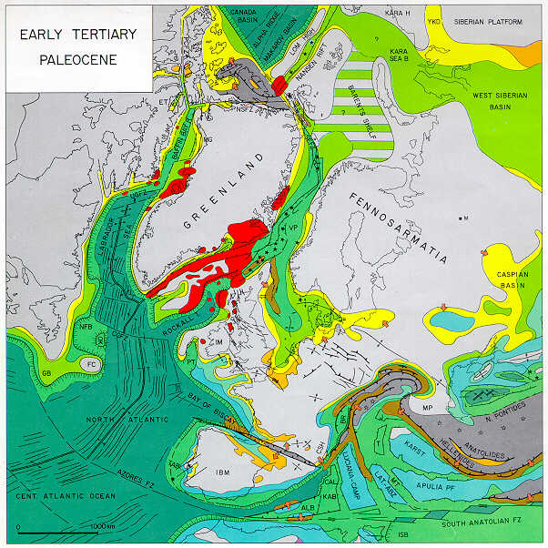
Eurekan
“Orogen”
Dniepr-Donets
Basin
Late Cretaceous-Palaeocene:
intraplate inversion
structures
from Peter Ziegler’s atlas (1990)

Slide 5
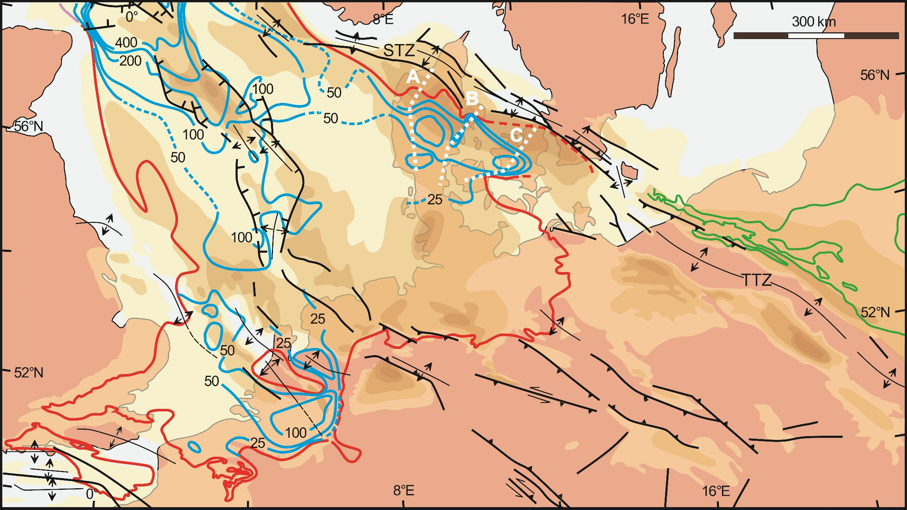
Inversion structures on the European continent; thickness of Late Cretaceous-Danian depocentres (yellow to brown colours increasing to >1500 m respectively), Middle-Late Palaeocene depocentres (blue contours; red line is depositional limit), Polish Basin Palaeocene depocentre (green lines).

Slide 6
Precise chrono-stratigraphic data show that the style of intraplate inversion in central Europe (Danish Basin) has an interesting complication (Nielsen, Stephenson & Thomson, 2008, Nature).

Slide 7
Eurekan
“Orogen”
Dniepr-Donets
Basin
Late Cretaceous-Palaeocene:
intraplate inversion
structures
from Peter Ziegler’s atlas (1990)

Slide 8
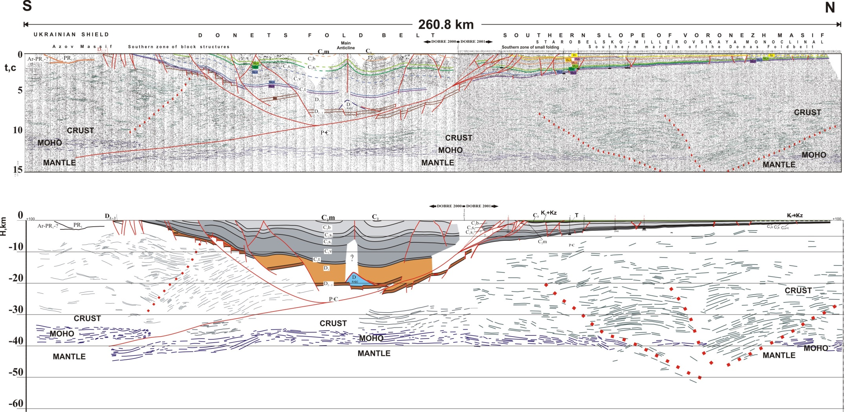
The DOBRE seismic image:
a crustal scale “pop-up” structure accommodates (~12 km) shortening
there is no significant inversion (compressional shortening) older than the Late Cretaceous
salt is in the core of the Main Anticline

Slide 9
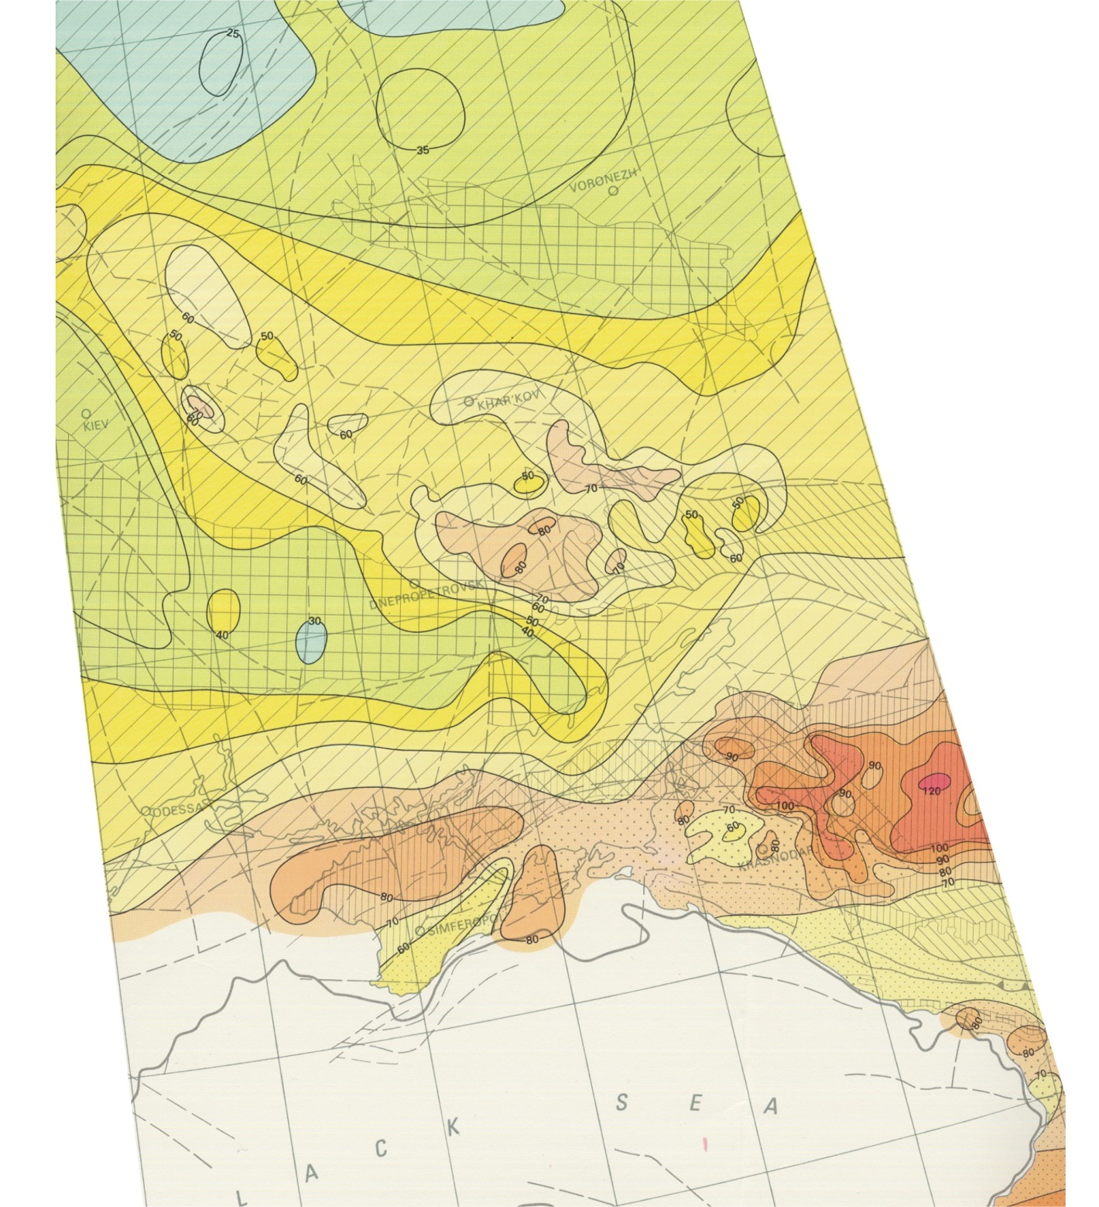
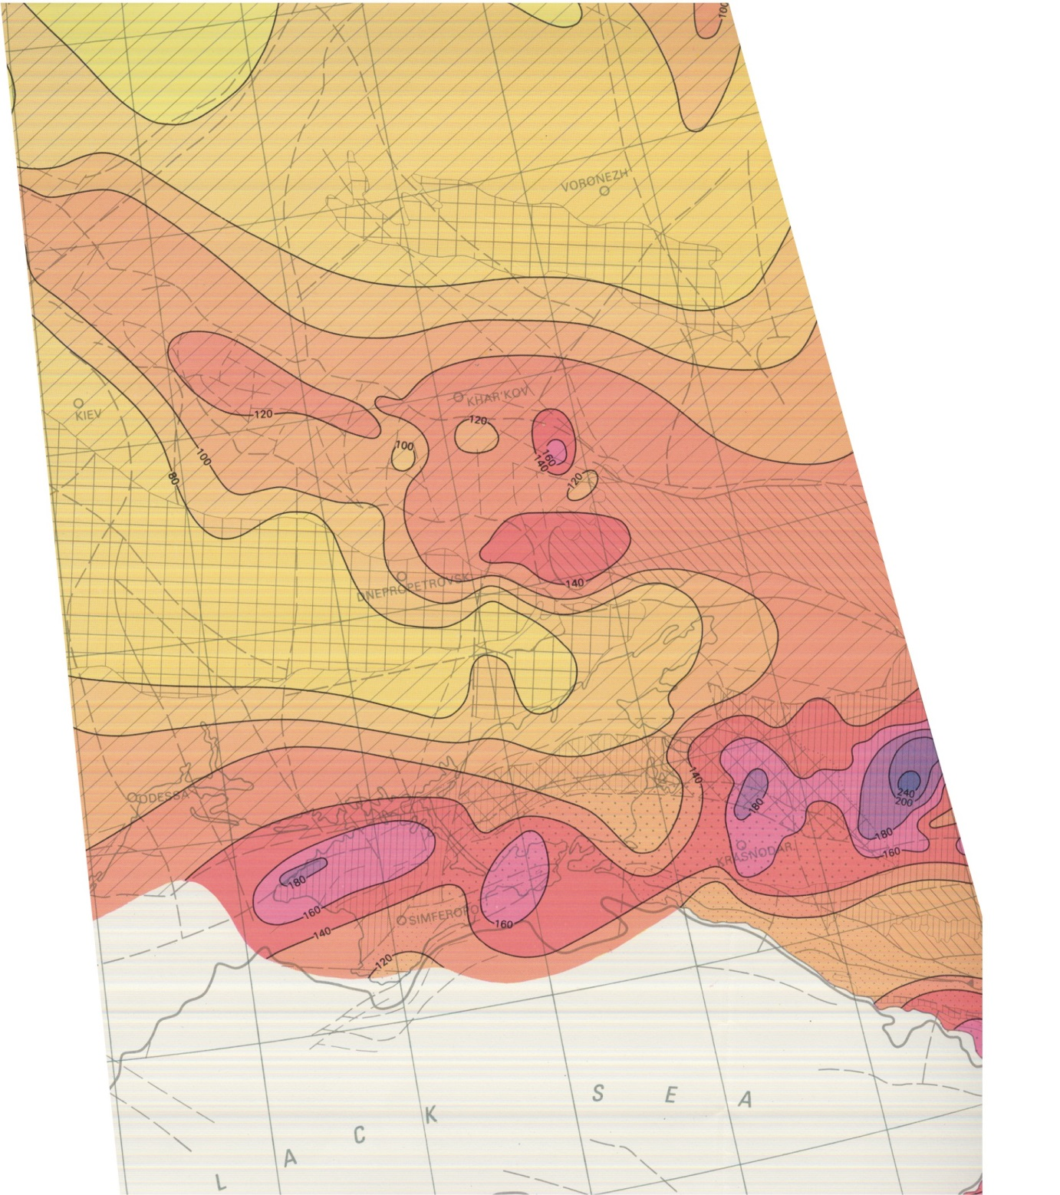
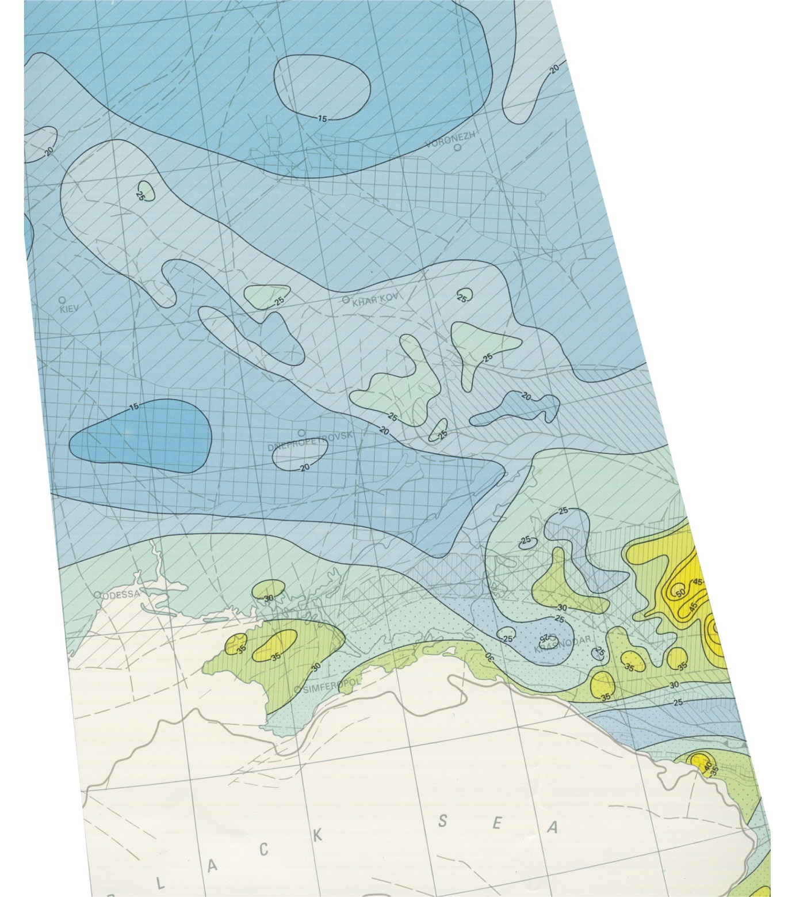
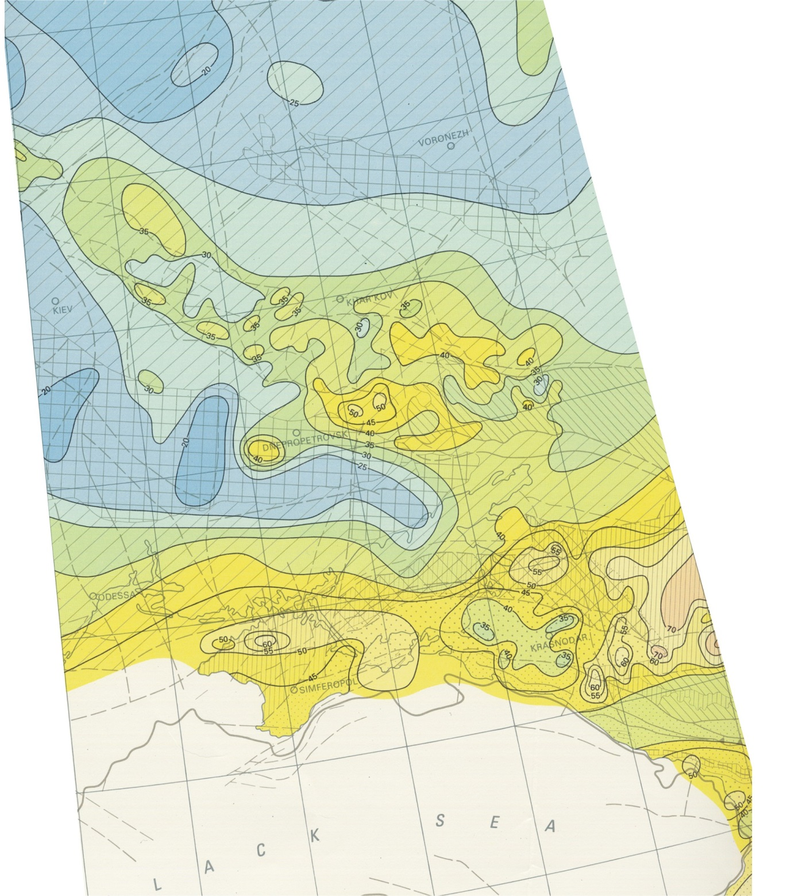
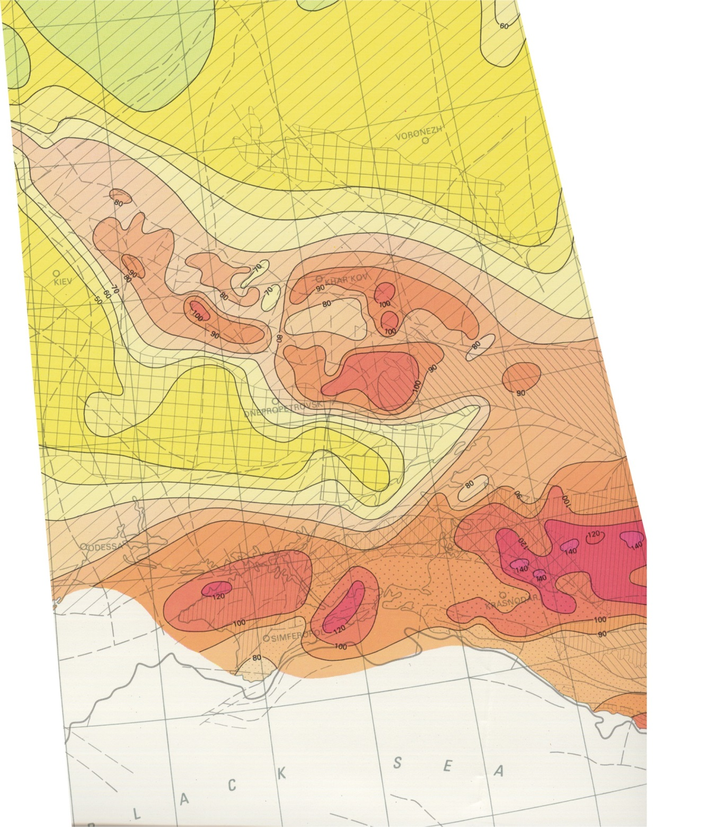
Thermal Atlas of Europe
T – 500 m depth
T – 3000 m depth
T – 2000 m depth
T – 5000 m depth
T – 1000 m depth

Slide 10
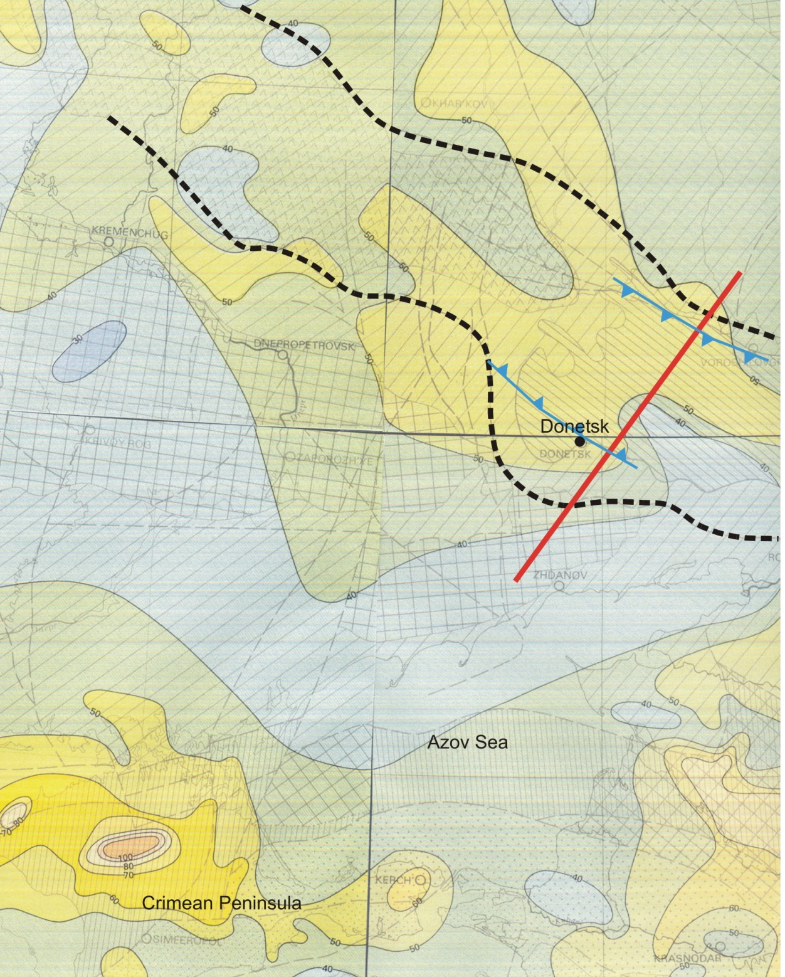
Heat Flow at the surface
Thermal Atlas of Europe

Slide 11
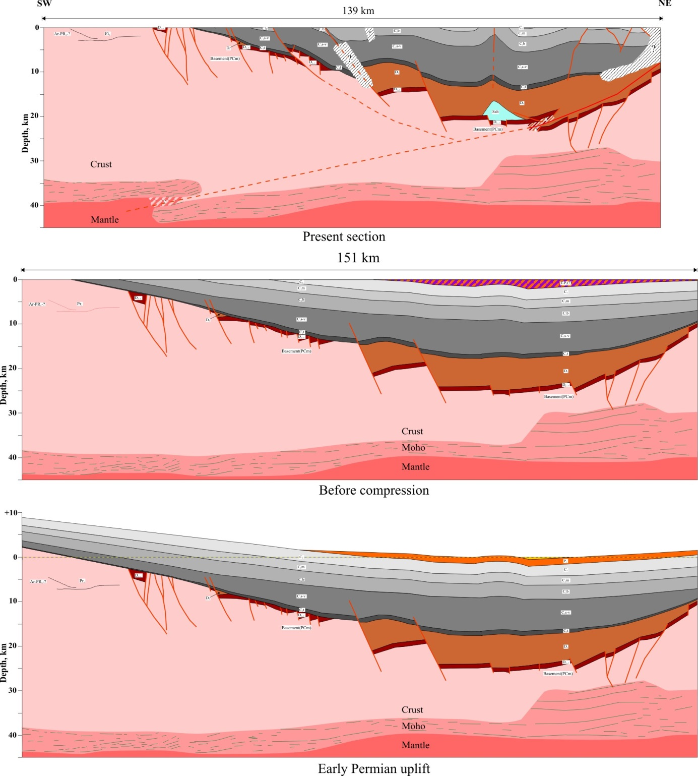
~12 km of
shortening
pre-inversion
basis of the
numerical model
from Maystrenko et al., 2003 – Geology

Slide 12
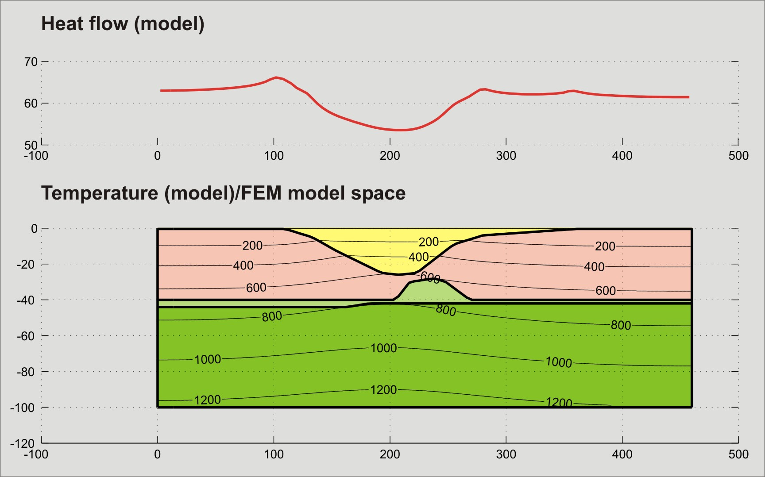

Slide 13

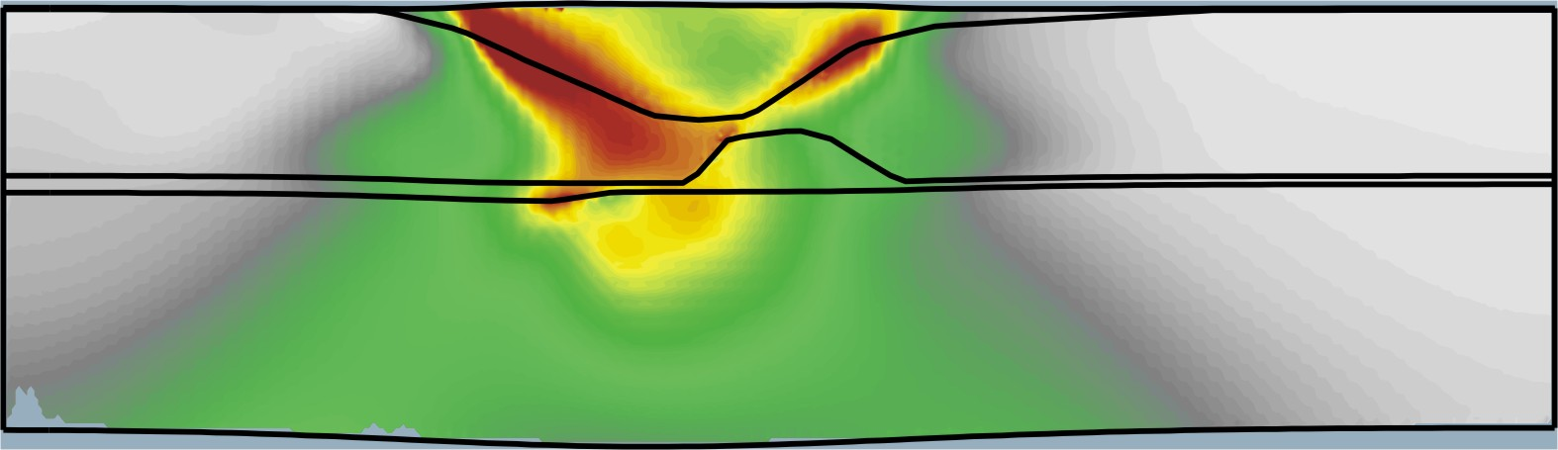
Elastic-viscous-plastic finite element model – total strain
12 km shortening/10 Myr
0.08
crust
0.04
mantle
0.00

Slide 14
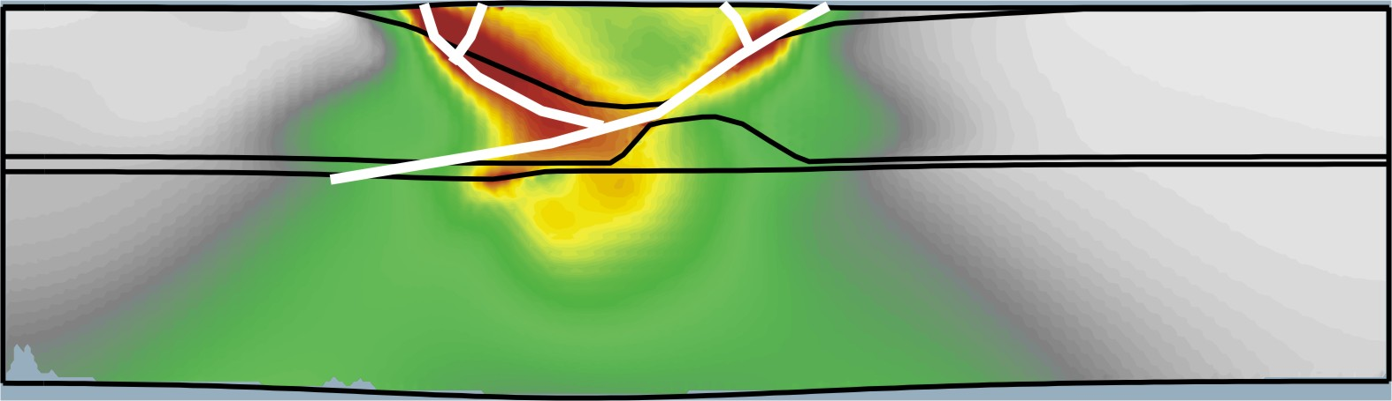
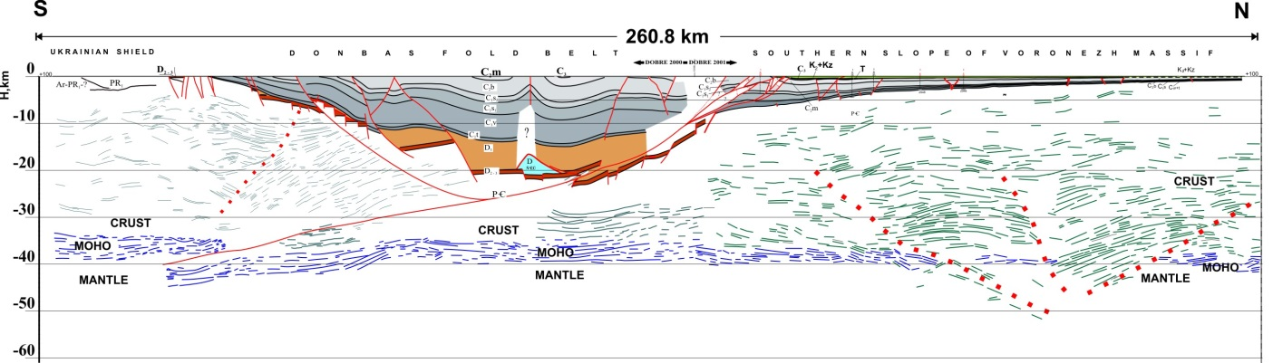
Elastic-viscous-plastic finite element model – Donbas faults
12 km shortening/10 Myr
0.08
crust
0.04
mantle
0.00

Slide 15
Eurekan
“Orogen”
Dniepr-Donets
Basin
Late Cretaceous-Palaeocene:
intraplate inversion
structures
from Peter Ziegler’s atlas (1990)

Slide 16
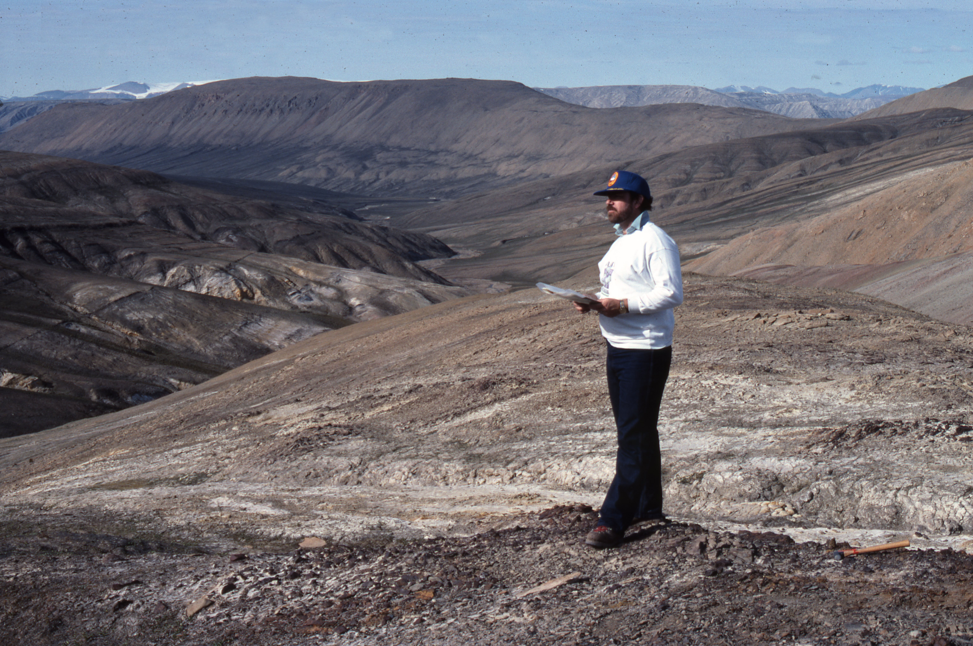
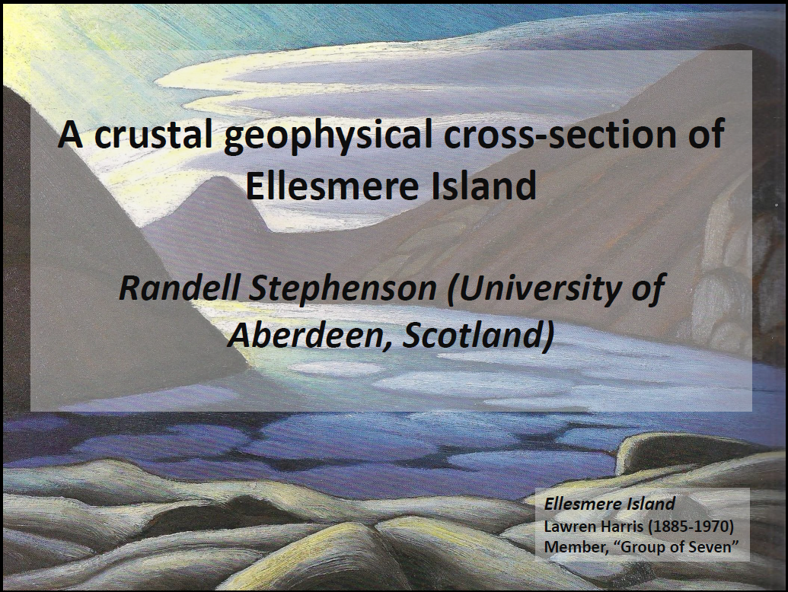

Slide 17
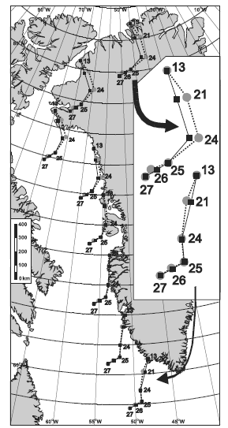
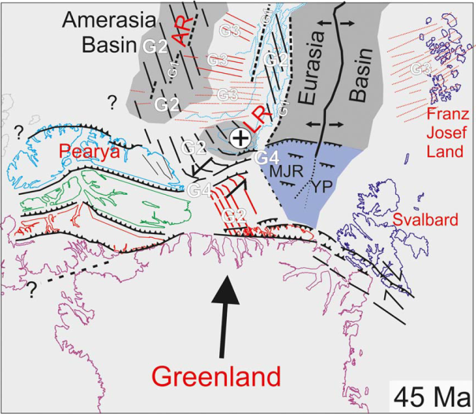
Opening of the North Atlantic-Eurasia Basin and the Eurekan Orogeny
Døssing et al. (2013)
Oakey and Chalmers (2012)

Slide 18
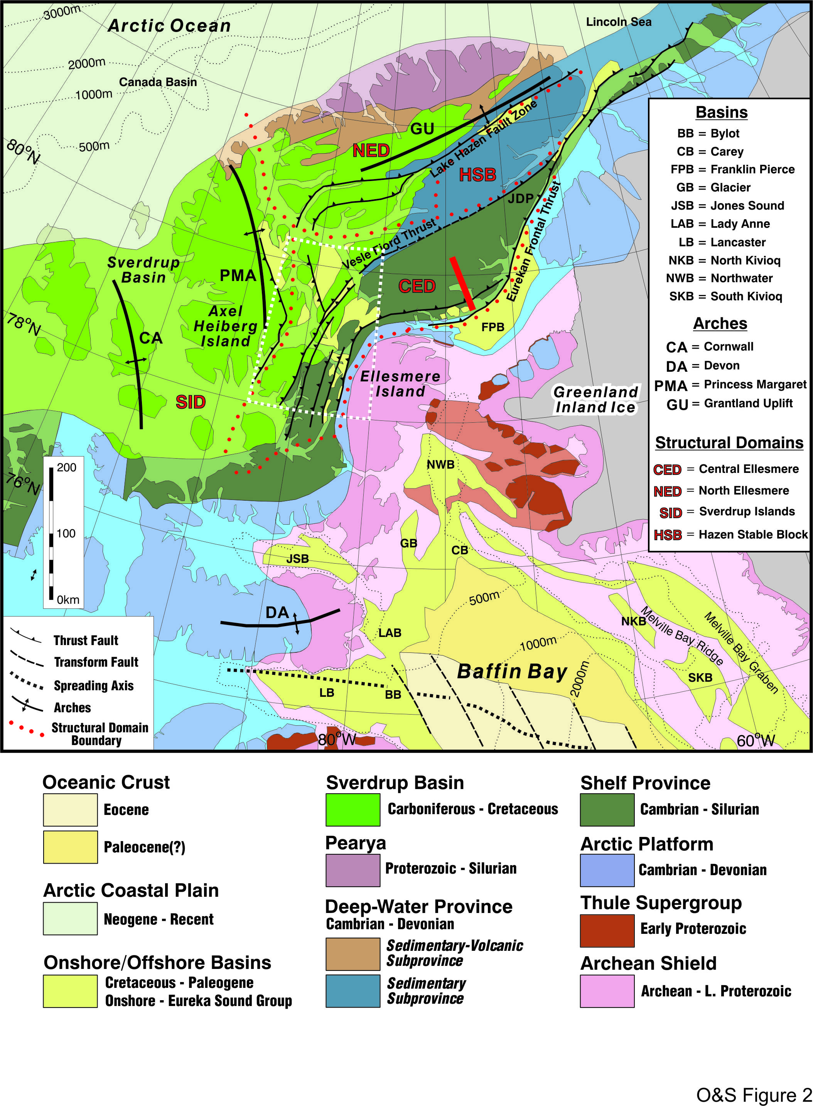
Eurekan structural domains
SID (Sverdrup Island Domain):
young rocks/young deformation
NED (Northern Ellesmere Domain):
old rocks/mostly old deformation/some young deformation
HSB (Hazen Stable Block):
old rocks/severe old deformation/no young deformation
CED (Central Ellesmere Domain):
old rocks/young deformation
*old – Precambrian-Early Palaeozoic (Caledonian-aged deformation)
*young – Mesozoic-Cenozoic (Eurekan-aged deformation)

Slide 19
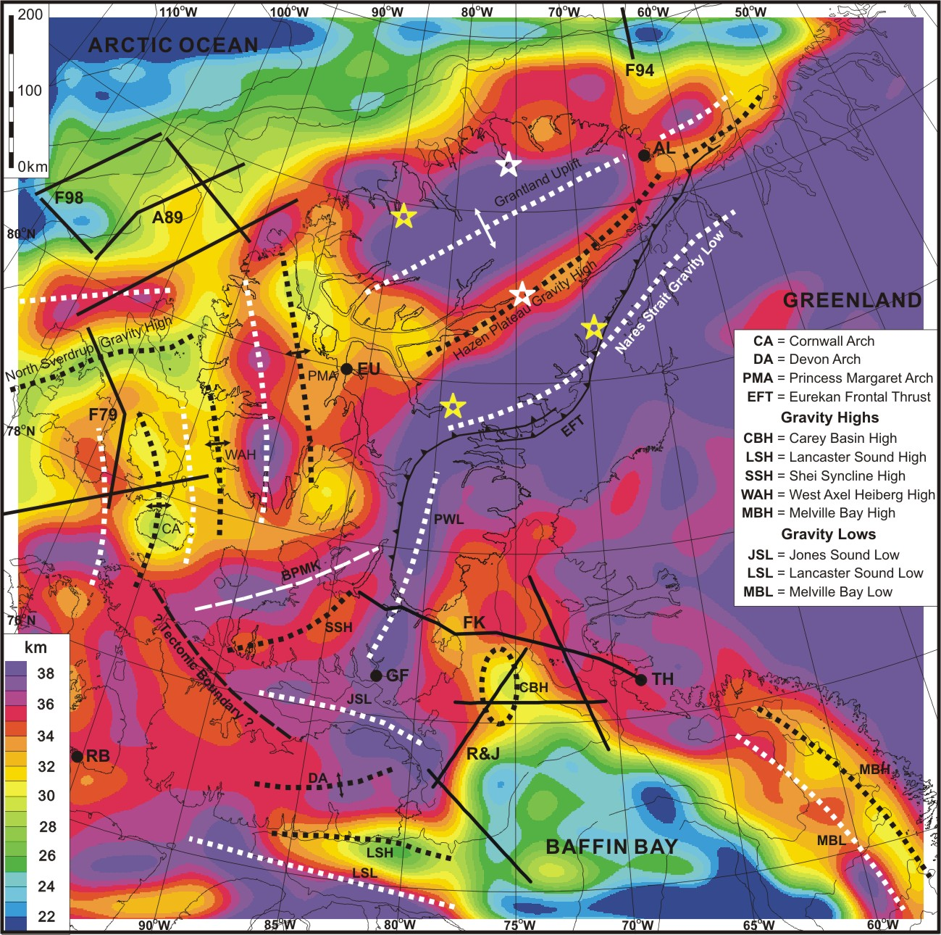
Crustal structure
Depth to Moho (km) by filtering and inversion of the sediment and water corrected gravity field of the Innuitian region
Oakey & Stephenson, 2008; Geophysical Journal International

Slide 20
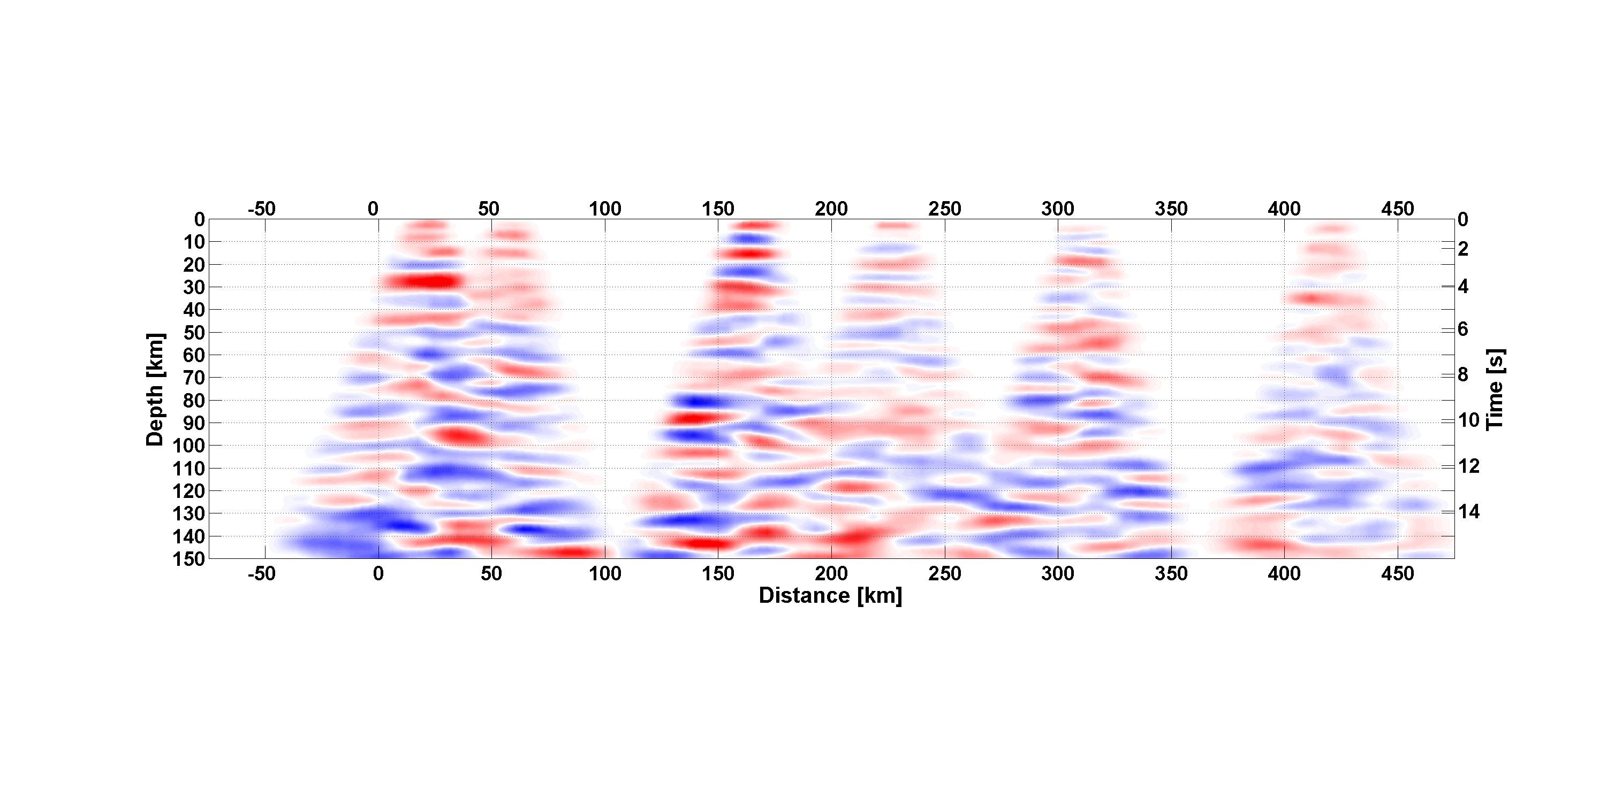
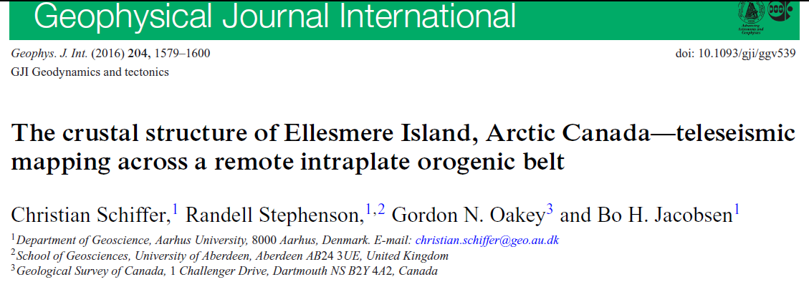
N
S

Slide 21
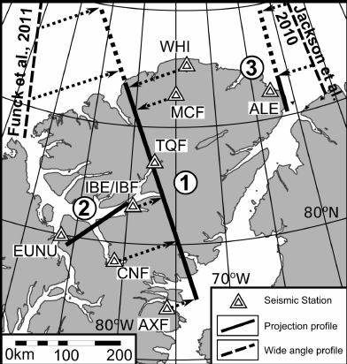
Receiver Functions – interpretation
S-wave model results (upper panel) and P-wave model results (lower panel) interpolated between each back-azimuth bin and along the average ray path (black lines) projected onto a profile across Ellesmere Island. M—Moho.

Slide 22
Receiver Functions – interpretation

Slide 23
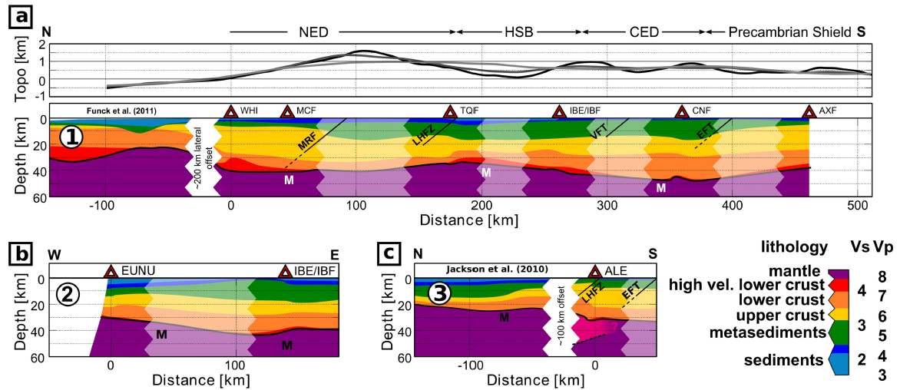
As before but with crust resolved into geological layers, with interpolated segments indicated and Funck et al. (2011) WARR velocity model added, as well as profiles (lower panel) utilising EUNU and ALE permanent stations and Jackson et al. (2010) WARR velocity model added. M—Moho.

Slide 25
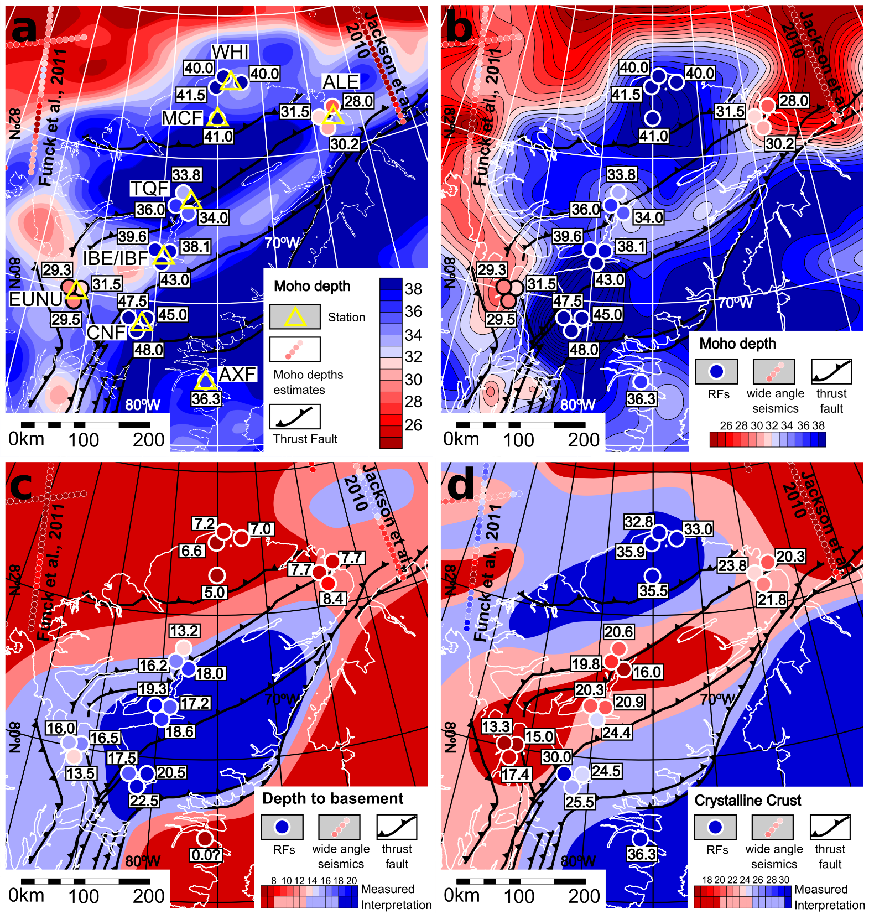
Available deep geophysical data in the area of Ellesmere Island showing where they provide Moho depth constraints. Small circles – wide-angle seismic data. Large
circles – Receiver Function data. Triangles – seismological stations.
Background (a) – Moho depth from gravity modelling (Oakey & Stephenson 2008). Background (b) – Moho depth incorporating new data (Schiffer & Stephenson 2017)

Slide 26
Available deep geophysical data in the area of Ellesmere Island showing where they provide Moho depth constraints. Small circles – wide-angle seismic data. Large
circles – Receiver Function data. Triangles – seismological stations.
Background (c) – Depth to “basement” (Schiffer & Stephenson 2017)
Background (b) – Thickness of crystalline crust (Schiffer & Stephenson 2017)

Slide 27
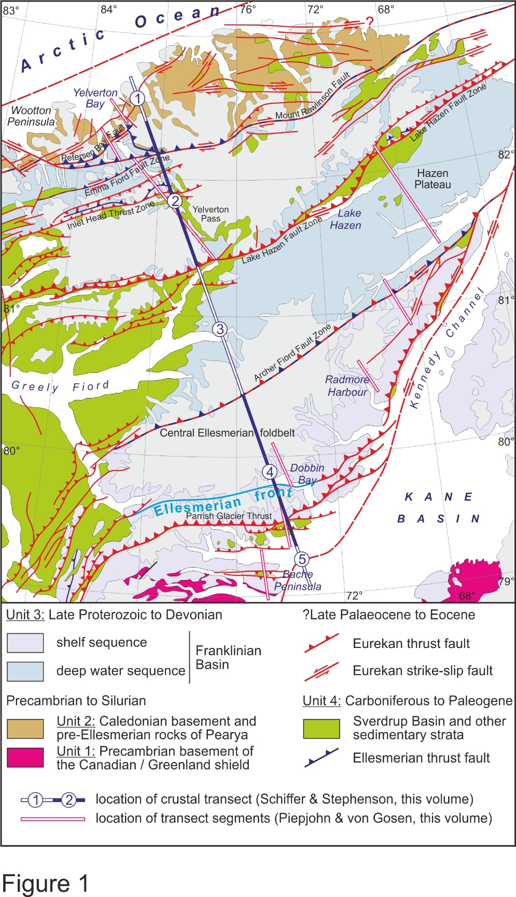
Structural cross-sections (double red lines) made by Piepjohn & von Gosen (2017; see also Piepjohn, von Gosen & Tessensohn 2017) and compiled into a regional cross-section projected onto (solid and double) blue line, this then used as an image and surface “boundary condition” for gravity 2-D modelling along the (solid and double) blue line. The starting density structure for the gravity modelling is based on the P- and S-wave velocity model derived from the Receiver Functions.

Slide 28
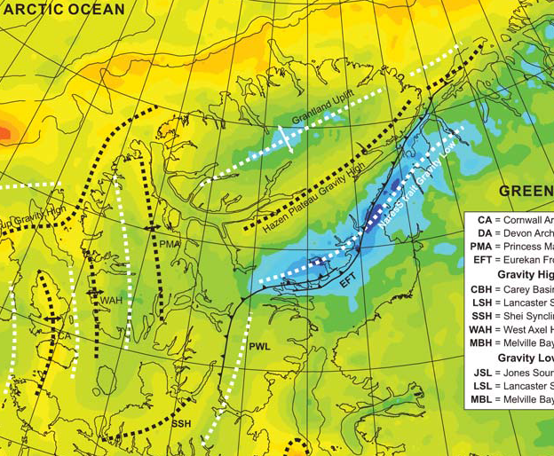


Slide 29
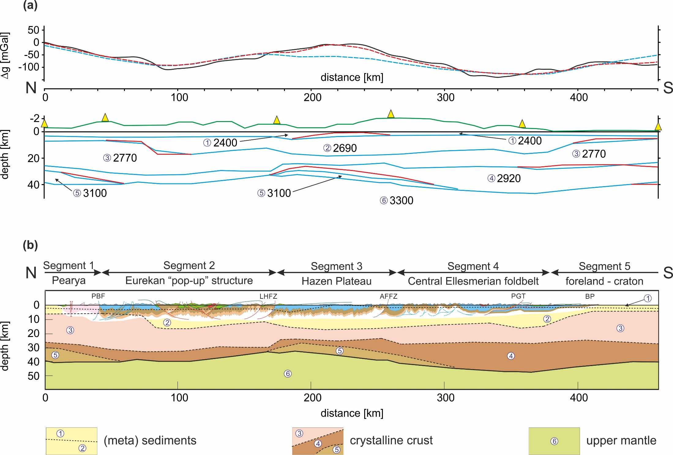
observed gravity: black line / RF model: blue line / RF model adjusted: red line
topography: green line

Slide 30
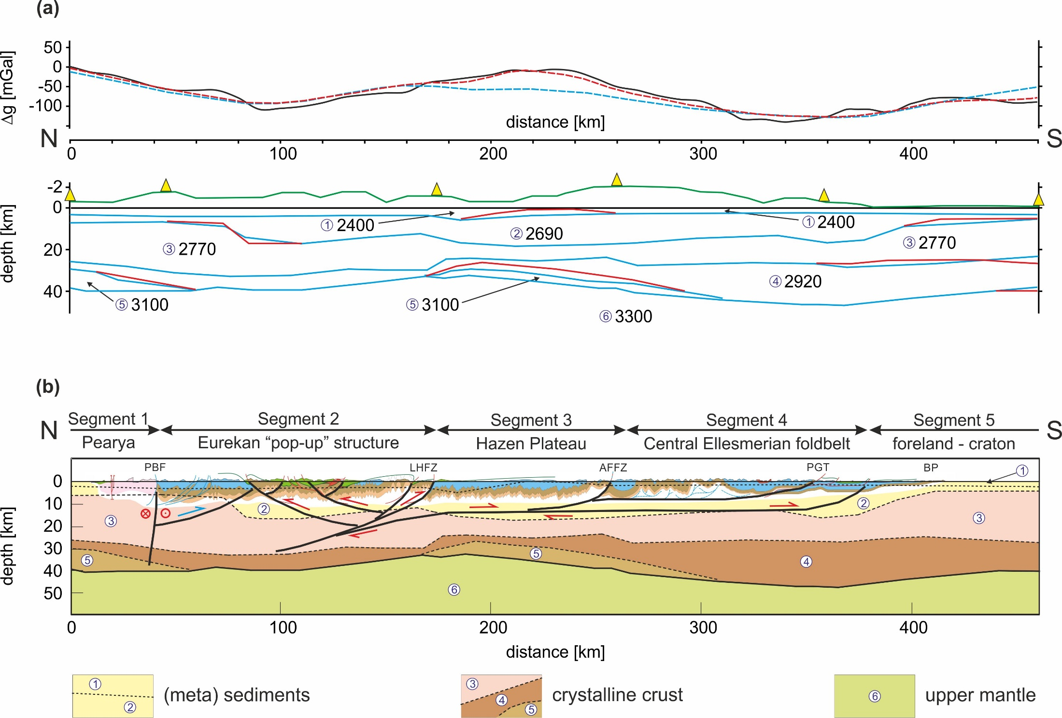
observed gravity: black line / RF model: blue line / RF model adjusted: red line
topography: green line

Slide 31
Segment 1
-Pearya Terrane high velocity and density lower crustal body – mafic “underplate” linked to Cretaceous-Paleogene HALIP?
-No strong evidence of crustal affinity change at the Petersen Bay Fault

Slide 32
Segment 2
-Abrupt deepening of top crystalline basement at ~km 80 – speculatively a pre-Eurekan basement involving thrust
-Northern Ellesmere Eurekan shortening expressed as a crustal-scale “pop-up” structure underlain by and centred on a crystalline basement high (at ~ km 160)
-Moho geometry possibly indicative of crustal underthrusting

Slide 33
Segment 3
-Eurekan-aged structural detachment beneath Hazen Plateau though there is no direct evidence from the crustal model
-Hazen Plateau high velocity and density lower crustal body – inherited from Early Palaeozoic Franklinian margin or linked to Late Palaeozoic Sverdrup Basin formation

Slide 34
Segments 4-5
-Thickest crust and deepest Moho Central Ellesmerian foldbelt – crystalline crust as a whole flexed downwards to the north beneath the load of the structurally thickened supracrustal strata of the foldbelt

Slide 35
Eurekan lithosphere shortening
-Tens of kilometres at most (no quantitative analysis done)

Slide 36
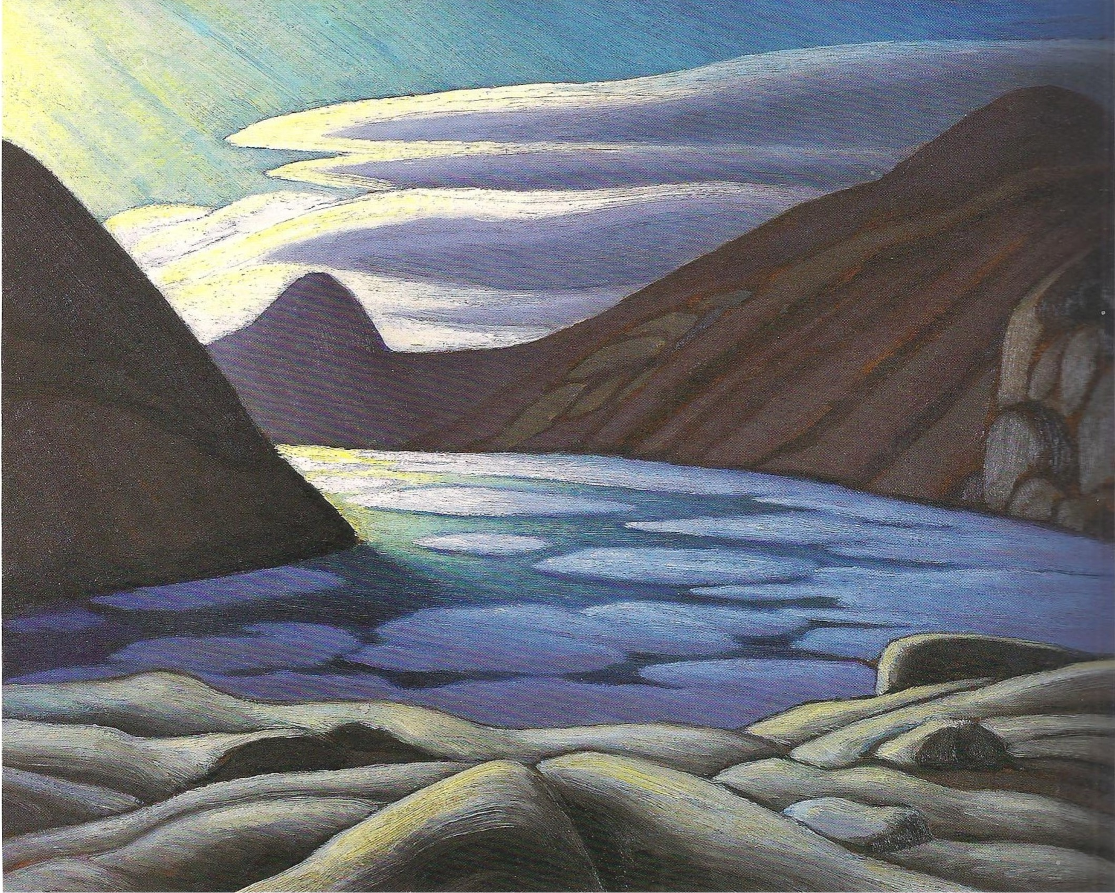
Thanks
Ellesmere Island
Lawren Harris (1885-1970)
Member, “Group of Seven”

Slide 37
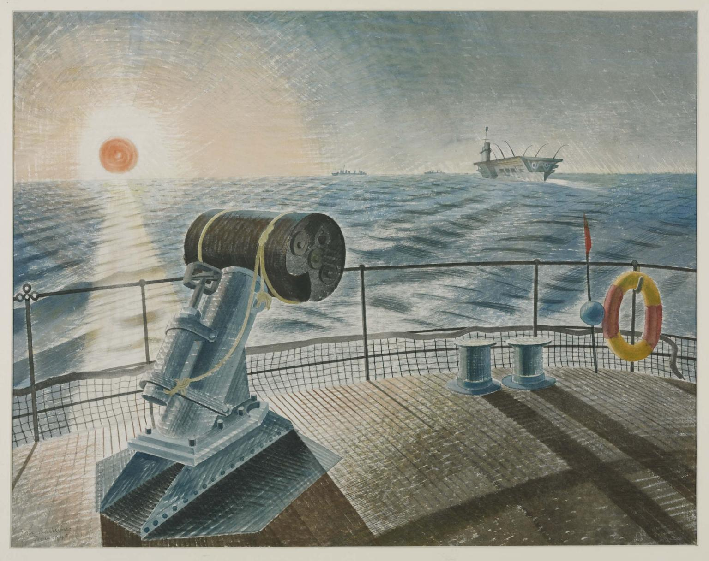
Midnight Sun
Eric Ravilious (1903-1942)
died Kaldadarnes, Iceland

Slide 38
Midnight Sun
Eric Ravilious (1903-1942)
died Kaldadarnes, Iceland
Explanation: mantle plume

Slide 39
Late Cretaceous-Cenozoic intraplate deformation in the North Atlantic-western Tethys realm
-deformation removed from the incipient/forming plate boundary
-tectonic deformation recorded by fault activity (mainly)
-inversion structures
-structural reactivations
-map or series of maps (updated Ziegler maps)
-Late Cretaceous/Palaeocene/Eocene/Oligocene-Miocene
-base map and common set of paleotectonic/paleogeographic reconstructions
-describe and correlate
-discuss style and timing of tectonic “moments” with plate boundary processes/reconfigurations
-speculate about cause and effect with global plate tectonics

