Slide 1
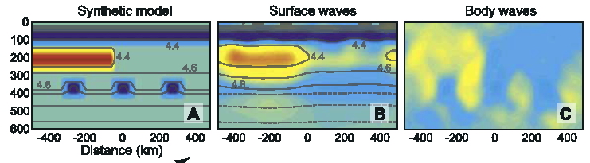
THE TAIL OF THE PLUME
These good souls of Academe
With dogma they divined,
All feared to see an Elephant
(Though all of them were blind),
Any observation
Would stultify the mind.
The First, a physicist, approached,
Leaving Guggenheim, in fear
Fell against its sturdy head,
And spoke so we could hear
“God bless me! but this Elephant
Is exactly like a sphere!"
These Nobel souls in research strong
To learning much inclined,
Went off to study mantle plumes
Which they no doubt would find.
Lacking an Alternative,
Nothing else could be divin'd.
With bulbous Head, and skinny Tail
A pachyderm appeared, undetect’d.
Emitting fluids and geochemical gases,
Enormous lips and trails of ejecta
This might be the plume
That they all had expect'd.

Slide 2
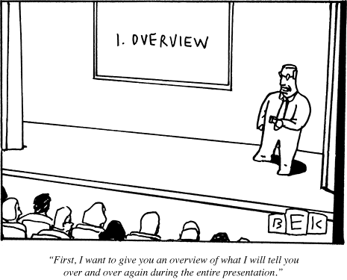
Santa Barbara Club

Slide 3
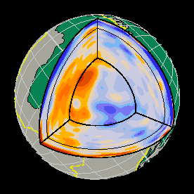
Modern* seismological views of Earth’s interior
*Caltech, UCSB, Harvard (sometimes)
Body waves, surface waves, normal modes, e.g. omni-directional data
Ritsema, van Heijst & Woodhouse (1999)
Notes:
FROM DEUSS

Slide 4

Santa Barbara
April 2012
The tale of the plume…
Don L. Anderson
Paradigms, Polywater, Piltdown, Phlogiston, Ptolemy, Parables…vs. Physics & Plato
But first, an overview, some poetry & philosophy,
then Physics

Slide 5
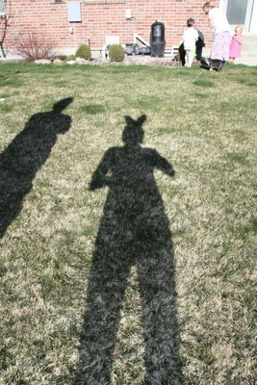

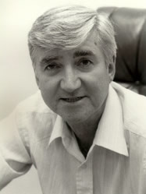
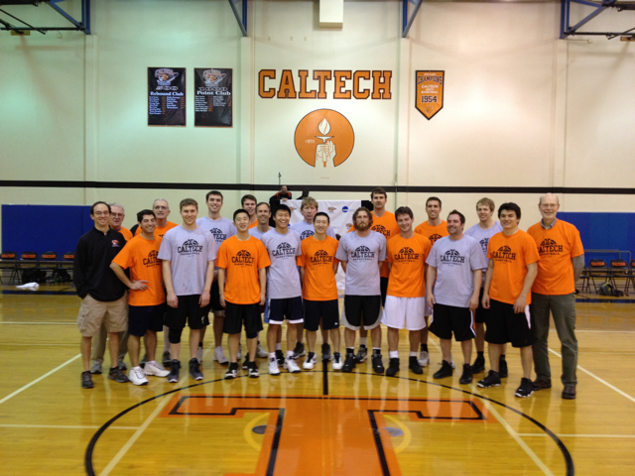
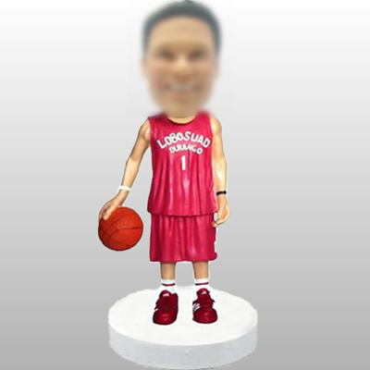
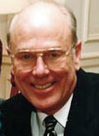
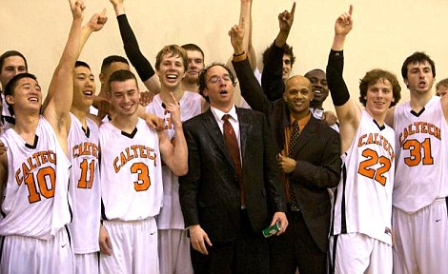

Slide 6

TOMOGRAPHY IS THE STUDY OF SHADOWS
Plato knew that shadows could be deceiving
Shadows of the world appear. There she sees the highway near Winding down to Camelot.

Slide 7
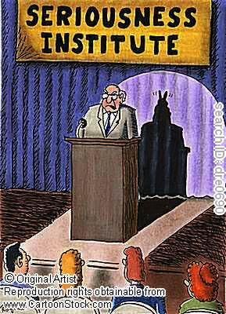
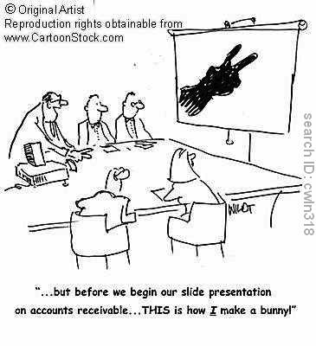
CALTECH
ALUMNI
Assoc.
An overview

Slide 8
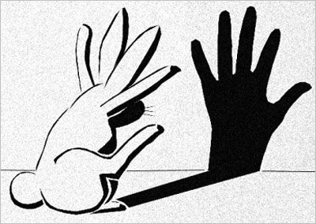
…things are not always what they seem. In Plato's cave people see only shadows and these are the only reality there is…they kill the messenger from the outside…

Slide 9
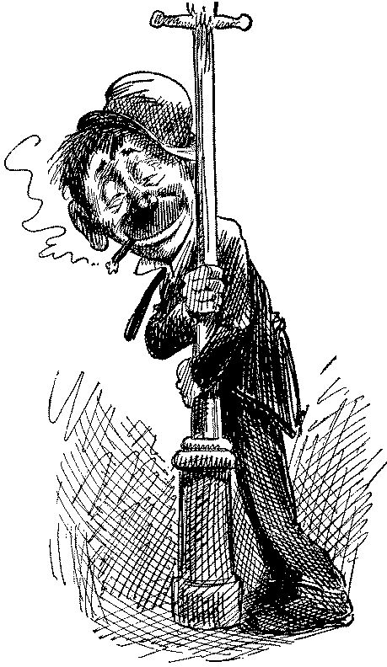
.…The first principle is that you must not fool yourself - and you are the easiest person to fool. by Richard P. Feynman.

Slide 10
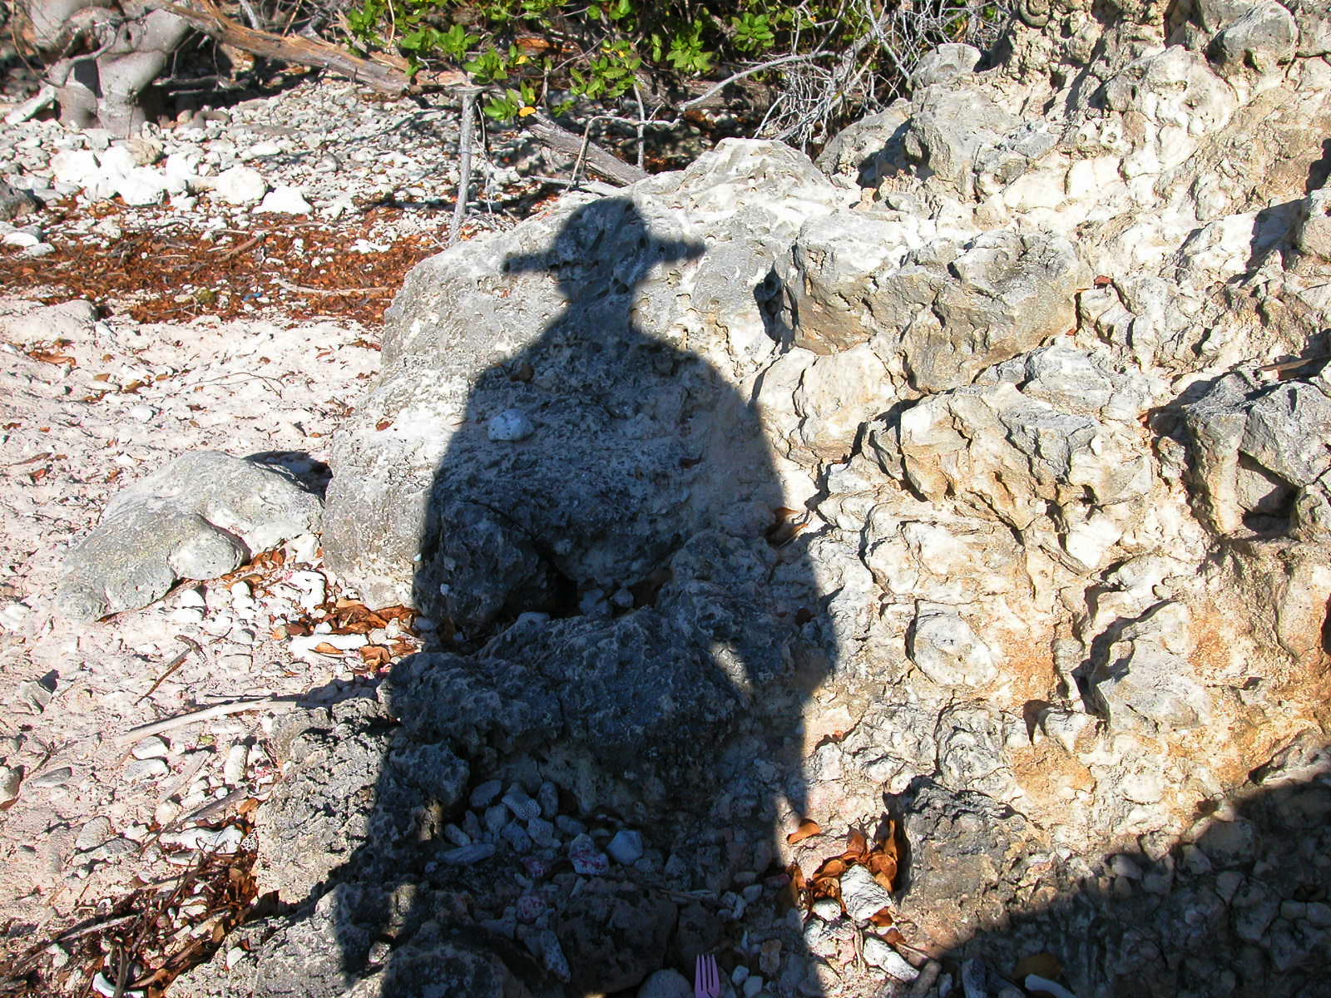
…let’s look [only] at…features where a plume…makes…geological sense and investigate those. H & H,
Science 2007
“Seek and ye shall find…”
Fallacies: Pick & Choose; Texas Sharpshooter

Slide 11
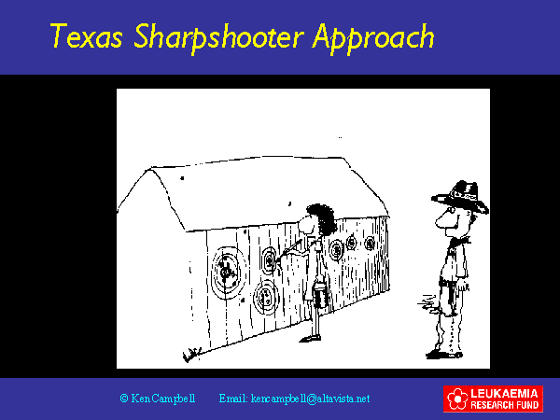

Slide 12
Hawaii, Yellowstone, Iceland…;
Superfical or profound?
“God bless me! but the Elephant
Is exactly like a sphere!"
Optics
Plato
Physics (the real elephant in the room)
Self-organization
Fallacies
physicist
arborist

Slide 13
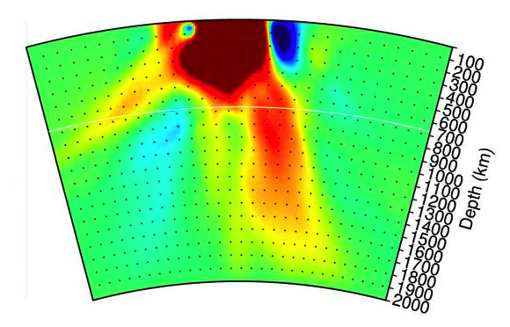
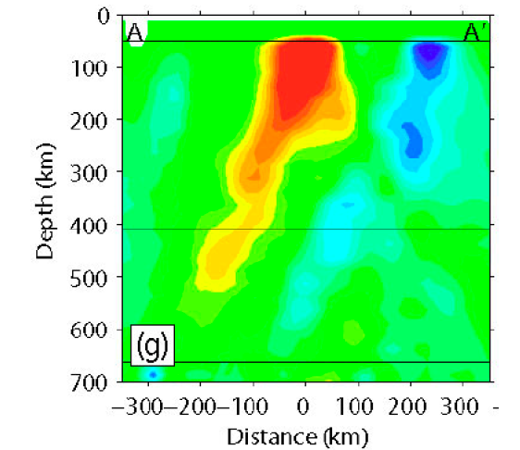
Rabbit ears artifacts
Yellowstone
Hawaii
Rabbit ear artifacts?
Wolfe et al. 2009

Slide 14



University of Texas

Slide 15
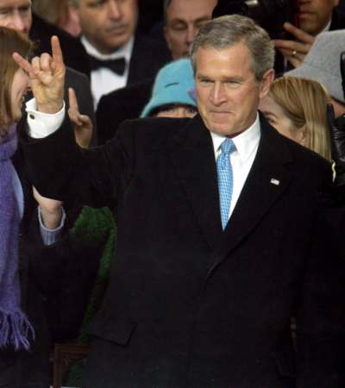
University of Texas

Slide 16
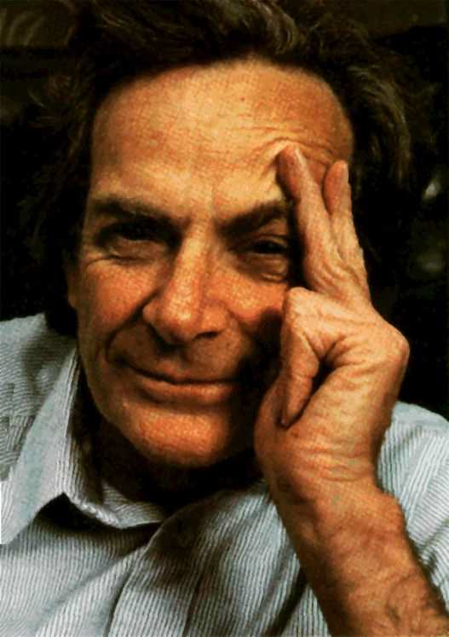

Or, as physicists are wont to say;
“Consider, for simplicity, a spherical elephant…”
“God bless me! but the Elephant
Is exactly like a sphere!"

Slide 17
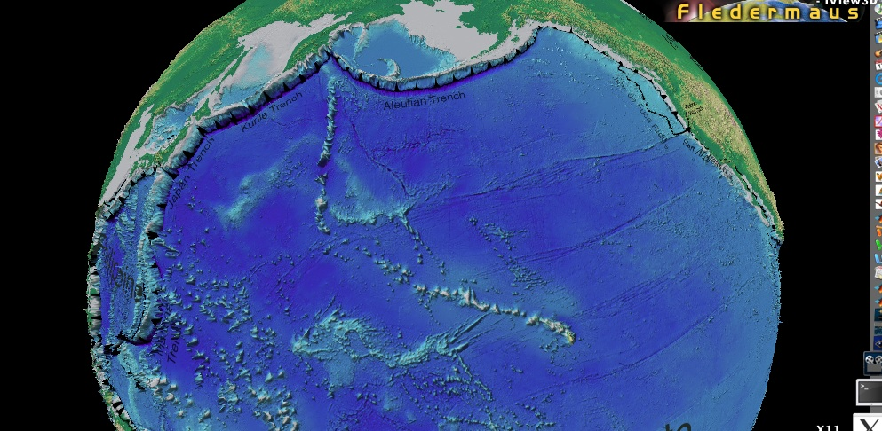
About 20 seamount chains are entering trenches
flood basalt at origin of track
large buoyancy flux
consistently high 3/4 ratios isotopes of helium
low shear wave velocity at 550-km.
6. geoid/topography ratio > 2.5 m/km
Volcanoes and seismology are the only ways to see into the mantle. Some assume that what they see exists only under the volcano or the array and not elsewhere, like the things seen under street lights. Hence, the plume hypothesis.
The drunk and the lamp post fallacy
Courtillot et al
Volcanoes are lamp posts

Slide 18
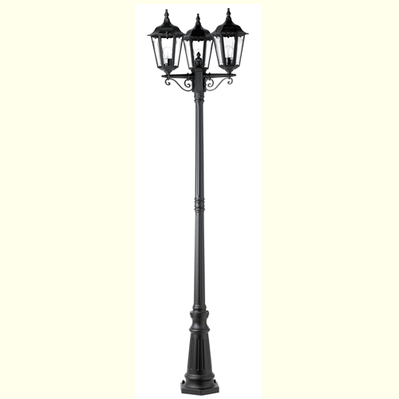
Seismic arrays
No arrays
No arrays
not
DELAMINATION

Slide 19
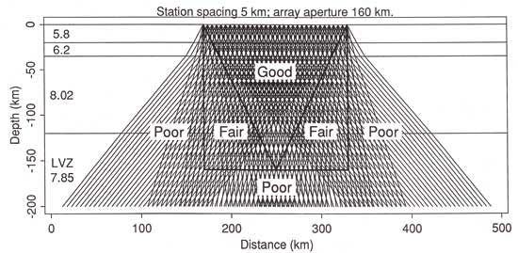
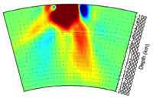
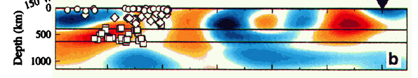
Hawaii
Figure from Wolfe et al (2009)
The PLUME experiment耀
Based on relative delay times & isotropic mantle
Figure from Evans & Achauer (1993)
High-resolution vertical tomography with surface waves & anisotropy included (Katzman et al. 1998)
Tonga
Hawaii
Notes:
Vertical tomography

Slide 20
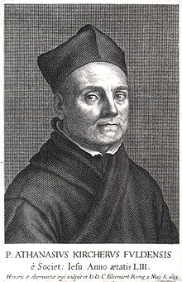
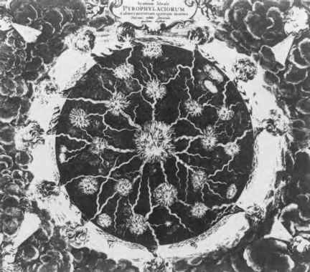
1664 AD
Figure 1.1. An early depiction of the Earth's interior, showing channels of fluid connected to a molten center. This was the prevailing view prior to the nineteenth century…and after 1988.

Slide 21
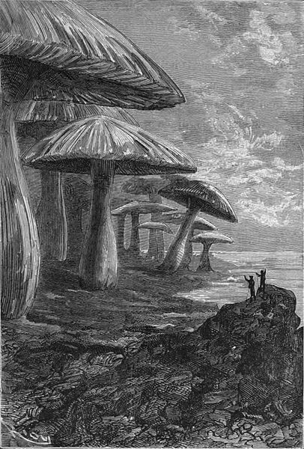
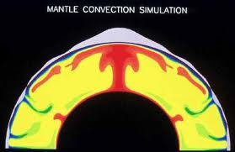
1864
“The travelers discover a giant cave filled with prehistoric mushrooms.”
Jules Verne
2000
Journey to the Center of the Earth

Slide 22
Immanuel Velikovsky to Freeman Dyson;
“How would you like it if I said you were the reincarnation of Jules Verne?”
1864
“The travelers discover a giant cave filled with prehistoric mushrooms.”
Jules Verne
2000
Journey to the Center of the Earth

Slide 23
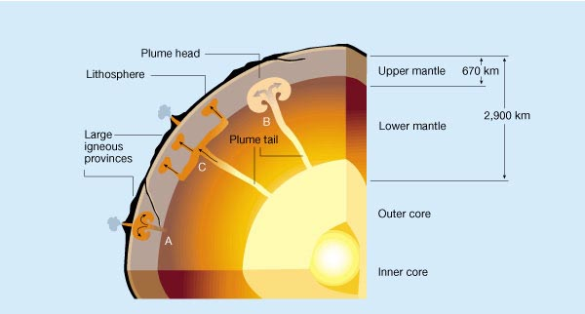
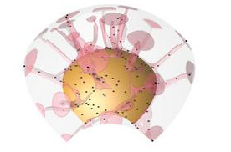
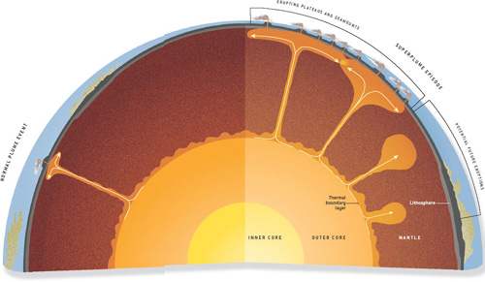
2005-2012 AD
Modern fanciful views
Nature
Science
Scientific American
Physics Today
Problems: no physics, no absolute seismic velocities, no anisotropy

Slide 24
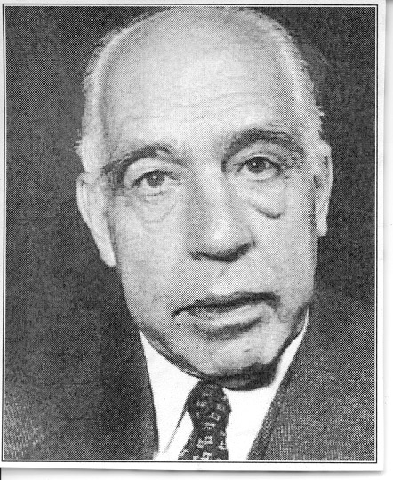

“I am not saying this in order to criticize, but this is sheer nonsense”
Niles Bohr

Slide 25
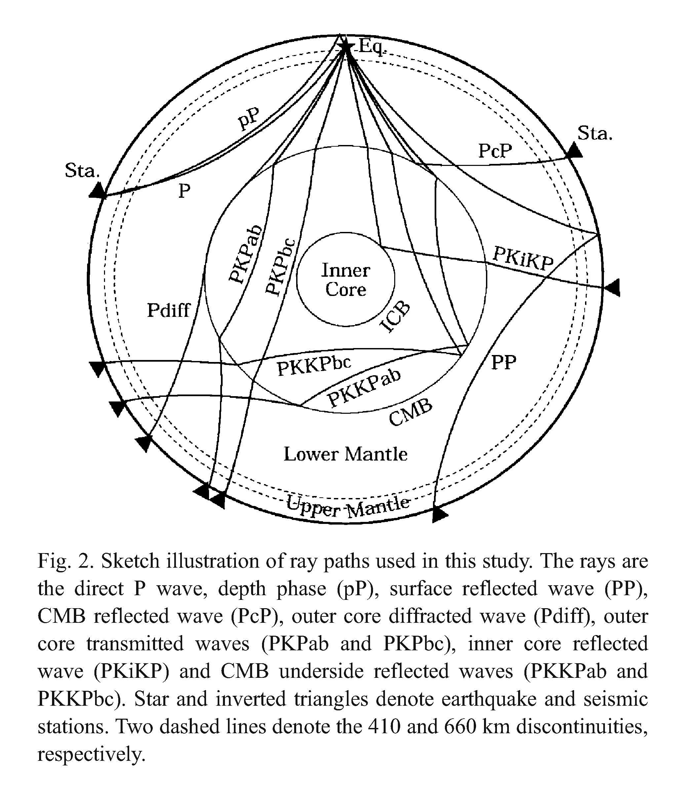
Absolute delay times are discarded
Hawaii; isolated
Recent studies consider only rays in the red cylinder and infer deep slow cylinders, as they must. Science and Nature like to publish these papers.
Vertical smearing
Depths cannot be determined
Relative delays do not mean absolute delays
TTTT
Notes:
Recentt studies consider only rays in the red cylinder and infer deep slow cylinders, as they must. Science and nature like to publish these papers.

Slide 26
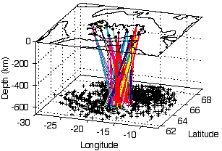
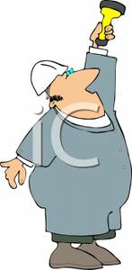
Seismometers on surface
image
object
Seismic waves
Teleseismic Transmission Travel Time Tomography
earthquake

Slide 27
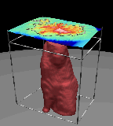

Another example of the Lamp Post Fallacy
TTTT
Mathematically, the slow regions dominate & bleed into the fast regions
Not only does one not know where the anomalies are, but a relatively slow feature can be absolutely fast!

Slide 28
TOMOGRAPHY IS THE STUDY OF SHADOWS
shadows can be deceiving; they can be mistaken for reality
Plato

Slide 29
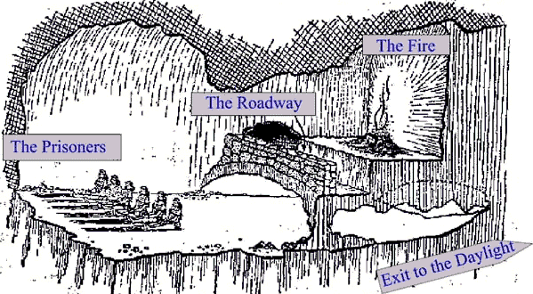
Plato’s Cave

Slide 30
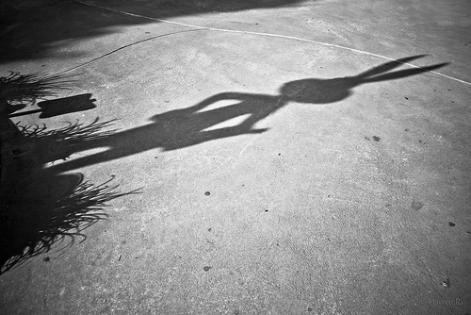
Plato’s Cave
Cave+fire+puppets+shadows = reality to prisoners

Slide 31
Global Mapping* is different than tomography
Allows us to look inside the Earth… but pictures alone can be deceiving…
…the mantle appears to convect in 3 layers.
*Gutenberg, Helmberger, Tanimoto…
Shear wave velocity model
S20RTS:
body waves
surface waves
normal mode splitting
functions
Ritsema, van Heijst & Woodhouse (1999)
Notes:
FROM DEUSS

Slide 32
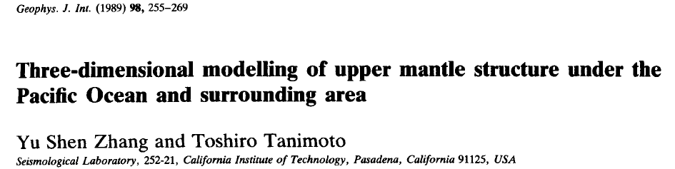
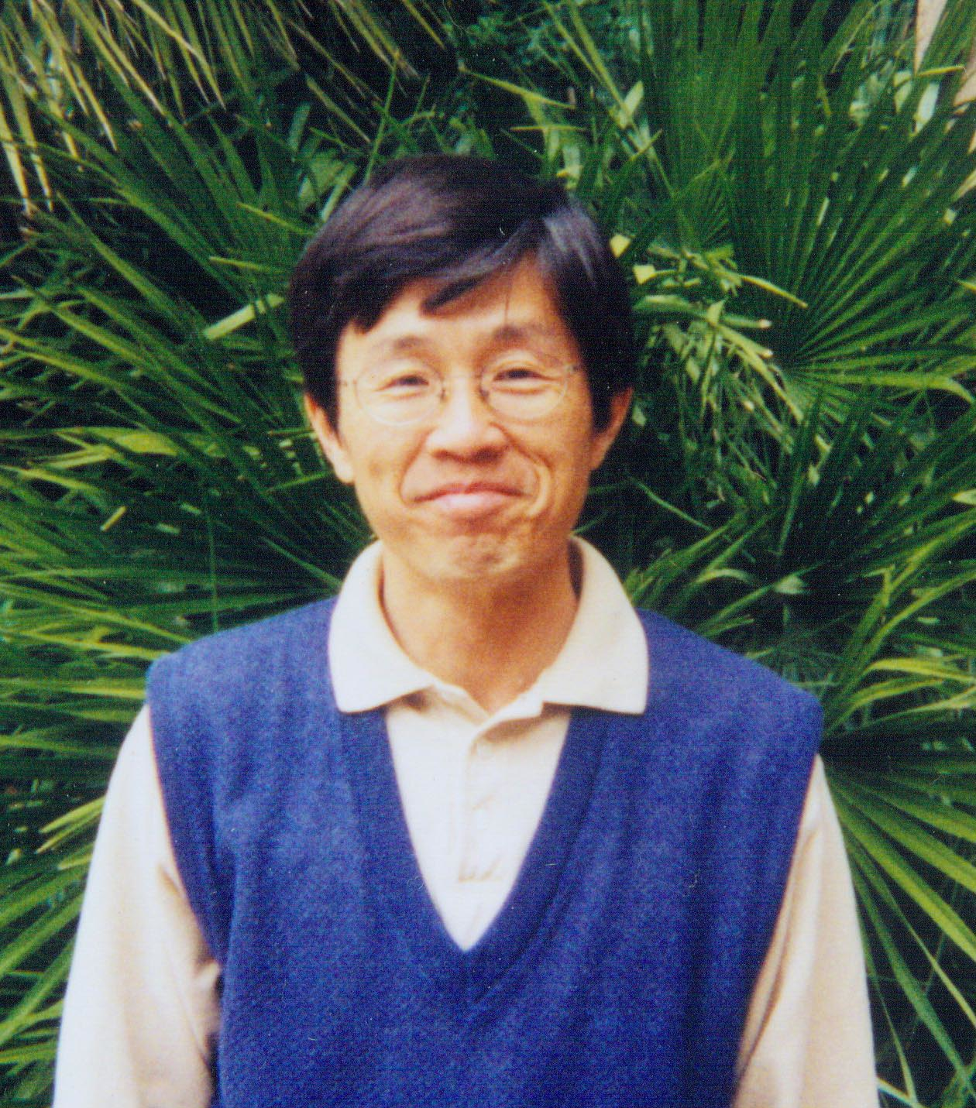
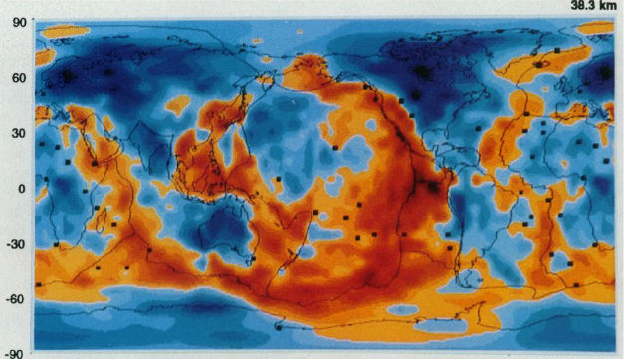
PLUMERIA : Plumeria rubra cultivars

Slide 33
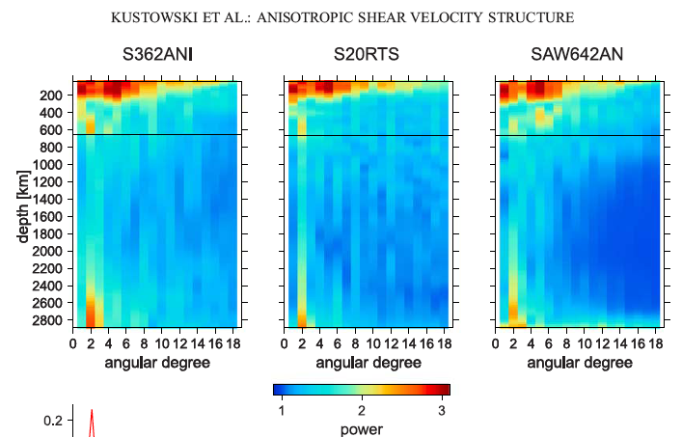
Upper mantle thermal & shear boundary layer
B
C
D
D”
B
B’
B”
Spatial domain
Spectral domain
Seismic velocity
Super-Domes
Various models
D”
Anisotropy!
Region B is the most heterogeneous & anisotropic region of the mantle
…in both the spectral & spatial domains

Slide 34
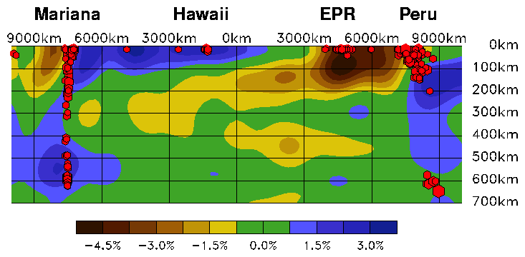

Slide 35
NETTLES AND DZIEWONSKI
What is unique about the mantle around Hawaii?
Anisotropy, not temperature or low seismic velocity
ridge
BL
velocity
A partially molten shear & thermal boundary layer
laminated
anisotropy

Slide 36
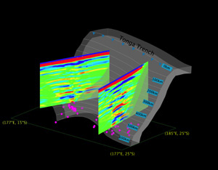
Laminated Upper mantle
Reflections under Africa
Seismic imaging reveals layered structures in the mantle.
Tonga slab is shown in gray, with earthquakes
in pink. (Y. Zheng and T. Lay).
Other regions cannot be studied so thoroughly but scattering &
anisotropy indicate that laminations may be common.
A sheared partially molten rock will segregate into melt-rich
layers & dunite.

Slide 37
Put seismology into the geotherm
Key concepts; high thermal gradient plus laminated fabric
Melt content
geotherm
VSV
100
Depth (km)
T
VSH
f
200
Based on Shapiro & Ritzwoller
I
I
I I
1000 1500 2000
4 5
Temperature (K)
S-wave velocity (km/s)
The variation of VSV & VSH show that high thermal gradients extend to >200 km & melt content is max at ~150 km
Notes:
FIG, 4: schematic geotherm, melt content and simplified VSV and VSH vs depth (Shapiro & Ritzwoller, ). Horizontally propagating S-waves, VSH, are mainly controlled by the velocities of the solid olivine-rich layers and their T and P derivatives. SV waves are mainly controlled by the low velocity melt rich layer or low-rigidity lamellae.
[ -.2 to -3 km/s per 100 km for shear wave gradient; 10 to 14 o/km used by Stixrude]

Slide 38

Mantle is a Top-Down System
Mantle viscosity may not regulate plate tectonics
Strong plates regulate the mantle
delamination
Sources of dissipation
The top boundary condition is not simple
And a Far-From-Equilibrium Self-Organized system (SOFFE)

Slide 39
1
Slow Vs & Vp direction
2
B
time
Cross-grain
Shear-driven melt segregation
Notes:
Bands form anastomising networks with larger bands at higher angles relative to the shear plane (flat red arrow) connected by smaller bands at lower angles. Smaller arrows indicate that the samples flatten and widen with shear. In three dimensions, the melt-rich layers connect and surround melt-depleted lenses.

Slide 40
LLAMA Model*
explains large relative delay times
*Laminated Lithologies with Aligned Melt Accumulations
SKS very late
S late
S early
HOT
teleseismic rays
Large lateral variation in relative delay times due to plate & LVZ structure & subplate anisotropy
Notes:
FIGURE 3: A variable thickness plate moves to the right and entrains the viscous underlying mantle, which is part of the thermal boundary layer. The temperatures increases by about 10 C/km with depth. Lithospheric steps cause disruption of the shear boundary layer and allow access to the deeper hotter portions. Note that the hotter parts of the boundary layer are almost stationary relative to the surface.

Slide 41
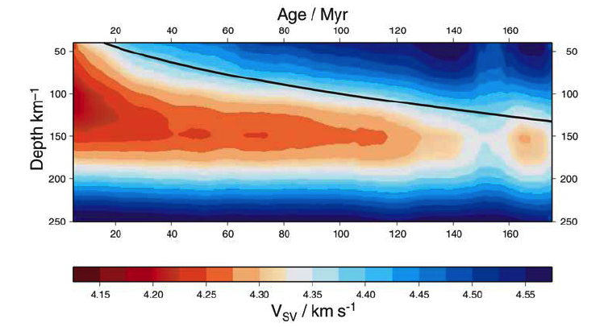
Base figure from Maggi
lithosphere
LID
TBL
LVZ
More & thicker melt-rich layers
More refractory layers

Slide 42
Examples of shear boundary layers (BL)

Slide 43
Lubricating Layer
Lubricating layer & aligned melt accumulations (e.g. LLAMA)
Weeks, W. F., and Anderson, Don L., 1958, Sea ice thrust structures: J. Glaciol., v. 3, no. 23,
p. 173-175.
Sea ice thrust structures

Slide 44
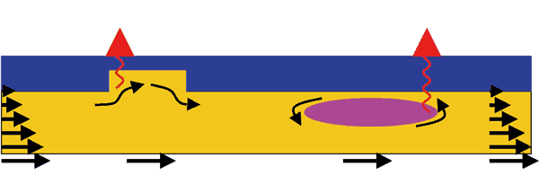
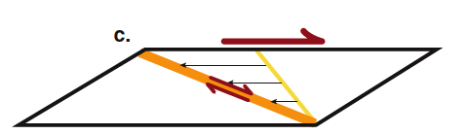
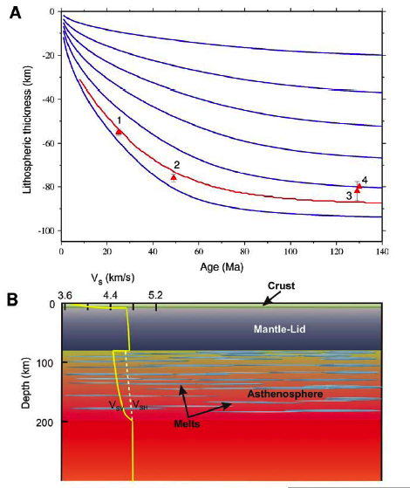
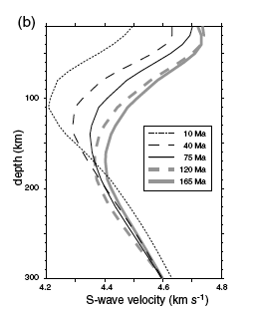
Shearing…
Lateral Advection
Shear plus magma…
Shear induced upwellings..
“fixed”
“hot”
moving
“fixed”
Thick conduction layer
Laminated…

Slide 45
S-velocity vs age & depth
Near-ridge & back-arc basin mantle is much slower than under “hotspots”
Negative velocity gradient implies large superadiabatic (conduction) thermal gradient
Older plates & Hawaii
Near-ridge mantle (cold? no melt lens?)
Very high gradient
Below 220 km, 10 Ma plates have higher Vs mantle than mantle under >40 Ma
plates. The Vs under young plates increases rapidly with depth below 100 km;
Sub-ridge mantle Vs exceeds Vs under older plates by a depth of 180 km.
Shapiro & Ritzwoller
Notes:
Shapiro & Ritzwoller
Note that below 220 km mantle under 10 Ma plates has higher Vs than mantle under >40 Ma plates. The Vs under young plates increases rapidly with depth below 100 km so that Vs exceeds Vs under older plates by a depth of 180 km.

Slide 46
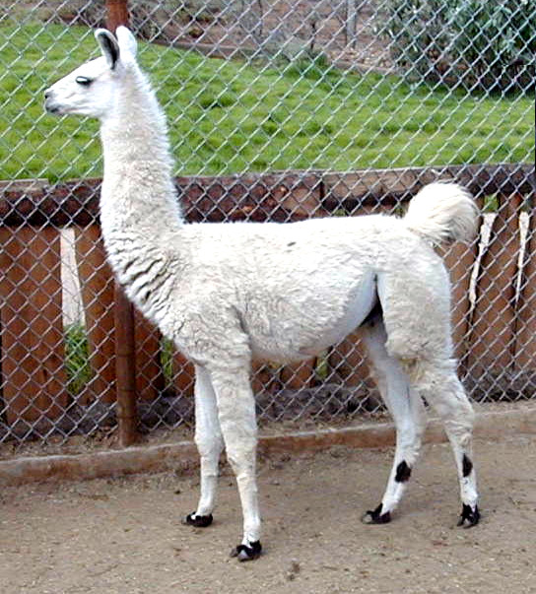
Surface waves show that the upper conductive boundary layer of the mantle is 200 km thick, is heterogeneous and extremely anisotropic.
This is best explained by a Laminated Lithology containing Aligned Melt Accumulations.
This I call LLAMA

Slide 47

But using teleseismic travel time transmission tomography, we have the rabbit ear artefacts!
Hawaii as seen by TTTT
As seen from Santa Barbara…

Slide 48
nomenclature
Crust
LID
220 km
410
650
1000
Lower
Mantle
CMB
A
B’
B”
C’
C’’
D’
D”
BL
Gutenberg’s Region B
Moho to 220 km
G
L
Potential temperature, Tp
LVL
Subadiabatic geotherm
Tp
Note: Tp in D” is not necessarily higher than in B
Bullen’s Region D”
BL
Notes:
FIGURE 1: Nomenclature of the mantle.The boundary between Regions B and C differs between Gutenberg (1959) and Bullen (1947 ). Gutenberg placed the boundary near 220 km while Bullen placed it near 410 km. The 650 km discontinuity was unknown at the time. The lower mantle (Region D) starts below 900 or 1000 km. The Transition Region was defined originally as the mantle between 410 and ~900 km. The Transition Zone (TZ) was later assigned to the regions between 410 and 650 km.The low-velocity anisotropic layer (LLAMA) extends from the Gutenberg discontinuity (G) to the Lehmann discontinuity (L). A schematic potential temperature (Tp) geotherm is shown, along with Boundary Layers (BL). The adiabatic interior of McK&B is replaced by an internally heated region that develops a subadiabatic gradient.

Slide 49
This type of structure mimics a vertical plume in TTTT
Thermal boundary layer
Shear boundary layer
unidirectional

Slide 50


What causes the…
?
A laminated shear boundary
layer is
the cause of upper mantle
anisotropy
The origin of the Pacific anisotropy anomaly is unknown; orientation of olivine due to
the shearing of the plate cannot explain all of the observations. It is unclear what shearing
mechanisms can give azimuthally random, but preferentially horizontal, alignment of crystals
beneath the middle of the Pacific plate… shearing in the asthenosphere may not be
dominated by coherent plate motions… a complex pattern by mantle plumes, could cause
small-scale variability…note that SH & SV vary differently with depth.
…and probably the cause of plume-like artifacts that
appear when only near-vertical seismic rays
& relative arrival times are used in the inversions
A laminated sheared structure solves these problems

Slide 51
The (left-out) Physics* of Boundary Layer Geotherms
Sub-plate boundary layer geotherm is
>200 ºC hotter than assumed because conductivity decreases with temperature
Potential temperatures in D” are lower than assumed because radioactive heating & global secular cooling yield subadiabats
“Excess temperatures” relative to MORB do not require plumes or jets or locally hot spots
Effects of compression; pressure broadening
* the unseen elephant in the room

Slide 52
PHYSICS (classical, modern, post-modern)
Kelvin
Secular cooling of the Earth
Second Law of Thermodynamics
Rutherford
Debye
Gruneisen
Far-From Equilbrium Self-Organization
Self Consistency
Self Compression
Self Similar
Self Organization
depth
The upper boundary layer is hotter & the lower boundary layer is colder than in canonical models

Slide 53

Rutherford and Kelvin Effects
O
Thermal maxima
X
Melts can exist in the BL
CMB can be hotter or colder than UM!
CMB

Slide 54
Potential temperatures of ambient mantle
McKenzie & Bickle (1988)
Artificially constrained Tp & BL thickness
When the temperature dependence of lattice conductivity is taken into account the temperatures in the boundary layer are > 200 C higher than in McKenzie & Bickle

Slide 55
cold warm cool cold

Slide 56

Hawaii-Tonga Corridor
Hawaii is not the slowest part of the central Pacific
anisotropy
The use of surface waves & reflected waves allows one to estimate absolute times & velocities
Blue!

Slide 57



surface waveform tomography of the Pacific upper mantle, obtained
using an automated multimode surface waveform inversion technique on fundamental and
higher mode Rayleigh waves…these give absolute velocities
300 km depth
Hawaii
100 km depth
Maggi et al. (2006)
Wolfe et al. looked at relative variations in this area & attributed relative slowness to plumes

Slide 58


HVA around Hawaii
Red is hot
Blue is not
Notes:
Figure 7. Horizontal slices through our tomographic model showing isotropic VSV at (a) 50 km, (b) 100 km, (c) 150 km, (d) 200 km, (e) 250 km and (f)
300 km depth. Throughout this paper, unless otherwise noted, tomographic results are plotted as a percentage variation with respect to the ORM model of
Fig. 2. Azimuthal anisotropy results are not plotted on the tomographic slices for clarity, although anisotropy was taken into account in the inversion.

Slide 59
0
200
400
PREM
LID
DEPTH
G
T
VSV
VSH
LLAMA
L
Central Pacific
Melt-rich lamellae
Motion vectors
4.4 4.6 4.8
km
Vs, km/sec
Notes:
59
FIGURE 2. Left. Seismic shear velocities, VSH and VSV, in the Central Pacific ( ) and in the global reference model PREM ( ). The steep
conduction part of the geotherm extends to >200 km depth. Right. The laminated boundary layer model ( ) along with the present
Interpretation of a sheared layer comprised of refractory and melt-rich lamellae.

Slide 60

Central Pacific
Ritzwoller
interpretation
Vs (T)
T
Vs(T,f)
f
G₁
G₂
VSH>VSV
Vs(T)
VSV=VSH (slow)
Decrease of Vs with depth due to high conduction thermal gradient and the variation of melt layer thicknesses and number
(VSH)²~G₁ (VSV)²~G₂/f
G_{1,2} = layer rigidities

Slide 61
“…let’s look [only] at…features where
a plume…makes…geological sense and
investigate
those.”
Hofmann
& Hart,
Science
2007
ex cathedra
Texas Sharpshooter Phallacy
Notes:
"ex cathedra" is meant a formal infallible decision

Slide 62



Slide 63

LLAMA
Plume hypothesis

Slide 64

Things are seldom what they seem,
Skim milk masquerades as cream;
Gild the farthing if you will,
Yet it is a farthing still.*
*H.M.S. Pinafore, Gilbert & Sullivan
And these good men of Prince O’Ton
To dogma much inclined,
Never saw an Elephant
(all of them were blind).

Slide 65

So, A Committee was formed
It’s a PLUME!
I did resolution tests!
The Noble ones of chemical persuasions
Inhaled the pachyderms exhalations
"Tis from the deep bowels" offered one
"A signature of intestinal fermentations".
"Tis primordial gas", gasped another
We'll get a Nobel prize for our exertations
Or at least a Science paper, with no deliberation!
The invisible elephant in the room is physics, logic & anisotropy

Slide 66
The Mycologist, feeling around below,
Cried, “Ho! we have here a mushroom
Very round and smooth and straight!
No further need to fume.
This wonder of an Elephant
Is certainly a plume!”
The Engineer demurred, he’d his own theory,
He tripped and fell (there was little room),
A squirming trunk brushed his face,
He spake with a sense of doom:
“I fear,” quoth he, “this object here
Really is a plume!”
The Geologist, who chanced to touch a brow,
Said: “Not an animal at all. I, instead
Can tell what this resembles most;
Deny not the fact" she said
"This marvel of an Elephant
Has a roundish plume head!”
The Herpetologist had begun
About the beast to roam,
Then, seizing on the swinging tail
That tangled with his broom,
“I agree,” quoth he, “this snake
Is very like a plume!”

Slide 67

Theory of the Earth
Earth is a well-differentiated body
Most of U, Th, K (LIL) in crust and upper mantle
Deep mantle is barren, depleted, inaccessible
Density & seismic velocity are not just functions of T
Geochemical cycles are all shallow
6 % of mantle is eclogite
2007
Mantle started hot, heterogeneous, differentiated…
Lower mantle, D”, core…have little to do with the surface

Slide 69





Thank you!
“God bless me! but an Elephant
Is exactly like a sphere!"
by Fred Anson
Tongues speaking, vision seeing, holy rolling…? …it's a historical fact! Google 2012

Slide 70
Other assumptions
High 3He/4He=high 3He
Homogeneous products=homogeneous sources
If A then B, if not B then not A
Red=hot=buoyant
Only some hotspots are real plumes
Mantle below 100 km=homogeneous, adiabatic, isotropic…

Slide 71


“This is not generally accepted and you don’t have to believe it…”
[but]
Sir Arthur Eddington

