Slide 1
3He abundances; MORB vs OIB

Slide 2
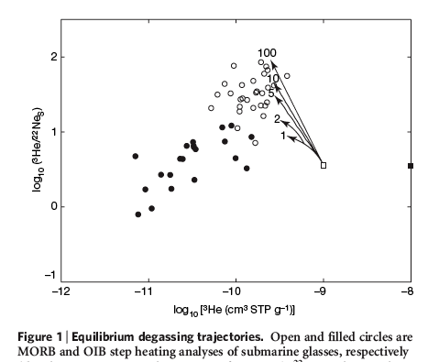
In all variants of the standard model, OIB gases are considered to be the residue of massive degassing
Degassed MORB has more ³He than OIB
Gonnermann & Mukhopadhyay
with additions
mixing
[³He]
Retained or residual gas
MORB
Expelled gas
Loihi
³He/²²Ne
MORB degassing
OIB
Popping rock
W.Greenland
Baffin Bay
Seawater, air, trapped exsolved gases, shallow mantle
“the gap” paradox
³He
In the Canonical Model OIB contains residual gas. In the perisphere model OIB picks up old exsolved gases plus air-like gas
Notes:
Either 99.9 % degassing to get to OIB values or .1 to 1 % efficient recovery of gases degassed from previous MORB degassing events.
…mixing line son other slides connect the primordial less degassed mantle
(PM) and degassed upper mantle (DM) with R values ((3He/22Ne)DM/(3He/22Ne)PM) of 1.6
[Mukhopadhyay, 2012] and 10 [Moreira et al., 2001]. These terms decrease upon degassing...

Slide 3
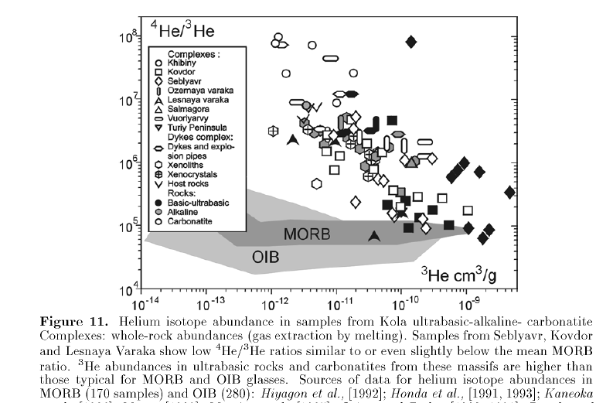
Tolstikhin
carbonatites
High 3He/4He & high 3He!
[³He]
HIMU
Note large (10³-10⁴) range
Loihi
“plume-magmas”, (e.g. Djibouti)
air
Carbonatites have ³He/⁴He ratios that extend from 0.04 to 39 Ra & average 9 +/- 14 Ra!
Notes:
Carbonatites are the only magmas that have both high 3He/4He and high 3He.

Slide 4
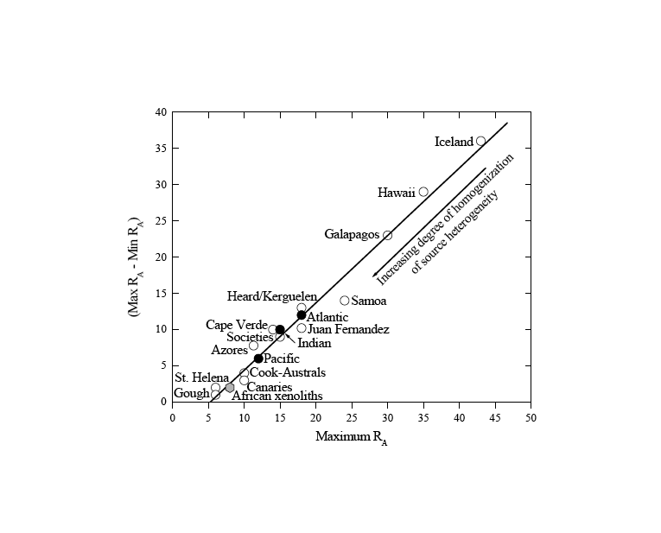
VARIANCE PARADOX
FOZO
³He/⁴He
Very few ³He atoms
“High” R/Ra basalts extend down to MORB
HIMU
MORB
“Low” R/Ra extend up to MORB
Meibom
Notes:
He isotope ratio distributions in basalts from individual ocean islands. Individual islands span a broad range in 3He/4He ratio, but with the exception of Heard and Kerguelen (#39 and 40), no volcano has lavas with ratios clearly on both sides of the MORB value (shaded).

Slide 5
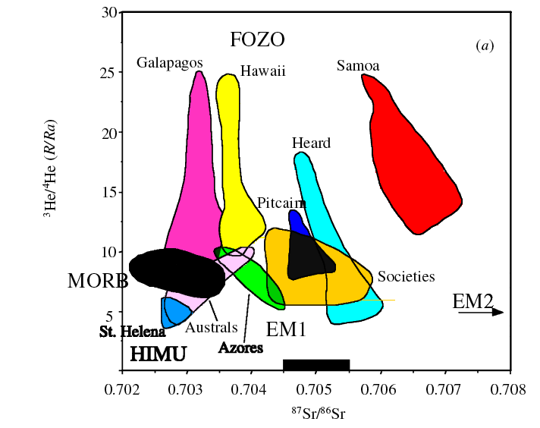
VARIANCE PARADOX
FOZO
³He/⁴He
Very few ³He atoms
“High” R/Ra basalts extend down to MORB
THE VARIANCE PARADOX; high R/Ra are always associated with low R/Ra
HIMU
MORB
“Low” R/Ra extend up to MORB
Unfortunately, maximum R/Ra values in Greenland, Samoa, Afar etc. are usually compared with the average MORB values
Meibom
Notes:
He isotope ratio distributions in basalts from individual ocean islands. Individual islands span a broad range in 3He/4He ratio, but with the exception of Heard and Kerguelen (#39 and 40), no volcano has lavas with ratios clearly on both sides of the MORB value (shaded).

Slide 6
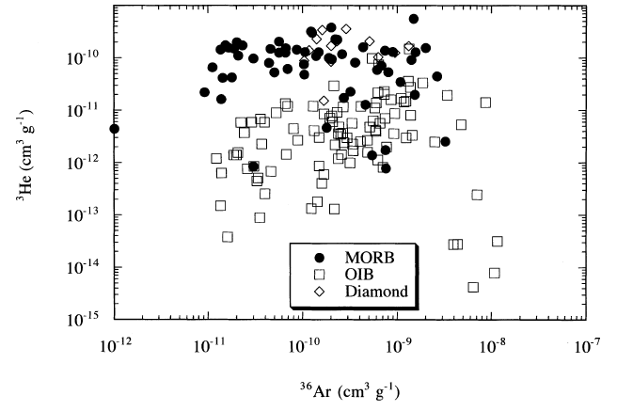
OIB are identical to MORB (with much lower ³He)
Hypothetical undegassed OIB
(no evidence for)
10⁻⁸
10⁻⁹
MORB
gap
High R/Ra
There is no reason to suppose & there never has been that high ³He/⁴He means high ³He! OIB are from ³He deficient sources
OIB
contamination
No degassing trends
High 3He/4He can & probably does mean low 4He, low U-Th
Ozima & Igarashi 2000

Slide 7
Distance from Mature Ridge
25
25
³He/⁴He
³He atoms
(R/Ra)
R/Ra of mix
R/Ra
8
OIB
Contribution from MORB
Contribution from ambient mantle
6
³He atoms

Slide 8
MORB has higher ³He than OIB, even after multiple stages of degassing. This is why high ³He/⁴He is a midplate signature
Gonnermann & Mukhopadhyay
with additions
mixing
Loihi
MORB degassing
OIB
Popping rock
Seawater, air, trapped exsolved gases, shallow mantle
MORB, if present, will dominate any mix
Notes:
primordial less degassed mantle
(PM) and degassed upper mantle (DM) with R values ((3He/22Ne)DM/(3He/22Ne)PM) of 1.6
[Mukhopadhyay, 2012] and 10 [Moreira et al., 2001].

Slide 9
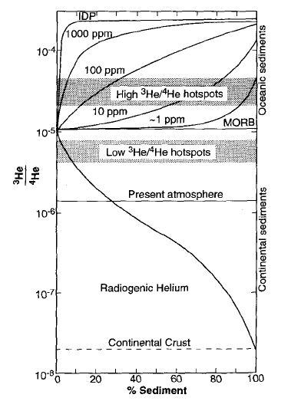
FOZO
Reason why high R/Ra samples are midplate or away from mature rapidly spreading ridges
High ³He/⁴He, low [³He] component only detectable away from MORB
High [³He] component (MORB) dominates
Change in perspective; “plume components” are not due to presence of plume but absence of ridge
EM2
100
50
0
% MORB
Anderson 1993
or FOZO/EM2

Slide 10
In all variants of the standard model, OIB gases are considered to be the residue of massive degassing
Degassed MORB has more ³He than OIB
Gonnermann & Mukhopadhyay
with additions
mixing
[³He]
Retained or residual gas
MORB
Expelled gas
Loihi
³He/²²Ne
MORB degassing
OIB
Popping rock
Seawater, air, trapped exsolved gases, shallow mantle
“the gap” paradox
³He
In the Canonical Model OIB contains residual gas. In the perisphere model OIB picks up old exsolved gases plus air-like gas
Notes:
Either 99.9 % degassing to get to OIB values or 0.1 to 1 % efficient recovery of gases degassed from previous MORB degassing events

Slide 11
MORB has higher ³He than OIB, even after multiple stages of degassing. This is why high ³He/⁴He is a midplate signature
Gonnermann & Mukhopadhyay
with additions
mixing
MORB
MORB degassing
OIB
Popping rock
Seawater, air, trapped exsolved gases, shallow mantle
GAP
MORB, if present, will dominate any mix
Ambient or hotspot mantle

Slide 12
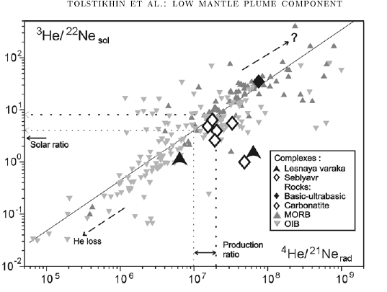
OIB is not extensively degassed; it is moderately contaminated
Carbonatites: slab components?
MORB
Residual gases
Degassed gases
OIB
vesicles
Secondary trapped He
Atmospheric/seawater contamination
Notes:
can be interpreted as a rotation of the OIB trend by nucleogenic ingrowth, i.e., MORB source is aged OIB source. In this simple model MORB = OIB + time. OIB and MORB could have evolved from a common parent at some time in the past. Old MORB gases (from ancient degassed MORB) stored in a depleted refractory host (e.g., olivine crystals, U+Th-poor lithosphere) will have high ³He/⁴He and low He/Ne compared to current MORB magmas.

Slide 13
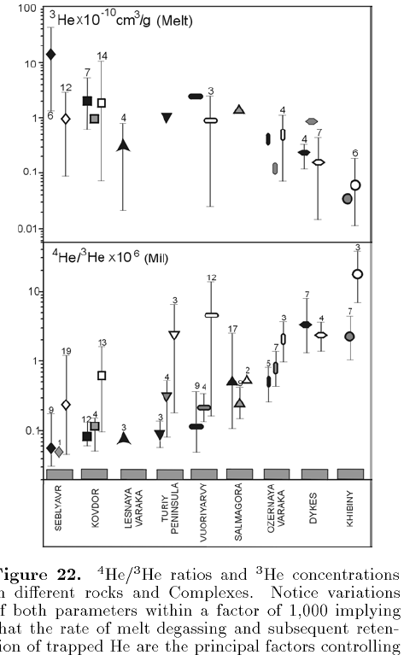
MORB is gas rich!
High levels of ³He
Popping rock
Because of their high ³He concentrations, MORB & some carbonatites dominate any mixing
MORB
Kola peninsula kimberlites & carbonatites & inclusions
[³He]
Most OIB
Most continental “plumes”
U=18 to 0.1 ppm
Mantle xenoliths in carbonatites can have high R/Ra and [³He]
0.07
R/Ra
These are attributed to plumes but they are part of a continuum
7
24
It is not true, as often asserted that all xenoliths are ~< 8 R/Ra
These are grab samples from the
shallow mantle
Tolstikhin

Slide 14
Highest 3He
Highest 3He/4He
Hypothetical undegassed reservoir
MORB
Highest ³He materials on Earth: popping rock, MORB, carbonatites, manganese nodules
OIB

