Slide 1
Region C vs the Transition Zone
Bullen and Jeffreys gave the boundaries of Region C in terms of radius of the mantle, which round off to 410 and 980 km depth. Subsequently a major seismic discontinuity was discovered at a depth of 650 km
The Transition Zone (TZ) is defined by the discontinuities near 400 and 650 km depth
All of these discontinuities vary by at least 20-30 km
Notes:
So Bullen’s Region C and Birch’s Transition Layer reflect regions of the mantle where the lateral and radial gradients in seismic velocity and density are high, probably reflecting changes in composition, lithology, & mineralogy. The Transition Zone (TZ) is a later concept, because the discontinuities were discovered in the 60’s.

Slide 2
The Heterogeneous Mantle
Pyrolite is a homogenous equilibated assemblage of minerals
The mantle may be an unequilibrated mixture of eclogite and harzburgite
Piclogite is neither; large blobs of eclogite are inserted into the mantle and neither mix nor equilibrate
Seismic waves and volcanoes average over large volumes

Slide 3
JOURNAL OF GEOPHYSICAL RESEARCH, VOL. 112, B08301, doi:10.1029/2006JB004853, 2007
Trans-Pacific upper mantle shear velocity structure
Ying Tan and Don V. Helmberger
Seismological Laboratory, California Institute of Technology,
Pasadena, California, USA
Abstract
[1] We use 50 Tonga-Fiji events recorded at the broadband TriNet array, southern California, to develop a pure path upper mantle shear velocity model across the Pacific. At the epicentral distances of 70°–95°, multibounce S waves up to S5 are observed, including their triplicated branches, which become particularly clear after stacking. Since these S wave multiples turn at various depths, simultaneously modeling their differential traveltimes and waveforms provides strong constraints on the radial velocity structure. We parameterize the velocity model according to a priori information from the previous oceanic models, so that we can take a grid search approach, to fully investigate possible interdependencies among the model parameters. We construct synthetics with a reflectivity code and study both the SH and SV components. By modeling the whole recordings from events at different depths, with different mechanisms, we are able to separate shallow low-velocity zone (LVZ) features from deeper structure. Our preferred model (PAC06) contains a fast lid (Vsh = 4.78 km s−1, Vsv = 4.58 km s−1) with a thickness of ~60 km. The underlying LVZ is prominent with the lowest velocities Vsh = 4.34 km s−1, and Vsv = 4.22 km s−1 occurring at a depth of ~160 km. These velocities are below the estimates of solid-state LVZ, suggesting the presence of partial melt. The anisotropy (Vsv < Vsh) of PAC06 extends to ~300 km depth, which is constrained by S5 turning at this depth. Besides the 406 km and 651 km discontinuities, PAC06 also has a small (~1%) velocity jump at ~516 km. We consider these main features of PAC06 to be well determined, since PAC06 explains a large data set from various events. Therefore it is ideally suited for comparing with mineralogical mode

Slide 5
Transition zone
‘The transition layer appears to hold the key to a number of major geophysical problems.’ Francis Birch 1952
‘There may also be a concentration of alumina, lime, and alkalies toward the upper part of the mantle, in and above the transition layer but below the crust, existing in minerals of high elasticity such as garnets and jadeites.’ Below a depth of 800-900 km the mantle is relatively homogeneous.

Slide 6
Mantle differentiates during accretion
Magmas and crustal and upper mantle materials toward the top (basalts, olivine)
Aluminous phases in the crust and TZ
Lower mantle is FeO rich and refractory; residual of accretional melting and differentiation

Slide 7
Earth is compositionally stratified by density
In the large; atmosphere, hydrosphere, sediments, crust, mantle, core
In sedimentary basins
In the crust
In the shallow mantle (Jordan, Lee, James)
Probably shallow mantle, upper mantle, TZ, lower mantle, D”…all differ in composition

Slide 8
Bullen’s Region C (Birch’s transition layer)
Extends from 410 km (+-20 km) to ~900 km (the Repetti Discontinuity)
Is bounded by discontinuities and contains 2 or 3 discontinuities and low-velocity zones
Slabs are trapped between 650 and ~900 km
Lateral variability is high
Chemically distinct from shallow and deep mantle (eclogitic)

Slide 9
Lithological stratification
Eclogites, pyroxenites, piclogites, komatiites…are generally denser than the mantle above 400 km but less dense at depths varying from 400 to 650 km, depending on FeO, SiO2, CaO…contents, temperature and the density of ambient mantle in the TZ
Phase changes in olivine and opx can trap eclogite sinkers

Slide 10
All eclogites are not the same
Subducted oceanic crust and MORB-eclogite can reach 650 km because of the high density of stishovite and Ca-perovskite
Delaminated lower crust is warmer and less SiO2 rich and may be trapped at shallower depths
It may not have to removed from a harzburgite base

Slide 11
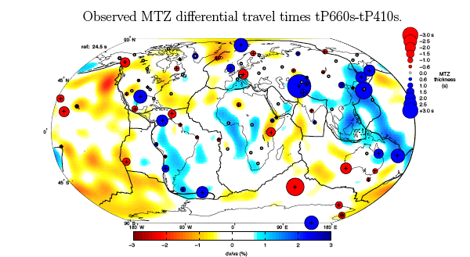

Slide 12
Figure 6. Differential travel times tP660s-tP410s depend on the thickness and pattern of seismic
heterogeneities within the MTZ. Differential travel times under each station are represented relative
to the global average MTZ thickness of 24.5 s. The IASP91 reference value for tP660s-tP410s is
slightly weaker (24s). Positive (suggesting a thicker MTZ) and negative (suggesting a thinner MTZ)
differential travel times are shown with plain blue (red) circles. The background velocity model used
here is a radial average of S20RTS ([4]) through the transition zone. Fast (slow) anomalies are in
blue (red). Our travel-time measurements are in qualitative agreement with S20RTS despite the
different lateral resolution of both data sets (few hundred of km for Pds waves and about 2000 km
in S20RTS).

Slide 13
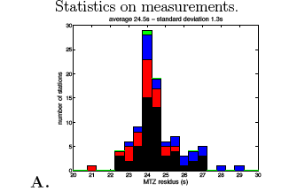
Notes:
Red=subduction. Blue=“plume”, green=both
Mean 24.5+-1.3 sec

Slide 14
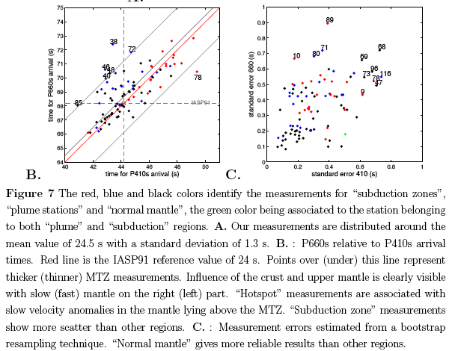

Slide 15
References
[1] Ligorr`ıa, J. and Ammon,Iterative deconvolution and receiver function estimation C., Bull. Seismol. Am.,vol 85, 1395-1400, 1999.
[2] Kennett, B.L.N., Iaspei 1991 seismological tables, Res. Sch. of Earth Sci. Int., Aust. Nat. Univ., Canberra, 1991.
[3] Debayle, E., Kennett, B.L.N., Priestley K., Global azimuthal seismic anisotropy and the unique plate-motion deformation of Australia, Nature 433,
509-512 (2005).
[4] Ritsema, J. and van Heijst, H. J., Seismic imaging of structural heterogeneity in Earth’s mantle: Evidence for large-scale mantle flow, Science
Progress, 83, 243-259, 2000.
[5] Courtillot, V., Davaille, A., Besse, J. Stock, J. 2003, Three distinct types of hotspots in the Earths mantle, Earth and Planetary Science Letters
205 3-4, 295-308.
[6] Montelli, R., G. Nolet, F. A. Dahlen, and G. Masters (2006), A catalogue of deep mantle plumes: New results from finite-frequency tomography,
Geochem. Geophys. Geosyst., 7, Q11007, doi:10.1029/2006GC001248.
[7] Gudmundsson, ., and M. Sambridge (1998), A regionalized upper mantle (RUM) seismic model, J. Geophys. Res., 103(B4), 71217136.
[8] Van der Lee, S., and A. Frederiksen, 2005, Surface Wave Tomography applied to the North American upper mantle, in AGU Monograph ”Seismic
Data Analysis and Imaging With Global and Local Arrays”, Eds: Nolet and Levander, 67-80.

Slide 16
The average MTZ thickness for “plume” stations is 24 s with a standard deviation of 0.7 s.
This average does not differ significantly from the “normal mantle” in spite of slightly higher standard errors than for “normal mantle” stations…+-7 km

Slide 17
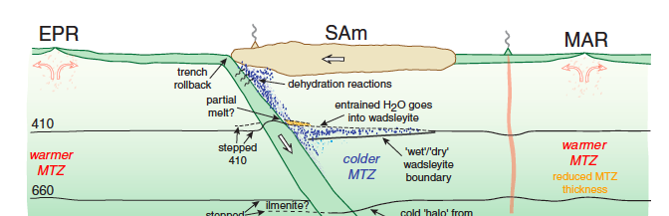
Broad upwelling
up
elevated
up
depressed
elevated
slab
Depressed 650

Slide 18
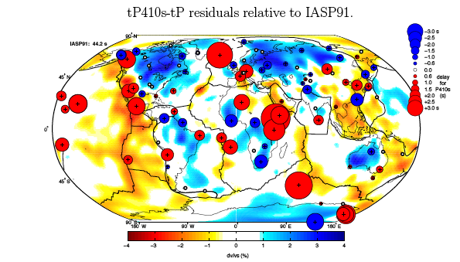
Notes:
B.Tauzin, E.Debayle, G.Wittlinger
There is no relation to hotspots or lower mantle superswells.
http://www.mantleplumes.org/TransitionZone3.html

Slide 19
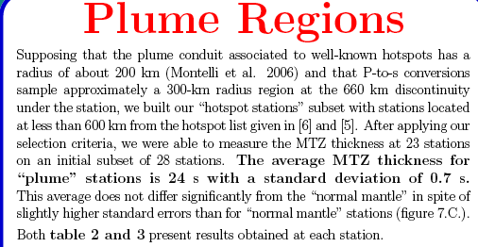

Slide 20
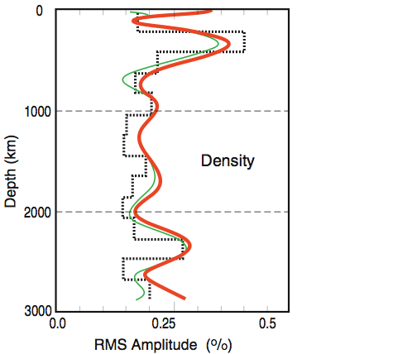
Density variations
Notes:
Lateral variations are largest in TZ, consistent with slabs and delaminates piling up.MORB-eclogite should be denser and deeper than arclogites.

Slide 21
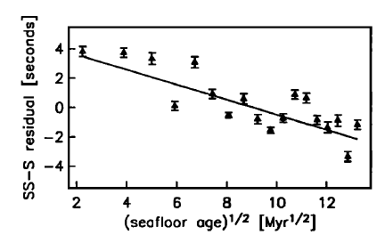

Slide 22
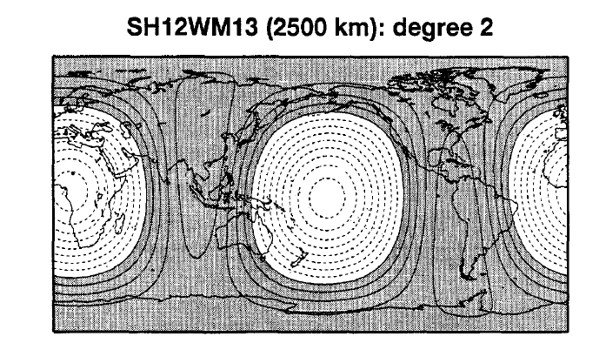

Slide 23
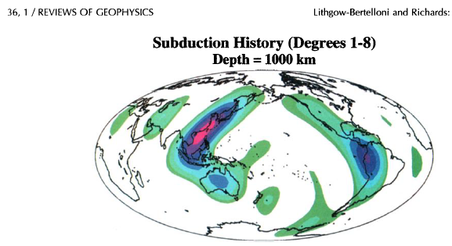
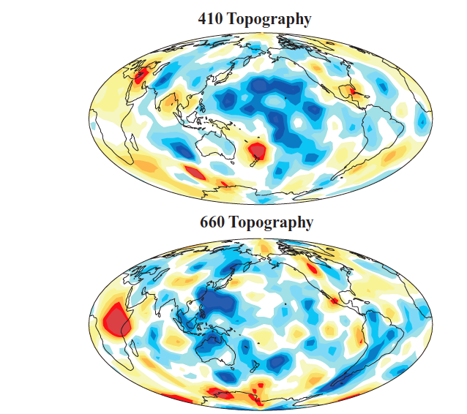
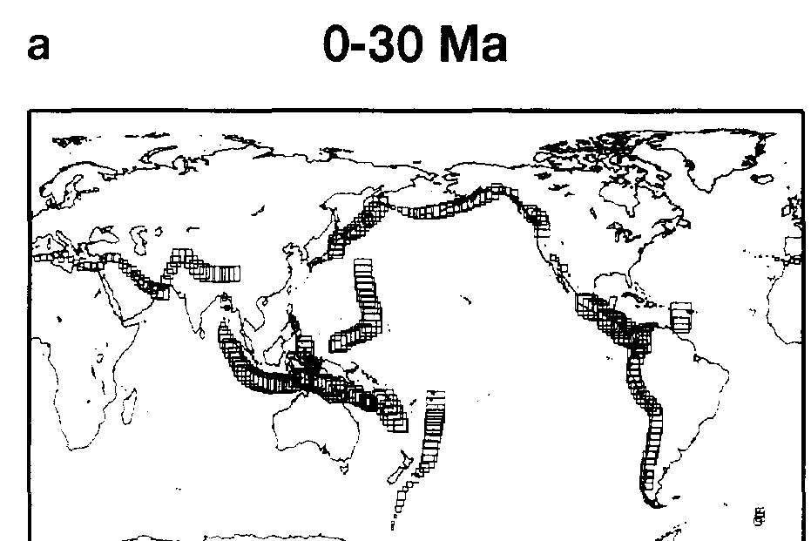
Notes:
Subduction histroy correlates much better with 650 than with 410. We have shown that the transition zone width and 660 km
discontinuity topography are correlated to transition zone velocity
structure, but the 410 km discontinuity is uncorrelated. In addition,
the 410 km discontinuity topography is slightly correlated rather
than anticorrelated with the 660 km discontinuity as would be expected
for a vertically coherent thermal anomaly.

Slide 24
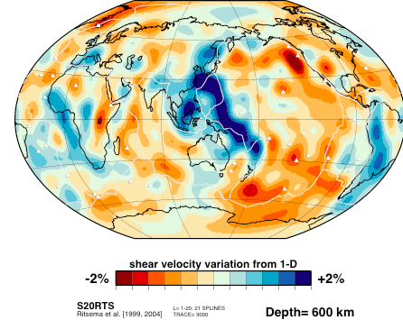
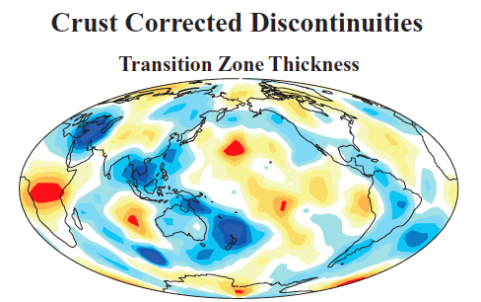
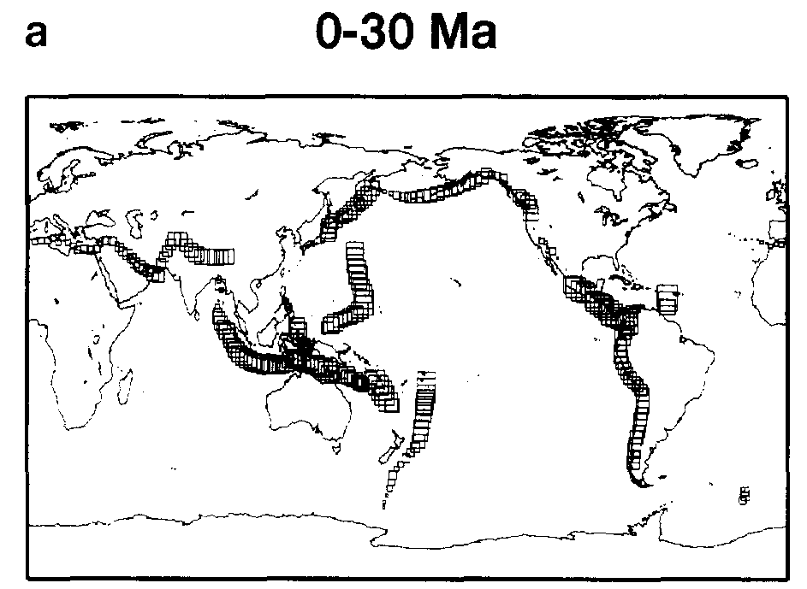

Slide 25
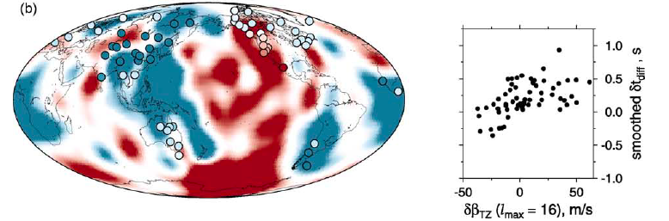
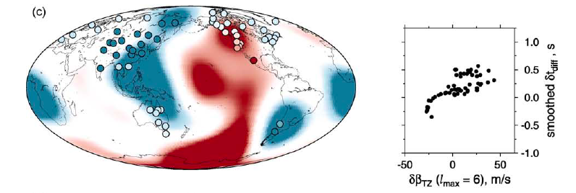

Notes:
Fig. 11. Measurements of the differential-time anomaly δtdiff at 77 stations around the world compared with the transition zone S-velocity
anomaly δβTZ according to the degree-16 tomographic model S16B30 (Masters et al., 1996). Circles denote seismic stations and are
filled with color showing tdiff anomaly. Left: δtdiff measurements superimposed on the 550 km cross-sections through S16B30; right: δtdiff
measured at each station vs. δβTZ beneath the station…(b) S16B30 is unfiltered; δtdiff distribution is smoothed laterally with Lδt = 2500 km and wmin = 1.5; the
smoothing could be done at 63 stations only (see text for explanation). (c) S16B30 is truncated at spherical-harmonic degree lmax = 6;
δtdiff distribution is smoothed with Lδt = 3000 km and wmin = 2.5 (60 stations).

Slide 26
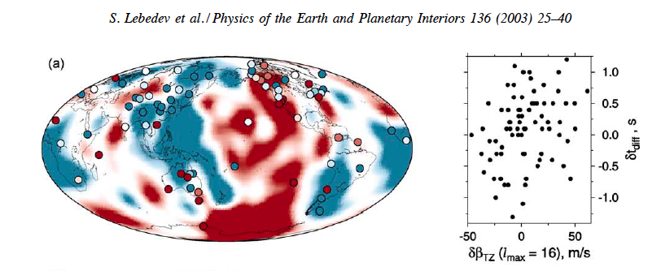
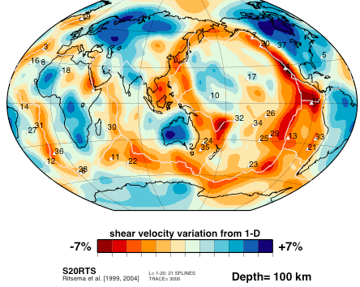
TZ
100 km

Slide 27
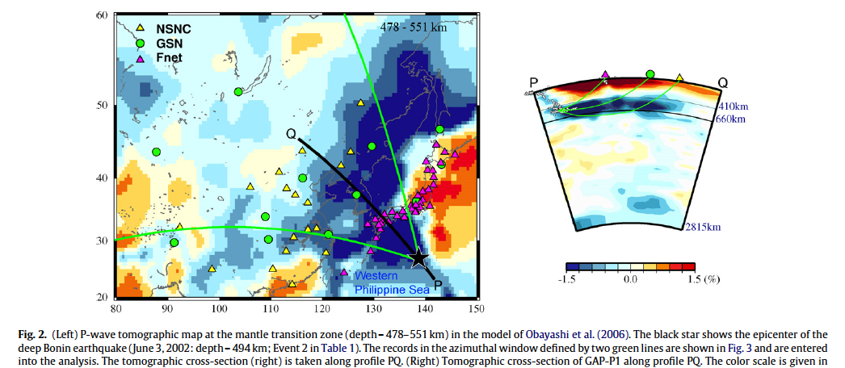
Transition Zone under WUSA, E.Asia, S.Europe…cooled by subduction
H. Sugioka et al. / Physics of the Earth and Planetary Interiors 179 (2010) 1–6
Notes:
PEPI 2010 Sugioka…The theoretical travel times are in good agreement with observation
for both P and S waves for a value of R of 1.4, which implies
that the seismic velocity anomalies associated with the stagnant
slab can be explained as the thermal effect. The stagnant slab is
estimated to be 250–300K colder than the surrounding mantle. H. Sugioka et al. / Physics of the Earth and Planetary Interiors 179 (2010) 1–6

Slide 28
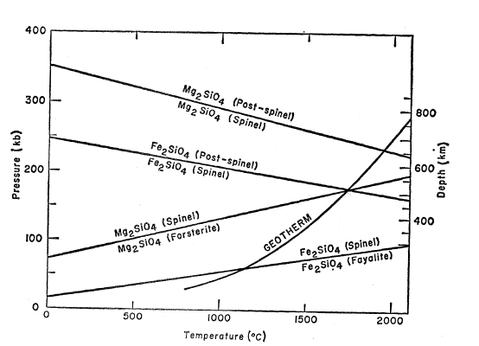
410 & 650 should be anticorrelated for whole mantle convection & throughgoing slabs & plumes
subadiabat
Cold slab
410
650

Slide 29
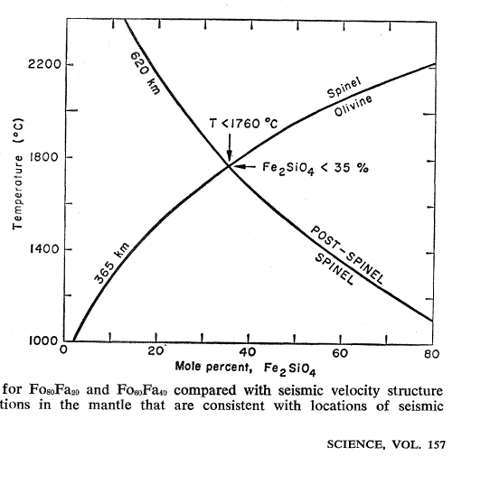

Slide 30
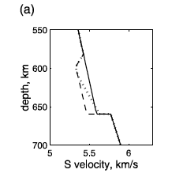
Shen & Blum
Melt or eclogite?

Slide 31

Low-velocity zone atop the 410-km seismic discontinuity in the northwestern United States
Teh-Ru Alex Song, Don. V. Helmberger & Stephen P. Grand
400-km

Slide 32
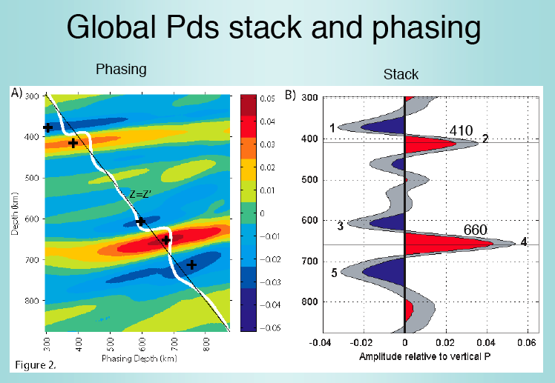
Dueker
Notes:
Yellowsstone

Slide 33
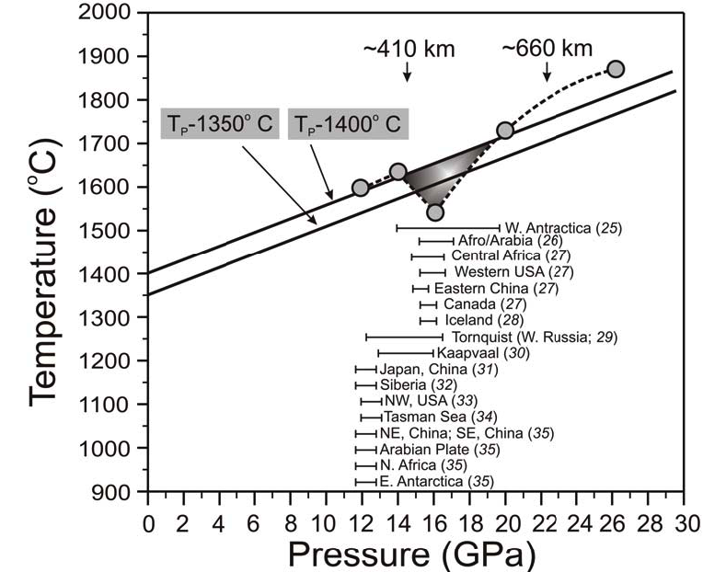
Low-Velocity Anomalies
Notes:
Shantanu Keshav^{1*}, Gudmundur H. Gudfinnsson¹, and Dean C. Presnall^{2,3,+}
Widespread Carbonatitic Melts at Depths of 400-600 km in the Earth
Iceland Vinnik, L., Foulger, G. L. & Du, Z. (2005). Seismic boundaries in the
mantle beneath Iceland: a new constraint on temperature.
GeophysicalJournal International 160, 533^538.

Slide 34
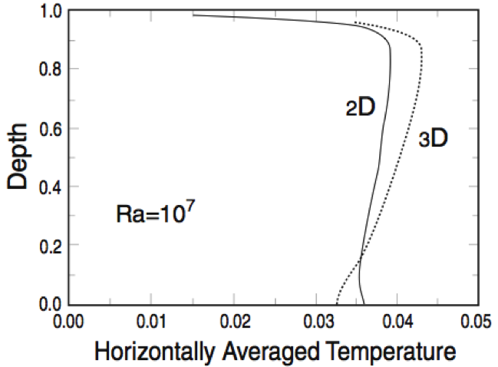
MORB
O
X
OIB
Amount & depth of melting depends on CO2, H2O, fertility
CMB
Notes:
OIB can be hotter than MORB because it comes from deeper. It can also come from more fertile mantle.

Slide 35
Notes:
Section conclusions･12 km depression in the 410 under Dillion Montanaabout 140 km NW of Yellowstone Caldera is consistentwith 110 degree thermal anomaly. Would require a 15degree dipping to the NW conduit to connect withYellowstone Caldera.･･Negative velocity gradient at 380 km (atop the 410) and at 720 km (below 660).

Slide 36
Notes:
Harzburgites and dunites are less dense than pyrolite and fertile peridotites. Eclogites and Hawaiian lherzolites are even more dense, but they can be trapped above the beta spinel phase boundary. Some arclogites can be trapped above 500 km depth, while many MORB eclogites can be trapped at 650 km.

Slide 38
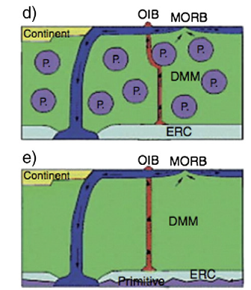
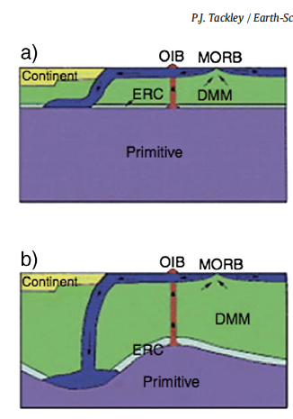
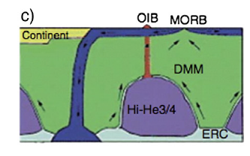
OIB MORB
LLAMA
TZ
DMM
BAM
Notes:
Fig. 10. The time evolution of a laboratory thermo-chemical convection experiment (right column) compared to various mantle models proposed to explain geochemical observations
(left column). Cartoons in the left column are from Tackley (2000). (a) Layered at the 660 km discontinuity; (b) deep, high-topography hidden layer (Kellogg et al., 1999); (c)
‘piles’ (Tackley, 1998) or ‘domes’ (Davaille, 1999a); (d) primitive blobs (Davies, 1984; Manga, 1996; Becker et al., 1999; du Vignaux and Fleitout, 2001); (e) whole-mantle convection
with thin dense layer at the base.

Slide 39
THE ECLOGITE ENGINE
Basalt+pressure
Eclogite
Down stroke
Heating+melting
Expansion
Rising
volcanism
Blob gains heat from mantle, delivers it to surface

Slide 40
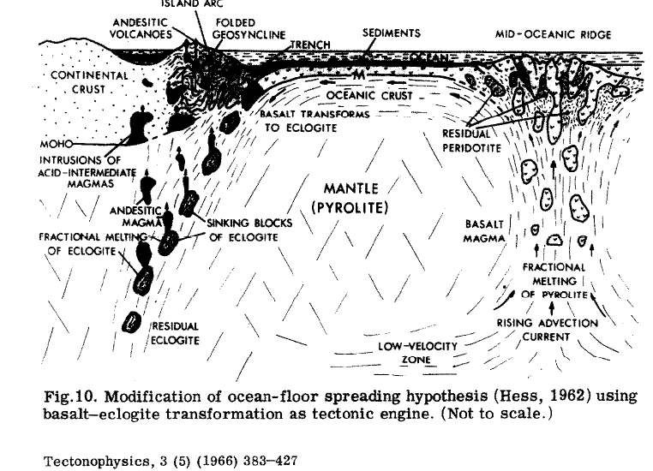
Fertile blobs
Not plume tails
Narrow active cold downwelling
PASSIVE
Ringwood & Green

Slide 41
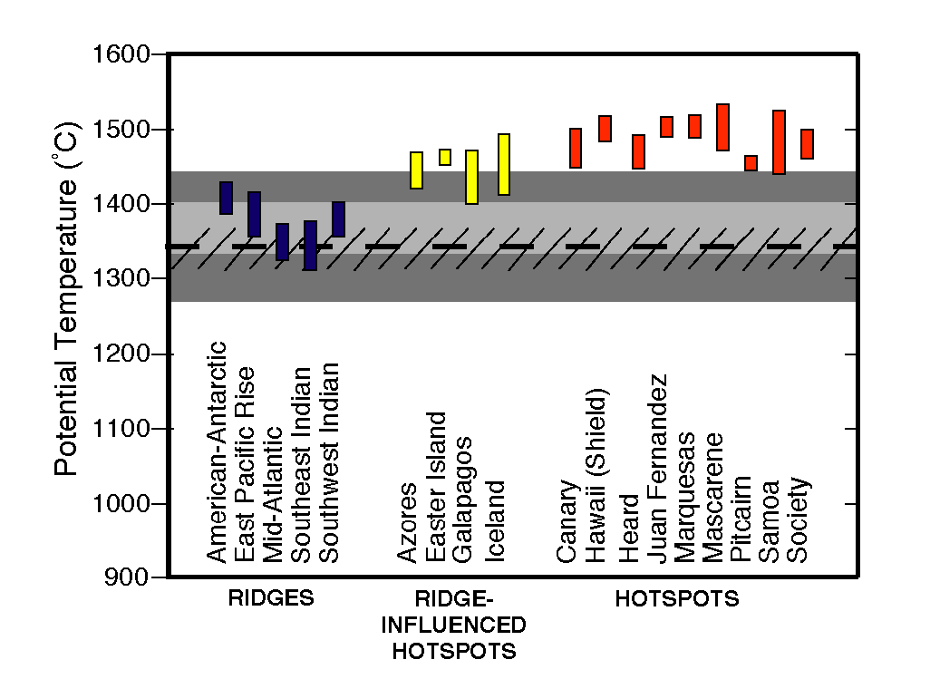
Coutier et al. 2007
P&G

Slide 42
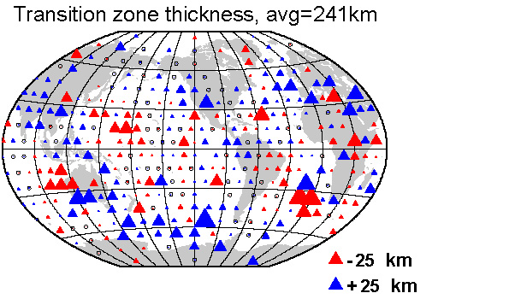
Deuss
Notes:
The TZ is generally thick under both trenches and back-arc basins, consistent with colder than average mantle. Many ridge segments also have
Thicker TZs than midplate locations.

Slide 43
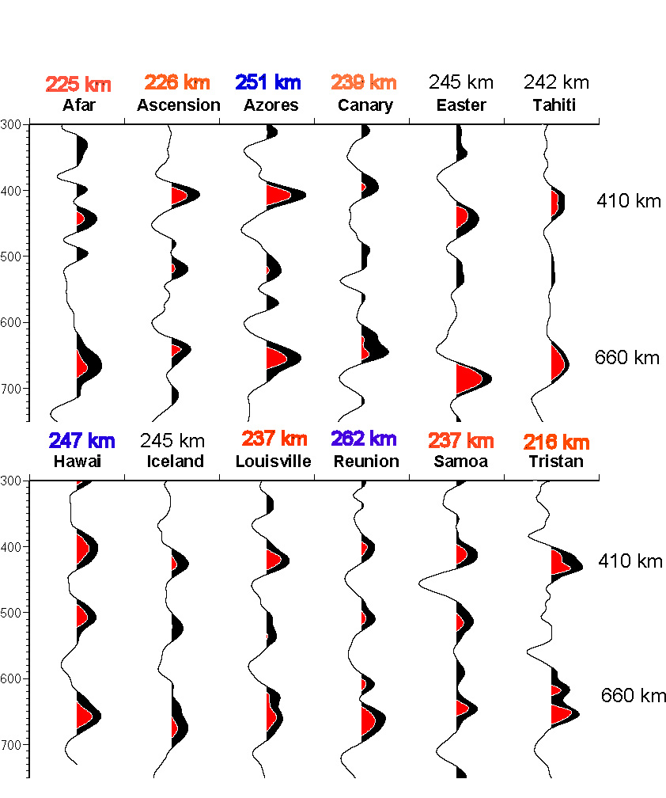
Of hotspots with possibly deep origin (Courtillot et al. 2003, Montelli et al. 2004) only Afar, Ascension and Tristan have thinner TZ than average.
Azores, Hawaii and Reunion have thicker TZ than average

Slide 44
There is some indication that the 650 is deeper when influenced by slabs
There is no suggestion of thin TZ above the lower mantle “superplumes”
The 410 and 650 depths are uncorrelated
“Hotspots” and inferred locations of deep mantle slabs have normal 410 depths and TZ thicknesses(?)

Slide 45
Baig & Dahlen
RMS heterogeneity of approximately 1 to 2 per cent may be present in the upper mantle for scale lengths greater than 100 km. The upper mantle is substantially more heterogeneous than the lower mantle, by at least a factor of 2.
Notes:
1 to 2 % at 100 km scale length in upper mantle (Earle & Shearer). Lower mantle is more homogeneous at these wavelengths by a factor of 2 to 10. At global scales (Ishii and Tromp) the TZ is considerably more variable in density than any part of the deeper mantle, including D”.

Slide 46
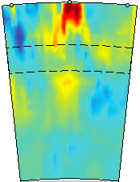
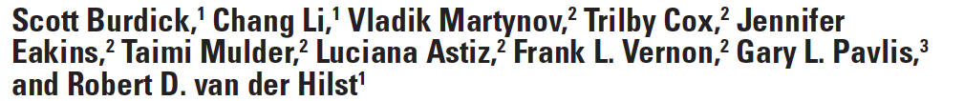
Yellowstone

Slide 47
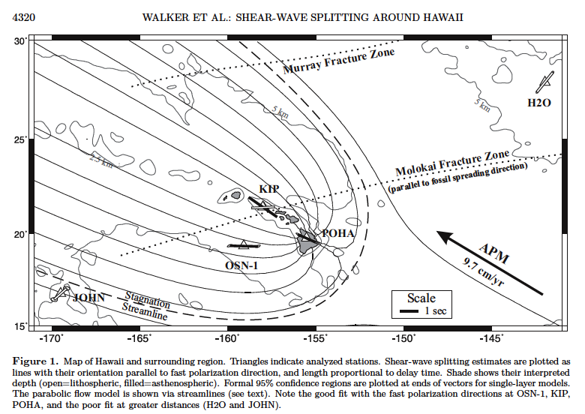

Slide 48
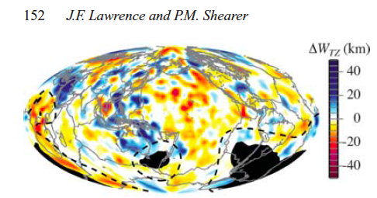
The average transition zone thickness within 2◦ radii of hotspots is 3.9 km thinner than the randomly sampled locations….about the same as ridges… The minimum TZ thickness within 2◦ radii of the hotspots is 5.2 km thinner than the randomly sampled locations. A temperature increase between 25◦ and 40◦K would result in ∼4 km thinning…10 % to ~5% of total range…
Notes:
we compare the difference in average and minimum
transition zone thickness beneath hotspot locations (Fig. 13h)
(Steinberger&O’Connell 2000) with equivalent values beneath randomly
sampled locations. By repeating the random resampling 25
times we obtain a more reliable result and a measure of uncertainty
in the result. The average transition zone thickness within 2◦ radii of
the hotspots (excluding regions with insufficient resolution) is 3.9°æ
1.1 km thinner than the randomly sampled locations. The minimum
transition zone thickness within 2◦ radii of the hotspots (excluding
regions with insufficient resolution) is 5.2 °æ 1.7 km thinner than the
randomly sampled locations. A temperature increase between 25◦
and 40◦K would result in ∼4 km thinning….
On average, hotspots are located above or near
discontinuous regions of thinned transition zone. Further kinematic
thermal modelling suggests that the large amplitudes of the thinned
anomalies likely result from warm upwellings that originate from
higher temperature sources much deeper in the mantle. The average transition zone thickness within 2◦ radii of
the hotspots (excluding regions with insufficient resolution) is 3.9°æ
1.1 km thinner than the randomly sampled locations. The minimum
transition zone thickness within 2◦ radii of the hotspots (excluding
regions with insufficient resolution) is 5.2 °æ 1.7 km thinner than the
randomly sampled locations. A temperature increase between 25◦
and 40◦K would result in ∼4 km thinning.

Slide 49
Shearer & Earle (2004)
We find that most scattering occurs in the lithosphere and upper mantle
Some lower mantle scattering is likely also required.
We find 3% to 4% RMS velocity heterogeneity at 4-km scale length in the upper mantle and 0.5% RM heterogeneity at 8-km scale length in the lower mantle

Slide 50
This is the stratigraphy for a density stratified mantle
Notes:
Harzburgites and dunites are less dense than pyrolite and fertile peridotites. Eclogites and Hawaiian lherzolites are even more dense, but they can be trapped above the beta spinel phase boundary. Some arclogites can be trapped above 500 km depth, while many MORB eclogites can be trapped at 650 km.

Slide 53
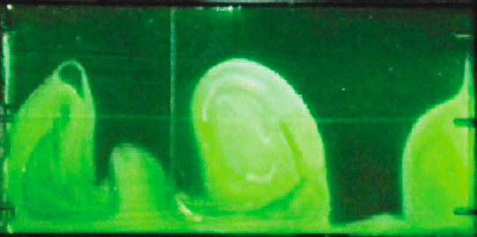
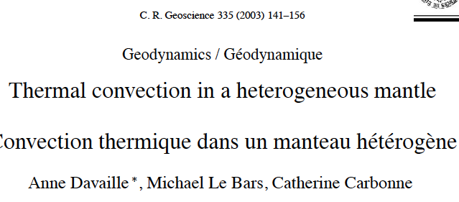
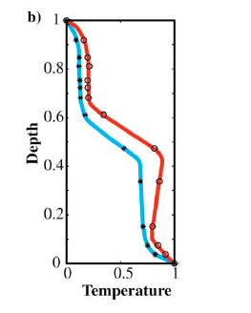
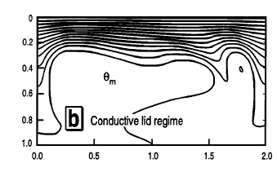
trenches
ridges
trenches
2-layers
Narrow fast
Broad slow
Heated from below
Heated from within
Notes:
(b) Vertical thermal structure
associated with the cold descending currents in the cusps (blue) and with the hot narrow plume conduit (red).
A. Davaille et al. / C. R. Geoscience 335 (2003) 141–156

Slide 54
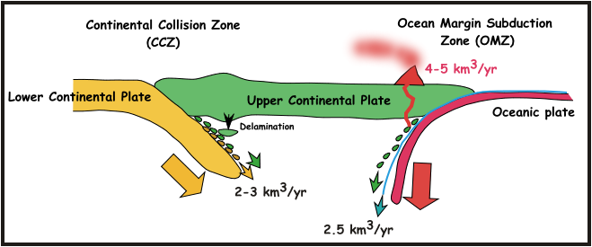
Estimating mantle sources & sinks, continental addition & loss, through time, depends critically on when deep subduction, got underway
1 Gyr of oceanic crust subduction=70 km of eclogite
But lots of other things get put into the mantle
OIB
~2 Km³/yr
20 km³/yr
David Scholl
Piles up @ 70 km/Gyr

Slide 55
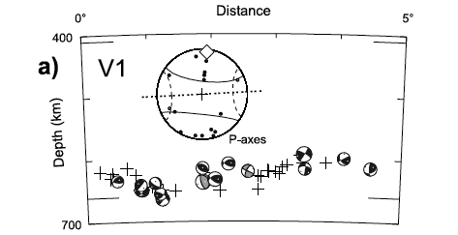
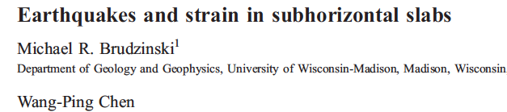
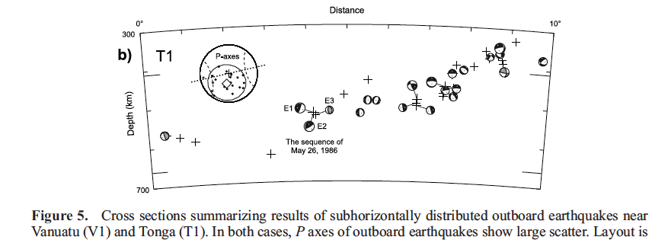
Flat slabs at 650 inferred from mechanisms, locations, anisotropy..

Slide 56
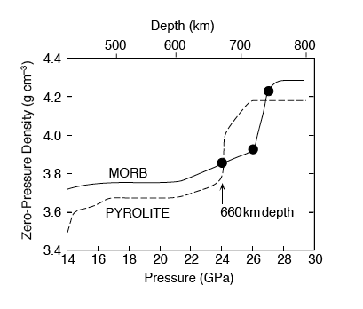
Ponding of eclogite
PREM is
Denser than pyrolite
Density
crossover
Notes:
Very cold MORB-eclogite, or high SiO2 or CaO (Ca-perovskite) can make MORB denser than pyrolite but the TZ and lower mantle may themselves be denser than pyrolite (which is based on upper mantle samples).

Slide 57
Transition Zone thickness is independent of hotspot and ‘megaplume’ locations
Notes:
If seismic velocities, TZ thickness, and melting anomalies at the Earth’s surface are measures of mantle temperature, these parameters should all be related.
Constraints on the mantle transition zone structure from P-to-Sv converted waves. Most 410 are between 400 and 425
Benoît Tauzin, Eric Debayle & Gérard Wittlingerl
http://www.mantleplumes.org/TransitionZone3.html

Slide 58
Gilbert et al.
640
670
425
410
km
395
650 km
Notes:
No correlation

Slide 59
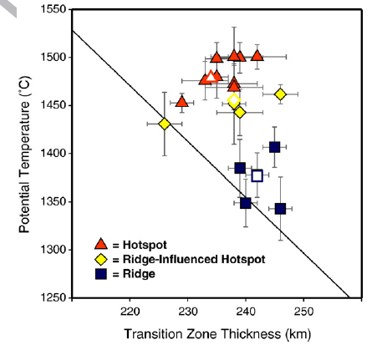

Slide 60
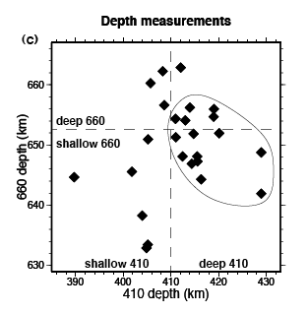
Deuss

Slide 61
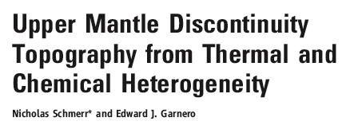

Slide 62


Slide 63
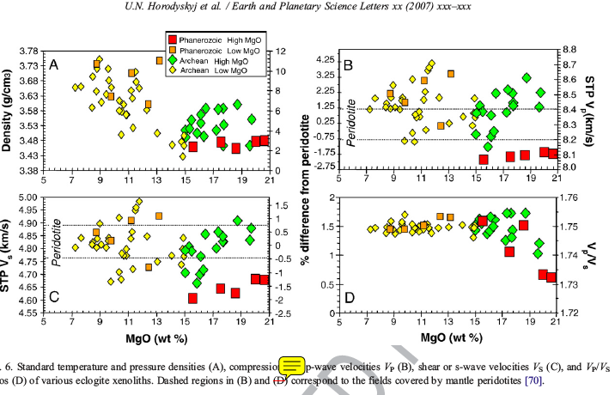
Eclogite sinkers can look like hot plumes
Low shear velocity!

Slide 64

Notes:
a scenario in which the 410 and 660 km discontinuities are anticorrelated
and accompanied by high Vp/Vs ratios due to the presence
of a few percent water. This scenario does not agree with our findings
since it also indicates that the 410 and 660 km discontinuities
should be anticorrelated and that a shallow 410 km discontinuity
it is likely that the 410 km discontinuity
does respond as expected in the presence of a thermal anomaly.
The fact that it is not globally anticorrelated with the 660 km discontinuity
or correlated with the velocity structure…water?...should correspond to regions of slow shear velocities, which we do
not observe. To date, the chemical and mineralogical implications
of the curious topography of the 410 km discontinuity has to be fully
explored.

Slide 65


410
660
Notes:
Houser SS

Slide 66
Notes:
The average continental crust is density stratified; granite, basalt, granodiorite, anorthosite, gneiss, diorite, dolerite, gabbro, amphibole, pyroxenites…

Slide 68
TZ thicknesses
Notes:
Shearer group

Slide 69

Notes:
Keshav…Your MORB adiabat requires a crossover - identical shear velocity (identical melt-fraction) as the Hawaiian geotherm - at about 100 km, 1250 C. This is in very strong disagreement with the Maggi diagram. Also, low-velocity areas are centered at two pressures, 11.5 and and 16.5 GPa (see summary in Keshav et al., 2011, Fig. 14). The pressure gap between these two (~13-14.5 GPa) is exactly the pressure range of closest approach (smallest melt fraction) of the solidus to my geotherm, with larger melt fractions expected at both smaller (<13 GPa) and greater (>14.5 GPa) pressures. Then at ~17.5 GPa, the diagram shows the geotherm passing to subsolidus conditions (higher velocity).

Slide 70
Notes:
Depth of “410” and thickness of TZ; Iceland 238 km , 395 km

Slide 71


Slide 72

About 50 years ago Caltech seismologists discovered two major discontinuities in the transition region of the upper mantle

Slide 73

Notes:
Ridges have shallow 410 and 650. Both are deep under w.South America.

Slide 74

Flat slabs at 650 km cool off the mantle & thicken the TZ
Slide 2

Slide 75

Correlations between seismic velocities (solid) and between velocities and densities (dots and dashes)
Notes:
If temperature is the controlling parameter in changing velocity and density there should be strong correlations between these paramaters at all depths; there is not. Furthermore, the correlation coefficients suggest that the mantle is subdivided into at least three regions, the upper, mid and deep mantle. As can be seen from the figure, buoyant regions need not have low seismic velocity. Ishii, M. and Tromp, J., 2004. Constraining large-scale mantle heterogeneity using mantle and inner-core sensitive normal modes: Physics of the Earth and Planetary Interiors, v. 146, p. 113–124

Slide 76

Dense Domes
Not Megaplumes

Slide 77
Buoyant & high velocity
Dense but low velocity
Notes:
Cold slabs in the TZ will be high velocity and dense but the correlation between velocity and density is actually negative. Eclogite sinkers will be dense or neutrally buoyant and have low seismic velocities; as they warm up and melt they continue to have low velocities but can have low densities and will rise. The shallow mantle has such a positive correlation between density and velocity. In the upper mantle dense materials will sink; buoyant material can be low density and high velocity (harzburgite). In the shallow mantle, eclogite is dense and high velocity compared to peridotite.

Slide 78

Notes:
The maximum lateral variabity of density in the mantle is in the transition zone. This is consistent with variable lithology, created by subduction and delamination, and with variable melt content, a function of duration of heating.

Slide 79

Tri-partite mantle
DYNAMIC
Sinking & rising blobs
ISOLATED
DYNAMIC
SLUGGISH

Slide 80
WHERE ARE THE SLABS PREDICTED TO BE?
HOTSPOTS (CIRCLES) are where slabs are not
Predicted locations of slab material; correlations best @ 800km

Slide 81




Notes:
NewTOE FIGURE 6.5 vs Burke et al 20120 FIGURE 1
Diamonds sampled by plumes from the core–mantle
boundary
Trond H. Torsvik1,2,3, Kevin Burke3,4, Bernhard Steinberger1,2,5, Susan J. Webb3 & Lewis D. Ashwal3NATURE| Vol 466| 15 July 2010
And various FIGURES in Seton et al.

Slide 82

BLUE REGIONS ARE SLAB GRAVEYARDS (FARALLON,TETHYS)
1100 km depth
Blue regions are probable fossil slabs. Red can uplift surface
Notes:
Two blue regions give a strong degree 2 heterogeneity
Borneo and Equador are the strongest anomalies and are on the equator. They may control the rotation axis

Slide 83

600 km depth
BLUE Africa ?? SE Asia Slabs? Andes Slabs?
Notes:
Degree 2 is stronger in TZ. These blues are stronger than Tehys and Farallon “slabs”
The slowest regions at 600 km are; S. of NZ, offshore Pacific NW, e. equatorial Africa,the fastest regions are Yonga to China, Andes, Borneo, w. Africa

Slide 84

Upper mantle ~ Geology + half-space cooling
Lower mantle ~ Subduction history
Transition zone?
Ritsema et al. (2004)
Notes:
Slow; EAR

Slide 86

Phase changes V V V
410 520 650
Chemical boundaries
Chemical discontinuities & blobs
Phase changes are flat and stack-up. Chemical boundaries & blobs are variable depth.
Notes:
24 reflections above 400 km; 18 near 400 km (380-420 km); 9 near 500 km; 5 above 630 km; 17 near 650 km; about 25 below 720 km
There is a dearth of relectors 340-360, 560-620, and 680-740.
390-430 km peak is plausibly interpreted as the variability in depth of the 420. The 630-670 km as the variabilty in the 650. 490-530 an the 500. High resolution studies often find 2 reflectors near 410 and 650 km; sometimes none, implying low impedance contrast for some frequencies and some angles of incidence.

Slide 87
Phase vs chemical boundaries
Phase change boundaries are expected to vary by only 20-30 km
Chemical boundaries may vary by about 100-200 km
Histograms of reflection depths will therefore be more sharply peaked at phase boundaries, and chemical boundaries will be spread out in depth

Slide 89

Lowermost mantle vs TZ
The thinnest TZ are not above the so-called “superplumes”

Slide 90



Notes:
There is no correlation of TZT with superplumes.

Slide 91
Notes:
There is no correlation of TZT with superplumes.

Slide 92

Some thin TZs
Notes:
Thin TZ are uncorrelated with the “superplumes” below

Slide 93
Transition Zone thickness is independent of hotspot and ‘megaplume’ locations
Notes:
If seismic velocities, TZ thickness, and melting anomalies at the Earth’s surface are measures of mantle temperature, these parameters should all be related.
Constraints on the mantle transition zone structure from P-to-Sv converted waves. Most 410 are between 400 and 425
Benoît Tauzin, Eric Debayle & Gérard Wittlingerl
http://www.mantleplumes.org/TransitionZone3.html

Slide 94
Transition Zone thickness is independent of hotspot and ‘megaplume’ locations
Notes:
If seismic velocities, TZ thickness, and melting anomalies at the Earth’s surface are measures of mantle temperature, these parameters should all be related.
Constraints on the mantle transition zone structure from P-to-Sv converted waves. Most 410 are between 400 and 425
Benoît Tauzin, Eric Debayle & Gérard Wittlingerl
http://www.mantleplumes.org/TransitionZone3.html

Slide 95



Neither slabs nor hotspots have the predicted effects on TZ

Slide 96


Slide 97

Subadiabatic trends

Slide 98
Correlation coefficient (CC) between TZ thickness & Tp of magmas
CC=-0.3
e.g. no significant correlation

Slide 99
Hawaii is cold
Hawaii is “hot” but this means hot relative to midocean ridges.
There is no evidence that Hawaii represents a local (or deep)thermal anomaly.
Garrett Leahy
Geophys. J. Int. (2010) 183, 313–329
Underplating of the Hawaiian Swell:
Garrett M. Leahy

Slide 100
Some thin TZs
Notes:
Thin TZ are uncorrelated with the “superplumes” below

Slide 101
Lower mantle “superswells”

Slide 102
Reunion
Easter
Yellowstone
Tahiti
Hawaii
Azores Marquesases
Fernando
Cape Verde
San Felix
COLD
Crozet, Samoa
Siberia, Germany
Canary, Ascension
Pitcairn, Berkeley
Kerguelen, Harvard
Pasadena
Santa Barbara
HOT
Pitcairn, Baja, Discovery, Vema
Crozet, Iceland, Jan Mayen,Kerguelen, Darfur, Canary, Hawaii, Azores, Easter, Eifel
Notes:
Note: “Normal” mantle has thermal variations of order 300 C if TZ thicknesses and depths of discontinuities are thermally controlled. But there is little correlation between depths and thicknesses so something else is going on. The chemistry of the mantle varies laterally and vertically.

Slide 103
Reunion
Easter
Yellowstone
Tahiti
Hawaii
Azores Marquesases
Fernando
Cape Verde
San Felix
COLD
Statistically, hotspots are indistinquishable from random mantle…but some have tried to separate out those that make sense ( have the expected trends)…
Crozet, Samoa
Siberia, Germany
Canary, Ascension
Pitcairn, Berkeley
Kerguelen, Harvard
Pasadena
Santa Barbara
HOT
Pitcairn, Baja, Discovery, Vema
Crozet, Iceland, Jan Mayen,Kerguelen, Darfur, Canary, Hawaii, Azores, Easter, Eifel
Notes:
Note: “Normal” mantle has thermal variations of order 300 C if TZ thicknesses and depths of discontinuities are thermally controlled. But there is little correlation between depths and thicknesses so something else is going on. The chemistry of the mantle varies laterally and vertically.

Slide 104
Notes:
Figure 12. (a ﾐ d) West to east cross-sections of CCP stacked receiver functions. Locations of cross- sections are indicated on Figures 6 and 7 (A-A0, etc.). Radial P waves are scaled to unity for each trace. Color scale ranges between ｱ10% (positive, red, and negative, blue) of radial P. Stacked receiver functions are shown in black, and thinner blue lines are one sigma bounds derived from bootstrap resampling. White circles show picked depths found within each bin used to make discontinuity maps.

Slide 106


Slide 107



Slide 108
Neither slabs nor hotspots have the predicted effects on TZ
Notes:
Ridges have shallow 410 and 650. Both are deep under w.South America.

Slide 109

Seismic tomography
Near surface
Old oceans fast
Young oceans slow
Cratons (old parts of continents) fast
Core-mantle boundary
Past subduction fast
African and Pacific anomalies slow
Cause?
Ritsema

Slide 110
Earth structure
Phase transformations
Produce discontinuities
Thermometers
Influence dynamics
Computation
Global Gibbs free energy minimization
New self-consistent method
  Phase equilbria
  Physical properties
  Elasticity
Stixrude & Lithgow-Bertelloni (2005) GJI
Stixrude & Jeanloz (2007) Treatise on Geophysics

Slide 111

Influence of phase transitions on mantle dynamics
Temperature
Composition
Nakagawa & Buffett (2005)

Slide 112


Slide 113


Slide 114


