Slide 1
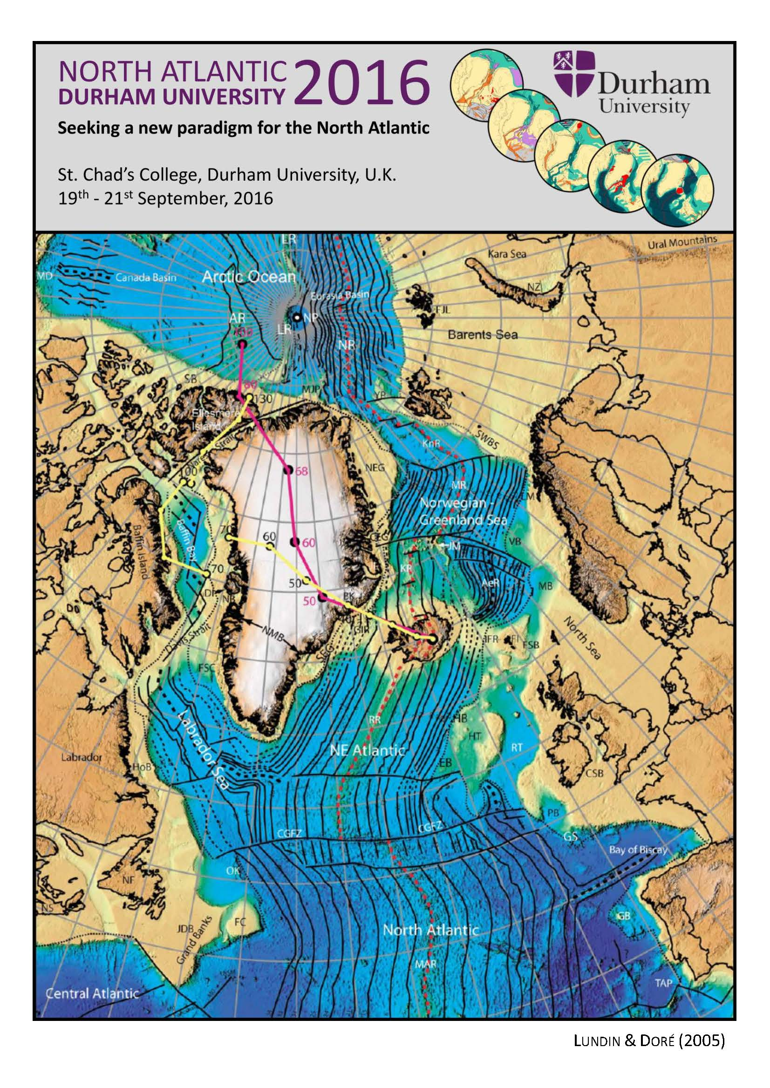

Slide 2
Welcome Introductions Announcements

Slide 3
Planned ESR papers
General overview (Leader: Gillian Foulger, everyone a co-author).
What is the nature of Iceland? Does it contain a continental sliver? Structure, gravity, kinematics. (Leader: Ármann Höskuldsson & Gillian Foulger).
What is the process and chronology of breakup? Conditions, rift propagation towards hotspots, kinematics, kinematic history up to the present. (Leaders: Laurent²)
North Atlantic thermochronology (Leader: Søren Nielsen).
What are the reasons for melting? Could be whether hot or cold, or extension rate controls volcanic rate. How wet? How fertile? What do we know and what not? Relationship with extension and vertical motions. (Leader: Malcolm Hole).
Inheritance. Piercing points, mantle reflectors, reactivation of Caledonian, delamination, numerical modelling, dynamic uplift. Could be from earliest known orogeny to present. (Leaders: Tony Doré & Christian Schiffer).
Reykjanes Ridge (Leader: Fernando Martinez).
Structure from top to bottom Crust, mantle. (Leader: Nick Kusznir).
Comparisons/extensions to other regions in particular Tristan and Réunion systems. (Leader: Alex Peace).

Slide 4
Towards a new paradigm
Gillian R. Foulger

Slide 5
Breakup & “inheritance”
Continents break up via propagating rifts.
Propagation along pre-existing structures results in simple boundaries
Propagation across pre-existing structures results in complex boundaries
Breakup style related to interaction of structural anisotropy & stressfield orientation

Slide 6
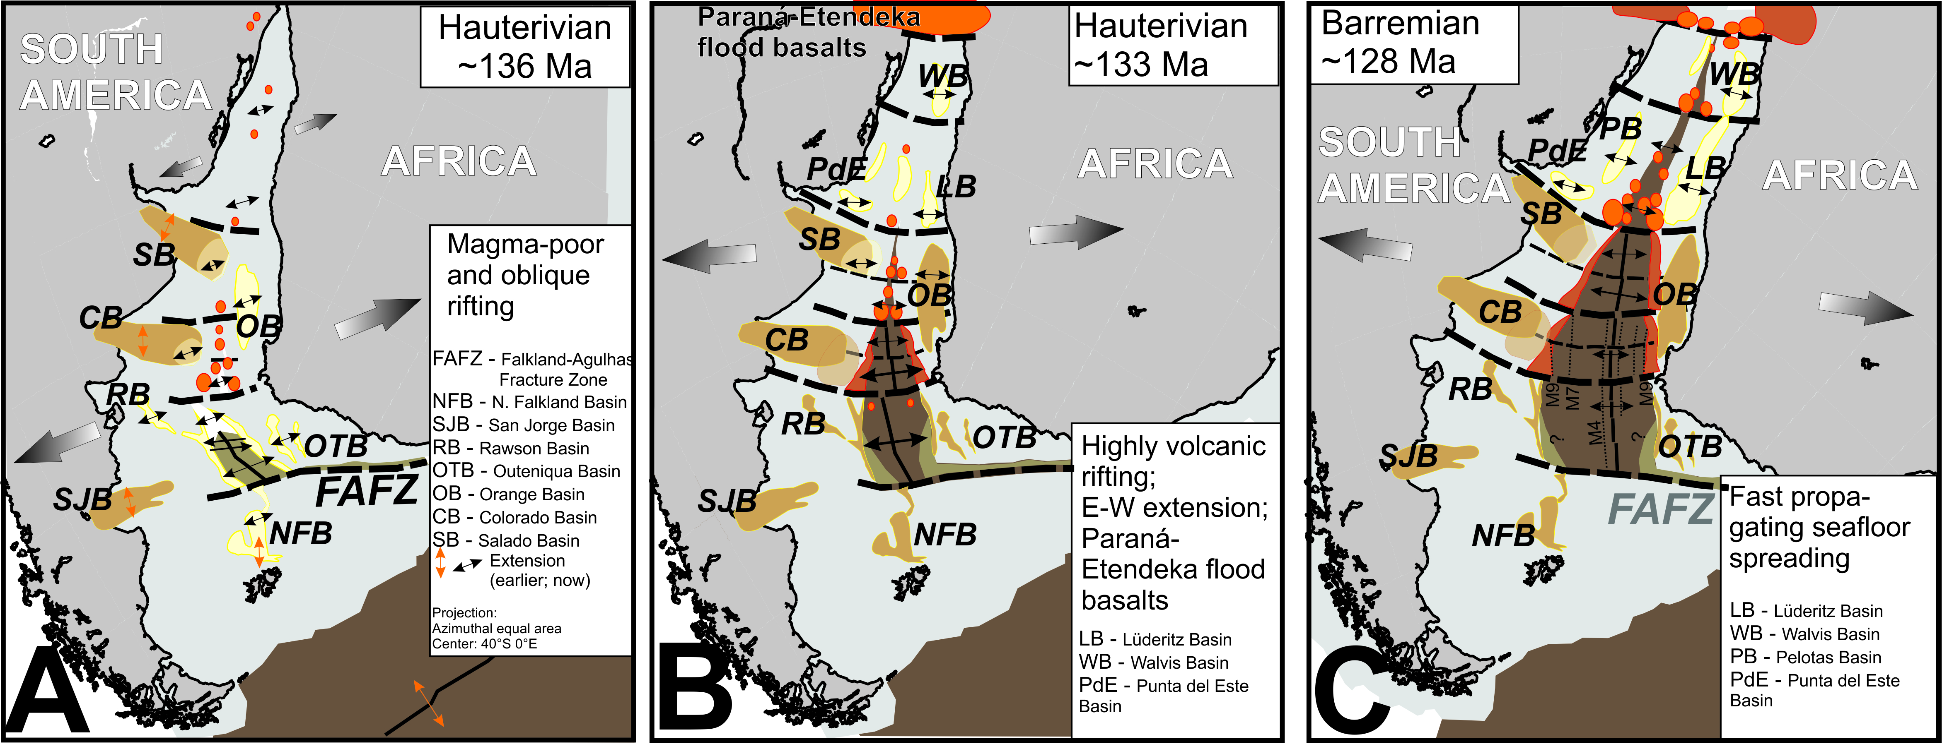
“Transfer zones” (discontinuities)
Franke (2013)

Slide 7
4 Discontinuity Scenarios Scenario 2
Major deformation within the continents takes up strain until breakthrough achieved
Blocks separated by sutures/weak-zones move relative to one another; continent may be destabilized throughout a wide region
Example: Tristan region

Slide 8
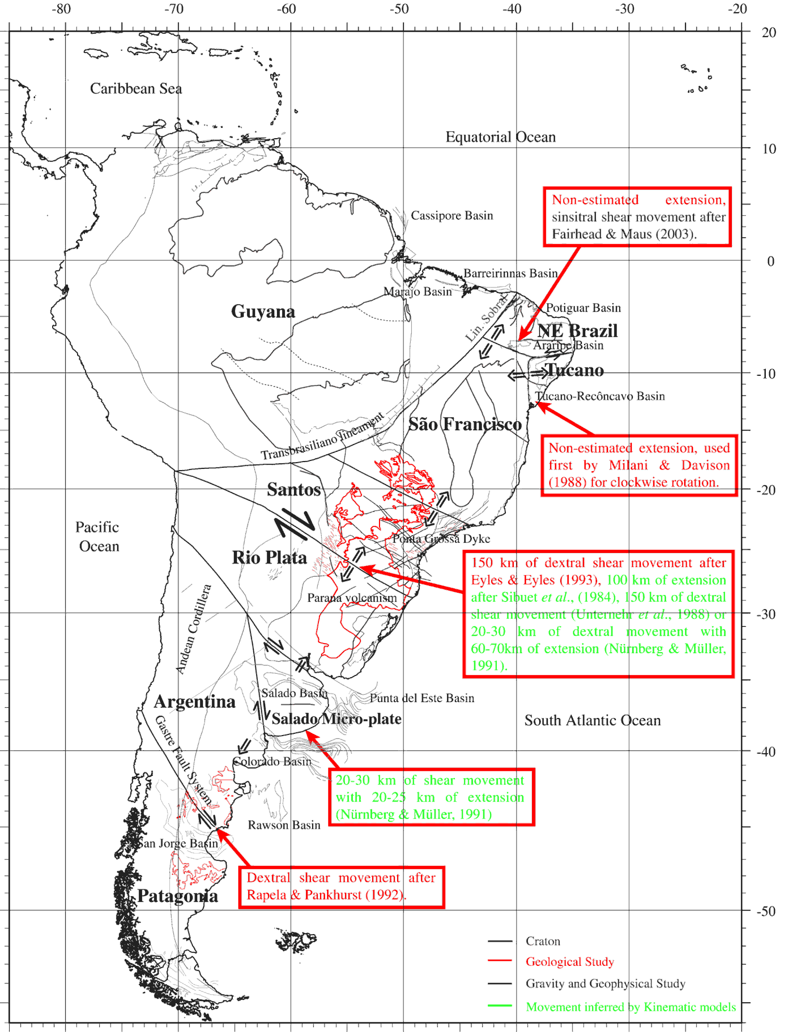
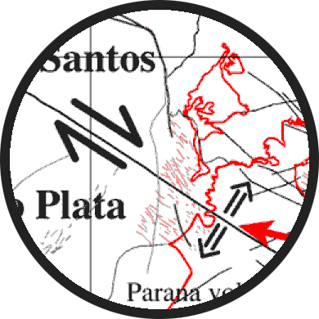
Evidence for extension
Kinematic estimates: 60-100 km extension + dextral shear
Moulin et al. (2010)

Slide 9
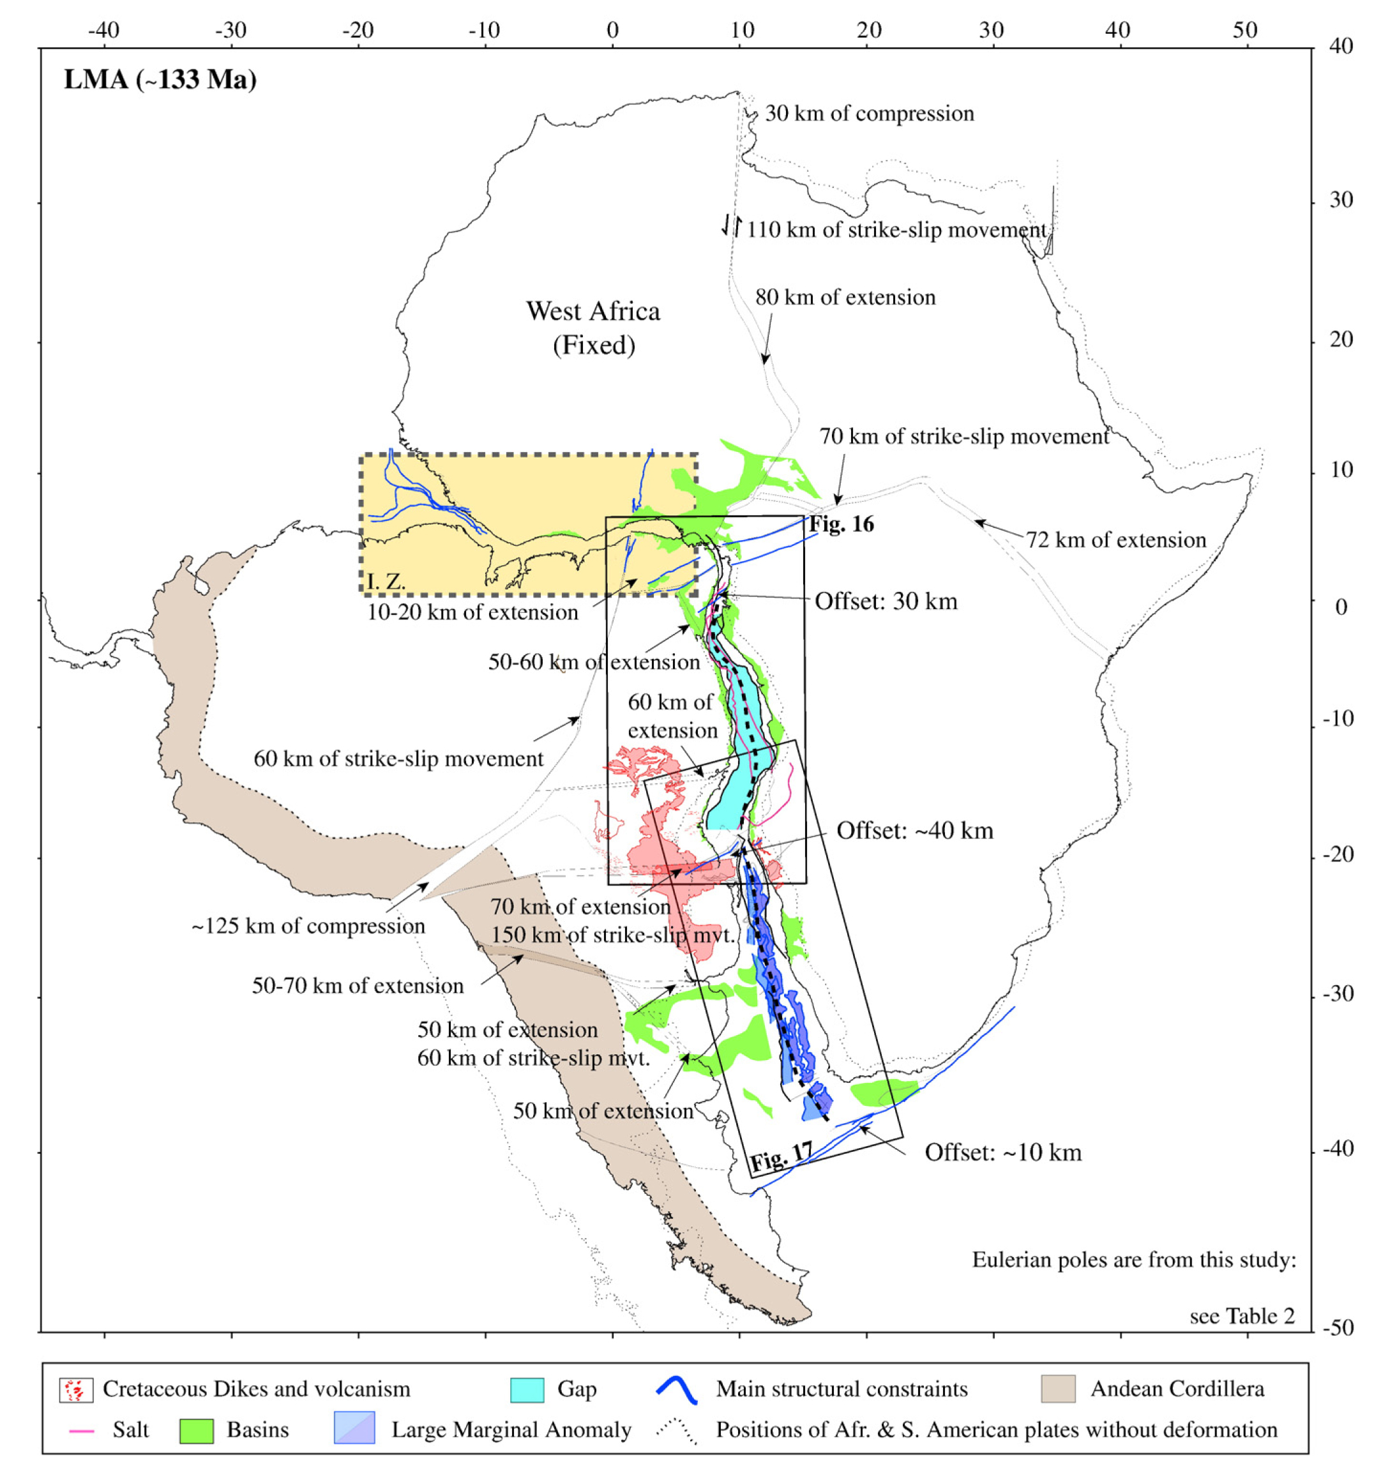
Moulin et al. (2010)

Slide 10
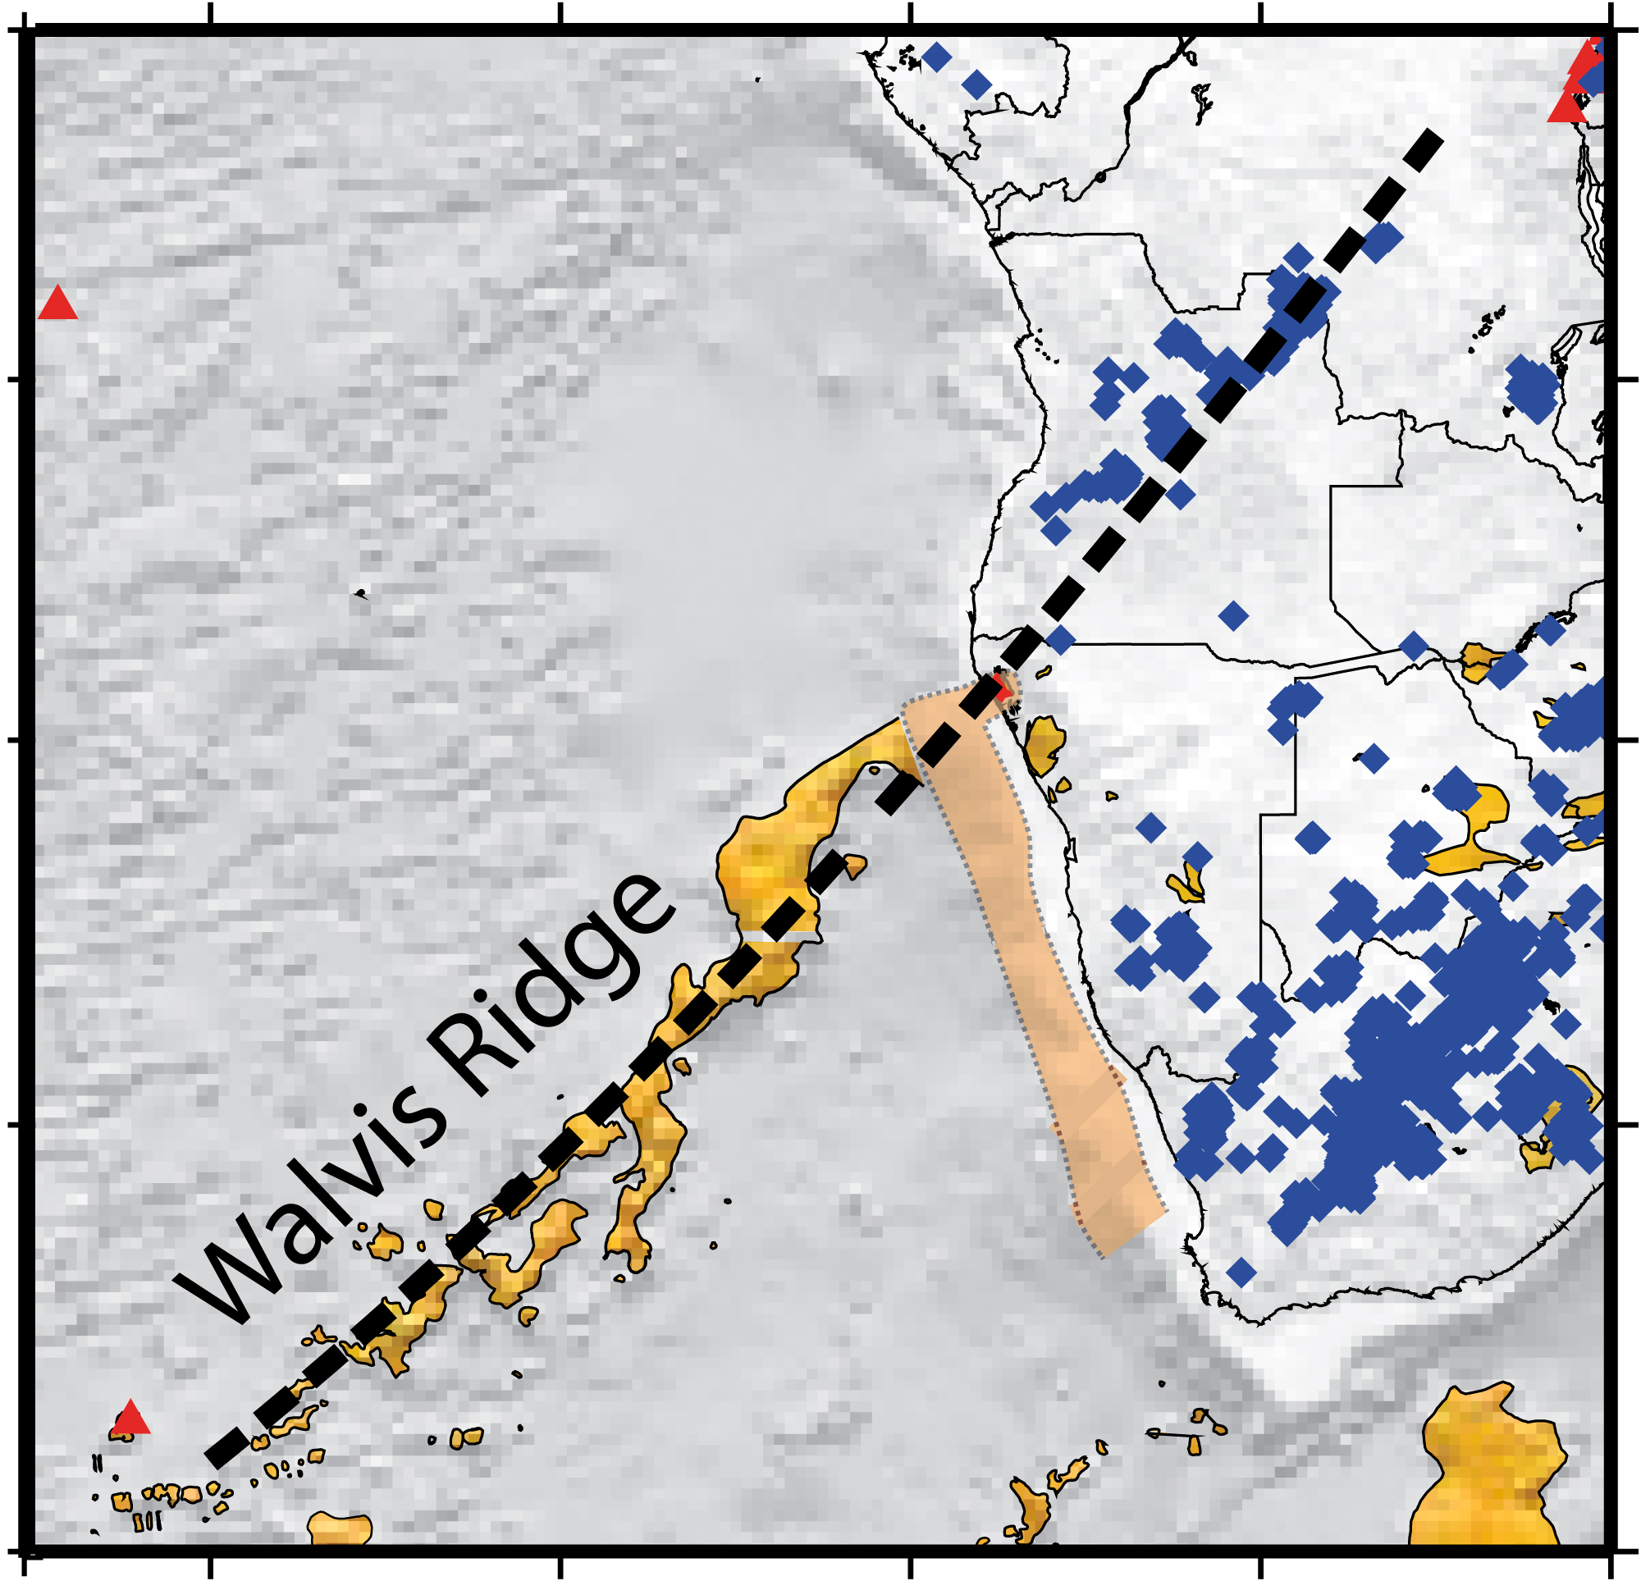
Fromm et al. (2015)

Slide 11
4 Discontinuity Scenarios Scenario 3
A triple junction forms
Rifting initially takes one ephemeral path or two attempted paths before becoming established on one path
Example: Labrador Sea/North Atlantic

Slide 12
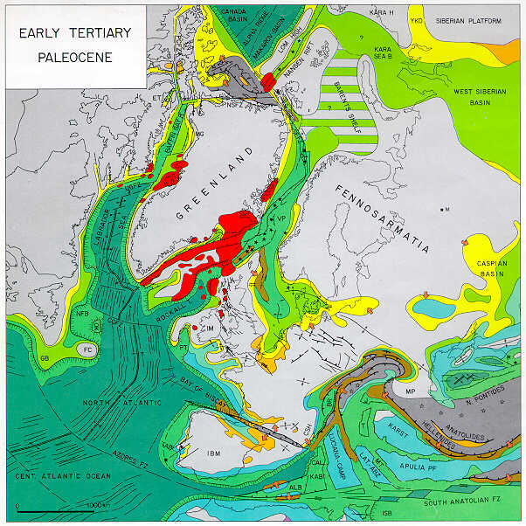
Late Cretaceous-Palaeocene:
intraplate inversion
structures
From Randell Stephenson’s PPP in the last workshop
from Peter Ziegler’s atlas (1990)

Slide 13
4 Discontinuity Scenarios Scenario 4
Breakup of continent in two areas simultaneously, rifts propagate towards one another
For stressfield-related reasons they cannot meet up, resulting in persistent instability at overlap
Leads to
propagation of one & retreat of other,
rotations,
extensions and balancing compressions,
ridge migrations,
ridge jumps,
continental and oceanic microcontinents/microplates (“C blocks).

Slide 14
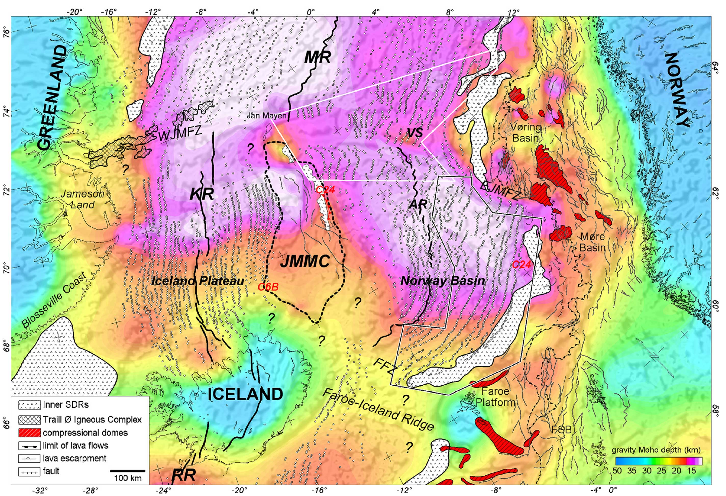
Propagators, rotations, extensions & compressions, ridge migrations, ridge jumps, continental crust
compressions
CC
CC?
CC?
Gernigon et al. (2012)

Slide 15
Magmatism
Released where extension
Suture-zone lithosphere more fertile & hydrated than cratons larger volumes
Persistent ridge-parallel extension leads to zone of anomalous magmatism as ocean widens, e.g., Greenland-Iceland-Faroes

Slide 16
Depth-dependent extension
Hydrated lithosphere weaker & susceptible to depth-dependent extension
May result in thinning or removal of mantle lithosphere before sea-floor spreading
Causes asthenosphere to rise & decompress
Volcanism may occur before sea-floor spreading, e.g., Paraná basalts, Thule line, Deccan Traps, Afar flood basalt

Slide 17
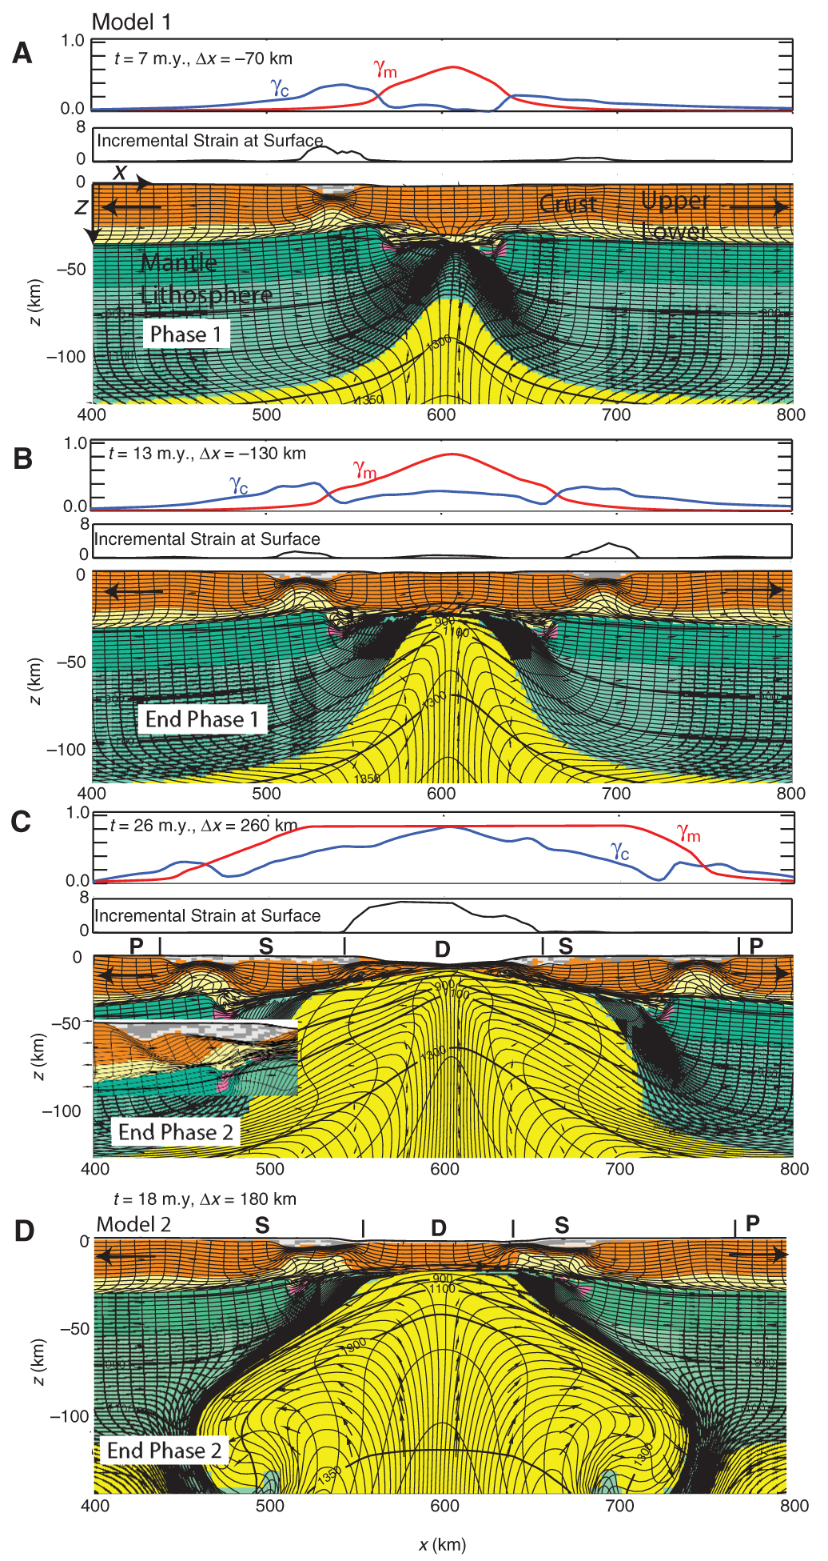
Central Atlantic:
Up to ~250 km of pre-rupture lithosphere extension, taking ~ 25 Ma
Huismans & Beaumont (2008)

Slide 18
End

Slide 19
Remaining puzzles

Slide 20
Plans & time-frame for submission of papers
Date & place of 3rd workshop

Slide 21
Earth-Science Reviews papers
• 30 Apr: Send Gillian placeholder titles + frameworks
Ongoing updating of draft papers
• 31 Oct: Drafts of papers circulated to enable coherence and cross-referencing
• 31 Jan: Submission deadline to ESR

Slide 22
End

