Slide 1
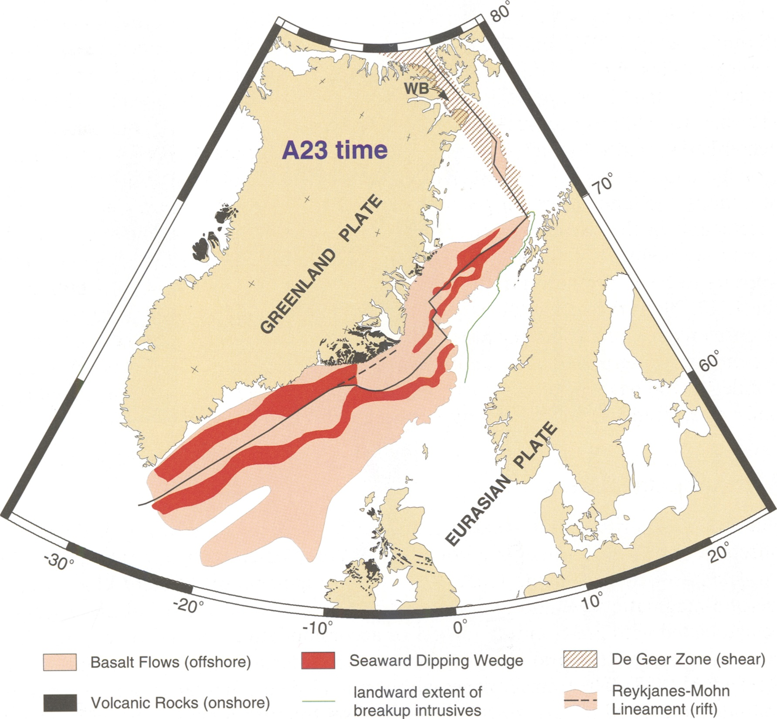
Volcanic Rifting in
NE Greenland
Dieter Franke
Eldholm, O., Tsikalas, F., and Faleide, J.I., 2002, Continental margin off Norway 62-75 degrees N; Palaeogene tectono-magmatic segmentation and sedimentation: Geological Society Special Publications, v. 197, p. 39-68.

Slide 2
Fixed hotspot
moving hotspot
Gaina, C., Gernigon, L., and Ball, P., 2009, Palaeocene–Recent plate boundaries in the NE Atlantic and the formation of the Jan Mayen microcontinent: Journal of the Geological Society, v. 166, p. 601-616.

Slide 3
Abdelmalak, M.M., Planke, S., Faleide, J.I., Jerram, D.A., Zastrozhnov, D., Eide, S., and Myklebust, R., 2016, The development of volcanic sequences at rifted margins: New insights from the structure and morphology of the Vøring Escarpment, mid-Norwegian Margin: Journal of Geophysical Research: Solid Earth, v. 121, p. 5212-5236.

Slide 4
Geissler, W.H., Gaina, C., Hopper, J.R., Funck, T., Blischke, A., Arting, U., Horni, J.Á., Péron-Pinvidic, G., and Abdelmalak, M.M., 2016, Seismic volcanostratigraphy of the NE Greenland continental margin: Geological Society, London, Special Publications, v. 447.

Slide 5
Voss, M., and Jokat, W., 2007, Continent-ocean transition and voluminous magmatic underplating derived from P-wave velocity modelling of the East Greenland continental margin: Geophysical Journal International, v. 170, p. 580-604.

Slide 6
Voss, M., Schmidt-Aursch, M.C., and Jokat, W., 2009, Variations in magmatic processes along the East Greenland volcanic margin: Geophysical Journal International, v. 177, p. 755-782.

Slide 7
Meyer, R., van Wijk, J.W., and Gernigon, L., 2007, North Atlantic Igneous Province: A review of models for its formation, in Foulger, G.R., and Jurdy, D.M., eds., Plates, Plumes, and Planetary Processes, Volume 430, Geological Society of America Special Paper, p. 525-552.

Slide 8
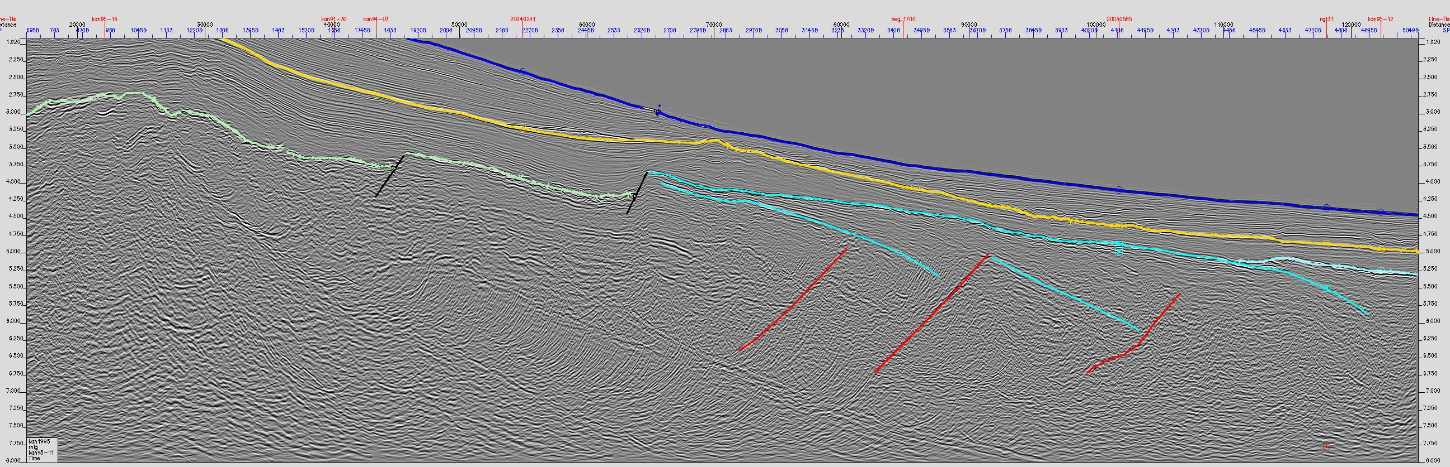
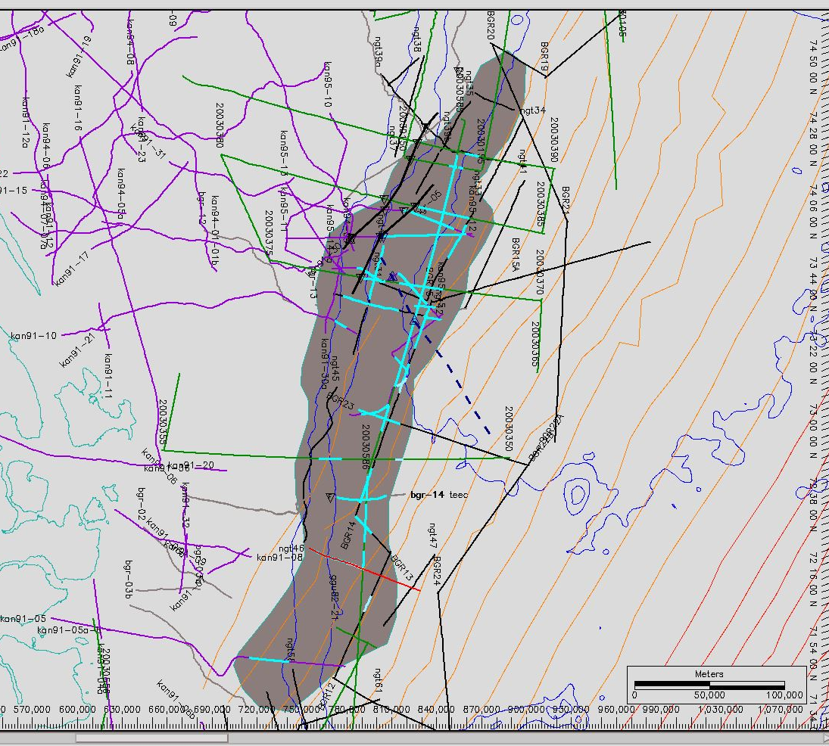
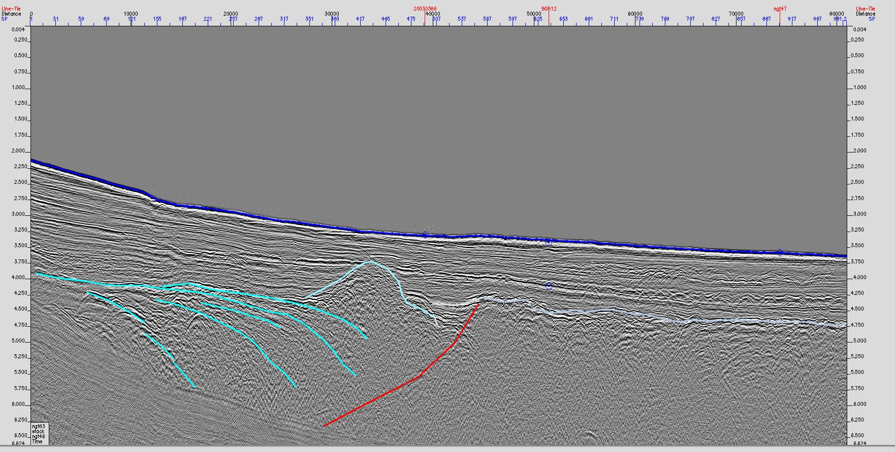
C24
C23

Slide 9
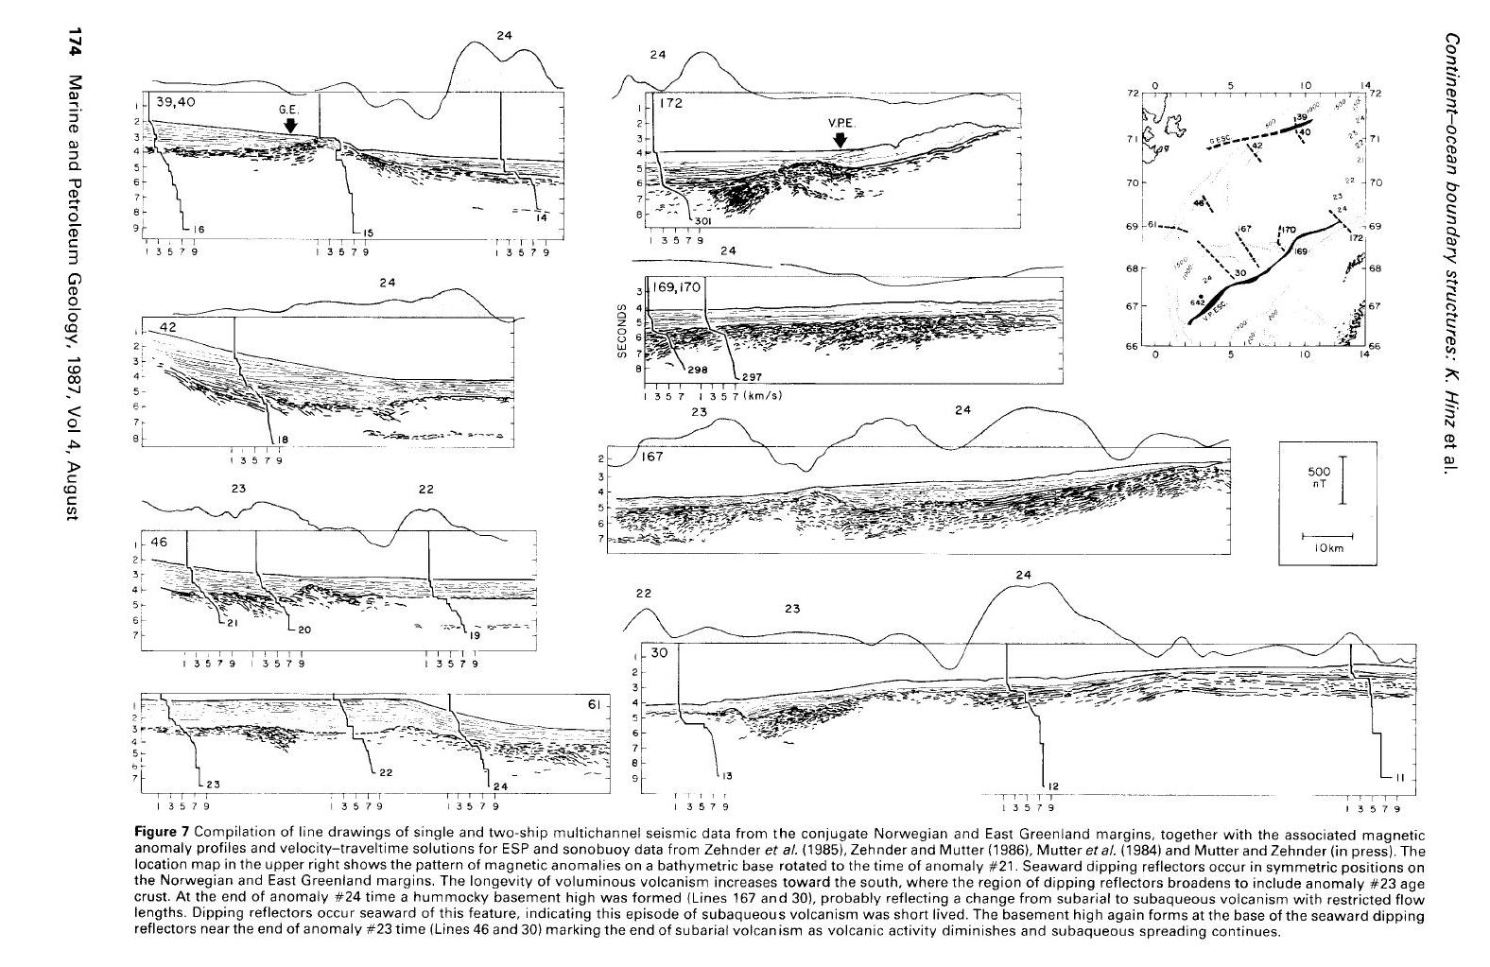
Greenland
Norway
Greenland
Hinz, K., Mutter, J.C., and Zehnder, C.M., 1987, Symmetric conjugation of continent-ocean boundary structures along the Norwegian and East Greenland Margins: Marine and Petroleum Geology, v. 4, p. 166-187.
Norway

Slide 10
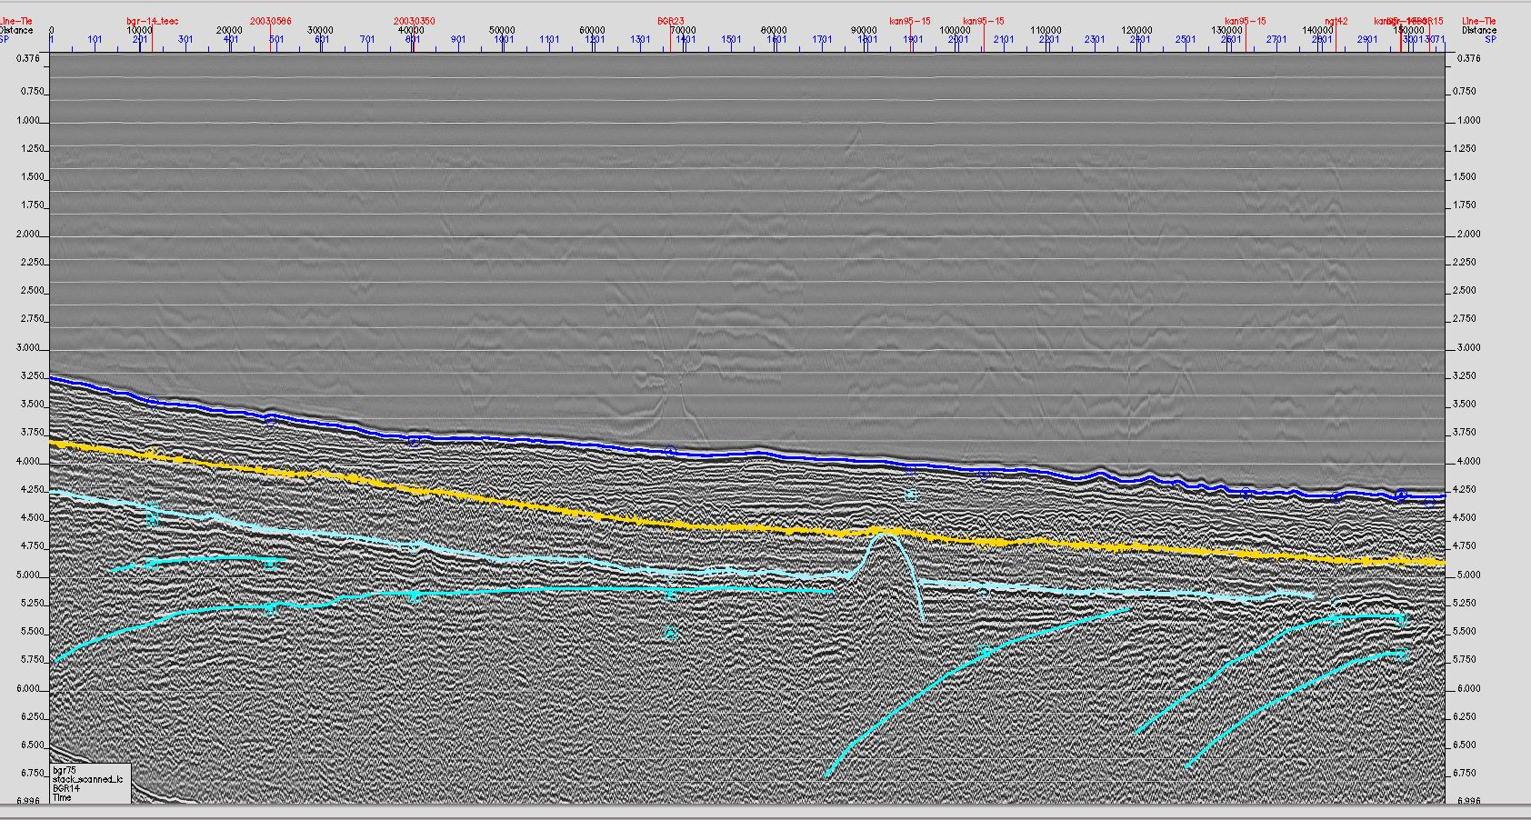
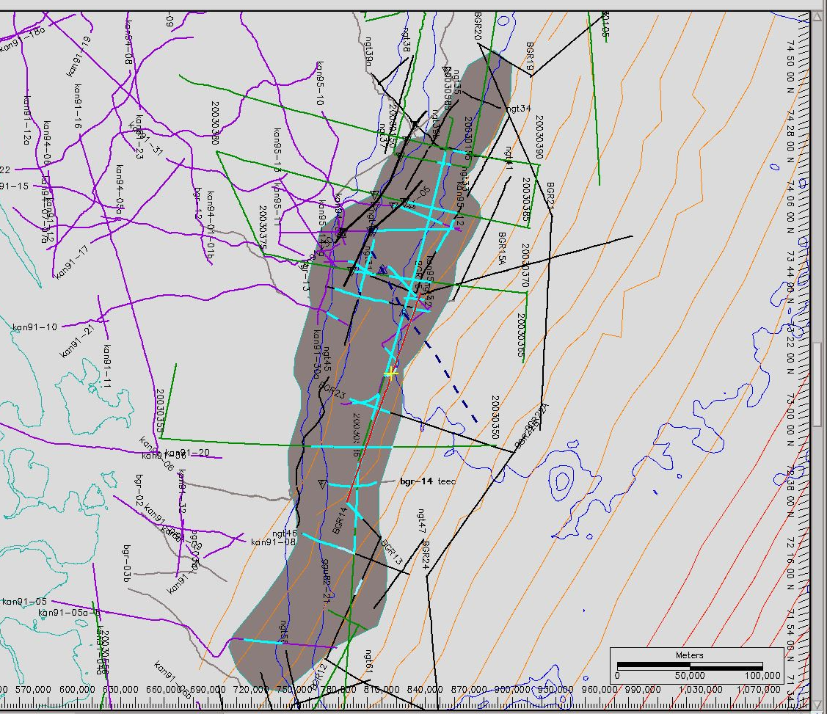
S
N
C23
C24

Slide 11
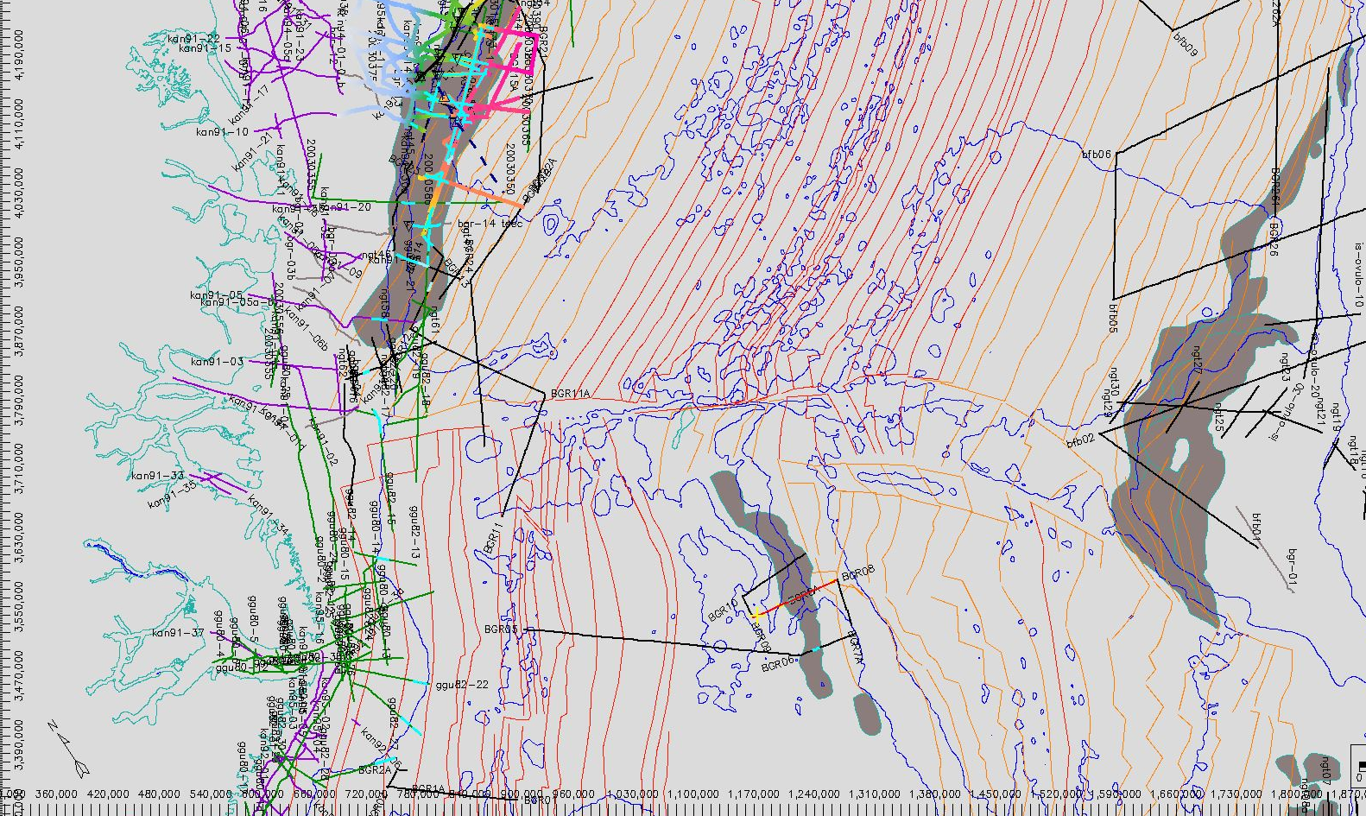
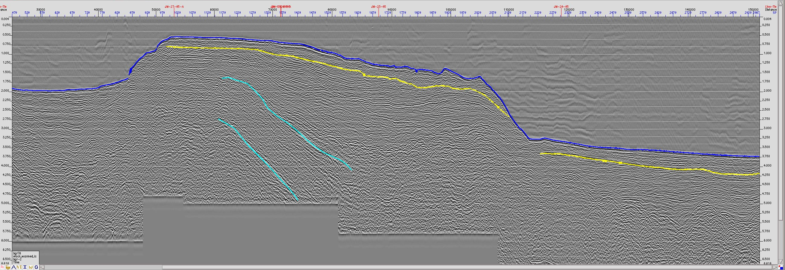
East Jan Mayen volcanic rifted margin

Slide 12
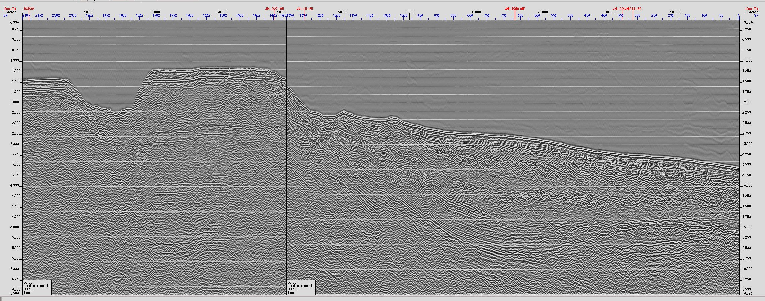
East Jan Mayen volcanic rifted margin

Slide 13
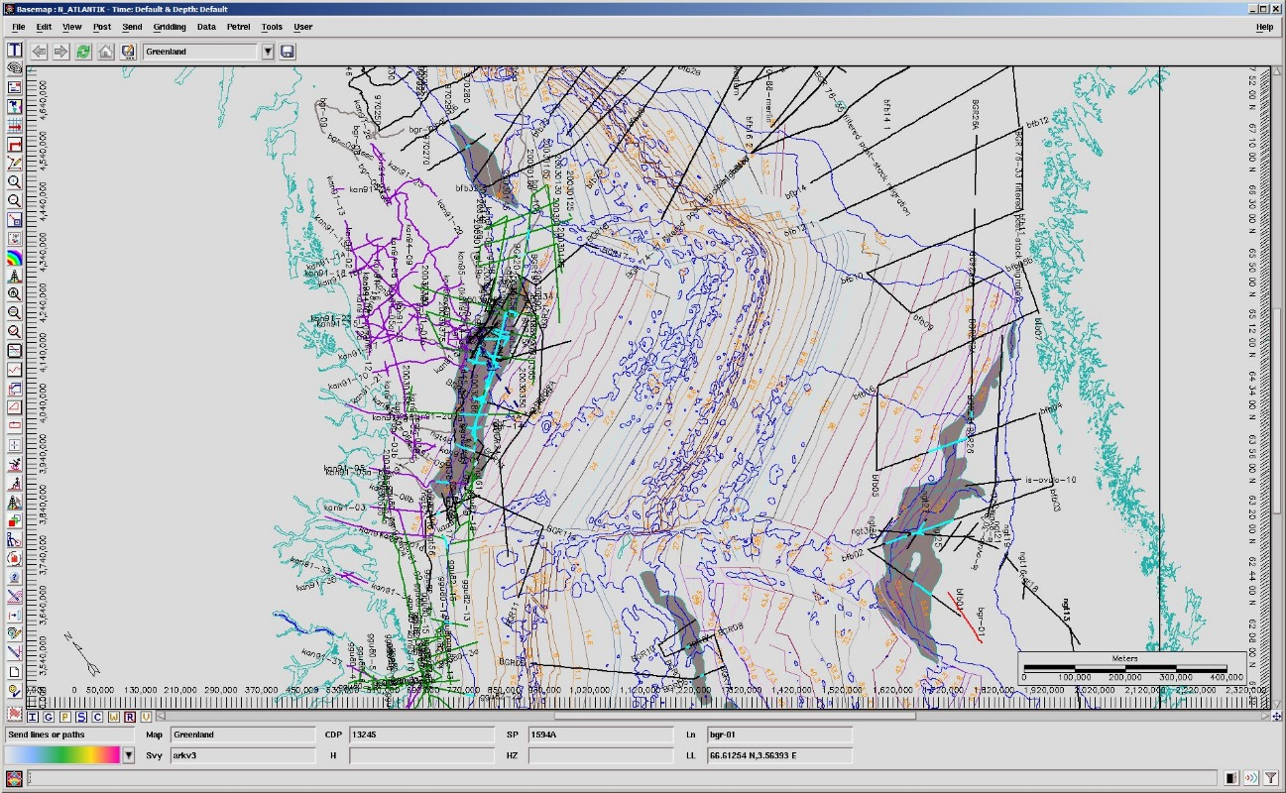
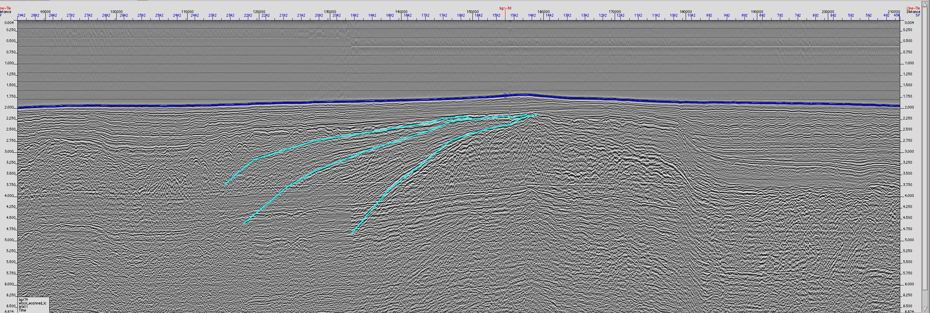
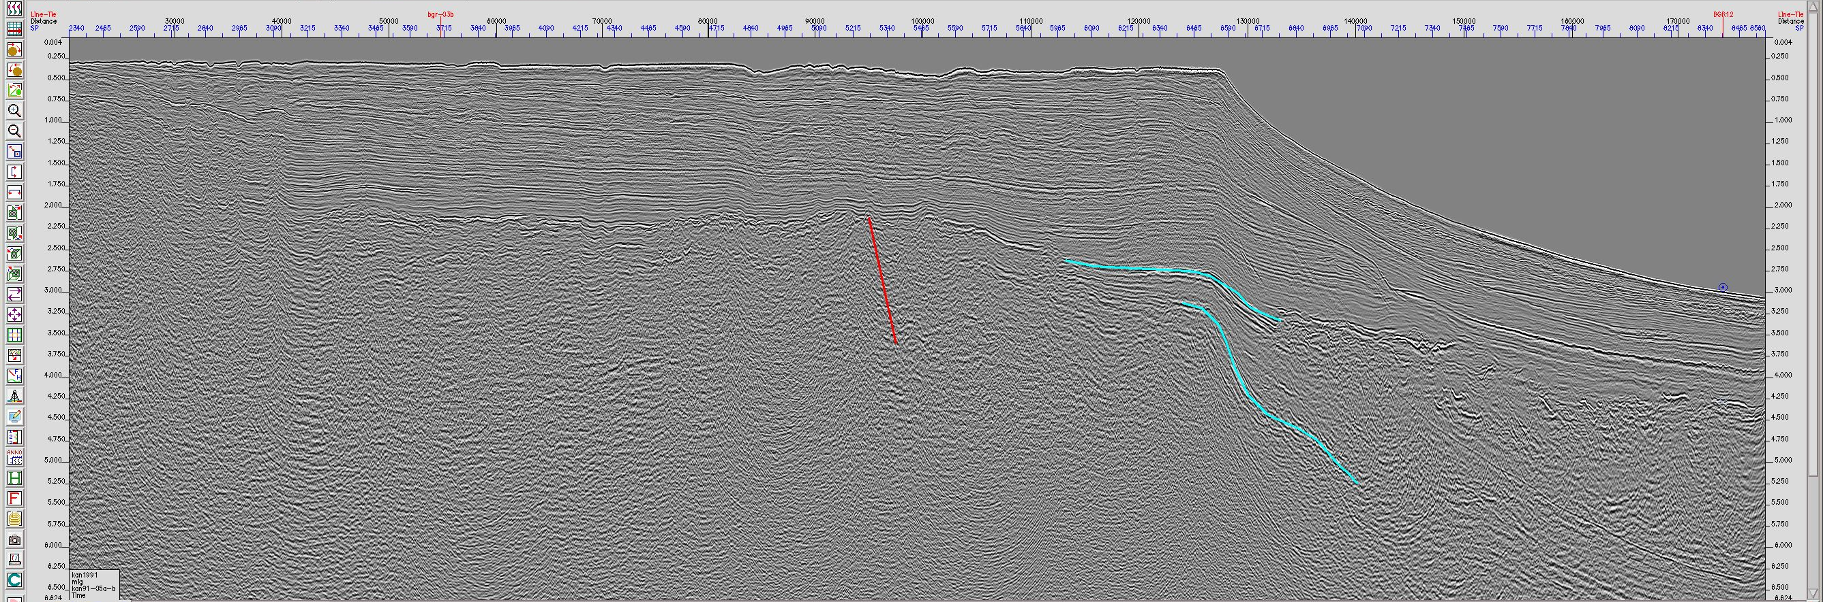
Jan Mayen
Fracture Zone

Slide 14
Some remarkable results:
Across-margin asymmetry in magmatic budget
Segmented and likely oblique opening of the Greenland-Norway Sea. (N-S extension?)
Major, 5–10 km thick and 150 km wide magmatic „underplate“ where the Jan-Mayen FZ intersects with the continent. Conspicuously absent is coast-proximal evidence of extrusives (SDRs)
Crustal nature uncertain

Slide 15
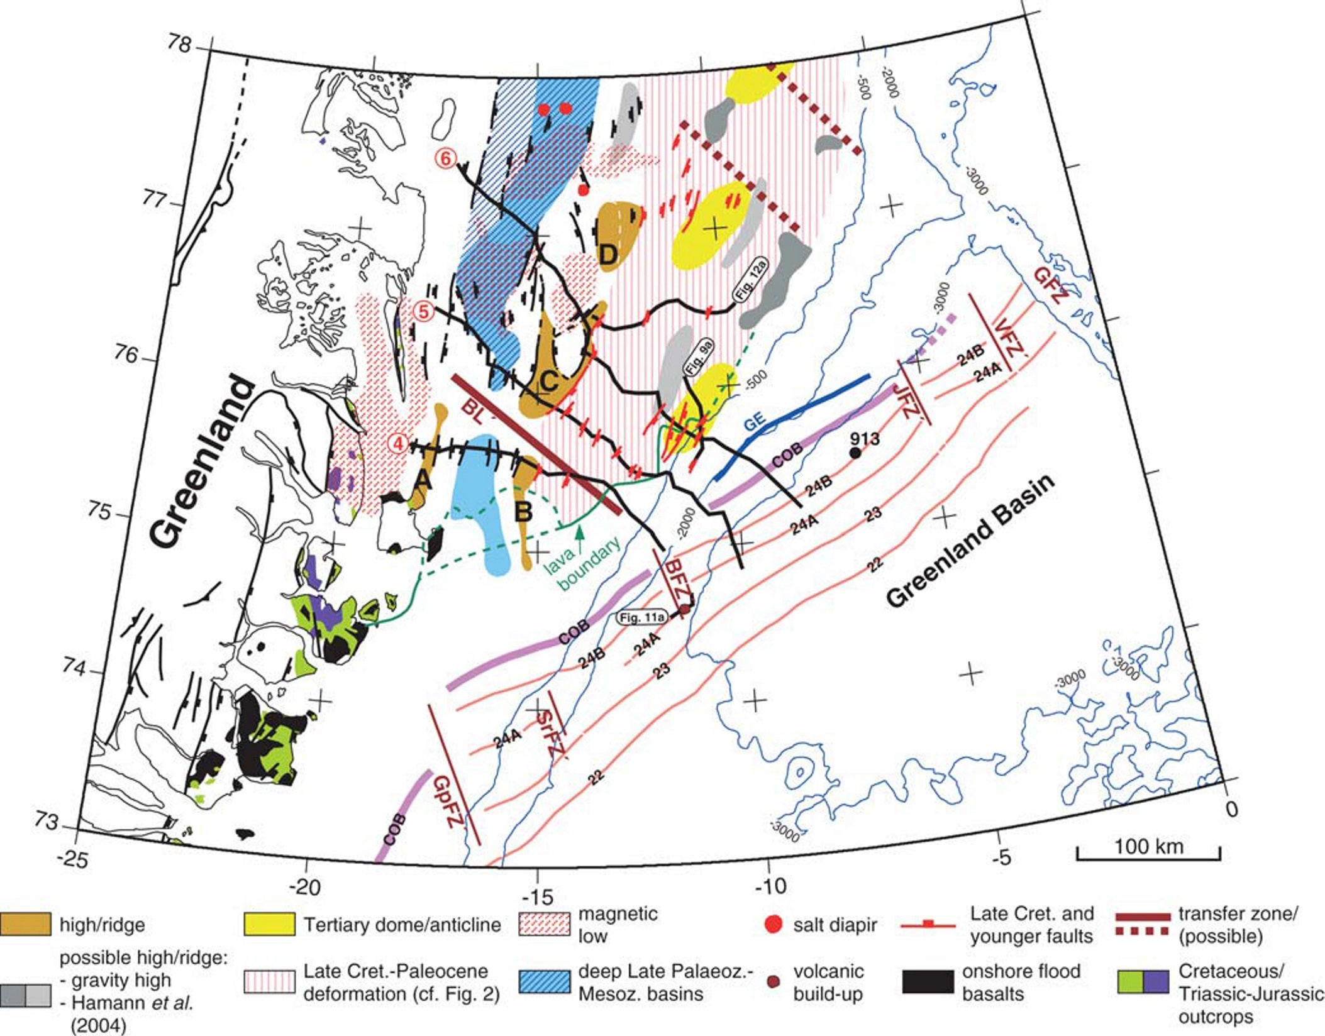
Tsikalas, F., Faleide, J.I., Eldholm, O., and Wilson, J., 2005, Late Mesozoic–Cenozoic structural and stratigraphic correlations between the conjugate mid-Norway and NE Greenland continental margins, in Doré, A.G., and Vining, B.A., eds., Petroleum Geology: North-West Europe and Global Perspectives, Volume 6: London, Geological Society, London, Petroleum Geology Conference series, p. 785-801.

Slide 16
Tsikalas, F., Faleide, J.I., Eldholm, O., and Wilson, J., 2005, Late Mesozoic–Cenozoic structural and stratigraphic correlations between the conjugate mid-Norway and NE Greenland continental margins, in Doré, A.G., and Vining, B.A., eds., Petroleum Geology: North-West Europe and Global Perspectives, Volume 6: London, Geological Society, London, Petroleum Geology Conference series, p. 785-801.

Slide 17
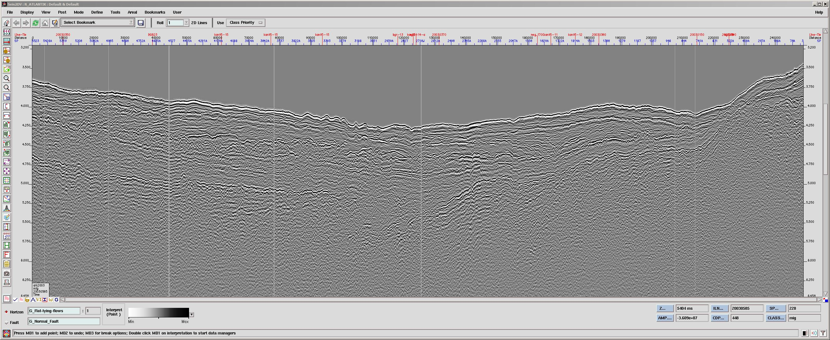
Bivrost Fracture Zone ?
S
N

Slide 18
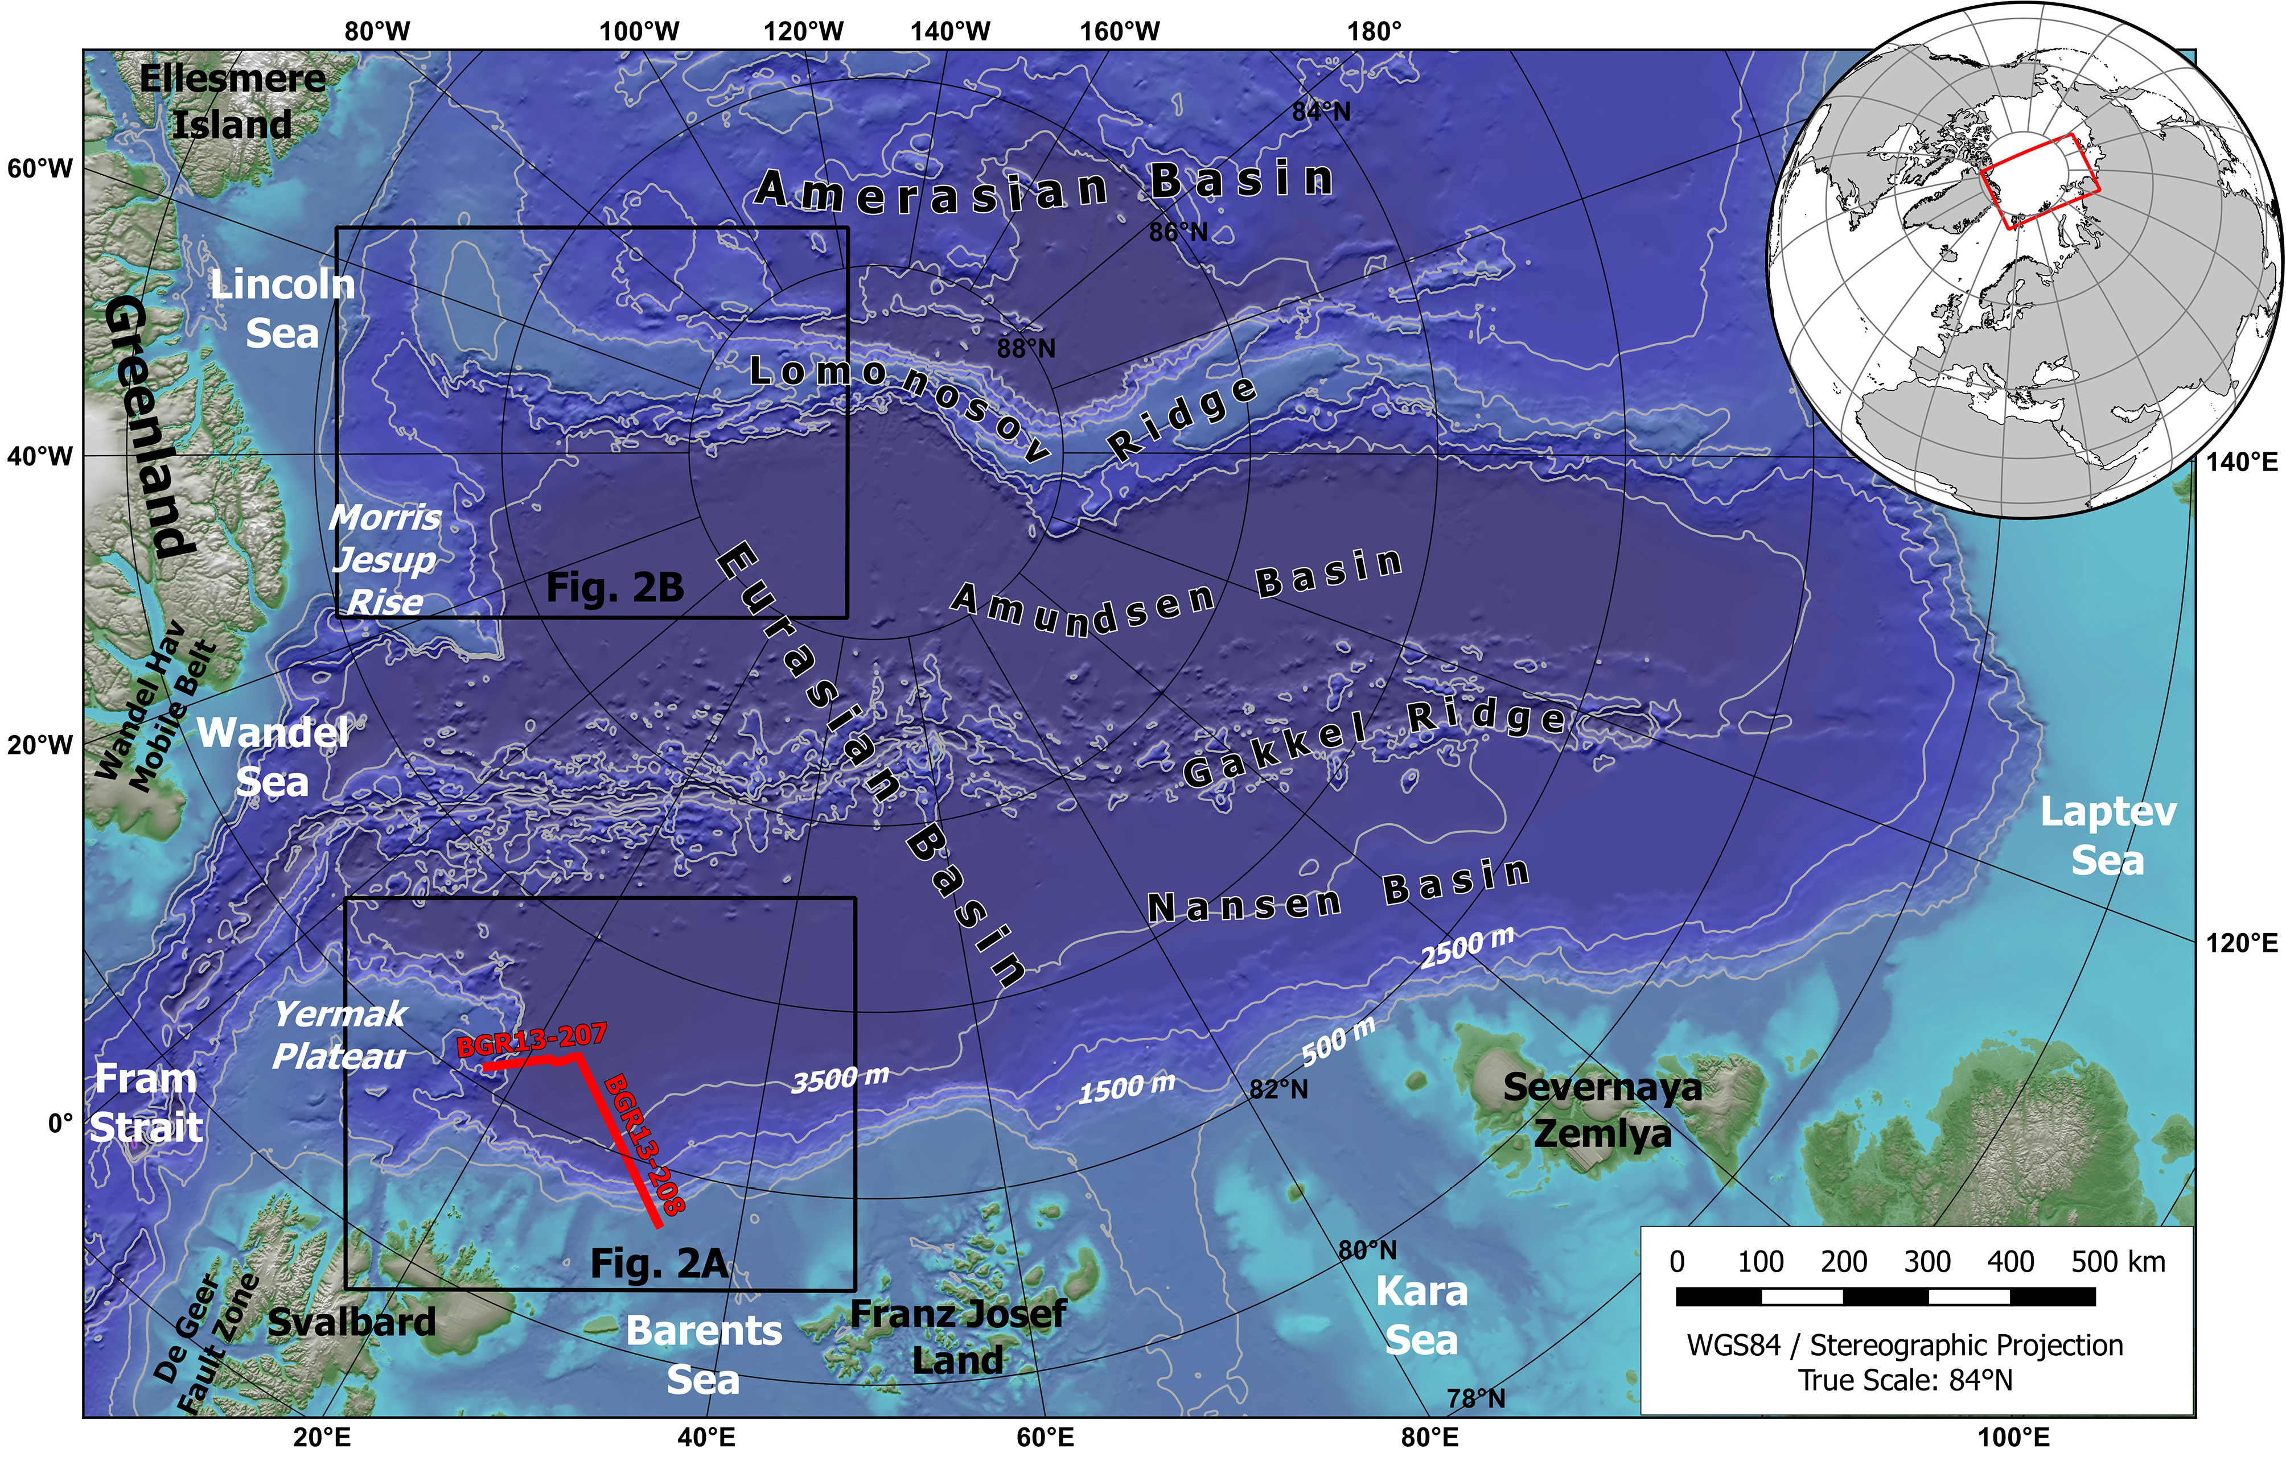
Berglar, K., Franke, D., Lutz, R., Schreckenberger, B., and Damm, V., 2016, Initial opening of the Eurasian Basin, Arctic Ocean: Frontiers in Earth Science, v. 4.

Slide 19
Voss, M., Schmidt-Aursch, M.C., and Jokat, W., 2009, Variations in magmatic processes along the East Greenland volcanic margin: Geophysical Journal International, v. 177, p. 755-782.

Slide 20
