Slide 1
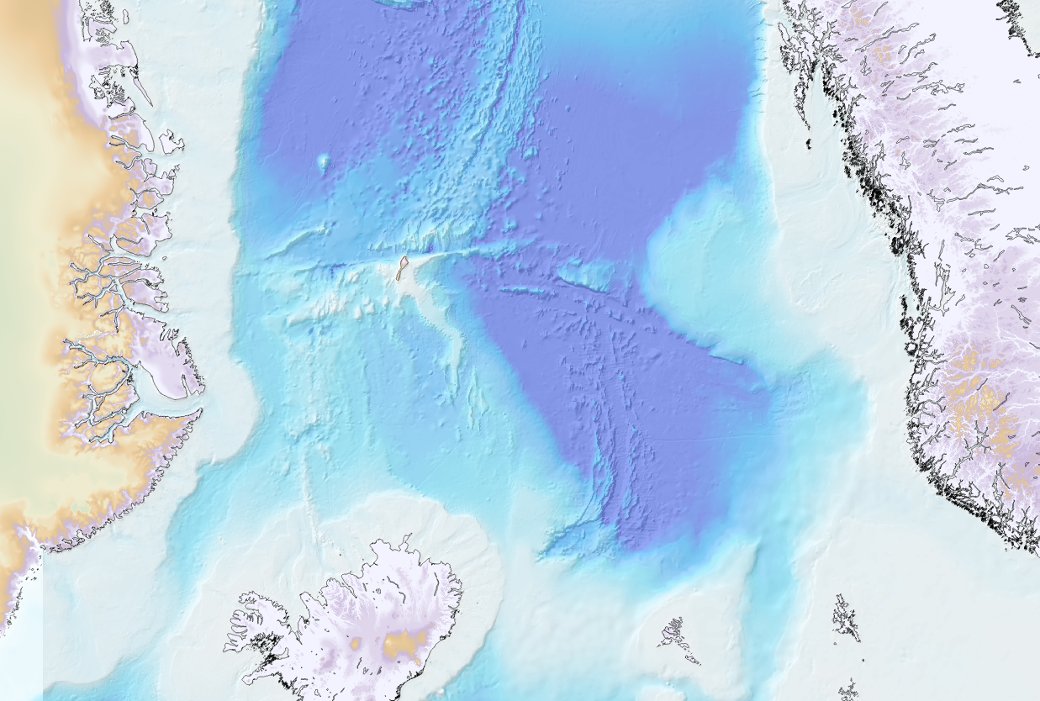

Some comments about recent ‘hyperextension’ models
of the mid-Norwegian margin
Gernigon, L.
Continental Shelf Geophysics, Geological Survey of Norway (NGU)
Total
January 2017
Notes:
As you can see on the slide displayed, Today I am planning to say a few words about the tectonic evolution of and the implication
This work was carried out in collaboration with my colleagues from NGU

Slide 2
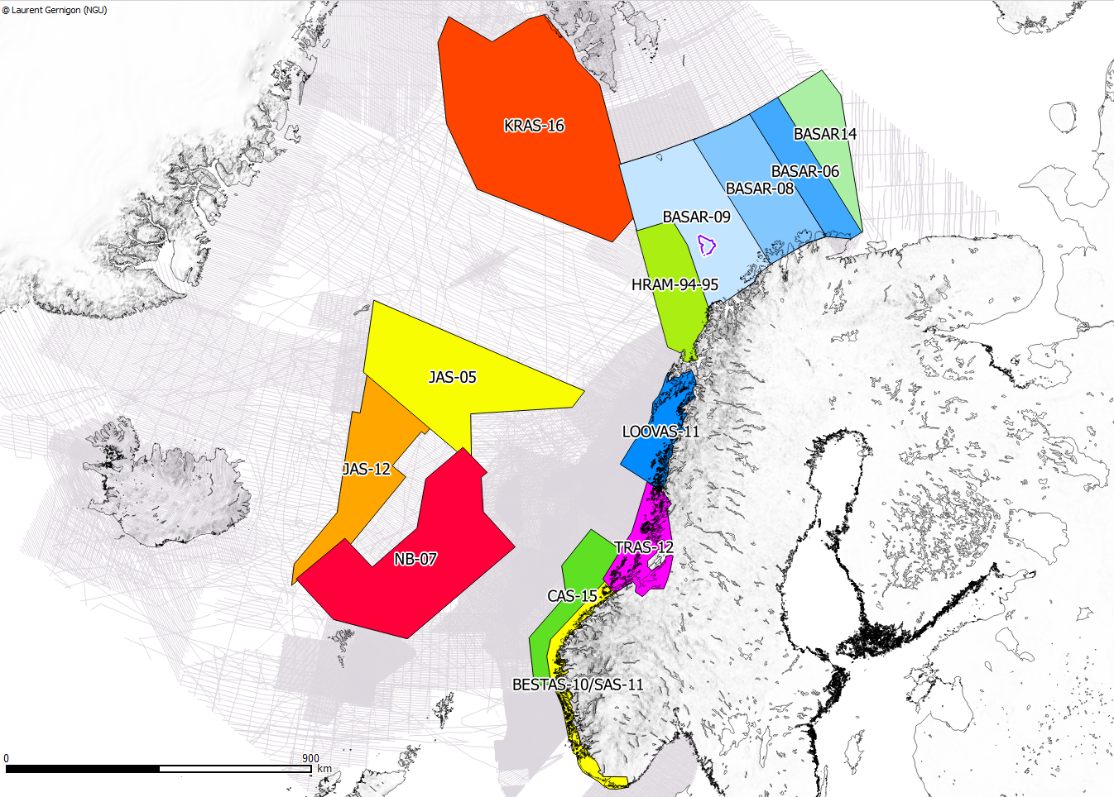
BASAR PROJECT: Regional setting – scientific issues
A decade of new high resolution aeromagnetic surveys
GREENLAND
Barents Sea
SDR
JMMC
Vøring
Møre
Faroe
Plateau
North Sea
Notes:
And I will mostly focus in this specific area
which has been together with the Barents Sea fully cover by new and modern HR aeromagnetic data over the last 10 years

Slide 3
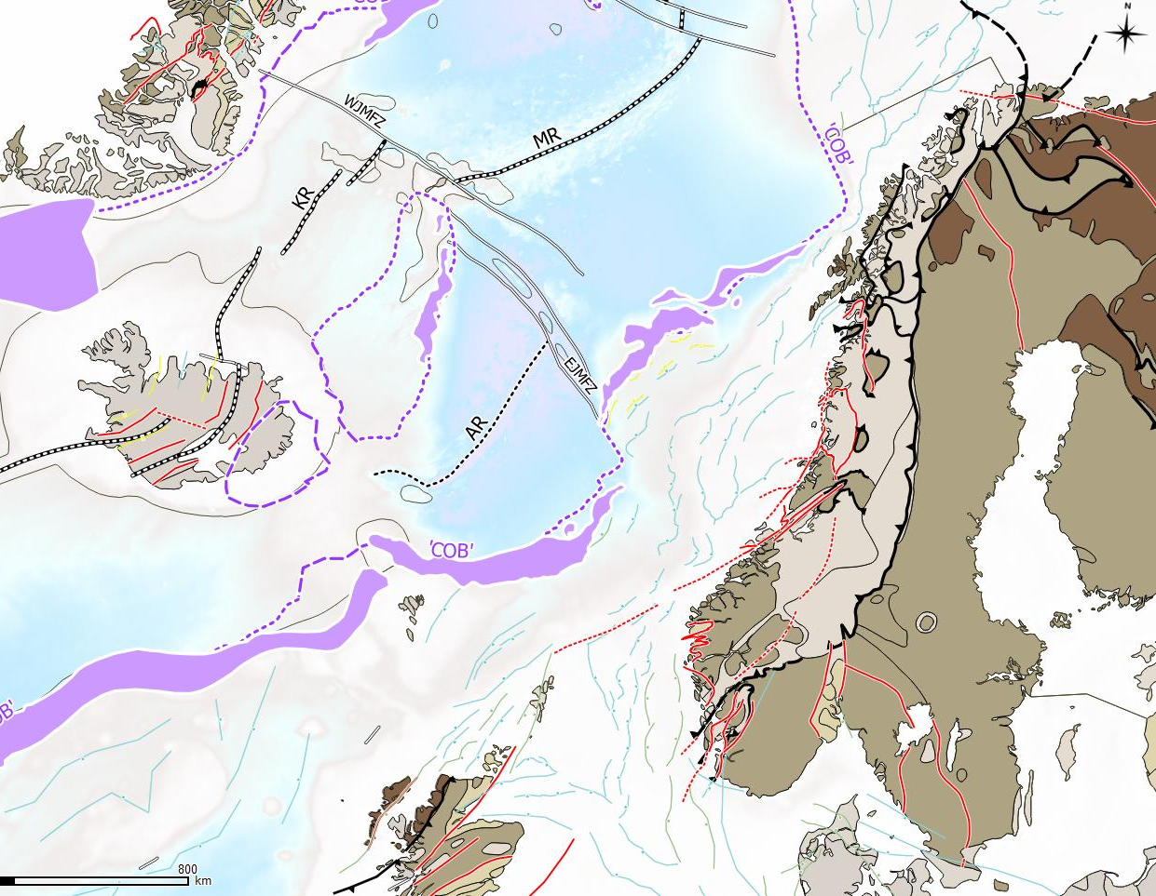
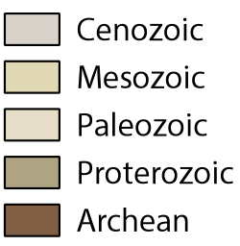
BASAR PROJECT: Regional setting – scientific issues
Geological setting: from Caledonides to sea-floor spreading
Neo.
GREENLAND
Paleo.
breakup
Cretaceous
SDR
JMMC
Jurassic
Iceland
Vøring
~300 My of episodic rift events
Triassic
Møre
Permian
NORWAY
Faroe
Plateau
Carbon.
SDR
North Sea
Devonian
Caledonides
Rockall
Trough
Notes:
As you can see on the slide display, I will focus my talk on the Mid. Norwegian margin, which is the final result of a complex rift history leading to breakup in the Early Tertiary.
The spreading history is also characterised by the formation of the so-called JMMC originally located between the Faeroe Plateau and the distal part of the Vøring
The JMMC resulted from 2 phases of breakup: the first phase of breakup at 55 Ma leading to the opening of the Norway Basin and a second phase of breakup leading to the final spreading ridge relocation between the extinct AR and the KR around 24 My ago.
One of the main characteristic of the Mid Norwegian margin is the extremely long period of rift episodes that affect the pre-existing Caledonian and basement from the Devonian collapse of the Caledonides to the Eocene phase of breakup. Basically, we have to deal with almost 300 my of episodic rifting events.
A second specificity of the Mid. Norwegian is the volcanic margin formation and the emplacement of volcanic SDRS during the onset of breakup in the distal margin. Similar VRM are also observed Faeroes and Hatton bank area, the VRM are relatively sharp and off axis compared the main Jurassic-Early Cretaceous rift system. VRM also affects a crust relatively thick crust which is not totally the case the case of the Mid. Norwegian margin
My challenge today is to show you my present day understanding of the volcanic rifted margin evolution not only form onshore to offshore but also from rifting to seafloor spreading

Slide 4
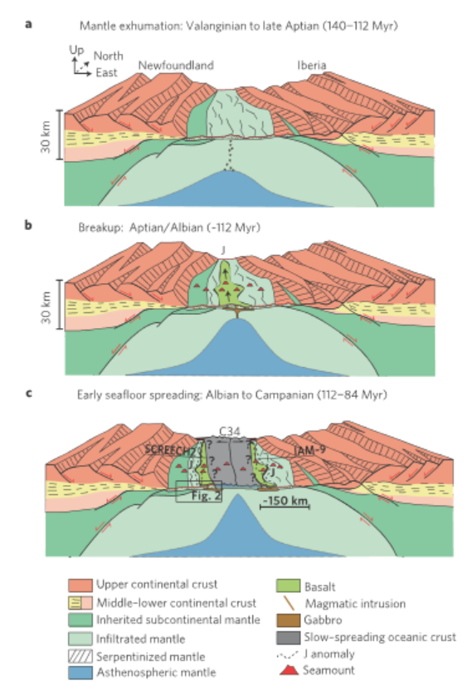
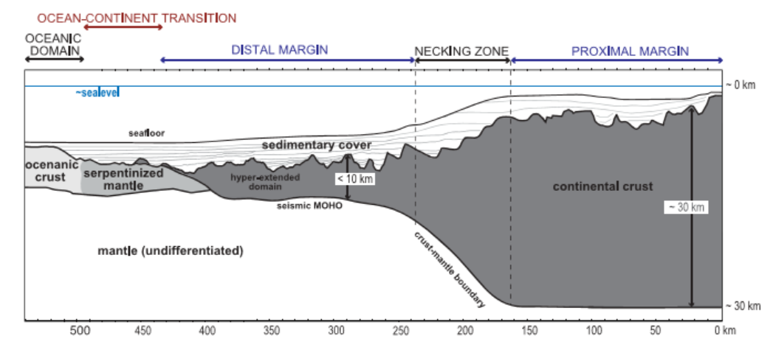
Hyperextension, LCB
Studies conducted in (some) present-day magma-poor rifted margins reveal that the transition from weakly thinned continental crust (>30 km) in proximal margins to hyper-extended crust (≤10 km) in distal margins occurs within a narrow zone, referred to as the necking zone
+7 km/s
Bronner et al., 2011
Mohn et al., 2012 ->

Slide 5
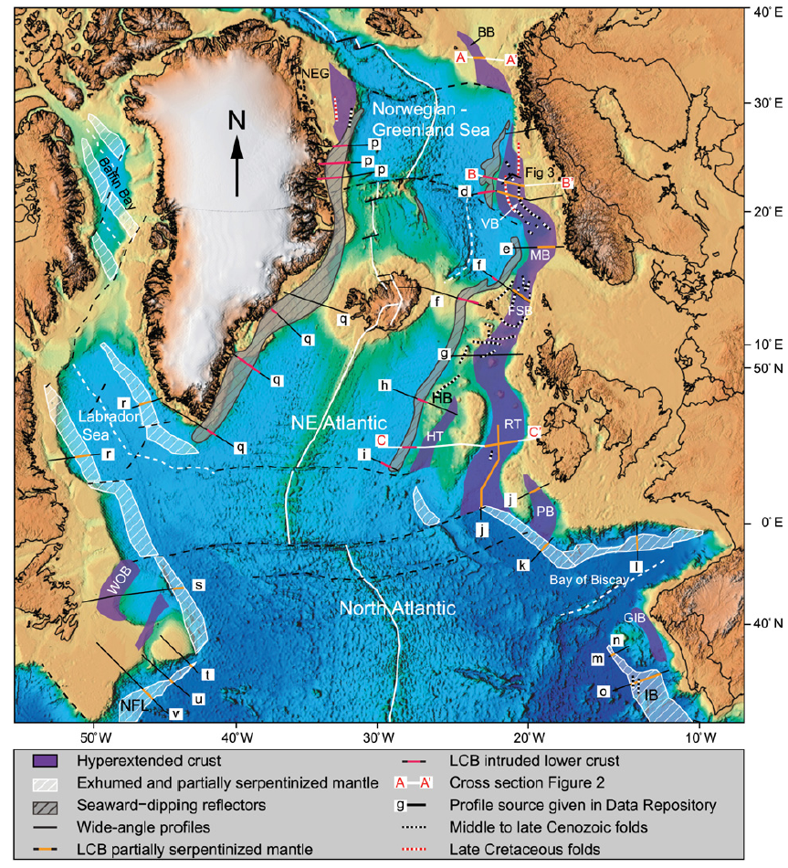
Hyperextension, LCB – open questions
“ The deformation both predates and postdates the magma-rich breakup. The hyperextended basins are often underlain by high-velocity lower crustal bodies (LCB), which we argue represent partially serpentinized upper mantle…
…. “ We conclude that hyperextension and associated partial serpentinization of the mantle leads to long-term weakening and that hyperextended basins are prone to compressive deformation”
(Lundin and Doré, 2012)
Hyperextension (crust<10 km) everywhere ??
Do we really need serpentinized mantle to localised the compression ?
Evidences of serpentinization ?
What are the meaning of the pre-breakup LCBs ?

Slide 6
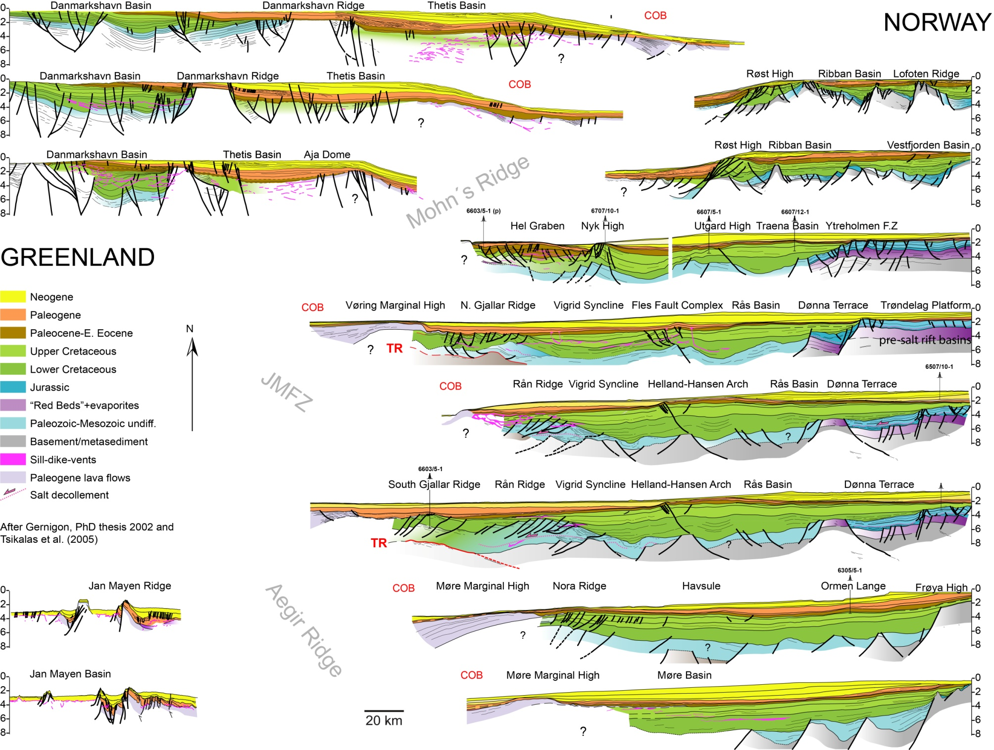
The Mid Norwegian margin: known and unknown
LOFOTEN
LCB
BCU
VØRING
?
BCU
LCB
TB?
?
Basement origin/depth underneath the sedimentary basins ?
Inheritance -rift/margin development ?
Breakup and post-breakup evolution ?
Analogies with magma-poor margin ??
TB?
?
MØRE
?
Notes:
Thanks to decades of geophysical exploration, the main structural elements of the Mid-Norwegian margin are now pretty well defined.
Thanks to petroleum activities, we have good constrains on the geology of the Triassic-Jurassic Platform domain along the shelf. Underneath the Triassic salt, we also have growing evidences of deeper and older Permo-Triassic grabens
We also know that a drastic Late Jurassic –Early cretaceous rifting event led to the platform dislocation and formation of a large and very deep Cretaceous sag basin at the edge of large Jurassic terrace. The sag is characterised by the BCU which is locally can reach 8-9 km in depth.
In the distal part of the sag basin, the OVB is particularly characterised by a complex system of ridge and sub-basin particularly affected by a specific Late Cretaceous-Paleocene rift event initiating the volcanic margin formation and later breakup between the Norwegian and East Greenland margin.
large uncertainties still remain, However, about the deep basin and basement configuration of whole margin. The depth, natures and structure of the basement rock expected in the prolongation of the Precambrian/Caledonian basement terranes observed onshore are fundamentally unknown.
The nature of the distal high density/high velocity bodies recognised in the distal part of the margin and mode of deformation leading to continental breakup and subsequent sea-floor spreading is also unclear.
Different scenarios can be proposed for the high Velocity LCB that coincides with deep seismic reflection, for example the T Reflection close to the basaltic domain

Slide 7
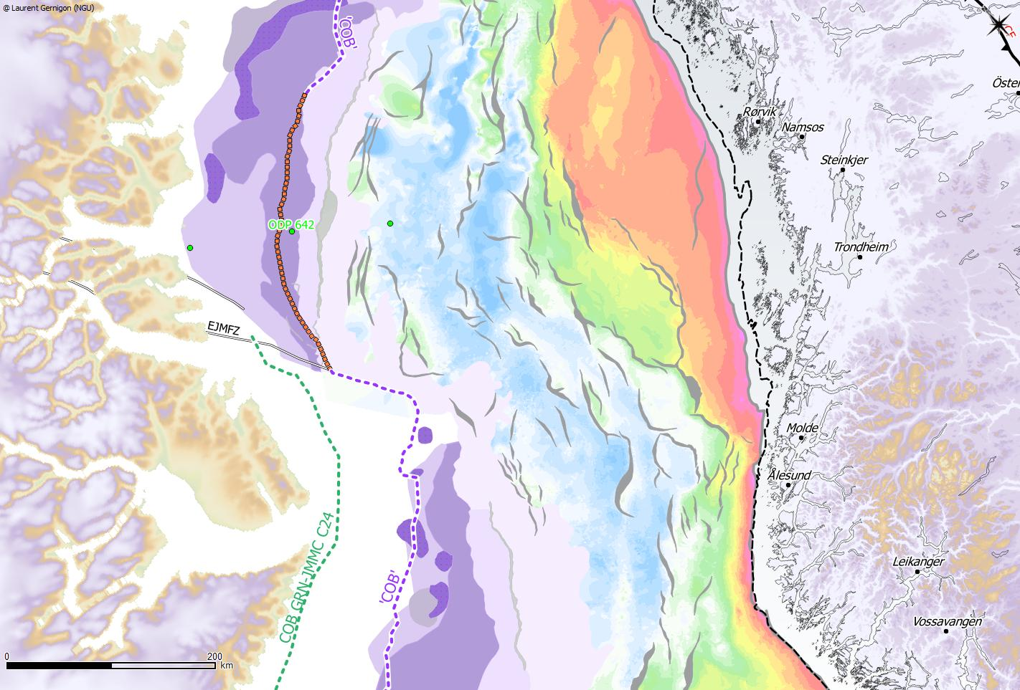

BASAR PROJECT: Regional setting – scientific issues
Base Cretaceous- Pre-Cretaceous rift system
The Jan Mayen corridor: a major ‘crustal transfer zone’ between the Møre and the Vøring basins. An oblique transition between narrow and wide platform regions. “en échelon” deep crustal rafts in the middle
Which kind of deformation and crustal structure occurs at this level ?
Trøndelag
Platform
Vøring Basin
wide
Halten
Terrace
Traillø
S. Gjallar-Rån
MTFC
Frøya
High
Vøring transform margin
Jan Mayen corridor
Greenland at C24
(~54 Ma)
Proto-JMMC
narrow
Møre Basin
SDR
(BCU and COBs after Gernigon et al., 2015). Volcanism modified after Berndt et al., 2001 and Abdelmalak et al., 2015
Notes:
This is a regional map of the Base Cretaceous unconformity between the Møre and Vøring basins. This map shows the structural configuration of the rift system below the Cretaceous sediments
And one specific margin segment of the mid Norwegian margin is the Jan Mayen corridor, which represents major crustal and basin scale transfer zone between the Møre and Vøring margin
in the proximal part of the margin, it marks a clear oblique transition zone between the narrow Møre platform clearly influenced by the MTFC and the wide platform system observed between the Trondelag Platform and the Halten Terrace.
In the central part, it is characterised by” deep crustal rafts showing at BCU level clear En echelon geometries suggesting a rift origin
In the deep offshore, the JMC coincides with the prolongation of the Vøring transform margin which formed between the Gjallar-Rån ridge complex and the proto-JMMC

Slide 8
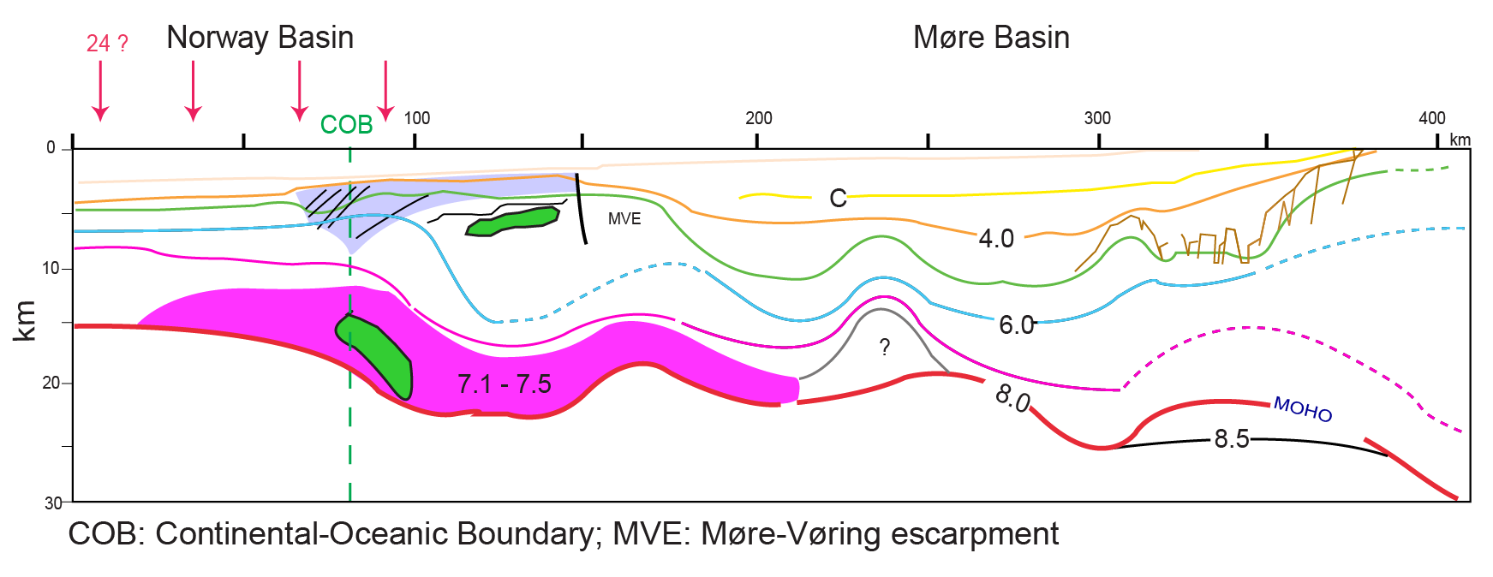
The Møre margin: crustal structures and concepts
Møre marginal High
(volcanic margin)
Deep sag-basin
Proximal platform
LCB
LCB
After Olafsson et al., 1992
LCB: Lower crustal Body

Slide 9
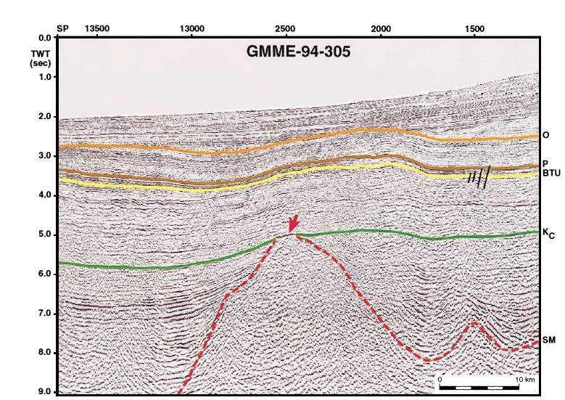
Nature of the crust in the Møre/Jan Mayen Corridor
Deep sag-basin/Grip High
Proximal platform
NW
Jan Mayen corridor
South Halten Terrace
SE
)
C24B
C24A
transition crust
l
)
200
a
l
40
G
a
FAA
m
G
20
100
(
m
a
(
C25?
0
t
A
0
o
A
-100
t
F
-20
g
-200
a
250
300
350
400
450
500
550
600
650
M
0
400U
ESP87
ESP38
ESP37
ESP36
ESP 35
ESP34
-10
Moho OBS ligne 8B1996
6.1
after Raum, 2000
6.5
6.7
6.4
?
7.0
6.1
7.1
2
4
6
8
6.8
7.6
HVLC
-20
Vp (km/s)
M
o
h
o
Moho below the Møre Marginal High
7.7
after Olafsson et al.,1992
Modelled Moho
6.7
-30
Section after Gernigon et al., 2002
Transect 2
2
4
6
8
2
4
6
8
2
4
6
8
2
4
6
8
0
4
8
2
4
6
8
0
10
20
30
40
50
Vp(km/s)
Vp(km/s)
Vp(km/s)
Vp(km/s)
Vp(km/s)
Vp (km/s)
km
Neogene
Paleocene-E.Eocene
Cretaceous
L.Trias-L. Jurassic
Devonian ?- L. Trias
Basement
Early Cretaceous
Seamount ??
*
Seismes and magnitude
5.2
*
Anatexis of the sedimentary rocks ?
High Velocity lower crust (underplating?)
High Velocity lower crust (Eclogite ?)
High Velocity lower crust (>7km/s)
Lundin and Doré (1997)
6.4
Crustal velocity in km/s

Slide 10
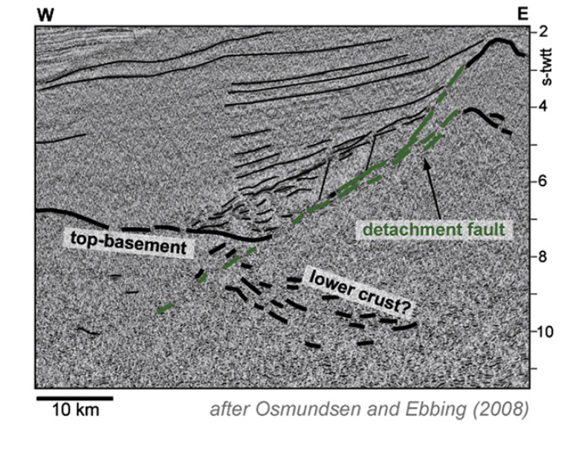
Nature of the crust in the Møre/Jan Mayen Corridor
Deep sag-basin/Grip High
Proximal platform
NW
Jan Mayen corridor
South Halten Terrace
SE
)
C24B
C24A
transition crust
l
)
200
a
l
40
G
a
FAA
m
G
20
100
(
m
a
(
C25?
0
t
A
0
o
A
-100
t
F
-20
g
-200
a
250
300
350
400
450
Grip High
Klakk F.C
M
500
550
600
650
0
400U
ESP87
ESP38
ESP37
ESP36
ESP 35
ESP34
Moho OBS ligne 8B1996
BCU
6.1
-10
after Raum, 2000
6.5
6.7
6.4
?
7.0
6.1
7.1
2
4
6
8
6.8
7.6
HVLC
-20
Vp (km/s)
M
o
h
o
Moho below the Møre Marginal High
7.7
after Olafsson et al.,1992
Modelled Moho
6.7
-30
Old section after Gernigon et al., 2002
Transect 2
2
4
6
8
2
4
6
8
2
4
6
8
2
4
6
8
0
4
8
2
4
6
8
0
10
20
30
40
50
Vp(km/s)
Vp(km/s)
Vp(km/s)
Vp(km/s)
Vp(km/s)
Vp (km/s)
km
Neogene
Paleocene-E.Eocene
Cretaceous
L.Trias-L. Jurassic
Devonian ?- L. Trias
Basement
Basement rocks
under the BCU !!??
*
Seismes and magnitude
5.2
*
Anatexis of the sedimentary rocks ?
High Velocity lower crust (underplating?)
High Velocity lower crust (Eclogite ?)
High Velocity lower crust (>7km/s)
Peron-Pinvidic et al., 2013
6.4
Crustal velocity in km/s

Slide 11
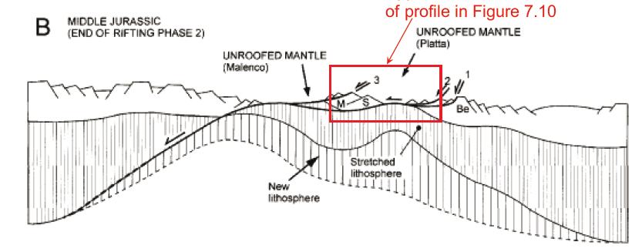
Nature of the crust in the Møre/Jan Mayen Corridor
Deep sag-basin/Grip High
Proximal platform
NW
Jan Mayen corridor
South Halten Terrace
SE
)
C24B
C24A
transition crust
l
)
200
a
l
40
G
a
FAA
m
G
20
100
(
m
a
(
C25?
0
t
A
0
o
A
-100
t
F
-20
g
-200
a
250
300
350
400
450
500
550
600
650
M
0
400U
ESP87
ESP38
ESP37
ESP36
ESP 35
ESP34
Moho OBS ligne 8B1996
BCU
6.1
-10
after Raum, 2000
6.5
6.7
6.4
?
7.0
6.1
7.1
2
4
6
8
6.8
7.6
HVLC
-20
Vp (km/s)
M
o
h
o
Moho below the Møre Marginal High
7.7
after Olafsson et al.,1992
Modelled Moho
6.7
-30
Section after Gernigon et al., 2002
Transect 2
2
4
6
8
2
4
6
8
2
4
6
8
2
4
6
8
0
4
8
2
4
6
8
0
10
20
30
40
50
Vp(km/s)
Vp(km/s)
Vp(km/s)
Vp(km/s)
Vp(km/s)
Vp (km/s)
km
Neogene
Paleocene-E.Eocene
Cretaceous
L.Trias-L. Jurassic
BCU
Devonian ?- L. Trias
Basement
*
Seismes and magnitude
5.2
*
Anatexis of the sedimentary rocks ?
High Velocity lower crust (underplating?)
Vigra/Grid Highs: crustal allochthon
or serpentinised mound?
High Velocity lower crust (Eclogite ?)
High Velocity lower crust (>7km/s)
Reynisson (2012)
6.4
Crustal velocity in km/s

Slide 12
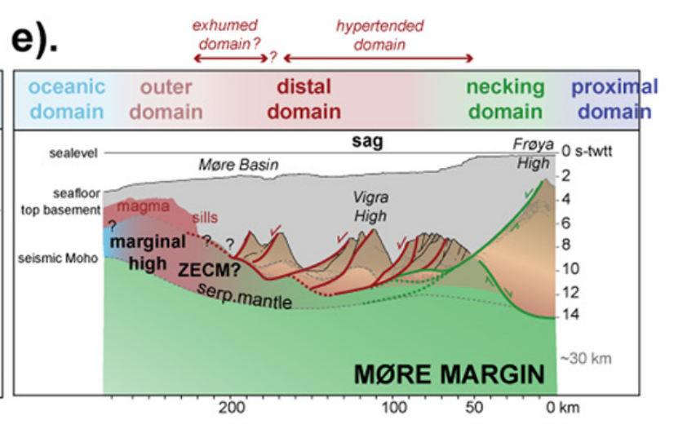
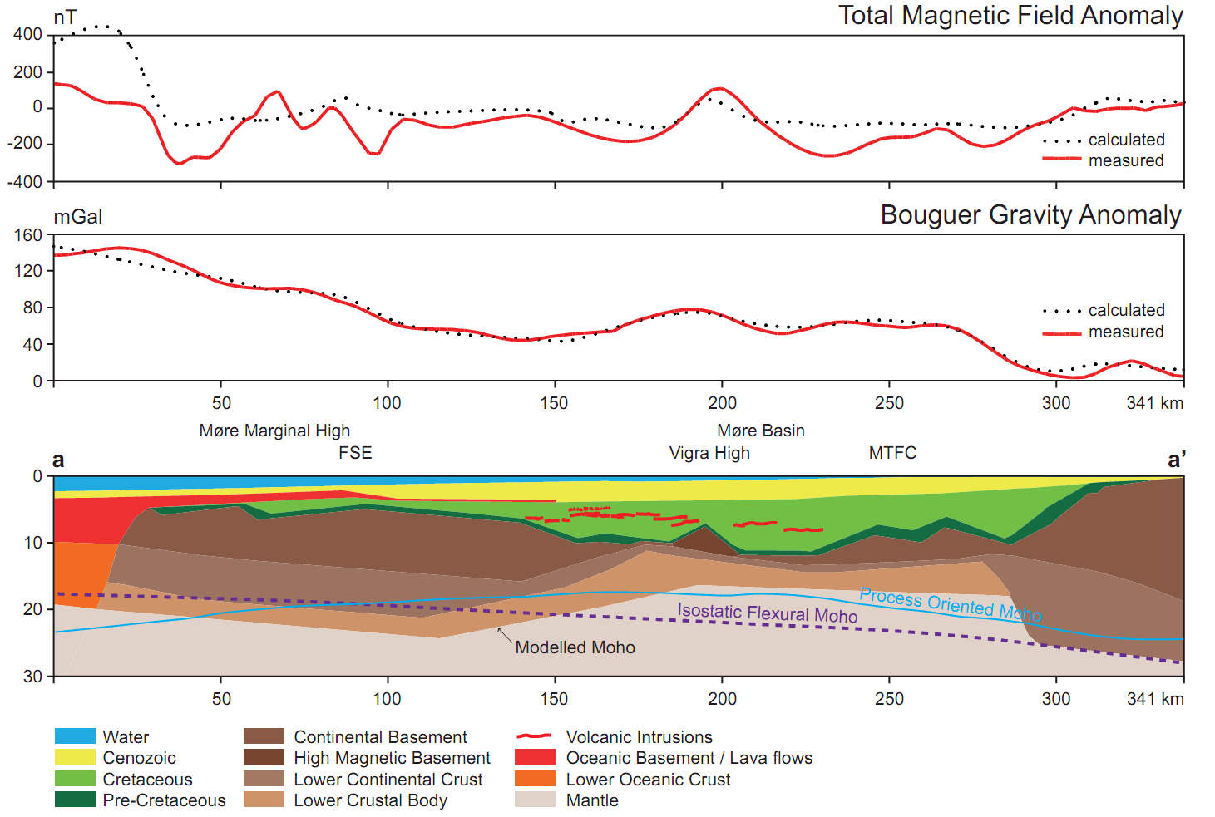
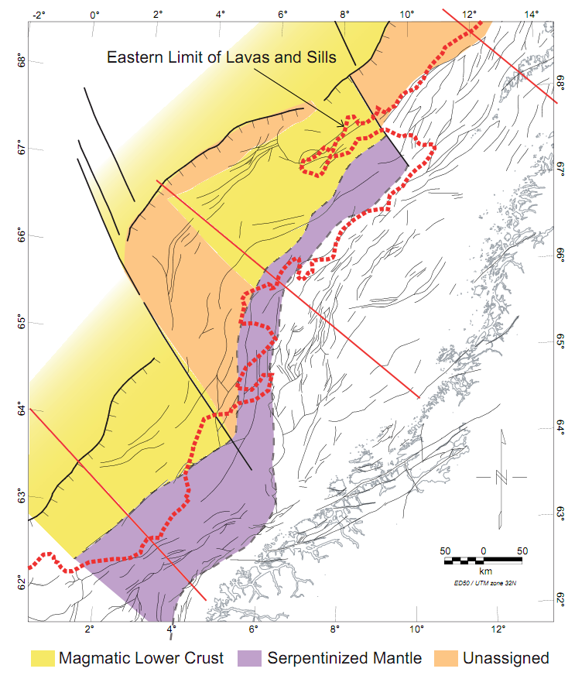
Nature of the crust in the outer margin
LCB
Ribbon ??
Peron-Pinvidic et al. (2013)
Reynisson et al. (2011)
Seeing hyperextension (crustal thickness < 8-10 km) and associated serpentinised mantle from proximal to distal margin is popular
…..but evidences are still low both in the inner and outer parts of the Møre. How to quantify ?
Even the new seismics do not always allow a proper and deep investigation of the sub-sag system (Lower crustal level still poorly constrained by reflection seismics !). Sill and lava hide a large part of the outer sag system
Implications: integrity of the pre-Cretaceous petroleum system in the outer Møre/JMMC
The meaning of the LCBs is somehow unclear and ambiguous and complete different interpretation have already been proposed

Slide 13
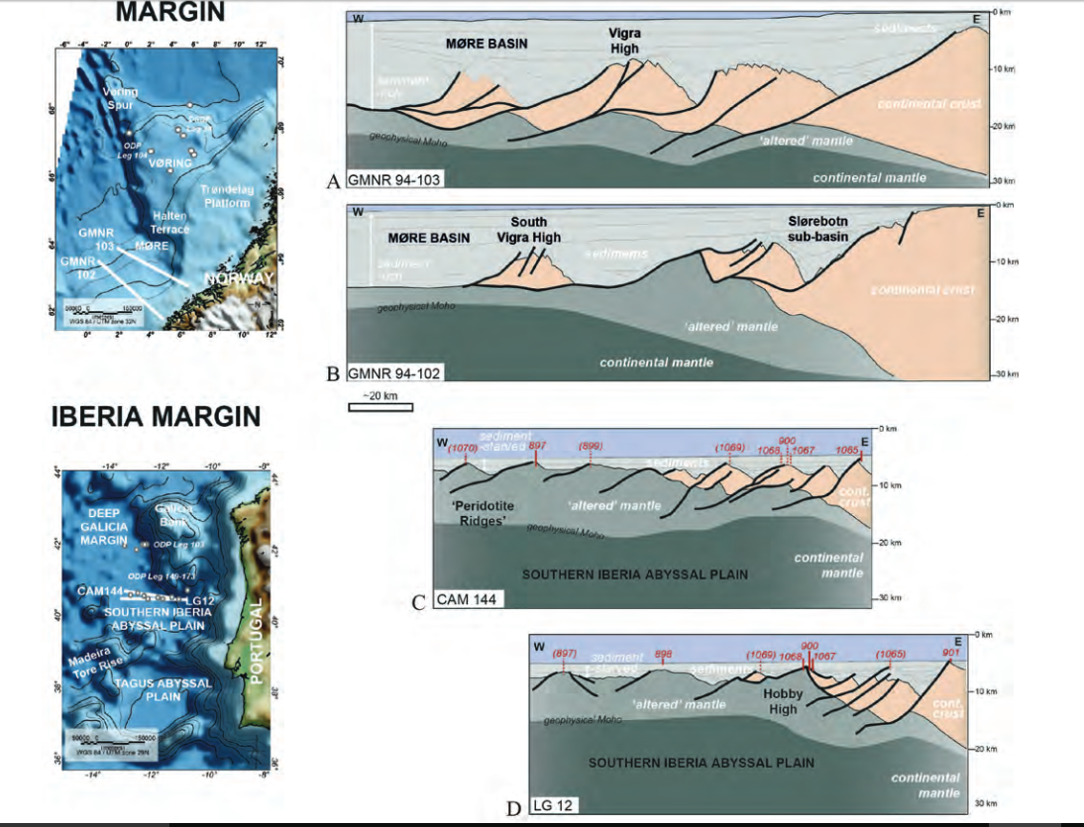
Model with comparison with More and Iberia margins
MORE MARGIN
??
IBERIA MARGIN
Osmundsen et al., 2017

Slide 14
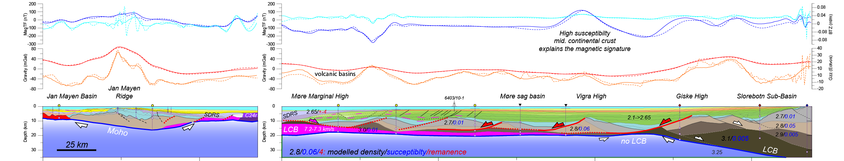
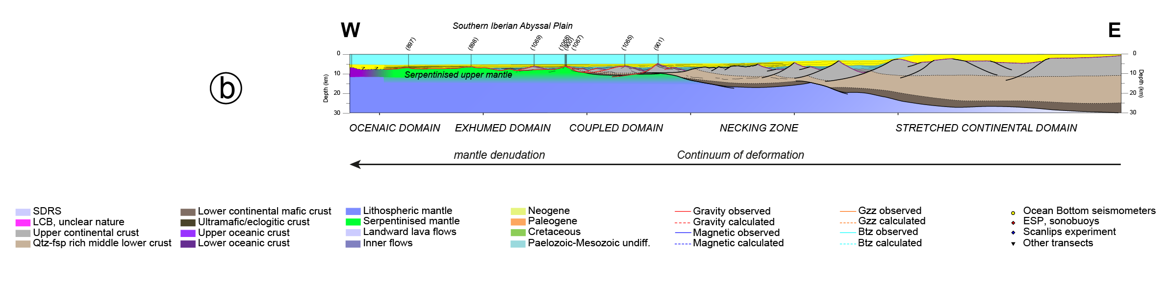
Pre-breakup: validity of the magma-poor models ?
COOP 2- structure of the central Møre margin (update)
JMMC
Breakup axis
Møre volcanic “rifted margin”
10 km
No LCB
Marginal plateau
Necking zone
Volcanic
margins
Jurassic-E.Cretaceous rifted system
Gap >30-60 Ma
Comparison with magma-poor system is ...not so obvious:
we have more crust and less thinning under the Møre sag-basin
hyper
super
Exhumed serpentinised mantle?
? comparison with the Iberian margin has been proposed (Osmundsen and Ebbing, 2008) ?
Gernigon et al., 2015 Tectonic
Notes:
This conjugate crustal section illustrates the pre-breakup crustal configuration of the volcanic rifted system before continental breakup constrain by the more recent potential field dataset
On the Norwegian side, we have to deal with deep Cretaceous sag basin overlying a crustal crust which has been significantly thinned during Jurassic to E.Cretaceous time
However, our crustal estimation suggests that the thinning is not so drastic compared to the Iberian magma-poor and hyper-extended system, recently used as a possible analogue for the Møre Basin. Important thinning is observed locally in the necking zone but we have no evidence of LCB
Although we must considerthe existence of some extension during the latest Cretaceous and Paleocene, it is, however, important to note that the main stretching and thinning event leading to volcanic passive margins successful break-up to the west occurred regionally during the Eocene
This mean that there is a huge gap in time and dynamical contexts exists between the old thinning event and the final Latest-Cretaceous (?)-Eocene events that led to break-up..

Slide 15
Validity of the magma-poor model: not the same scale !
COOP 2- structure of the central Møre margin (update)
JMMC
Breakup axis
Møre volcanic “rifted margin”
10 km
No LCB
Marginal plateau
Necking zone
Volcanic
margins
Gap >30-60 Ma
Comparison with magma-poor system is ...not so obvious :
we have more crust and less thinning under the Møre sag-basin
More “Super” (βc <4) than “hyper”-extension (βc >>4)
hyper
super
Iberian magma-poor margin
(same 1x1 scale)
(after Sutra et al., 2013)
Gernigon et al., 2015 Tectonic
Notes:
This conjugate crustal section illustrates the pre-breakup crustal configuration of the volcanic rifted system before continental breakup constrain by the more recent potential field dataset
On the Norwegian side, we have to deal with deep Cretaceous sag basin overlying a crustal crust which has been significantly thinned during Jurassic to E.Cretaceous time
However, our crustal estimation suggests that the thinning is not so drastic compared to the Iberian magma-poor and hyper-extended system, recently used as a possible analogue for the Møre Basin. Important thinning is observed locally in the necking zone but we have no evidence of LCB
Although we must considerthe existence of some extension during the latest Cretaceous and Paleocene, it is, however, important to note that the main stretching and thinning event leading to volcanic passive margins successful break-up to the west occurred regionally during the Eocene
This mean that there is a huge gap in time and dynamical contexts exists between the old thinning event and the final Latest-Cretaceous (?)-Eocene events that led to break-up..

Slide 16
Pre-breakup: validity of the magma-poor model ?
COOP 2- structure of the central Møre margin (update)
JMMC
Breakup axis
Møre volcanic “rifted margin”
No LCB
Marginal plateau
Necking zone
Volcanic
margins
Jurassic-E.Cretaceous rifted system
Gap >30-60 Ma
Also timing and continuum of deformation issues:
>120 my of continuous crustal thinning seems to be unlikely in the Møre.
The thinning system in the Møre Basin aborted during Mid Cretaceous ?
hyper
super
Gernigon et al., 2015 Tectonic
Notes:
This conjugate crustal section illustrates the pre-breakup crustal configuration of the volcanic rifted system before continental breakup constrain by the more recent potential field dataset
On the Norwegian side, we have to deal with deep Cretaceous sag basin overlying a crustal crust which has been significantly thinned during Jurassic to E.Cretaceous time
However, our crustal estimation suggests that the thinning is not so drastic compared to the Iberian magma-poor and hyper-extended system, recently used as a possible analogue for the Møre Basin. Important thinning is observed locally in the necking zone but we have no evidence of LCB
Although we must considerthe existence of some extension during the latest Cretaceous and Paleocene, it is, however, important to note that the main stretching and thinning event leading to volcanic passive margins successful break-up to the west occurred regionally during the Eocene
This mean that there is a huge gap in time and dynamical contexts exists between the old thinning event and the final Latest-Cretaceous (?)-Eocene events that led to break-up..

Slide 17
Super/hyper versus Vp velocity and serpentinisation ?
Locally too much continental crust to get massive serpentinisation. Massive serpentinisation required a crustal thinning of less that 4 km/s as observed in Iberia-Newfoundland (Hooper et al., 2007)
Locally major crustal thinning does not necessarily fit with high velocity (LCB) layer symptomatic of a mantle serpentinised layer (e.g. Kvarven et al., 2014)
Some LCB Vp in the outer Møre margin (7.2 to 7.5 km/s) values are locally too low to agree a zone of exhumed continental mantle (ZECM) with pervasive serpentinisation.
How to make a difference
with “inherited LCB” ?
High
serpentinisation
Low
serpentinisation
No serpentinisation
hyper-extension
Super-extension
No LCB
P2
Vp versus thickness ranges in the Møre
(Kvarven et al., 2014, Nirrengarten et al., 2014)
Mantle P-wave velocity just below the Moho as a function of thickness of the overlying crust (Hooper et al., 2007) and comparison with LCB Vp values observed in the outer Møre margin (Nirrengarten, Gernigon and Manatschal, 2014)
No LCB
P1

Slide 18
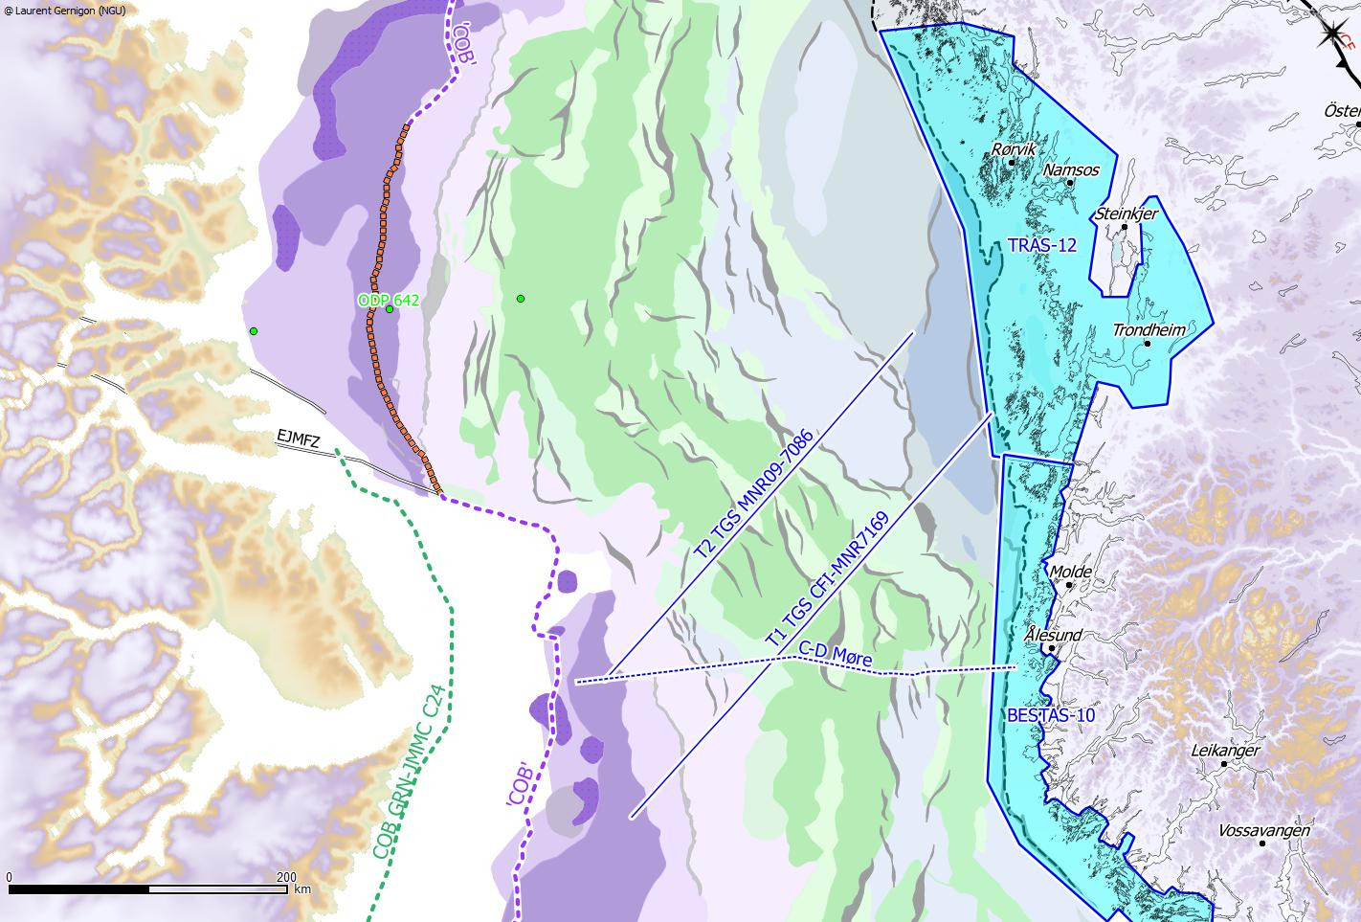
BASAR PROJECT: Regional setting – scientific issues
Onshore-offshore evolution / new aeromagnetic data
New high resolution aeromagnetic surveys (Sokkelgeofysikk COOP 1 and 2 results 2014-2015) have been acquired to better constrain the basement evolution of the Jan Mayen corridor
OFFSHORE
ONSHORE
Trøndelag
Platform
SDR
Vøring Basin
Halten
Terrace
Froan
Basin
SR
Frøya
High
Vøring transform margin
GH
VH
Møre
Marginal High
SDR
GH: Grip High
SR: Slettringen Ridge
GH: Grip High
Greenland at C24
Møre Basin
Regional CFI-MNR seismic lines by courtesy of TGS Nopec
New volcanic and structural map after NGU/VBPR/UiO/TGS mapping project (Gernigon et al. In prep)
Notes:
During the COOP 1 and 2 project, a large amount of new aeromagnetic data have been acquired to fully cover the onshore-offshore transition zone of Norway from the North Sea up to the Trondelag regions
We have combined the most up to date potential field and seismic data to constrain the deep crustal architecture of the Jan Mayen corridor from the platform domain up to the SDR of the Møre Marginal High close to the breakup axis.
We have carried out Potential field modelling across two regional transects. One from the Froan Basin to the Møre Marginal and one from the southern Trondelag platform to the More marginal High
The section also cross over the central crustal rafts including Vigra, Grip Highs and the Slettringen Ridge to the north

Slide 19
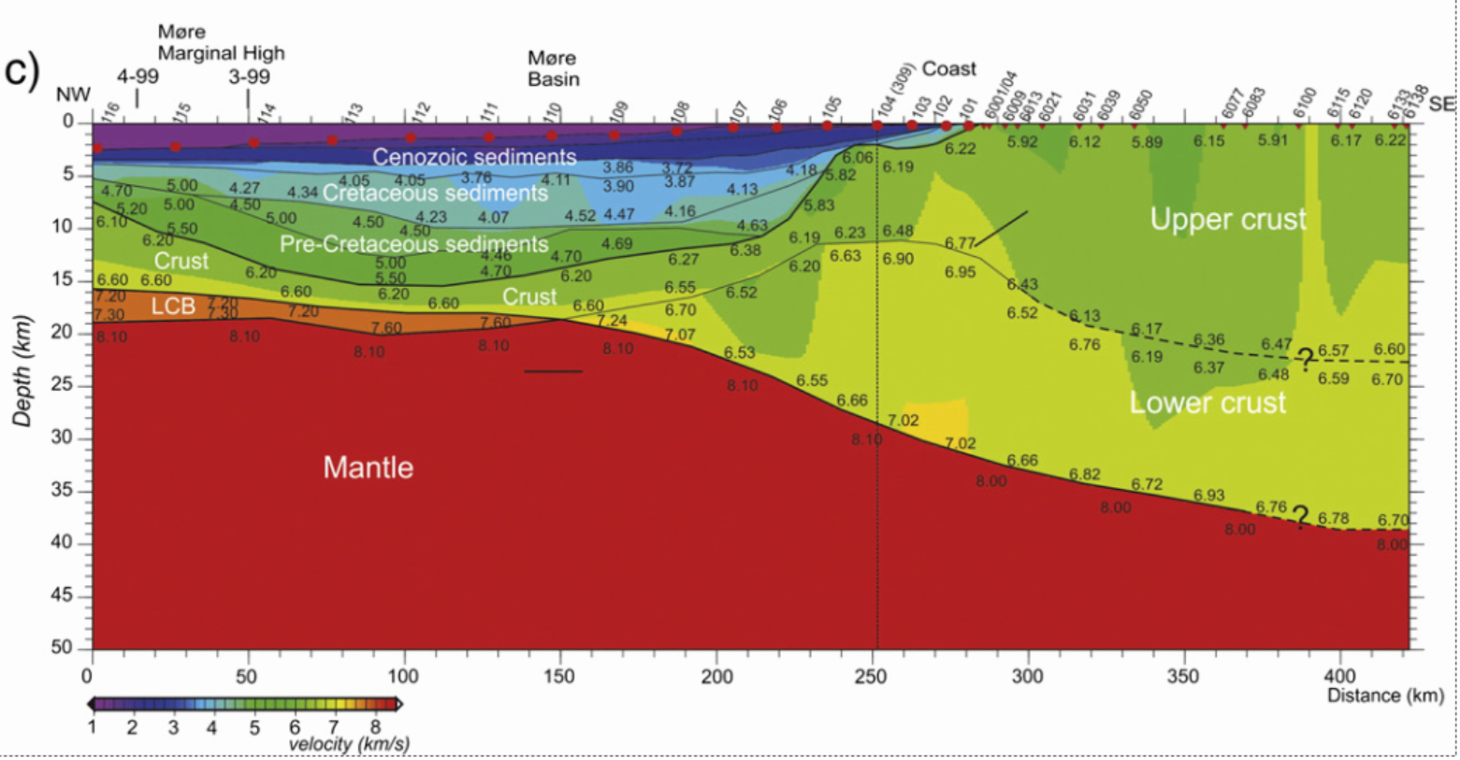
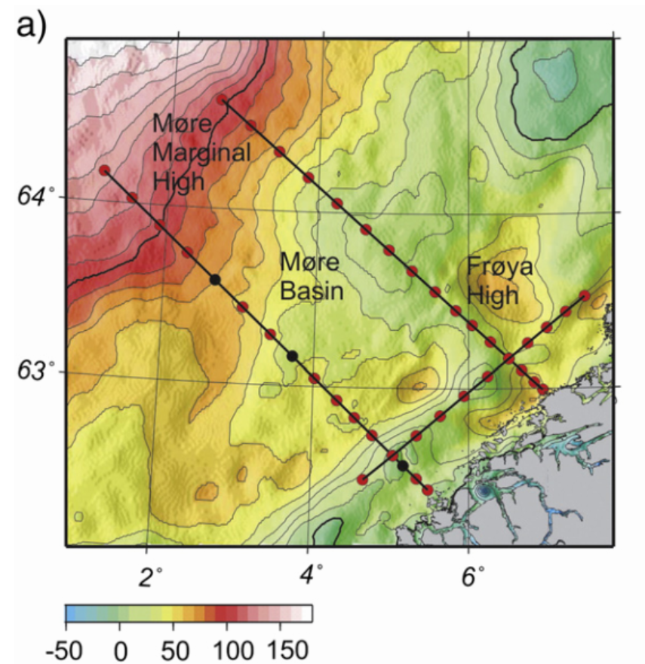
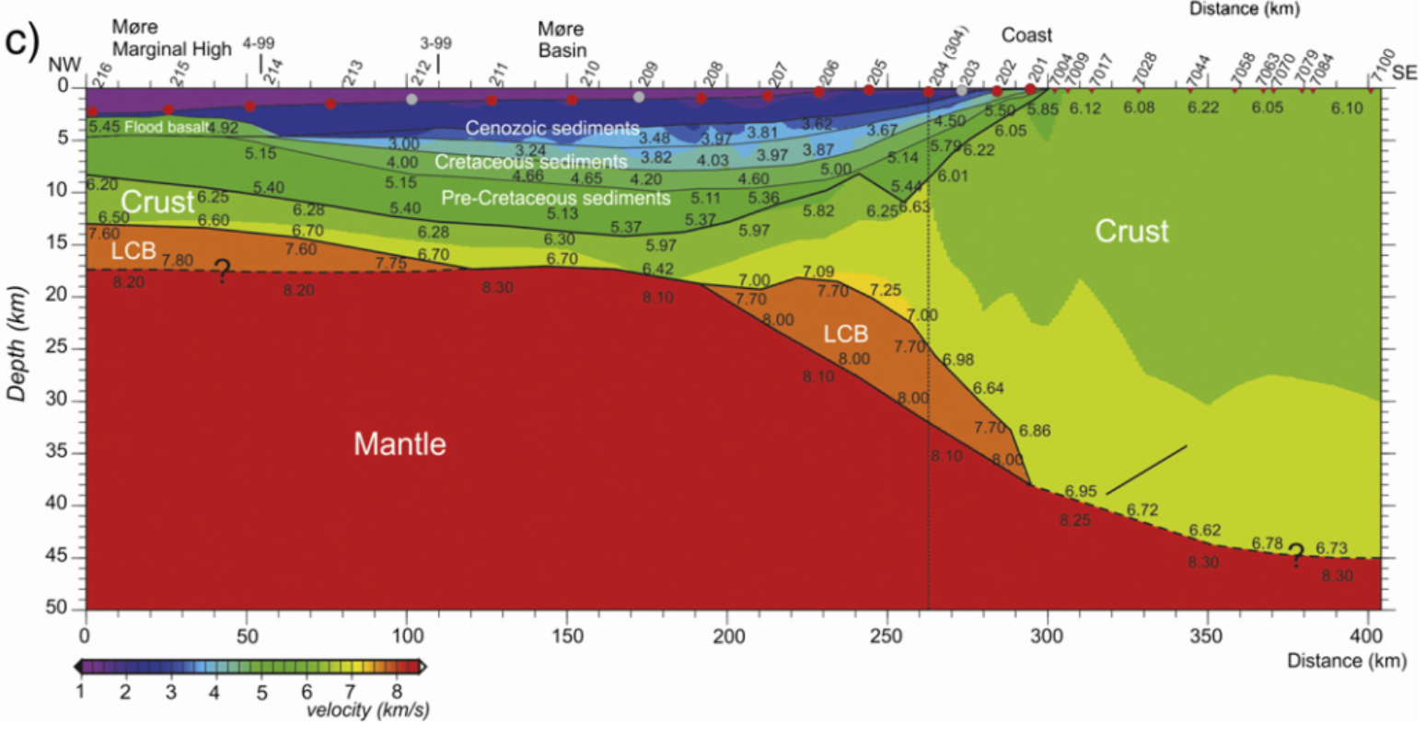
Some LCB also to the south (Kvarven et al., 2014)
NO LCB !
mGal

Slide 20
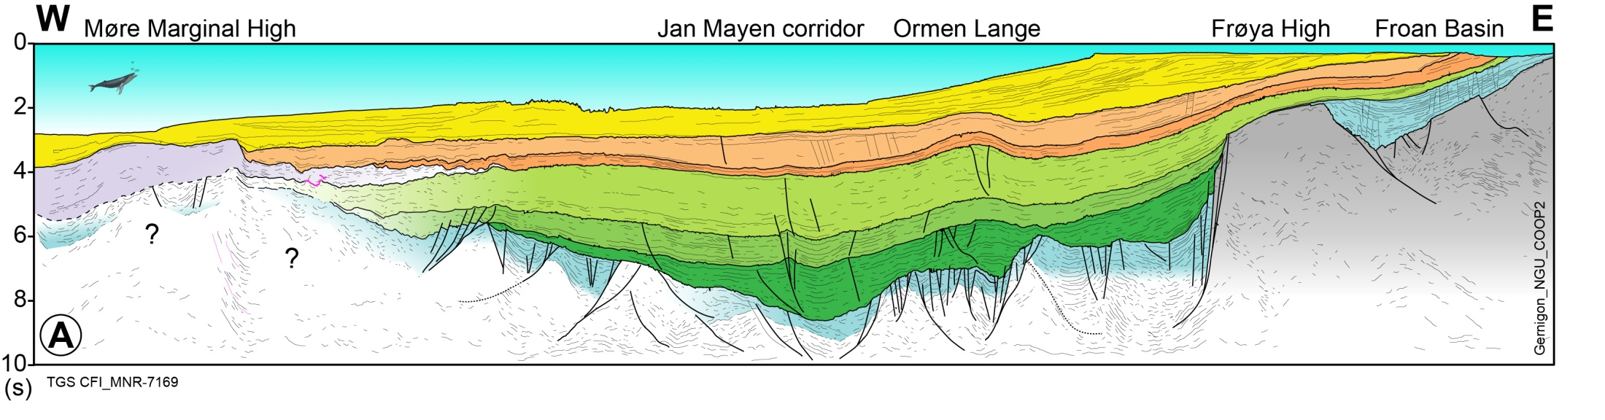
Nature of the distal margin: no continuum of deformation !
1-Mid-Mesozoic rift
S1
T1
SE
SE
T1
S1
VOLCANIC MARGIN
BCU stage
Post-breakup sag
SDR
BCU
cooling sag
Preserved marginal plateau
Terrace and platform
Conjugate necking zone
Necking zone
MT
D
S2
Thermal cooling/strain hardening
S: Stretching/minor thinning
T: Thinning/minor streching
SE: Super-extension
D: Diking and magmatic plumbing
MT: magmatic thinning (syn-SDR)
OC: Oceanic crust
Rift migration or jump
2- L. Cretaceous-Paleocene magmatic rift
Gap >30-60 Ma
>120 my of continuous and severe crustal thinning seems to be unlikely in the Møre Basin and Jan Mayen corridor
The Mid-Mesozoic thinning system in the Møre Basin failed or globally slowed down during Mid Cretaceous ?
Reactivation of previous
stretched marginal domain
(e.g the conjugate necking zone+
Proto JMMC)
Notes:
I am a bit suspicious (to be polite ☺) about the existence of a large zone of exhumed serpentinised mantle just underneath the basalt in the Outer Vøring and outer Møre basin
Our results do not support a drastic crustal thinning in most of the Outer Møre. A little bit more than 10 km is observed at that level and ate 5 to 8 km of crust seems to be preserved on top of the controversial and deep LCB
The outer Møre is interpreted as a marginal plateau possibly including a system of pre-Cretaceous terraces attached to proto-JMMC and the Faeroes block before the onset of breakup
5. Although we must consider the existence of some extension during the latest Cretaceous and Paleocene, it is, however, important to note that the main stretching and thinning event leading to volcanic passive margins successful break-up to the west occurred regionally during the Late Paleocene-Early Eocene
6. This mean that there is a huge gap in time and dynamical contexts between the old Jurassic-Early Cretaceous thinning event and the final Paleocene Eocene thinning events that led to break-up. No continuum of deformation = no exhumation. Conclusions : we got an iso-Halten/Dønna here !!!!! and no mantle rocks beneath BCU.
Ps: Note that I am still uncertain about the syn-rift/post rift phase of sagging. However at that stage I can not develop much during the talk. In general people do not understand that the BCU is not the syn-rift/subsidence limit, so talking about syn-tectonic sag versus syn-cooling and syn-flexural phases of sagging is too complex to explain in 1 mn

Slide 21
BASAR PROJECT: Regional setting – scientific issues
Section CFI MNR09-7179
OFFSHORE
ONSHORE
Trøndelag
Platform
Vøring Basin
Halten
Frøya
High
Vøring transform margin
Greenland at C24
Møre Basin
SDR
Regional CFI-MNR seismic lines by courtesy of TGS Nopec
Notes:
In the North Atlantic, the singularity of volcanic segments of passive margins and the formation of microcontinents particularly involve and question mantle dynamics, crustal structure, inheritance and plate kinematics.
Thanks to decades of geophysical exploration, the main structural elements of the Mid-Norwegian margin are pretty well defined. However, large uncertainties still remain about the structure and petrological nature of the deep crust and the prolongation of the Precambrian/Caledonian basement underneath the sedimentary basins. The mode of deformation leading to continental breakup and subsequent sea-floor spreading is also unclear and alternative scenarios can be proposed.
Grugro stopped they acquisition at the edge of the Gplate COB. However, this COB is wrong and they simply missed several Km2 of continental maetrial+UC+Pal

Slide 22
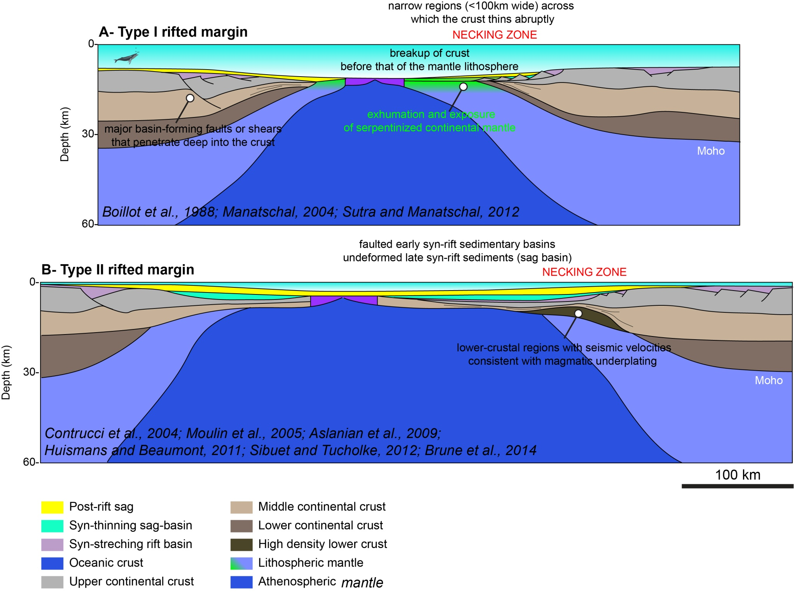
Møre margin: similarities with Type II ”Angola” type
In light of the early modelling, we favoured a type II system in the central Møre Basin
However, the thinning system abort in (mid?) Cretaceous before reactivation and magmatic breakup ~50-60 My later

Slide 23
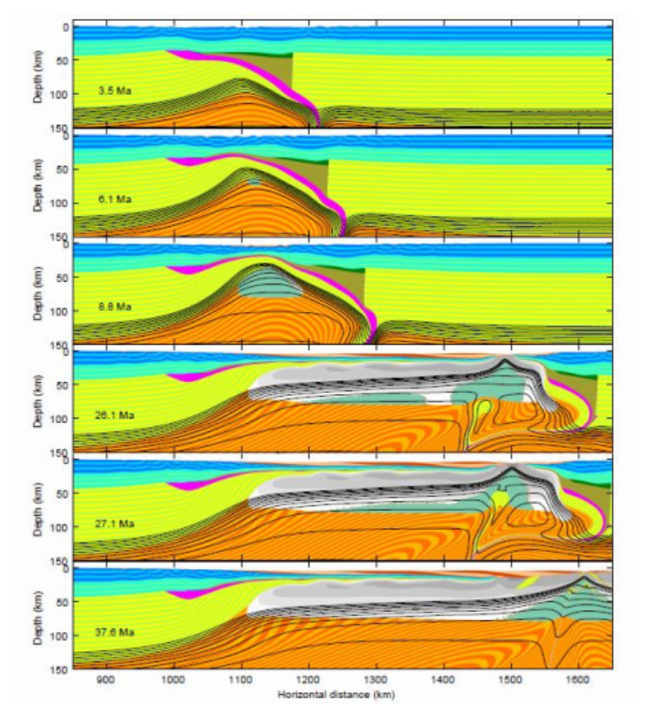
LCB, Inheritance and superextension
Old slab
Petersen and Schiffer, 2016

Slide 24
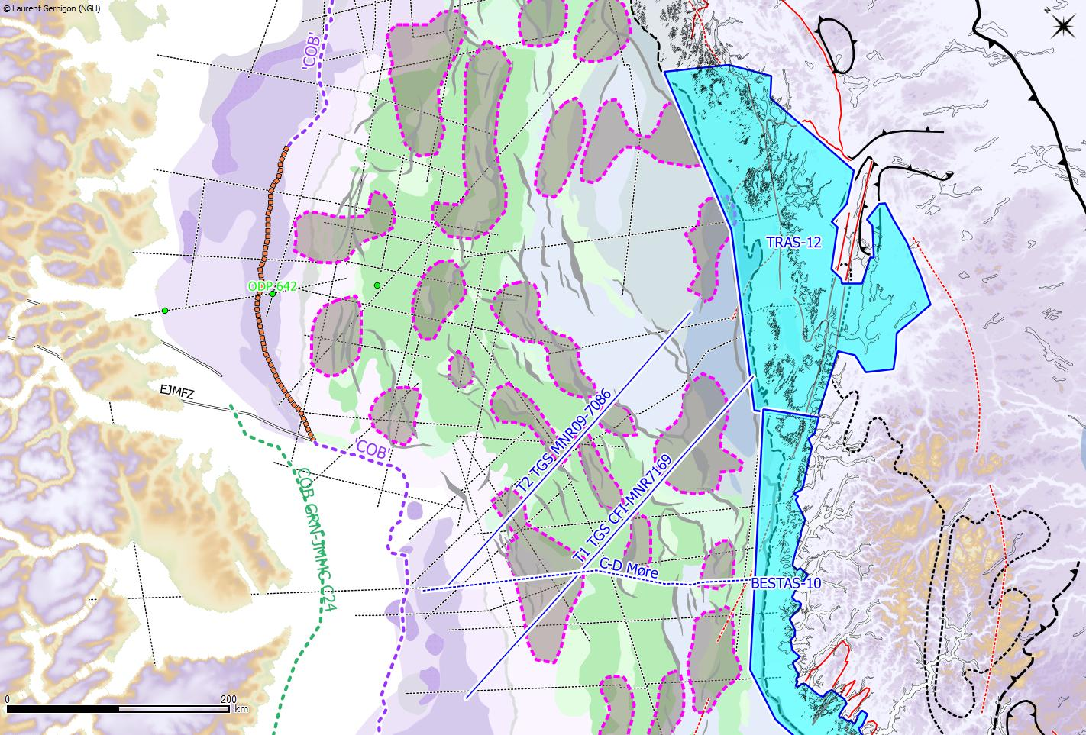
Outline of ”inherited” and pre-basalt LCB (thicker than 3km)
High density/High velocity LCBs are preferentially interpreted as inherited high-grade metamorphic rocks (the deep roots of the collapsed Caledonian orogen ?)
Utgard High:
Ultra dense LCB
In the outer Vøring Basin
the LCB fits with the T reflection outline
(e.g. Gernigon et al., 2003, 2006)
Sharp necking
TR
Permo-Triassic
basins
Inherited slab material
offshore East Greenland
(Schiffer et al., 2015)
TR
Smooth necking
TR ?
Frøya High/MTFC:
Ultra dense LCB
LCB
Sharp necking
Inherited LCBs have an influence on the necking and rift evolution
Such root is the preferred site for drastic thinning ?
The distal LCB are more controversial (underplating?, inherited? lower crust, exhumed serpentinised mantle ?)
Notes:
Our new potential field transect have been combined with our previous modelling and pre-existing OBS already publish to get a better idea of the LCB distribution
across the rifted margin
High density/High velocity LCBs are preferentially interpreted as inherited high-grade metamorphic rocks (the deep roots of the collapsed Caledonian orogen ?)
Remember for future work: note the correlation between the presence of P-T basin and the regional lack of inherited LCB. Need to be tested better when all MNR will be release or eventually try to get the rest of them directly with companies. Should be the time to initiate a sub-salt basement study here ?? But may be after BOOST ?? I saw recently that this old Permian play was again popular in East Greenland again. I have to remember about the ref
May be should not be mentioned at the O-O conference ??

Slide 25
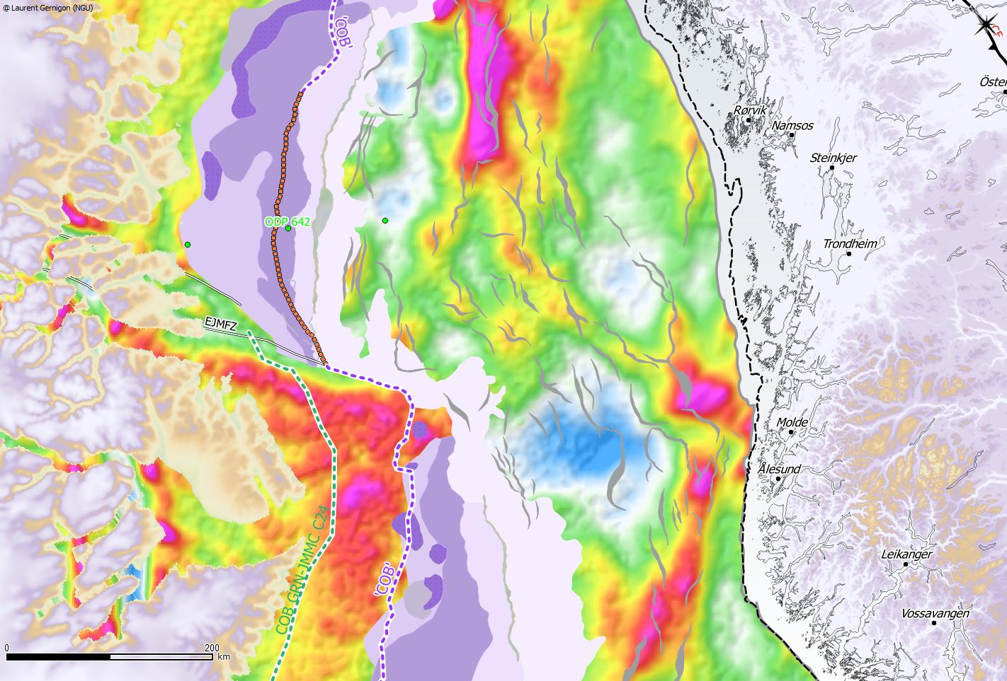

BASAR PROJECT: Regional setting – scientific issues
Outer Vøring Basin
Outer Voring Basin
SDR
Necking zone
Vøring Basin
MTFC
Frøya
High
Vøring transform margin
MTFC
Greenland at C24
Møre Basin
SDR
Gravity data after DTU 2013.
Notes:
In the gravity, the JMC show a clear negative signature.
It also coincides with a bend of the prominent gravity anomalies between the MTFC and the Klakk FC, with a distinct gravity anomaly fitting with the Frøya High in between

Slide 26
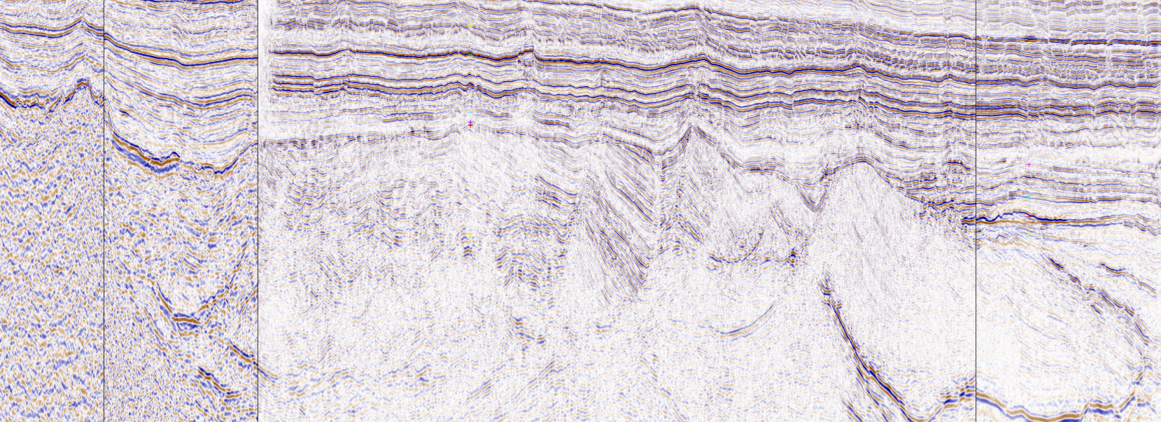
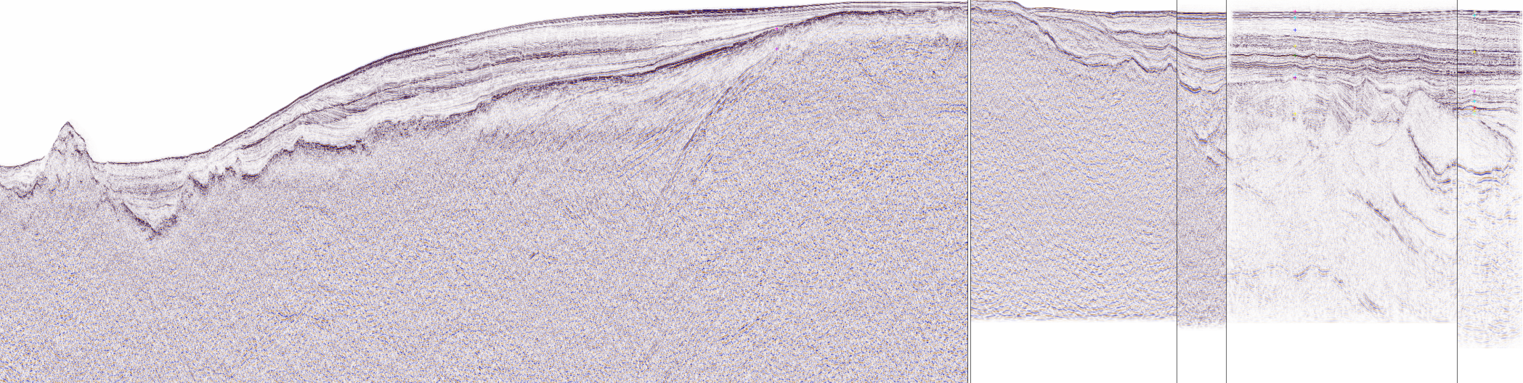
Onset of breakup: timing issues and LCB/TR discussion
6407/12-1
6705/10-1( Asterix)
6704/12-1 and 6705/10-1 show a hiatus between Late Maastrichtian/Early Paleocene (~BTU Unc)
Influence of the TR before Early Eocene and Paleocene
Tilt and faulting during Campanian-Maastrichtian
Minor faulting during mid/Late Paleocene -> migration of the deformation
- TopEocene
Post-breakup
- Opal CT
- Late Eocene
- TopEocene
- Mid.Eocene
- Late Eocene
Top Pal-Ypresian-
- E.Eocene
- Mid.Eocene (~49 Ma, C22n)
- BTU
BTU ?
BTU
- Maastrichtian
BTU
Syn-SDRS
-Ypreseian Tare (~54 Ma, C24B)
Cretaceous >
Top Pal Tang (~55.9 Ma, C24r)
Early-Mid Paleocene ?
BTU
Paleocene
- Thanetian (C25-C24r) LS/US
- L. Campanian
Cretaceous >
- Danian/Selandian (~60 Ma, C26)
- BTU
- BTU (~66 Ma)
- Maastrichtian
- L. Campanian
- Ceno-Coniacian
Cretaceous >
sill
Cretaceous <
- Ceno-Coniacian
Pre-breakup
Volcanic flexure zone
(magmatic necking)
ODP 642
Lava delta-paleoshoreline
6407/12-1
6705/10-1
W
Oceanic domain
Volcanic COT
Continental domain
E
2 -
Post-breakup
propagator
“K” ?
Tertiary
3 -
Top Basalt
US
JMFZ
LS
4 -
“K”
Cretaceous >
Paleocene
Volcanic basin ?
5 -
SDRs
Cretaceous <
No exhumed mantle here ?
6 -
Dike swarm, faults
7 -
Albian-BCU ?
8-
Vp>7km/s
TR
CLCB
9-
Top OLCB ?
3D-SG9604
3D-GR02
US: Upper series: transitional E-MORB Type -> ODP/DSDP K-Ar Age: unclear (63 to 46 Ma) mostly biostratigraphy around 56-54 Ma (Sinton et al., 1998) (C24r),
LS: Lower series: rhyolite, ignimbrite, andesite, dacite -> Age: 57.8 Ma (LeHuray and Johnson, 1989; Sinton, 1998, Meyer et al., 2007)-
> CONTINENTAL CONTAMINATION and SUB-AERIAL VOLCANISM !!
Notes:
In the Vøring Marginal High, shallow to sub-aerial paleowater depth conditions before and during the onset of breakup and evidences of continental contamination of the erupted lava flows do not easily support the presence of a large zone of the exhumed and denudated mantle material lying just underneath the first basaltic layers and late Inner SDR.
Remember. In Galician margin the volcanic pulse create basalt emplaced in the exhumed mantle...... but at 2000-3000 m bsl !!!!. Once again I have to be polite but this is non-sens to apply this model in the outer Møre/Vøring. How could you explain that in terms of isostasy ? And low density ?-> you must have crust and basin preserved here.
In Vøring the drilled basalt at sub-aerial ☺ and show more that clear evidence of continental contamination. Once again, no mantle beneath basalt but few km of Mesozoic-Paleocene sediment. Trias-Jurassic locally ???(e.g Rån Ridge Gernigon et al., 2003)
We preferentially interpret the nature of the deep crust and lower crustal bodies closer to the SDR as a mixture of residual and inherited continental crust later affected by breakup-related intrusions. A renewed phase of extension and normal faulting occurred during the latest Cretaceous and Paleocene in the outer part of the pre-existing rift axis. It most likely affected the outer Vøring Basin which was partly preserved and less thinned during the previous Late Jurassic-Early Cretaceous extensional phase of the rifted margin (e.g. a conjugate necking zone?).
ps: For future COOP, remind me to insist a bit on the necking analogue. What we can learn from Frøya can helps us to refine TR. Also note that the flat magnetic signature: 20-30% serpentinization would simply create a much dominant signature!! But It is not observed in the OVB !. This is also an good argument to definitively get rid of this stupid hyperextension model. It simply does not work here at all. We have to think about that for the future reply. Off course in a ‘gentleman way’ ☺ . For the reply paper, I aslo asked Romain to write a bit on the melting of the crust. It happens at 10 km below the Lower series and simply suggest that at 10 km below “K” you still have continental material. I ve asked him few week ago if we could explain the geochemy with some mix between the rising magma and “possible” ZECM but his answer was “NO WAY”. I also got similar comments from Natland and Hole, I have met in Durham 2 weeks ago. Also not that melting of the crust is ~>500C. You can not easily produce serpentinisation at such high temperature. Same explanation in present day magma spreading segments. Here during SDR the magmatic and volcanic production was x 3-5 higher. End of the story !

Slide 27
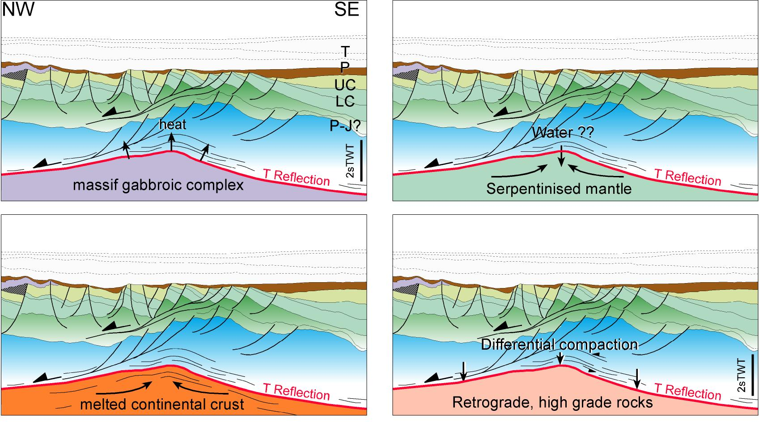
Lower crustal bodies (Vp>7km/s): weigh up the pros and cons
Eldholm et al., 1989; Mjelde et al., 1997;
Skogseid et al., 2000
Walker et al., 1997, Ren et al., 2003
Lundin and Doré, 1997
Gernigon et al., 2003, 2004
MAGMATIC MODELS
Previous interpretation
MAGMA-POOR MODELS
Challenging interpretation
Similar discussion we had in the outer Vøring Basin ~10 years ago. The problem is complex and depends on several parameters (thinning processes, timing, Temperature, water supply, ..)
Notes:
As seen on the previous slides,

Slide 28
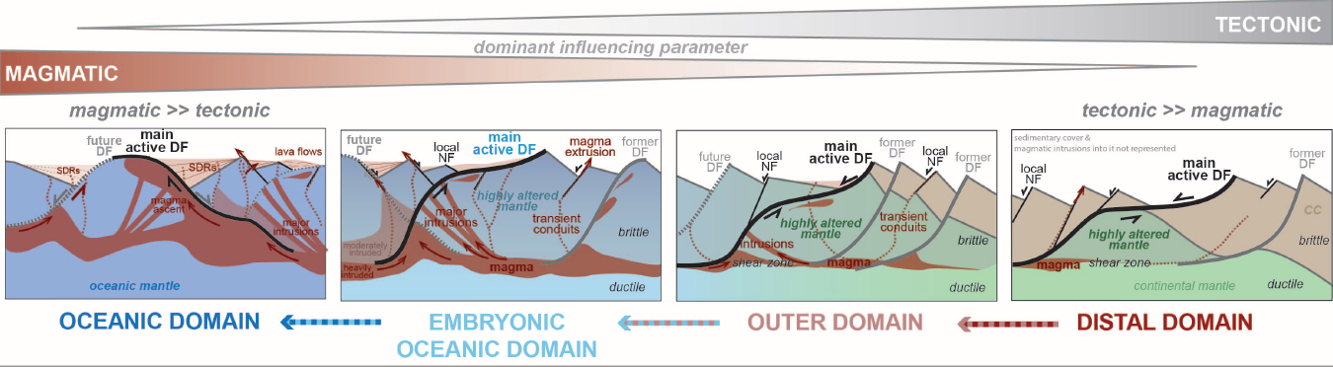
Magma-poor model in the outer Vøring: fact or reality ?
Ygg High
Gjallar
A magma-poor scenario in the outer Vøring is speculative (for me). Few geological and geophysical issues
Conceptual/fashion model ?, no clear evidence for that
No fault coupling, thicker sedimentation, fluid origin ?
To much crust to reach a real hyperextended feature
Like Møre, no continuum of deformation
No magnetic signature, why ?
Temperature versus serpentinisation
Magmatic rates !
Different palaeography-water depths
Evidence of continental contamination
Evidence of sub-basalt sediments (not serpentinised mantle !) (e.g. CVX survey)
> Volcanic margins are fundamentally different from magma-poor margin !
-> The hyperextended model applied to the outer Møre/Vøring is also very ‘oil’ pessimistic
Peron-Pinvidic and Odmundsen, 2016
Notes:
Good example of geofantasy ! And how to applied a popular model in a different setting to fit the fashion model of the month. Don´t believe in that, please !!
Here are few elements/problem Peron-Pinvidic and Osmundsen should think about. They also forgot that the ODP well show clear evidence of continental contamination ☺. They should check again the old literature !-> implication: you drill the mantle ! Ygg seismic show sediments !
I am a bit suspicious (to be polite ☺) about the existence of a large zone of exhumed serpentinised mantle just underneath the basalt in the Outer Vøring and outer Møre basin
Our results do not support a drastic crustal thinning in most of the Outer Møre. A little bit more than 10 km is observed at that level and ate 5 to 8 km of crust seems to be preserved on top of the controversial and deep LCB
The outer Møre is interpreted as a marginal plateau possibly including a system of pre-Cretaceous terraces attached to proto-JMMC and the Faeroes block before the onset of breakup
5. Although we must consider the existence of some extension during the latest Cretaceous and Paleocene, it is, however, important to note that the main stretching and thinning event leading to volcanic passive margins successful break-up to the west occurred regionally during the Late Paleocene-Early Eocene
6. This mean that there is a huge gap in time and dynamical contexts between the old Jurassic-Early Cretaceous thinning event and the final Paleocene Eocene thinning events that led to break-up. No continuum of deformation = no exhumation. Conclusions : we got an iso-Halten/Dønna here !!!!! and no mantle rocks beneath BCU.
Ps: Note that I am still uncertain about the syn-rift/post rift phase of sagging. However at that stage I can not develop much during the talk. In general people do not understand that the BCU is not the syn-rift/subsidence limit, so talking about syn-tectonic sag versus syn-cooling and syn-flexural phases of sagging is too complex to explain in 1 mn

Slide 29
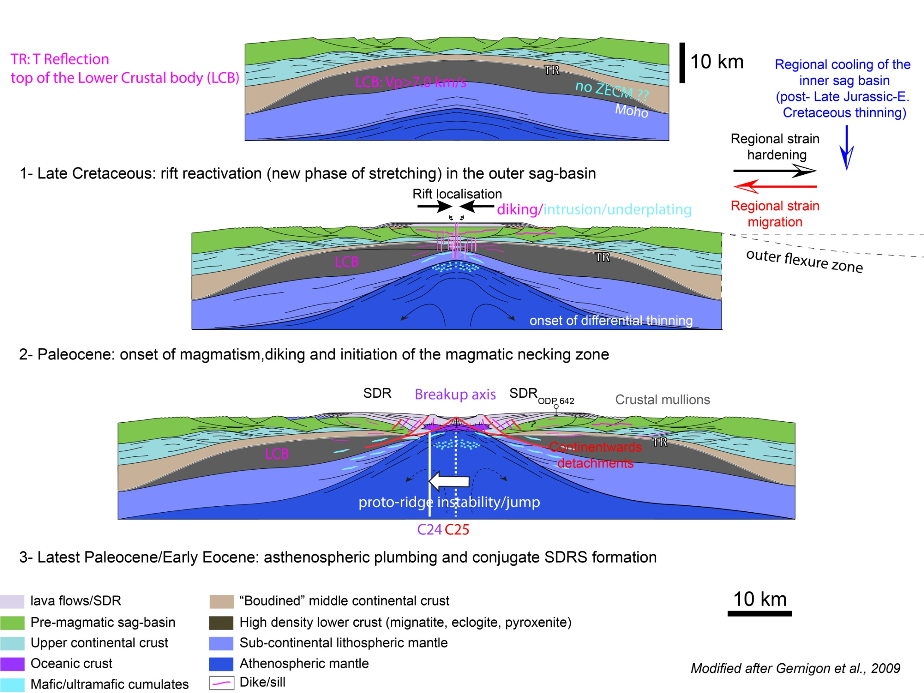
Onset of breakup: diking, plumbing and magmatic necking
Marginal Plateau
(continental crust preserved)
No clear ZECM
decoupling
Onset of breakup scenario (modified after Gernigon et al., 2006)
Notes:
In or model we assume a period of thermal cooling between the late Jurassic-Early Cretaceous thinning episode and the renewed phases of stretching and thinning in Late Cretaceous-Paelocene
In this case, the initial extensional shaping of the sag and underlying rifted crust should lead to a stronger rheology in the inner part of the margin and a weaker rheology at the edge of the previous rift system
For that reason, a new phase of stretching and thinning would preferentially focus in western and original flank of the Late Jurassic Early Cretaceous rift system where a preserved marginal plateau relatively preserved from drastic thinning
During the onset of breakup, magmatism most likely control the breakup, dikes swarm and crustal intrusion could have control the localisation of the deformation required to initiate the rupture of the lithosphere even before the total thinning of the preserved crust
Basically the same kind of model was proposed in the OVB….. >15 year ago☺

Slide 30
Conclusion: a complex rift to drift evolution
Meaning of the LCB is the key to decipher in between the different rifted margin models – very complex and controversial issue
A super-extended scenario is proposed for the ’failed’ part of the rifted margin
The volcanic margin (stricto-sensu) affected a distal domain partly preserved from the Late Jurassic-Early Cretaceous thinning phase ->different system !
No continuum of deformation , a specificity of the North Atlantic margin
Continental breakup affected both thick and thinner crustal domains.
Locally too much continental crust to clearly support a large zone of exhumed and denudated serpentinised mantle in the outer part of the margin.
Breakup is probably sharp and magmato-tectonic processes (plumbing, diking) are most likely involved (cf. other volcanic margins worldwide)

Slide 31
Continental LCB: different interpretation
70ies-early 90ies
Dominant group
How to argument and prove
a preferred model is
THE scientific key issue !
UNDERPLATING FASHION
GROUP
?
MAGMA-MODERATE
LOWER CRUST FASHION
GROUP
SERPENTINE FASHION
GROUP
1990-2005
The growing minority

Slide 32
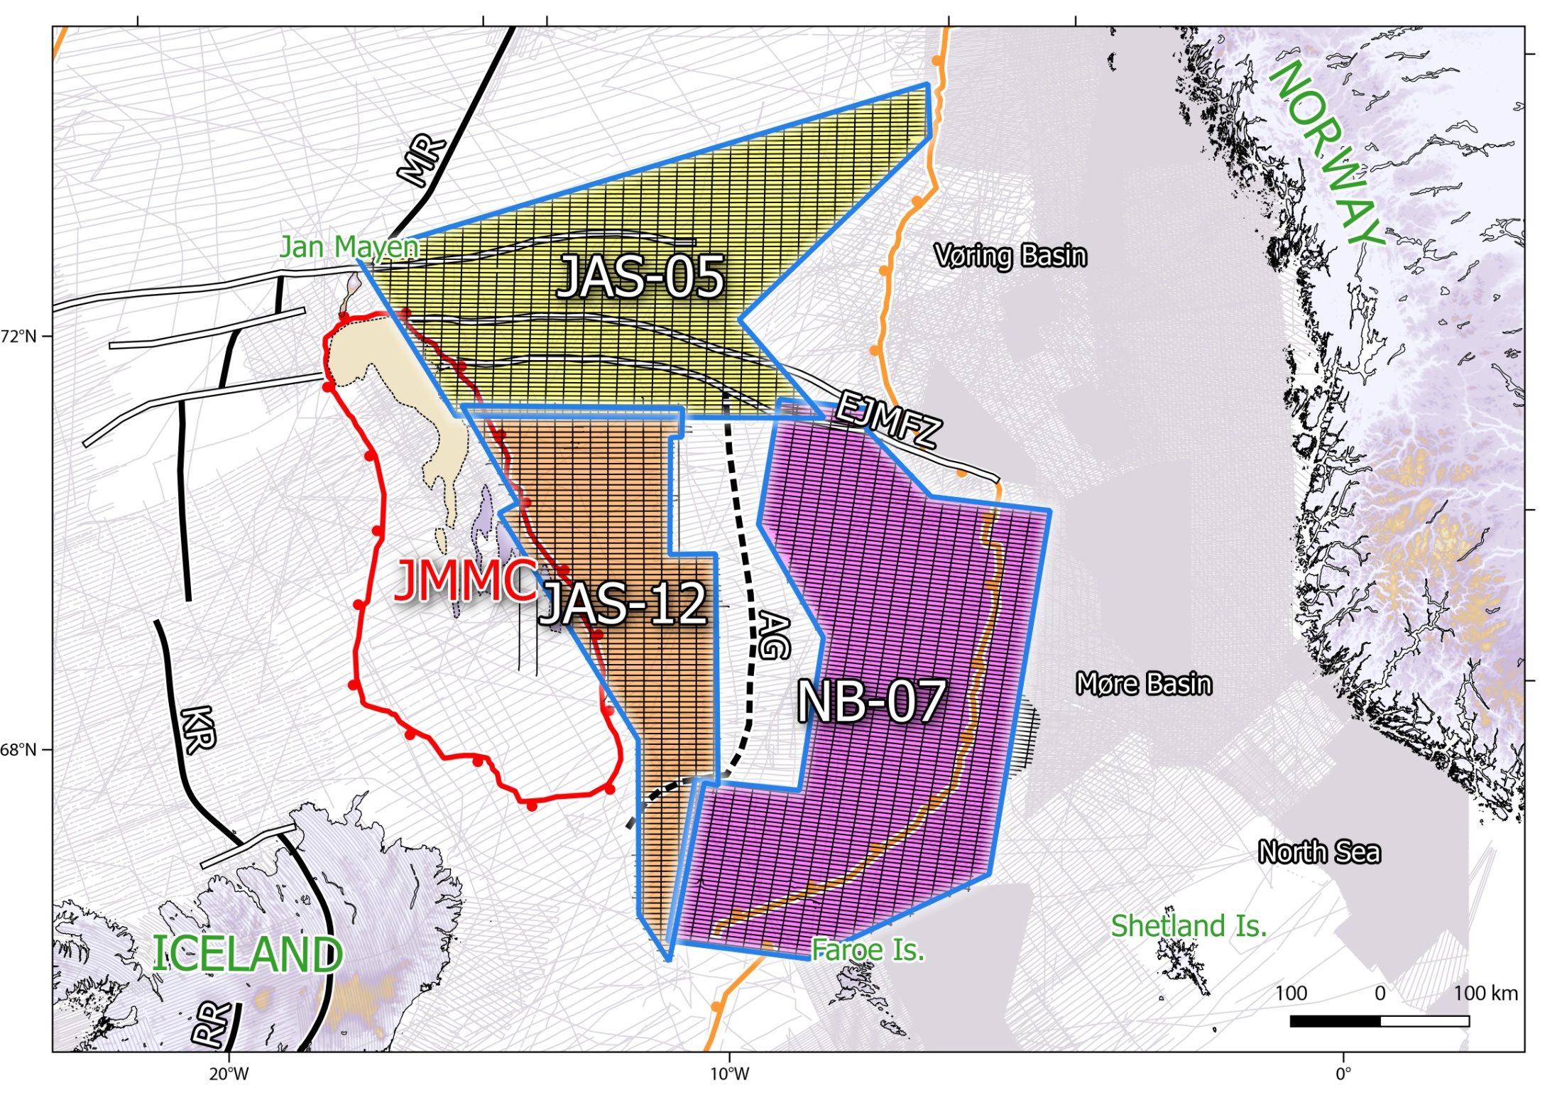
The Norway Basin: new HR/HQ mag from COB to COB
A total of 88.100 km of new HR/HQ magnetic profiles
Line/tie-line spacing: 6/20 km
Sensor elevation: 230 m
Area coverage: 80.000 km²
Total flying distance: 17.600 km
Notes:
Then to really get a complete mapping of the entire NB, we filled the reaming gaps between the Aborted Aegir Ridge and the JMMC between 2011 and 2012
At the end, we acquired a total of more than 88 000 km of new , high quality, high resolution magnetic profiles in the Norway Basin from COB to COB

Slide 33
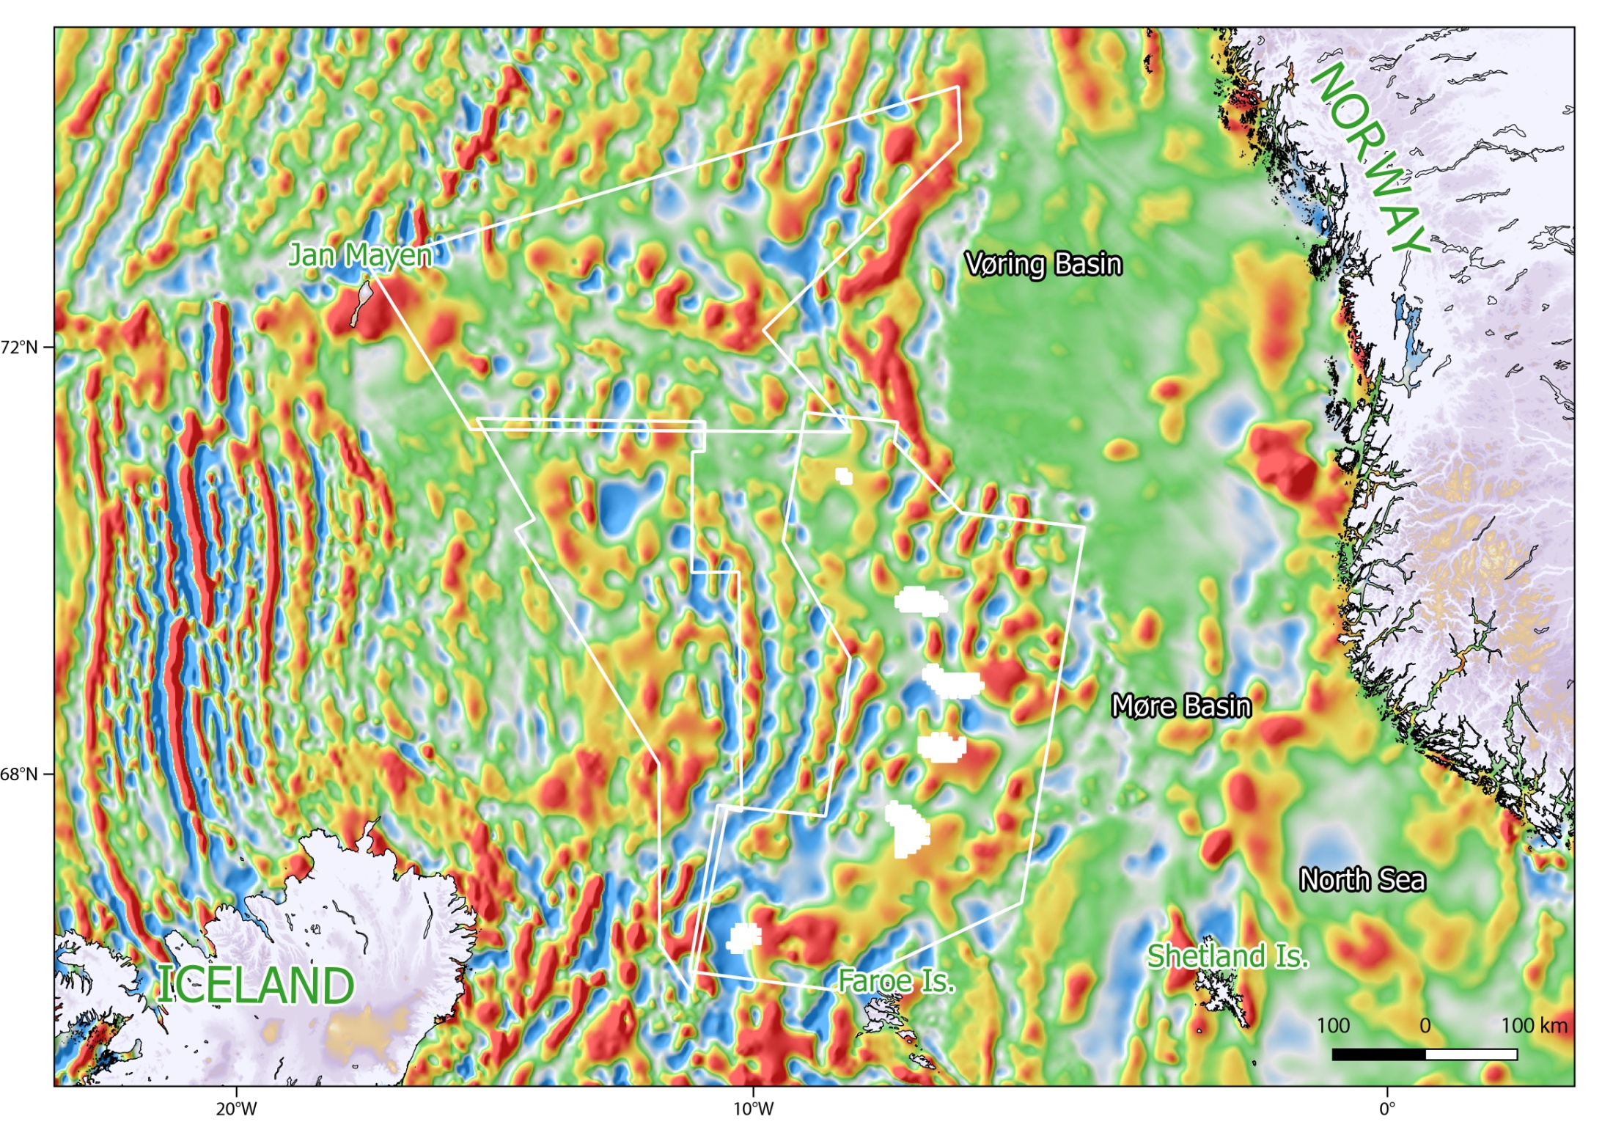

Comparison with vintage aeromagnetic (released) data
Old magnetic grid based on ”unreliable” vintage dataset
(e.g. release data, NGDC, Verhoef, CAMP, NAGTEC, EMAG2 )
Previous “Vintage” compilation after Olesen et al (2010)
Notes:
Here is the previous grid based on the vintage dataset we had before the new surveys

Slide 34
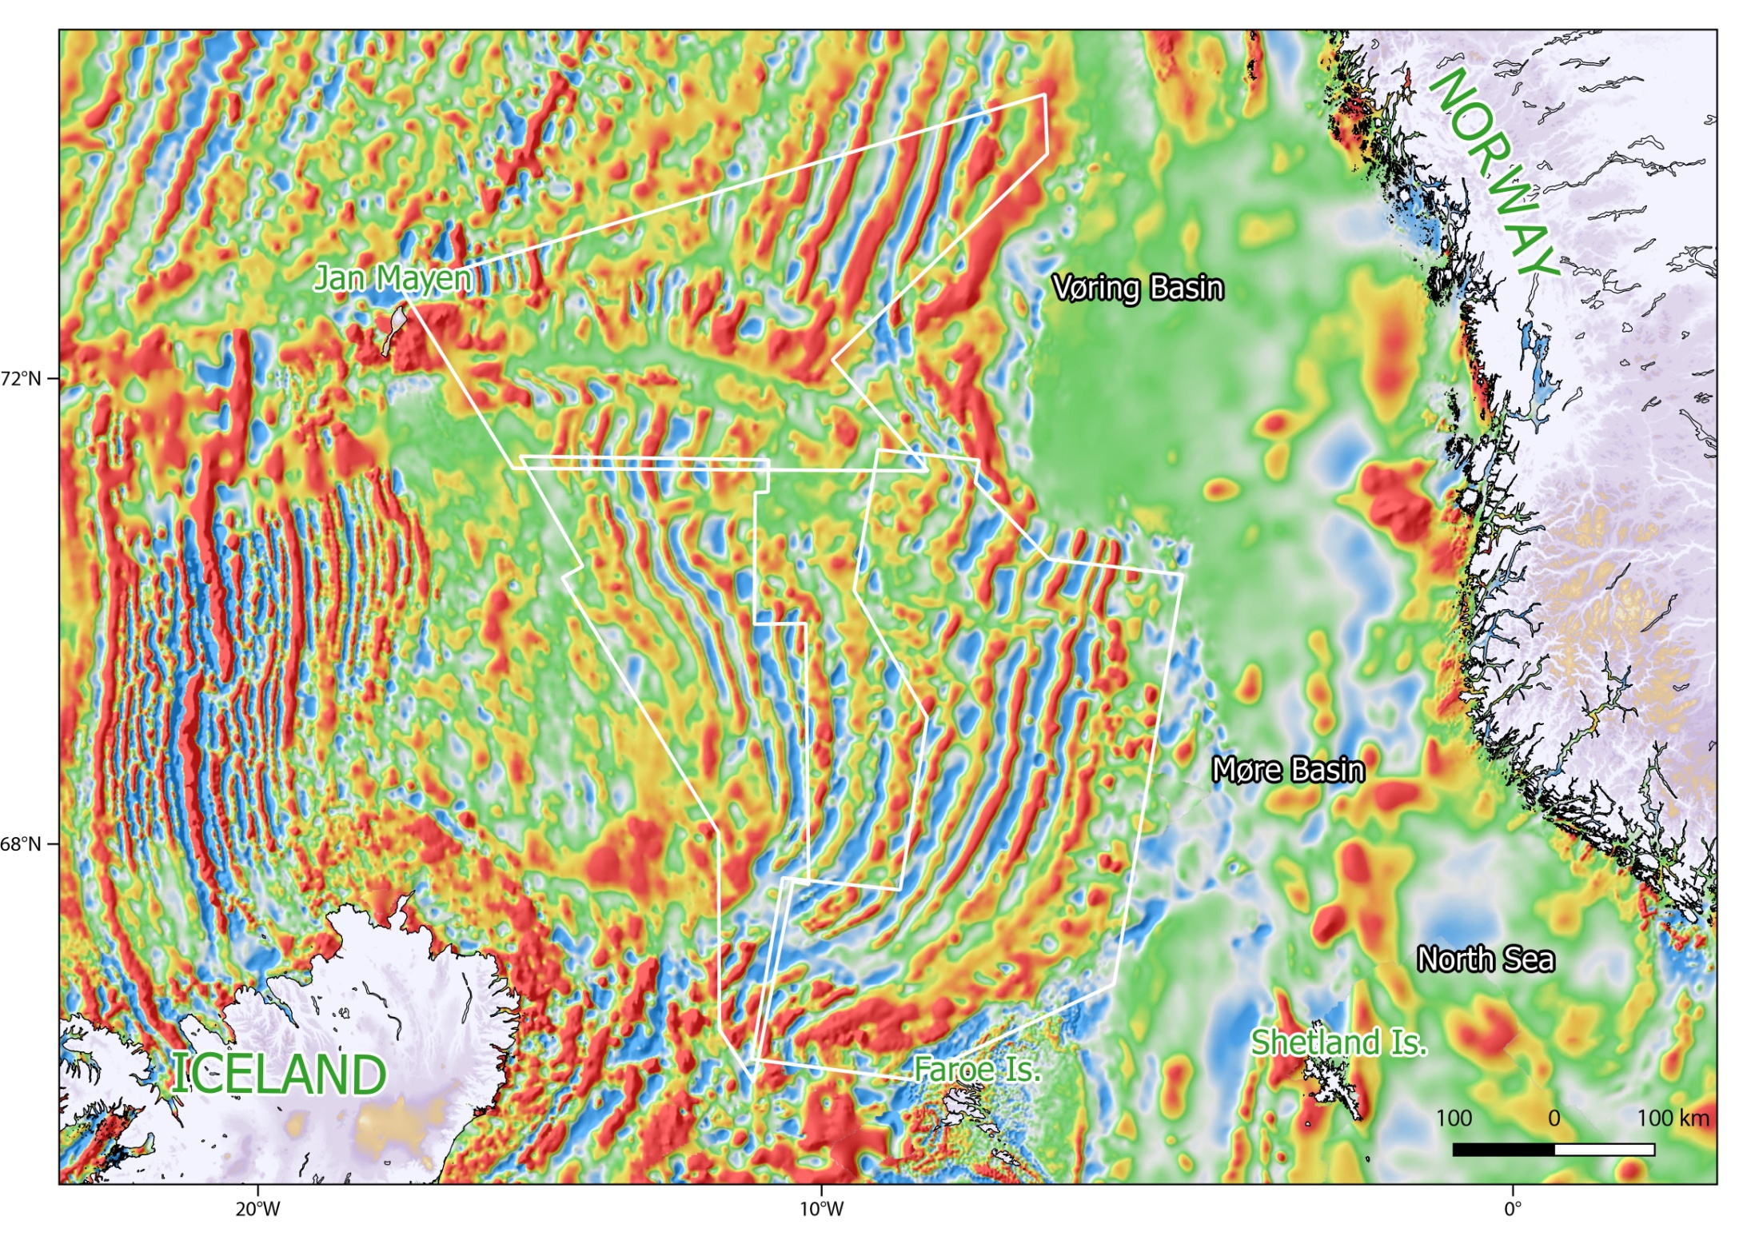
Up-to-date Continental Shelf Geophysics team compilation
© continental shelf geophysics NGU
New total magnetic field grid +MF7 satellite correction
The new NGU compilation also includes the reprocessing of all surrounding dataset (Gernigon et al., 2015)
*:New COOP aeromagnetic data not included
Notes:
Here is the last and up to date NGU compilation of the Norwegian Greenland Sea
You can easily see that the definition and resolution of the magnetic spreading anomalies and associated fractures zones improved quite a lot.

Slide 35
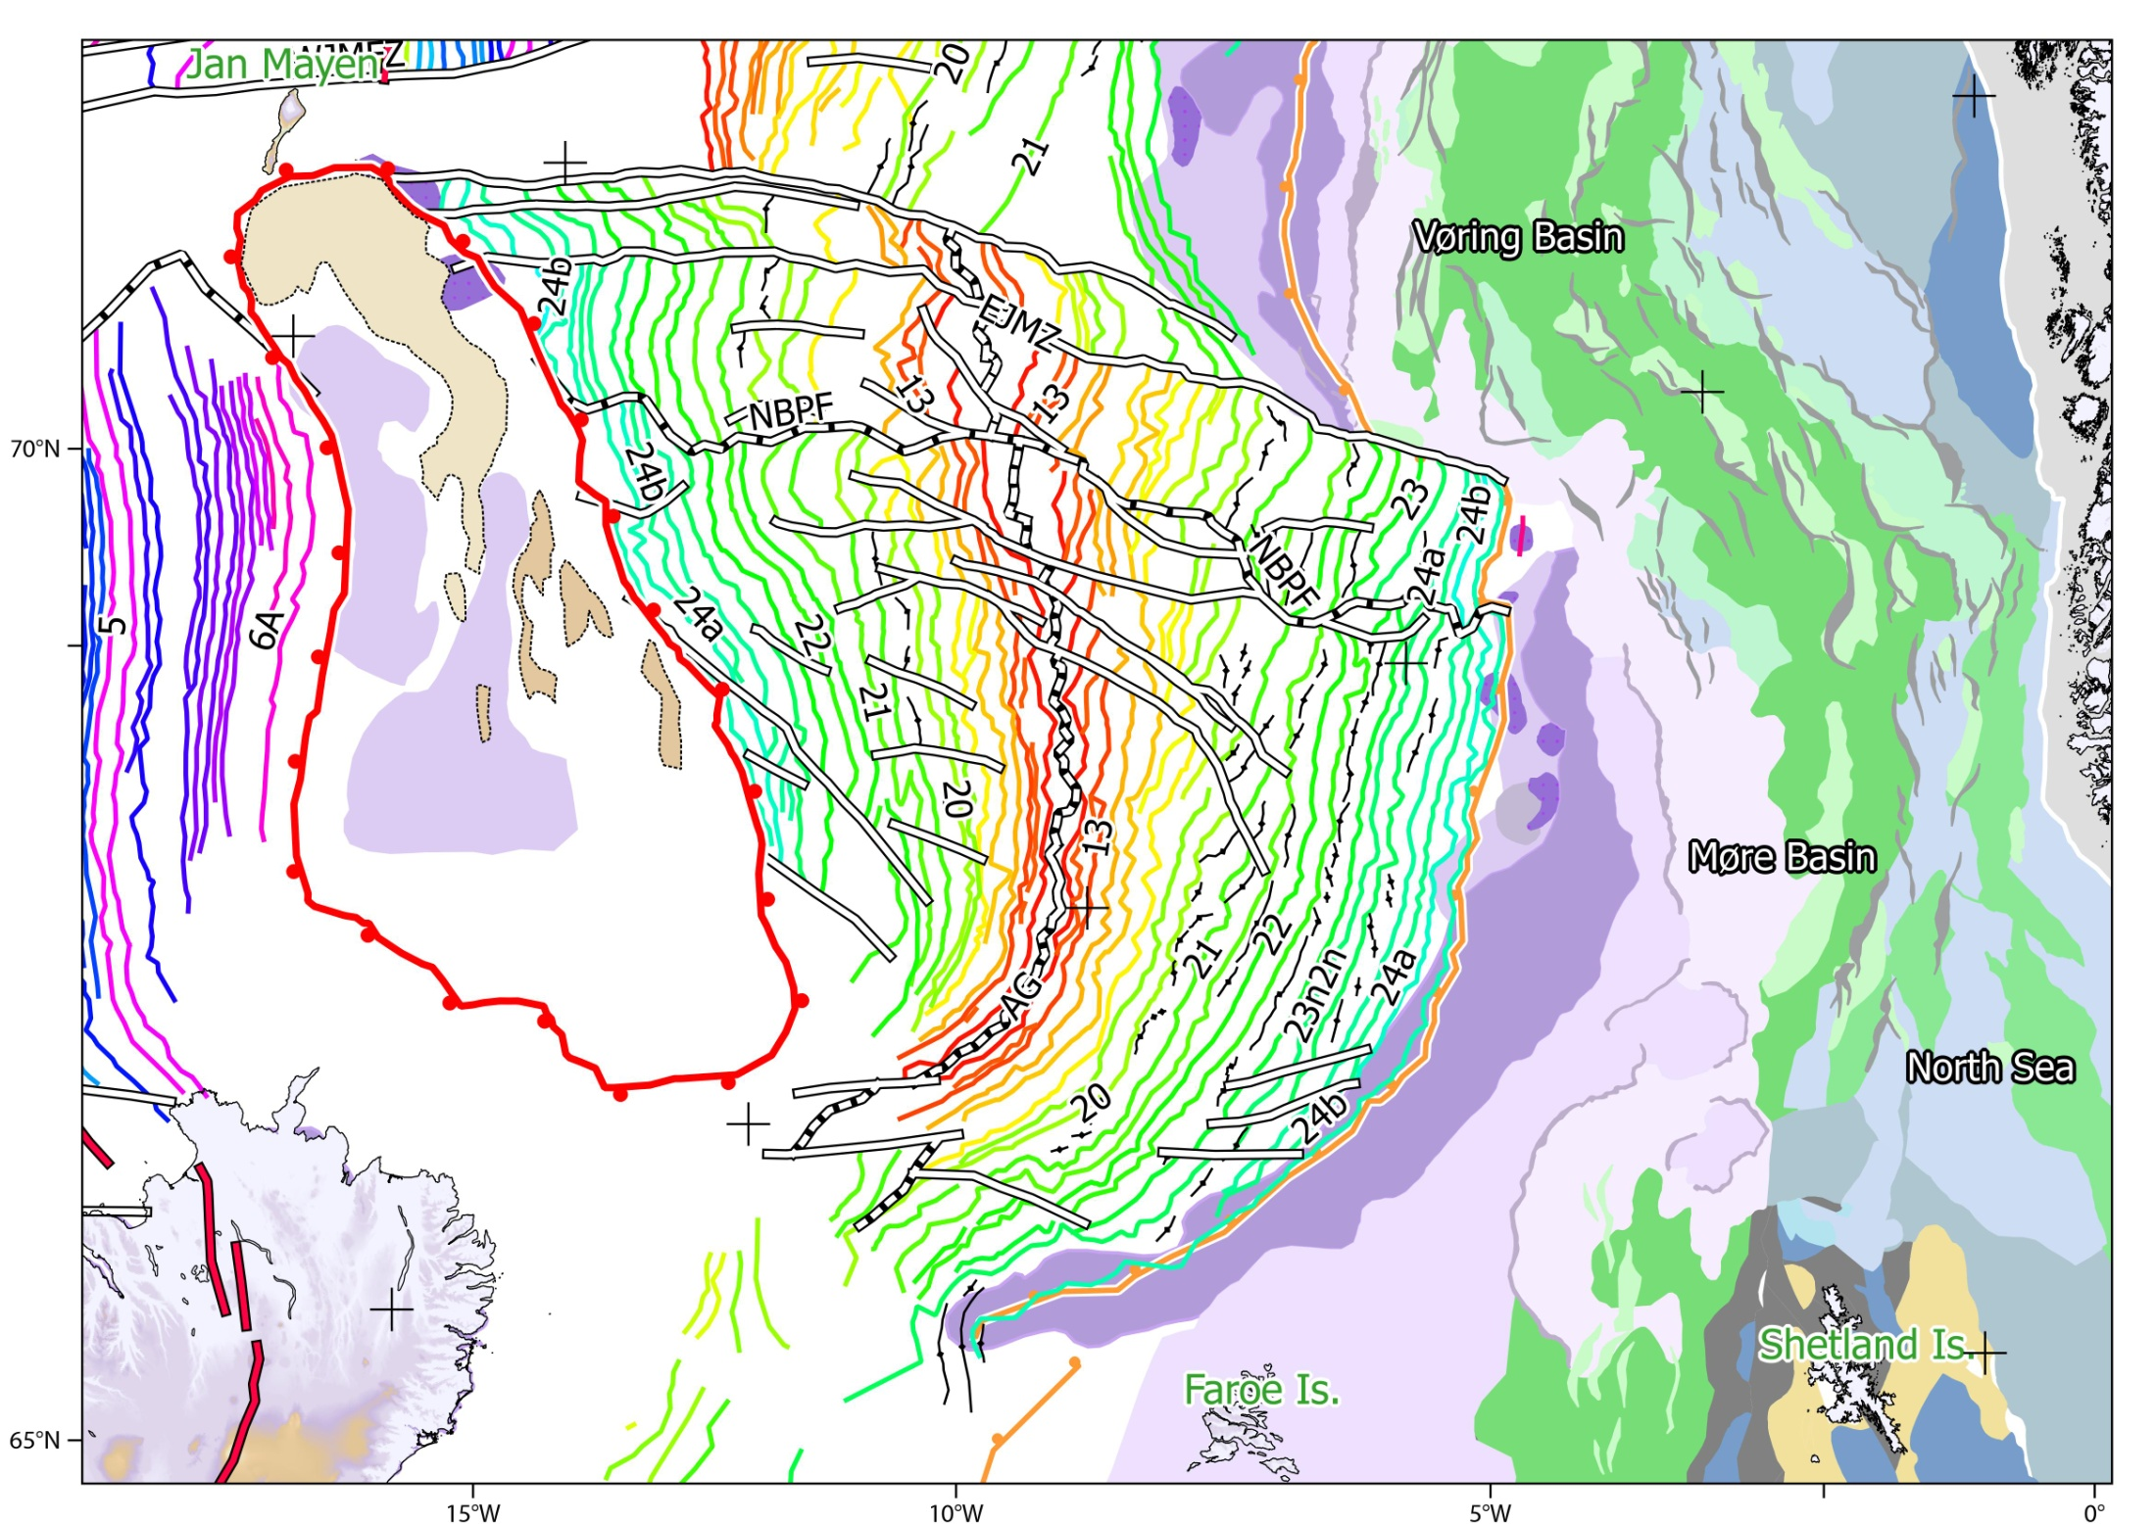
Norway Basin: COB, spreading and structural interpretation
SDR
COB defined west of the C25(?) embryonic ridge.
COB
COB
?
?
SDR
?
COB
Complete and conjugate sets of magnetic chrons from C24B to C10 have been identified on both sides of the Aegir Ridge -> a clear fan-shaped spreading system !
Updated “COBs” interpretation (first steady state magmatic oceanic crust)
Notes:
This is our last interpretation of the Norway Basin
Thanks to the new survey, the main structures of the NB is well constrain now.
We have been able to map accurately a complete conjugate set of magnetic chrons from C24B to C10
We can see that the Norway Basin is truly and clearly characterised by a fan-shaped structure
The COBs have been also better defined on both side of the Norway Basin

Slide 36
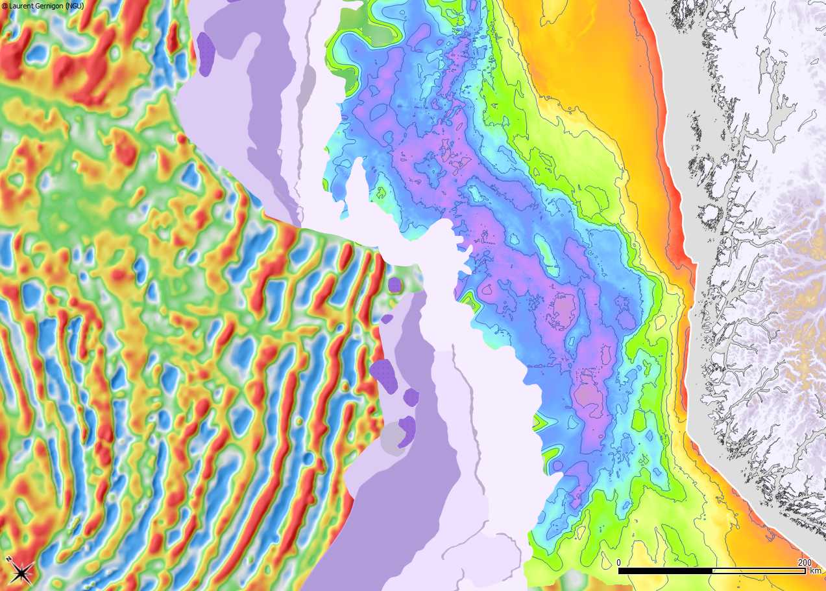
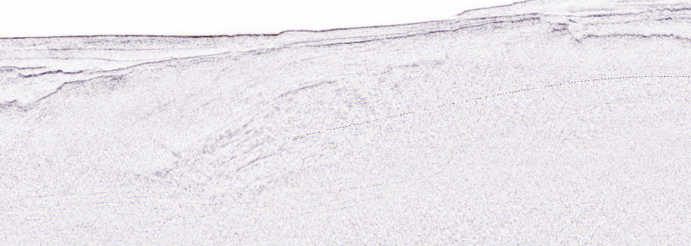
Volcanic margins: diachronic SDRs and embryonic crust
SDR
The Vøring transform margin, formed in line with the Jan Mayen corridor, an old and major transfer zone between the Møre and Vøring Basin.
Extinct spreading ridge axis around C25? (~57.5 Ma) - (interpreted as an embryonic oceanic domain before ultimate breakup at ~C24r (~54Ma)
The SDRs in the outer Møre (Thanetian/Ypresian in age, < C24r) are syn-thinning
They developed (1-2 Myr) before the SDRS drilled in the Vøring Marginal High (only Ypresian in age, > C24r (cf. ODP 642 well results)
Vøring
Marginal
High
Vøring
Basin
Trøndelag
Platform
ODP642
Jan Mayen F.Z.
NBFZ
C23
C24n3n
Jan Mayen corridor
Early breakup initiated here
NORWAY
Møre
Marginal
High
Rift Necking zone
C22
C23
C24r
SDR
A
SDR
Base of the Cretaceous sag
(first phase of thinning rift geometry)
Magmatic
necking zone
Syn-magmatism/syn-thinning SDRS
Notes:
In this context, the volcanic SDR formed during the breakup correspond to a magmatic phase of thinning leading to sharp magmatic necking zone observed from the Faeroes
Some SDRs in the outer Møre (Thanetian/Ypresian in age, < C24r) are syn-thinning (second phase) and developed before the SDRS drilled in the Vøring Marginal High (only Ypresian in age, > C24r)
No SDRs south of the Vøring transform margin formed in line with the Jan Mayen corridor, an old and major transfer zone between the Møre and Vøring Basin
Some aborted spreading axis around C25? (~57.5 Ma) (interpreted as an embryonic oceanic domain before ultimate and steady state breakup at ~C24r (~54Ma)
Ps: I have new ideas when making the figure. I have to check the petrology with Romain but Vøring breakup could eventually be younger, if you assume specific magmatic chamber processes that may prevent continental contamination due to high magmatic rate. It may explain some issues with the last update of our plate reconstuction. However, I am waiting the new mag to refine this model.

Slide 37
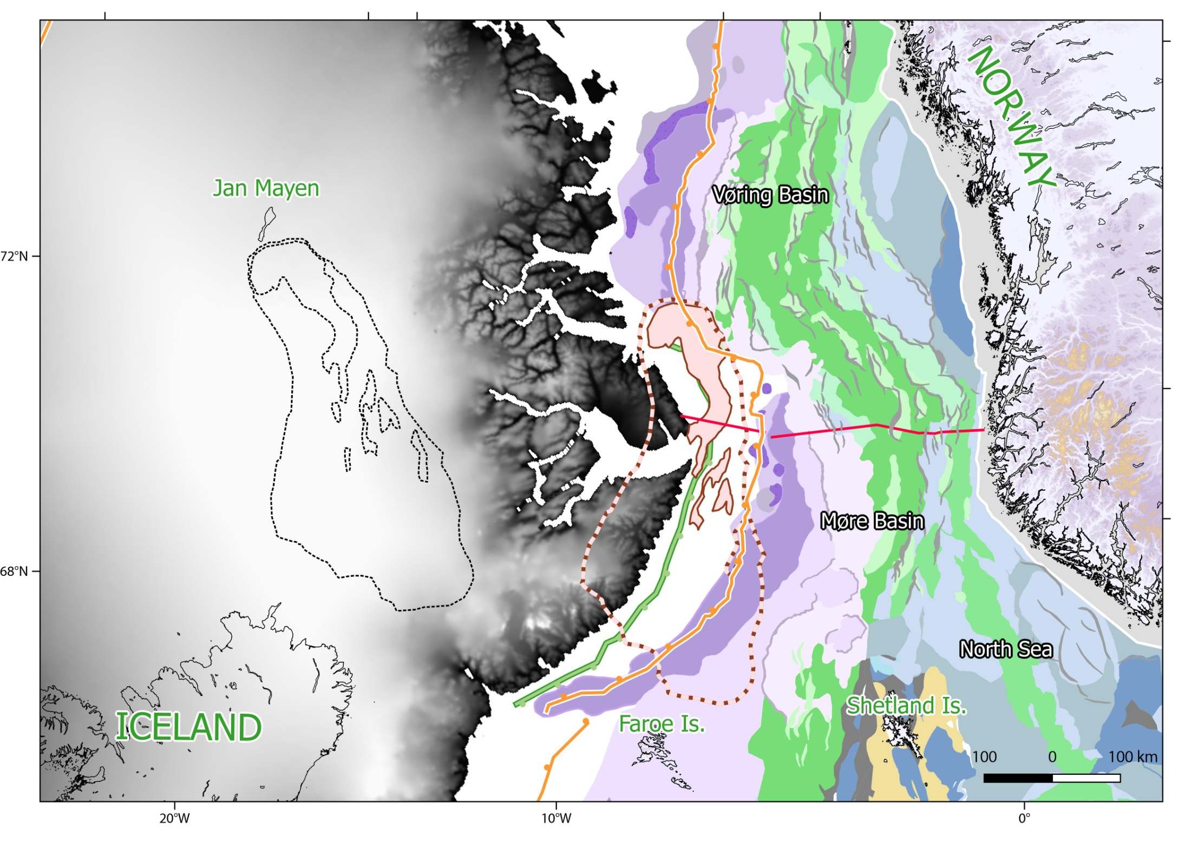
Proto-JMMC overlaps and space issue at C24
The proto-Jan Mayen developed along the axis of the ~C25 embryonic domain. It was part of the outer Møre marginal plateau
Significant overlaps between the present-day outline of the JMMC and the original space allocated between Greenland and the Møre margin at C24B (~54 Ma)
SDR
<20% of extension)
C6-C7
JMMC
at present day
(>500% of extension)
SDR
<50 km
290 km
Limit of the basaltic province
=> Significant post-breakup deformation of the JMMC is required
Notes:
A second problem observed in the pre-breakup configuration is the significant overlaps between the present-day outline of the JMMC and the original space allocated between Greenland and the Møre margin at C24B (~54 Ma). Note that JMMC dislocate at the edge of the embryonic domain (e.g Gernigon et al., 2009)- Possibly a c-Block structure.
Ps: could have been the early sources and /or prolongation of the Tulipan pro-delta lobes ? Going down during the syn-thinning/syn-SDR.
Less that 100 to 50 km of space was modelled between the Norwegian and Greenland COBs when almost 300 km of uncertain crust JMMC between the first and second COB
Significant post-breakup deformation the JMMC is required. I has use to say , I won´t invest my money in the South JMMC: most likely continental crust not so much preserved here !
Ps: We also have to think about a paper more focus on the COB. I just realised that all the seismic stops at the edge of the old Gplate COB, probably back to Skogseid et al.. Obviously it is not correct. We may have 100 of km2 continental domain not covered by any proper seismic just because the geophy companies think it was oceanic crust. Like the OBS, it fits to well to be true ☺

Slide 38
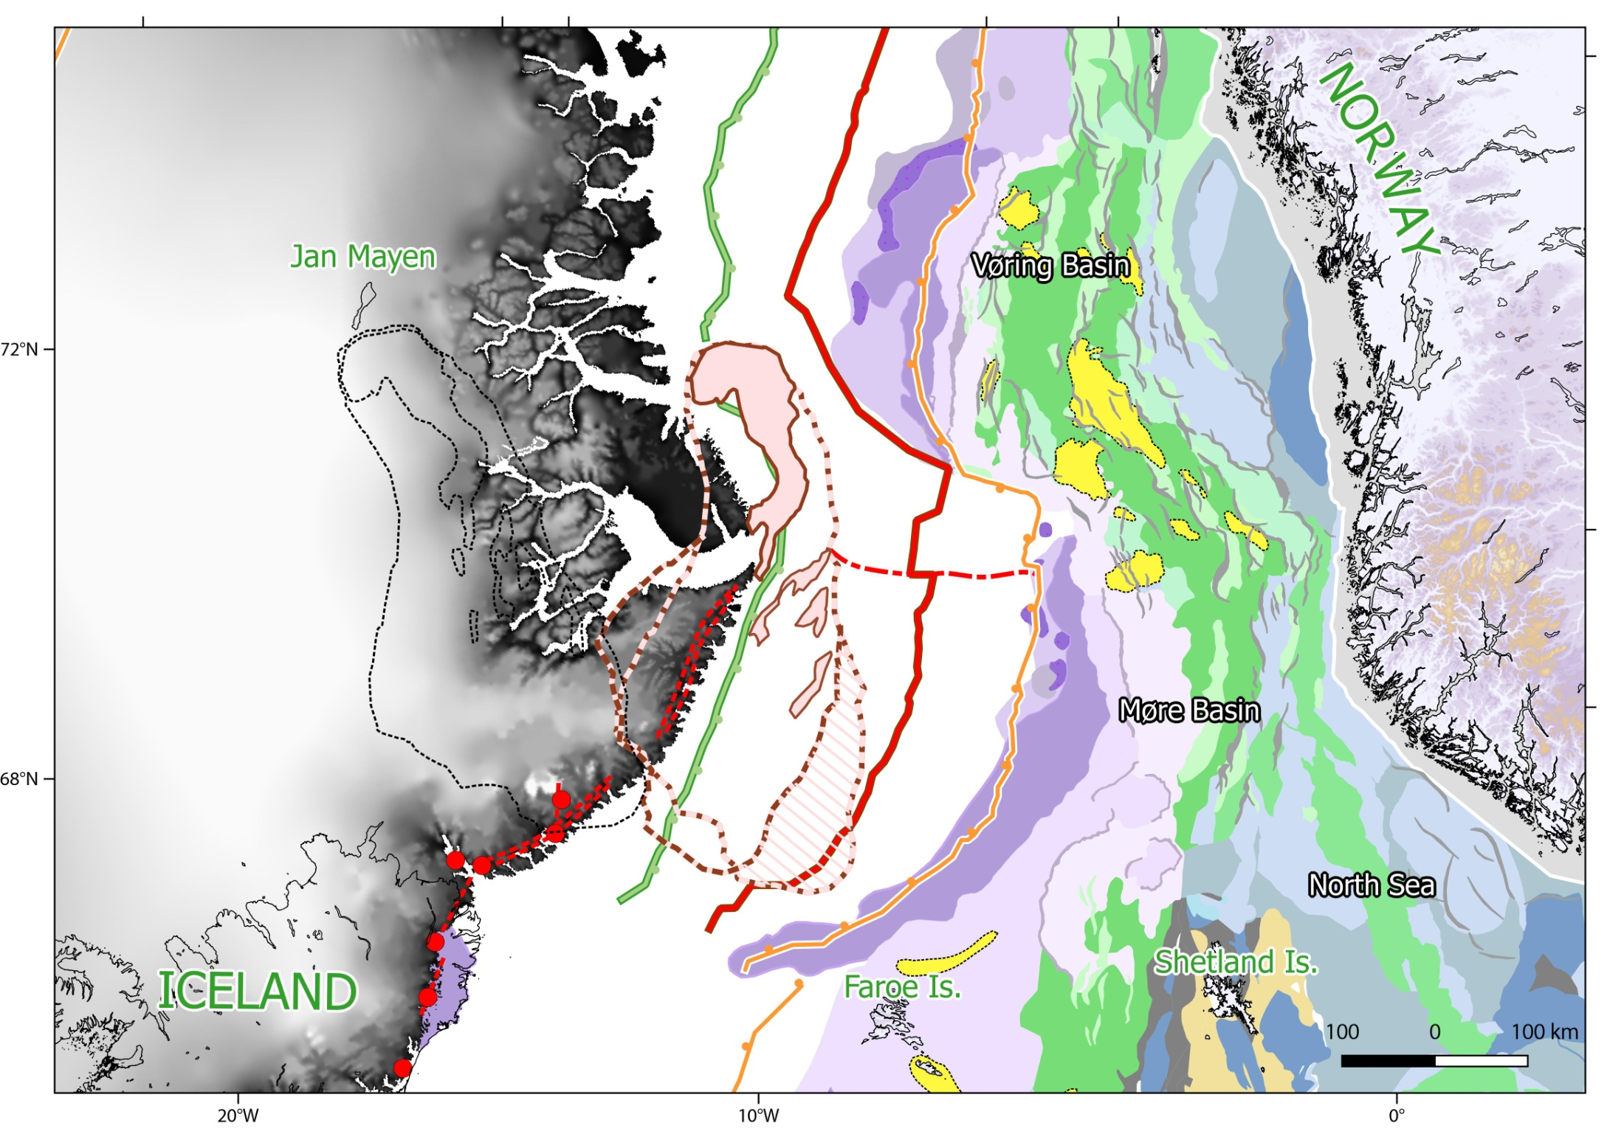
Eocene reorganisation stage: fit at C21n old (47.9 Ma)
Onset of compression
In Mid Norway (Eocene)
JMMC
at present day
Kap Dalton
Igtertiva
dike swarm
Preserved
crust ?
Misfit assuming northern Euler pole
Dike swarm at Kap Dalton re-assignement at 49-44 Ma and not 55 Ma ! (Larsen et al., 2013)
?
REYKJANES RIDGE
Notes:
We think that This Mid-Late Eocene event could coincides with an increasing phase of extension into the southern JMMC in order to counter balance the growing fan-shaped development of the Norway basin
This period coincides with the onset of extension between East Greenland and the Proto-JMMC in front of the propagating Reykjanes located to the south.
Our new Magnetic observation fits pretty well with the recent dike swarm age re-evaluation and the rift onset observed in East Greenland
It is also important to not that this reorganisation also fit with the onset of compression in the mid Norwegian margin

Slide 39
C21-C7 climax of the rifting between JMMC and Greenland
Transpression ?
Late Eocene-Oligocene
Isolated oceanic cells ?
?
?
ICELAND
Subsequent fan-shaped opening of the NB was still compensated and balanced by significant extension south of the proto-JMMC, rotating anticlockwise until complete separation with East Greenland ~24 Ma ago (C7-C6)
Notes:
Subsequent fan-shaped opening of the NB was still compensated and balanced by significant extension south of the proto-JMMC, rotating anticlockwise until complete separation with East Greenland ~24 Ma ago
This compensating system was certainly not so perfect and for that reason, we also expected some transpression SE of the JMMC, this may explain unclear magnetic features recently revealed by the new JAS-12 survey along the Jan Mayen margin

Slide 40
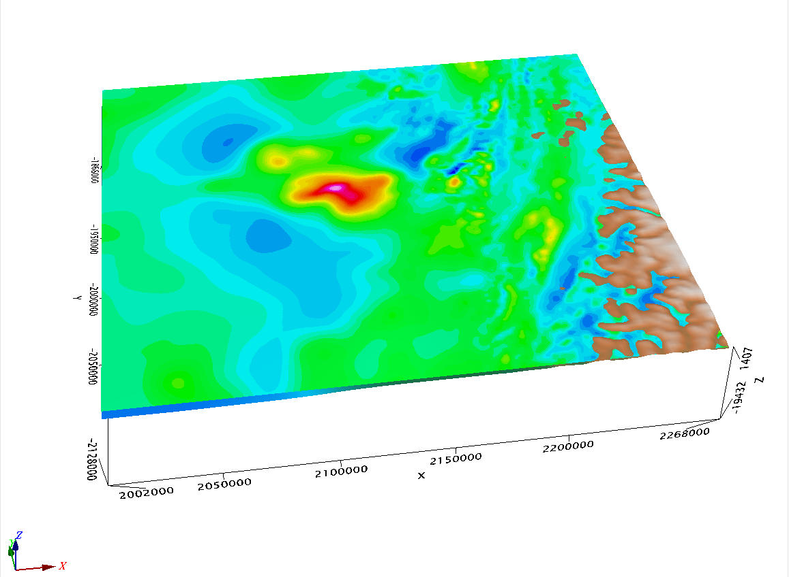
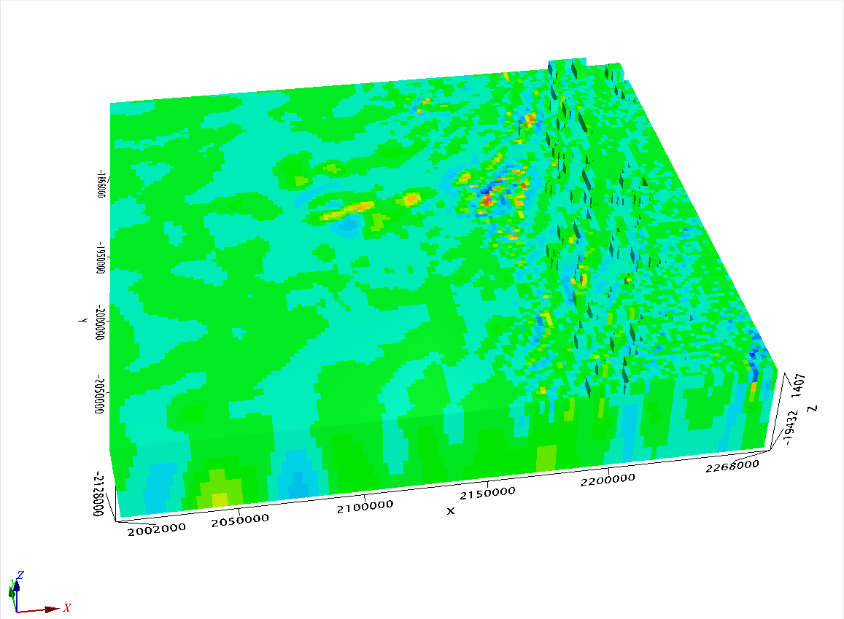

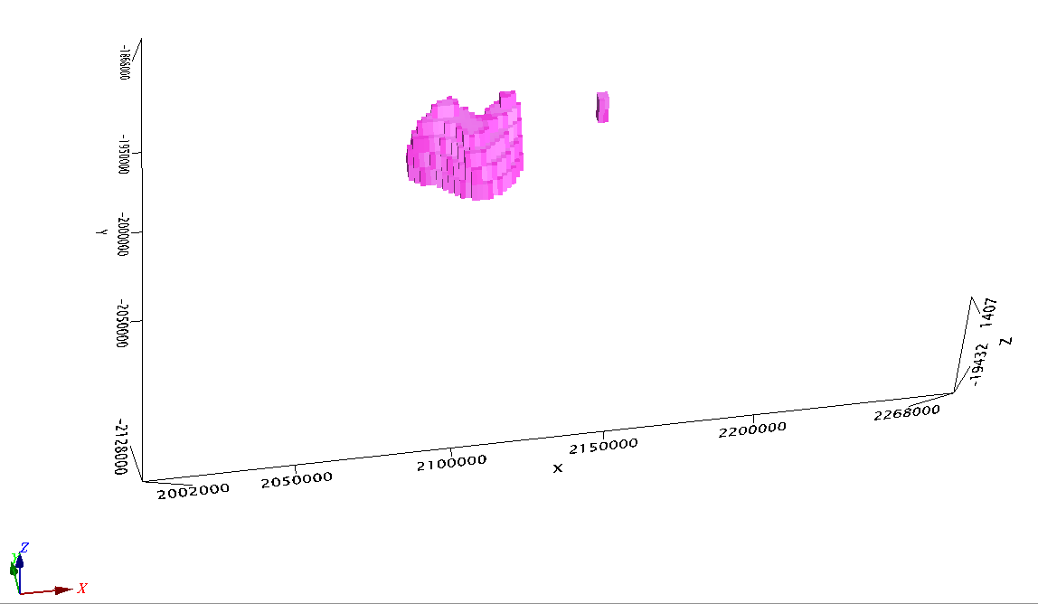
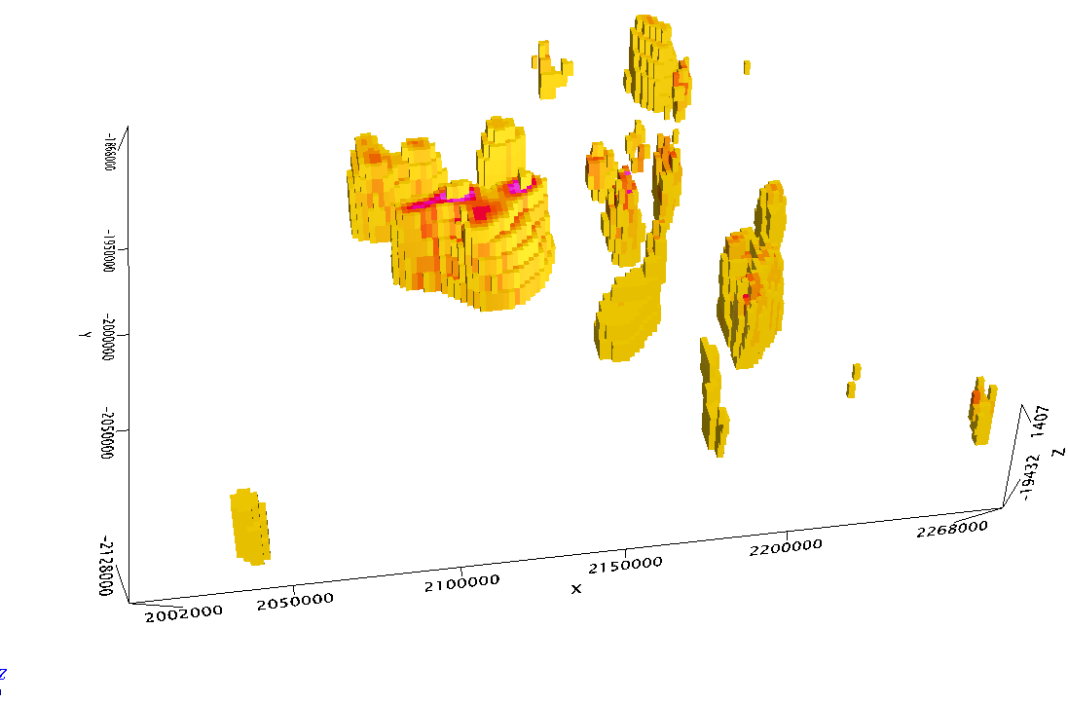
Comparison with Inversion results
Susceptibility voxel result (all SI values)
0.07
Føya High
0
SI > 0.03
SI > 0.01

Slide 41
BASAR PROJECT: Regional setting – scientific issues
Section CFI MNR09-7179
OFFSHORE
ONSHORE
Trøndelag
Platform
Vøring Basin
Halten
Frøya
High
Vøring transform margin
Greenland at C24
Møre Basin
SDR
Regional CFI-MNR seismic lines by courtesy of TGS Nopec
Notes:
In the North Atlantic, the singularity of volcanic segments of passive margins and the formation of microcontinents particularly involve and question mantle dynamics, crustal structure, inheritance and plate kinematics.
Thanks to decades of geophysical exploration, the main structural elements of the Mid-Norwegian margin are pretty well defined. However, large uncertainties still remain about the structure and petrological nature of the deep crust and the prolongation of the Precambrian/Caledonian basement underneath the sedimentary basins. The mode of deformation leading to continental breakup and subsequent sea-floor spreading is also unclear and alternative scenarios can be proposed.
Grugro stopped they acquisition at the edge of the Gplate COB. However, this COB is wrong and they simply missed several Km2 of continental maetrial+UC+Pal

