Slide 1
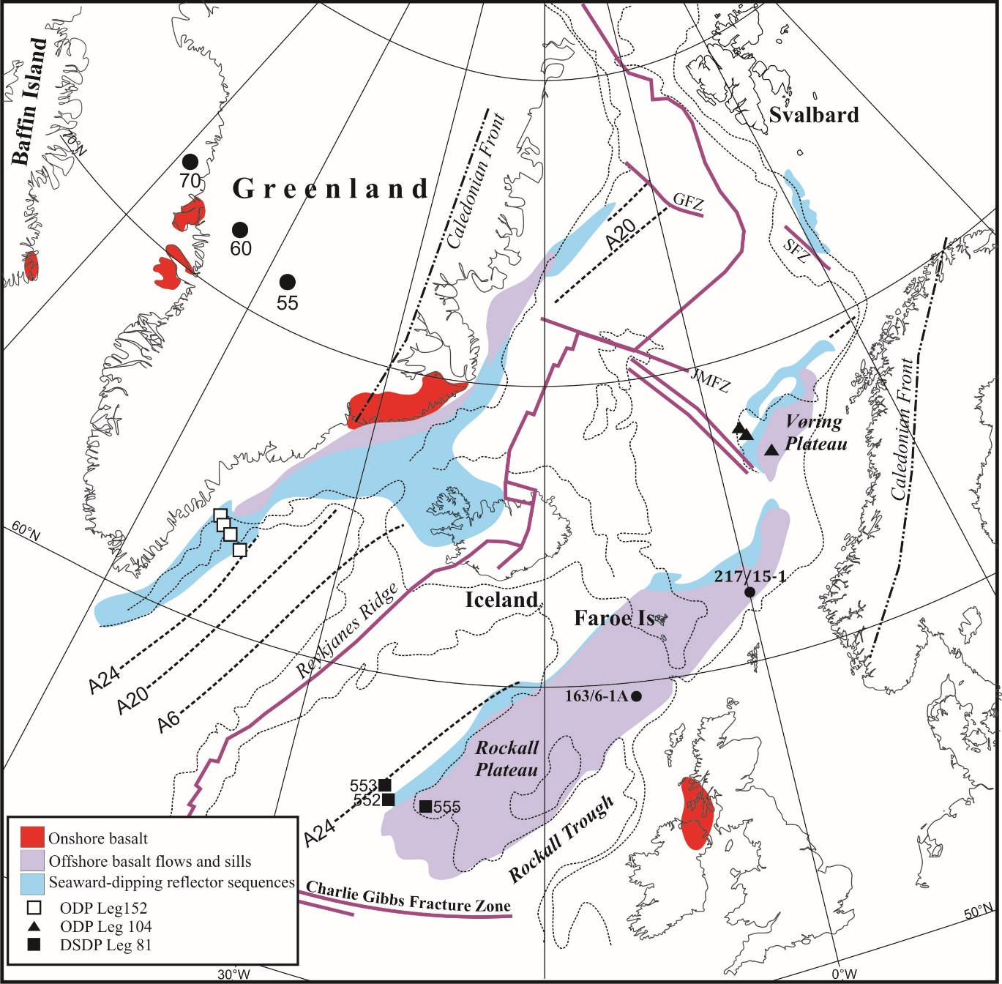

Slide 3
217/15-1 (Lagavulin)
2.6 km section of basalts
Lower depleted picrites (low TiO₂ MORB)
Upper “FIBG” enriched basalts (high TiO₂)
Major unconformity between the two
Basin-wide

Slide 4
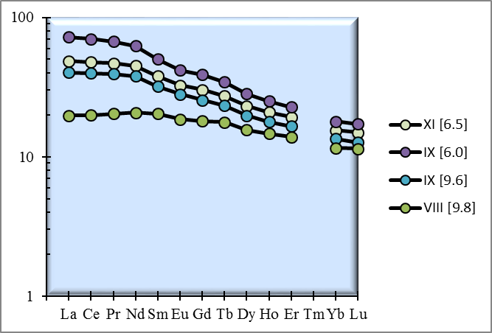
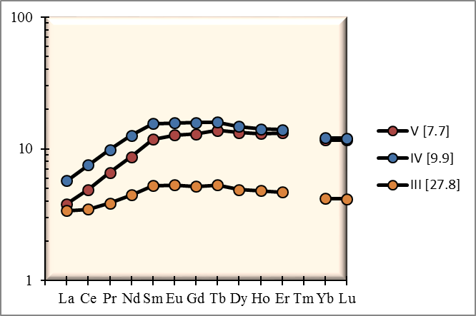
Upper
Lower

Slide 5
Repeat relative uplift and subsidence history
Hyaloclastite and subaerial lava flows
Volcaniclastic sequence with soil weathering profile

Slide 6
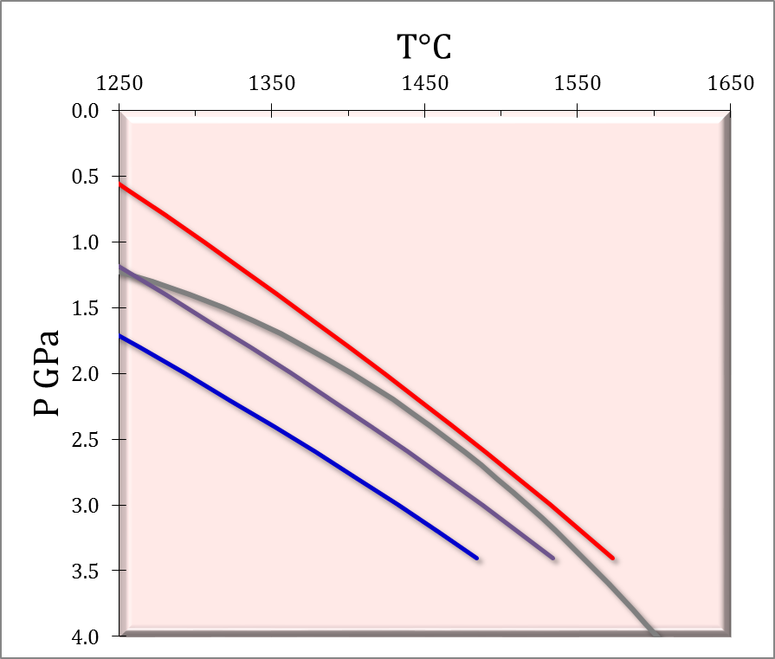
Experimental constraints on the damp peridotite solidus and oceanic mantle potential temperature
Upper mantle contains 50-200μg/g H₂O dissolved in nominally anhydrous minerals (NAM)
Supression of solidus by 50-100°C at 2.5 GPa compared to dry mantle
At ocean ridges
1350°C
1410°C
1480°C
0
200
400
Sarafian et al., Science 355, 942–945 (2017) 3 March 2017

Slide 7
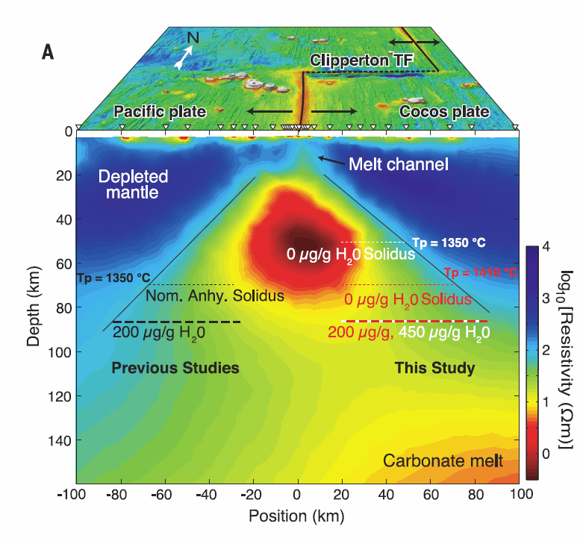
Experimental constraints on the damp peridotite solidus and oceanic mantle potential temperature
Magnetotelluric data suggest initial melting at depth of ~80 km
For 200μg/g H₂O ~1410°C for ambient MORB mantle
Ocean ridges 60°C hotter than previously thought
Reconciling geophysical observations of the melting regime beneath the East Pacific Rise with our experimental results requires that existing estimates for the oceanic upper mantle potential temperature be adjusted upward by about 60°C.

Slide 8
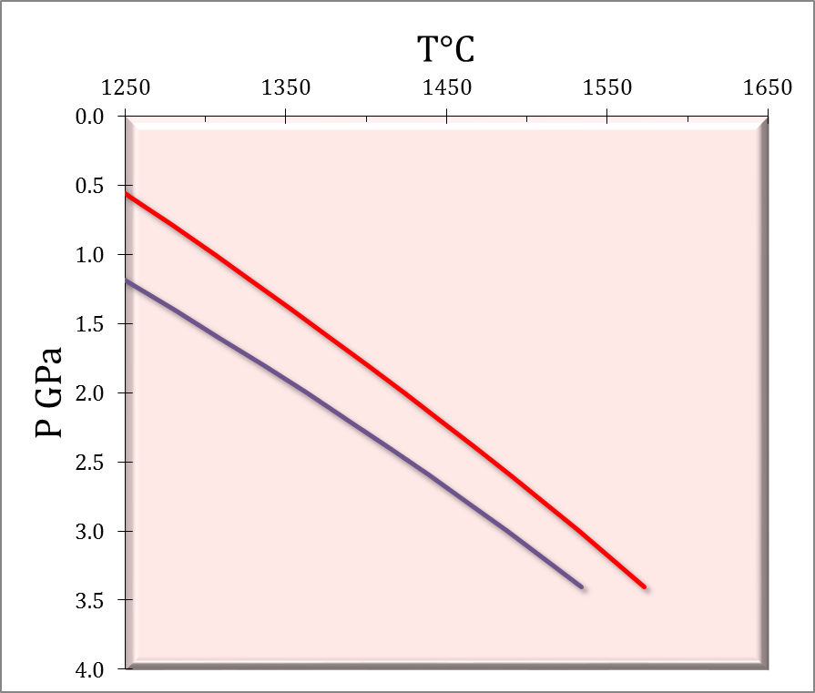
Experimental constraints on the damp peridotite solidus and oceanic mantle potential temperature
MORB T_{P} = 1410°C
Iceland T_{P} = 1480°C
Pi ~3.0 GPa (Maclennan et al.)
ΔT_{P} = +70°C
1410°C
1480°C
MORB T_{P} = 1410°C
Iceland T_{P} = 1440°C
Pi = 3.0 GPa
ΔT_{P} = +30°C
0
200
Azores T_{P} = 1420°C
570 – 680 ppm H₂O
ΔT_{P} = +10°C
?
Sarafian et al., Science 355, 942–945 (2017) 3 March 2017

Slide 9
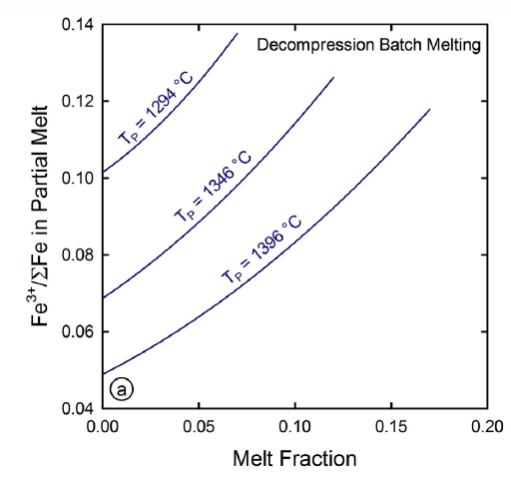
The behavior of Fe³⁺/ΣFe during the partial melting of spinel lherzolite
Iron oxidation state is effected by extent of melting as well as temperature/pressure
Large melt fractions should have higher Fe³⁺/ΣFe than smaller melt fractions
‘Long’ melting columns have the most extreme variability
Damp mantle should be more oxidized than dry mantle
Gaetani - Geochimica et Cosmochimica Acta 185 (2016) 64–77

Slide 10
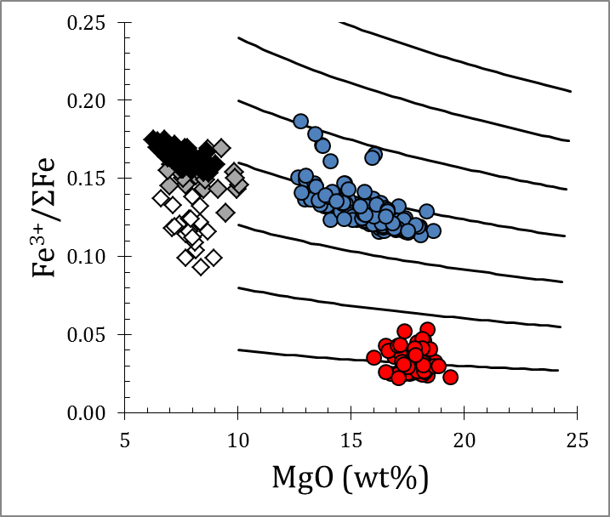
Fe³⁺/ΣFe Reykjanes Ridge (Shorttle et al. 2014)
Reykjanes (Shorttle et al.)
Bezos Humler
Cotterill & Kelly
The effect on T_{P} models is to reduce T_{P} by ~50°C by increasing Fe³⁺/ΣFe from 0.05 to 0.15
But is this feasible?
1450°C
1500°C

Slide 11
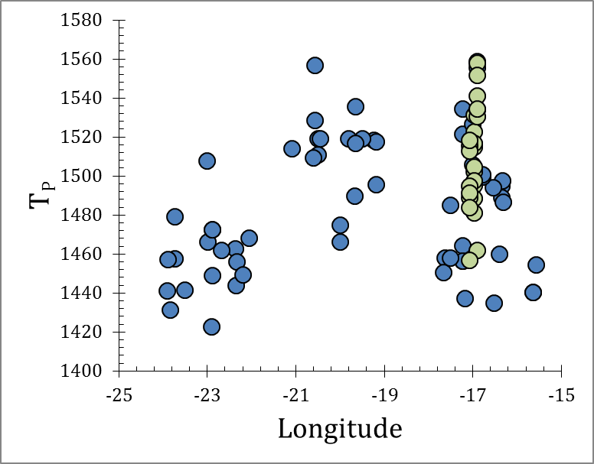
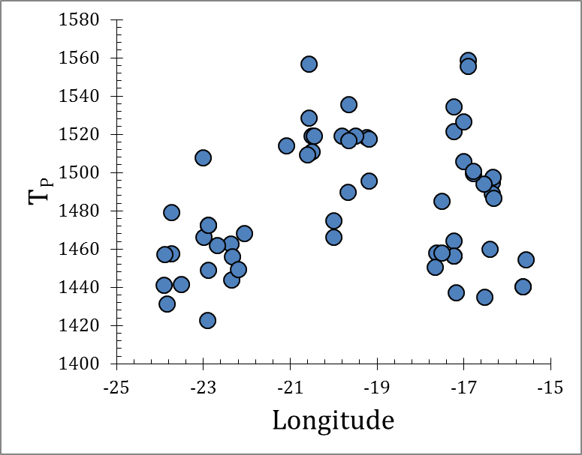
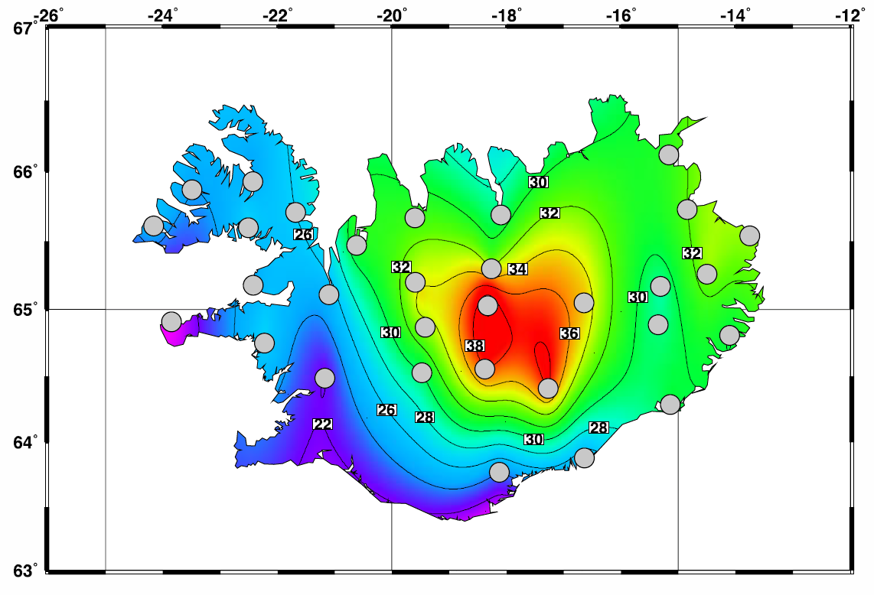
TP – longitude
65±0.5°N

Slide 12
Trace elements
Modern Iceland
East Greenland
Baffin Island E-type
[Olivine fractionation corrected]

Slide 13
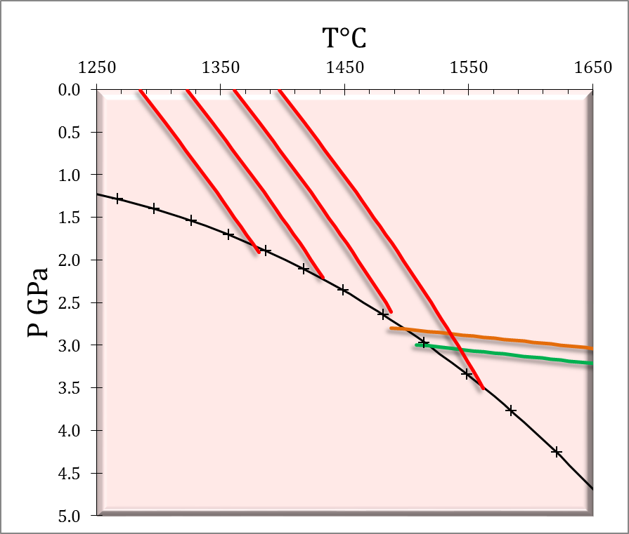
Olivine-spinel Al thermometry
No reference to whole-rock data
No model olivine addition
Temperature fluctuation of the Iceland mantle plume through time. Spice, H.E., Fitton, J.G. & Kirstein, L.A. G³ 17, 243-254 (2016)
The temperature of the Icelandic mantle from olivine-spinel aluminum exchange thermometry
S. Matthews, O. Shorttle and J. Maclennan
G³ 17 (2016)

Slide 14
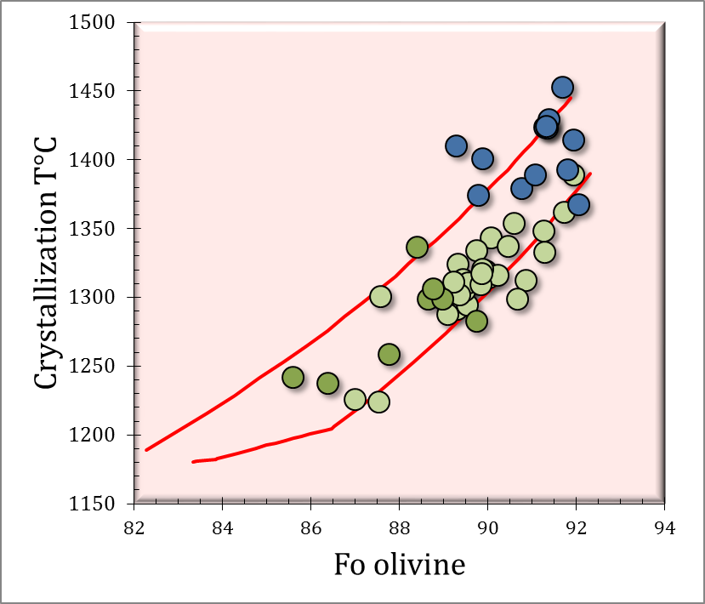
Mean Al-in-olivine temperature WG
Iceland (Liq)
Iceland(Al)
WG (Al)
Red lines – expected fractionation trends for crystallization from primary peridotite-derived magma
T_{P}~1450°C

Slide 15
Melting column effect
Deepest melts at highest temperature
Shallowest melts lower temperature
Requires compositional variation related to T_{P}

Slide 16
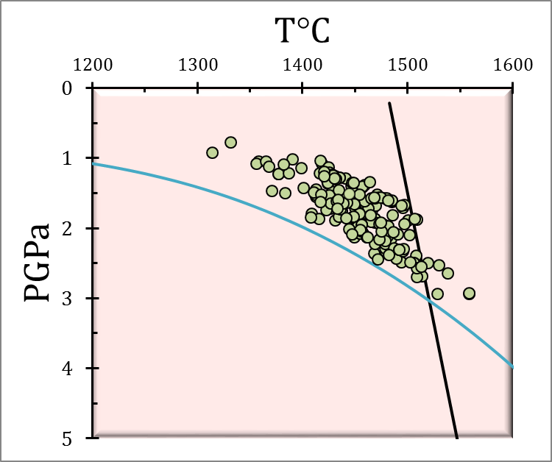
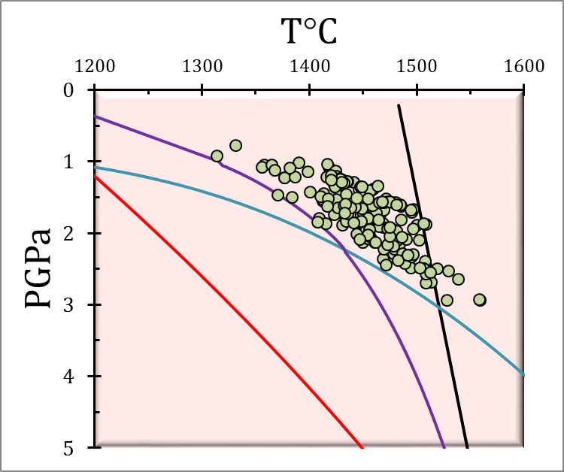
Pyroxenite melting
15:85
Pyx-Pdt
Crustal thickness estimates require pyroxenite and peridotite derived melt
Pyroxenite melts at lower T than peridotite – enhanced melt production
Pyroxenite from recycled oceanic lithosphere
Dry solidus
Pyroxenite I260
1480°C

Slide 17
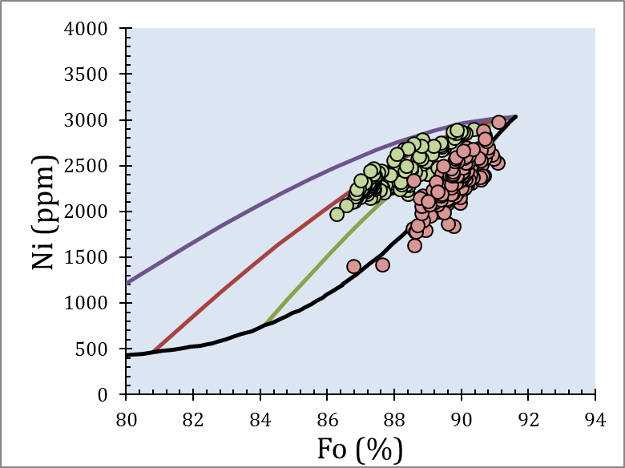
Olivine chemistry Theistareykir
Primary olivine
peridotite
Olivine chemistry indicator of pyroxenite in source
mixing
Olivine chemistry suggests mixing
crystallization
Primitve
Mixed

Slide 18
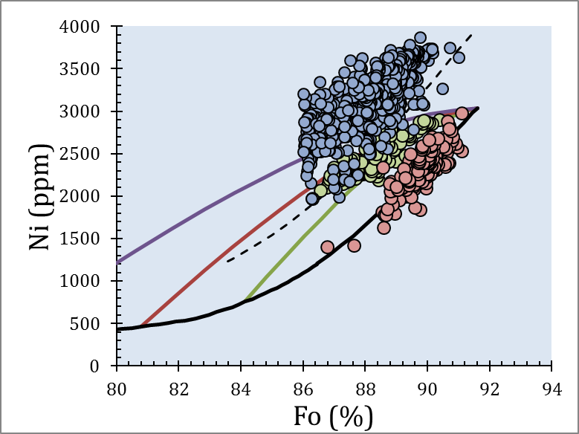
Olivine chemistry Hawaii (HSDP)
Primary olivine
pyroxenite
Primary olivine
peridotite
Olivine chemistry indicator of pyroxenite in source
mixing
Olivine chemistry suggests mixing
No primary evidence of pyroxenite involvement
crystallization

Slide 19
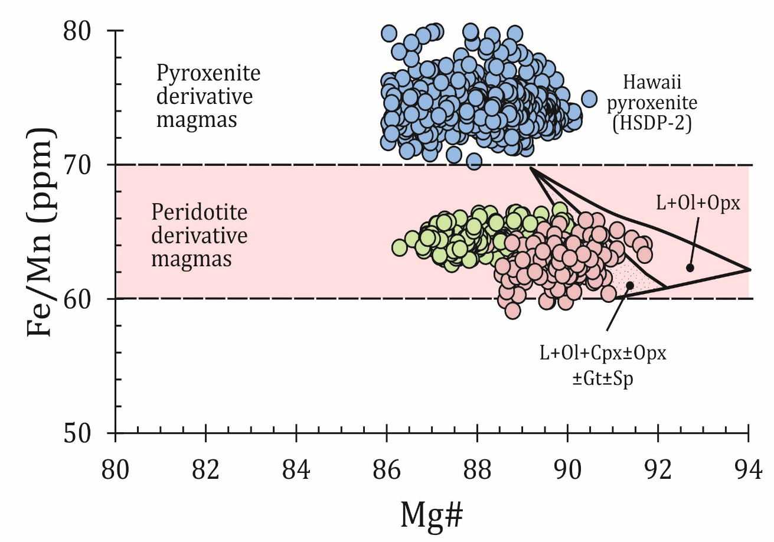
Pyroxenite & peridotite
Fe/Mn robust indicator of pyroxenite melting
Theistareykir olivines have Fe/Mn consistent with peridotite source
But Icelandic isotopic compositions suggest a recycled source
Shallow recycled component rather than deep recycling ?

