Slide 1
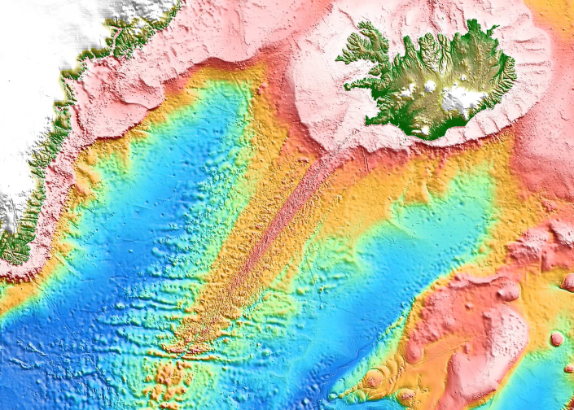
Formation and Elimination of Segmentation on the
Reykjanes Ridge
Fernando Martinez & Richard Hey
Hawaii Institute of Geophysics and Planetology
School of Ocean and Earth Science and Technology
University of Hawaii at Manoa
&
R/V Marcus Langseth Shipboard Science Party:
Ármann Höskuldsson, Deborah Eason, Jonathan Sleeper, Sigvaldi Thordarson, Irene Trujols, Joanna Dominiczak, Maria Laidla, Alica de Witt, Elías Eyþórsson, Jóhannes Jóhannesson, Chris Horvath, Ashley Paradiso
With thanks to Ásdís Benediktsdóttir for magnetic data analysis
and R. SEARLE & S. MERKOURIEV for generous data contributions

Slide 2
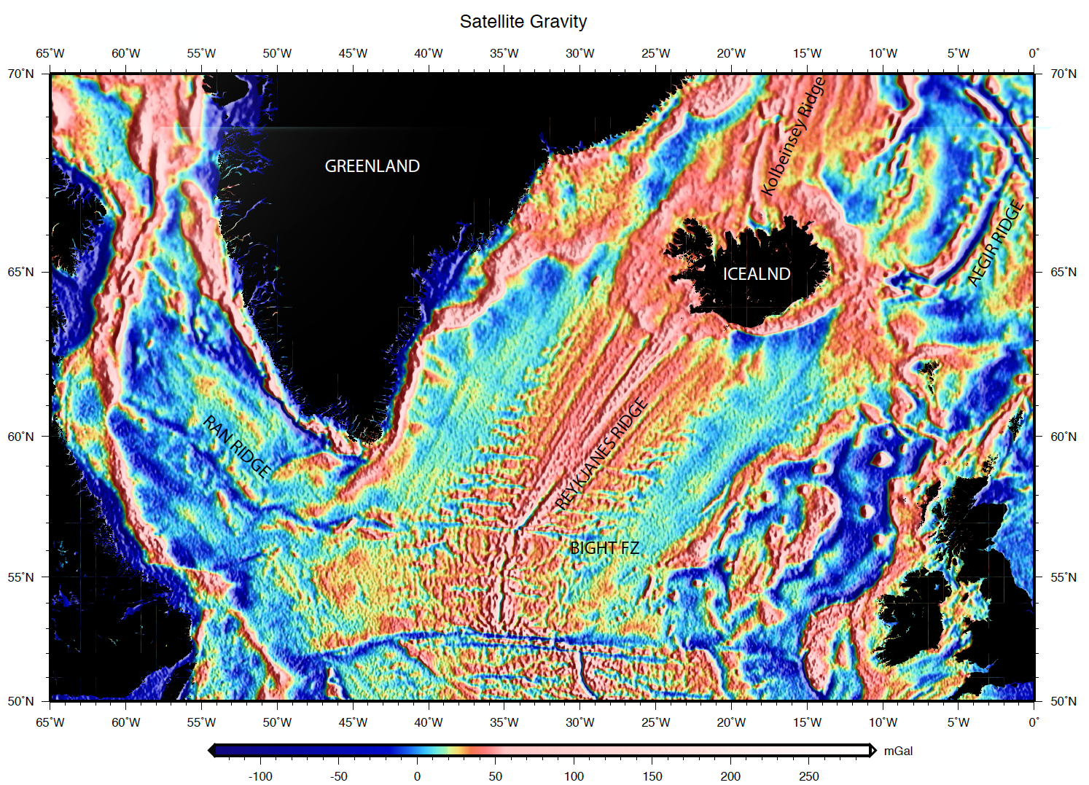
Notes:
GREENLAND – EUROPE BREAKUP ~ 55 MA
CHANGE IN OPENING DIRECTION & FRACTURE ZONE FORMATION ~ 37 MA
FRACTURE ZONE ELIMINATION BEGINS FROM THE NORTH ~ 40 MA

Slide 3
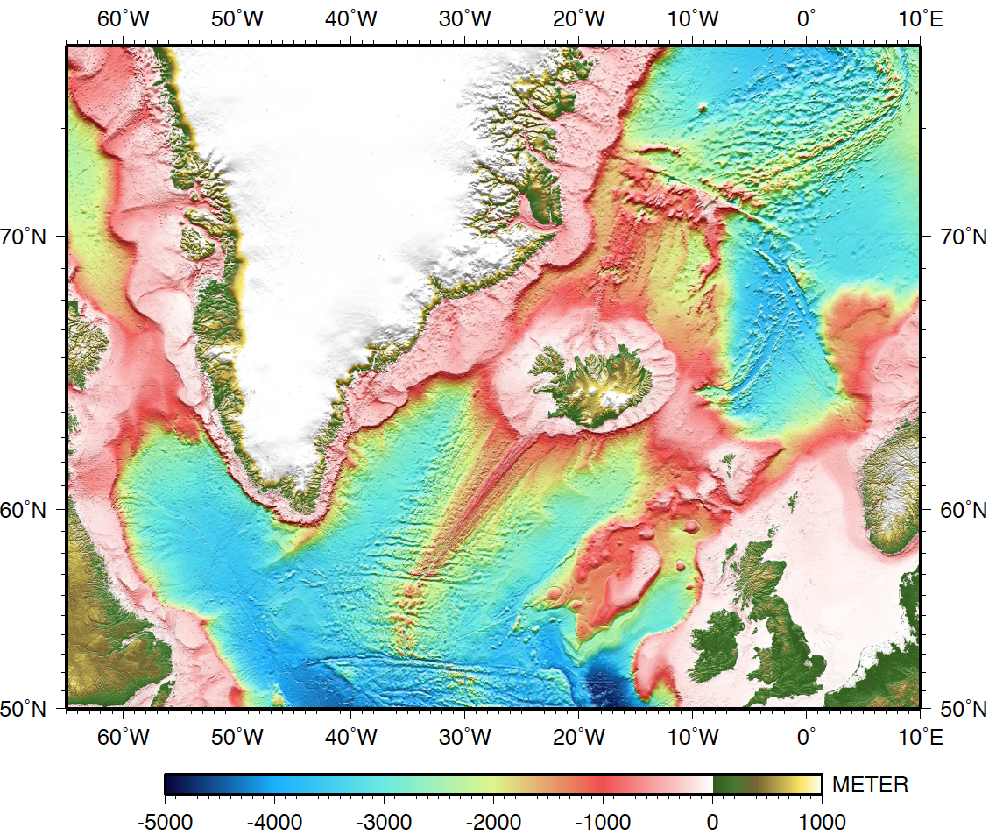
GREENLAND
ICELAND
REYKJANES RIDGE
Bight FZ
EURASIA
NORTH
AMERICA
Notes:
The Reykjanes Ridge is the portion of the mid-Atlantic ridge that extends southward from Iceland to the Bight FZ.
This is a bathymetry map and shows that on the ridge flanks basement structure is rapidly obscured by sediments. So for the rest of this talk I’ll be primarily showing regional gravity and magnetic maps that better delineate the tectonic structure.

Slide 4
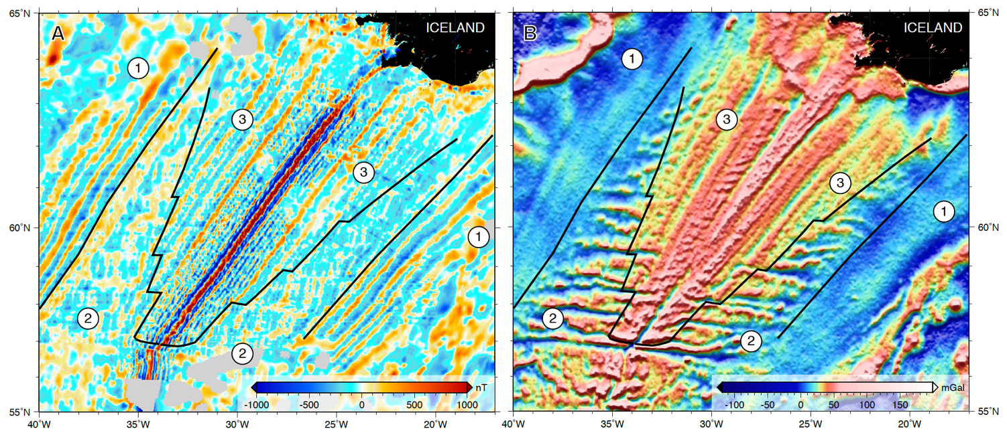
3 MODES OF SEAFLOOR SPREADING FLANKING THE REYKJANES RIDGE
MAGNETICS
SATELLITE-DERIVED GRAVITY
UNSEGMENTED ORTHOGONAL SPREADING ON A LONG LINEAR RIDGE (THICK CRUST)
ORTHOGONAL SPREADING ON A SEGMENTED RIDGE (THINNER CRUST)
OBLIQUE SPREADING ON AN UNSEGMENTED LINEAR RIDGE (THICK CRUST)
Notes:
Corresponding to the changing opening kinematics the Reykjanes Ridge exhibits three distinct types of seafloor on its flanks. The first is unsegmented orthogonal spreading on a long linear axis as shown by magnetic isochrons and satellite-derived gravity data. The second is an abrupt transition to segmented orthogonal spreading on a stair-step geometry axis. And the third is a diachronous transition to unsegmented oblique spreading replacing the stair-step axis with a growing linear axis from north to south and forming V-shaped ridges and troughs on the ridge flanks.

Slide 5
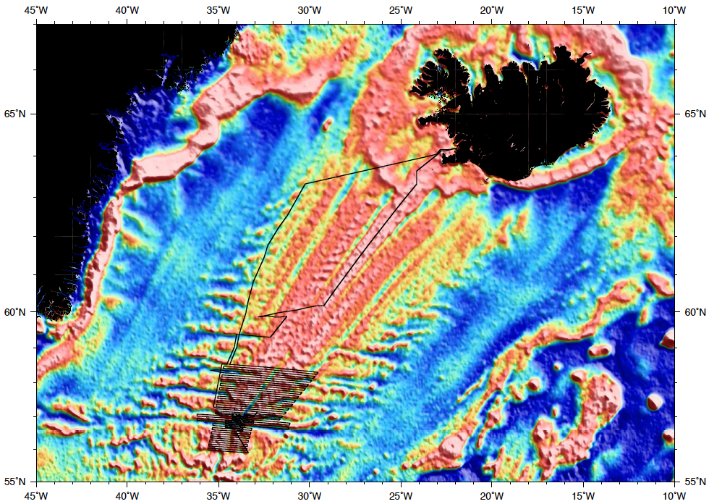
R/V MARCUS G LANGSETH SURVEY TRACK
GREENLAND
ICELAND
REYKJAVIK
CRUISE MGL1309
R/V MARCUS G LANGSETH
MAIN DATA SETS:
MULTIBEAM BATHYMETRY
GRAVITY
MAGNETICS
Notes:
In order to investigate the tectonic reconfiguration and elimination of transform faults we conducted a 32-day cruise on R/V Marcus G. Langseth to the southern end of the oblique Reykjanes Ridge collecting multibeam, gravity and magnetics data.

Slide 6
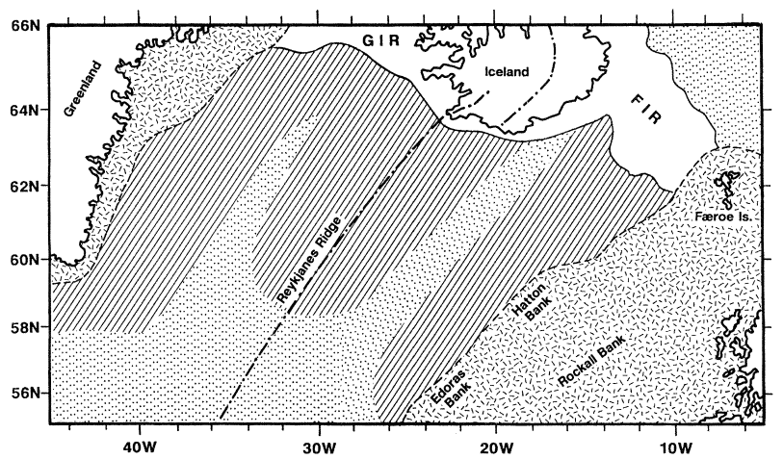
Tectonomagmatic regimes inferred to result from mantle plume temperature variations
White, 1997, Phil. Trans. R. Soc. Lond.

Slide 7
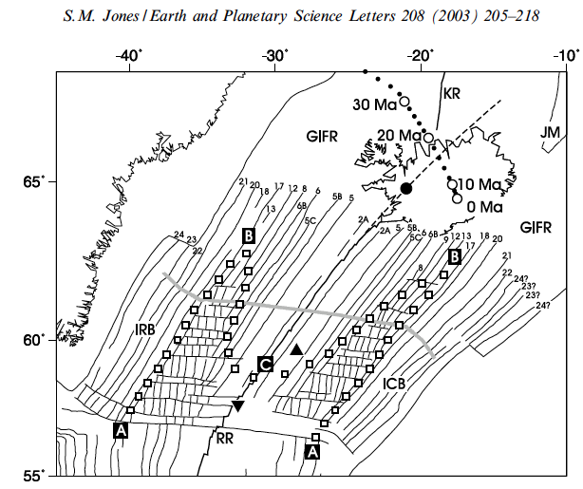
Red line:
Spreading flow line
Notes:
In the plume model the intersection of the plume thermal structure with the ridge axis lead to brittle and ductile behavior of the lithosphere resulting in the formation and elimination of transform faults

Slide 8
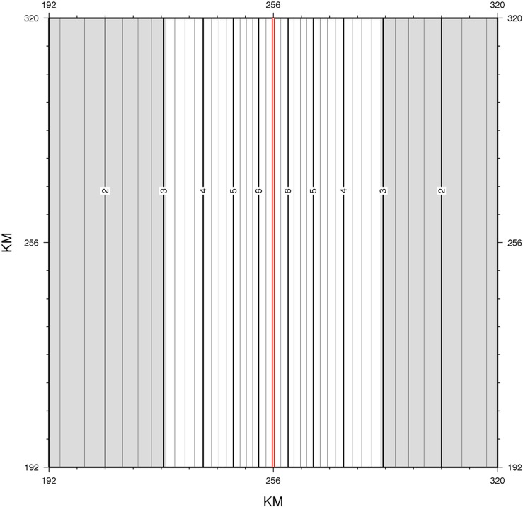
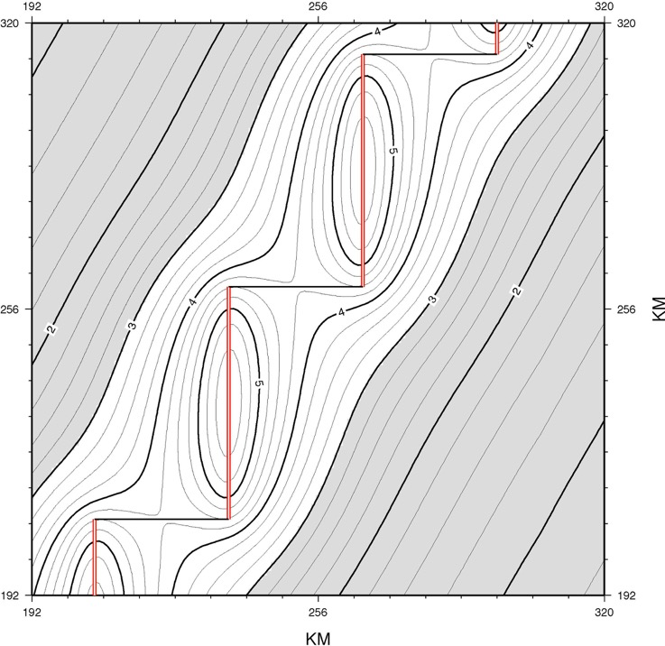
TOTAL VERTICAL MANTLE UPWELLING BETWEEN 6-60 KM DEPTH
UNSEGMENTED RIDGE
SEGMENTED RIDGE 52 X 30 KM
VOLUME RATE OF UPWELLING = 12,148 KM³/M.Y.
PEAK UPWELLING RATE = 6.37 KM³/M.Y.
VOLUME RATE OF UPWELLING = 8,671 KM³/M.Y.
PEAK UPWELLING RATE = 5.68 KM³/M.Y.
~ 30 % less upwelling generated by segmented ridge than unsegmented ridge

Slide 9
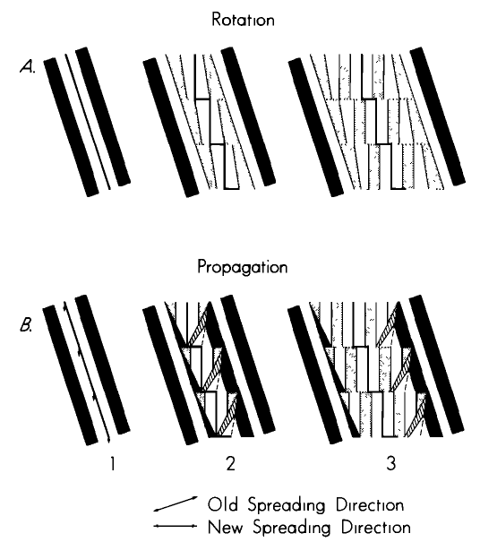
Changes in Direction of Seafloor Spreading Revisited
R.N. Hey, H.W. Menard, T.M. Atwater, D.W. Caress
JGR, 1988

Slide 10
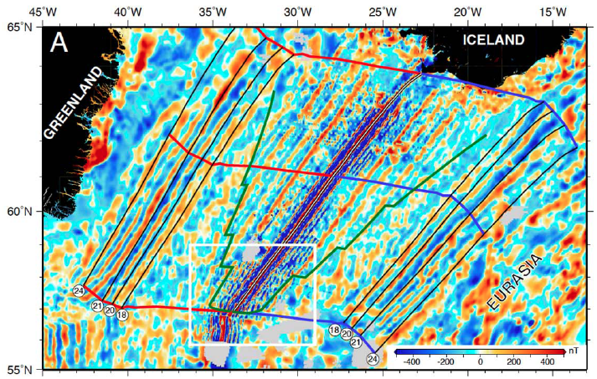
MAGNETIC ANOMALY
Notes:
The close geometric fit of Anomalies 24 to 18 to the rotated Reykjanes Ridge means that the present day Reykjanes Ridge reconfigured its geometry to closely conform to its original geometry and position at the time it formed, despite an intervening fragmentation of the plate boundary and ~30° rotation of the opening direction. It means that the present-day ridge is spreading 30° obliquely because it wants to maintain the original geometry it had with respect to the mantle despite the plates now opening obliquely to the original direction.

Slide 11
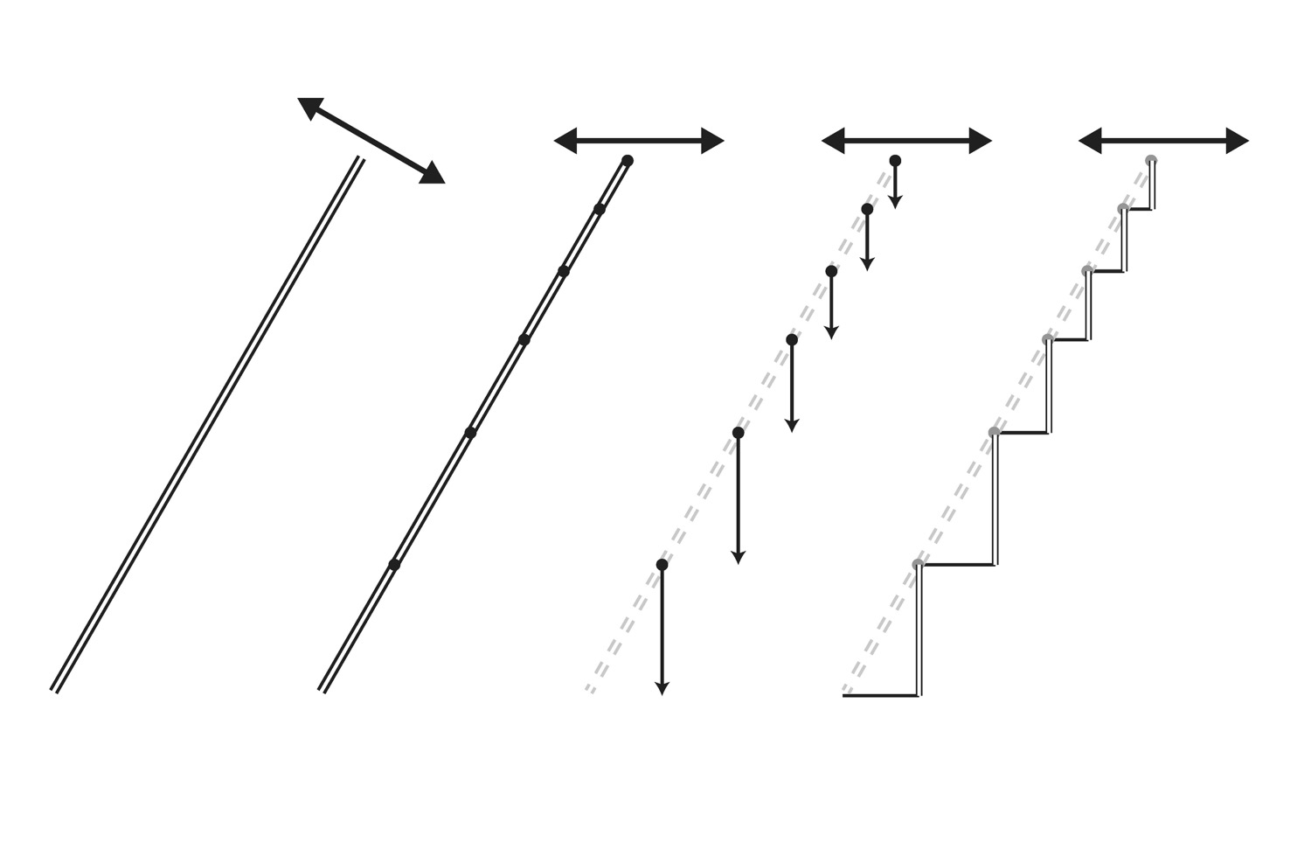
Notes:
Model for formation of segments from a linear axis – nucleation of a series of propagating ridges that form a stair-step plate boundary.

Slide 12
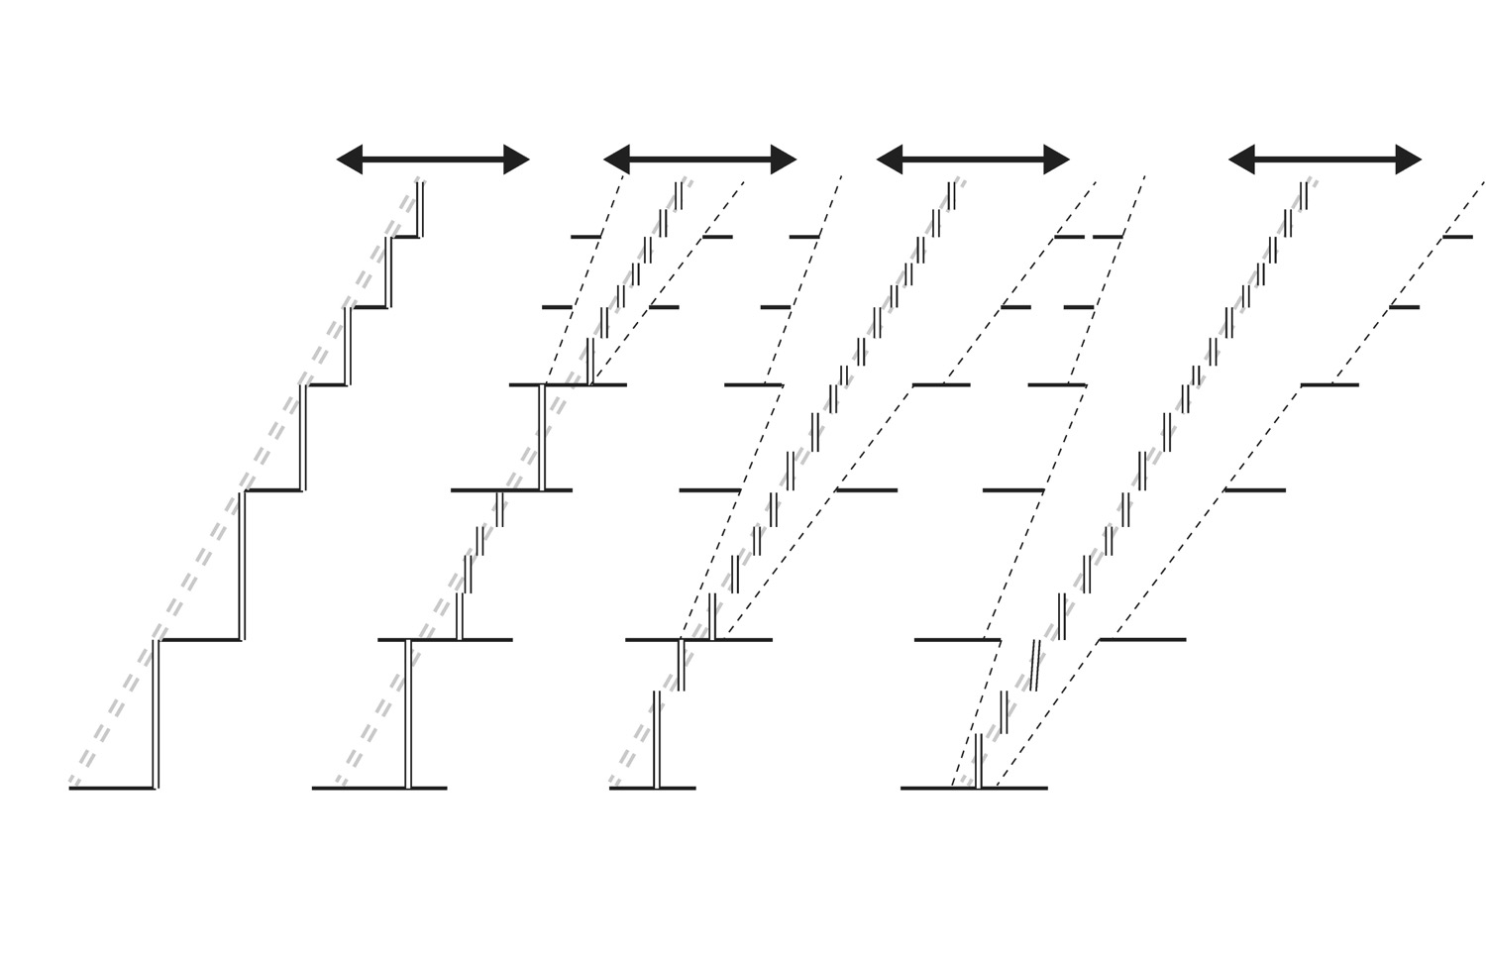

Slide 13
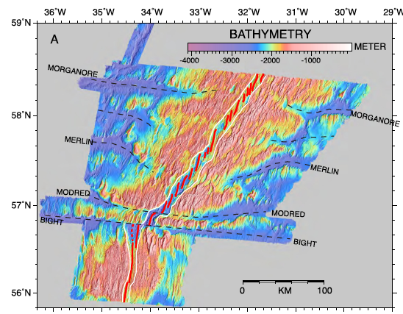

Slide 14
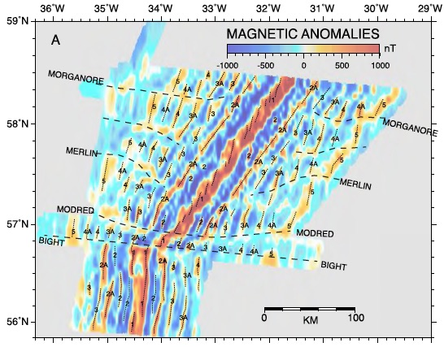

Slide 15
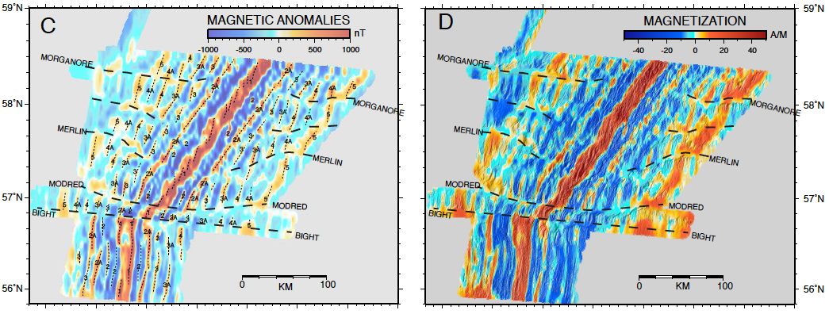
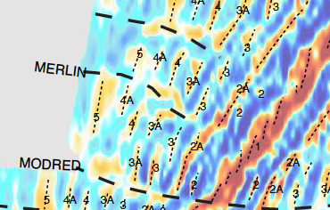
Magnetic isochrons show that ridge segments first migrate toward each other decreasing the offsets across transform faults and non-transform discontinuities. Then the ridge segments break up into smaller segments to form an oblique plate boundary zone.
Notes:
Axial offsets across transform faults becomes smaller with time before the ridge merges into an oblique axis so that the change from segmented to non segmented plate boundary was not achieved by ridge propagation but rather by offset ridge axes moving toward each other with time.

Slide 16
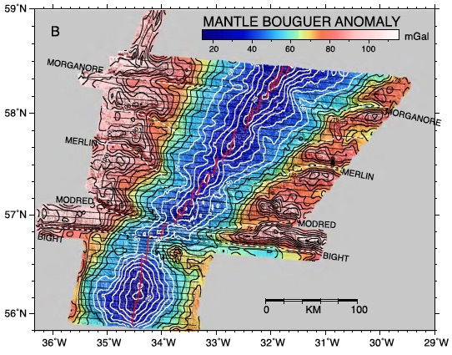

Slide 17
Thanks

