Slide 1
Durham Workshop, April 2017
Examples of W Greenland AFT-derived temperature histories
Explanation of the topography of the Nuussuaq Basin, W Greenland
magmatic Province
    Søren B Nielsen, Department of Geoscience, Aarhus University

Slide 2
Data and references
Data are from Paul Green’s geotrack report #883 (the Geus data set) and from Eoin McGregors thesis (Baffin).
Some (only few) references:
Japsen, P., Green, P.F. & Chalmers, J.A. Separation of Palaeogene and Neogene uplift on Nuussuaq, West Greenland, 2005. Journal of the Geological Society 162, 299-314.
Gregers Dam, Michael Larsen & Martin Sønderholm Sedimentary response to mantle plumes: Implications from Paleocene onshore successions, West and East Greenland, 1998. Geology 26, 207–210.
Larsen, L.M., Pedersen, A. K., 2009. Petrology of the Paleocene picrites and flood basalts on Disko and Nuussuaq, W Greenland. Journal of Petrology 50, 1667-1711.
McGregor, E.D., Nielsen, S.B., Stephenson, R.A.ab, Petersen, K.D.b, MacDonald, D.I.M.a. Long-term exhumation of a Palaeoproterozoic orogen and the role of pre-existing heterogeneous thermal crustal properties: A fission-track study of SE Baffin Island. Journal of the Geological Society 169, 515-530.

Slide 3
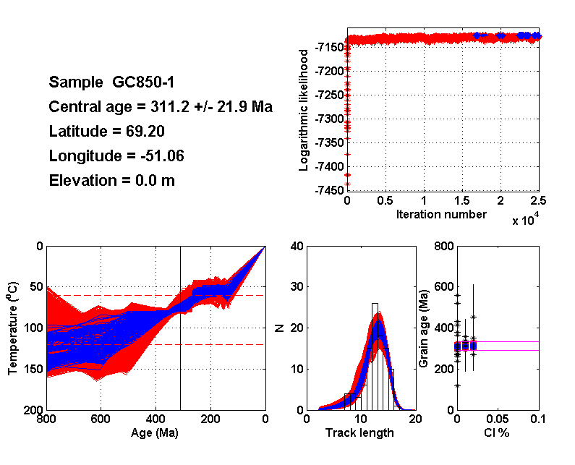
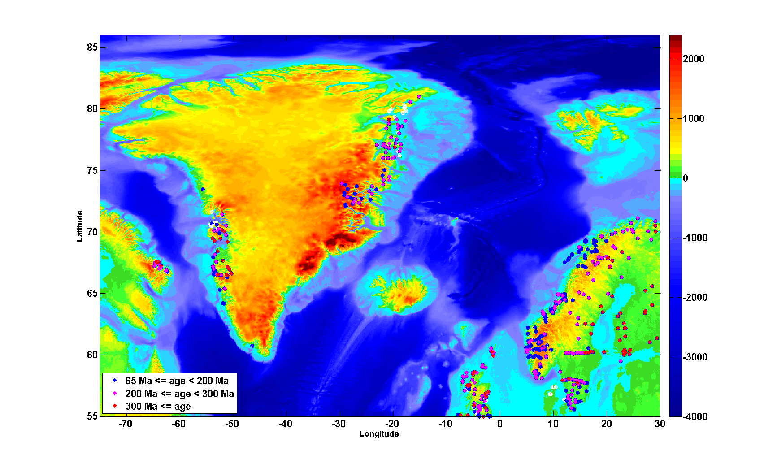

Slide 4
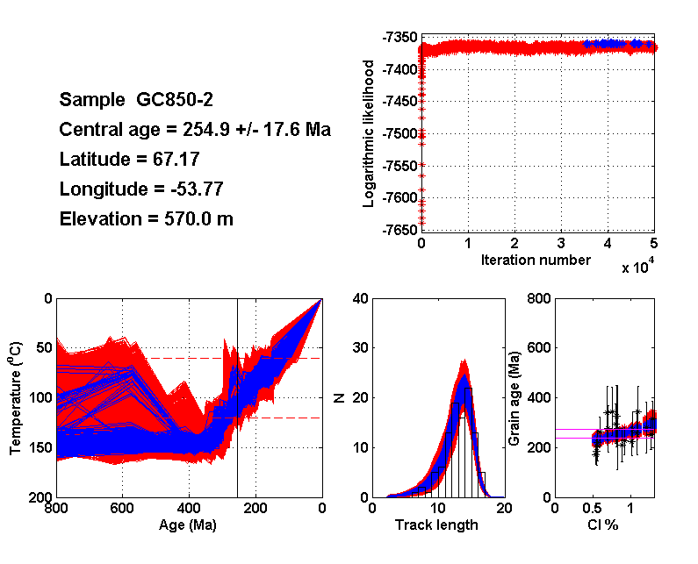

Slide 5
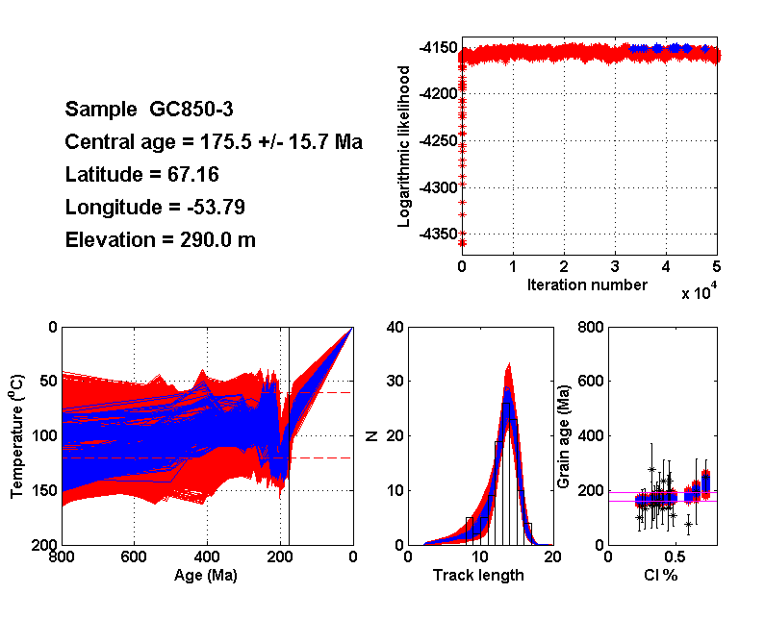

Slide 6
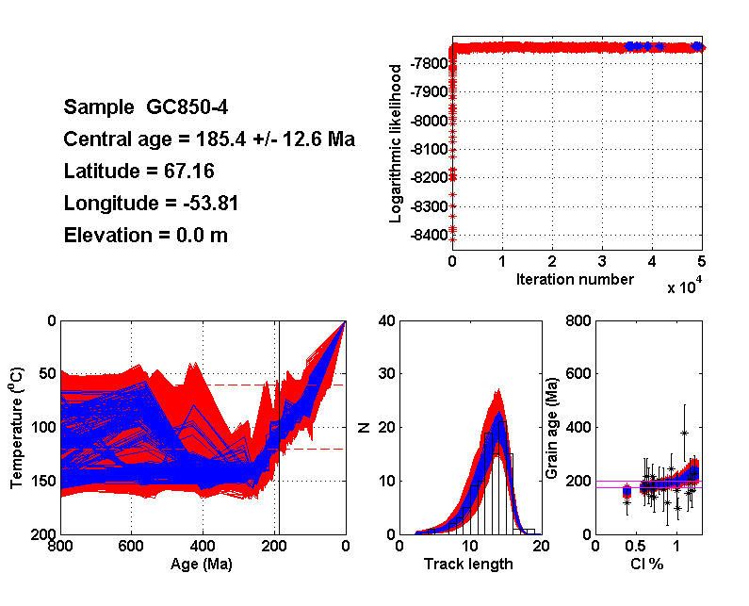

Slide 7
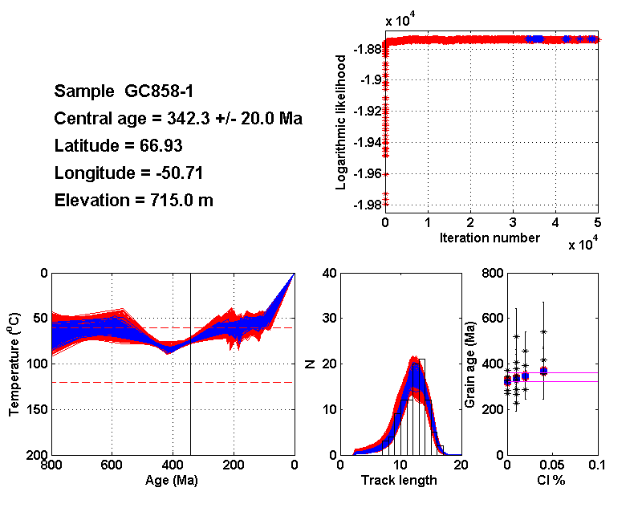

Slide 8
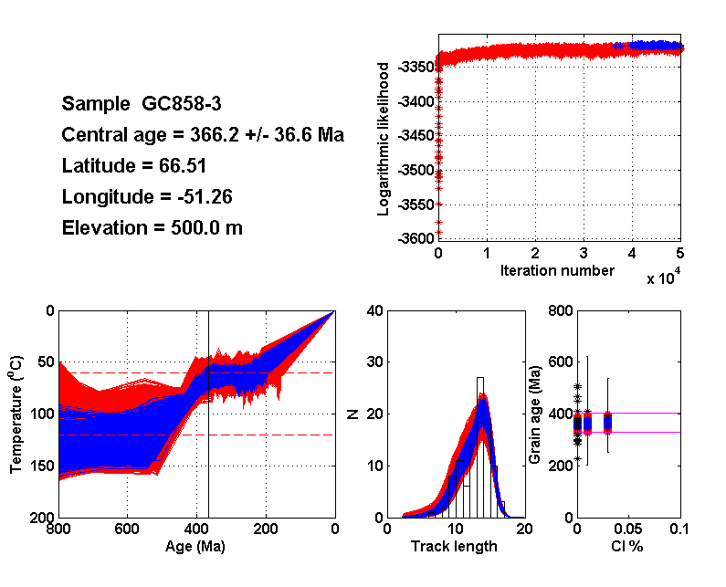

Slide 9
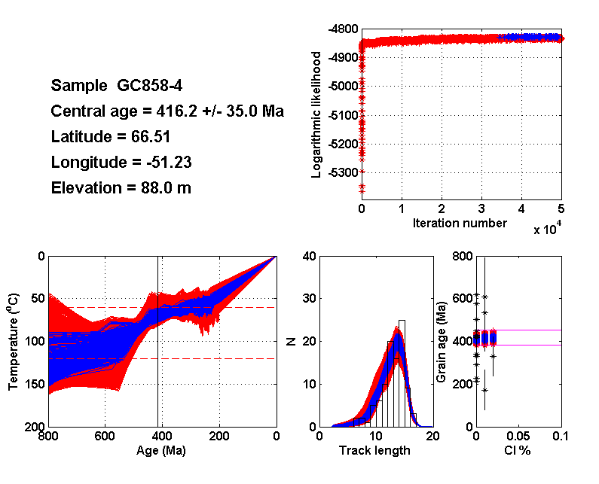

Slide 10
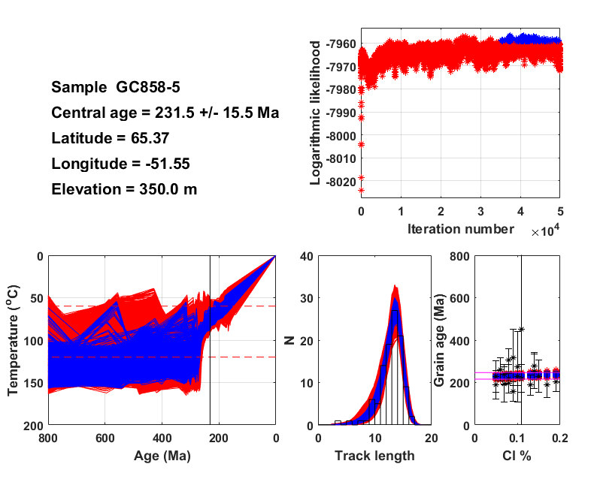

Slide 11
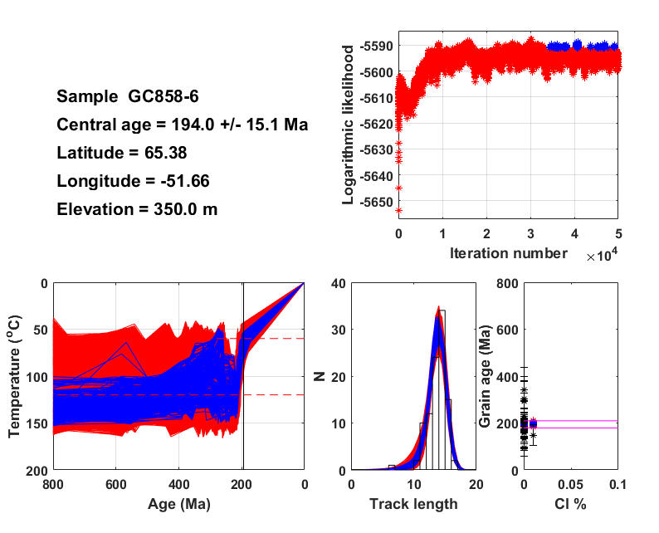

Slide 12
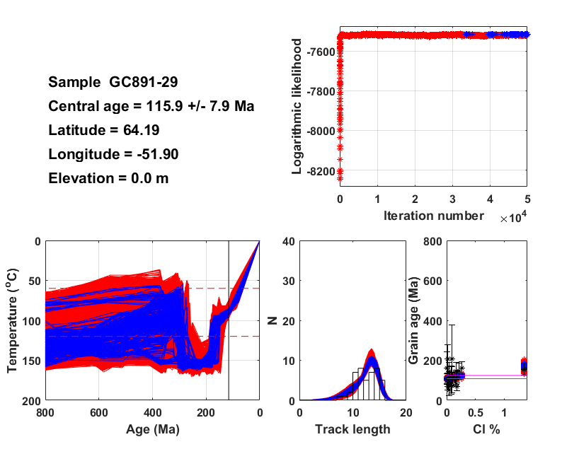

Slide 13
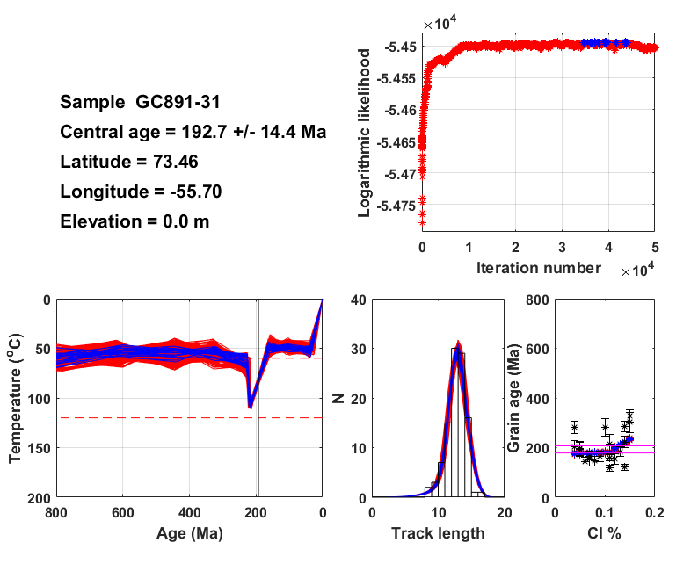

Slide 14
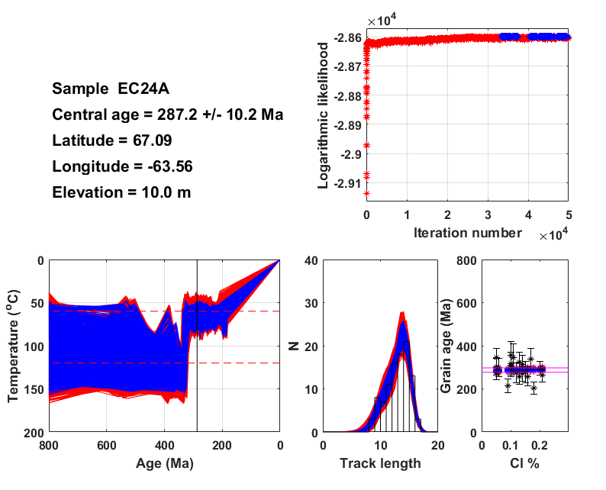

Slide 15
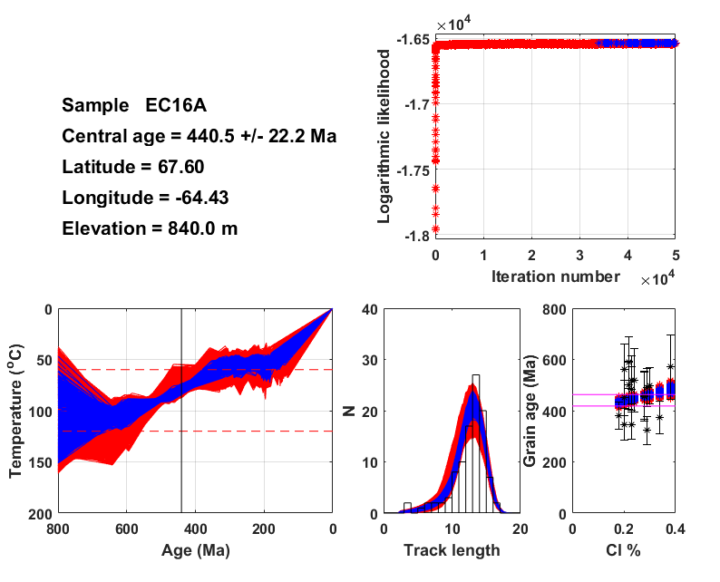

Slide 16
Conclusions, AFT temperature histories
Samples generally show Palaeozoic-Mesozoic cooling consistent with erosion of old topography and the separation of Greenland and N America.
The complex erosion history interpreted by Green and hence Geus cannot be corroborated.
Some samples in the Nuussuaq area are influenced by Paleogene magmatism.
McGregor et al.’s on- and offshore studies are in accordance with this.

Slide 17
Conclusions, AFT temperature histories
Samples generally show Palaeozoic-Mesozoic cooling consistent with erosion of old topography and the separation of Greenland and N America.
The complex erosion history interpreted by Green and hence Geus cannot be corroborated.
Some samples in the Nuussuaq area are influenced by Paleogene magmatism.
McGregor et al.’s on- and offshore studies are in accordance with this.

Slide 18
Topography of the Nuussuaq Basin
The Nuussuaq Basin is filled with Cretaceous-Paleocene fluvio-deltaic to marine sandstones and shales overlain by Paleocen-Eocene volcanic rocks (Dam et al., 1998; Larsen and Pedersen, 2009).
Most volcanic rocks extruded from 62-60 Ma. Volcanic rocks initially were marine and later became subaerial as the basin filled up. There are strong petrological arguments for the existence of crustal magma chambers during the last part of the eruption (Larsen and Pedersen, 2009). Today the marine/subaerial boundary in places is at altitide > 1500 m on the Nuussuaq peninsula.
This setting and some landforms have been suggested to be a case for Neogene uplift of unknown cause (Japsen et al. 2005).

Slide 19
Topography of the Nuussuaq Basin
The present-day topography and the high elevation of the marine/subaerial interface can be explained by differential erosion and associated flexural isostatic uplift of the shield volcano complex that formed from c. 62-60 Ma.
The magmatic activity caused crustal intrusions, which contributed (< 2-400 m) to the topography by km-scale thickening of the crust.
This is corroborated by interpretation of wells Gro-3, Gant-1, Umiivik-1, the VR and AFT data of which require the heat from crustal intrusions.
The well Ataa-1 is unaffected by intrusions.

Slide 20
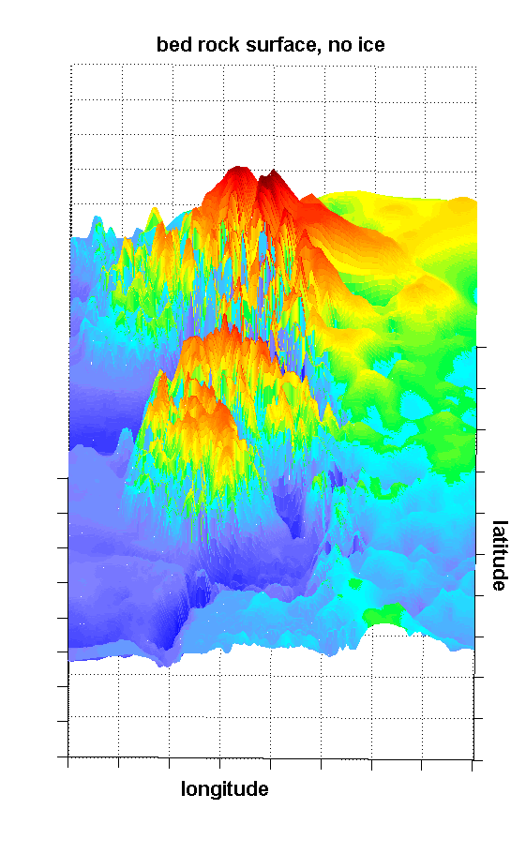
ETOPO 1
Marine Paleocene
sediments
at 1200 m elevation
Paul Green
GEOTRACK
REPORT #883
Nuussuaq
Disko
Disko

Slide 21
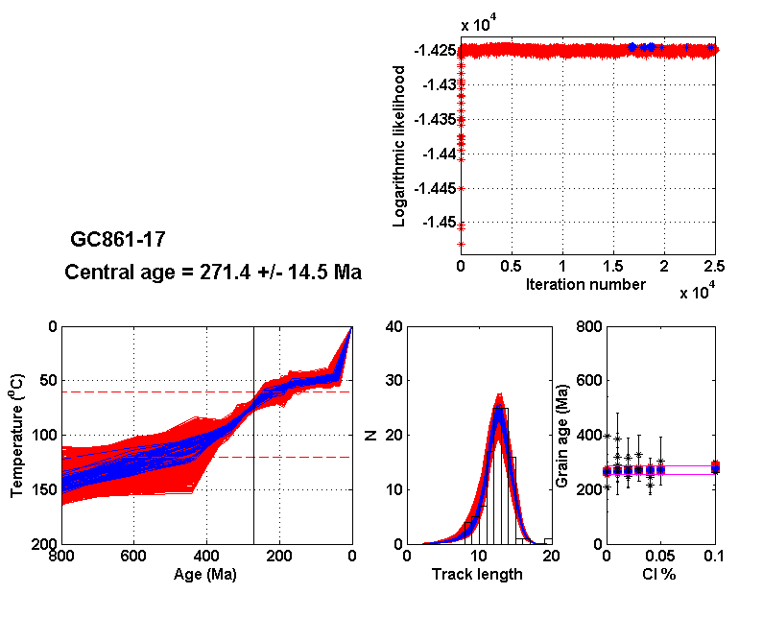
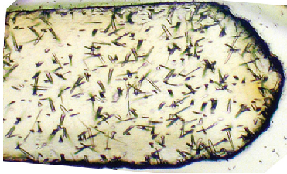
Typical apatite fission track bedrock sample
unaffected by magmatism

Slide 22
The subsurface thermal effect of magmatism
T
T
Z
Z

Slide 23
The subsurface thermal effect of magmatism
LAVAS
T
T
Z
Z

Slide 24
The subsurface thermal effect of magmatism
LAVAS
T
T
Z
Z
SILL
c
c
c

Slide 25
The subsurface thermal effect of magmatism
LAVAS
LAVAS
T
T
Z
Z
SILL
c
c
c

Slide 26
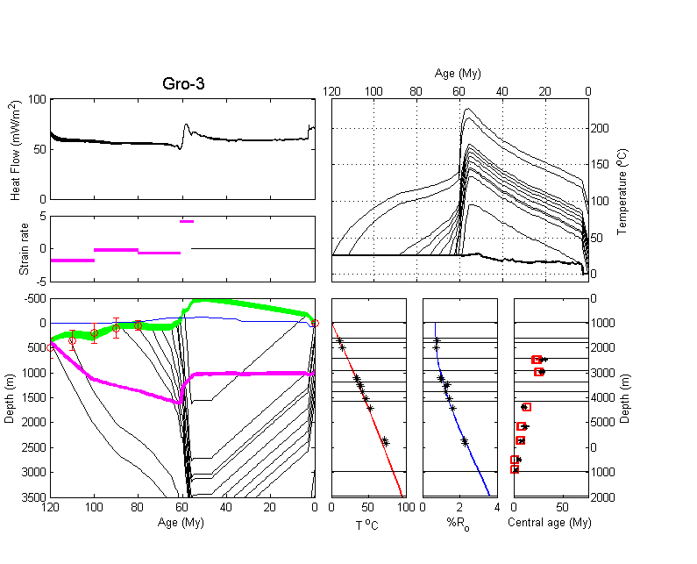
Wells Gro-3, Gant-1, Umiivík-1
LAVAS
(62-61 Ma)
SILL
(61 Ma)

Slide 27
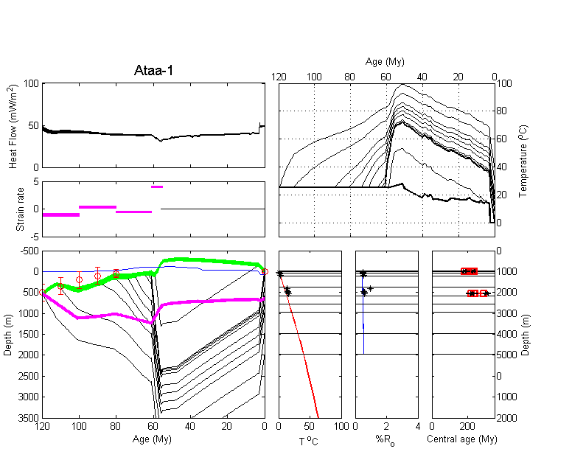
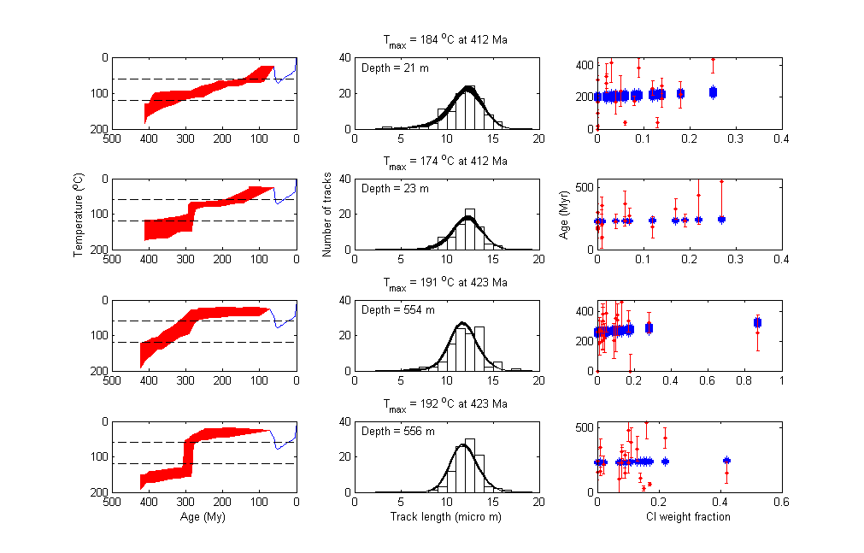
Well Ataa-1
Pre-depositional
thermal
history
explains
AFT ages
LAVAS
(62-60 Ma)

Slide 28
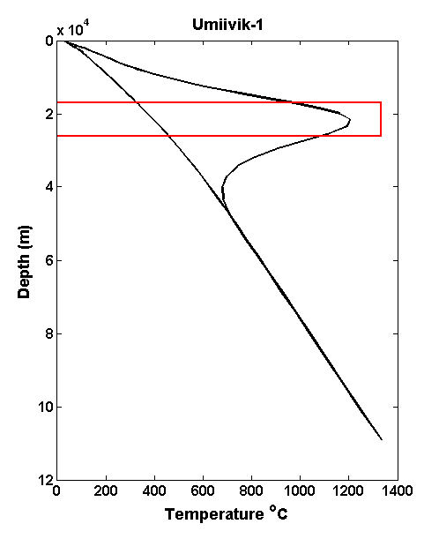
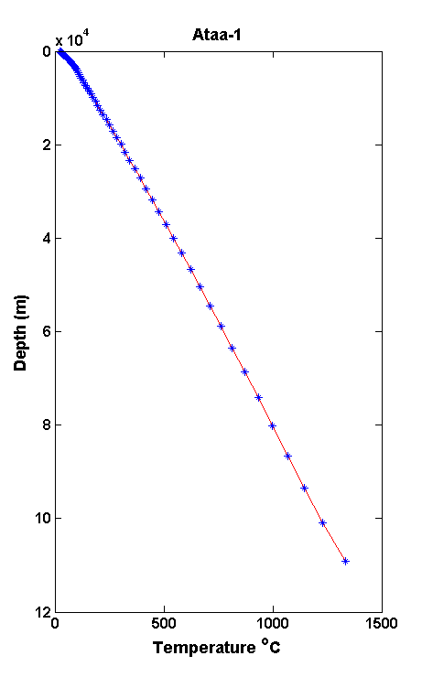
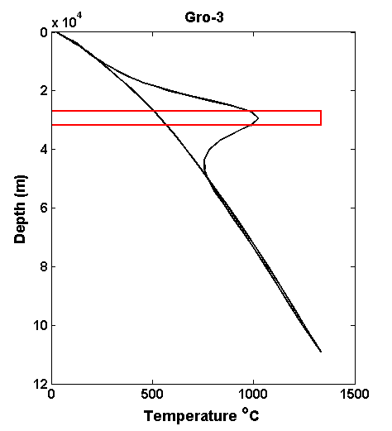
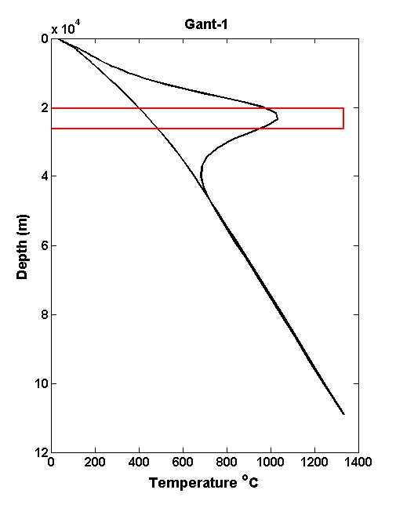
Temperature profiles
at 60 Ma
Sills are reuired to
explain Gro, Gant & Umiivik
Ataa-1
is
unaffected
by sills
Red square marks thickness of sill
required to produce the thermal effect that
together with lava deposition and erosion
explains VR and AFT data.
Heat of fusion is considered.

Slide 29
Flexural isostatic modelling of evolution of shield volcano
complex, crustal intrusions and differential erosion.
The gradual build-up of topography allows to determine
the position of the marine/subaerial boundary within the
volcanic succession and track its elevation during differential
erosion of topography.
Notice also the appearance and disappearance
of the observed paleo fresh-water lake SW of the Nuussuaq
peninsula.

Slide 30
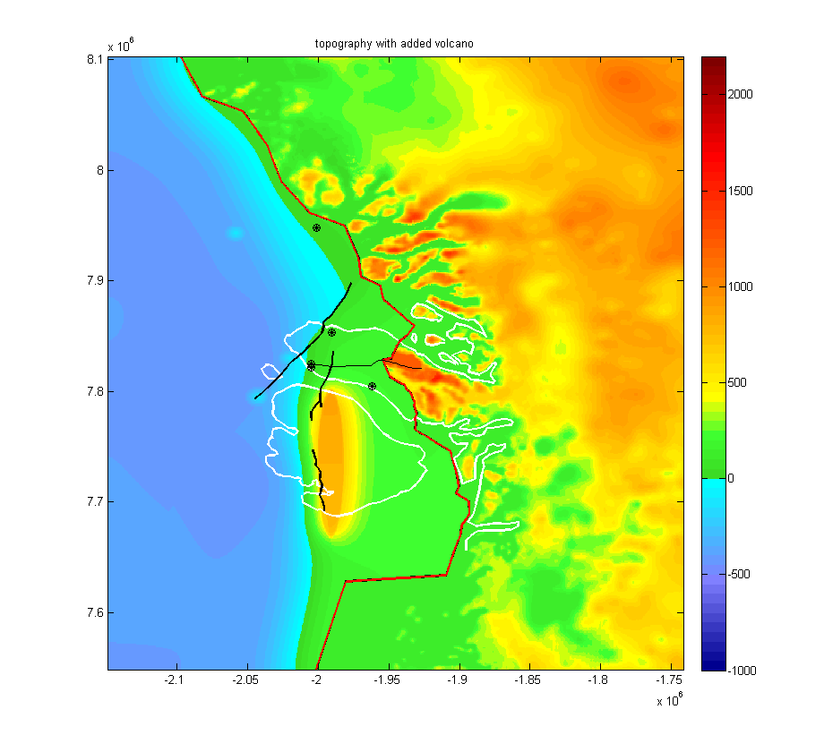
Disko
Gneis
Ridge

Slide 31
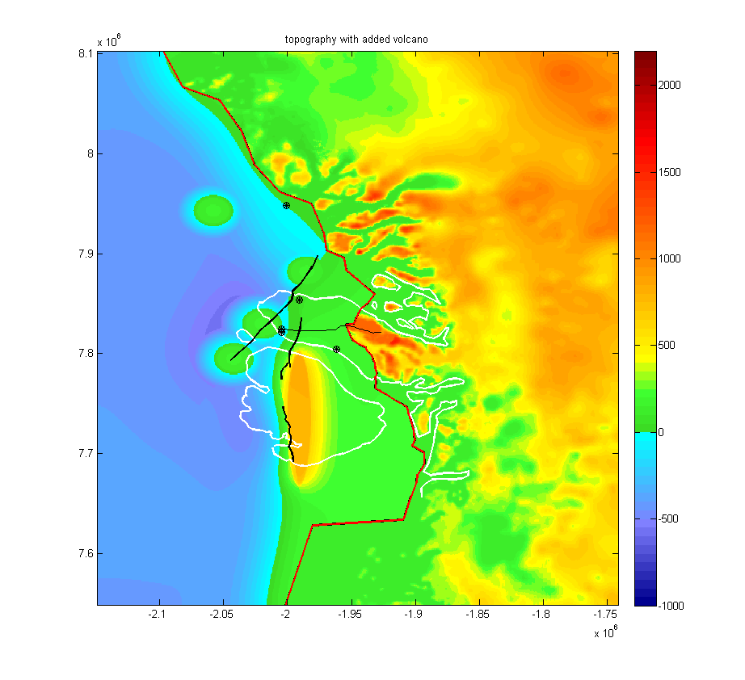

Slide 32
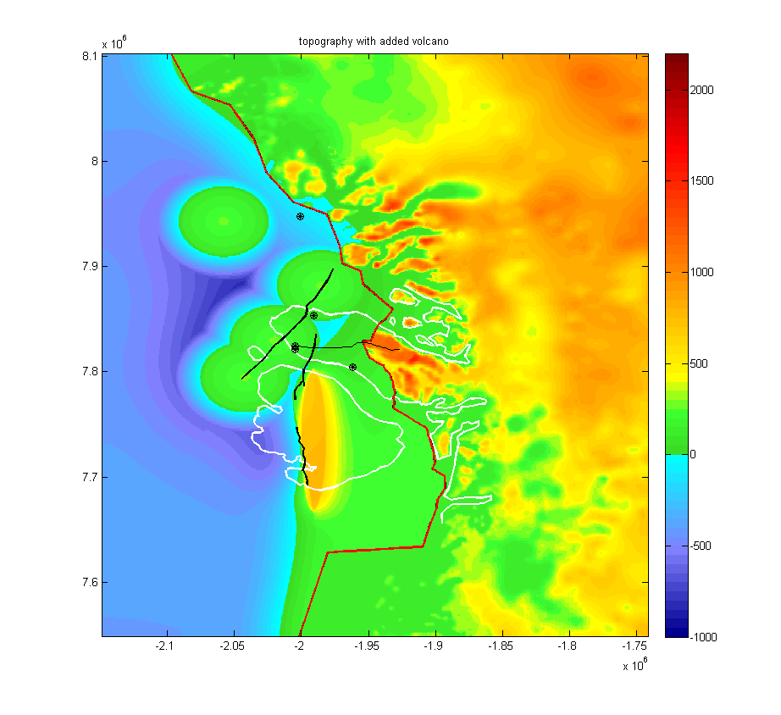

Slide 33
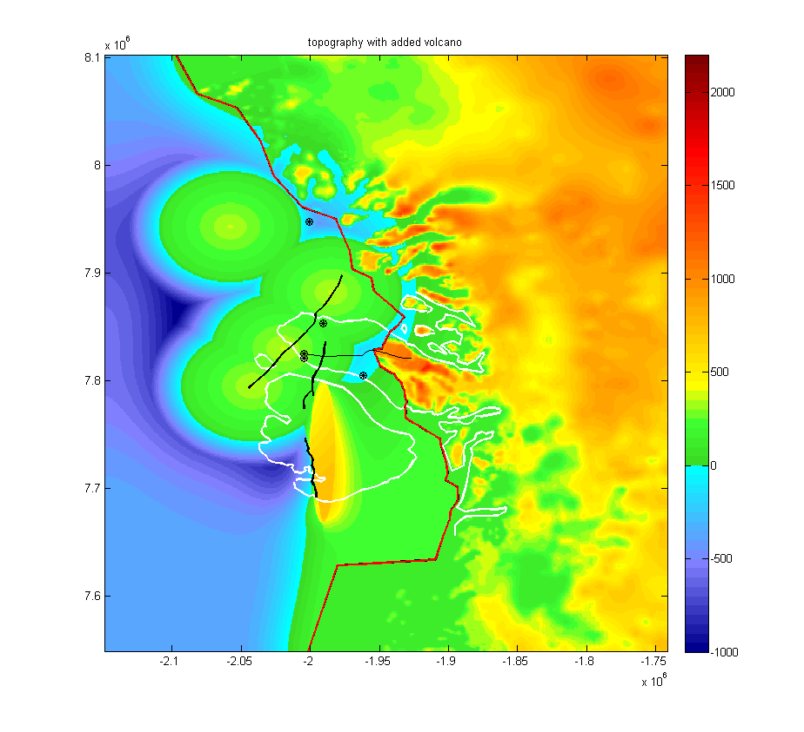

Slide 34
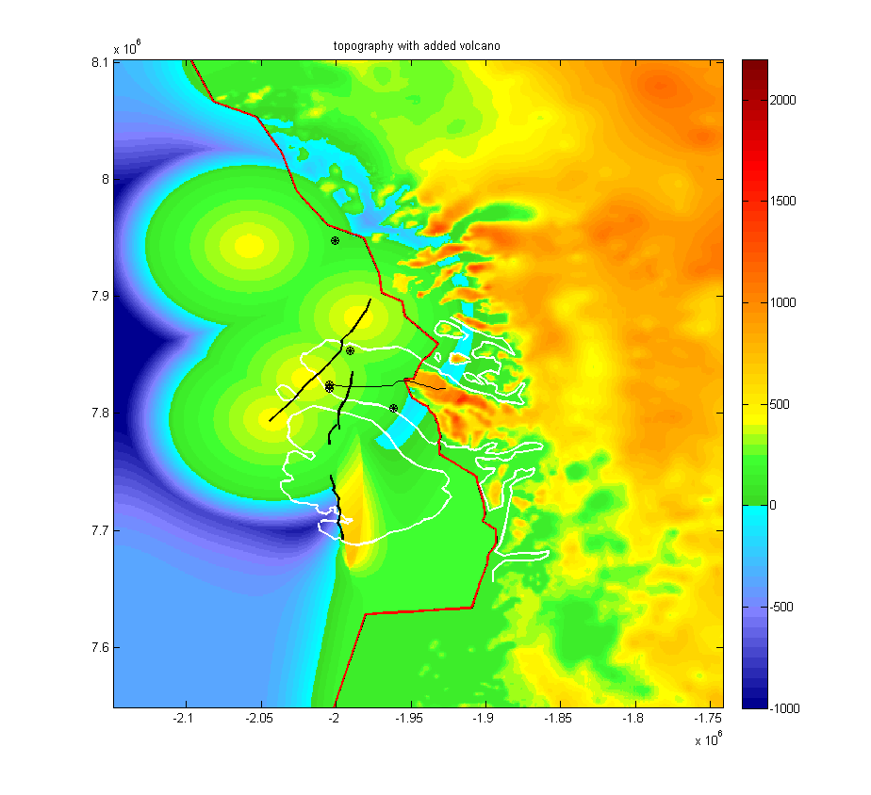
Fresh
water
lake

Slide 35
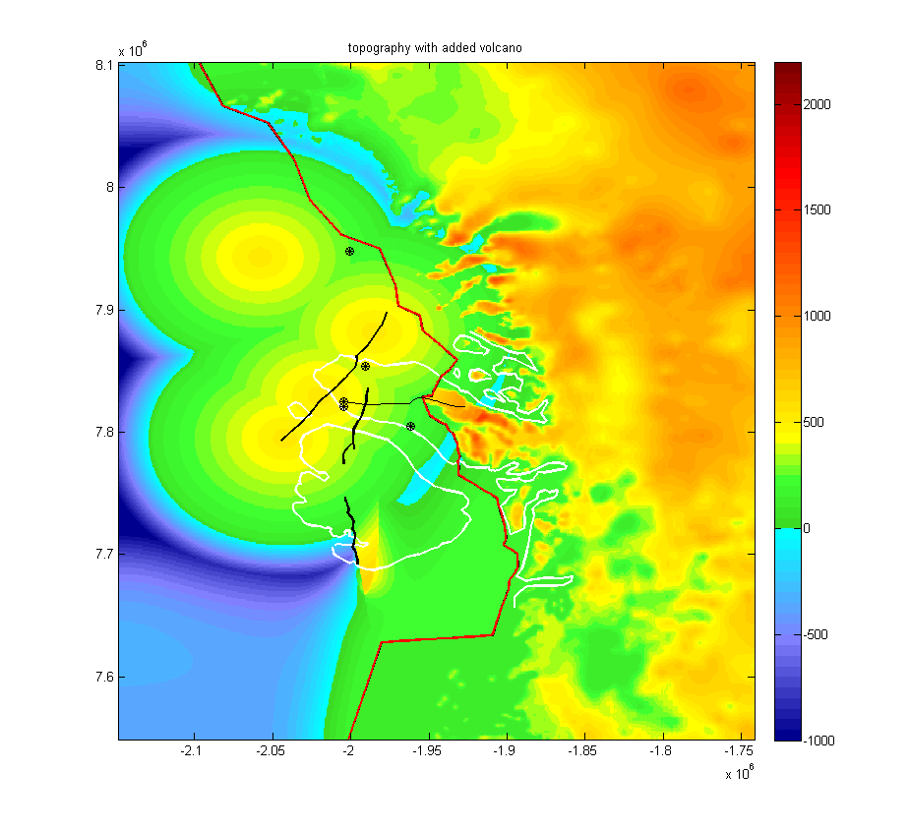
Fresh
water
lake

Slide 36
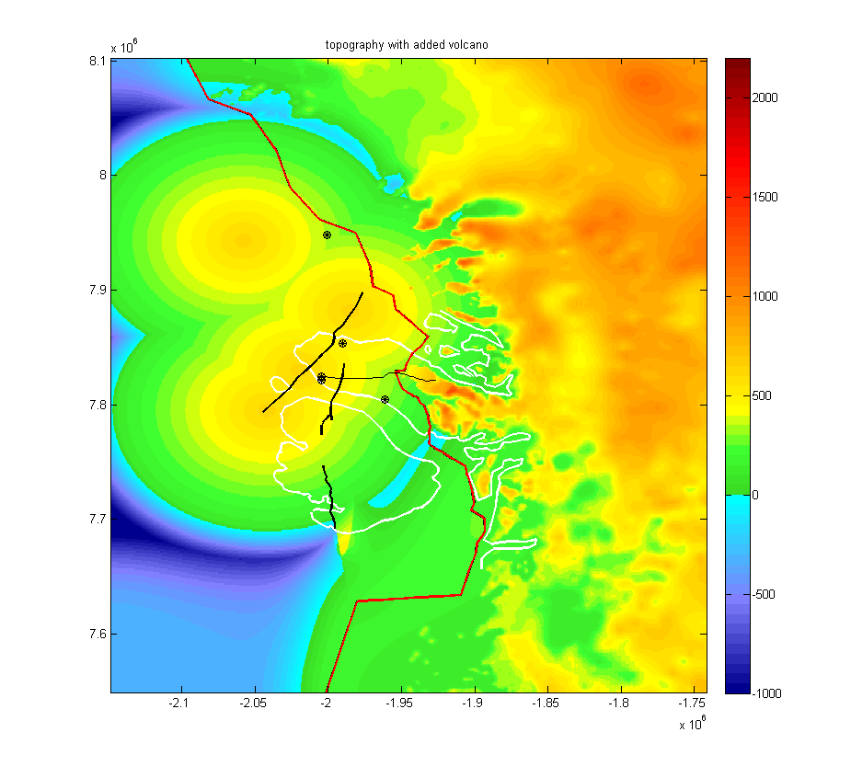
Fresh
water
lake

Slide 37
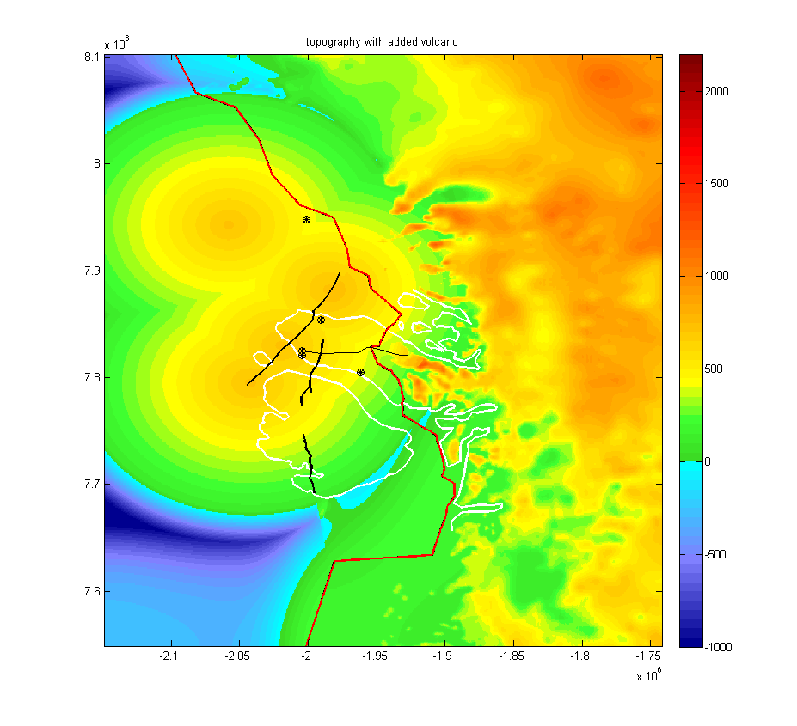
Fresh
water
lake

Slide 38
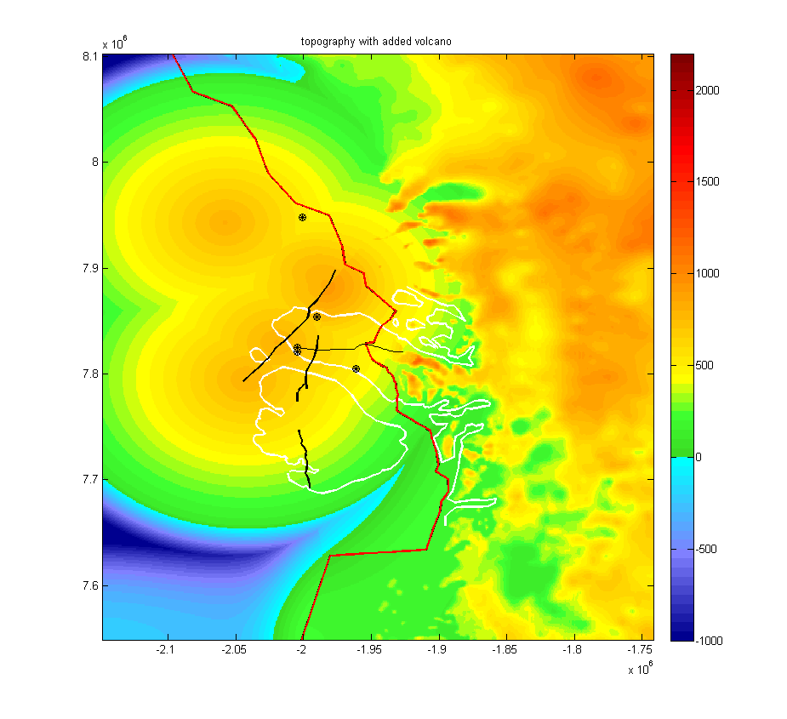

Slide 39
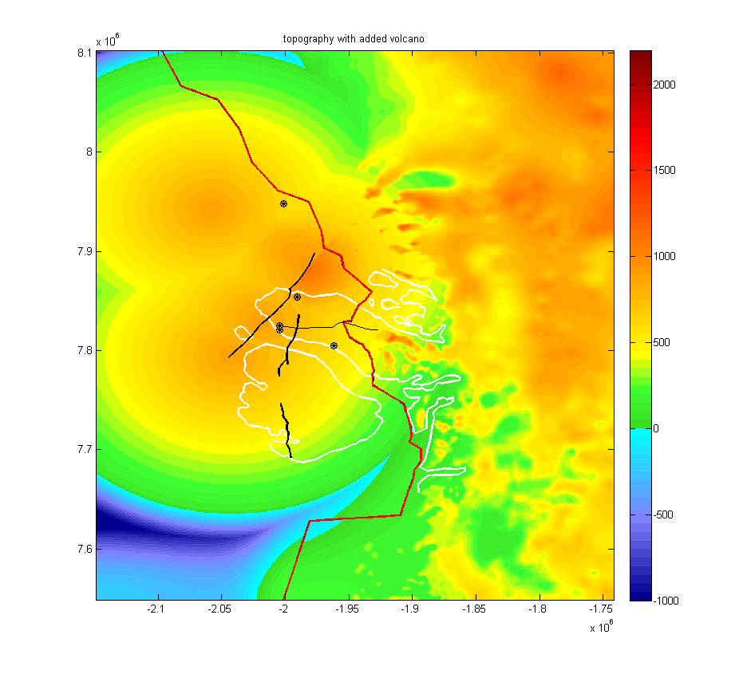

Slide 40
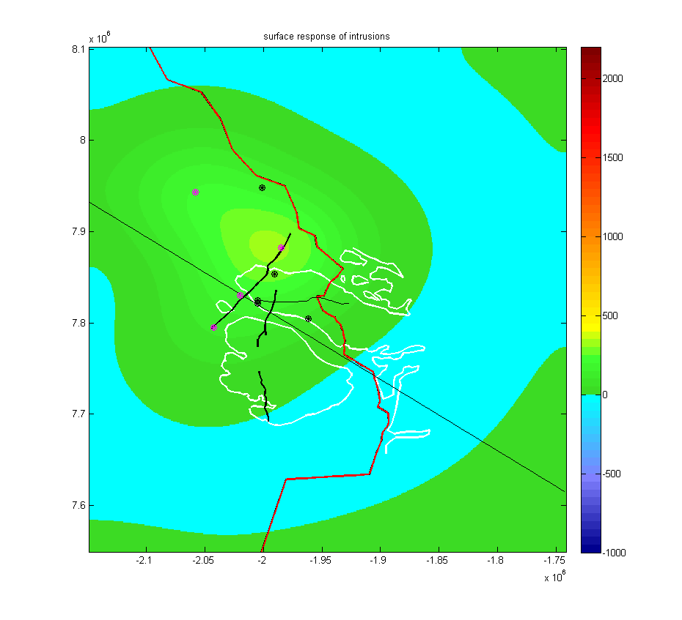
Flexural uplift of surface caused by crustal intrusions from 61-60 MA

Slide 41
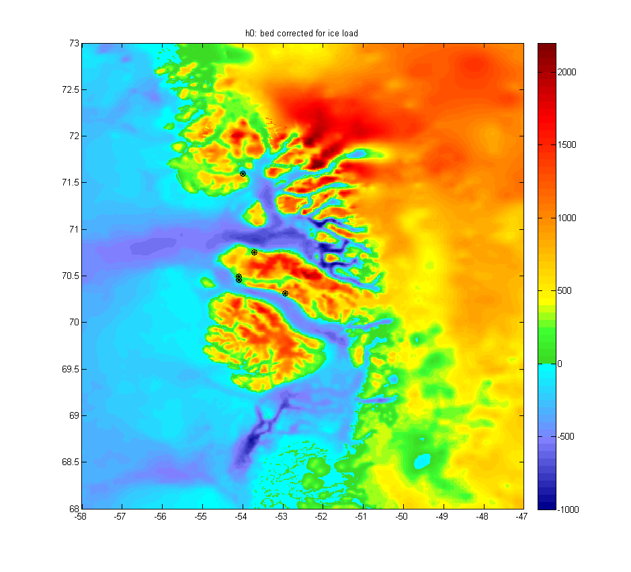
Topography after differential erosion of shield volcano complex. Very similar to today.

Slide 42
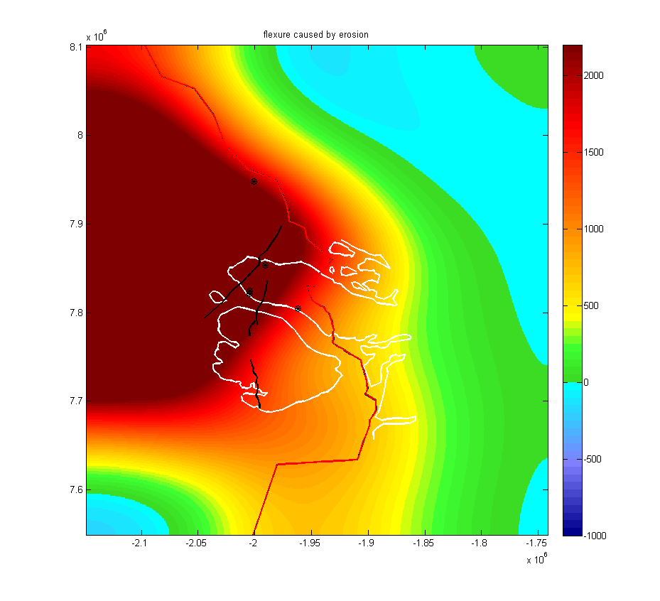
Flexural uplift caused by differential erosion

Slide 43
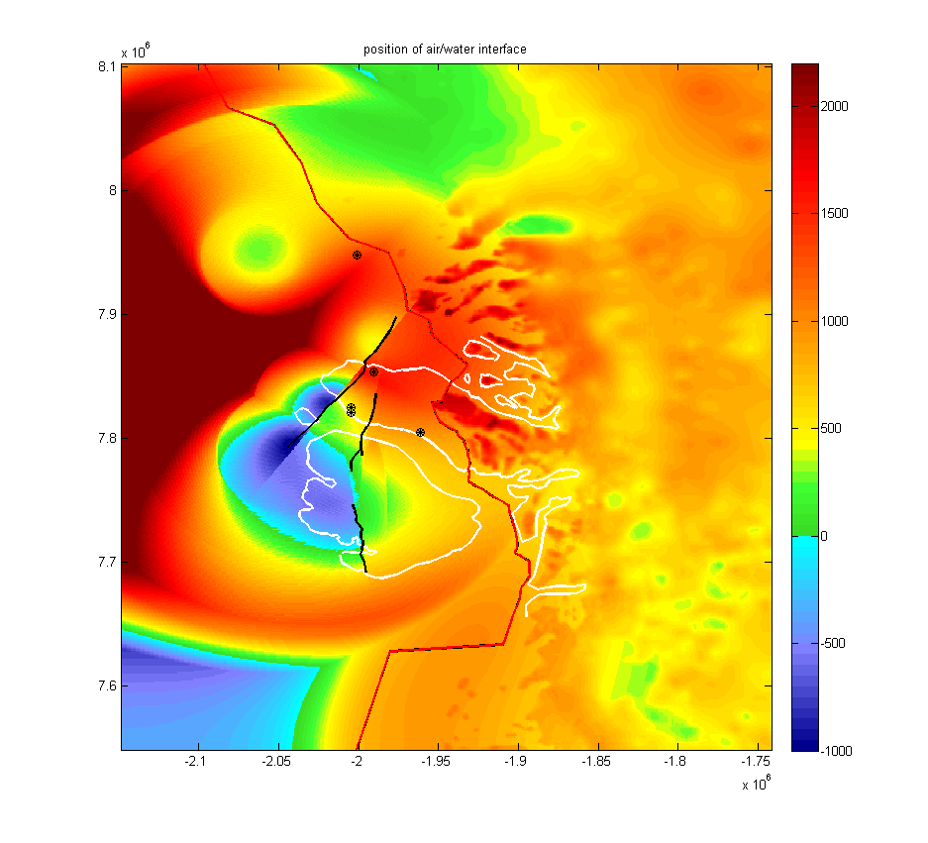
Present-day position of marine/subaerial interface

Slide 44
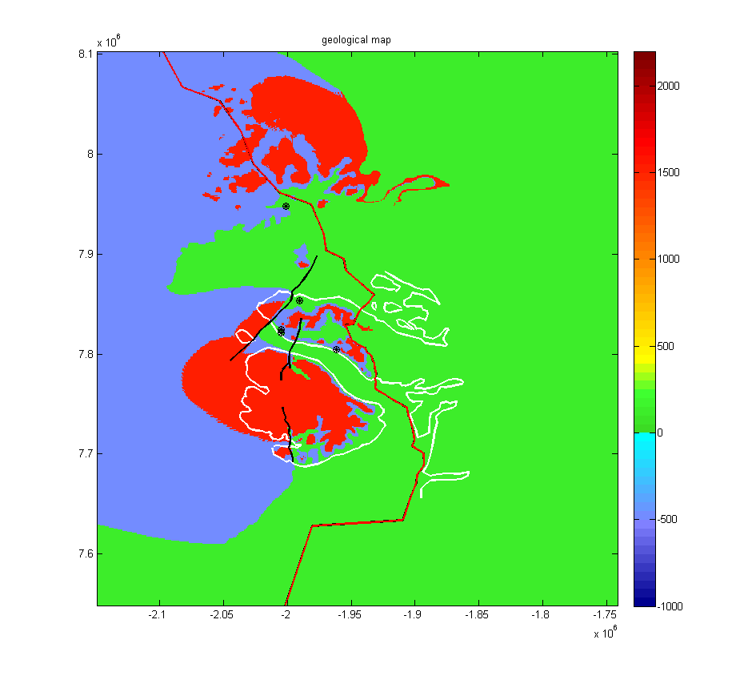
Modelled geological map
Blue: marine lavas
Red: subaerial lavas
Green: Cretaceous-
Paleocene sediments
East of red boundary fault is basement

Slide 45
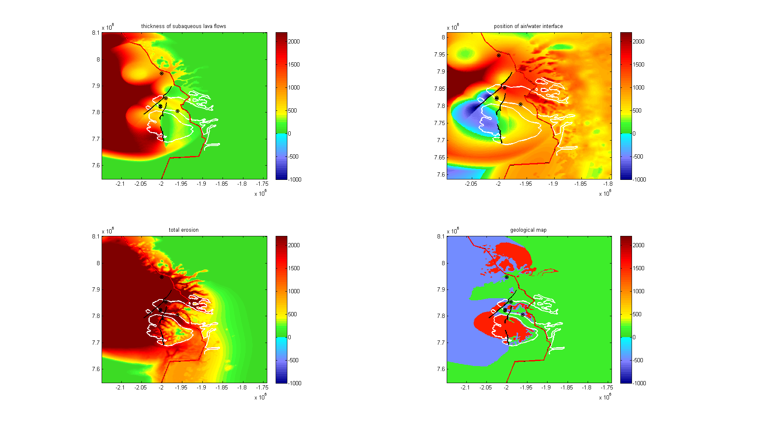
Summary. The resulting geological map in general terms agres
with observations on Disko and Nuussuaq

Slide 46
Topography of the Nuussuaq Basin: Conclusions
The present-day topography and the high elevation of the marine/subaerial interface can be explained by differential erosion and associated flexural isostatic uplift of the shield volcano complex that formed from c. 62-60 Ma.
The magmatic activity caused crustal intrusions, which contributed (< 2-400 m) to the topography by km-scale thickening of the crust.
This is corroborated by interpretation of wells Gro-3, Gant-1, Umiivik-1, the VR and AFT data of which require the heat from crustal intrusions.
The Neogene uplift is caused by flexural isostatic response to differential erosion.

