Slide 1
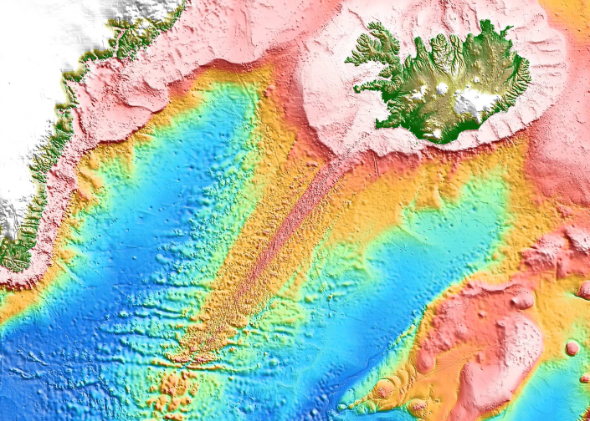
PLATE BOUNDARY PROCESSES AND SMALL-SCALE
MANTLE CONVECTION BENEATH
THE REYKJANES RIDGE
Fernando Martinez & Richard Hey
Hawaii Institute of Geophysics and Planetology
School of Ocean and Earth Science and Technology
University of Hawaii at Manoa
GSA 2017 SEATTLE, WA 25 OCTOBER 2017
Session T240. Structure and Evolution of the North Atlantic-Arctic Realm
Notes:
Abstract: Crustal features of Reykjanes Ridge and flanks have been interpreted as directly reflecting rapid mantle plume flow and temperature variations and as such arguably provide some of the strongest evidence for a dynamic classical plume (Morgan, 1971) beneath Iceland. Here we propose that plate boundary processes and small-scale buoyant mantle convection superimposed on a broad and relatively passive thermochemical mantle anomaly can instead explain these features (Martinez & Hey, 2017).
The Reykjanes Ridge originated as a linear unsegmented axis spreading orthogonally. It became segmented following a change in plate opening direction. Segmented crust was thinner than unsegmented crust. The ridge then systematically and progressively eliminated the just-formed segmentation to reestablish its original geometry, even though it had to spread obliquely to do this. Prominent ridge-flank V-shaped crustal ridges and troughs formed in this latest spreading stage. All of these features have been proposed to reflect mantle plume flow and temperature effects.
Plate boundary processes can instead account for all of them: The abrupt segmentation of a ridge following a change in plate opening direction has been observed at other spreading centers to be a kinematically-driven mechanical adjustment achieved through propagating ridges and need not involve mantle plume or thermal effects. Thinner crust accreted in the segmented stage is a predicted effect of segmentation on plate-driven mantle upwelling and does not require mantle temperature changes. The reassembly of an axis back to its original configuration suggests a “memory” of the plate boundary zone due to a deep low-viscosity “wet” melting regime that remained linear following the abrupt change in opening direction and guided the reassembly of the axis. V-shaped crustal ridges can result from small-scale mantle upwelling instabilities propagating along the long, deep and linear wet melting regime, instead of thermal pulses embedded in mantle plume flow.
The existence of the Iceland hotspot and associated regional excess melting on the Reykjanes Ridge may be explained by the slow advection of a broad low-viscosity thermochemical anomaly possibly from the deep mantle, as inferred from tomographic images (French & Romanowicz, 2015). This anomaly may have existed passively below solidus depths prior to North Atlantic continental rifting. As this low-viscosity fertile mantle rose above the solidus (driven by the initial continental rifting and subsequent seafloor spreading), it may have triggered shallow melt-induced small-scale convection as the direct cause of the excess hotspot melting, rather than by a rapidly rising jet of hot mantle (plume). Thus, dynamic crustal features of the North Atlantic margin and the Reykjanes Ridge and its flanks can be explained as the direct result of kinematic effects, plate boundary processes and small-scale upper mantle convection (which can evolve rapidly) superimposed on and and enhanced by a broad and relatively passive thermochemical mantle anomaly.
References:
French, S. W., and Romanowicz, B. (2015), Broad plumes rooted at the base of the Earth's mantle beneath major hotspots, Nature, 525(7567), 95-99.
Martinez, F., and Hey, R. (2017), Propagating buoyant mantle upwelling on the Reykjanes Ridge, Earth and Planetary Science Letters, 457, 10-22.
Morgan, W. J. (1971), Convection plumes in the lower mantle, Nature, 230, 43–44.

Slide 2
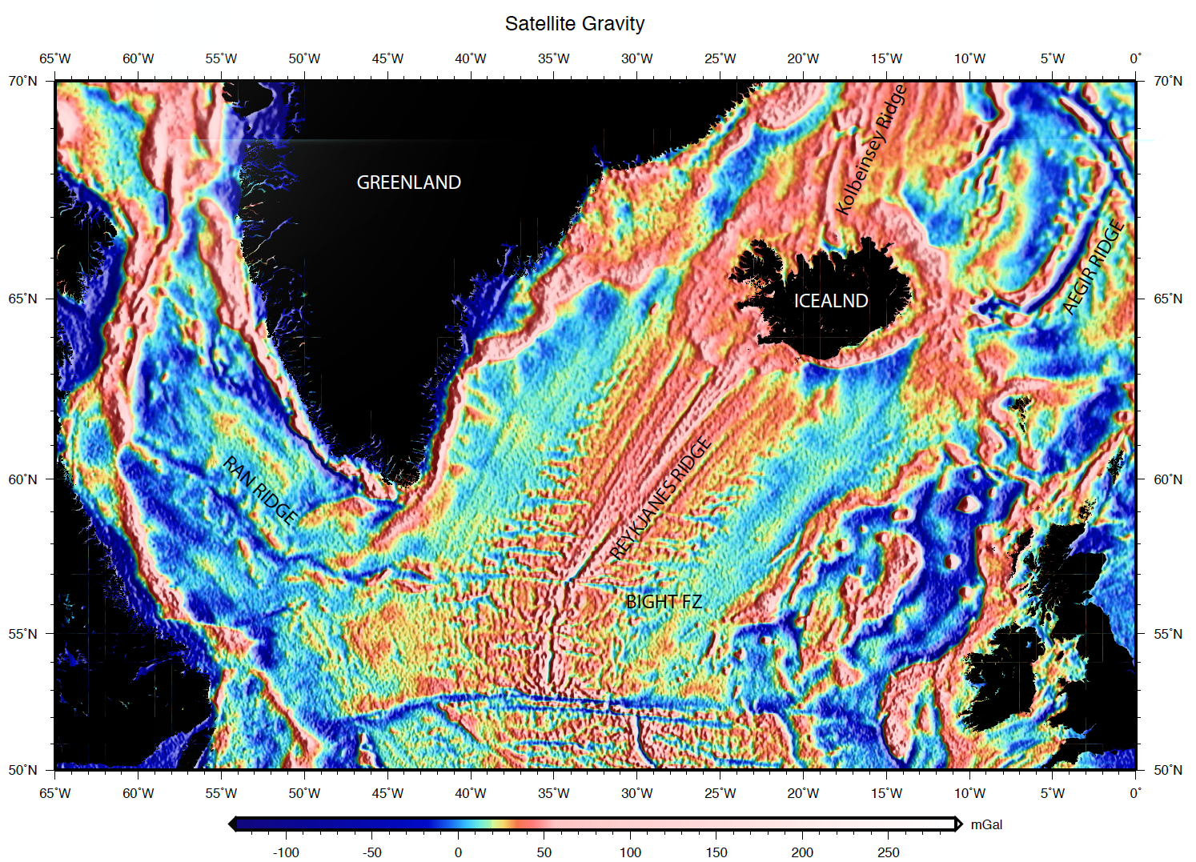
ICELAND
EURASIA
NORTH
AMERICA
Notes:
As the Reykjanes Ridge intersects the Iceland hotspot almost all of the features of the ridge and its flanks have been interpreted as due to variations in mantle plume flow and temperature.
Here I will argue that they can be explained instead by plate boundary processes and small-scale upper mantle convection.
Satellite gravity data show the tectonic structure of the North Atlantic Basin.
The Reykjanes Ridge had a distinct evolution from the Mid-Atlantic Ridge to the south. It originated as the plate boundary between Greenland and Eurasia when Greenland was a separate plate from North America.
Greenland was separating from North America across the Ran Ridge in the Labrador Sea and met the Reykjanes Ridge and southward continuation of the Mid-Atlantic Ridge at a triple junction. When the Ran Ridge became extinct ~37 Ma the triple junction was converted to a transform fault and spreading across the Reykjanes Ridge changed in direction by about 30 degrees.
GREENLAND – EUROPE BREAKUP ~ 55 MA
CHANGE IN OPENING DIRECTION & FRACTURE ZONE FORMATION ~ 37 MA
FRACTURE ZONE ELIMINATION BEGINS FROM THE NORTH ~ 40 MA
(Reference: Vogt and Avery, 1974, JGR)

Slide 3
ICELAND
MID-ATLANTIC
RIDGE
EURASIA
NORTH
AMERICA

Slide 4
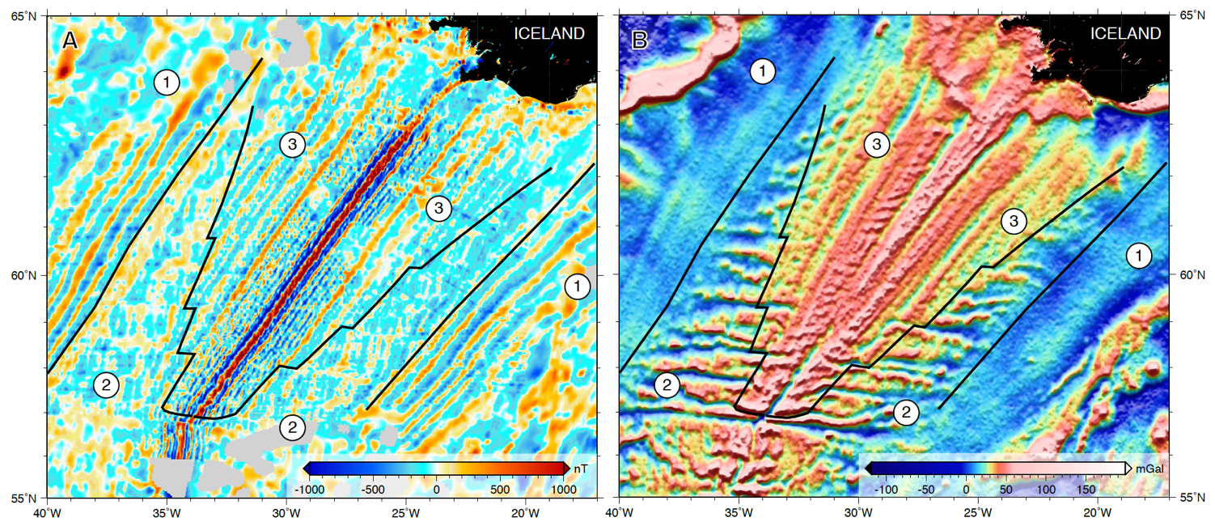
3 MODES OF SEAFLOOR SPREADING FLANKING THE REYKJANES RIDGE
MAGNETICS
SATELLITE-DERIVED GRAVITY
UNSEGMENTED ORTHOGONAL SPREADING ON A LONG LINEAR RIDGE (THICK CRUST)
ORTHOGONAL SPREADING ON A SEGMENTED RIDGE (THINNER CRUST)
OBLIQUE SPREADING ON AN UNSEGMENTED LINEAR RIDGE (THICK CRUST)
Notes:
The Reykjanes Ridge exhibits three distinct types of seafloor on its flanks. The first is unsegmented orthogonal spreading on a long linear axis as shown by magnetic isochrons and satellite-derived gravity data. The second is an abrupt transition to segmented orthogonal spreading on a stair-step geometry axis. And the third is a diachronous transition back to to unsegmented but now oblique spreading replacing the stair-step axis from north to south and forming V-shaped ridges and troughs on the ridge flanks. All of these phases have been associated with variations in mantle plume flow and temperature, but can be explained as plate boundary pro
cesses.

Slide 5
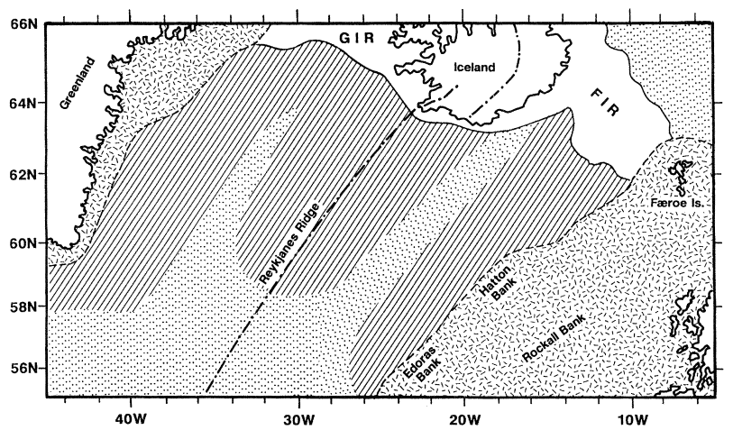
Tectonomagmatic regimes inferred to result from mantle plume temperature variations
Thick Crust
Thick Crust
Thick Crust
Thin Crust
Thin Crust
White, 1997, Phil. Trans. R. Soc. Lond.
Notes:
Various researchers have attributed the thicker crust of the unsegmented stages to hotter plume mantle relative to cooler mantle in the segmented stages and to dynamic advance and withdrawal of mantle plume material.
An underlying assumption in these interpretations is that transform faults (and ridge segmentation) cannot form when the mantle is too hot (due to mantle plume flow) because of a thermal weakening of the crust and/or lithosphere so that it behaves in a ductile manner.

Slide 6
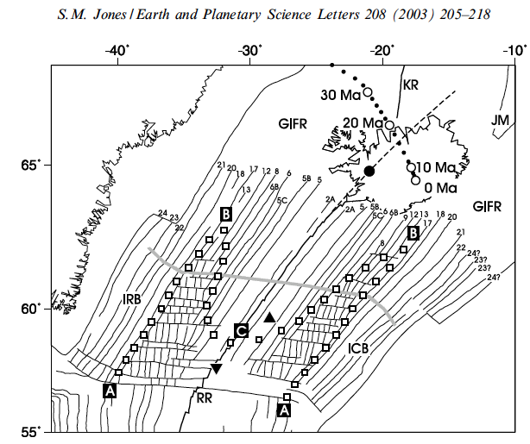
Mantle plume model proposes that
high mantle temperatures prevents
transform faults from forming so that
both changes in plate opening direction and mantle temperature were involved in forming transform faults but only an increase in temperature involved in eliminating the transform faults. This idea is based on the greater crustal thicknesses in the unsegmented stages of spreading.
Thick Crust
Thick Crust
Thick Crust
Thin Crust
Thin Crust
Red line:
Spreading flow line
Notes:
In the plume model the intersection of the plume thermal structure with the ridge axis lead to brittle and ductile behavior of the lithosphere resulting in the formation and elimination of transform faults

Slide 7
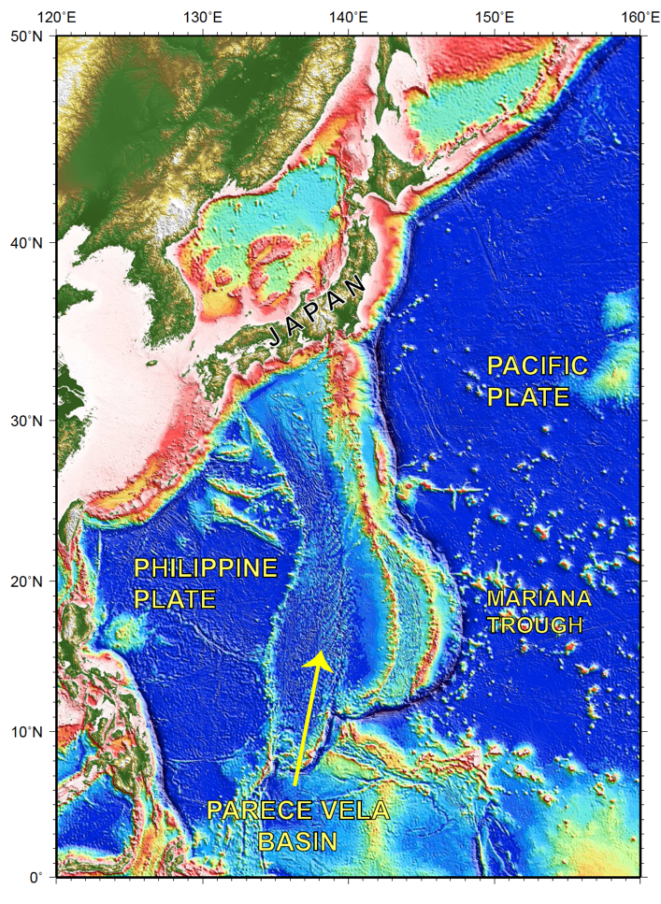
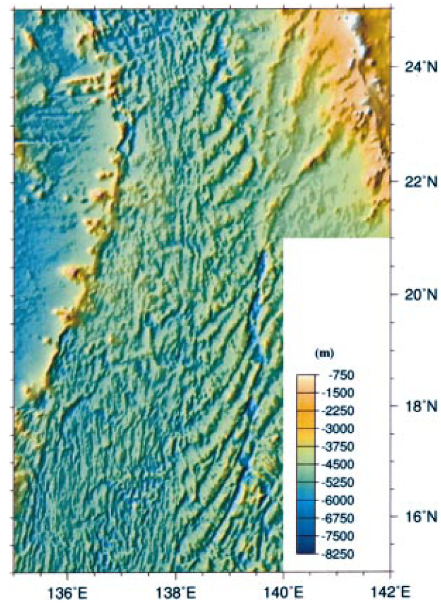
BATHYMETRY
Notes:
In the Parece Vela basin, a backarc basin in the western Pacific without hotspot effects, an abrupt change in plate motion lead to the immediate formation of a segmented plate boundary.
This geologic observation shows that mantle thermal effects are not required to form transform faults and that they can be explained instead by abrupt kinematic changes.

Slide 8
BATHYMETRY
Notes:
Red arrows indicate early nearly E-W basin opening with no transform faults followed by an abrupt change in opening direction essentially across an isochron (dashed line) to NE-SW opening.
An array of closely-spaced transform faults abruptly formed to accommodate the new opening direction. Because of the very abrupt transition over ~1000 km, mantle temperature changes are not likely.
There is no recognized plume that was active in this area.

Slide 9
Mantle plume model proposes that high mantle temperatures prevents transform faults from forming so that both changes in plate opening direction and mantle temperature were involved in forming transform faults but only an increase in temperature involved in eliminating the transform faults. This idea is also motivated by observed changes in crustal thicknesses between unsegmented and segmented stages of spreading.
Thick Crust
Thick Crust
Thick Crust
Thin Crust
Thin Crust
Red line:
Spreading flow line
Notes:
In the plume model the intersection of the plume thermal structure with the ridge axis lead to brittle and ductile behavior of the lithosphere resulting in the formation and elimination of transform faults

Slide 10
2-D plate-driven mantle
advection and melting
Langmuir et al., 1992
AGU Geophysical Monograph 71
Notes:
The interpretation of varying mantle temperature is based on a 2-D passive mantle upwelling model where temperature is the only variable controlling mantle melting.

Slide 11
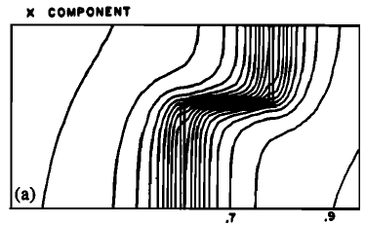
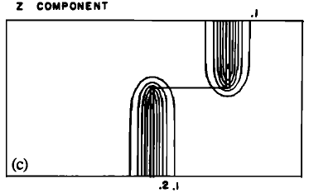
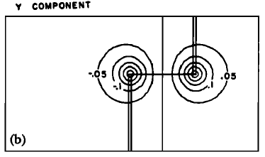
Three-Dimensional Flow and Temperature Perturbations Due to a Transform Offset: Effects on Oceanic Crustal and Upper Mantle Structure
Phipps Morgan & Forsyth, 1988, JGR
Passive plate-driven mantle upwelling decreases significantly at offset segment ends. Thus a segmented plate boundary will always generate less decompression melt than an unsegmented plate boundary due to the effect of segmentation on mantle advection with no mantle temperature changes.
Notes:
However, Phipps Morgan and Forsyth showed that 3-D plate boundary segmentation can affect mantle melting by controlling the pattern of mantle advection.
Along a segmented and offset ridge, mantle can flow into the segment horizontally (y component) across the segment ends. This decreases the vertical advection component near segment ends.
Since horizontally flowing mantle does not undergo decompression it does not melt and therefore decreases the total melt production.

Slide 12
Three-Dimensional Flow and Temperature Perturbations Due to a Transform Offset: Effects on Oceanic Crustal and Upper Mantle Structure
Phipps Morgan & Forsyth, 1988, JGR
Passive plate-driven mantle upwelling decreases significantly at offset segment ends. Thus a segmented plate boundary will always generate less decompression melt than an unsegmented plate boundary due to the effect of segmentation on mantle advection with no mantle temperature changes.
Notes:
Red arrows indicate the horizontal mantle flow component across segment ends.

Slide 13
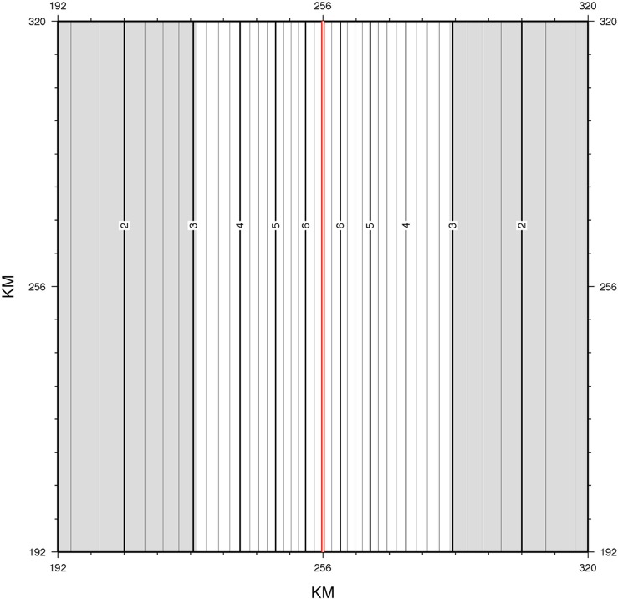
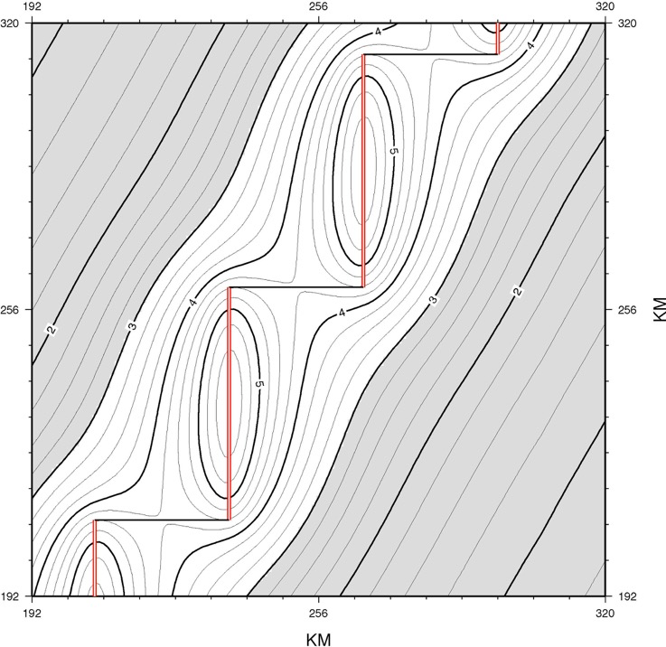
TOTAL VERTICAL MANTLE UPWELLING BETWEEN 6-60 KM DEPTH
UNSEGMENTED 2-D RIDGE
SEGMENTED 3-D RIDGE 52 X 30 KM
VOLUME RATE OF UPWELLING = 12,148 KM³/M.Y.
PEAK UPWELLING RATE = 6.37 KM³/M.Y.
VOLUME RATE OF UPWELLING = 8,671 KM³/M.Y.
PEAK UPWELLING RATE = 5.68 KM³/M.Y.
~ 30 % less upwelling generated by segmented ridge than unsegmented ridge
Notes:
A three-dimensional calculation of the total vertical advection generated by a segmented ridge (52 x 30 km) within the melting regime (60-6 km depth) shows about a 30% reduction in total vertical mantle advection. This translates directly into a 30 % crustal thickness reduction with no mantle temperature change. The reduction in melting and crustal thickness is due purely to the 3-D change in the pattern of mantle advection caused by ridge segmentation relative to a linear (2-D) ridge.

Slide 14
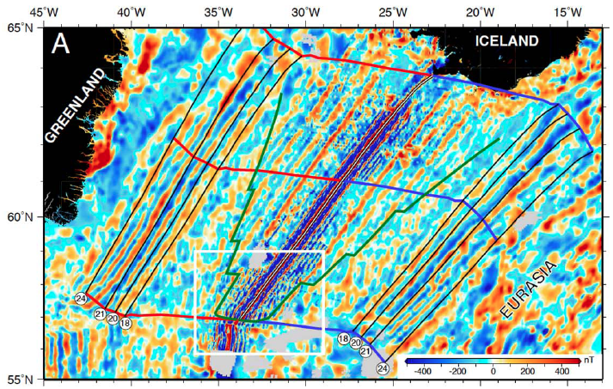
MAGNETIC ANOMALY
Notes:
The close geometric fit of Anomalies 24 to 18 to the rotated Reykjanes Ridge means that the present day Reykjanes Ridge reconfigured its geometry to closely conform to its original geometry and position at the time it formed, despite an intervening fragmentation of the plate boundary and ~30° rotation of the opening direction. It means that the present-day ridge is spreading 30° obliquely because it wants to maintain the original geometry it had with respect to the mantle despite the plates now opening obliquely to the original direction.

Slide 15
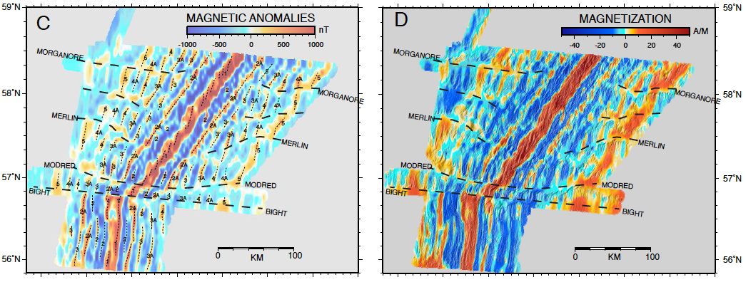
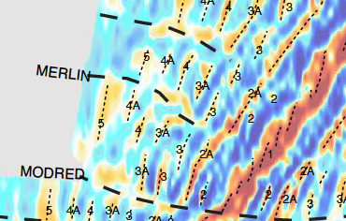
Magnetic isochrons show that ridge segments first migrate toward each other decreasing the offsets across transform faults and non-transform discontinuities. Then the ridge segments break up into smaller segments to form an oblique plate boundary zone.
Notes:
The elimination of the transform faults was not simply a brittle to ductile transition as inferred in plume thermal models.
Instead ridge segments migrated toward each other and toward their original locus to decrease the transform offsets.
Ridge segments then subdivided to the level of axial volcanic ridges arrayed en echelon to achieve an oblique plate boundary zone even as the individual axial volcanic ridges (AVRs) remain orthogonal to the spreading direction.

Slide 16
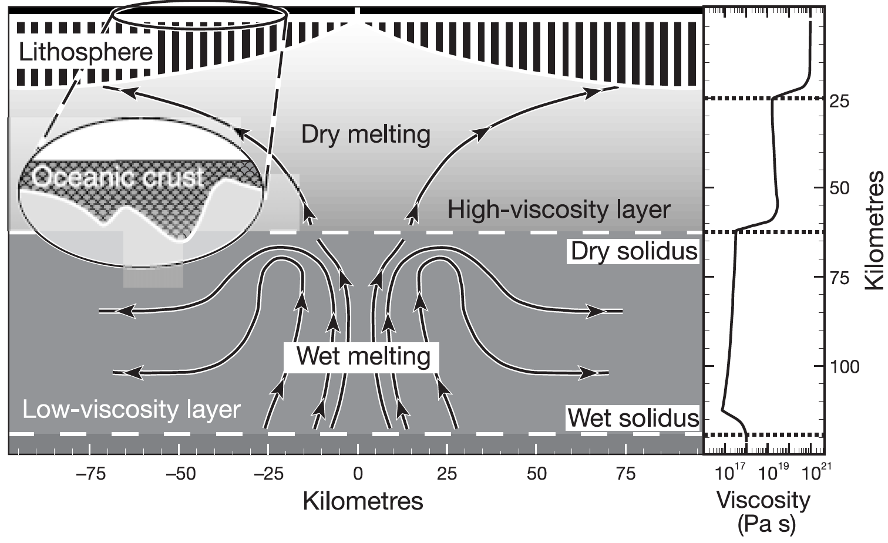
MANTLE FLOW AND VISCOSITY LAYERING
From Bonatti et al., 2003, Nature
Notes:
Viscosity structure of mantle:
Following an abrupt change in opening direction the upper high-viscosity mantle responded mechanically and broke into a new series of spreading segments orthogonal to the new opening direction.
The lower low-viscosity mantle was decoupled from this abrupt change and remained linear and guided the reassembly of the axis back toward its original configuration.

Slide 17
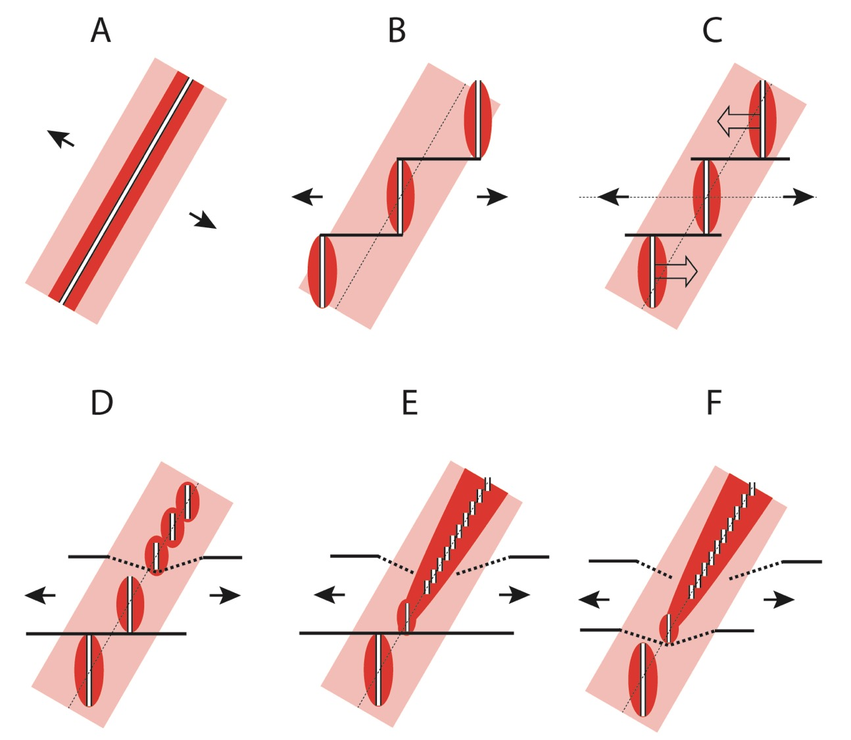
Notes:
In this map view depiction, the pink area represents the lower low-viscosity part of the melting regime and the red area the upper high-viscosity part of the melting regime.
When the abrupt change in opening direction occurred the upper high-viscosity layer reacted mechanically and broke into a new set of ridge segments oriented orthogonally to the new spreading direction.
The lower low-viscosity part of the mantle was decoupled from this abrupt change and persisted in its original configuration.
It guided the reassembly of the long linear axis even though it now had to spread obliquely to do this.

Slide 18
Notes:
V-shaped crustal ridges and troughs formed once the transform faults were eliminated. This has been explained in plume models as the result of thermal “pulses” embedded in mantle plume flow radiating outward from beneath Iceland and being entrained diachronously in ridge spreading.

Slide 19
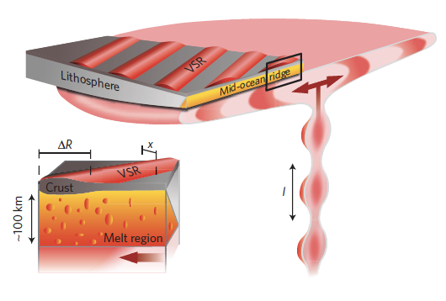
Pulsing plume model
Parnell-Turner et al., 2014
Nature Geoscience
Notes:
The prevalent plume model explains the V-shaped ridges as resulting from very high rates of upwelling within the plume stem with embedded thermal pulses.
The radially spreading part of the plume must be expanding at hundreds of mm/yr to account for the acute geometry of the V-shaped ridges with even faster rates of vertical advection within the plume stem due to radial spreading.
However, Ito (2001) calculated that such high rates of upwelling would produce hundreds of km of crustal thickness if allowed to cross the solidus.
He proposed that a high viscosity dehydration layer was required to laterally deflect the plume before crossing the solidus and that only the plate-driven component of extension would allow some hot plume material to be advected above the solidus and melt.
This component of plume mantle, advected diachronously into the ridge melting regime as the solid-state plume spreads radially beneath the solidus, forms the V-shaped crustal ridges and troughs.
Such a model, however, if generalized to other hotspots such as Hawaii would completely prevent plume melting since there is no ridge beneath Hawaii to provide the space and plate divergence needed for mantle advection above the solidus.
Thus the mantle dehydration model (Ito, 2001) would predict no mantle melting beneath intraplate plumes such a proposed for Hawaii.
References:
Ito, G. (2001), Reykjanes 'V'-shaped ridges originating from a pulsing and dehydrating mantle plume, Nature, 411(6838), 681-684.
Parnell-Turner, R., White, N., Henstock, T., Murton, B., Maclennan, J., and Jones, S. M. (2014), A continuous 55-million-year record of transient mantle plume activity beneath Iceland, Nature Geosci, 7(12), 914-919.

Slide 20
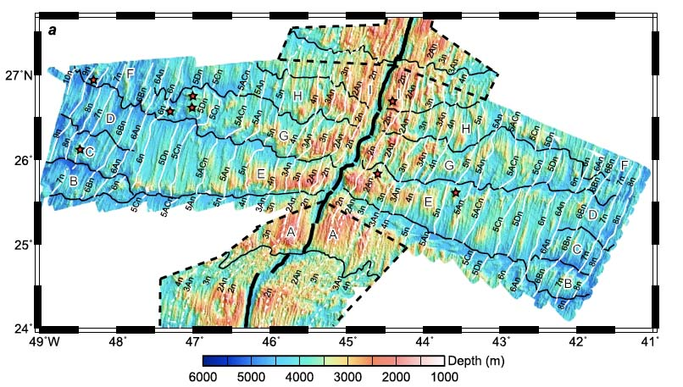
Wang, Tucholke & Lin, 2015, JGR
Notes:
Normal slow spreading ridges are underlain by cells of small-scale convection that produce crustal segmentation whether or not the axis is offset.
These segments of the Mid-Atlantic Ridge near 25°N have little to no offsets yet produce variations in crustal thickness of two km or more, the same as the Reykjanes Ridge V-shaped ridges.
These non-transform discontinuities migrate along axis, both to the north and south so are not propelled by a regional mantle flow.
They appear to migrate in response to small random variations in mantle properties, as they are not parallel to plate spreading flow lines (Wang et al., 2015).
Reference:
Wang, T., Tucholke, B. E., and Lin, J. (2015), Spatial and temporal variations in crustal production at the Mid-Atlantic Ridge, 25°N–27°30′N and 0–27 Ma, Journal of Geophysical Research: Solid Earth, 120(4), 2119-2142.

Slide 21
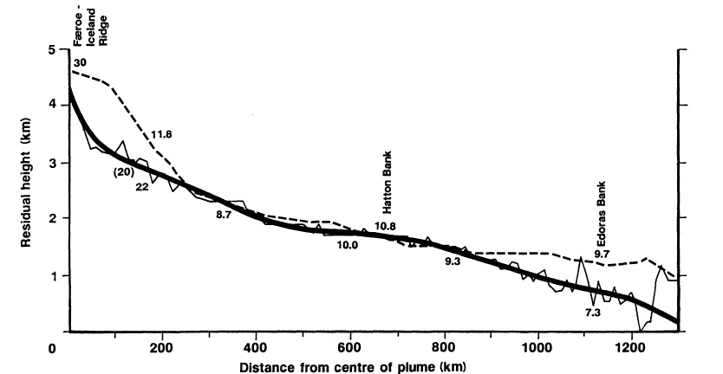
Residual Depth Anomaly
R. White, Phil. Trans. R. Soc. Lond., 1997
Notes:
In contrast, the Reykjanes Ridge has strong systematic variations in mantle properties as shown by the basement residual depth anomaly away from Iceland.
The profiles show a long-lived gradient from near the margin (dashed) to the present-day axis (heavy solid line).
Reference:
White, R. S. (1997), Rift-Plume Interaction in the North Atlantic, Philosophical Transactions: Mathematical, Physical and Engineering Sciences, 355(1723), 319-339.

Slide 22
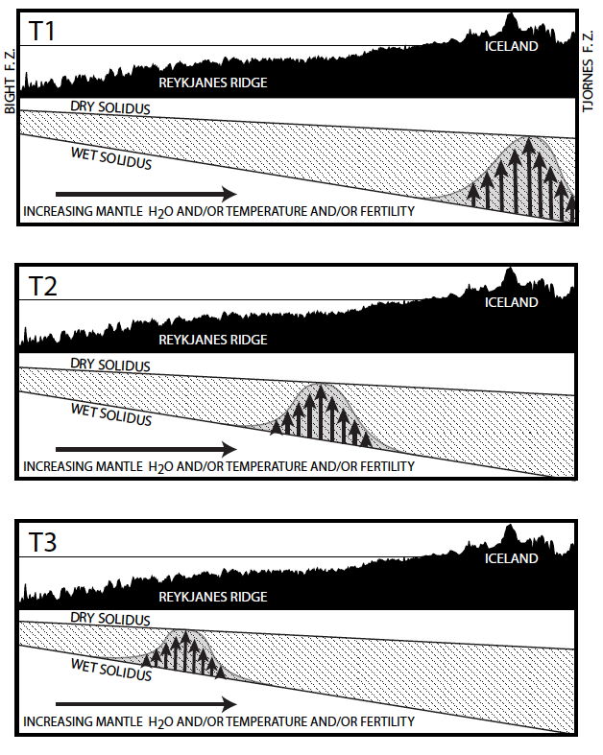
Sub-axial propagating buoyant mantle upwelling
At time T1 buoyant upwelling initiates beneath Iceland and begins to propagate southward as shown in panels T2 and T3.
The southward propagation is driven by gradients in mantle properties including elevated mantle water content and possibly temperature and fertility increasing toward Iceland.
An important feature of this model is that buoyant mantle flow is upward beneath the axis not along-axis. Thus extremely rapid radial mantle flow inherent in pulsing plume modes is not needed.
Propagating buoyant mantle instabilities can generate V-shaped crustal ridges without any mantle temperature variations and without any large-scale mantle flow.
Notes:
Given the long-lived, strong and monotonic gradient in mantle properties indicated by the residual depth anomaly, small-scale convective cells should propagate rapidly and monotonically southward along the Reykjanes Ridge axis in a wave-like manner. Since it is only the upwelling instability that migrates, along-axis flow is not implied by this model. Thus extremely rapid plume upwelling beneath Iceland is not needed and a dehydration layer to deflect the plume (Ito, 2001) is obviated.
This model also does not imply mantle temperature variations since the variations in crustal thickness are caused by greater upwelling rate beneath the small-scale convective cells, not greater temperature (Martinez and Hey, 2017).
References:
Ito, G. (2001), Reykjanes 'V'-shaped ridges originating from a pulsing and dehydrating mantle plume, Nature, 411(6838), 681-684.
Martinez, F., and Hey, R. (2017), Propagating buoyant mantle upwelling on the Reykjanes Ridge, Earth and Planetary Science Letters, 457, 10-22.

Slide 23
The V-shaped ridges on the Reykjanes Ridge and migrating non-transform discontinuities on slow-spreading ridges are fundamentally similar phenomena. On the Reykjanes Ridge a large and systematic mantle gradient propels small-scale convective instabilities rapidly and monotonically along axis whereas on the slow spreading central Mid-Atlantic ridge mantle gradients are small and random leading to slowly and randomly propagating cells.
Notes:
Atlantic 24-28°N figure from Wang et al., (2015)
Reference:
Wang, T., Tucholke, B. E., and Lin, J. (2015), Spatial and temporal variations in crustal production at the Mid-Atlantic Ridge, 25°N–27°30′N and 0–27 Ma, Journal of Geophysical Research: Solid Earth, 120(4), 2119-2142.

Slide 24
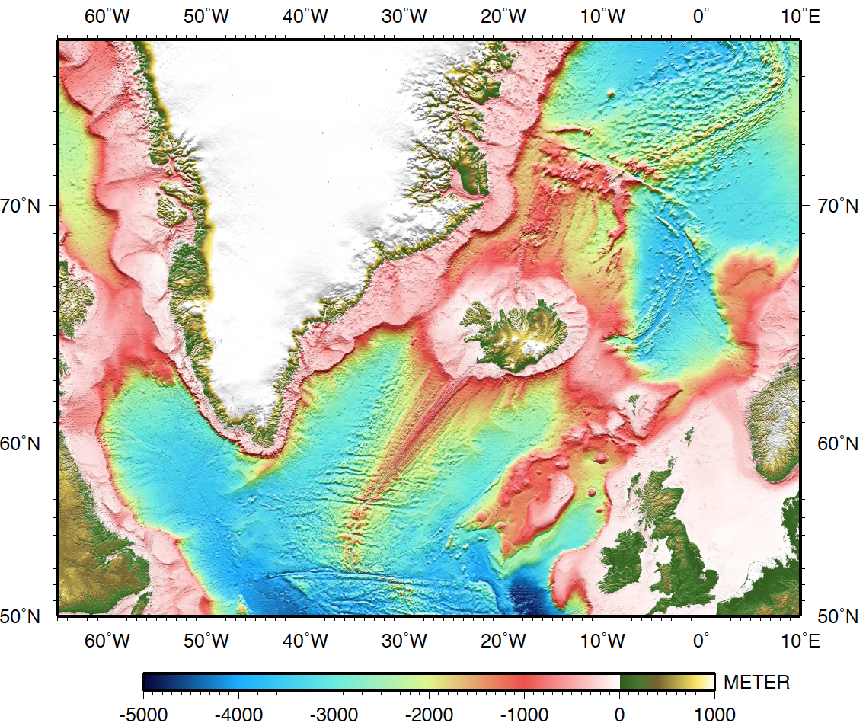
GREENLAND
ICELAND
EURASIA
NORTH
AMERICA
Notes:
The regional bathymetry of the North Atlantic basin indicates that there is anomalous mantle centered beneath Iceland.
What could cause this if not a plume?

Slide 25
Scott W. French & Barbara Romanowicz, Nature, 2015
Notes:
Recent global tomographic studies image what they interpret as broad thermo-chemical anomalies in the mantle (on the order of 1000 km in width) extending from the core to the lithosphere.
If these images are accurate, they suggest that “plumes” are not narrow rapidly rising jets, but in fact are very slowly advecting broad thermochemical anomalies.
Their size and geometry suggests relatively long-lived and passive features compared to upper mantle and lithospheric dynamics (French & Romanowicz, 2015).
Reference:
French, S. W., and Romanowicz, B. (2015), Broad plumes rooted at the base of the Earth's mantle beneath major hotspots, Nature, 525(7567), 95-99.

Slide 26
SUMMARY & CONCLUSION
Dynamic behavior attributed to the Iceland mantle plume is actually due to plate boundary processes and shallow small-scale mantle convection that can evolve quickly. Broad thermo-chemical plumes can only slowly advect and evolve. The direct cause of excess “plume” melting is shallow small-scale convection acting on an anomalously low viscosity and fertile but relatively passive thermochemical mantle anomaly.
Notes:
Dynamic behavior attributed to the Iceland mantle plume is actually due to kinematic effects, plate boundary processes and shallow small-scale mantle convection, which are processes that can evolve quickly. Broad (on the order of 1000 km) and deep mantle thermo-chemical anomalies (as inferred tomographically) can only slowly advect and evolve, and are likely relatively passive features compared to lithospheric and upper mantle dynamics. The direct cause of excess “plume” melting is shallow small-scale convection acting on an anomalously low viscosity and fertile but relatively passive thermochemical mantle anomaly.

