Slide 1
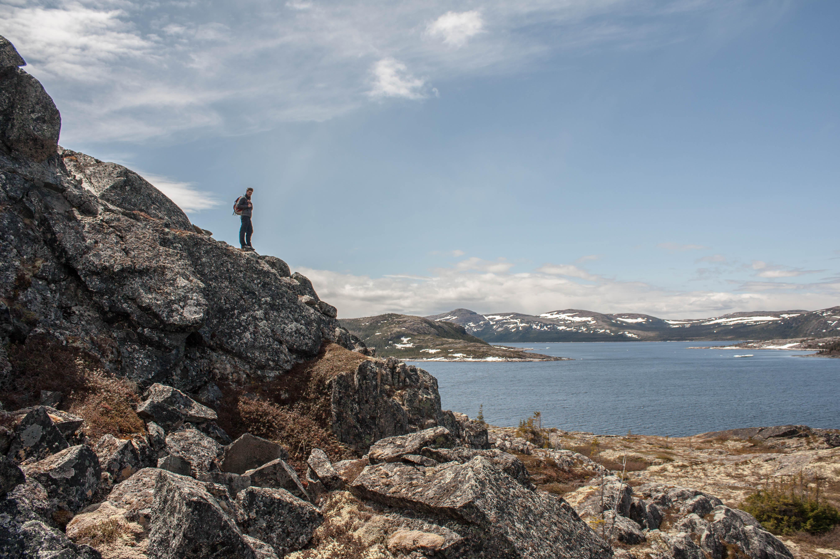
Onshore deformation associated with the opening of the Labrador Sea from the Aillik Domain of the Makkovik Province, Labrador, Canada
Alex Peace¹, Edward Dempsey², Ken McCaffrey², Jonny Imber², Jordan Phethean² & Kim Welford¹
¹Memorial University of Newfoundland, Canada
²Durham University, UK

Slide 2
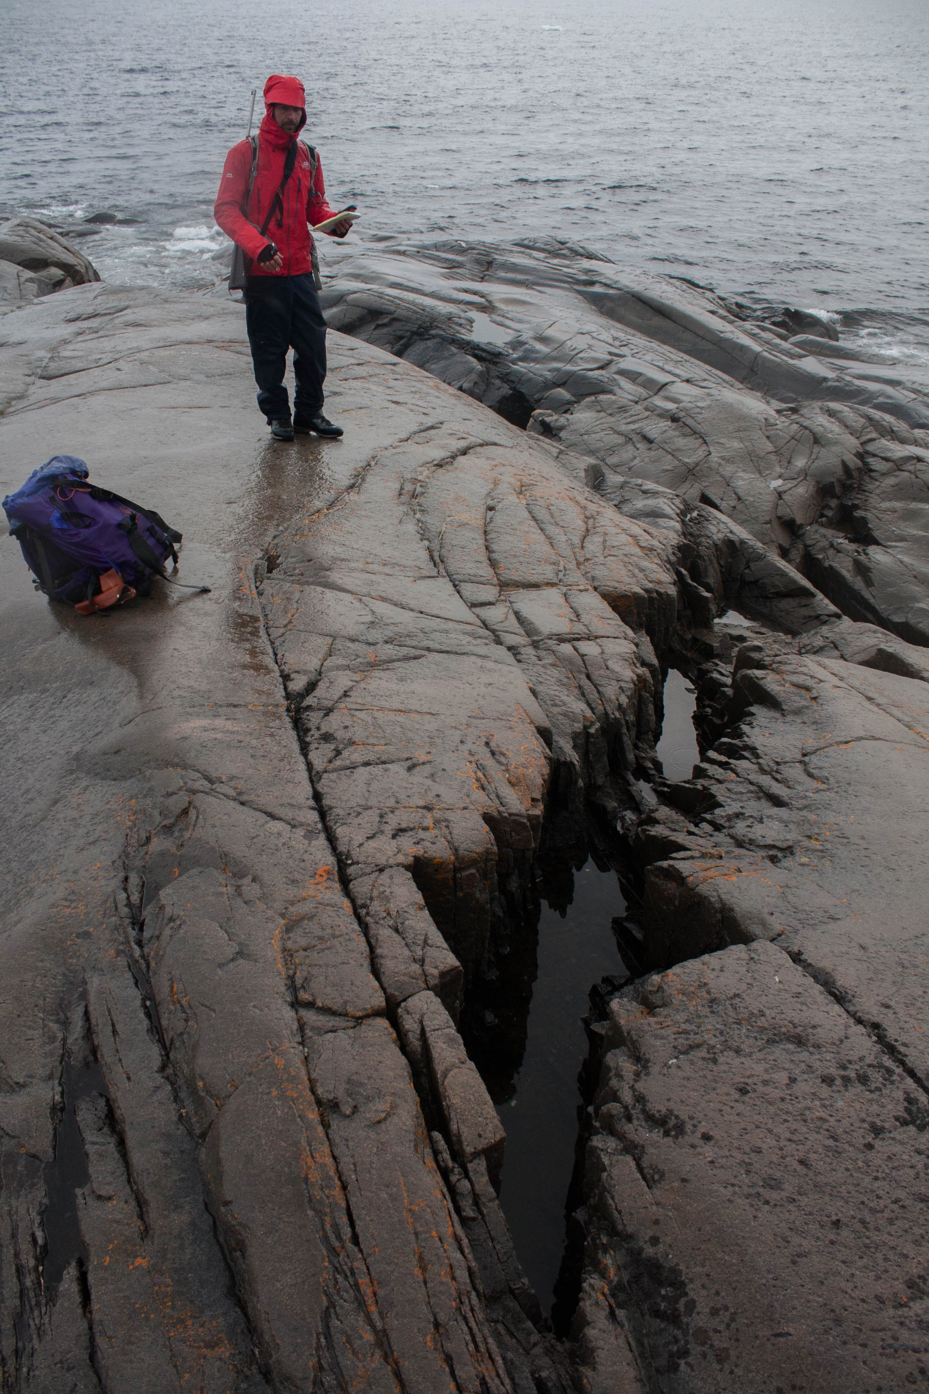
Presentation Outline
Aims, Context & Rationale
Study Area and Geological Setting
Approach and Methodology
Field Observations
Stress Inversion
MOVE Deformation Model
Conclusions
Future Research
South of Ikey’s Point, Labrador

Slide 3
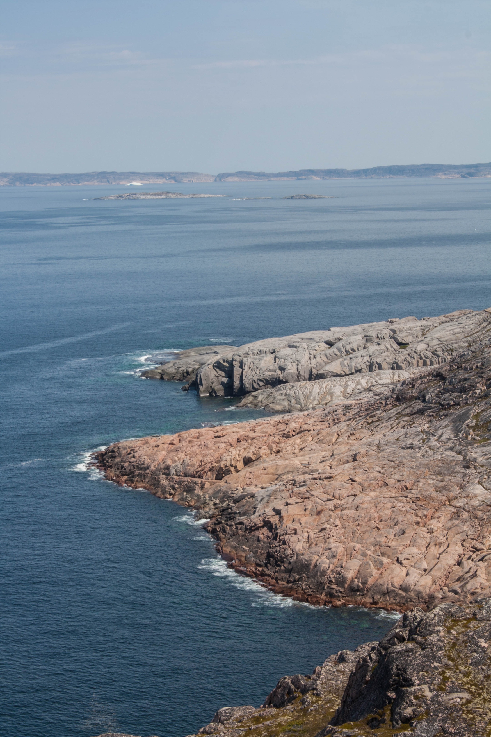
Study Context
In June and July 2015 4 weeks fieldwork was conducted in the Aillik Domain of the Makkovik Province, Labrador
The main aim of this study was to reevaluate the proposed Mesozoic rift-related magmatism
Presented here are the supplementary structural results collected alongside the aforementioned study
Cape Strawberry, Labrador

Slide 4
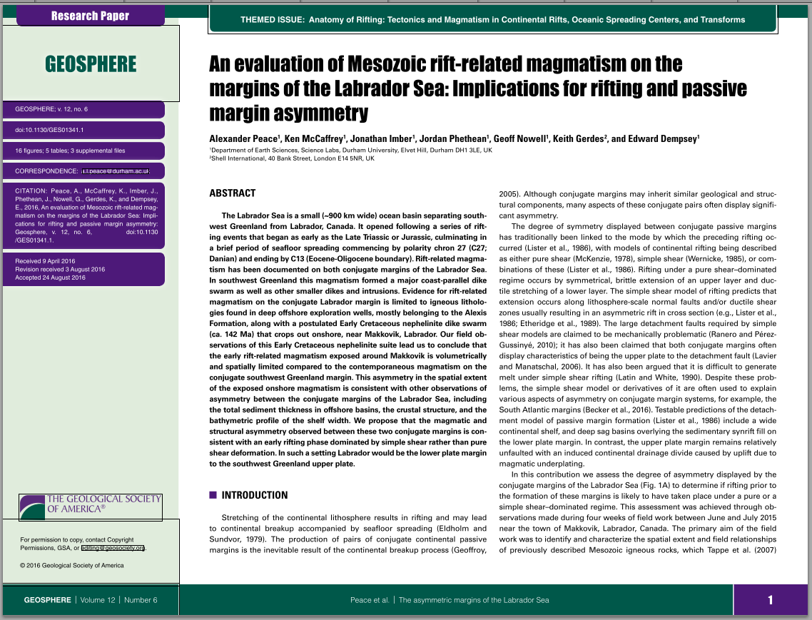
Study Context
In June and July 2015 4 weeks fieldwork was conducted in the Aillik Domain of the Makkovik Province, Labrador
The main aim of this study was to reevaluate the proposed Mesozoic rift-related magmatism
Presented here are the supplementary structural results collected alongside the aforementioned study
Cape Strawberry, Labrador

Slide 5
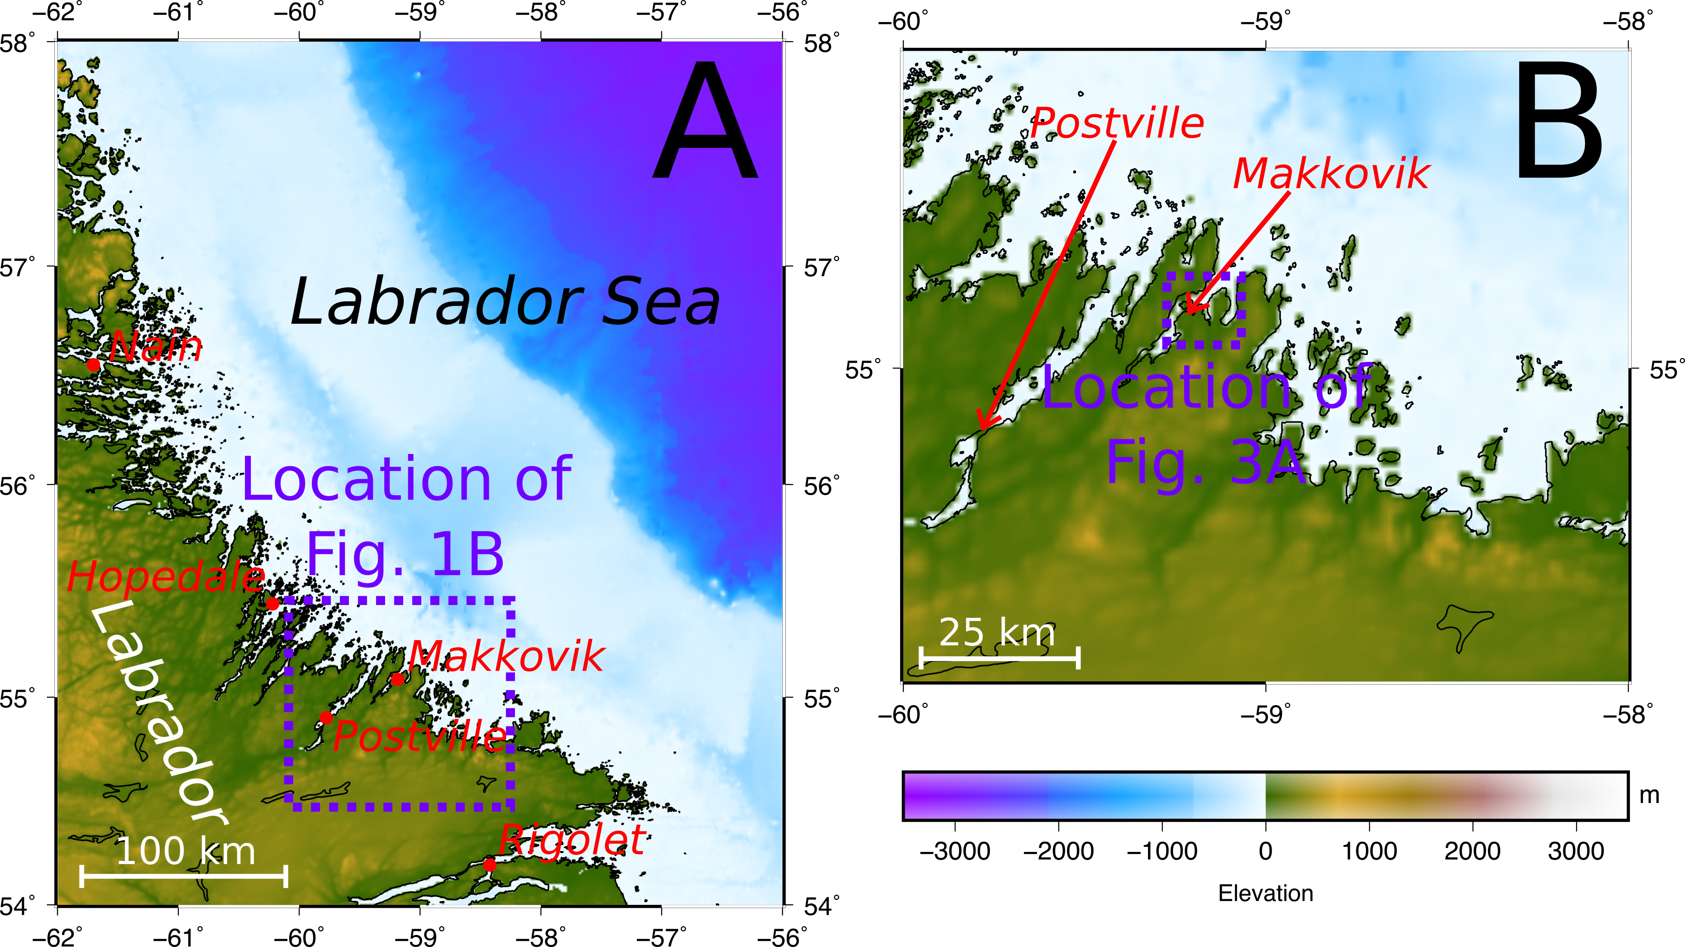
Study Area - Makkovik, Labrador

Slide 6
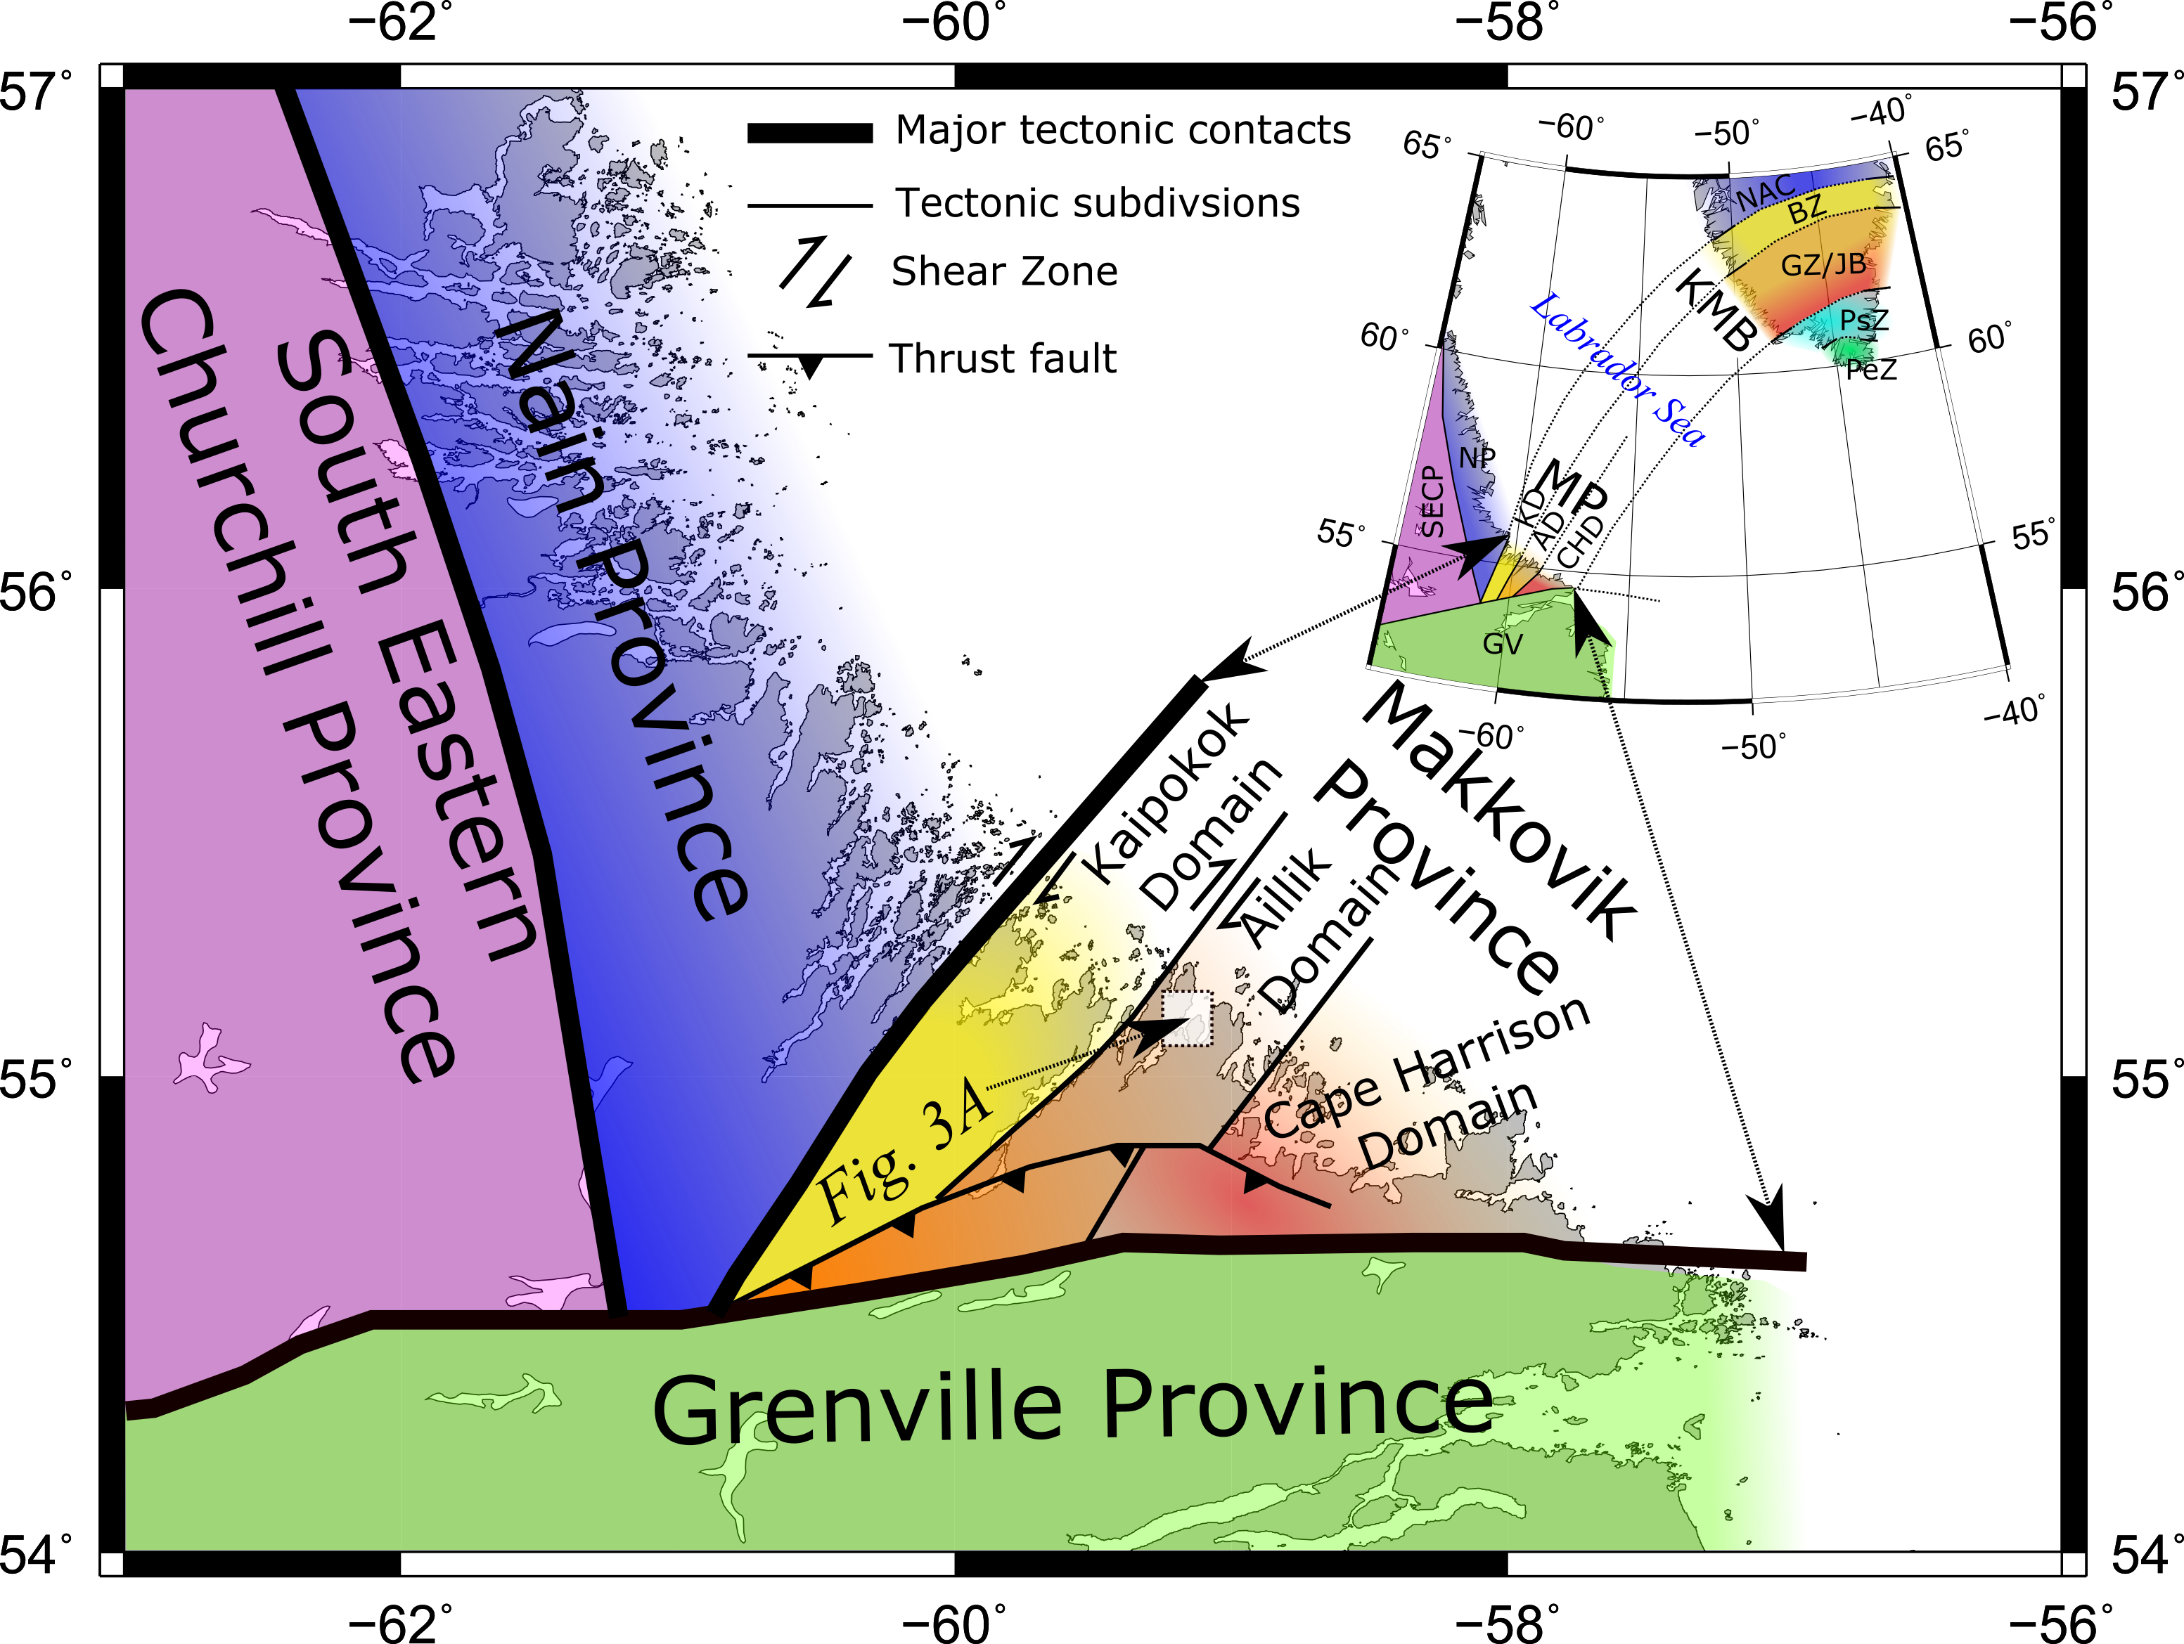
Geological Setting - The Makkovik Province

Slide 7
Rationale - Onshore structural studies in West Greenland
Previous work identifies the role of pre-existing structures in W.Greenland (Wilson et al., 2006)
Stress Inversion has been conducted in W.Greenland (Abdelmalak et al., 2012)
However, it has been suggested that different structural regimes were in operation on the conjugate margins during rifting (Peace et al., 2016)
Wilson et al. (2006)
Abdelmalak et al. (2012)
Peace et al. (2016)

Slide 8
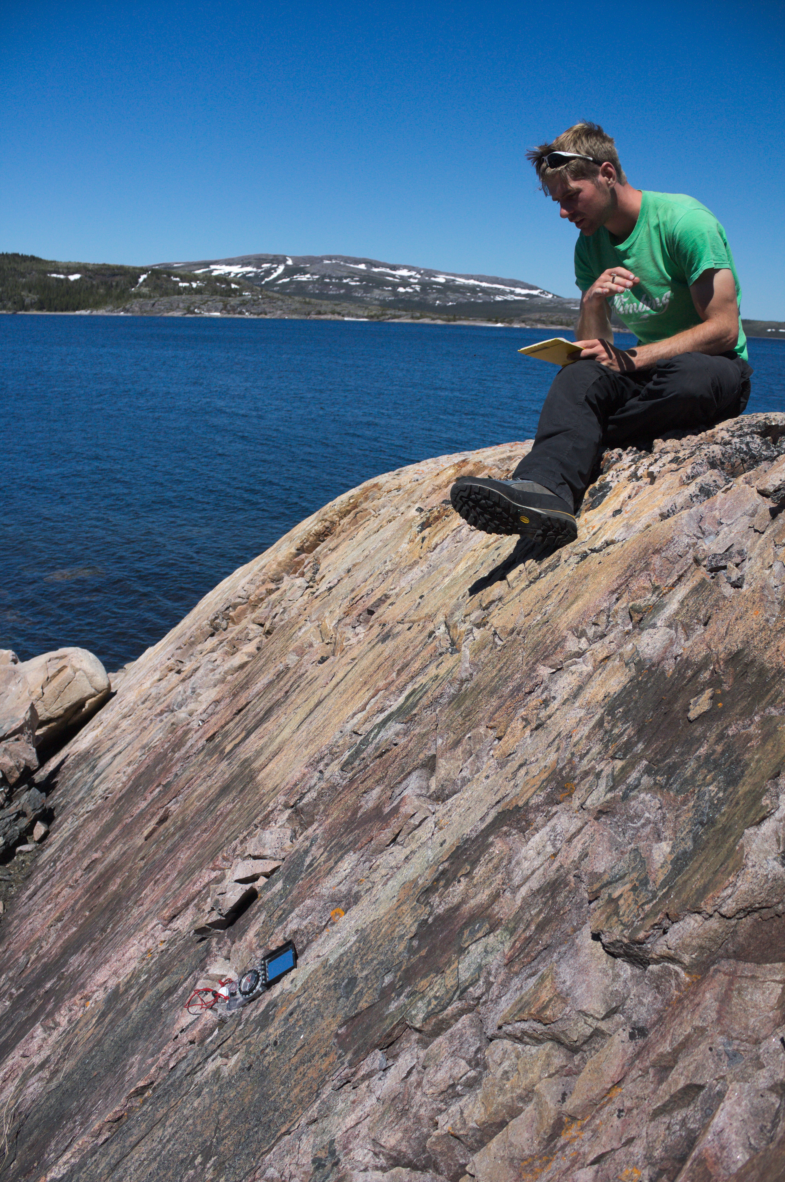
Study Aims
Characterise the structures that predate Mesozoic rifting (basement)
Understand the relationship of such structures to subsequent rifting
Identify any onshore deformation associated with the opening of the Labrador Sea
Peninsula north of Makkovik

Slide 9
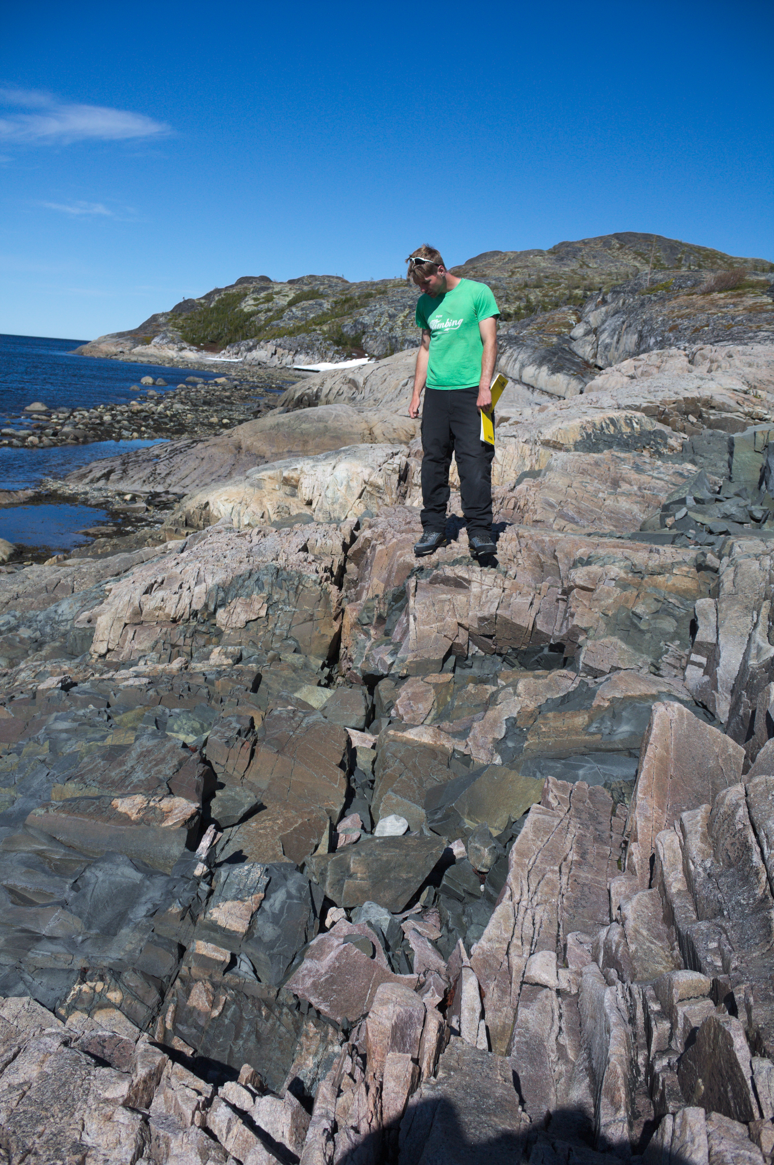
Approach and Methodology
Basement fabric
Measurements taken across a wide area in multiple lithologies within the Aillik Domain
Brittle deformation
Deformation with Kinematic indicators:
Paleostress analysis - ‘MyFault’ by Pangea Scientific
Comparison with paleostress analysis conducted elsewhere on the margins of the Labrador Sea
MOVE Structural reactivation modelling
Peninsula north of Makkovik

Slide 10
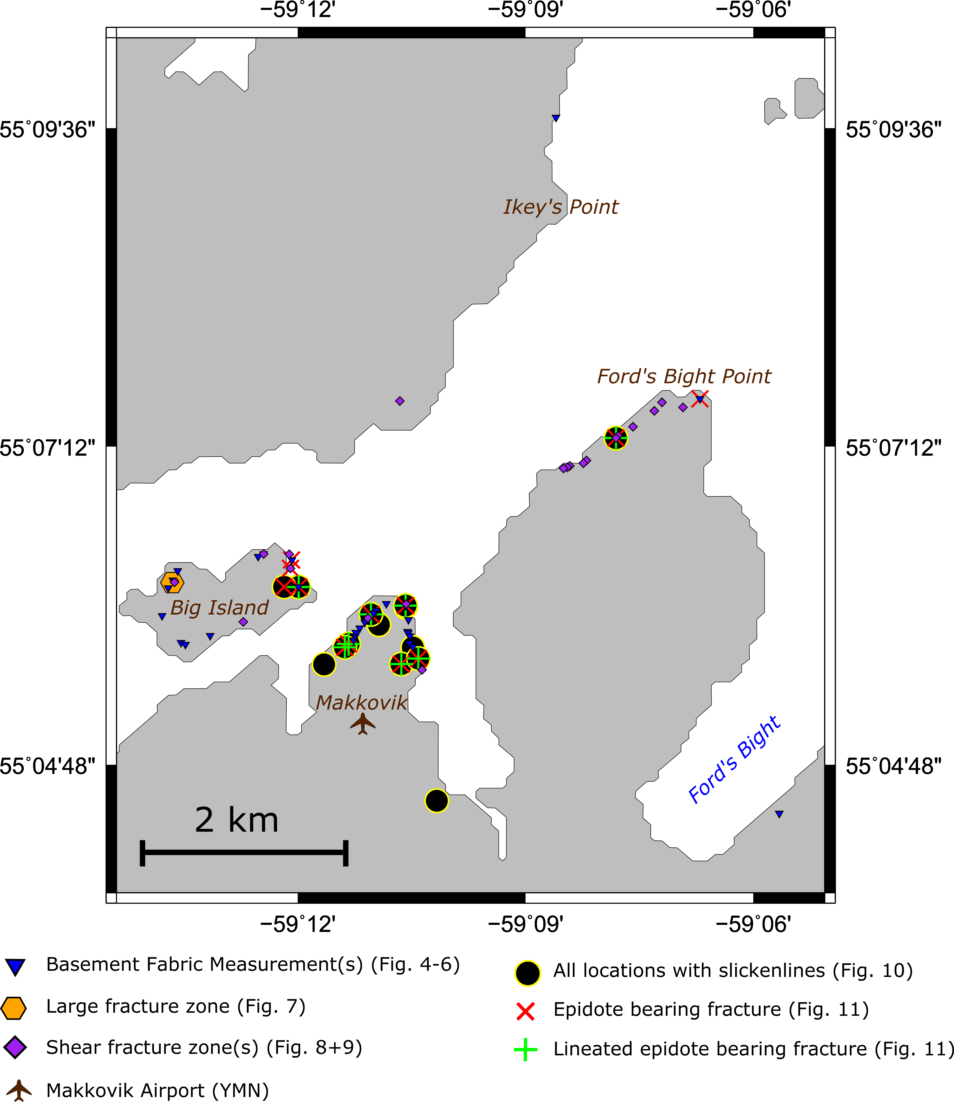
Sample and data collection locations

Slide 11
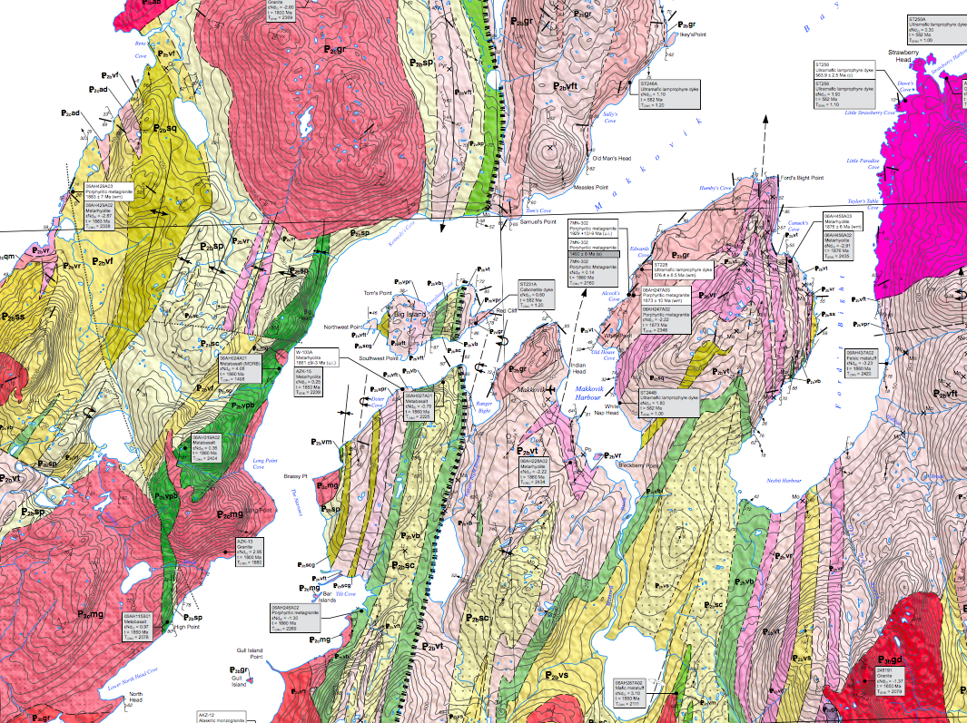

Slide 12
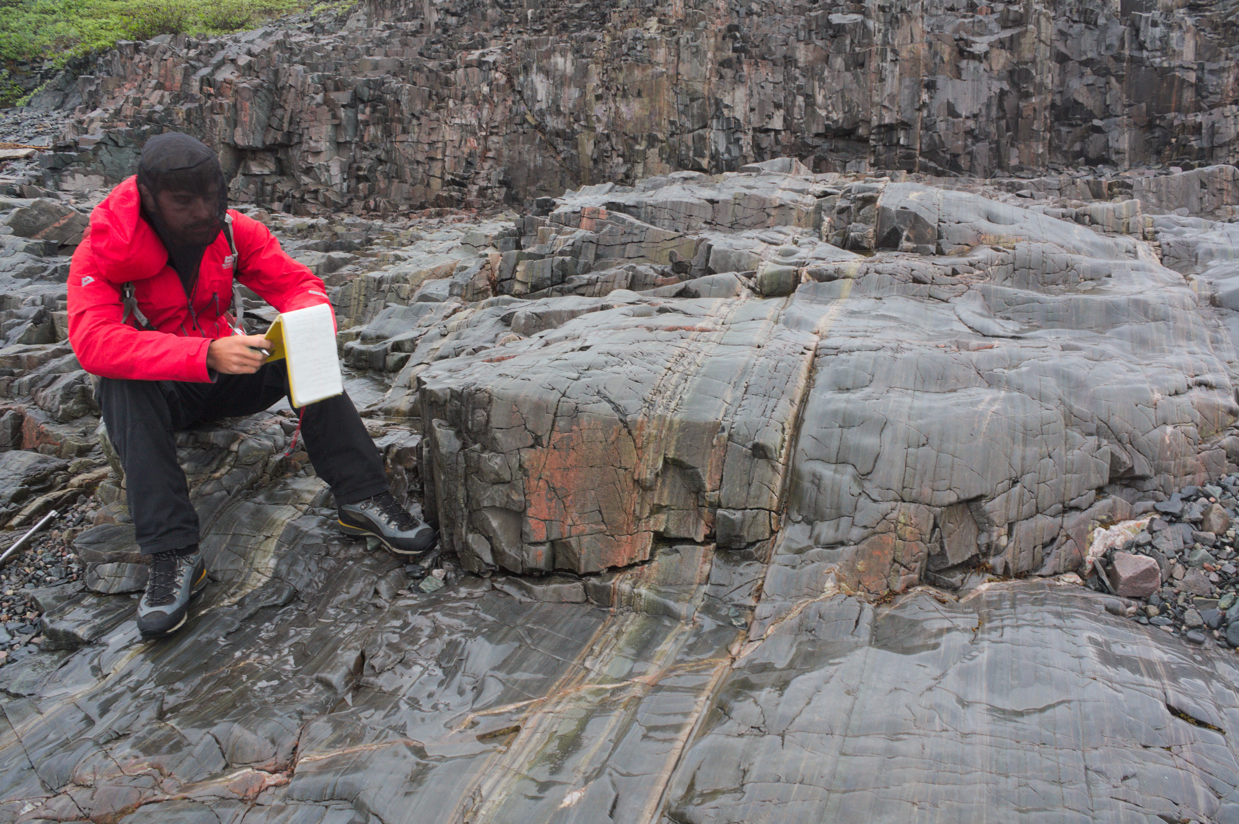

Slide 13
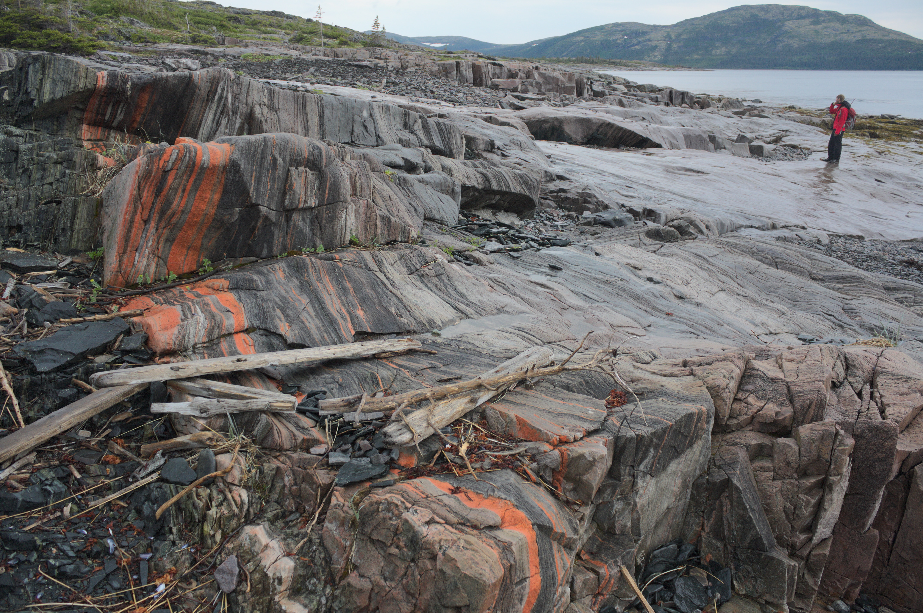

Slide 14
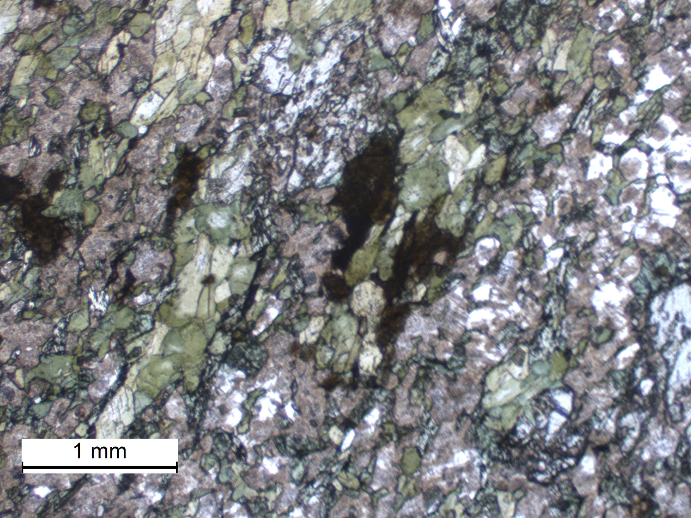

Slide 15
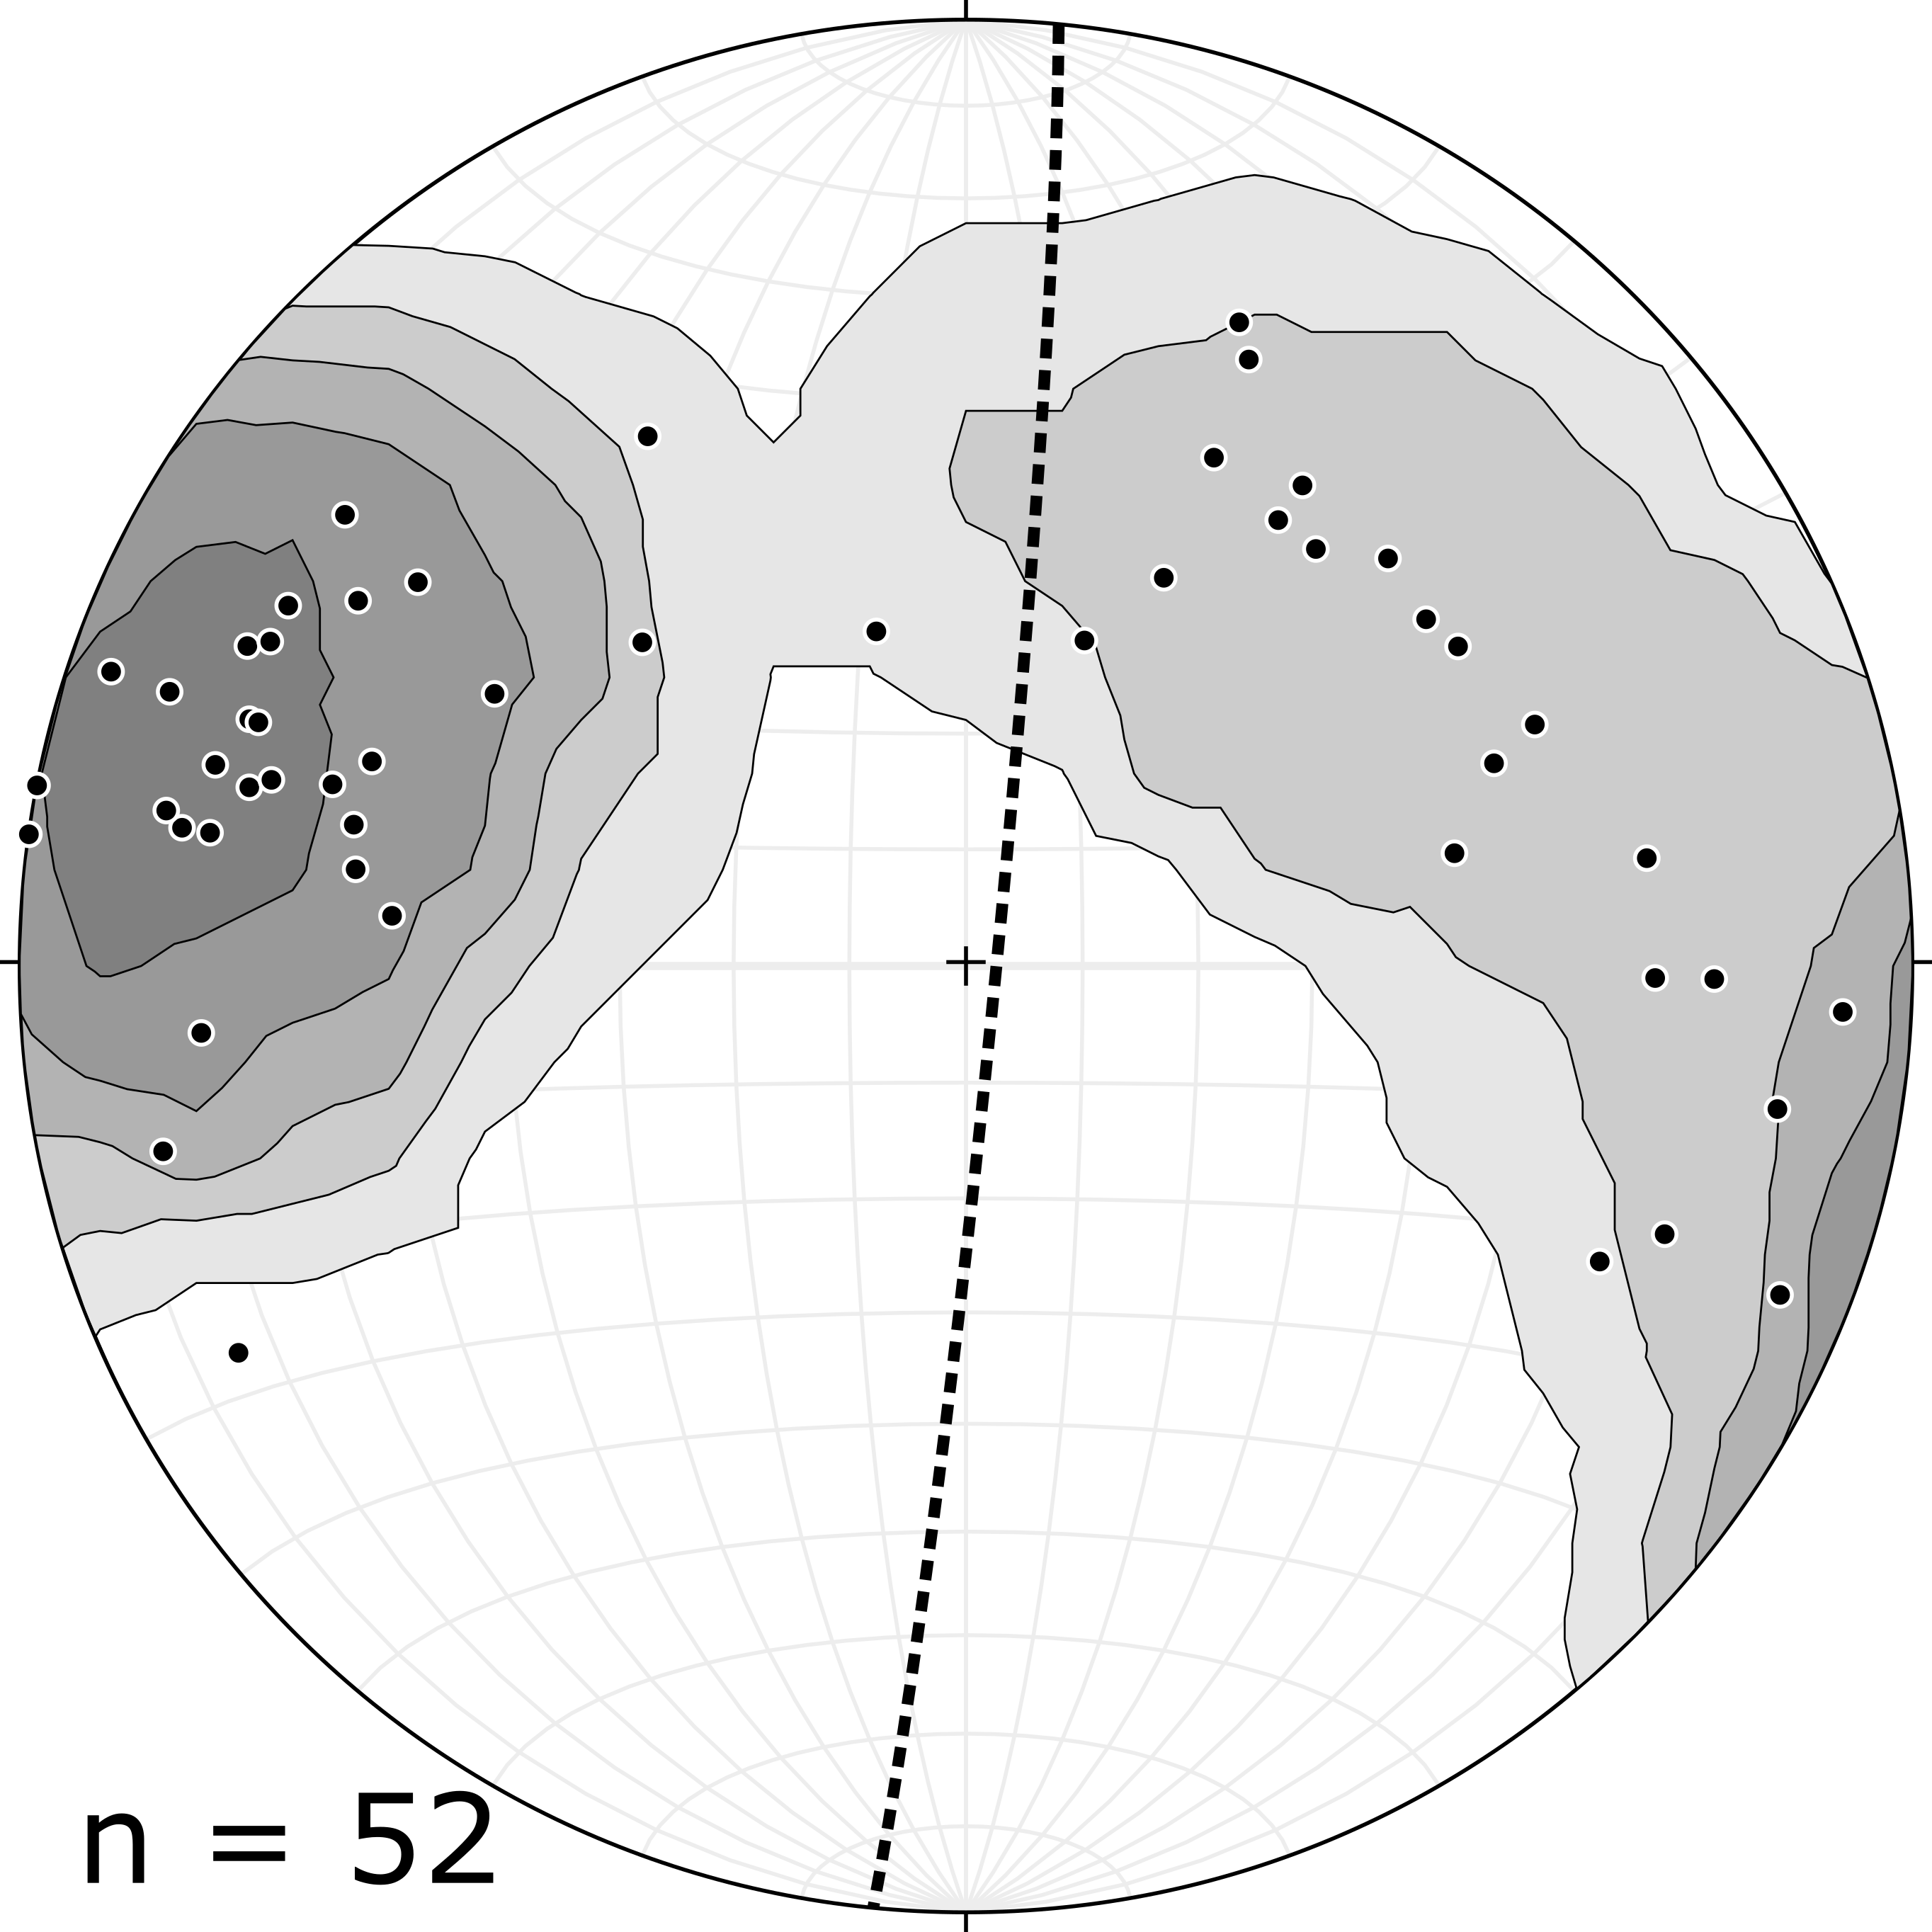
Planes to poles stereonet of Aillik Domain basement fabric measurements
Dominant structural trend of folding with E-W dipping limbs
2σ contour intervals
Axial plane for data calculated as: 005/87 E using Stereonet software for OSX (Cardozo and Allendinger, 2013)

Slide 16
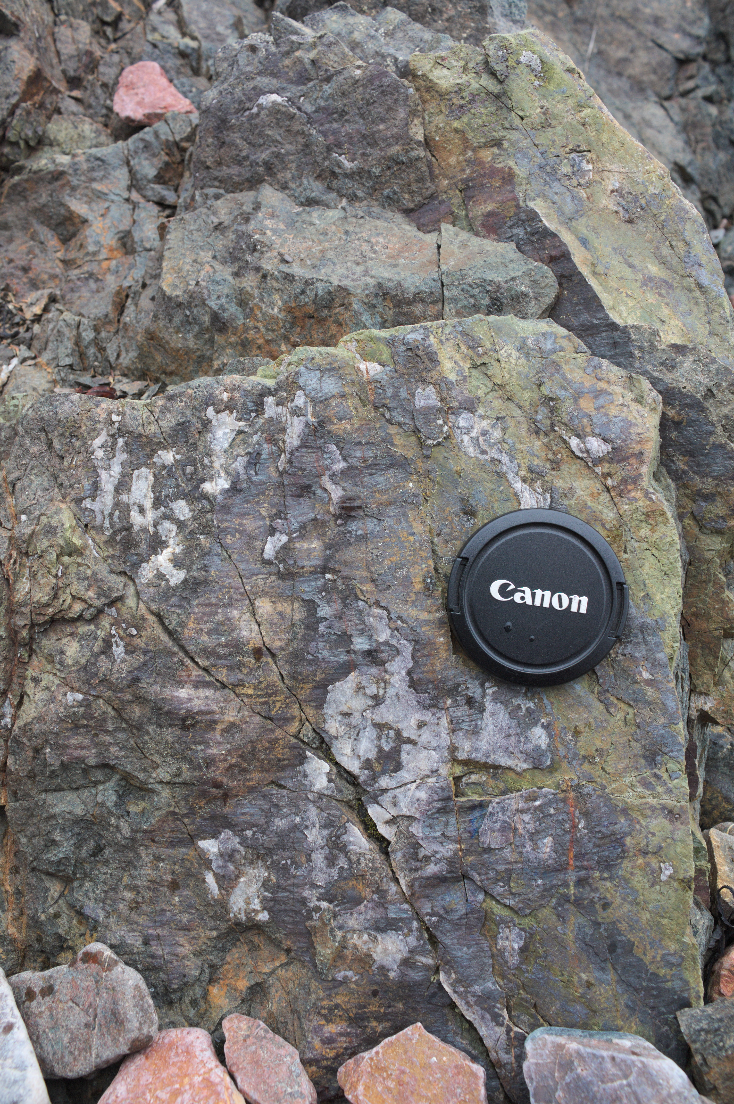
Brittle deformation with observable kinematic indicators
Brittle deformation is widespread but reliable kinematic indicators are surprisingly rare
Some of the deformation with kinematic indicators was associated with significant epidote dominated mineralization, whilst at other locations minimal mineralisation was observed
Epidote dominated mineralization usually associated with proximity to mafic dykes the youngest of which are ~550 - 590 Ma

Slide 17
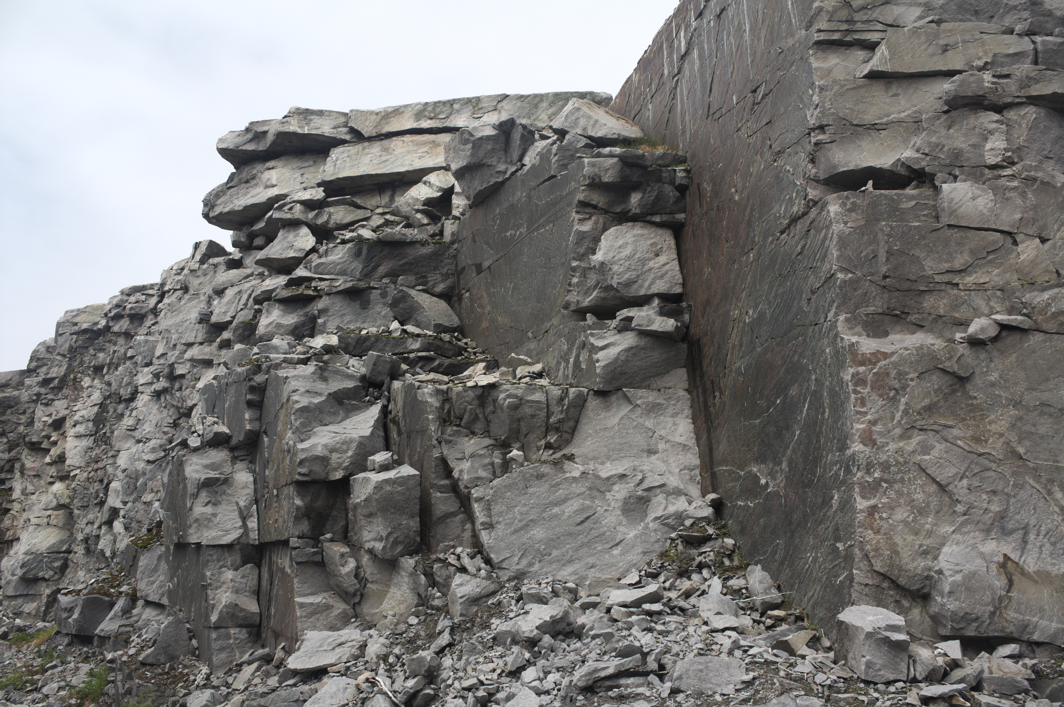
Makkovik Quarry

Slide 18
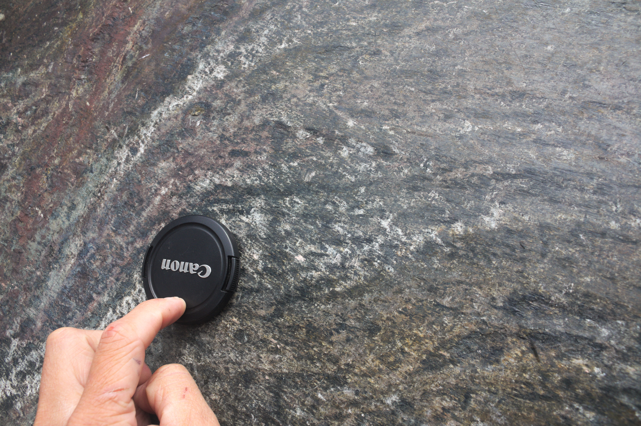
Slicken lines in Makkovik Quarry

Slide 19
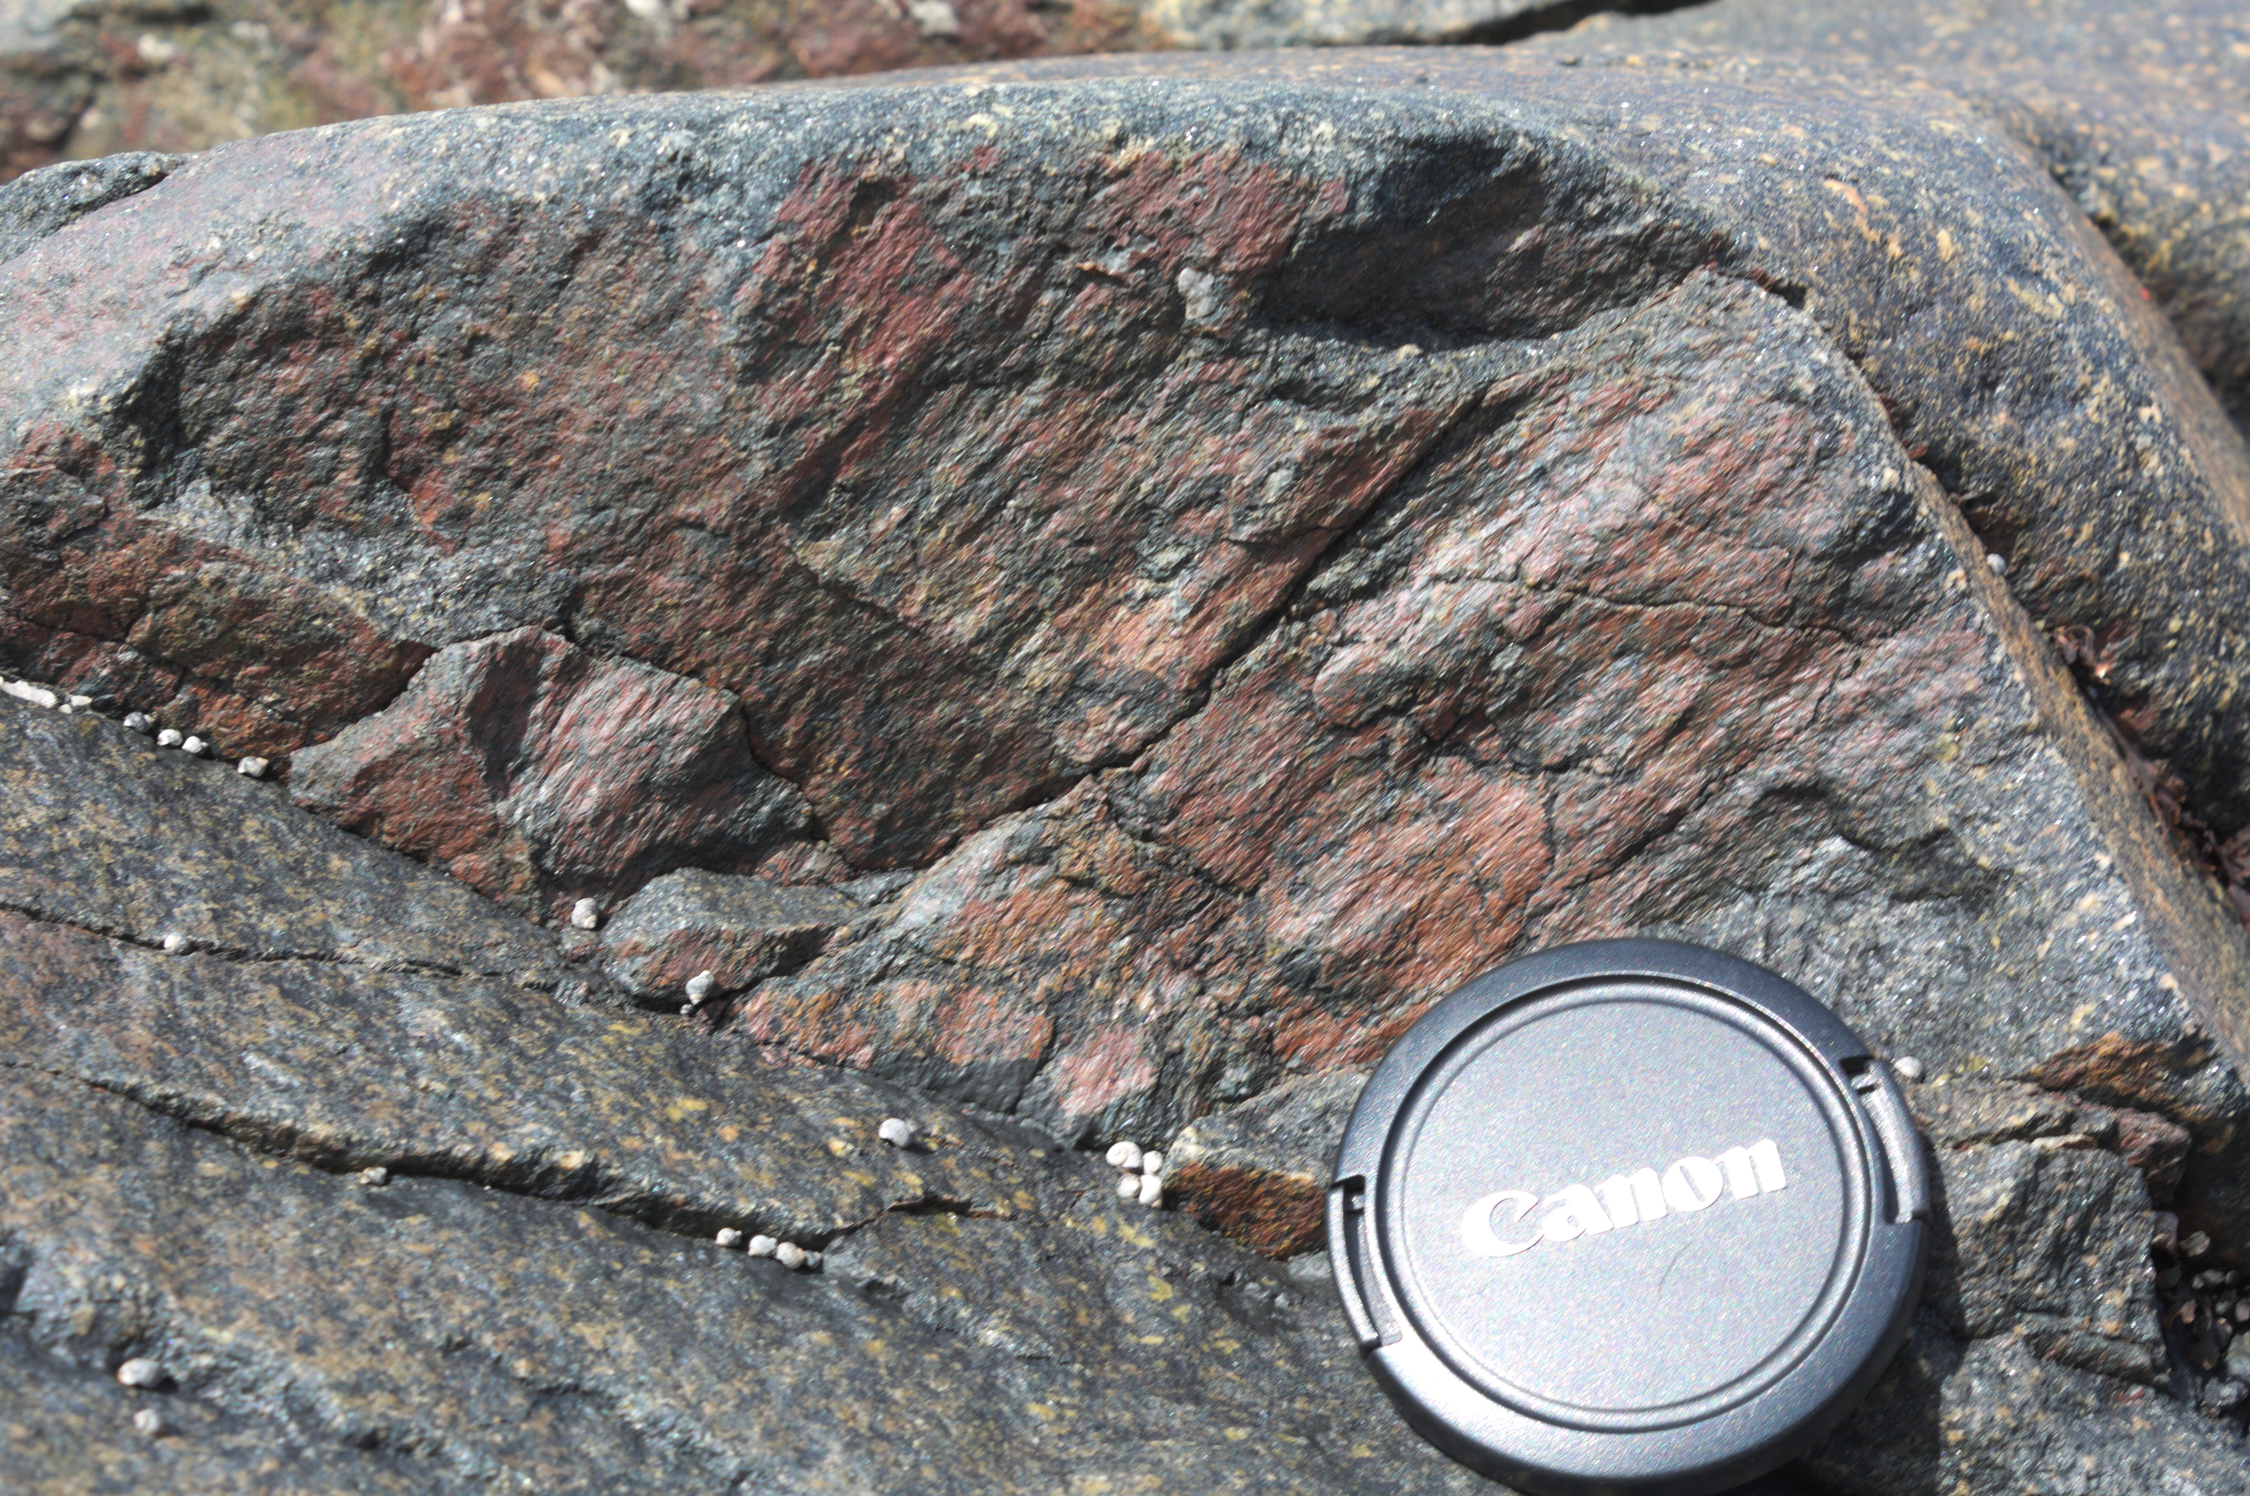
Slicken lines on Big Island

Slide 20
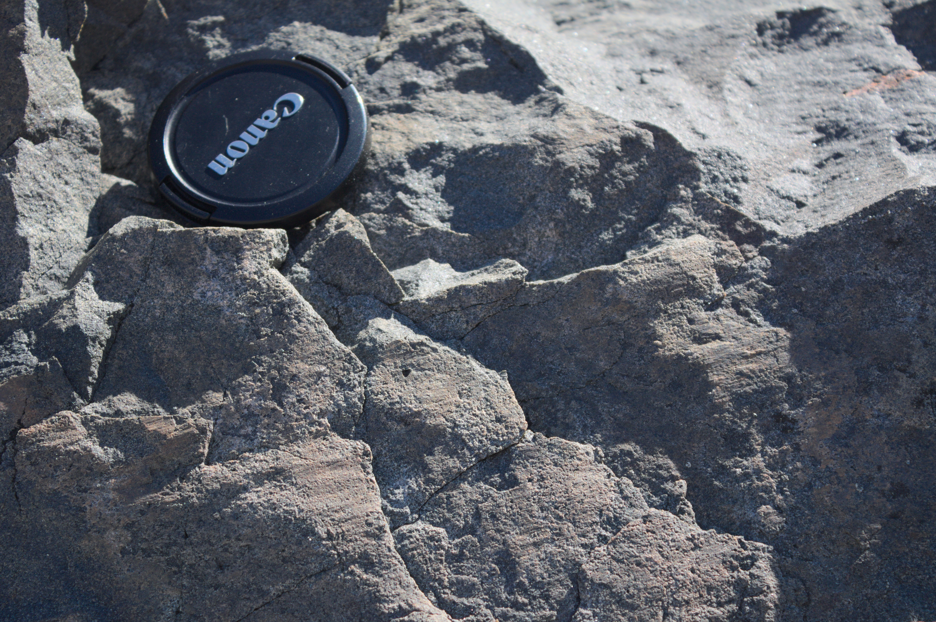
Slicken lines on Makkovik Peninsula

Slide 21
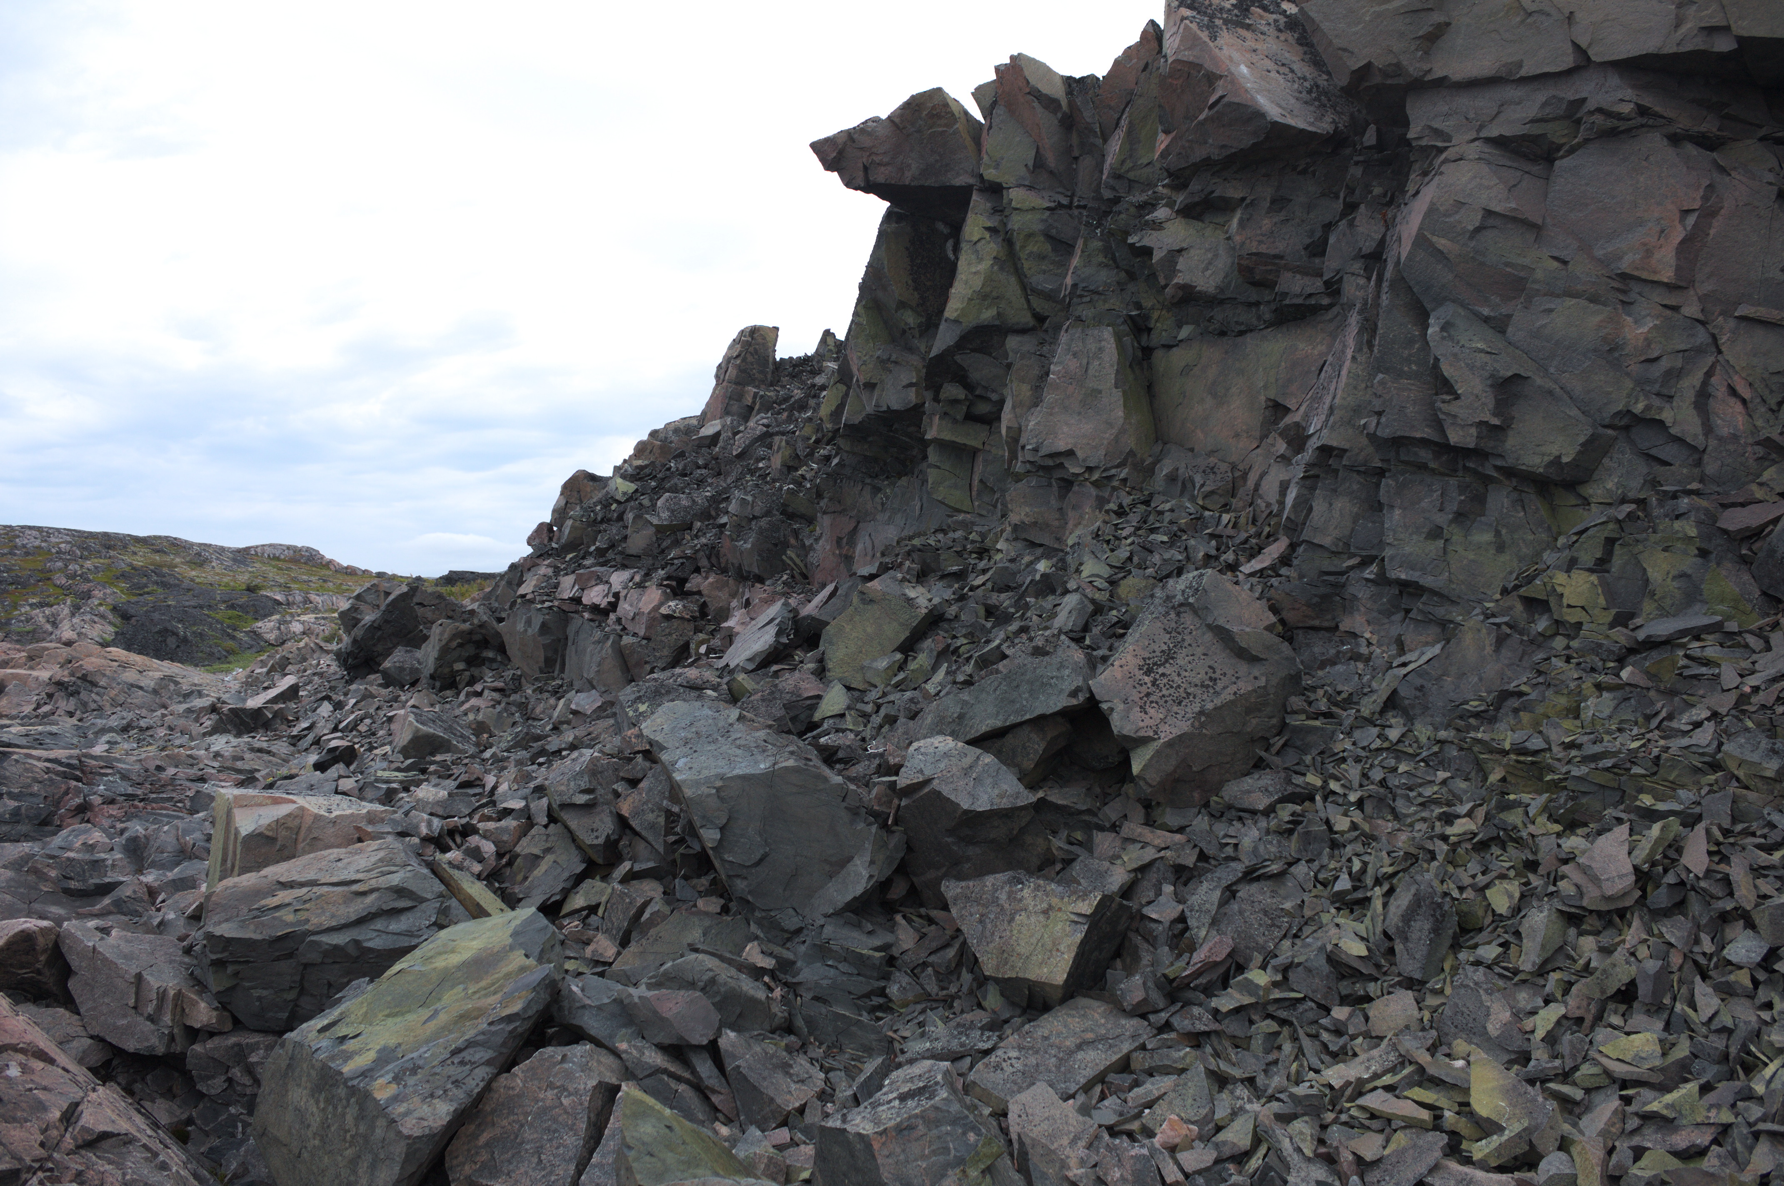
Damage zone on Big Island with abundant slip surfaces

Slide 22
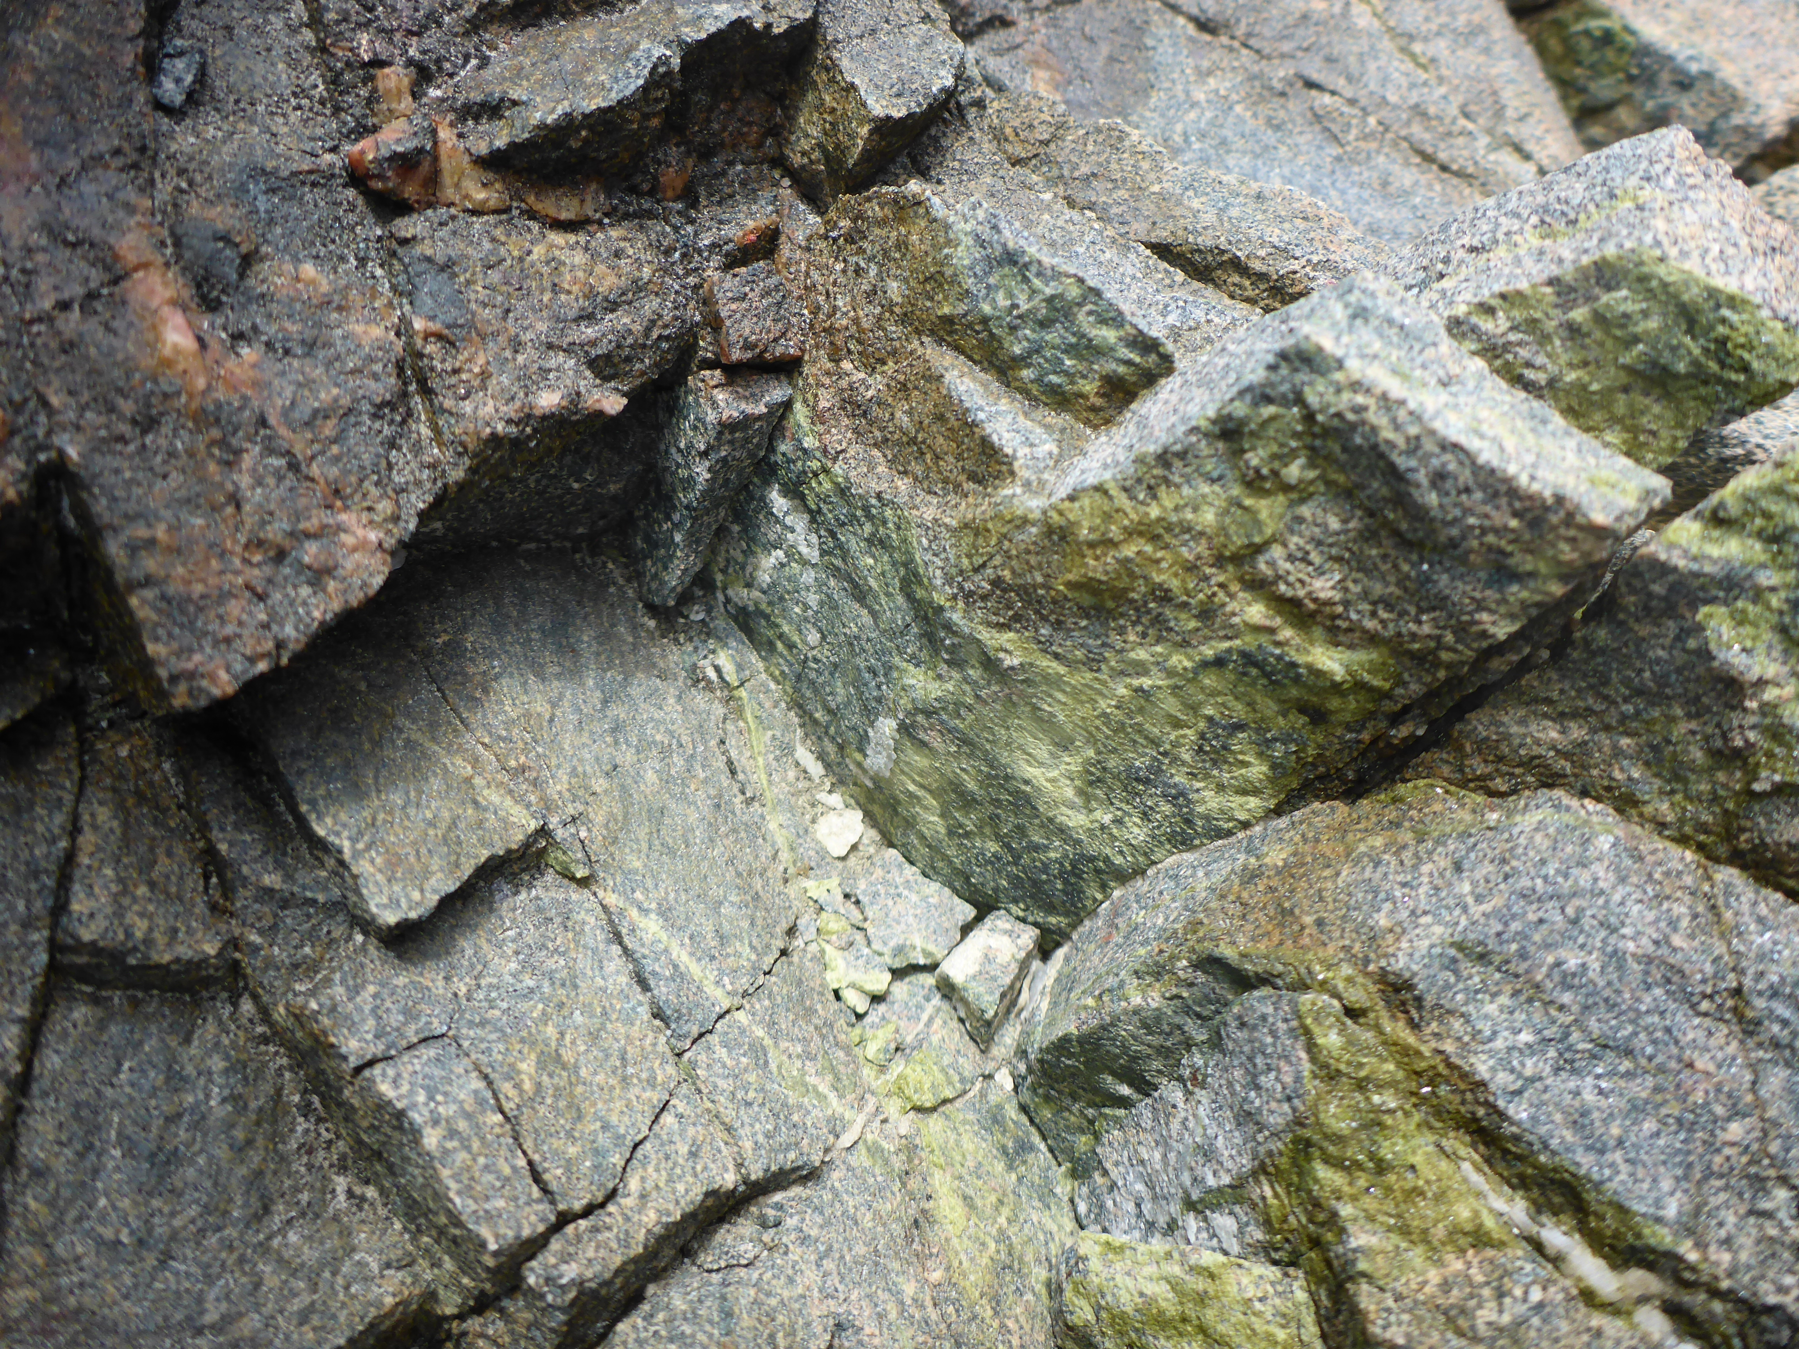
Mineralised fractures near Ford’s Bight Point

Slide 23
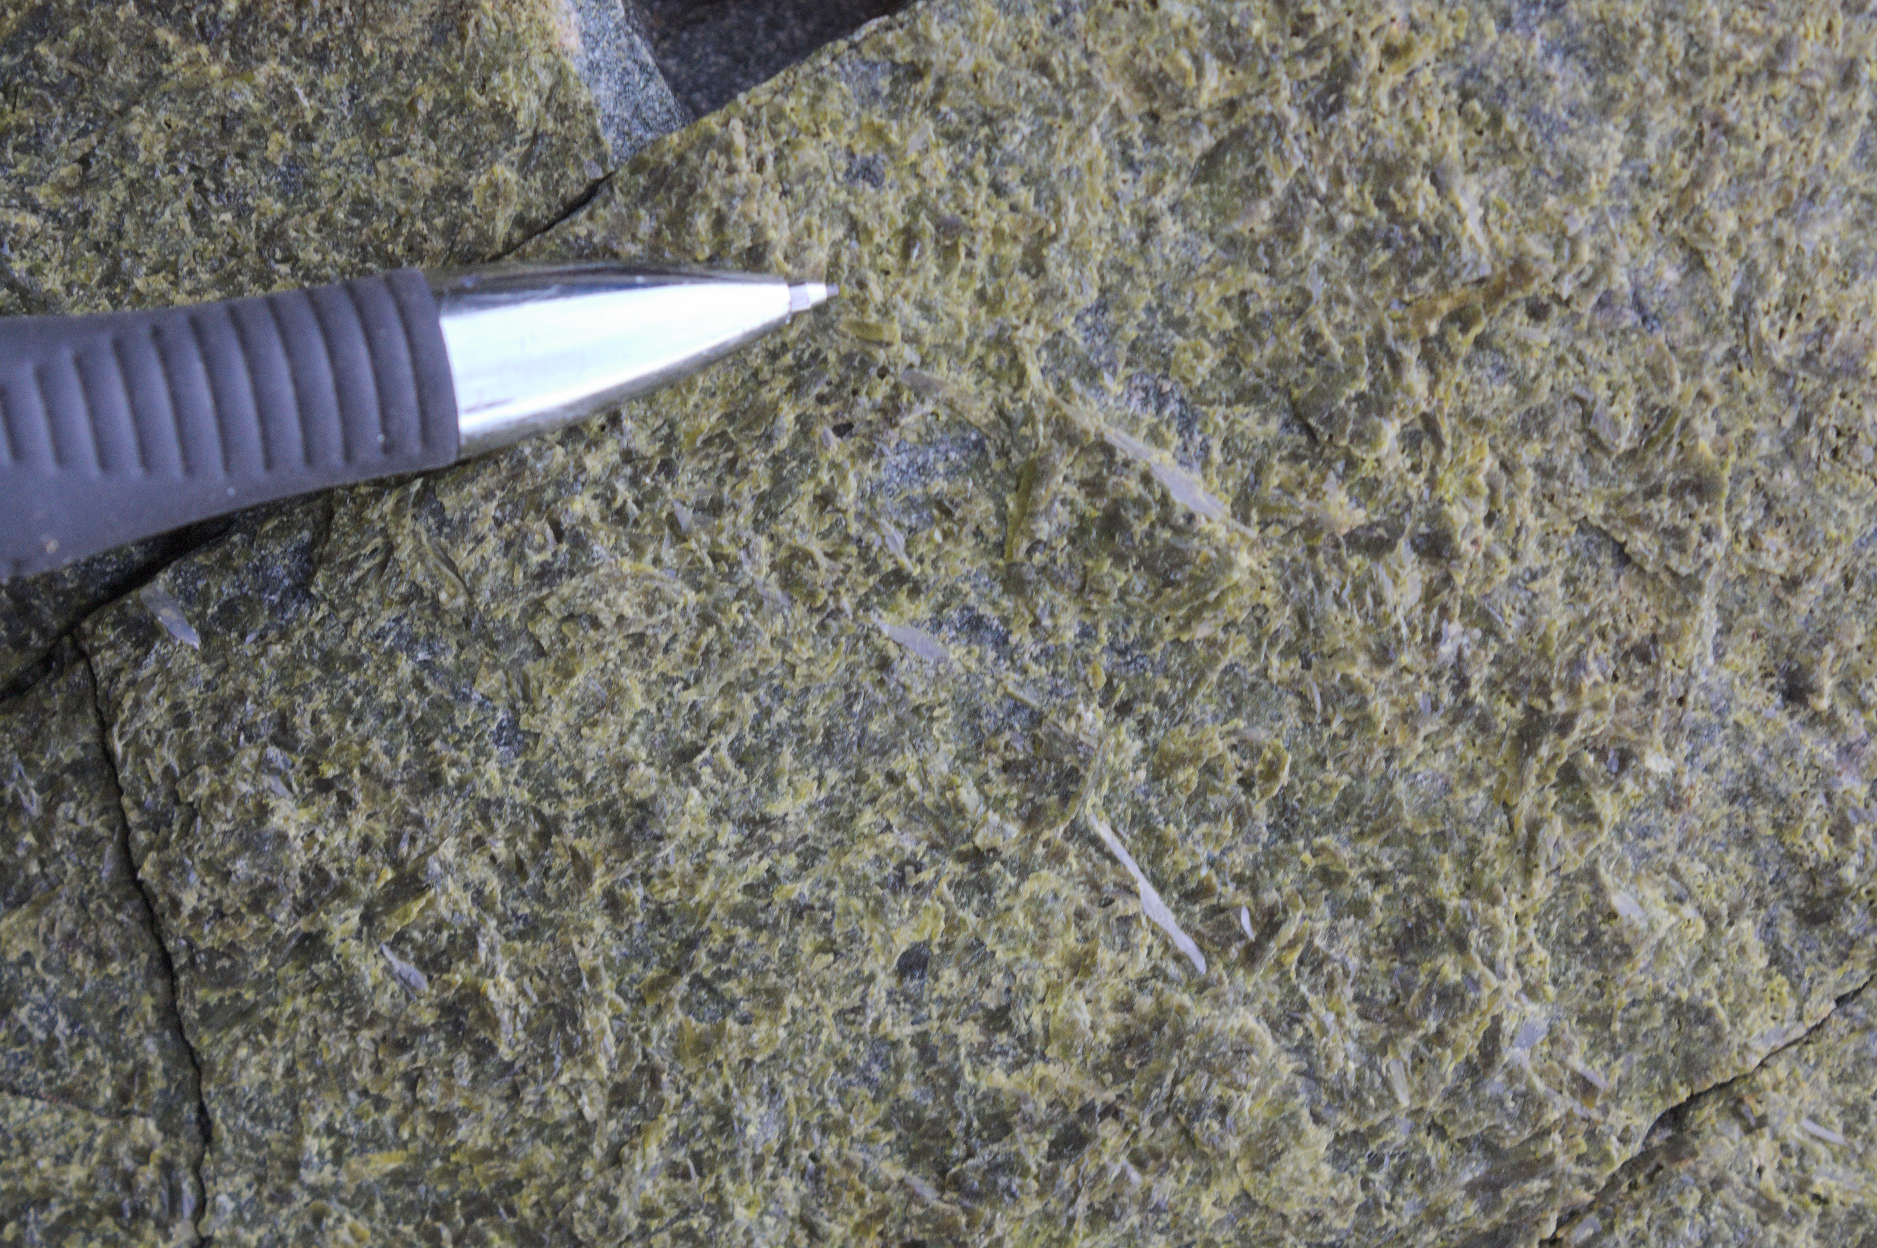
Epidote surface in Amphibolite dyke near Makkovik

Slide 24
Stress Inversion: Methodology
Important to separate deformation associated with different age events
Epidote mineralisation usually associated with deformation in ~ 590-555 Ma mafic dykes (Tappe et al., 2007; 2006)
Does all deformation represent the same event?
=
+
Model A
(All brittle deformation)
Model B
(Epidote bearing brittle deformation)
=

Slide 25
Stress Inversion - Results
All brittle
deformation
Epidote bearing brittle deformation

Slide 26
Stress Inversion - Results
All brittle
deformation
Epidote bearing brittle deformation

Slide 27
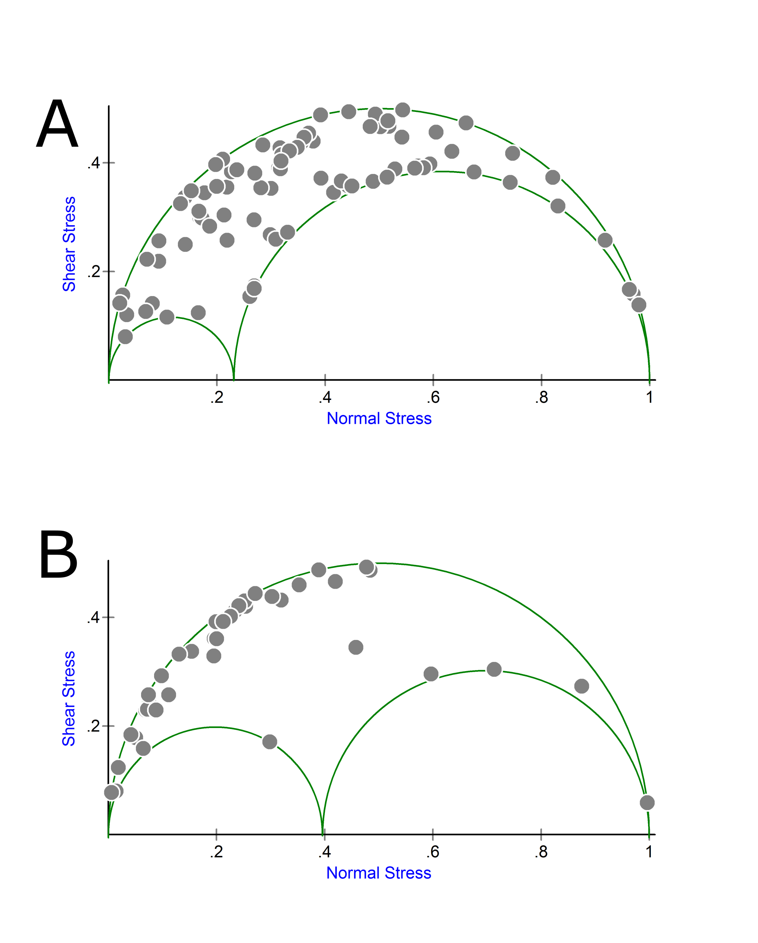
Stress Inversion - Results
All brittle deformation
Epidote bearing brittle deformation

Slide 28
Stress Inversion - Results
All brittle deformation
Epidote bearing brittle deformation

Slide 29
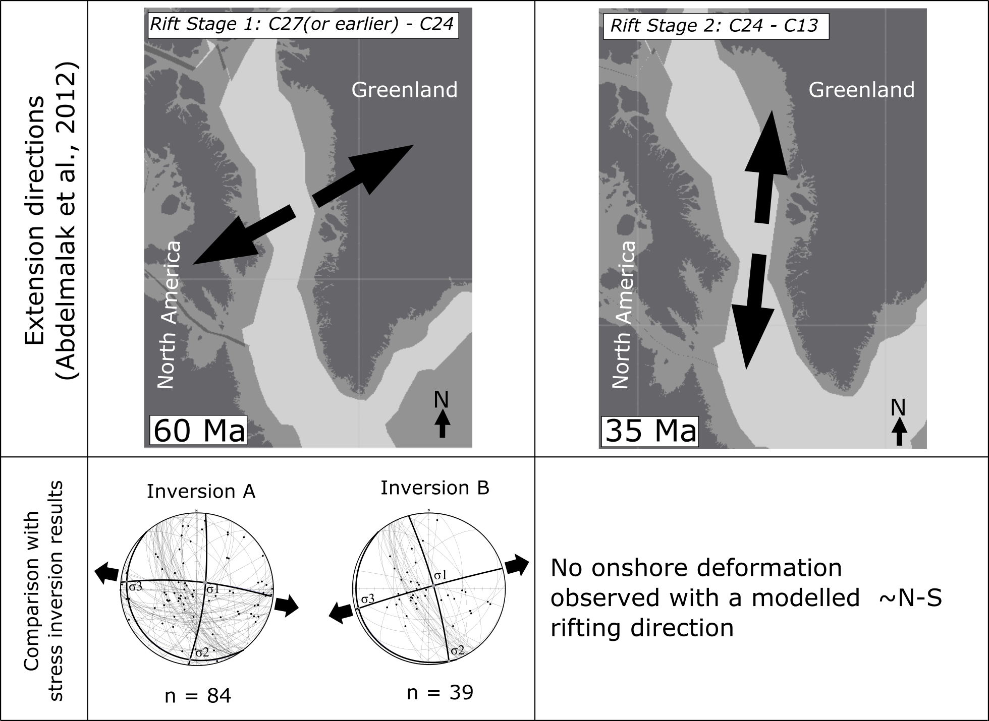
Paleostress Analysis - Comparison with W.Greenland
Greenland extension directions from Abdelmalak et al. (2012)

Slide 30
Paleostress Analysis - Comparison with W.Greenland
Greenland extension directions from Abdelmalak et al. (2012)

Slide 31
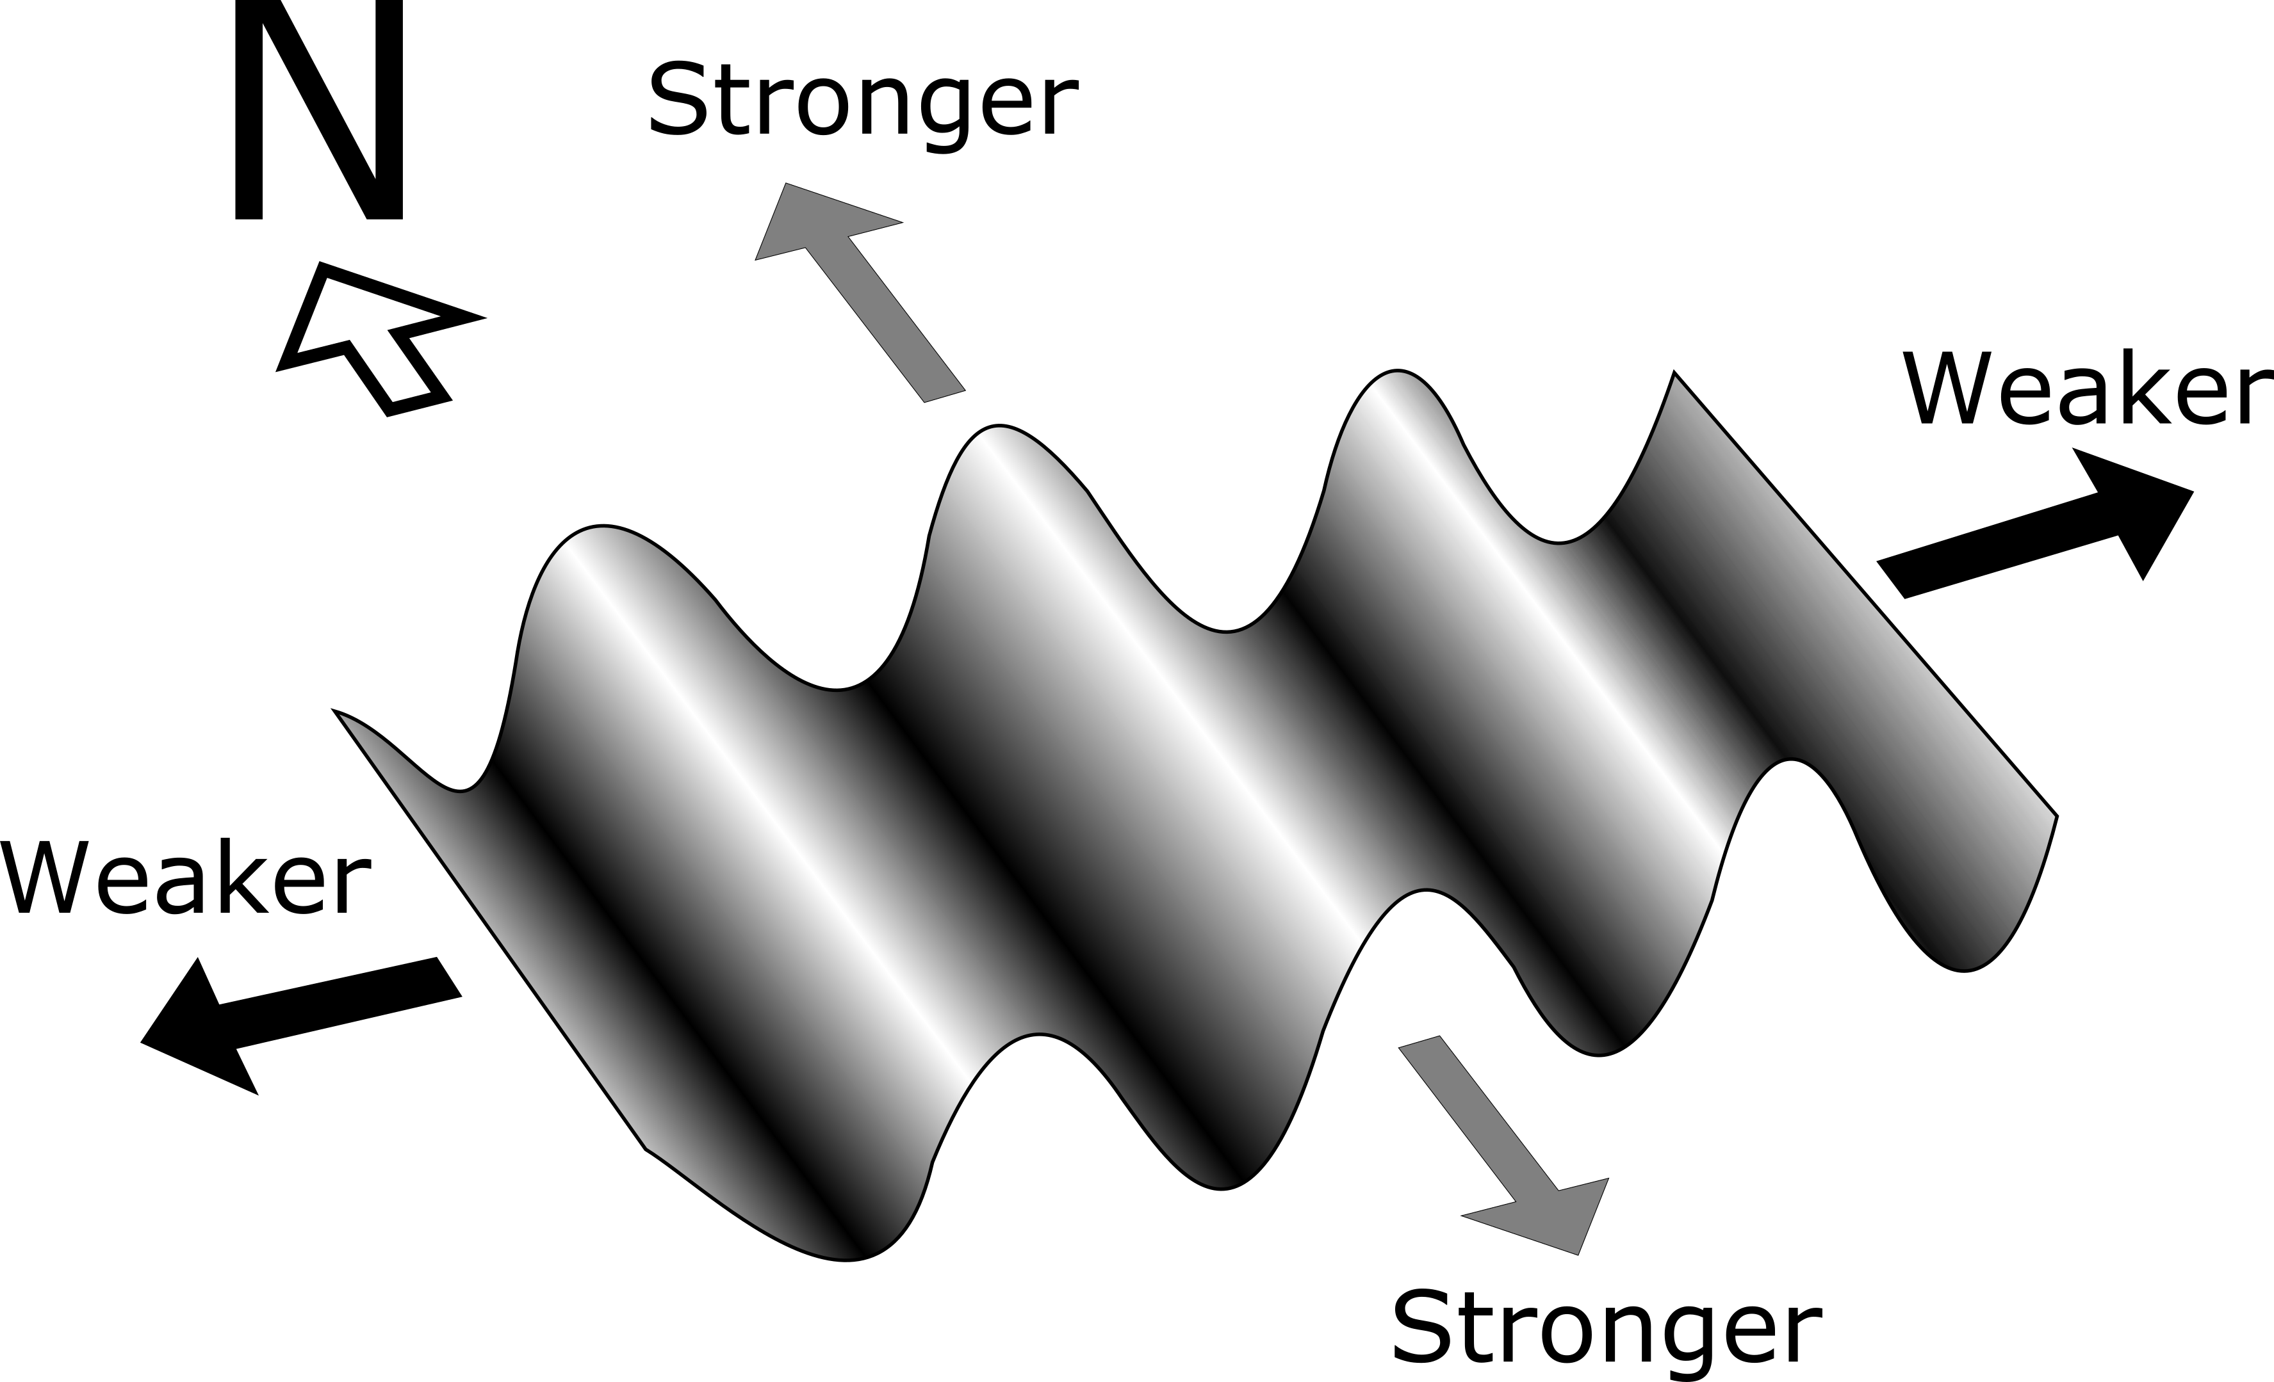
Rift propagation and basement fabric?
Extension direction from W. Greenland (Abdelmalak et al., 2012)

Slide 32
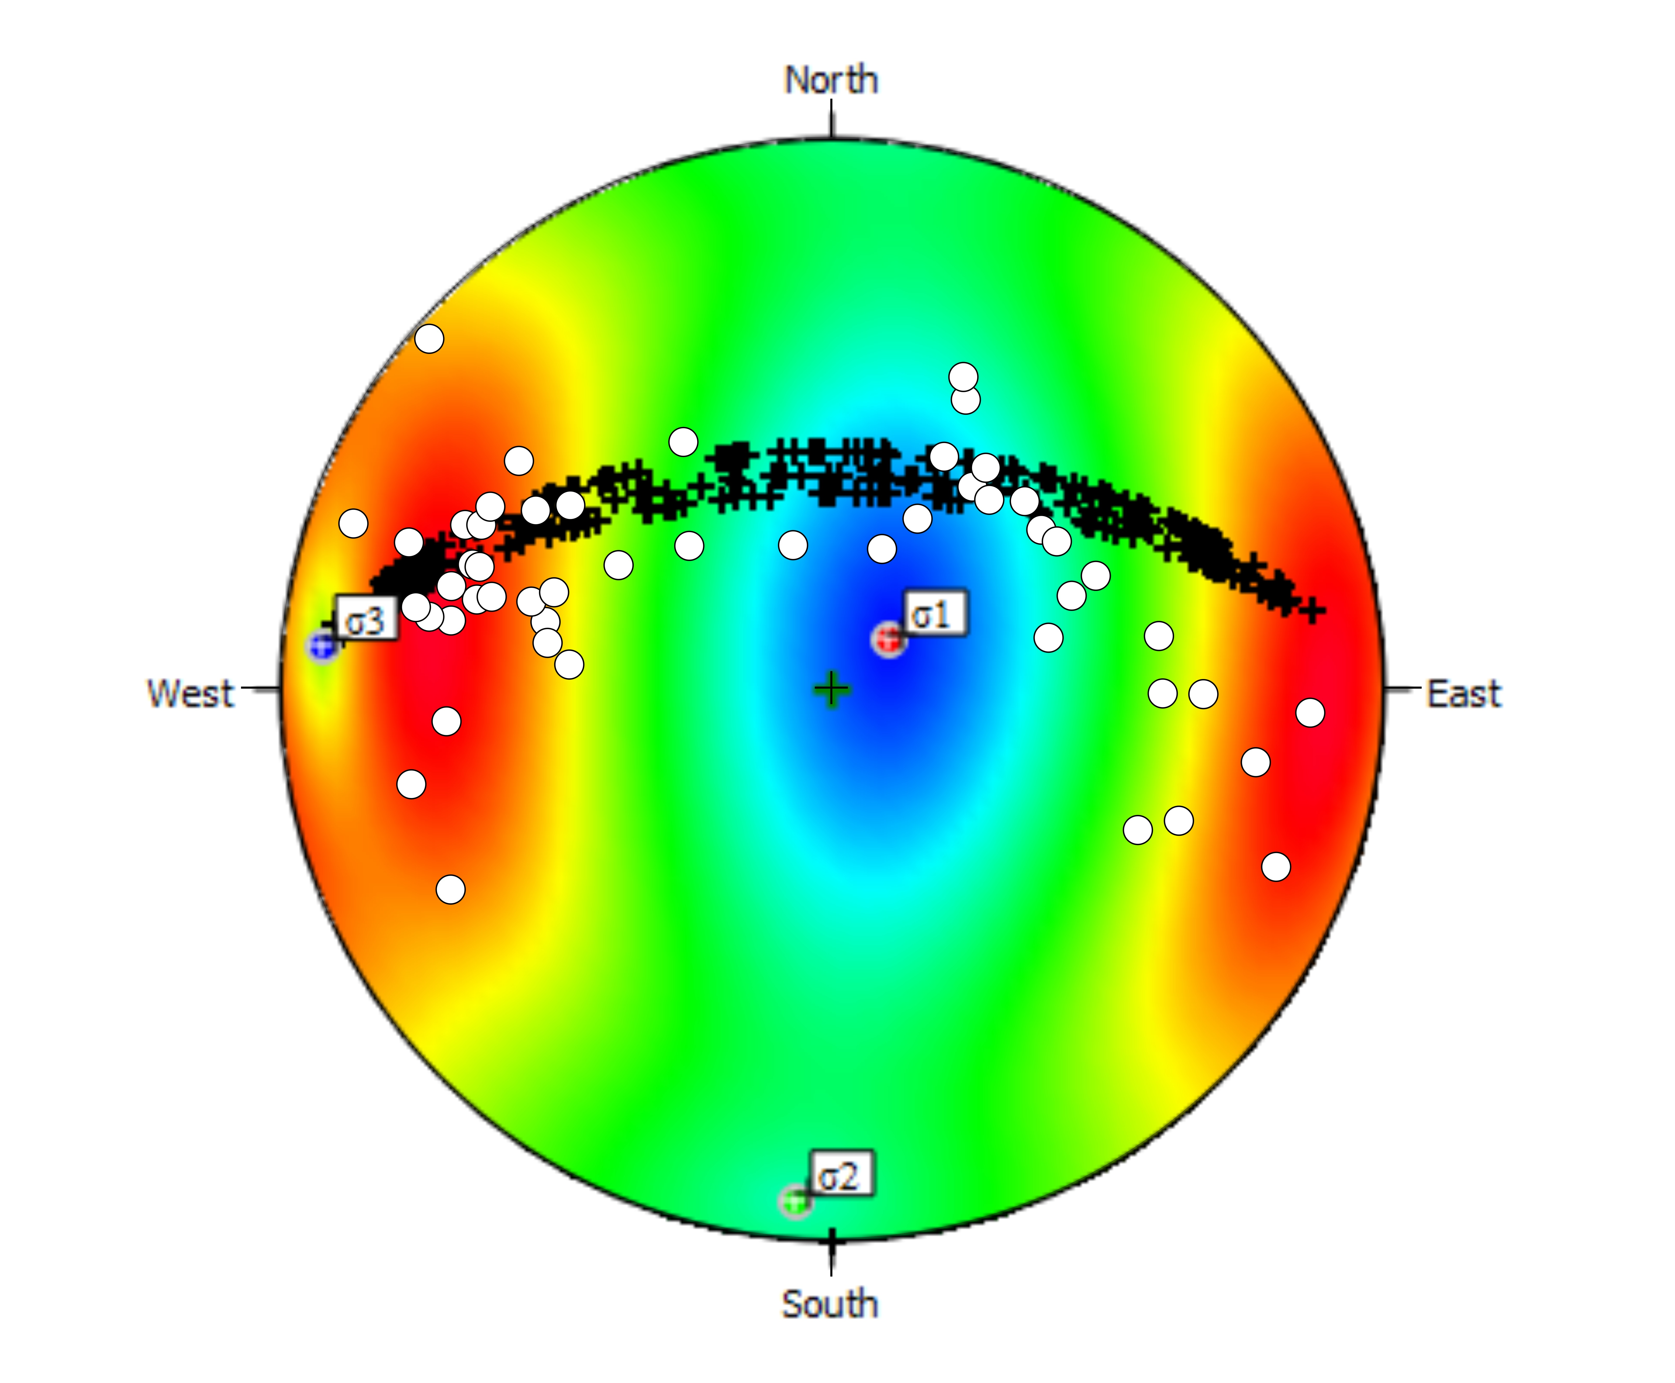
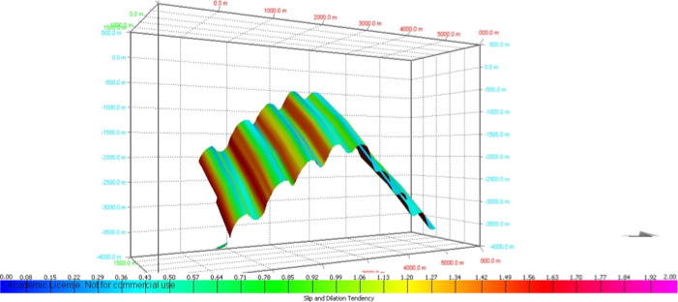
MOVE reactivation modelling results
Slip and Dilation Tendency - The ratio of resolved shear stress to normal stress on a plane
The greater the value the more likely slip is to occur
Black = Modelled
White = Observed
Low reactivation potential
High reactivation potential
Slip and Dilation Tendency

Slide 33
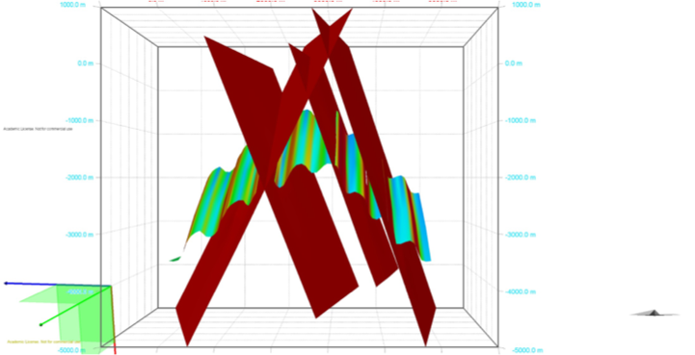
MOVE reactivation modelling results
Continentward
Oceanward
4 ‘easy slip’ horizons identified and allowed to slip
Modelled at 3 km

Slide 34
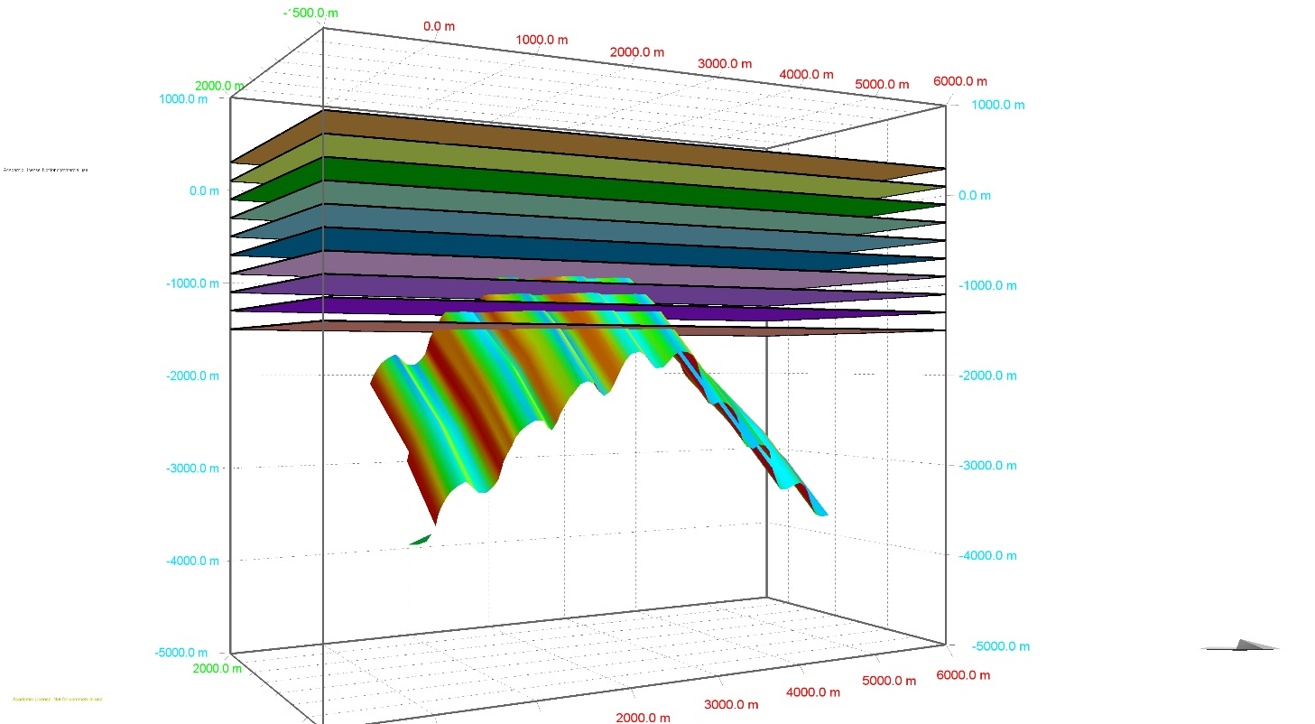
MOVE reactivation modelling results
Continentward
Oceanward
Each frame represents ~1% extension
Progressively allowing slip to occur on identified ‘weak’ surfaces and propagate through sediments above
Allows us to investigate how deformation may occur if it localised onto structures similar to those in the field area

Slide 35
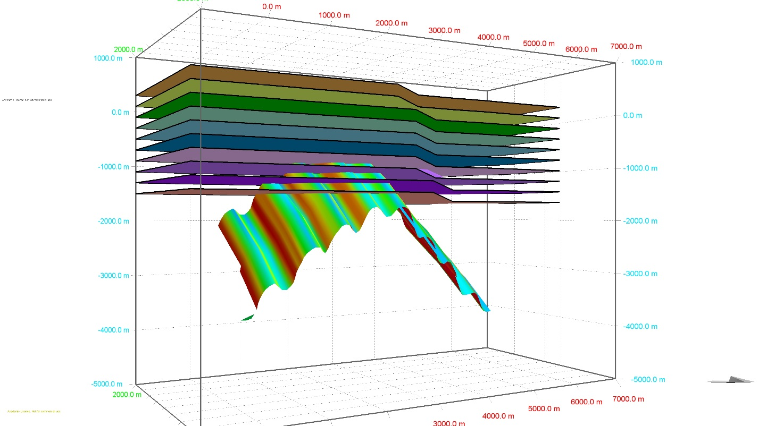
MOVE reactivation modelling results
Continentward
Oceanward
Each frame represents ~1% extension
Progressively allowing slip to occur on identified ‘weak’ surfaces and propagate through sediments above
Allows us to investigate how deformation may occur if it localised onto structures similar to those in the field area

Slide 36
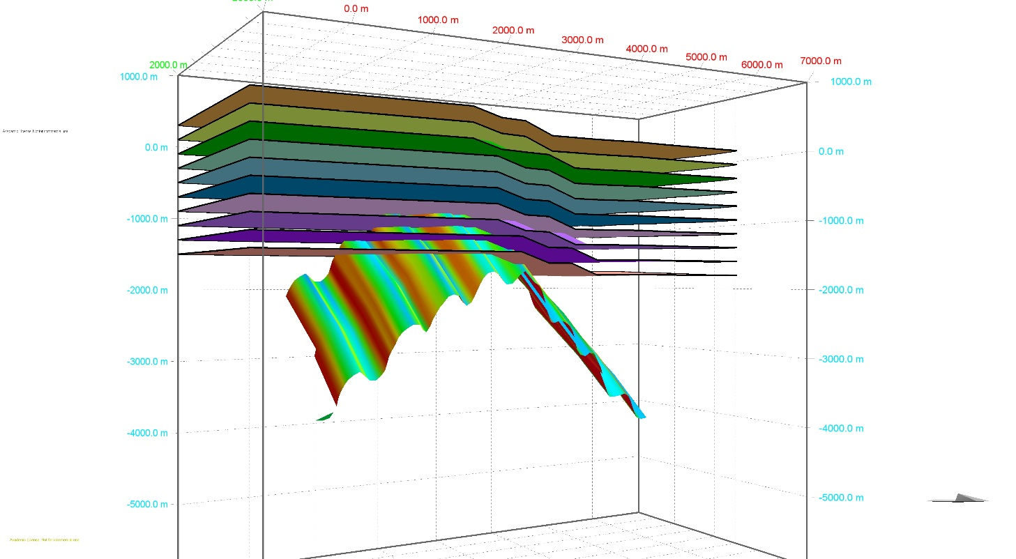
MOVE reactivation modelling results
Continentward
Oceanward
Each frame represents ~1% extension
Progressively allowing slip to occur on identified ‘weak’ surfaces and propagate through sediments above
Allows us to investigate how deformation may occur if it localised onto structures similar to those in the field area

Slide 37
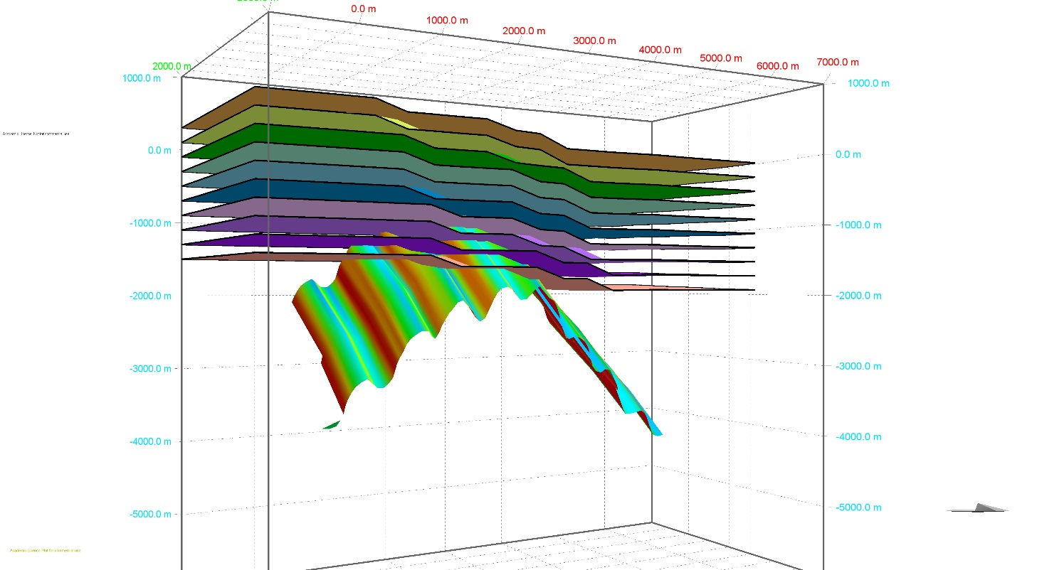
MOVE reactivation modelling results
Continentward
Oceanward
Each frame represents ~1% extension
Progressively allowing slip to occur on identified ‘weak’ surfaces and propagate through sediments above
Allows us to investigate how deformation may occur if it localised onto structures similar to those in the field area

Slide 38
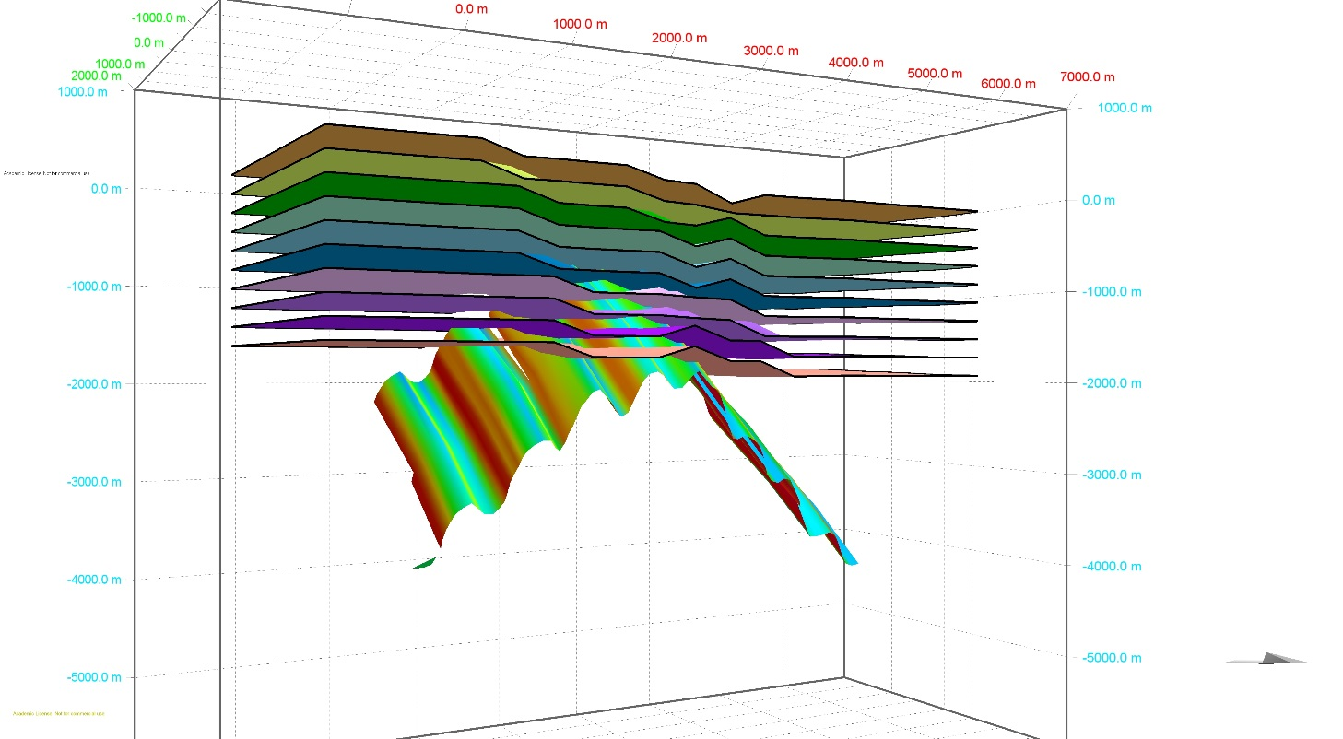
MOVE reactivation modelling results
Continentward
Oceanward
Each frame represents ~1% extension
Progressively allowing slip to occur on identified ‘weak’ surfaces and propagate through sediments above
Allows us to investigate how deformation may occur if it localised onto structures similar to those in the field area

Slide 39
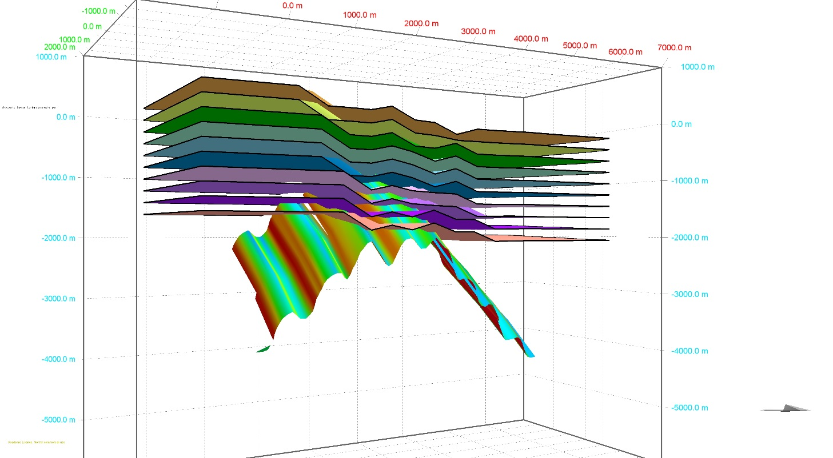
MOVE reactivation modelling results
Continentward
Oceanward
Each frame represents ~1% extension
Progressively allowing slip to occur on identified ‘weak’ surfaces and propagate through sediments above
Allows us to investigate how deformation may occur if it localised onto structures similar to those in the field area

Slide 40
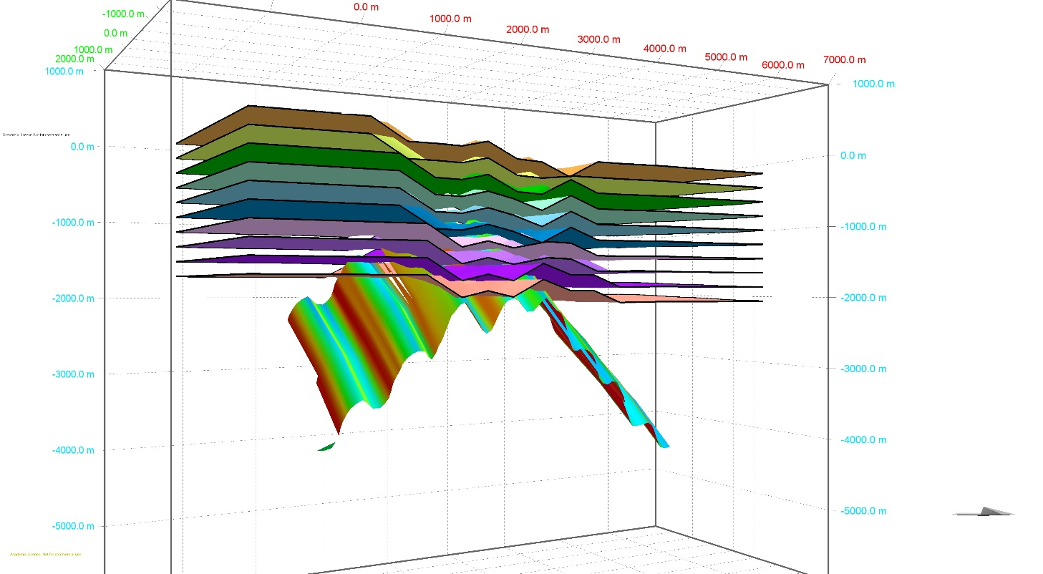
MOVE reactivation modelling results
Continentward
Oceanward
Each frame represents ~1% extension
Progressively allowing slip to occur on identified ‘weak’ surfaces and propagate through sediments above
Allows us to investigate how deformation may occur if it localised onto structures similar to those in the field area

Slide 41
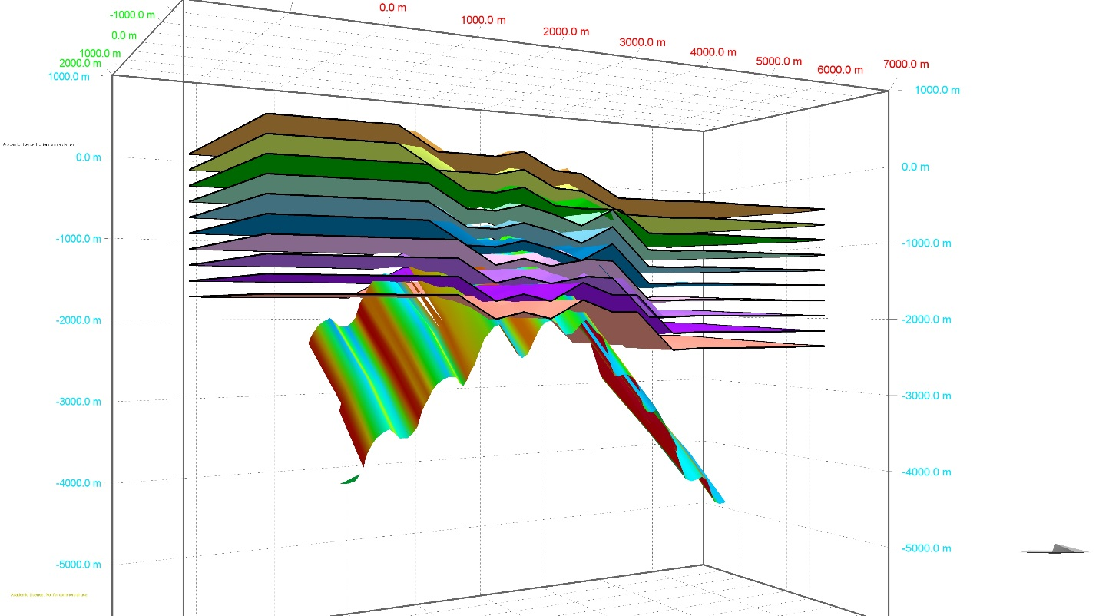
MOVE reactivation modelling results
Continentward
Oceanward
Each frame represents ~1% extension
Progressively allowing slip to occur on identified ‘weak’ surfaces and propagate through sediments above
Allows us to investigate how deformation may occur if it localised onto structures similar to those in the field area

Slide 42
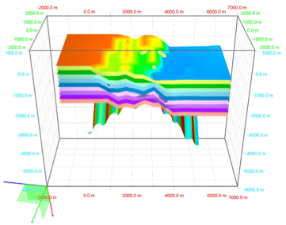
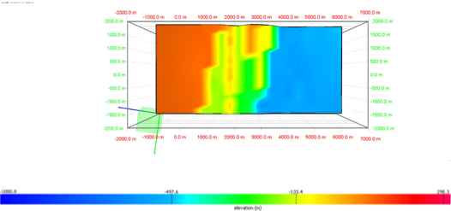
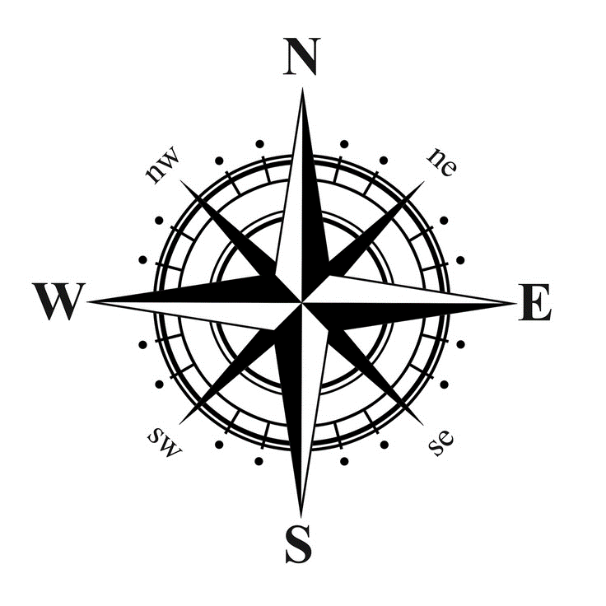
MOVE reactivation modelling results
Labrador
Labrador
Sea
Labrador
Sea
Labrador
-1000 m
300 m
Model suggests that the preferentially orientated pre-existing structures could have aided rift propagation through the proto-Labrador Sea region
But this model requires further developing and refining

Slide 43
Conclusions
The epidote deformation event was produced during an ENE-WSW extensional event younger than ~590-555 Ma (mafic dykes).
It is possible that this event produced all brittle deformation analysed, with the epidote mineralization being a localized mineralogical effect.
The deformation event(s) analysed in this study possibly represent an onshore expression of rifting prior to the opening of the Labrador Sea.
Basement fabric is orientated parallel to the rifting direction inferred by previous studies on the conjugate West Greenland margin and by our stress inversion
This orientation potentially made the Aillik Domain particularly susceptible to ~E-W rifting, allowing rifting to easily propagate.

Slide 44
Future Work
Devonian stress regime
Further analysis is required from elsewhere in Labrador
From both within the Makkovik Province but also from elsewhere on the margin
Chronology of deformation
Further develop MOVE models
Leading Tickles, Newfoundland
Permian stress regime

Slide 45
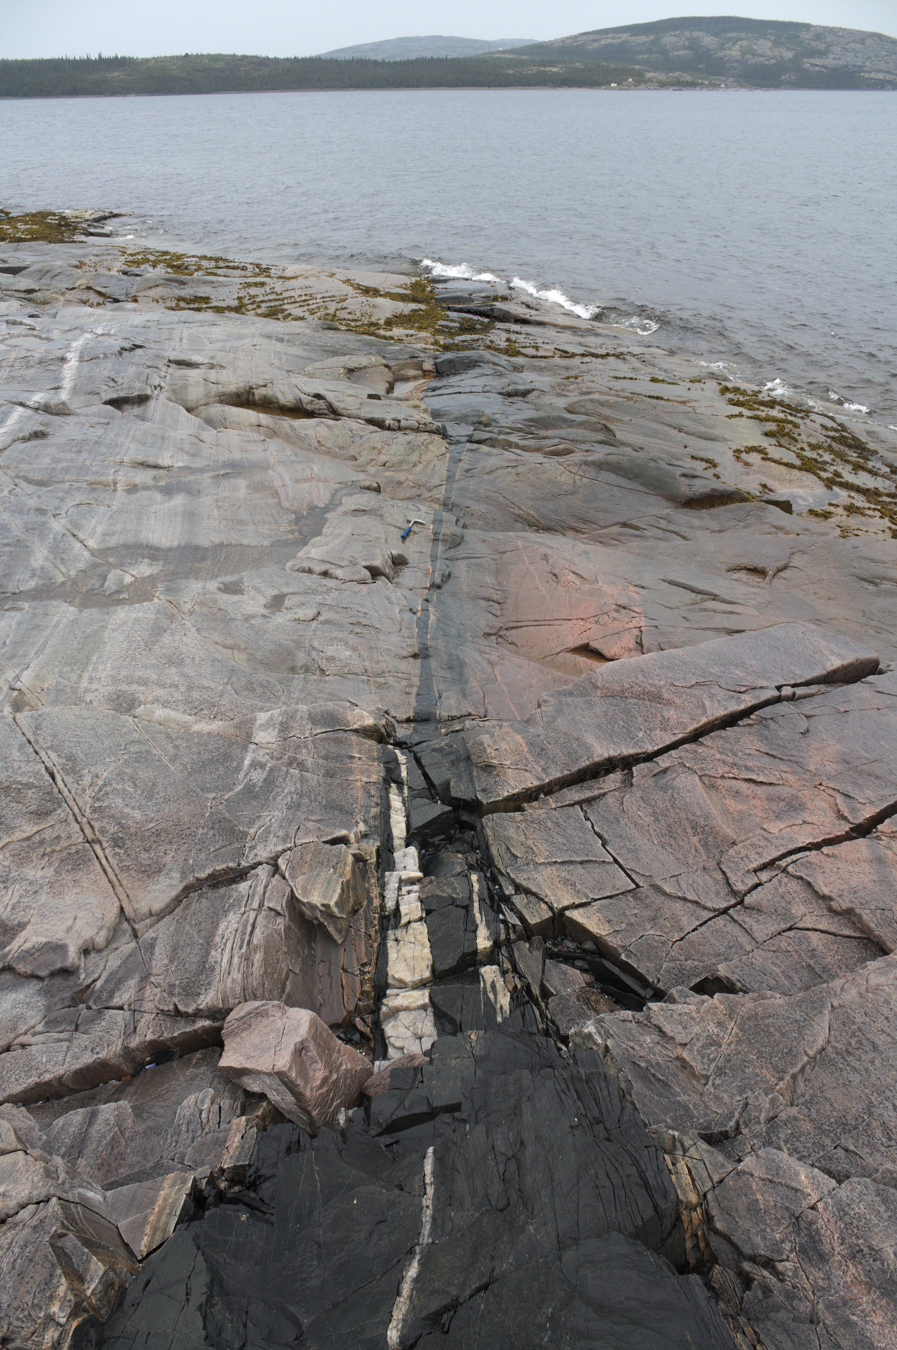
Future Work
Further analysis is required from elsewhere in Labrador
From both within the Makkovik Province but also from elsewhere on the margin
Chronology of deformation
Further develop MOVE models
Leading Tickles, Newfoundland
Boudinaged dyke on Big Island (upcoming JSG photo of the Month)

Slide 46
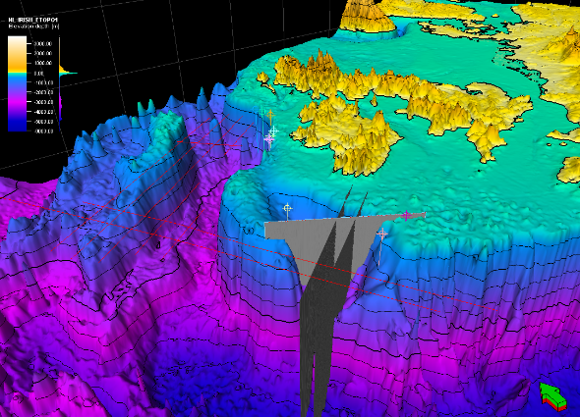
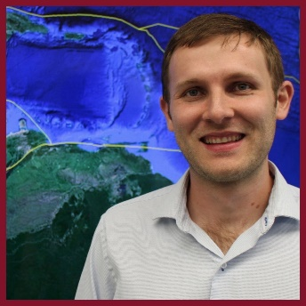
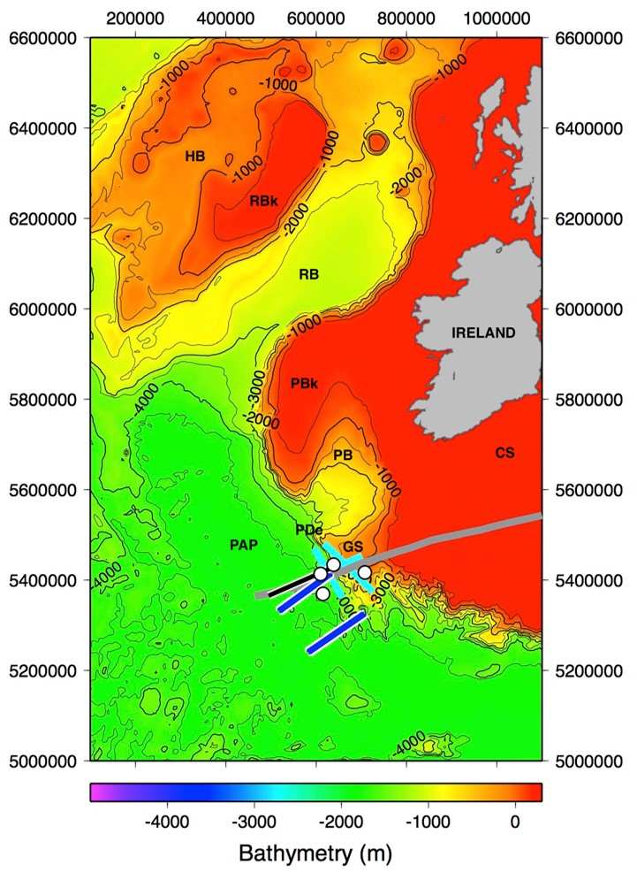
MAGRiT Group
Understanding the petroleum basin evolution of the West Orphan Basin and the conjugate Rockall Basin using seismic megatransects - Heide MacMahon - MSc. Candidate
Re-processing of Vintage Seismic Reflection Data Across the Continental Slope and Newfoundland Basin - Ryan Laidley - MSc. Candidate
A
A’
Understanding the petroleum basin evolution of the East Orphan Basin and the conjugate Porcupine Basin using seismic megatransects - MSc. Candidate
Rifted margin and sedimentary structure of the Porcupine Abyssal Plain, outboard of Goban Spur, southwest Ireland, from constrained seismic re-processing - BSc (hons.) student
+ Prof., PhD student and Postdoctoral fellow

Slide 47
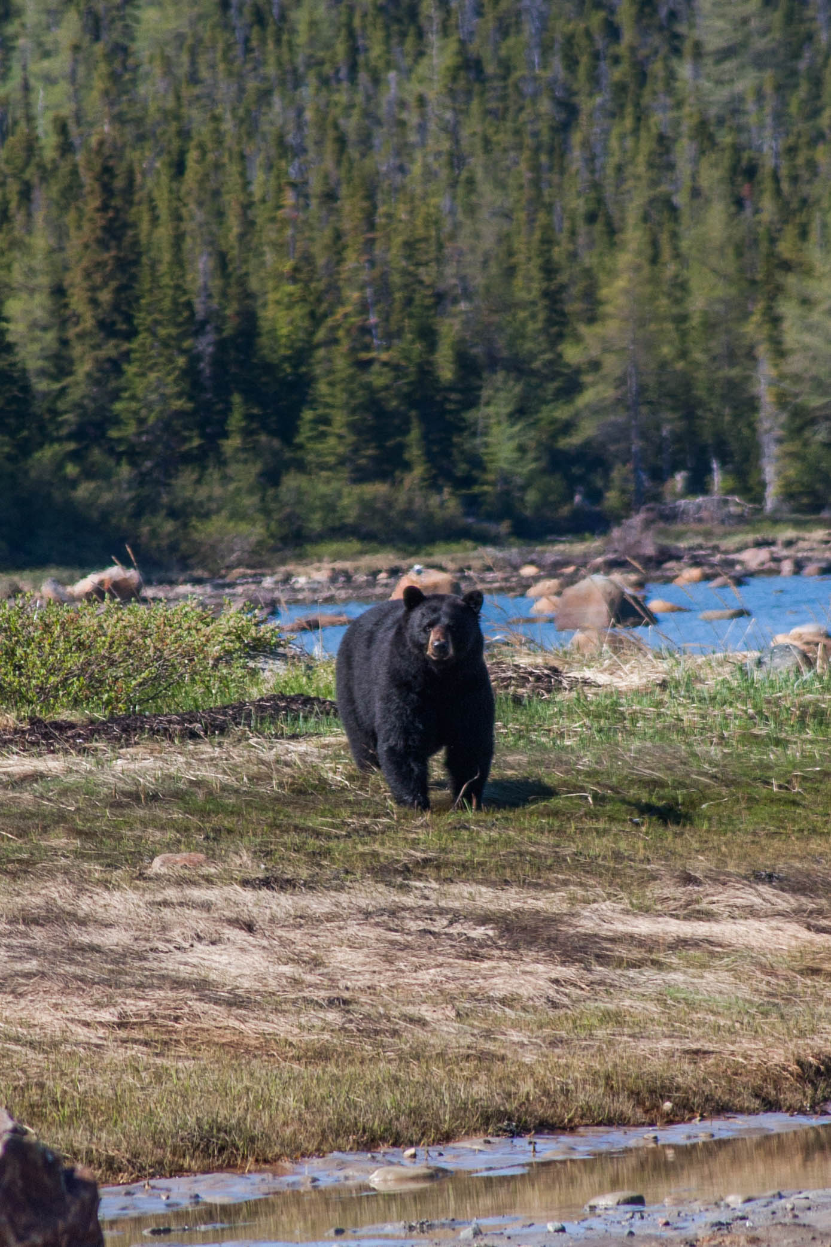
Thank you for listening!

Slide 48
North Atlantic analogues and intraplate deformation discussion
Some general thoughts
• Is it appropriate to bring in these two topics into one paper?
Or would be be better splitting this into multiple papers?
• How to organise the paper?
• I feel that intraplate deformation is one aspect of the comparison and should be a section within here but potentially also a paper on its own?

Slide 49
Comparison to other regions - how to organise the comparison?
• Multiple ways comparisons can be made – spatial, temporal etc.
• Comparison can be made with the different parts of the rift/breakup cycle
• Do we want to consider the whole Wilson Cycle – i.e. consider analogues to orogens that preceded the Atlantic Opening? This could build on work such as Krabbendam (2001) where the likelihood of opening along modern orogens is considered.
• Modern analogues vs. ancient analogues
• Does ‘other regions’ also include conjugates? Much of the previous work has been ‘one sided’ in this way.

Slide 50
Regions: modern analogues
Rifting:
• East African rift system
• Rio Grande
• Snake River Plain
Breakup achieved/happening:
Adjacent regions:
• South/Central Atlantic Opening
• Arctic Opening
• In what ways are these regions similar to different?
Elsewhere:
• Non-Atlantic passive margins e.g. Australia, Antarctica, India, East Africa, Red Sea, South China Sea

Slide 51
Regions: Ancient analogues
Rifting/breakup/margins:
• Tethys margin preserved in the Alpine orogeny
Many other ancient margins preserved in orogenic belts
As has been done extensively with the Alpine/Tethys margin do other preserved margins show similar structure?
Microcontinents:
Several preserved in accreted terrains e.g. Avalonia?

Slide 52
Specific aspects of the NA to make comparisons with
Microcontinents
Magmatism/melting anomalies
Transform margins
Intraplate deformation
Tectonic inheritance

Slide 53
Application of NA concepts to elsewhere
This is how I would propose bringing the paper together.
Can the concepts we have developed on the NA be applied to resolve ambiguities in other regions?
Maybe we can state whether the Atlantic is a ‘normal’ case or not when compared to ancient and modern analogues?

