Slide 1


North Atlantic geopotential stress field since breakup
Christian Schiffer
North Atlantic 2017, Durham
Geopotential stress from lateral pressure gradients in the lithosphere

Slide 2
North Atlantic geopotential stress field since breakup
Christian Schiffer
North Atlantic 2017, Durham
Lithospheric
Density structure

Slide 3
North Atlantic geopotential stress field since breakup
Christian Schiffer
North Atlantic 2017, Durham
Radial tractions -> dynamic topography

Slide 4
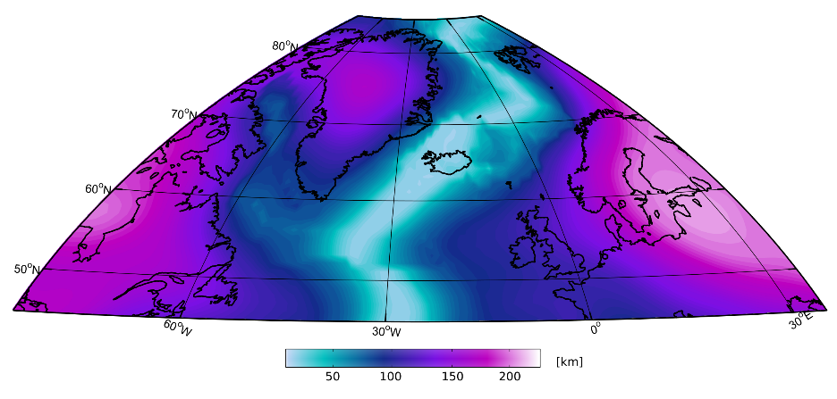
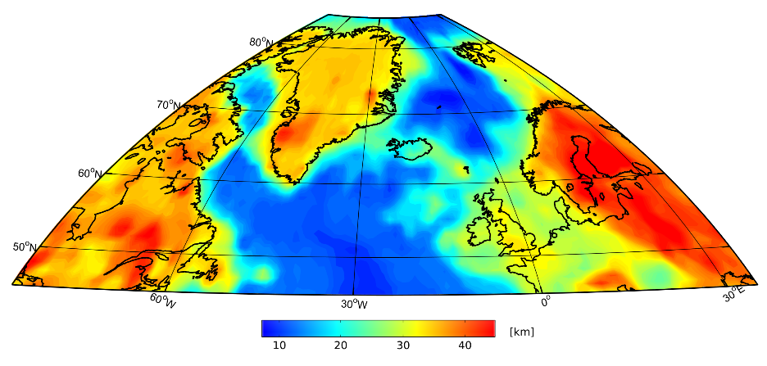
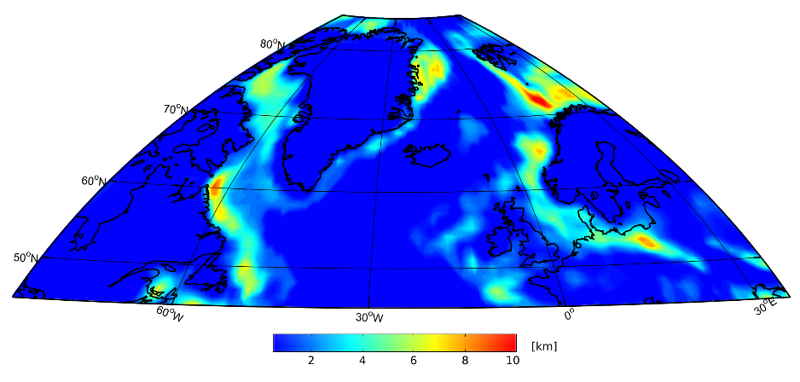
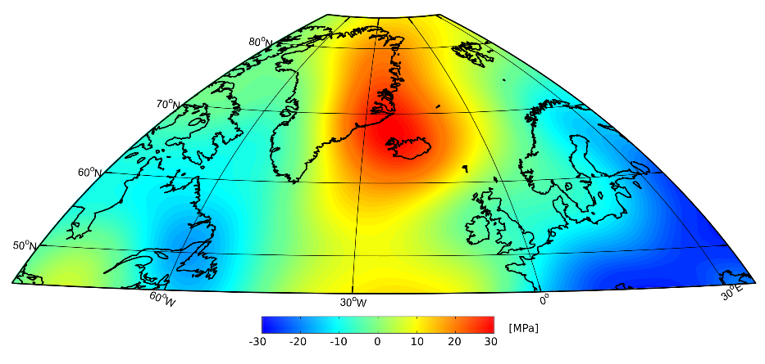
Lithospheric density structure
Depth to Lithosphere-Asthenosphere
boundary
Depth to Moho
Sedimentary thickness
Sub-lithospheric pressure anomaly

Slide 5
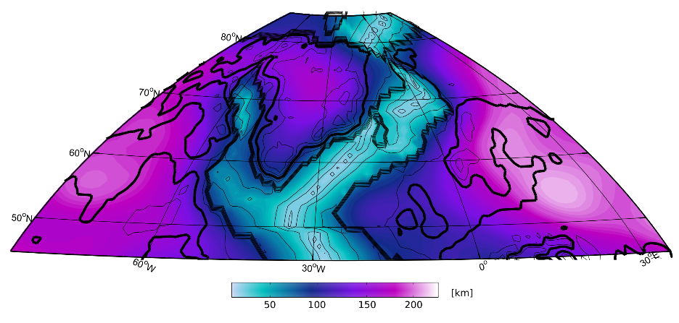
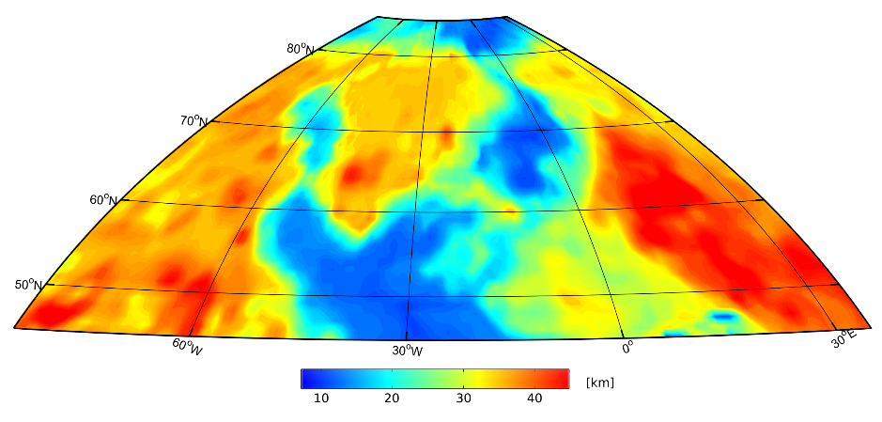
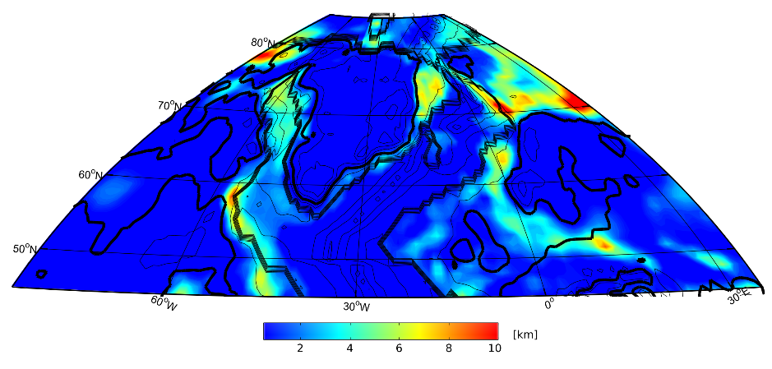
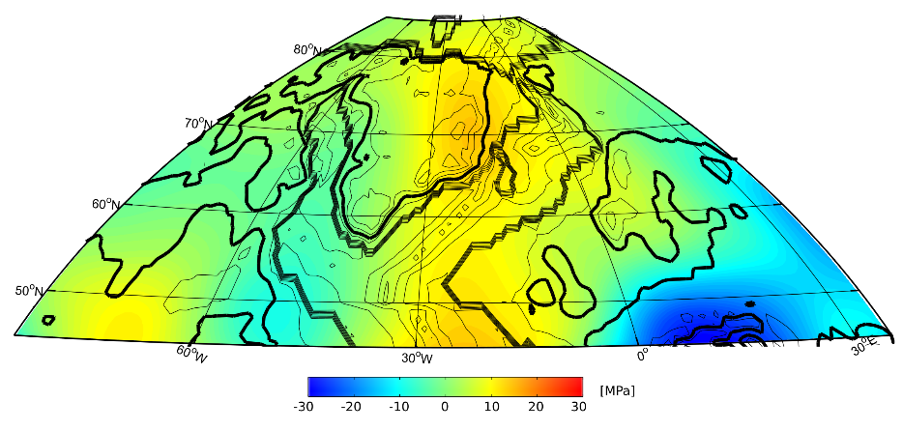
Reconstructions using Gplates
20 Ma
Depth to Lithosphere-Asthenosphere
boundary
Depth to Moho
Sedimentary thickness
Sub-lithospheric pressure anomaly

Slide 6
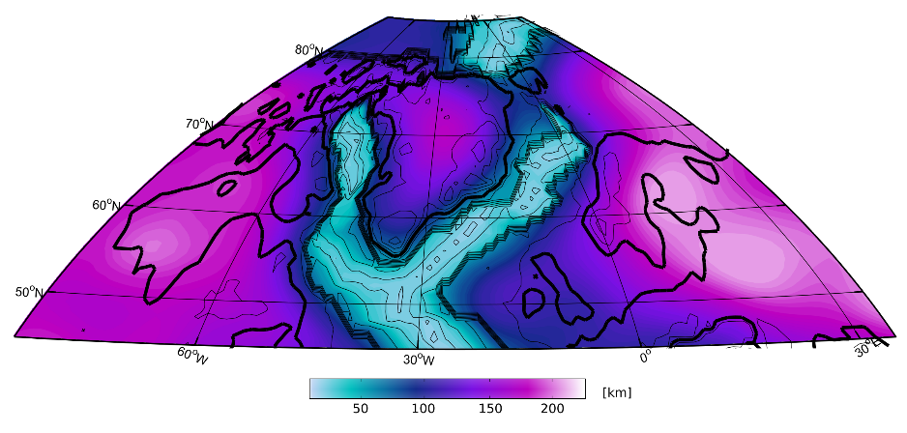
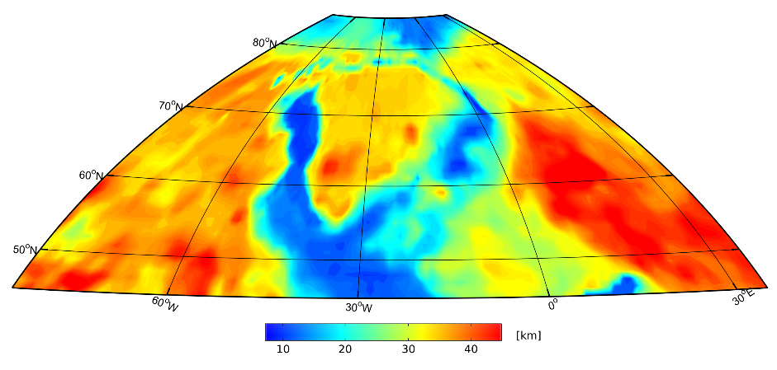
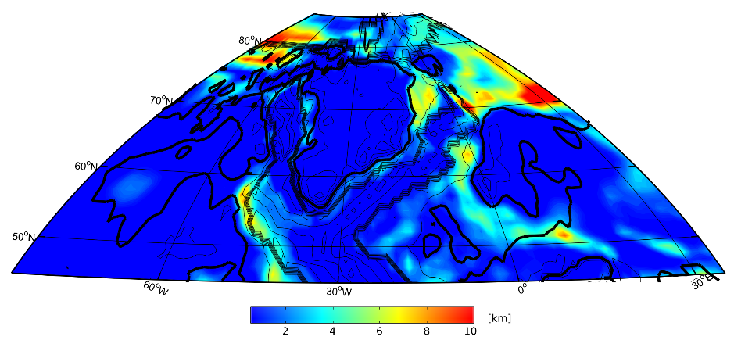
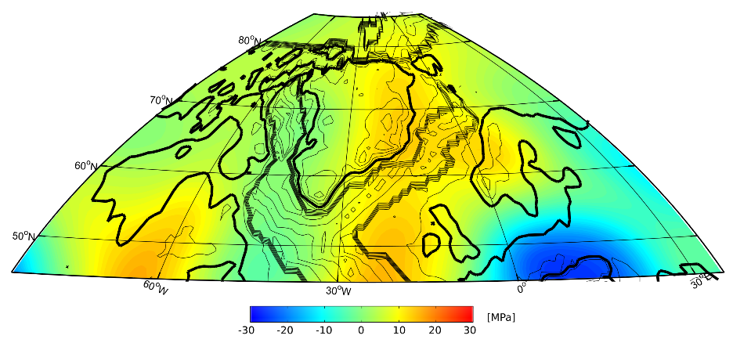
Reconstructions using Gplates
40 Ma
Depth to Lithosphere-Asthenosphere
boundary
Depth to Moho
Sedimentary thickness
Sub-lithospheric pressure anomaly

Slide 7
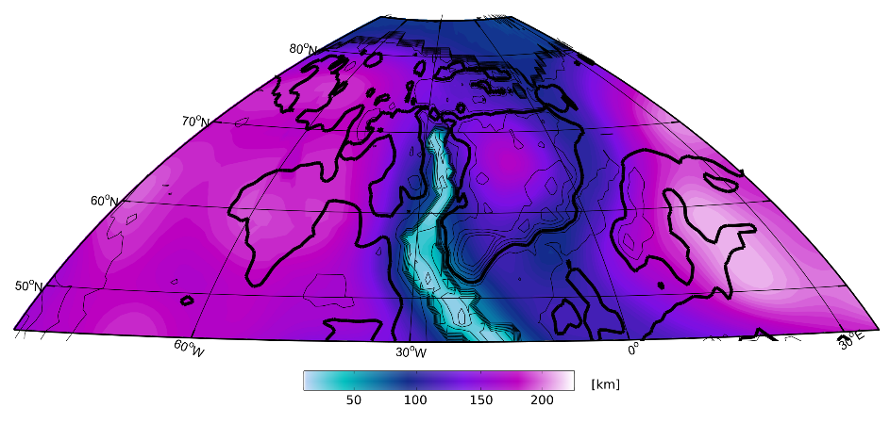
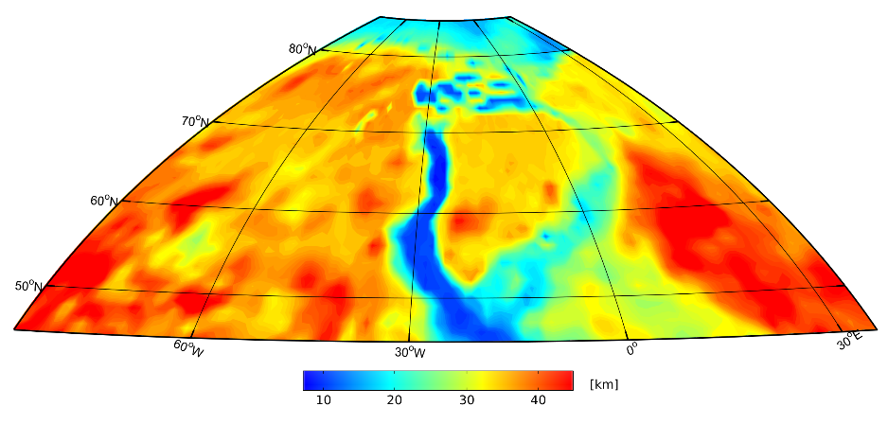
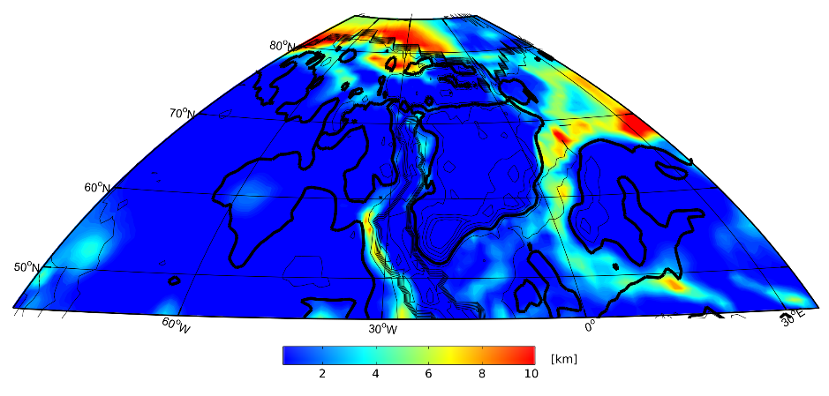
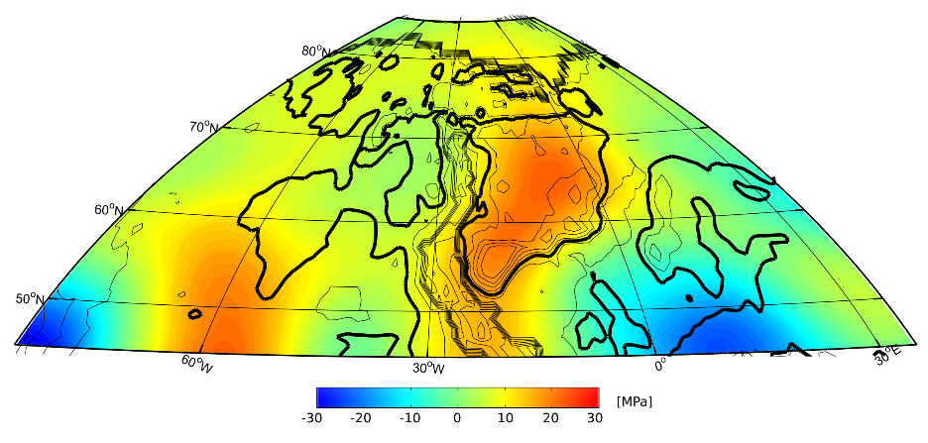
Reconstructions using Gplates
60 Ma
Depth to Lithosphere-Asthenosphere
boundary
Depth to Moho
Sedimentary thickness
Sub-lithospheric pressure anomaly

Slide 8
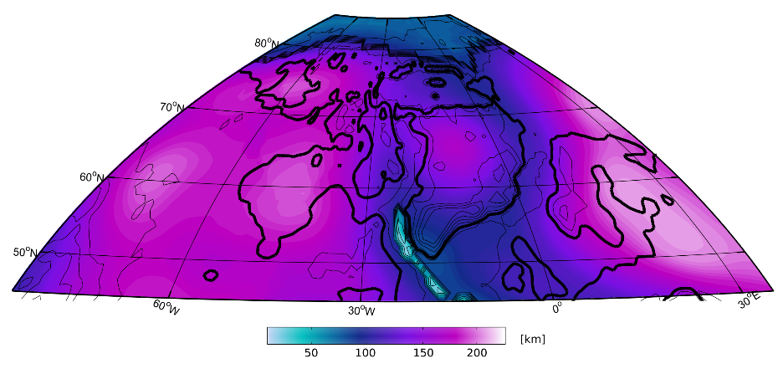
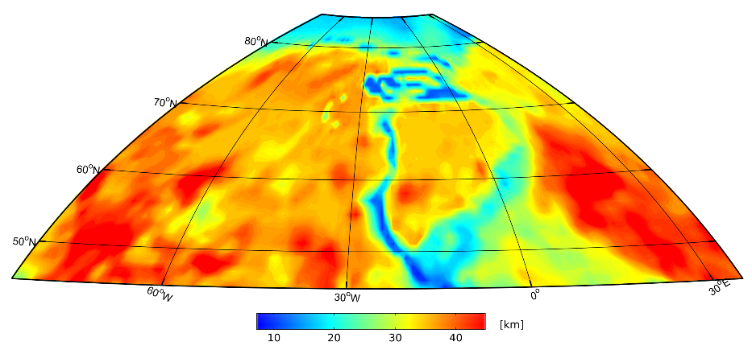
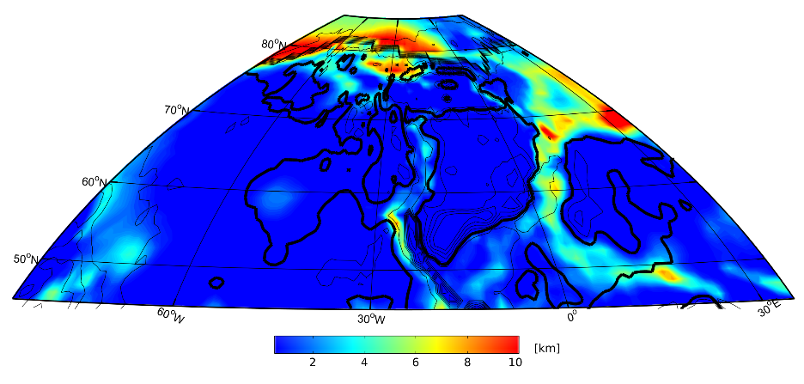
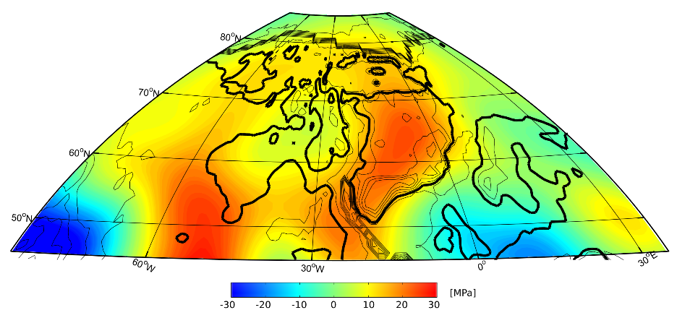
Reconstructions using Gplates
80 Ma
Depth to Lithosphere-Asthenosphere
boundary
Depth to Moho
Sedimentary thickness
Sub-lithospheric pressure anomaly

Slide 9
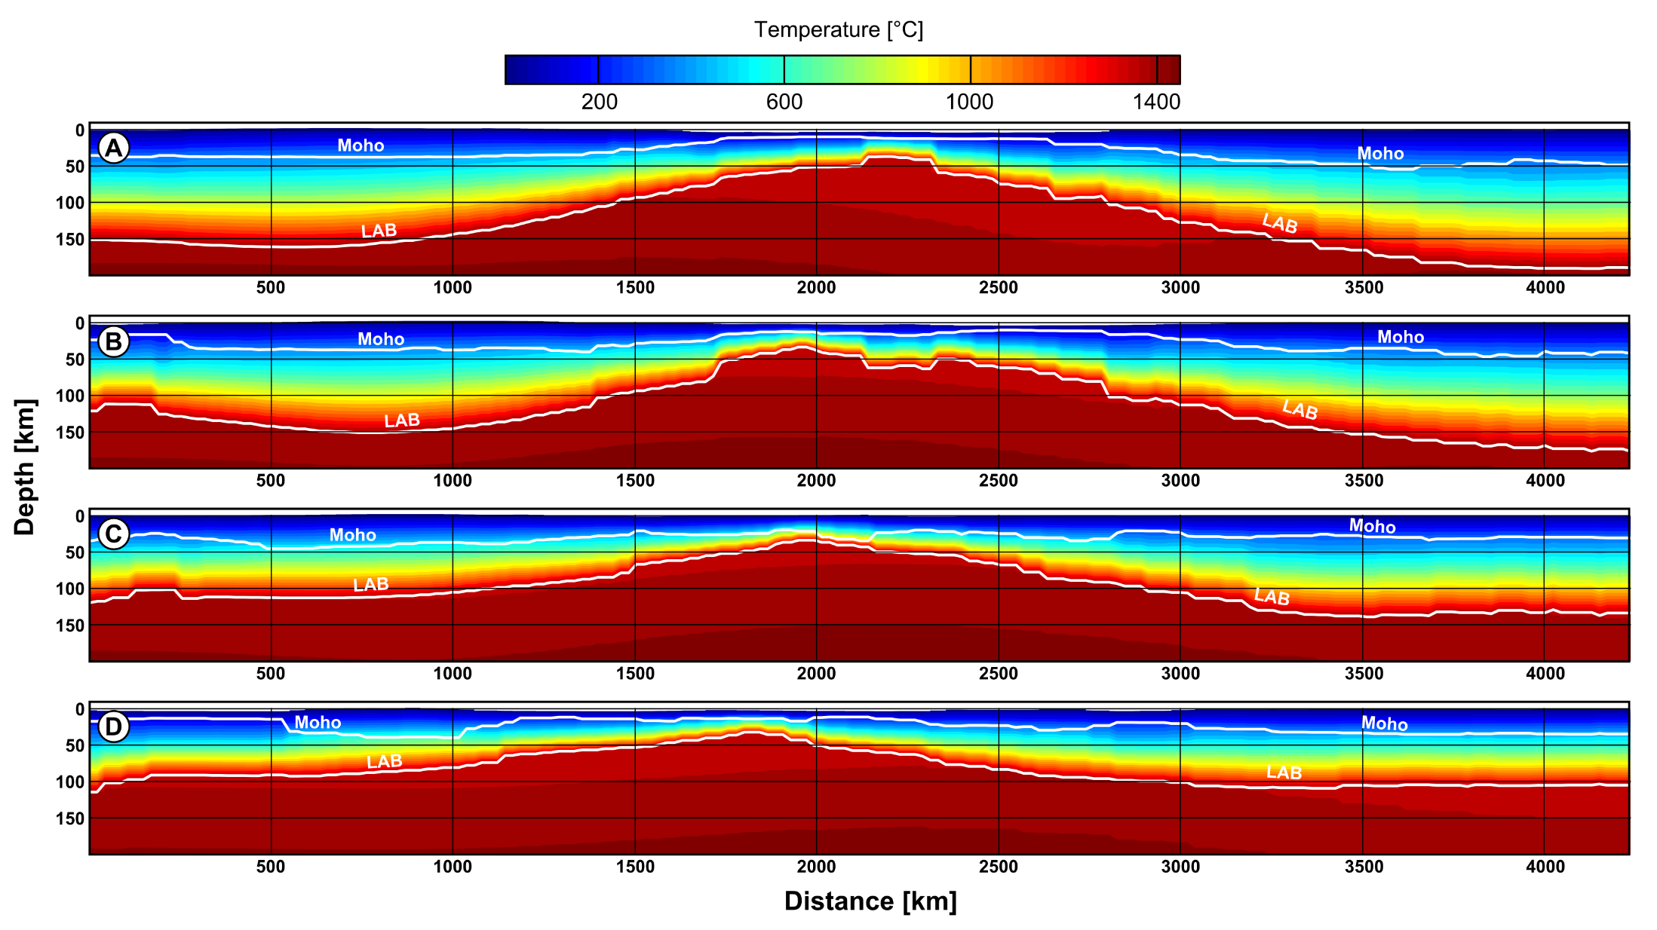
Thermal structure

Slide 10
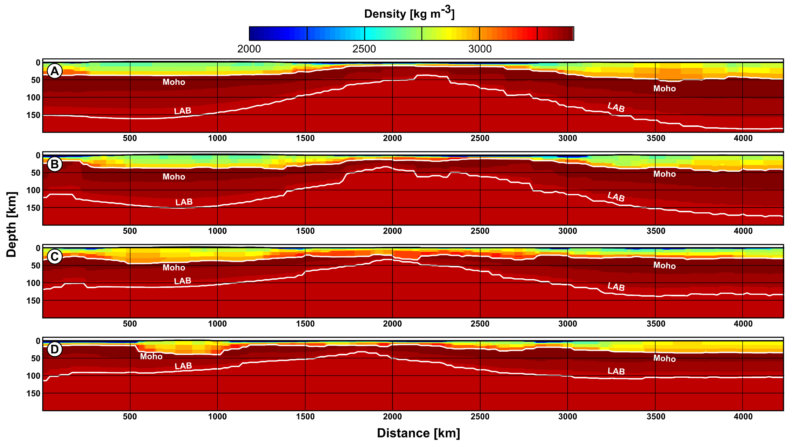
Density structure

Slide 11
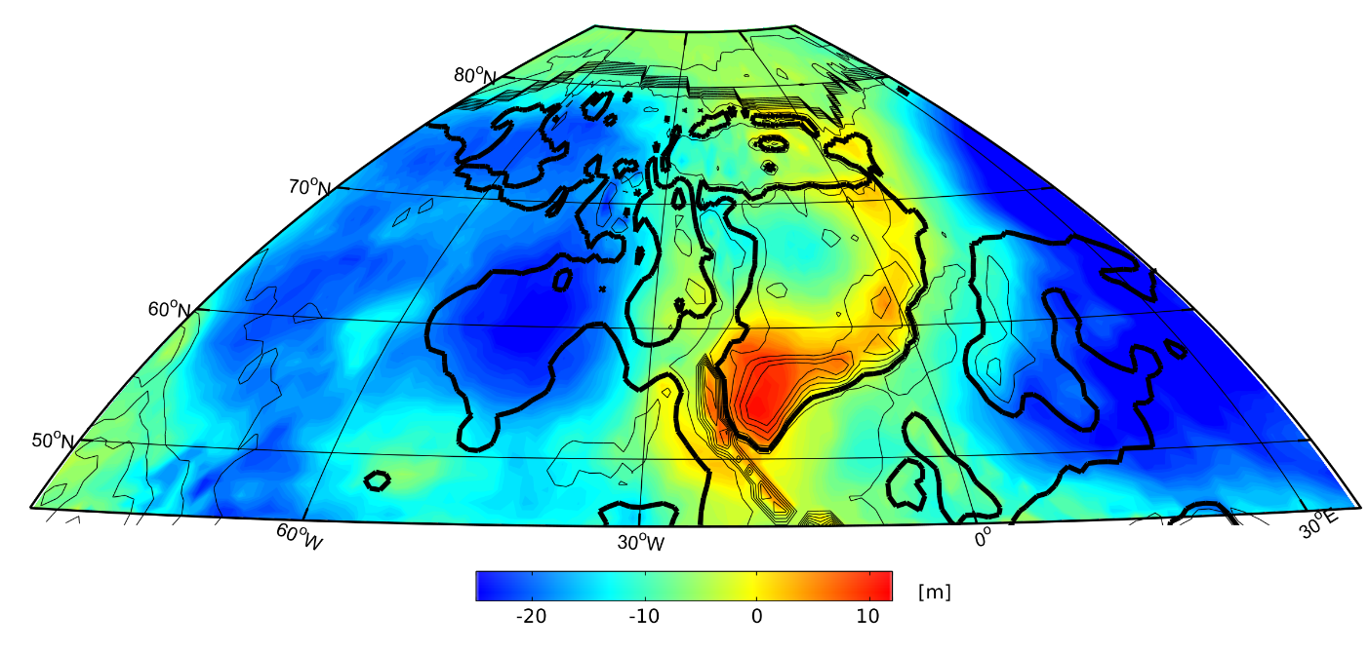
Geopotential energy

Slide 12
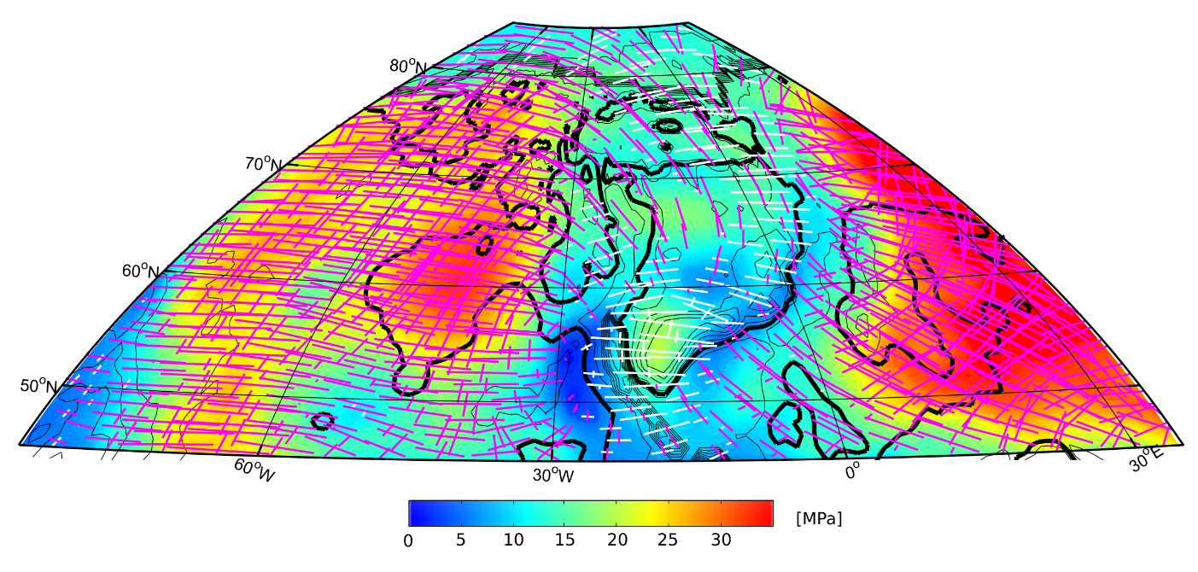
Geopotential stress field

Slide 13
Reconstructions using Gplates
80 Ma
Geoid/GPE
Stress field

Slide 14
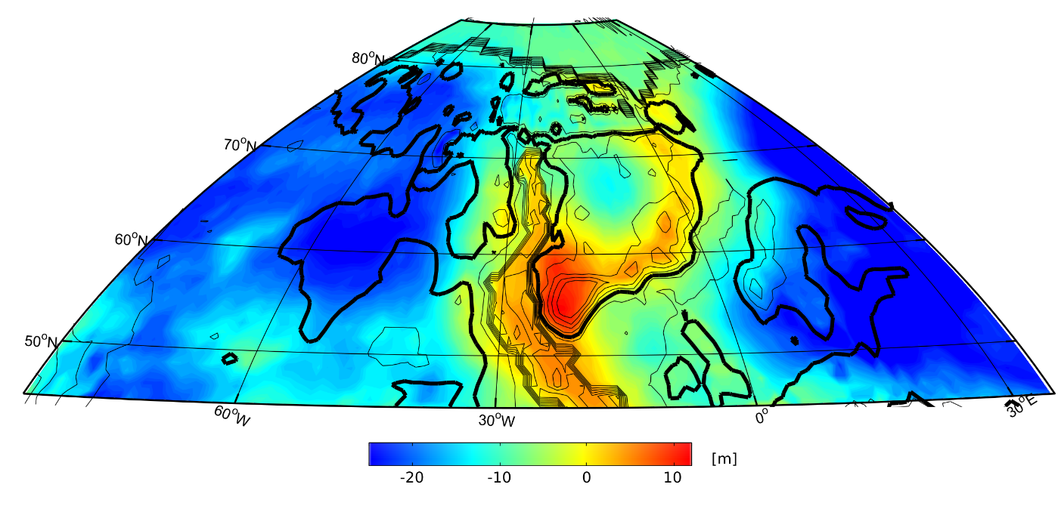
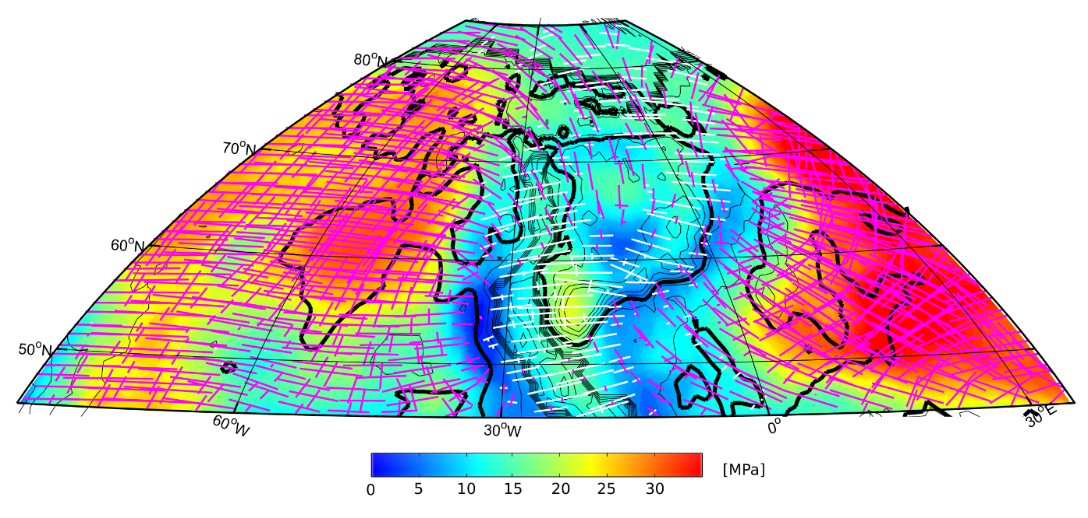
Reconstructions using Gplates
60 Ma
Geoid/GPE
Stress field

Slide 15
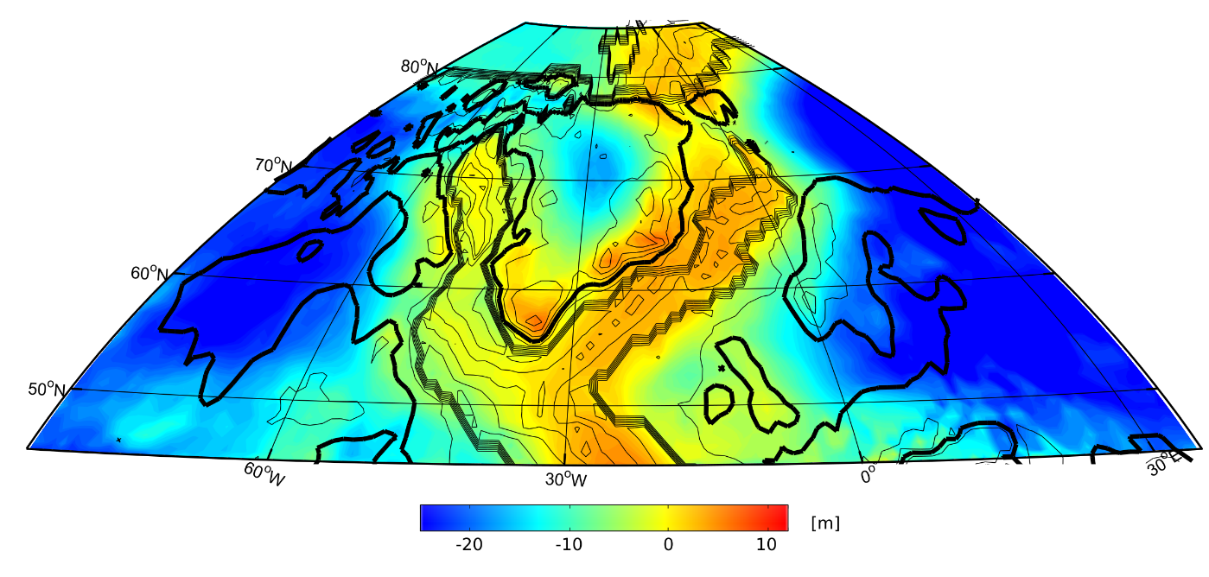
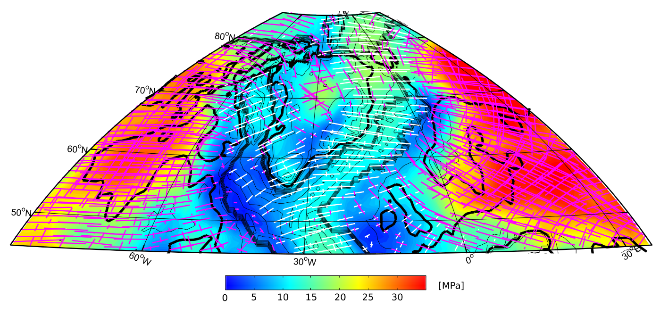
Reconstructions using Gplates
40 Ma
Geoid/GPE
Stress field

Slide 16
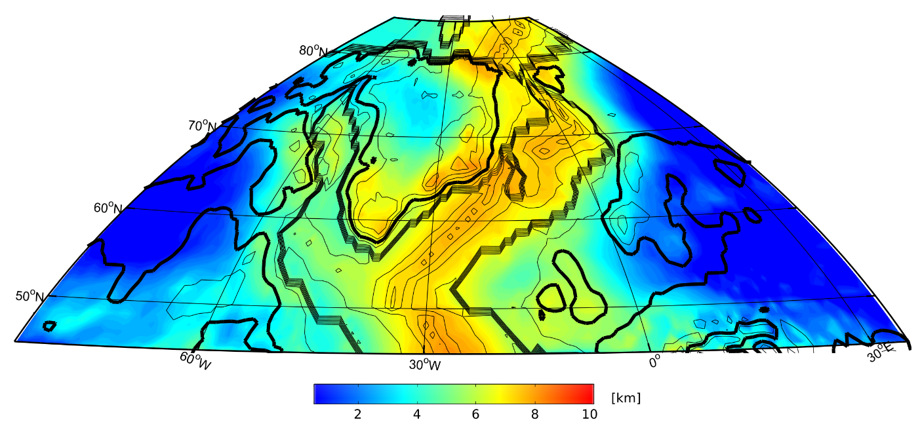
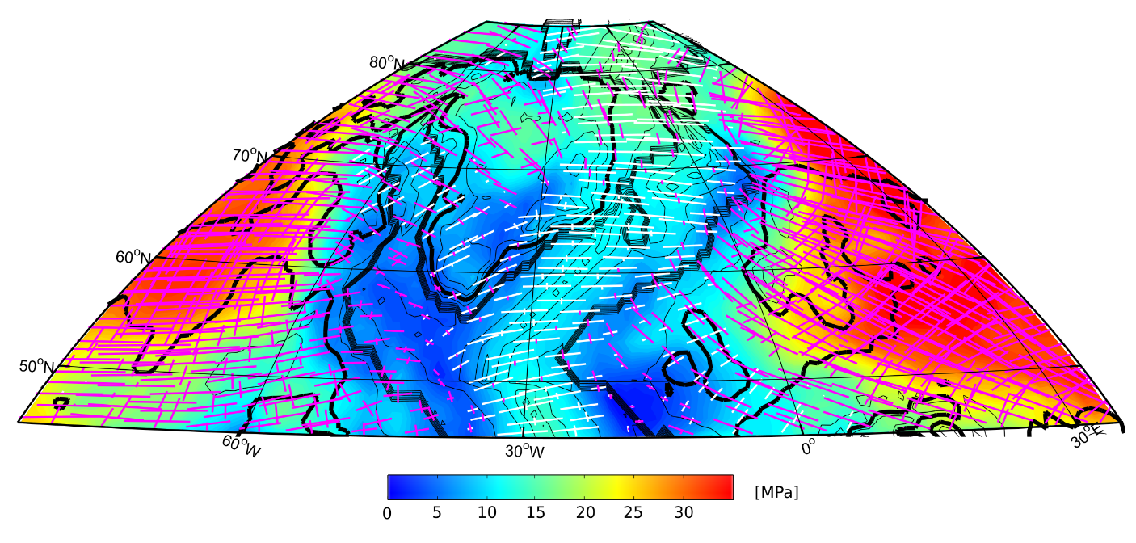
Reconstructions using Gplates
20 Ma
Geoid/GPE
Stress field

Slide 17
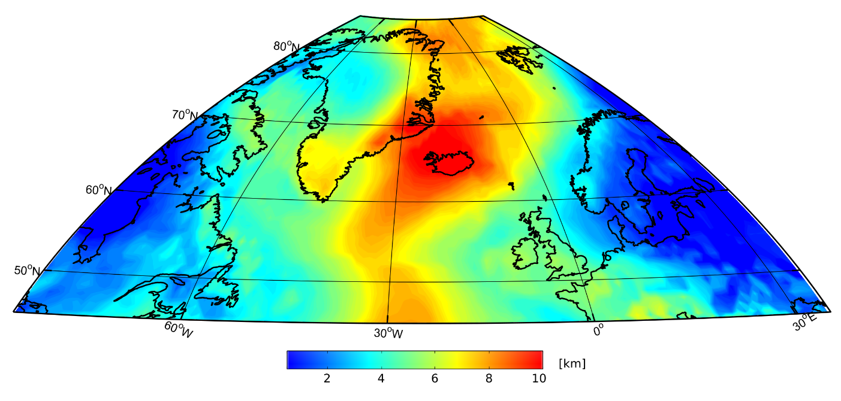
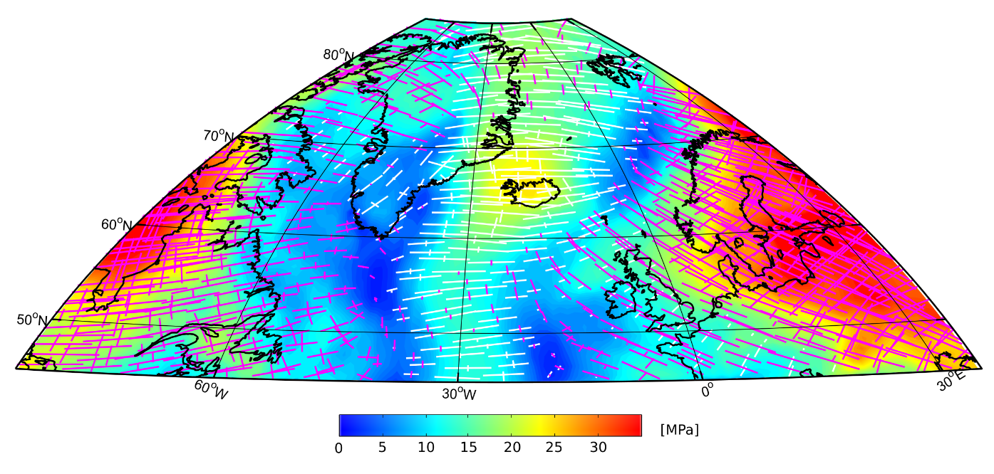
Reconstructions using Gplates
0 Ma
Geoid/GPE
Stress field

Slide 18
80 Ma

Slide 19
60 Ma

Slide 20
40 Ma

Slide 21
20 Ma

Slide 22
0 Ma

Slide 23
60 Ma

Slide 24
40 Ma

