Slide 1
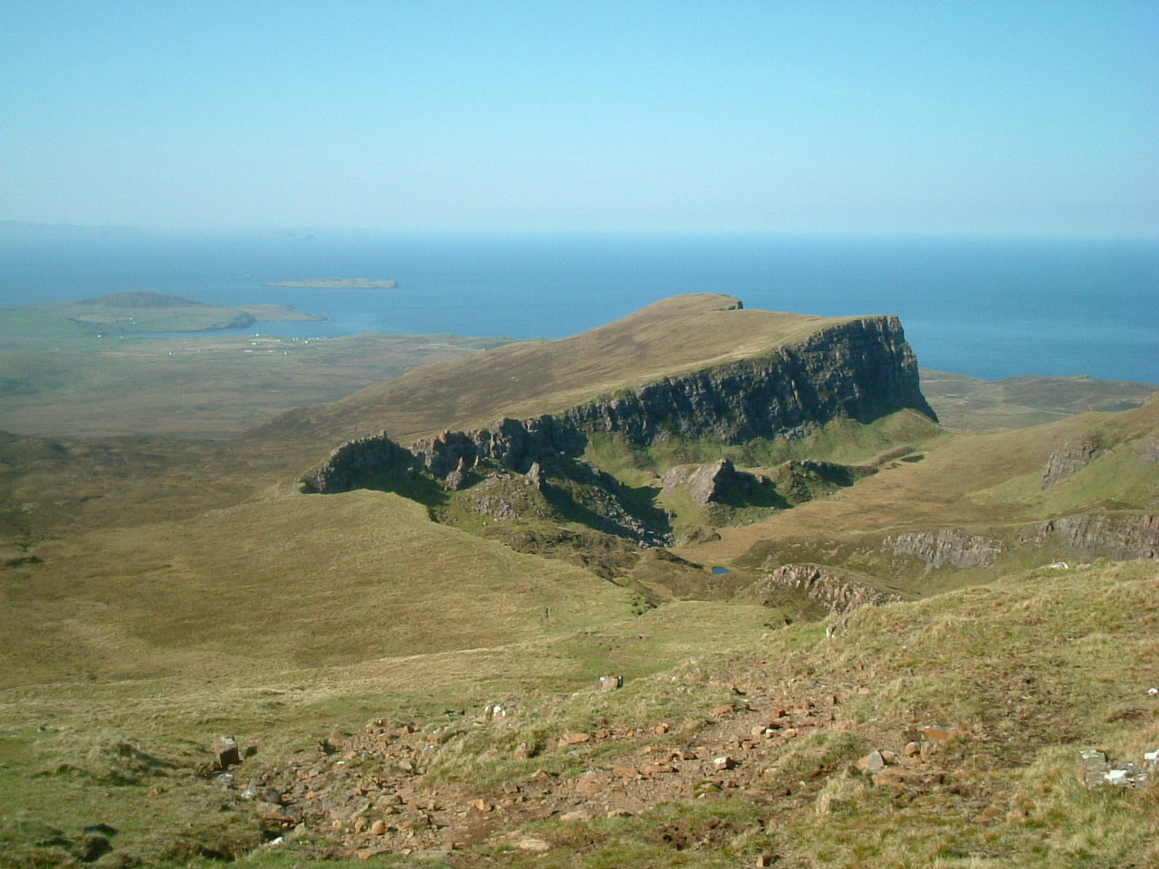


Two geophysical things from Europe (Scotland and Denmark) that tell us something about Iceland and the opening of the North Atlantic
Randell Stephenson

Slide 2
Post-orogenic sedimentary basins formed in an intraplate setting in a generally extensional tectonic setting.
Shortening deformation of these basins (“basin inversion”) occurs later in a generally compressional tectonic setting, the main driving forces linked to surrounding plate boundaries.
1. Dynamics of intraplate sedimentary basin inversion in north-central Europe

Slide 3
regional correlation of tectono-sedimentological-magmatic events in northern Europe and the North Atlantic
precise biostratigraphic dating of linked tectonic events during basin inversion (in Denmark)
a simple dynamic model of the intraplate effects of plate boundary changes
1. Dynamics of intraplate sedimentary basin inversion in north-central Europe

Slide 4
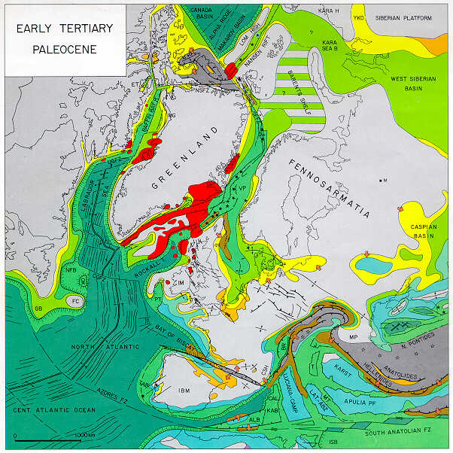
Late Cretaceous-Palaeocene:
intraplate inversion
structures
from Peter Ziegler’s atlas (1990)

Slide 5
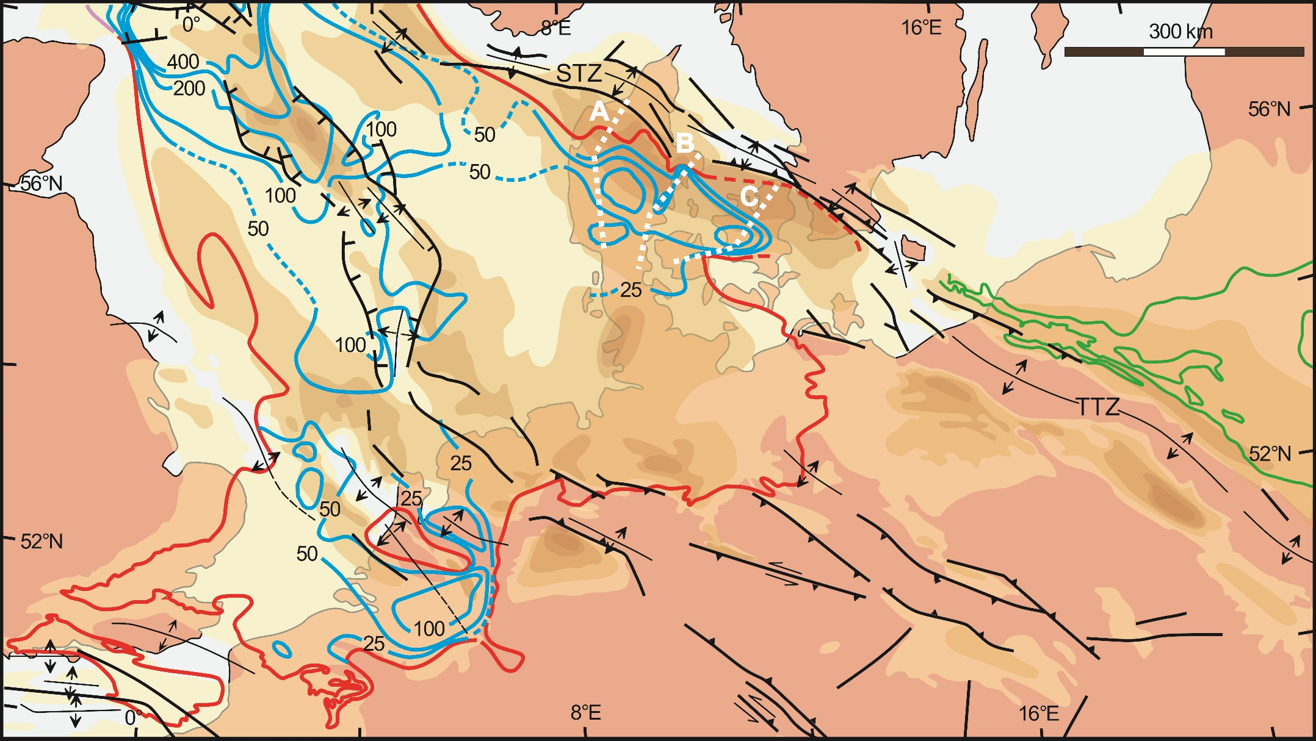
A
B
C
Inversion structures on the European continent; thickness of Late Cretaceous-Danian depocentres (yellow to brown colours increasing to >1500 m respectively), Middle-Late Palaeocene depocentres (blue contours; red line is depositional limit), Polish Basin Palaeocene depocentre (green lines).

Slide 6
Nielsen & Hansen, 2000, Geology

Slide 7
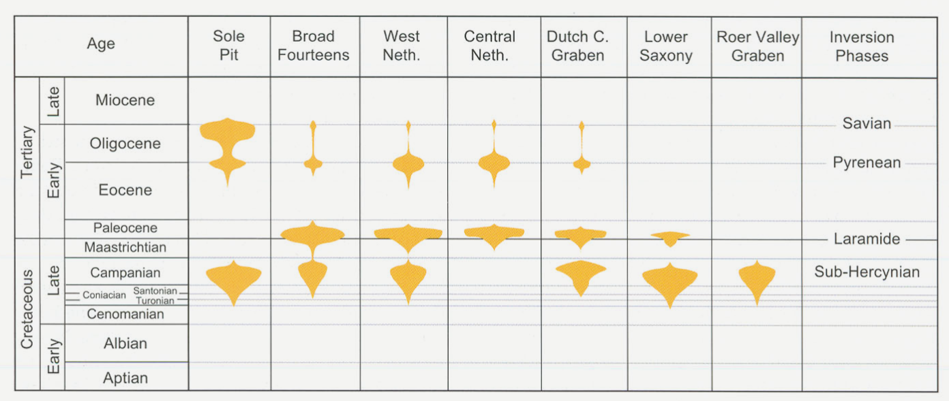
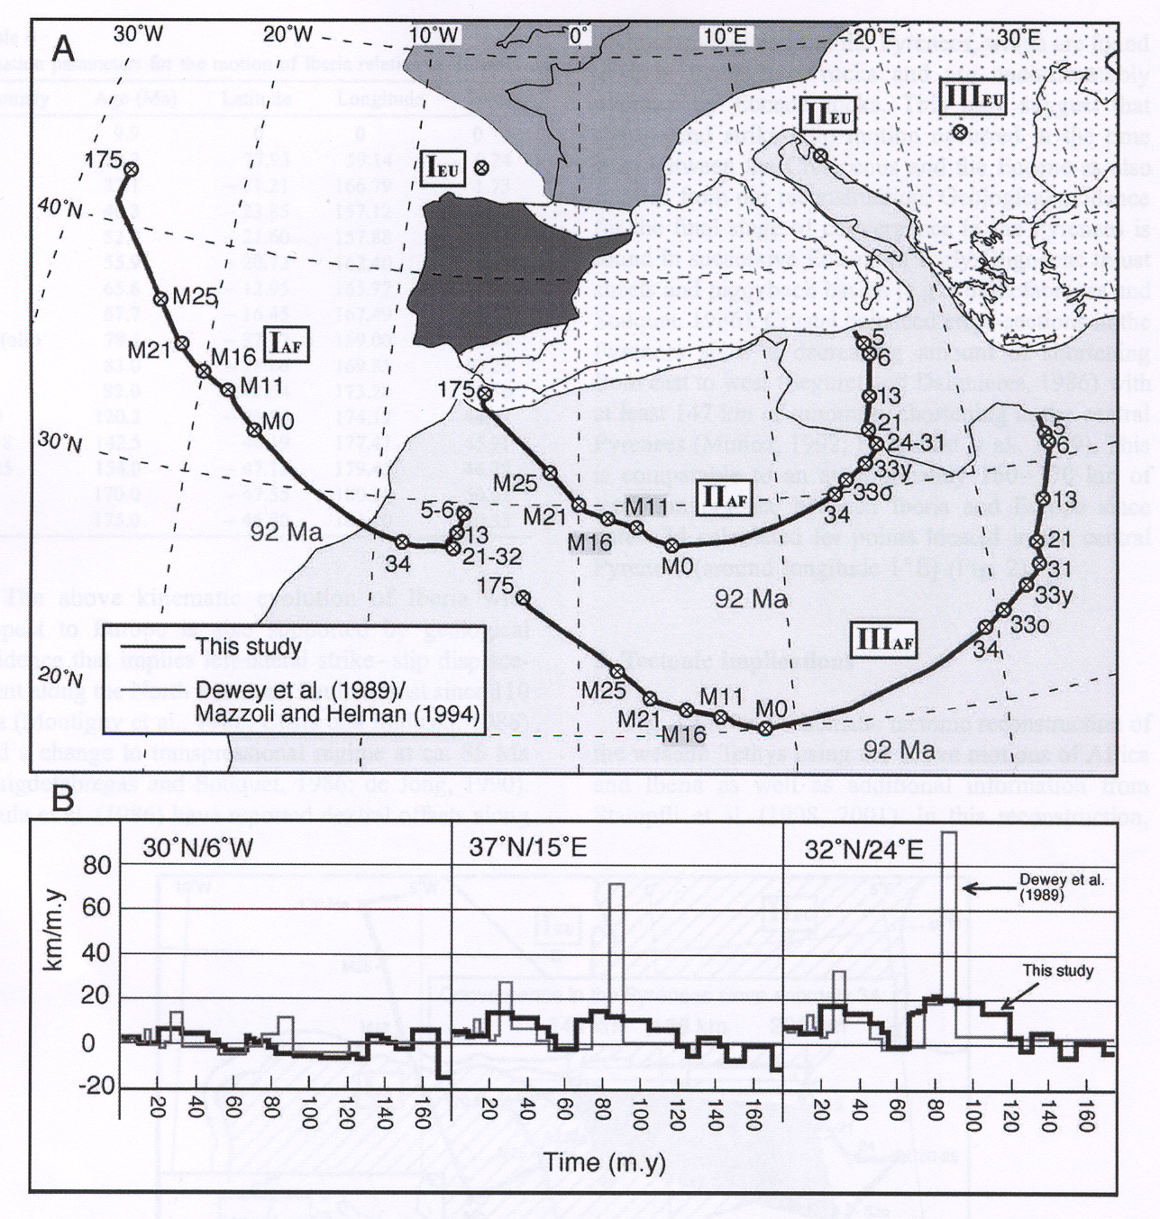
de Jager, 2003
Danish Central Graben, Sorgenfrei-Tornquist Zone, the Weald-Boulonnais Area (England-France), Polish Swell (Holy Cross Mountains), and the Donbas Foldbelt display similar behaviour
Rosenbaum, Lister, and Duboz, 2002

Slide 8
de Jager, 2003
Common interpretation: break in convergence leads to build-up of compression and mid-Palaeocene intraplate inversions in the European plate.
Let’s look at the style and timing of basin inversion in more detail…
Rosenbaum, Lister & Duboz, 2002

Slide 9
Inversion structures on the European continent; thickness of Late Cretaceous-Danian depocentres (yellow to brown colours increasing to >1500 m respectively), Middle-Late Palaeocene depocentres (blue contours; red line is depositional limit), Polish Basin Palaeocene depocentre (green lines).

Slide 10
Precise chrono-stratigraphic data show that the style of intraplate inversion in central Europe (Danish Basin) has an interesting complication (Nielsen, Stephenson & Thomson, 2008, Nature).

Slide 11
Other things that were happening at the
same time
The marginal trough of the inverted Danish Basin during the Palaeocene correlated with major regional, geological events in the North Atlantic realm. An abrupt shift in the depocentre occurs at ~62 Ma (between nannoplankton zones 5 and 6), reflecting a change from compressional to relaxational inversion style in central European intraplate basins [i].
62 Ma
[f] Onset of N. Atlantic volcanism and ridge spreading between Greenland and Norway. [g] Input of clastic sediments into the northern North Sea (Maureen Formation) coinciding with the Danian-Selandian boundary. [h] Temporary stop in convergence between Africa and Europe bracketed by datings of 65.6 Ma and 55.9 Ma.

Slide 12

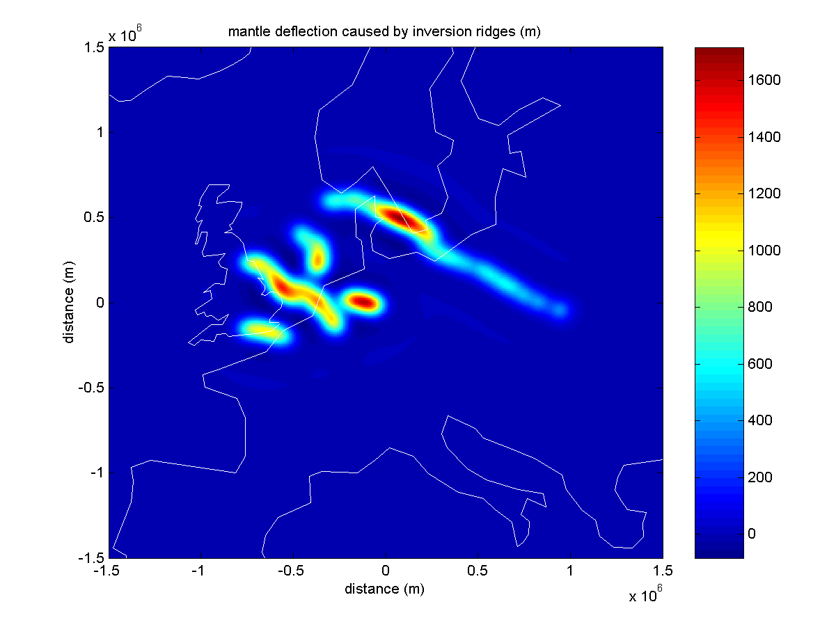
the “geology”
initial deflections from the geology

Slide 13
the “geology”
initial deflections from the geology

Slide 14
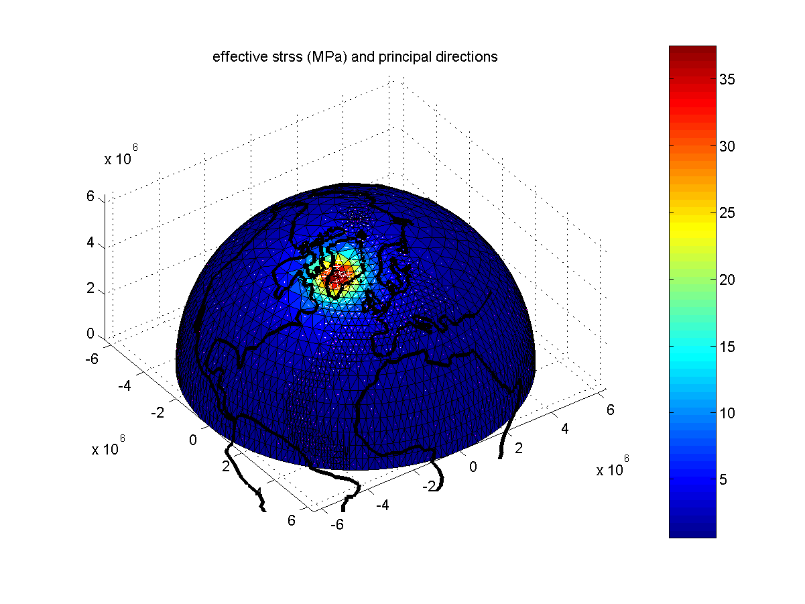
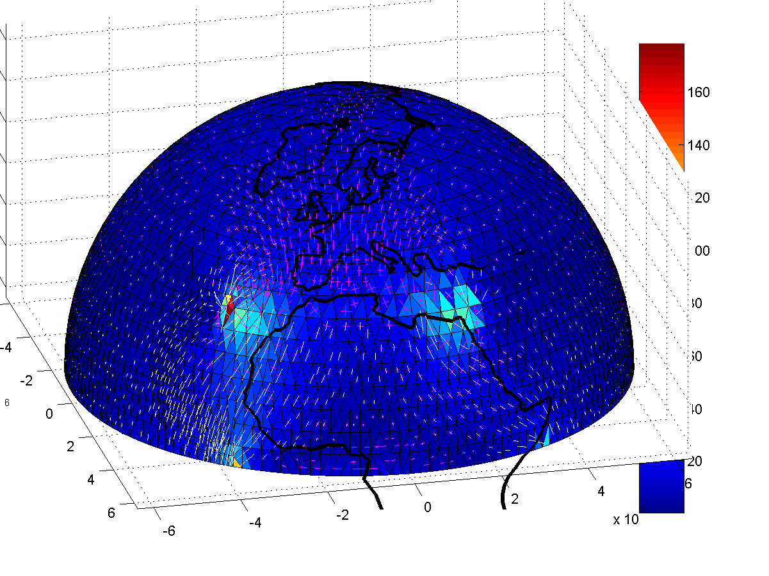
the “geology”
+ Iceland plume arrival
+ Africa push
initial deflections from the geology

Slide 15
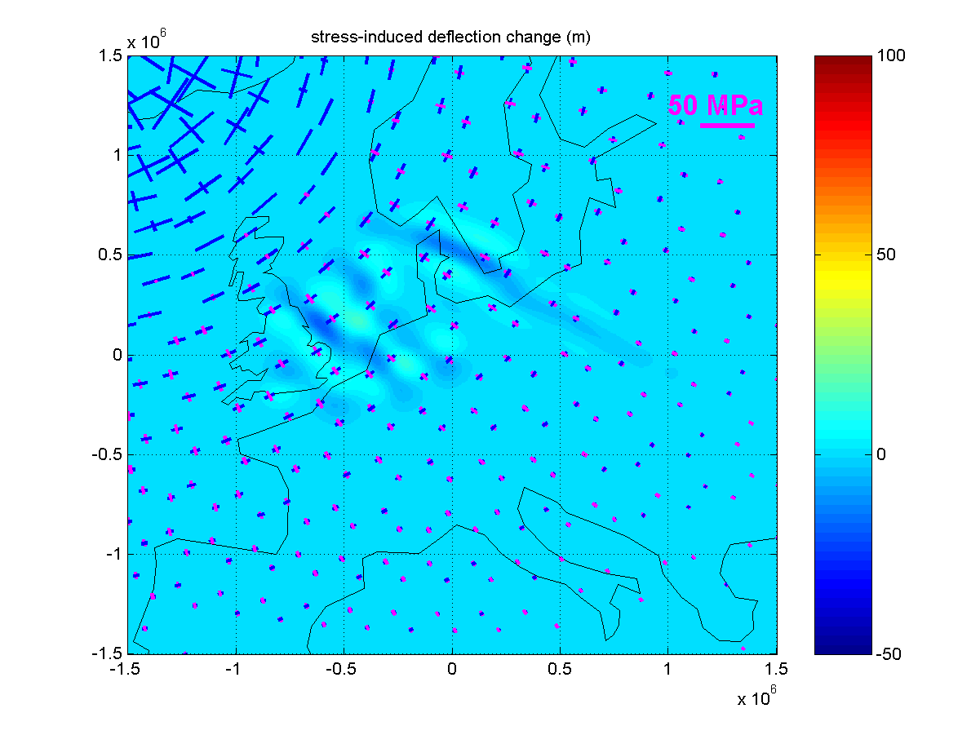
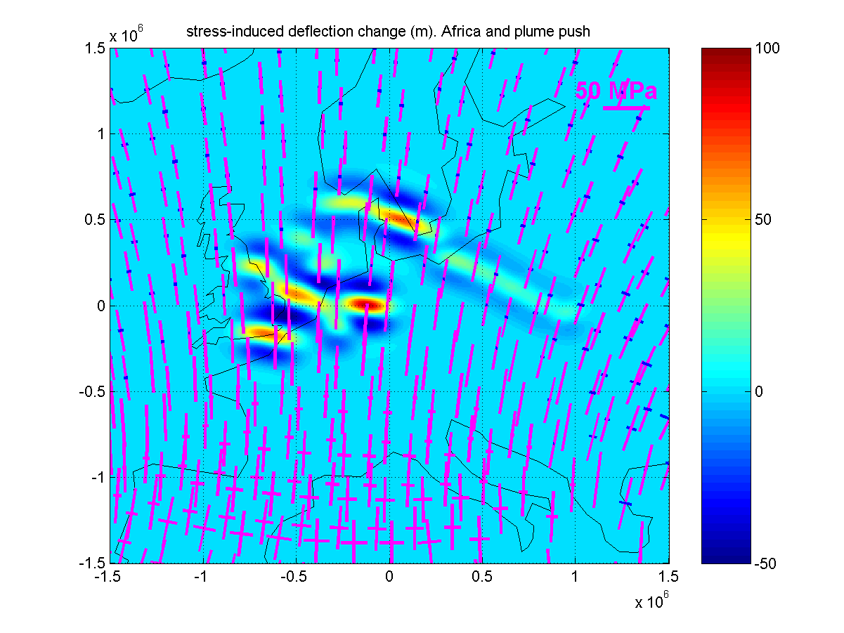
blue: extension – red/purple: compression
Iceland plume arrival
Extension perpendicular to strike of structures yields low-amplitude uplift
Africa push
Compression perpendicular to strike of structures yields over-deepening
initial deflections from the geology

Slide 16
blue: extension – red/purple: compression
Africa push cessation
An uplift of the same magnitude occurs - the inversion relaxation – when the push disappears with Europe’s NE translation starting at ~62 Ma. The initial (Late Cretaceous) inversion occurred when Europe had previously been caught between a rock (Greenland) and a hard place (Africa).
initial deflections from the geology

Slide 17
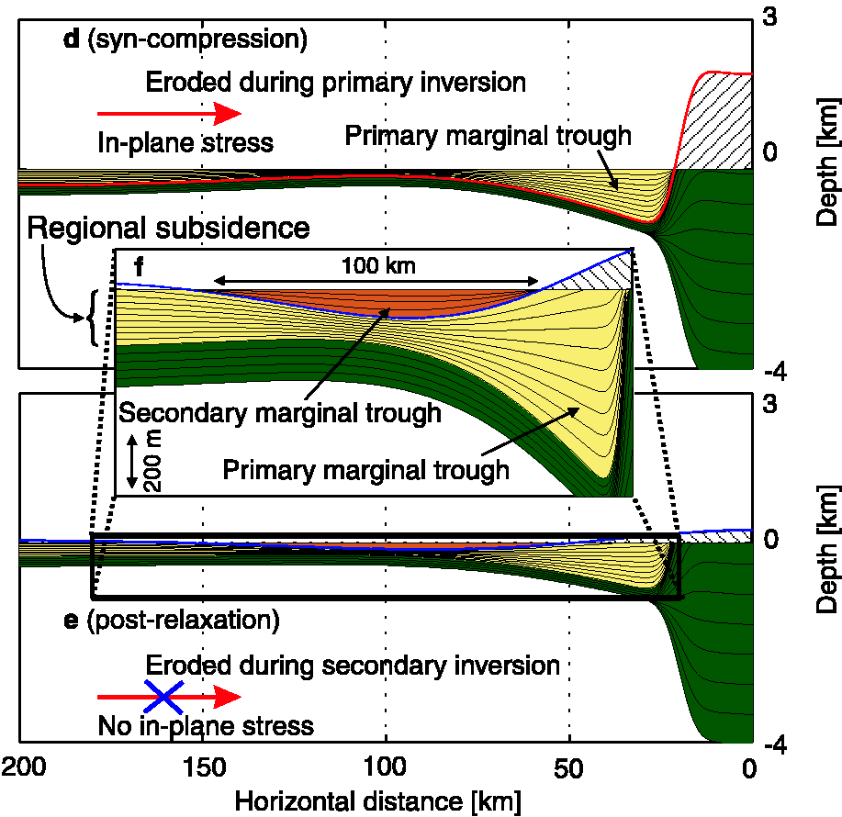
There was actually a sudden reduction of compression resulting in “inversion relaxation” (called “secondary inversion” in this figure; Nielsen et al. 2005).
It appears to be plate-wide and “synchronous” at ~ 62 Ma and is caused by a reduction of the stress
component perpendicular to the strike of the structure, therefore being a sensitive barometer of in-plane stress change.

Slide 18
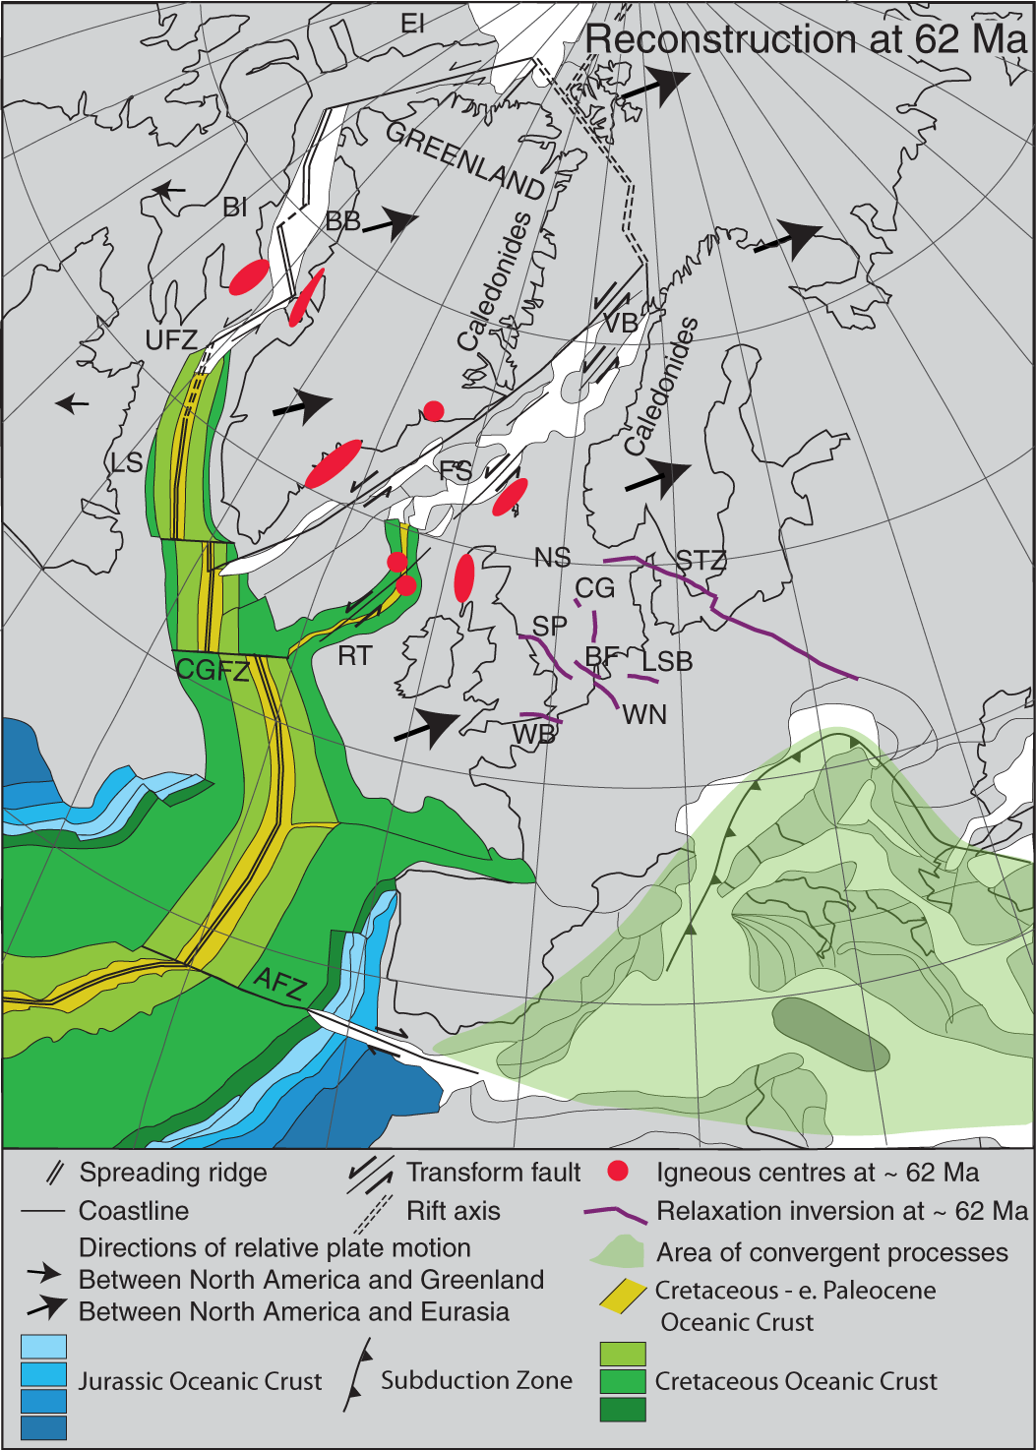
The Atlantic Ocean propagates northwards between Canada and Greenland – Cretaceous
Africa-Europe convergence “locks” and intraplate basins “invert” (crustal shortening) – Late Cretaceous
Europe (Eurasia) yields by breaking rapidly southeast of Greenland – mid-Palaeocene:
  overcompensated inverted basins relax
  Africa and Europe move together to the NE (no relative convergence)
  decompression melting and sudden magmatism
  Greenland more freely rotates leading initially to more rapid sea-floor spreading in Labrador Sea and Baffin Bay
Greenland-Canada convergence causes the Eurekan Orogeny – Late Palaeocene-Eocene
Atlantic northward propagation through the Canada-Greenland craton is abandoned in favour of the easier Caledonian route

Slide 19
The style of basin inversion in north-central Europe is consistent with rapid “plate fracture” in the incipient North Atlantic.
The style of basin inversion in north-central Europe is inconsistent with the slow arrival of a thermo-magmatic mantle plume in the incipient North Atlantic.
1. Dynamics of intraplate sedimentary basin inversion in north-central Europe – message

Slide 20
a “tie” from one conjugate margin to another used in plate tectonic reconstructions
usually a geological feature at the surface or near-surface structures mapped from geophysics
correlation (for the first time) of a lithosphere mantle feature from one conjugate margin to the other
2. A sub-crustal piercing point for North Atlantic reconstructions and tectonic implications

Slide 21
new data and something new discovered (in East Greenland) and old data and an old discovery (in Scotland)
recognition of a correlatable, inherited sub-crustal structure in the pre-North Atlantic mantle lithosphere
some interesting things about this correlation
2. A sub-crustal piercing point for North Atlantic reconstructions and tectonic implications

Slide 22
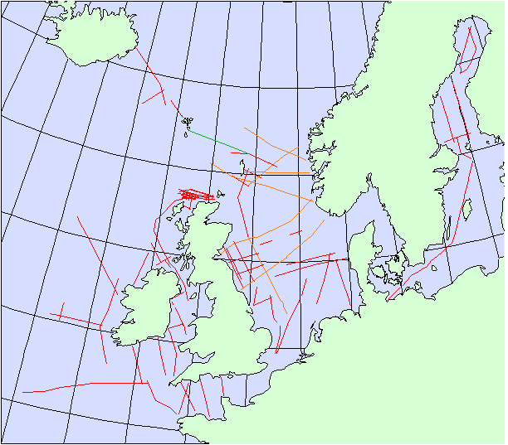
Flannan reflector

Slide 23
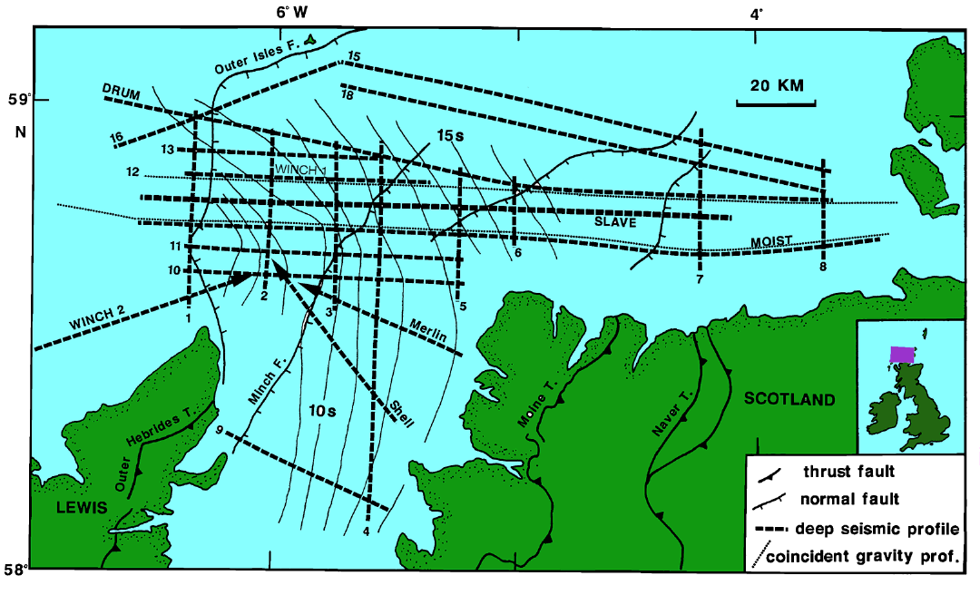
Flack and Warner, 1990

Slide 24
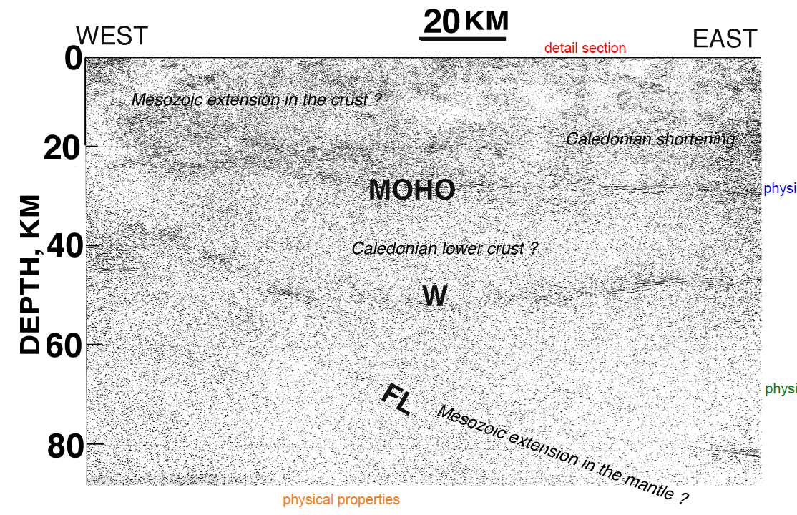
DRUM
BIRPS Atlas II

Slide 25
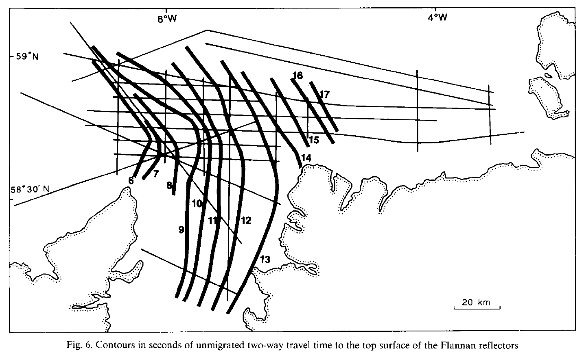
Flack and Warner, 1990

Slide 26
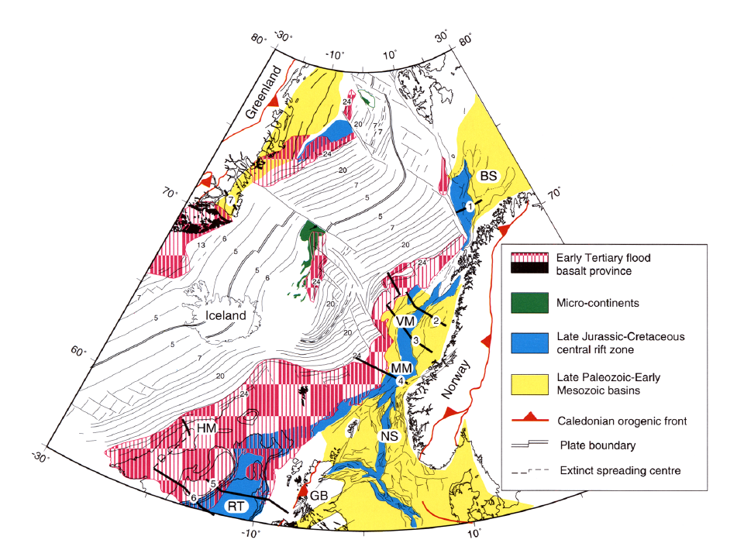
Skogseid et al., 2000
Ella Ø “converter”
Flannan reflector

Slide 27
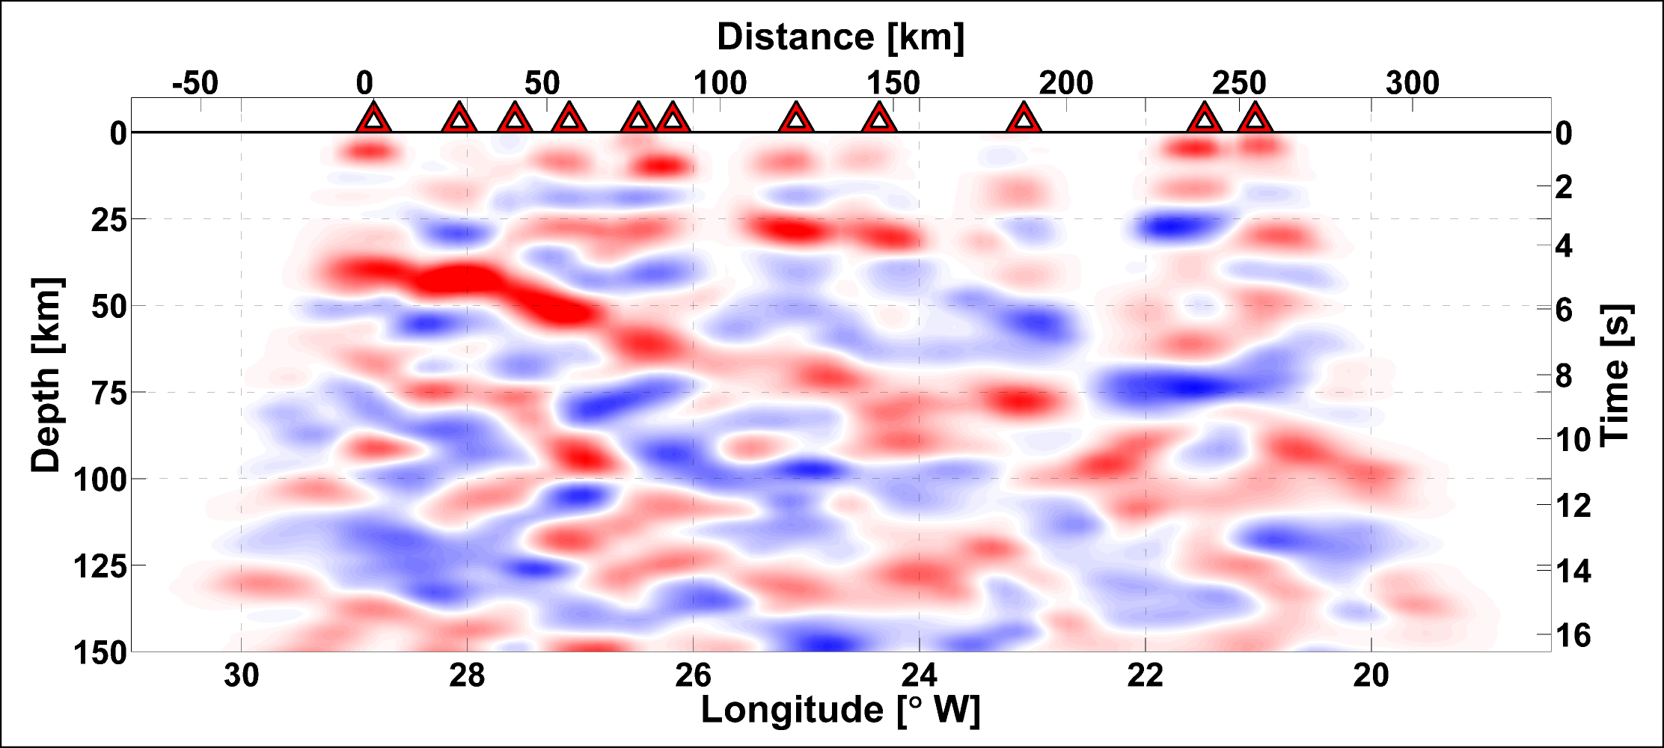
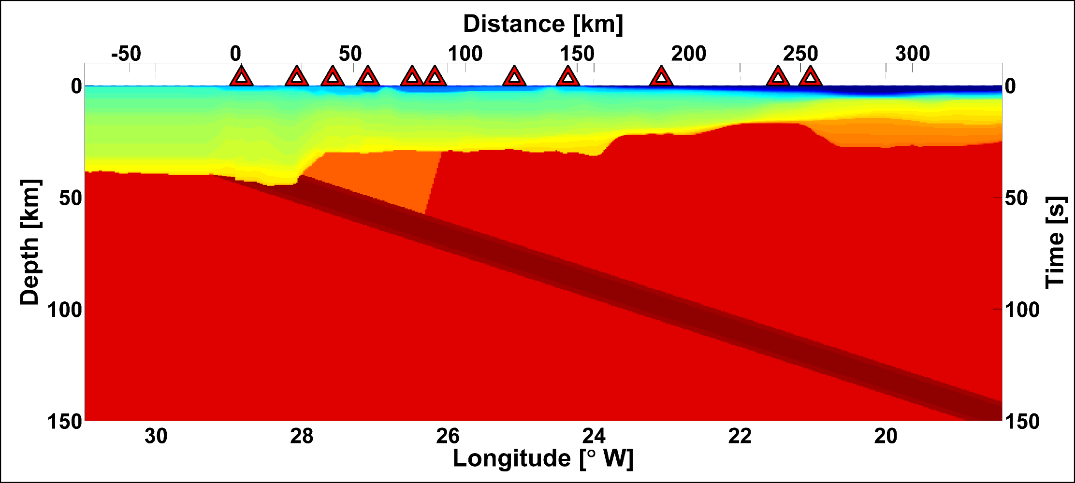
observed RFs
structural model, based on WARR crust-upper mantle velocity model (Schlindwein, V., and Jokat, W., 1999; Voss, M., and Jokat, W., 2007)
with 8 km thick 22° dipping slab with Vp=8.4 km/sec
Schiffer et al., 2014, Geology

Slide 28
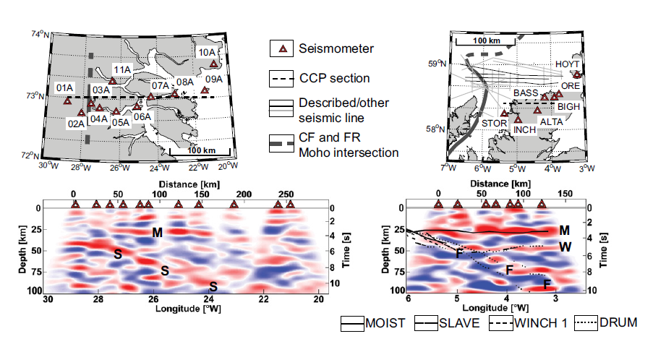

Slide 29
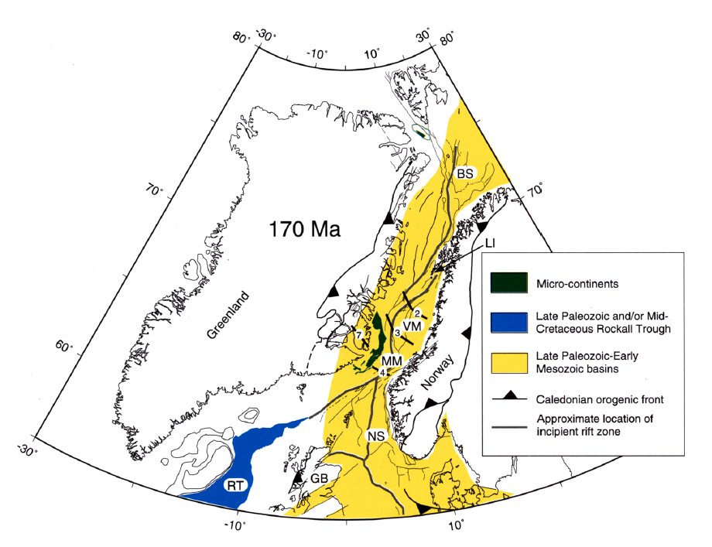
Skogseid et al., 2000

Slide 30

Skogseid et al., 2000

Slide 31
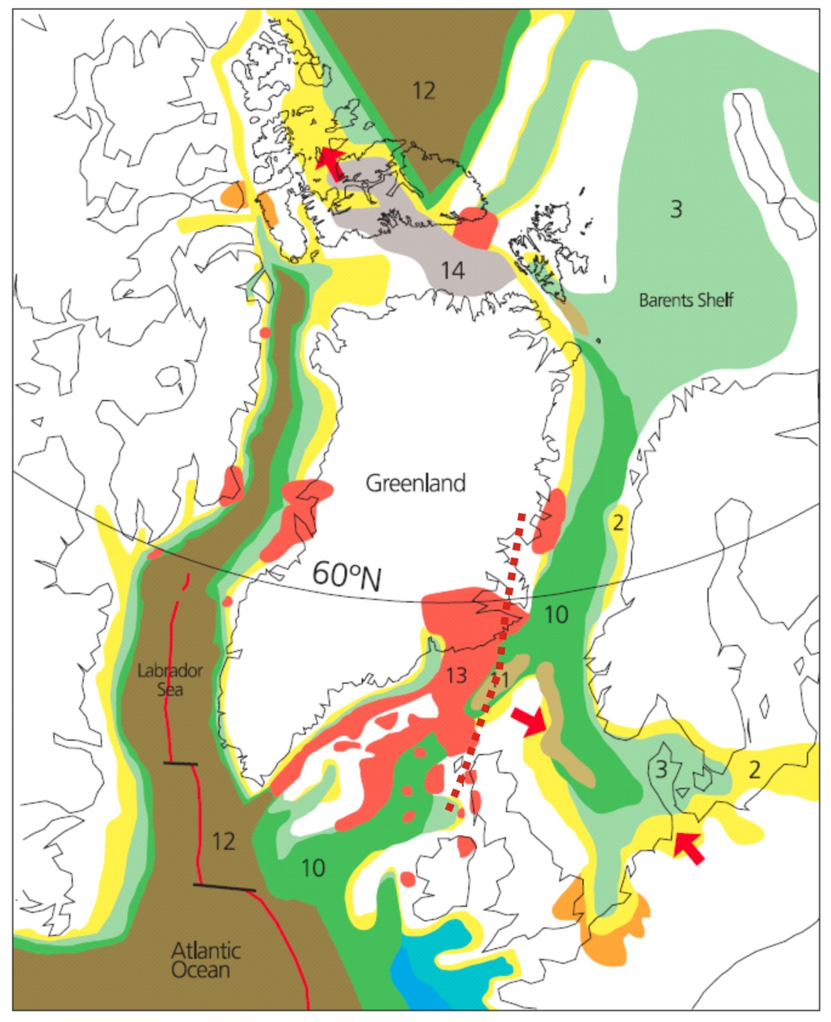
The magmatism (13) is ascribed by many to the “Iceland plume”, which is thought to have arrived at the base of the lithosphere around this time.
Palaeocene (60 Ma)
Torsvik et al., 2004

Slide 32
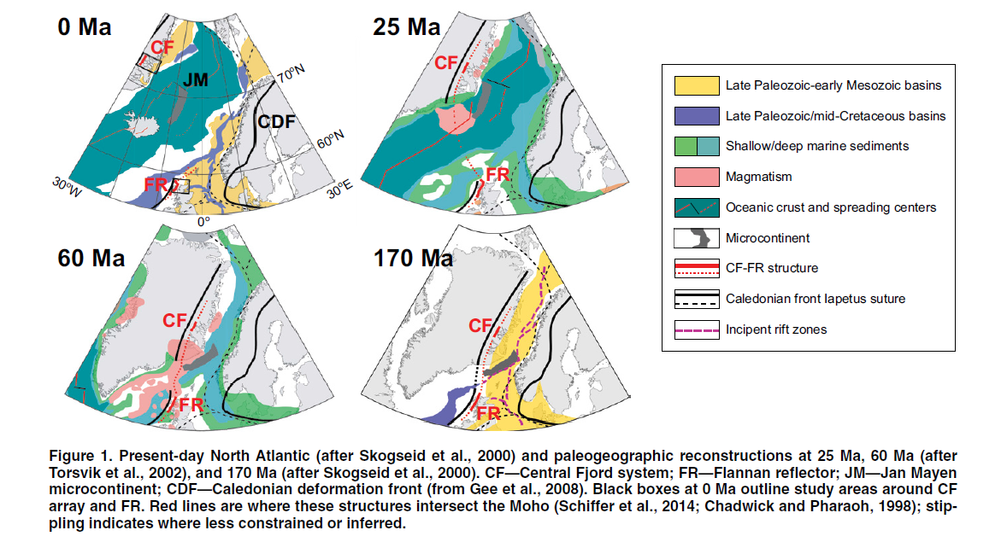
Schiffer et al. 2015. Geology

Slide 33
There is a fundamental, lithosphere-scale structure in the Laurentian lithosphere of the North Atlantic and the tectonic style of post-Caledonian geological evolution changes across this structure.
The present location of Iceland is at the intersection of this structure with the locus of rapid fracturing initiating ocean formation.
2. A sub-crustal piercing point and North Atlantic tectonic implications - message

