Slide 1
Top Driven Asymmetric Mantle Convection
Don
Anderson
Carlo
Doglioni
Sicily - 1990

Slide 2
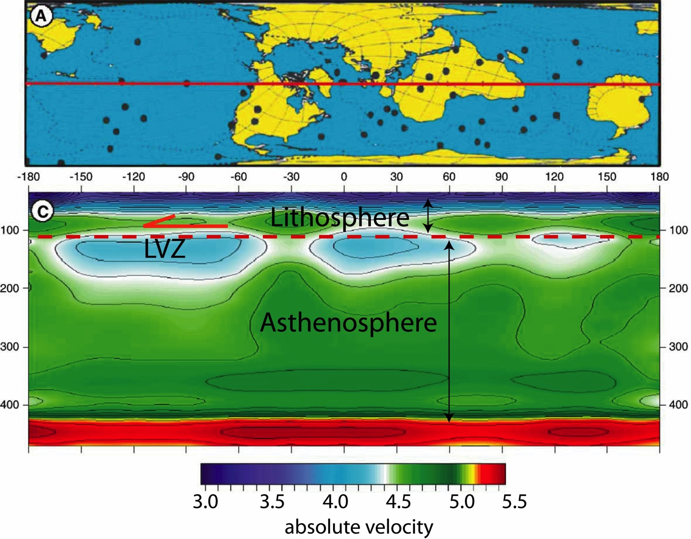
LowVelocity Zone
decoupling
Modified after Thybo, 2006
Riguzzi et al. 2010 Tectonophysics
Vs, km/s

Slide 3
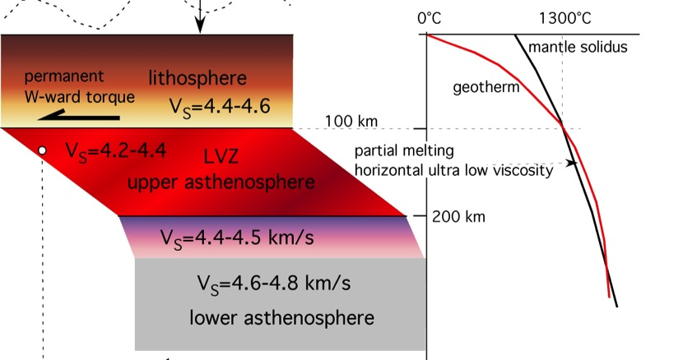
LowVelocity Zone
Modified after Thybo, 2006
Riguzzi et al. 2010 Tectonophysics
Riguzzi et al. 2010 Tectonophysics

Slide 4
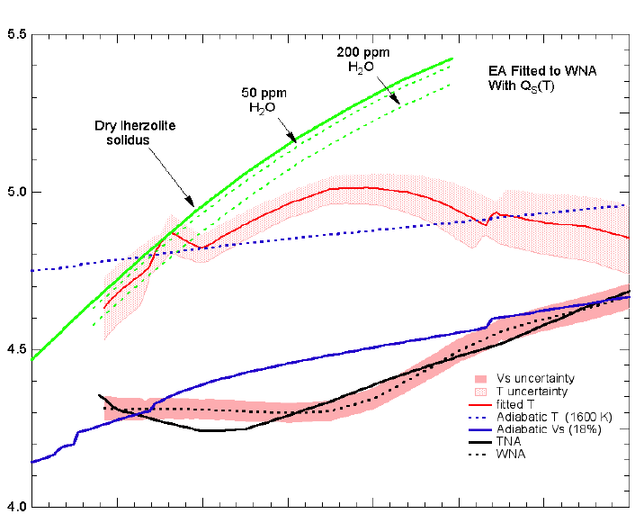
4 km/s
Vs
4.5
Tp
5.0
5.5
Vs wavespeed
CONDUCTIVE LITHOSPHERE
Dry lherzolite
solidus
insulation
100
pargasite breakdown
50 ppm
H₂O
Depth km
SUPERDIABATIC REGION
LVZ
Canonical 1600 K adiabat
Thermal bump region (OIB source)
200
Lehmann discontinuity
Geotherm from seismic gradients
300
SUBADIABATIC REGION
Modified after Xu et al. 2011, GJI
1600
1800
2000 K
T
Notes:
Laminated Lithologies (LL) and Region B00 contained Aligned Melt Accumulations (AMA).
Wavespeed gradients imply subadiabaticty below ~200 km. The average temperature increase inferred from seismic gradients across the upper 200 km of the mantle is ~1530 K. This causes the negative seismic wavespeed gradient and the Gutenberg low velocity zone, as has long been known but often ignored.
Thermodynamic inversion of seismological data show that there is at least a 200 C decrease in temperature between 200 km and the base of the transition zone…gradients of wavespeeds exceed those predicted for adiabatic self-compression of a homogeneous mantle for depths between 200 and > 350 km depth. (seismic gradients imply
subadiabaticity over most of the mantle Bullen, Birch)

Slide 5
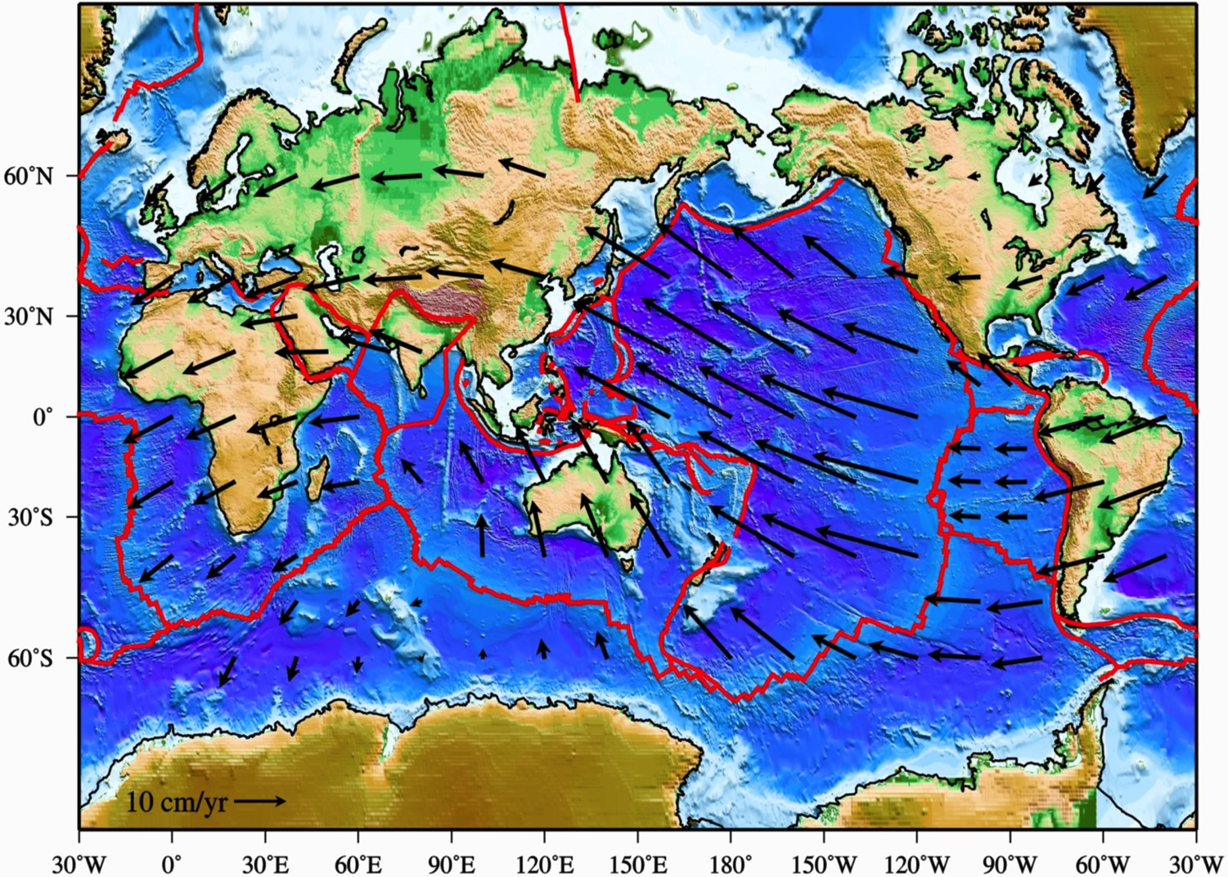
WESTWARD DRIFT OF THE LITHOSPHERE AND TECTONIC EQUATOR
Tectonic Equator
Shallow hotspot reference frame
Cuffaro & Doglioni, 2007 GSA Sp. Publ.

Slide 6
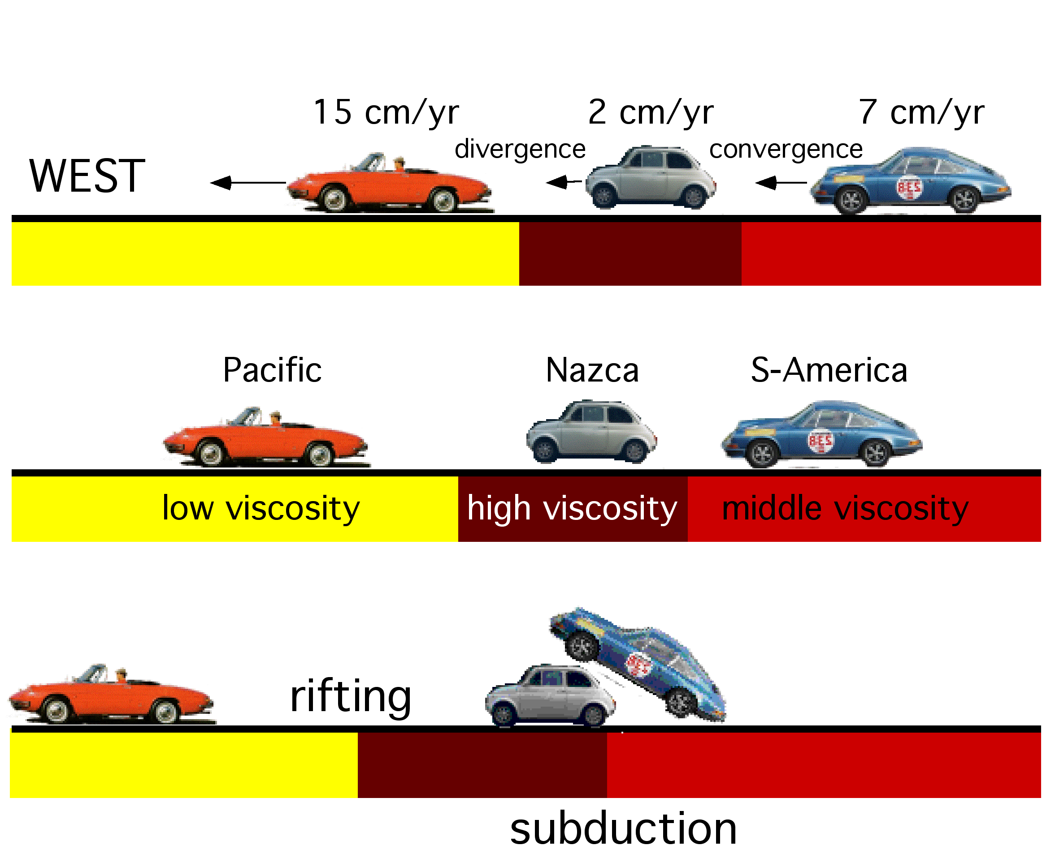
Westward drift of plates constrained by viscosity variations in the LVZ
LVZ
Cuffaro & Doglioni, 2007 GSA Sp. Publ.

Slide 7
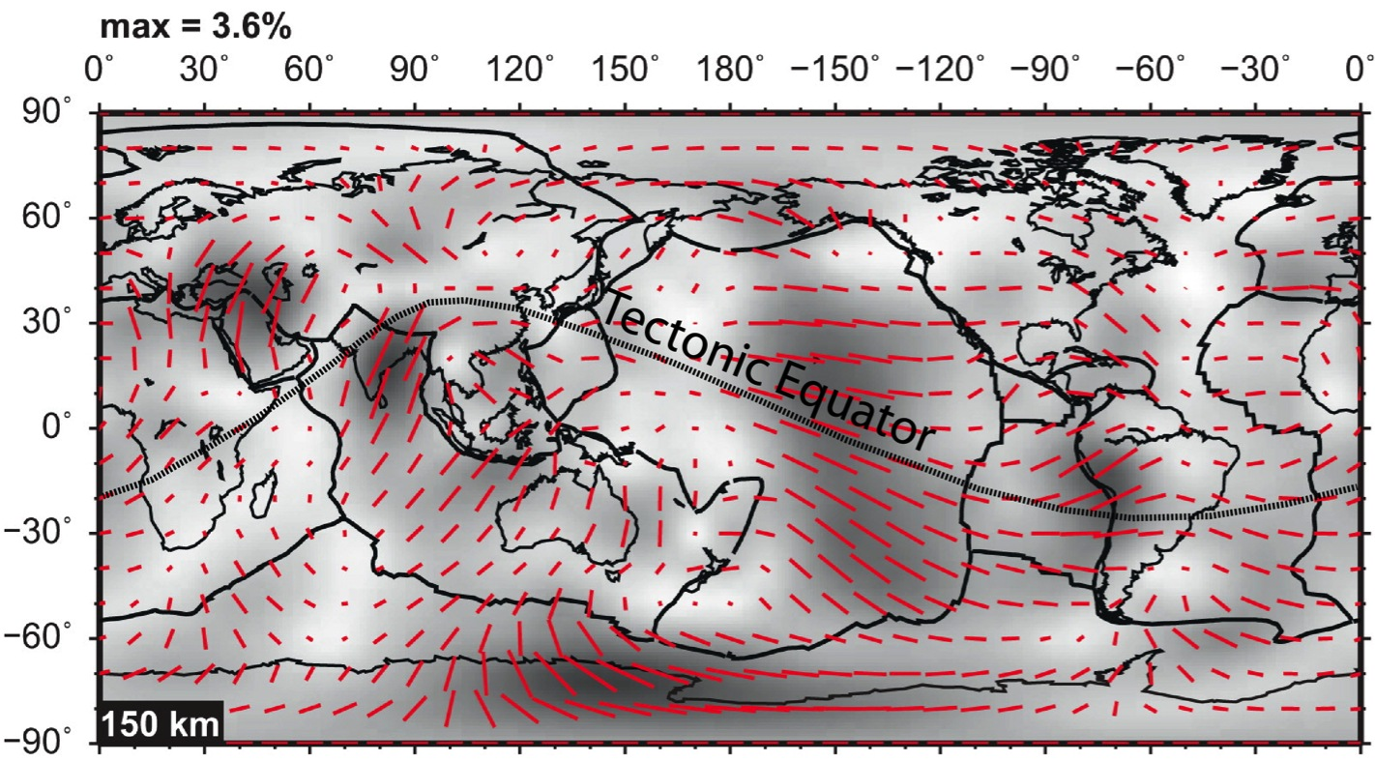
The tectonic equator fits the SKS of the LVZ
Modified after Yuan & Beghei, 2013 EPSL
In Doglioni & Anderson 2015, GSA-AGU Volume

Slide 8
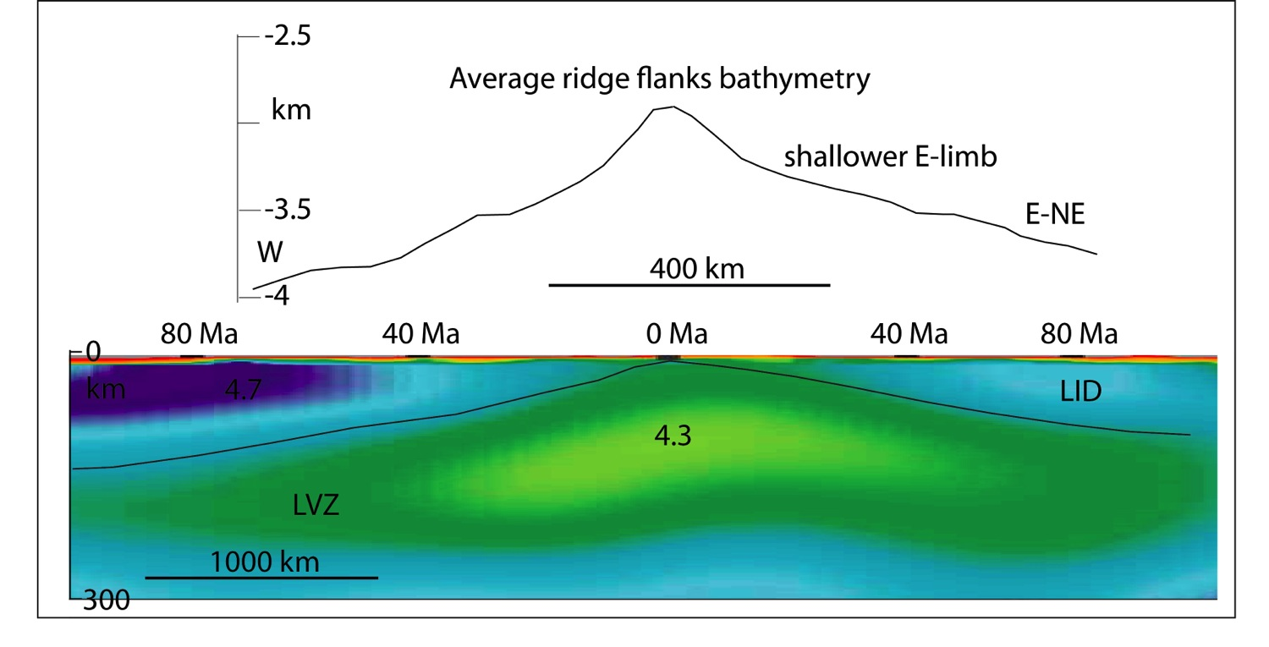
Asymmetric rifts
Mid Atlantic Ridge
Doglioni et al. 2014, Geoscience Frontiers

Slide 9
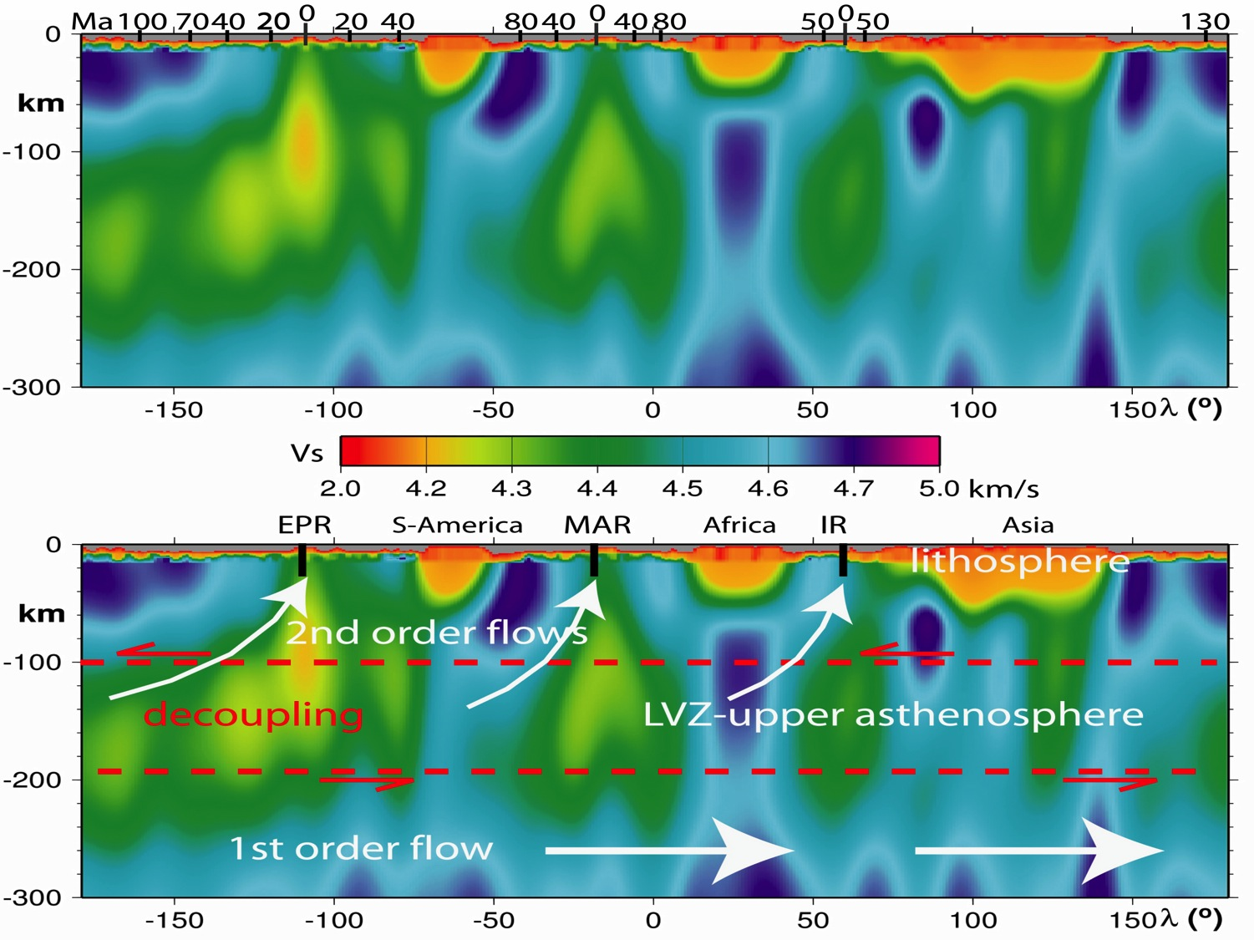
Asymmetric S-wave signature of ridges (faster western side)
Panza et al. 2010 Geology

Slide 10
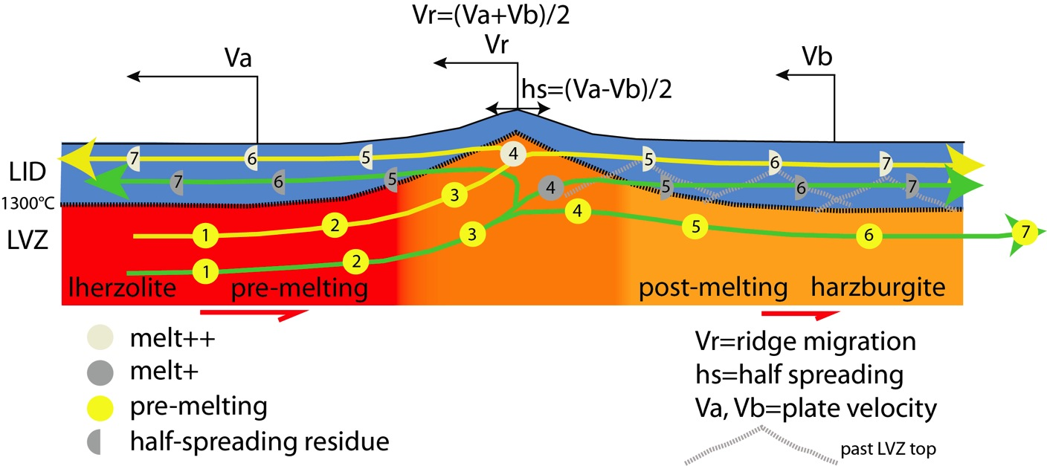
Westerly migrating ridge → LVZ & LID lateral heterogeneity & asymmetry
Chalot-Prat & Doglioni in prep.

Slide 11
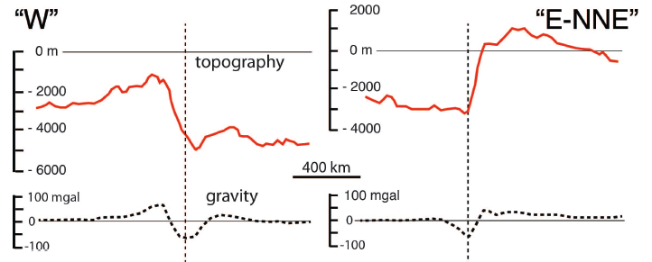
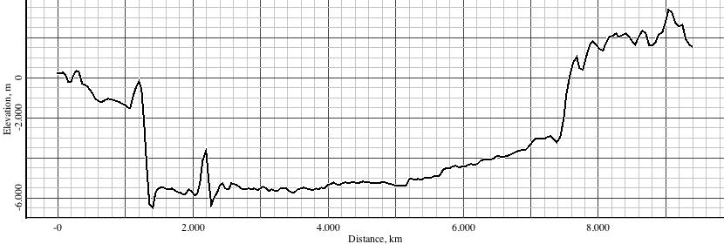
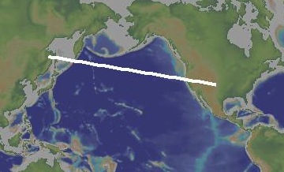
Asymmetric signature of topography and gravity
N-CORDILLERA
KURILI
Harabaglia & Doglioni, 1998, GRL

Slide 12
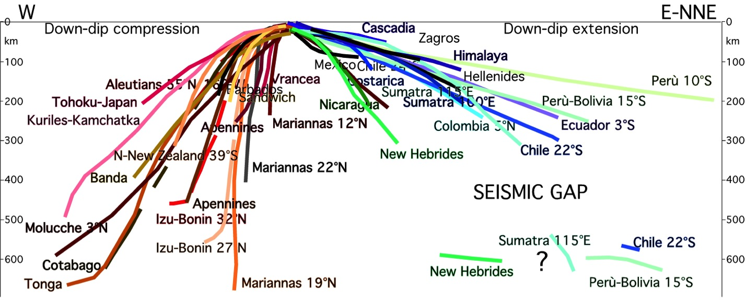
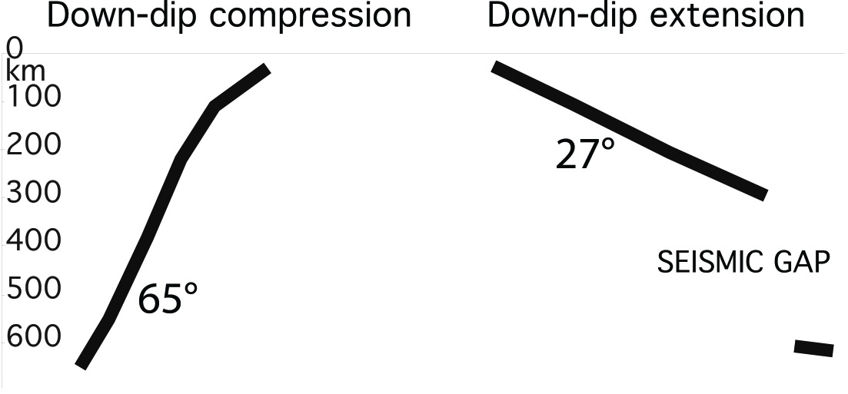
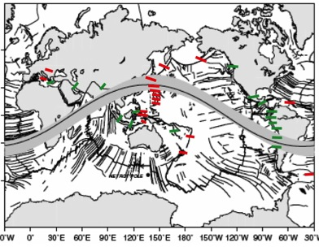
Asymmetric dip of slabs moving along the tectonic equator
Riguzzi et al. 2010, Tectonophysics

Slide 13
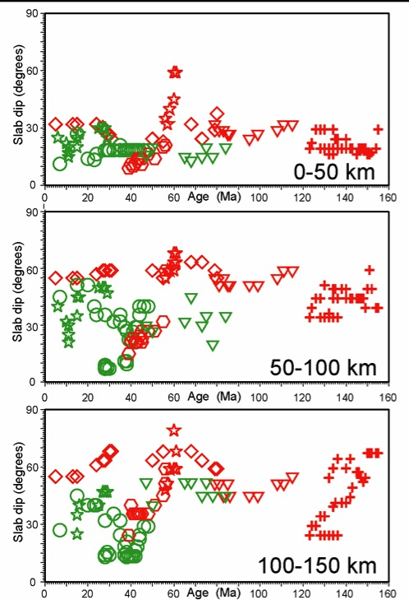
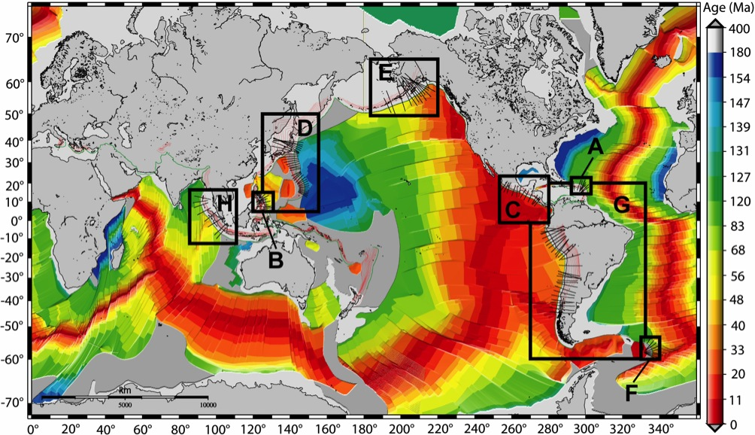
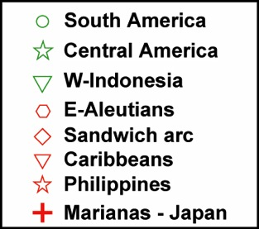
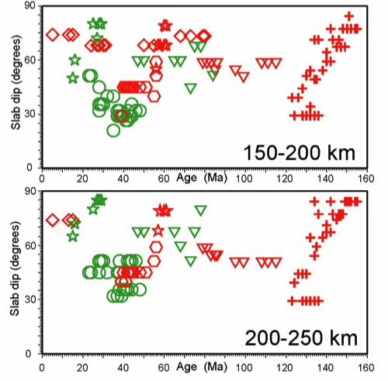
Cruciani et al., 2005, EPSL
slab dip vs. lithosphere age
same dip for variable ages = no correlation
No negative buoyance as cause of

Slide 14
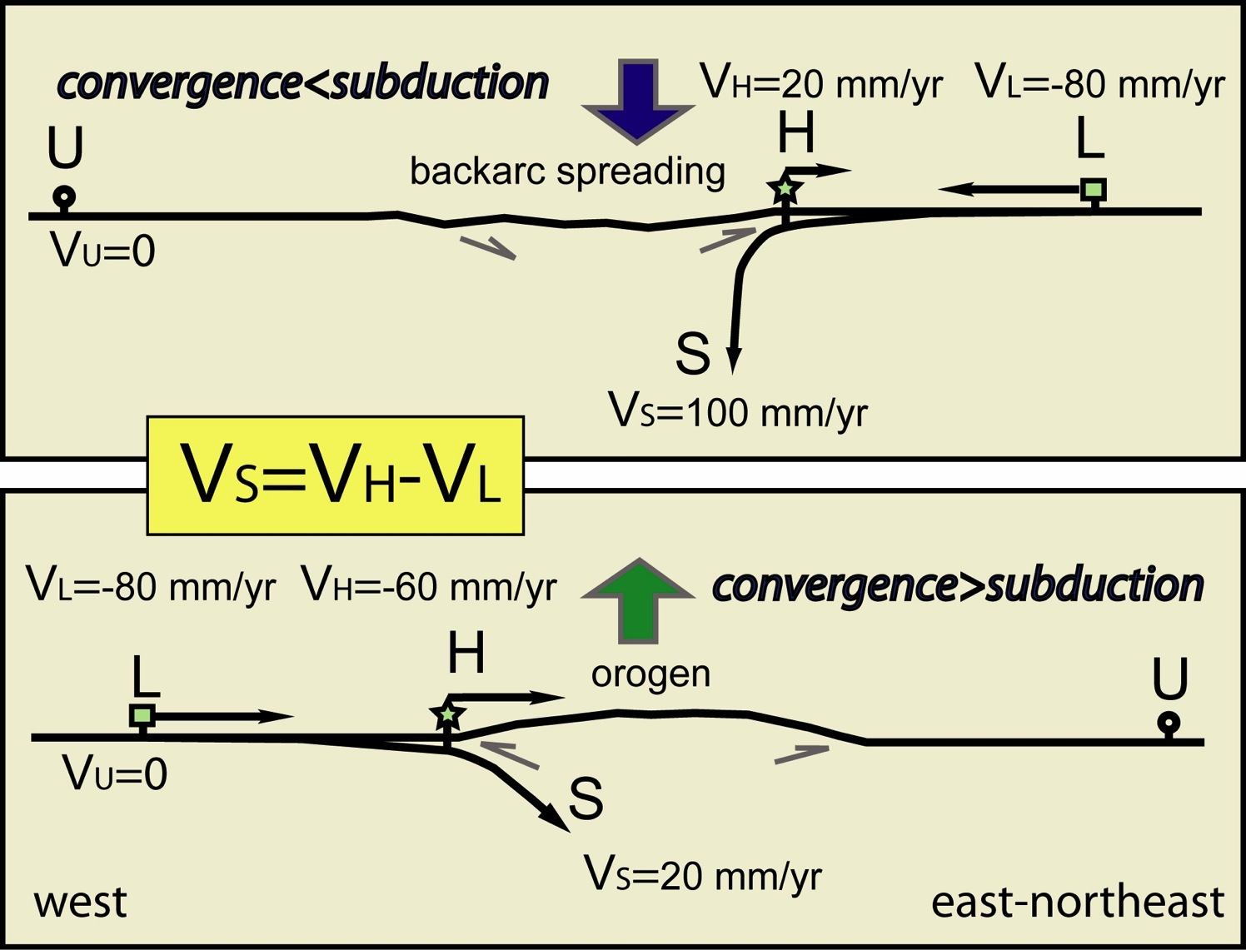
Doglioni et al. 2007 ESR

Slide 15
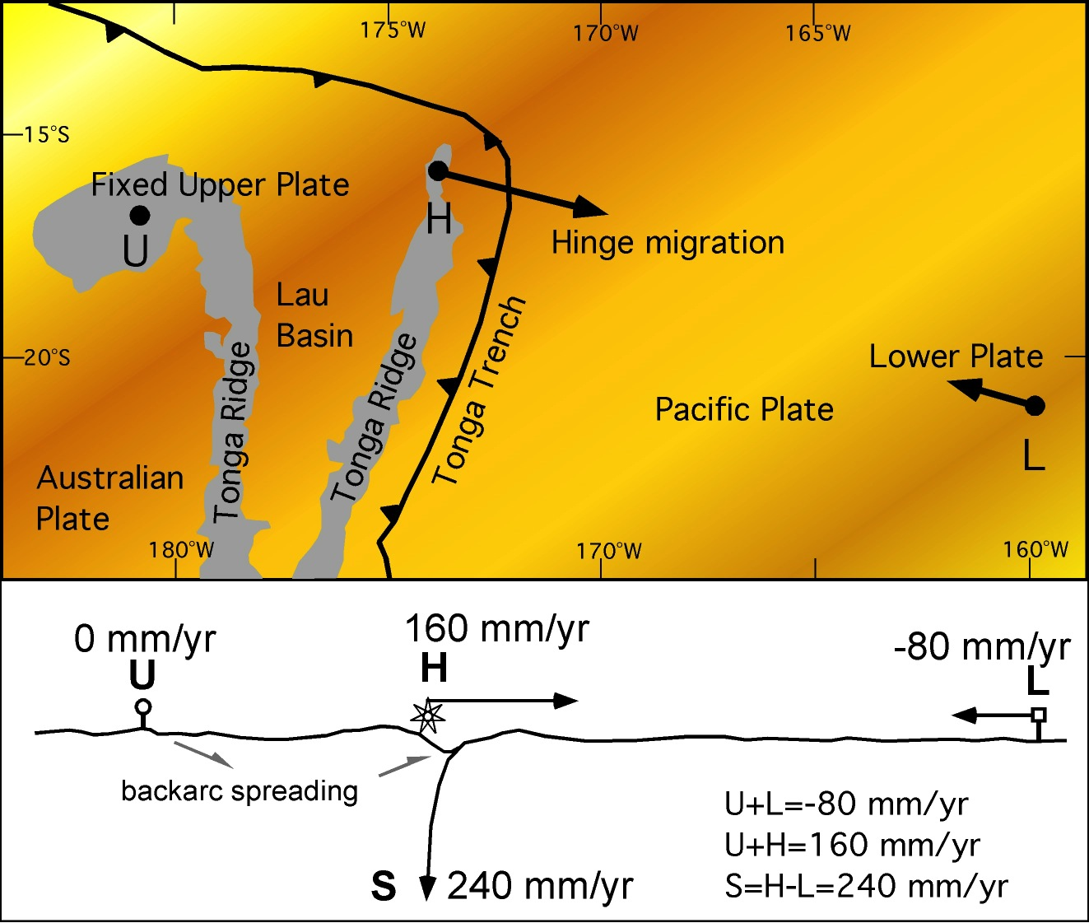
Doglioni et al. 2007 ESR

Slide 16
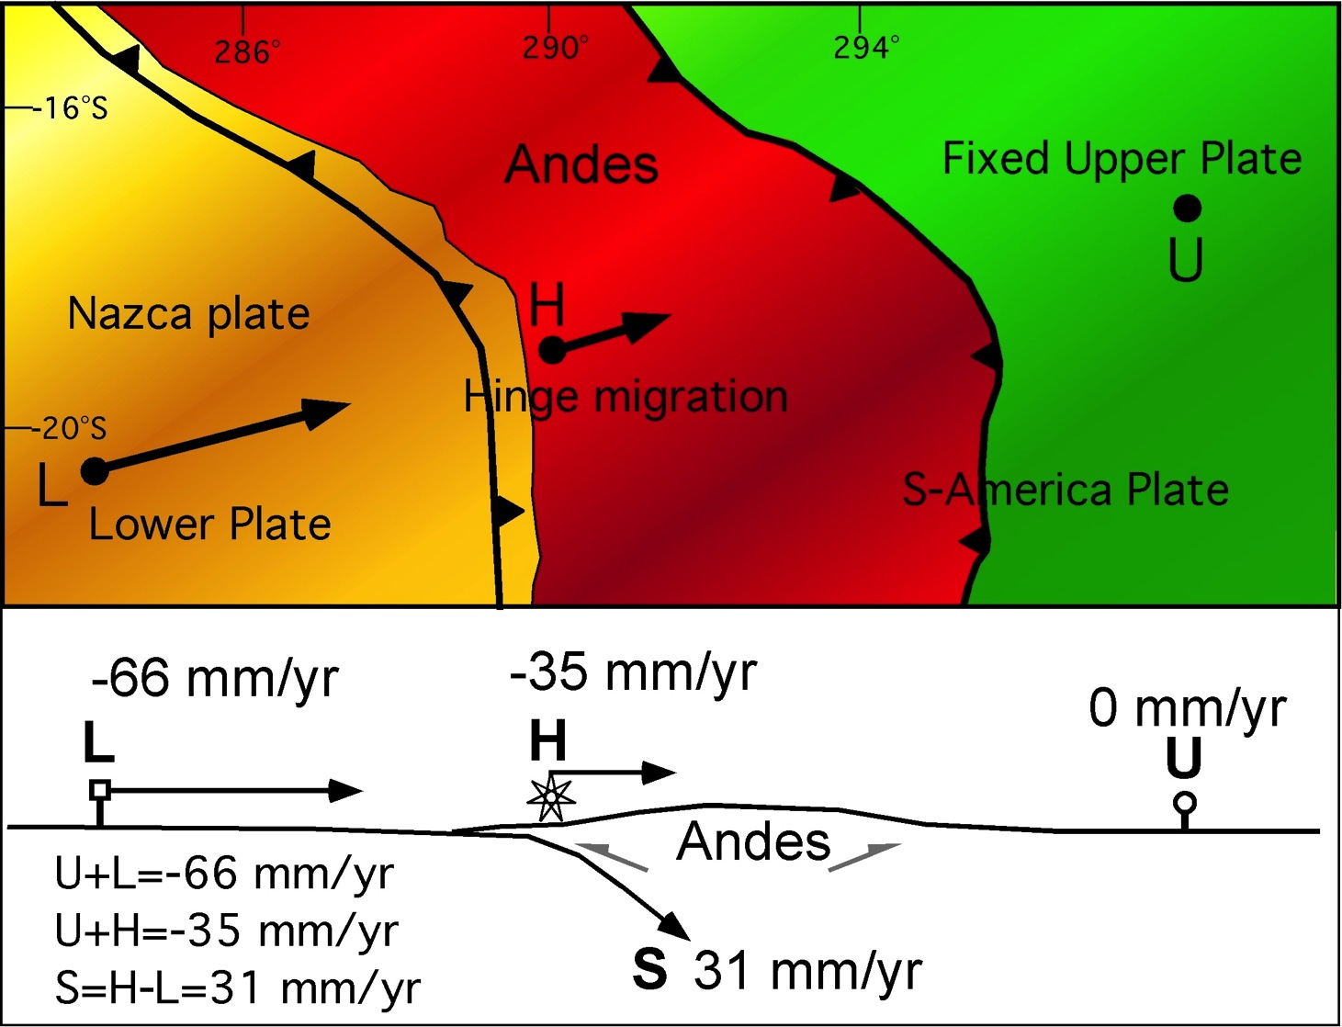
Doglioni et al. 2007 ESR

Slide 17
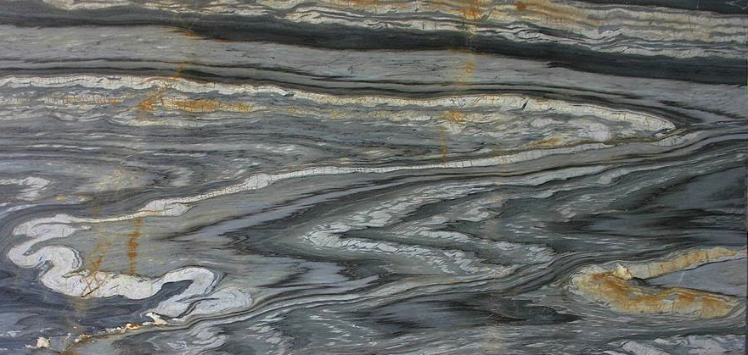
3 times larger volumes of lithosphere are westerly subducted
W-SW
E-NE
 |  |  |  |  |  |  |  | CONVERGENCE | HINGE WRT UPPER PLATE | SUBDUCTION RATE | VOLUME RATE
 |  |  |  |  |  |  | length | mm/yr | mm/yr | mm/yr | km3/yr
N-America |  |  |  |  |  | Barbados | 2273 | 0 | 20 | 20 | 4,5
S-America |  |  |  |  |  | Sandwich | 1582 | 0 | 18 | 18
S-America-Antarctica |  |  |  |  |  | Aleutians | 3674 | 65 | 15 | 80 | 37,9
Macquarie-NewZealand |  |  |  |  |  | Carpathians | 1110 | 0 | 2 | 2 | 0,3
Papua-NewGuinea |  |  |  |  |  | N-Japan | 1039 | 80 | -19 | 61 | 6,5
Indonesia |  |  |  |  |  | Nankai-Ryukyu-Phil. | 4320 | 70 | 23 | 93 | 39,3
Himalaya |  |  |  |  |  | Izu Bonin-Marianas | 4703 | 50 | 30 | 80 | 37,6
Zagros |  |  |  |  |  | NNewZealand-Tonga-Kerma | 3233 | 80 | 100 | 180 | 58,2
Dinarides |  |  |  |  |  | Bismarck-Solomon | 3457 | 60 | 20 | 80 | 27,7
Hellenides |  |  |  |  |  | Banda | 2555 | 0 | 10 | 10 | 2,5
Cyprus |  |  |  |  |  | Apennines | 1700 | 3 | 2 | 5 | 1
Taiwan-Borneo |  |  |  |  |  | Total length | 31787 |  |  |  | 232
Alps
New Hebrides
Caucasus
Total length
 |  | CONVERGENCE | HINGE WRT UPPER PLATE | SUBDUCTION RATE | VOLUME RATE
 | length | mm/yr | mm/yr | mm/yr | km3/yr
N-America | 2573 | 37 | -18 | 19 | 4,9 | Barbados
S-America | 9900 | 66 | -35 | 31 | 30,7 | Sandwich
S-America-Antarctica | 1641 | 22 | 14 | 12 | 1,9 | Aleutians
Macquarie-NewZealand | 2563 | 6 | -4 | 2 | 0,5 | Carpathians
Papua-NewGuinea | 2511 | 5 | -3 | 2 | 0,5 | N-Japan
Indonesia | 5127 | 75 | -50 | 25 | 12,8 | Nankai-Ryukyu-Phil.
Himalaya | 2995 | 36 | -30 | 6 | 1,8 | Izu Bonin-Marianas
Zagros | 3539 | 24 | -14 | 10 | 3,5 | NNewZealand-Tonga-Kerma
Dinarides | 1114 | 4 | -3 | 1 | 0,1 | Bismarck-Solomon
Hellenides | 952 | 36 | -15 | 21 | 2 | Banda
Cyprus | 731 | 10 | -5 | 5 | 0,4 | Apennines
Taiwan-Borneo | 2860 | 60 | -35 | 25 | 7,1 | Total length
Alps | 850 | 1 | -0,5 | 0.5 | 0,04
New Hebrides | 3098 | 60 | -40 | 20 | 6,2
Caucasus | 2481 | 12 | 8 | 6 | 1,5
Total length | 44728 |  |  |  | 74
Slab recycling volumes ≈ 306 km³/yr
Doglioni & Anderson, 2015, GSA-AGU Volume

Slide 18
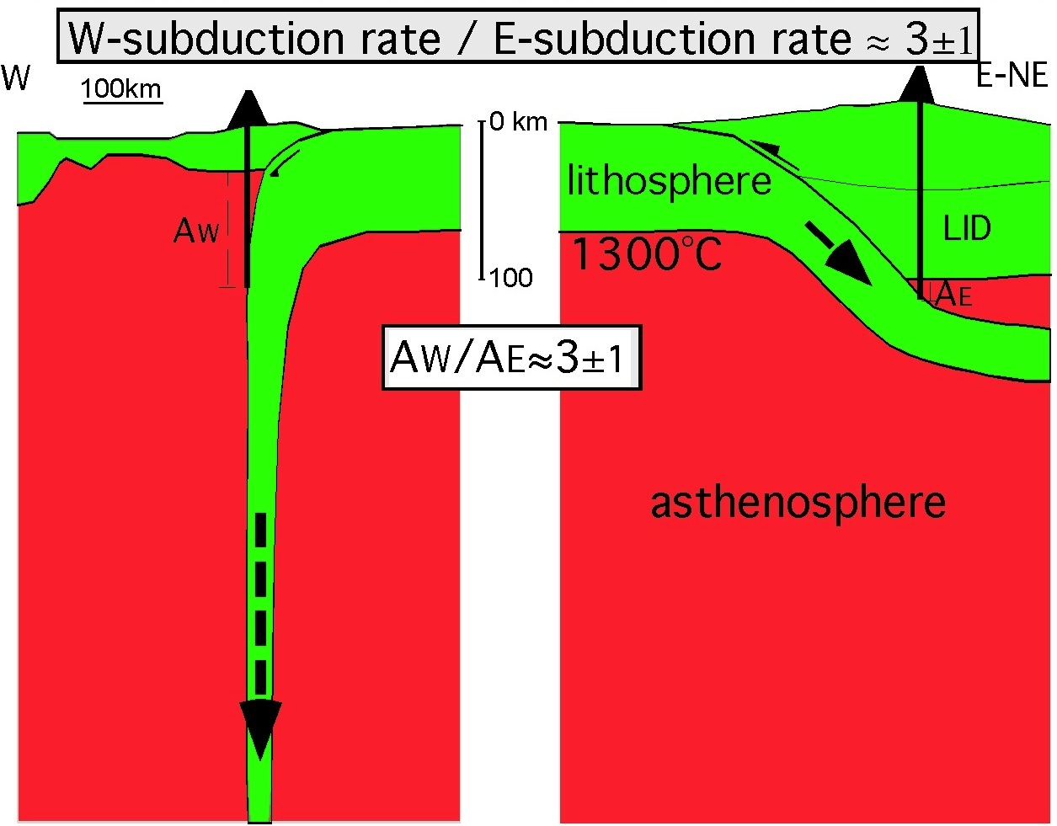
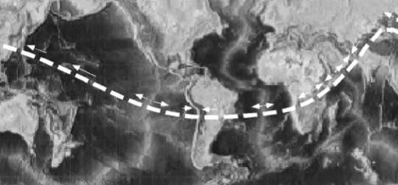
Doglioni et al. 2007 ESR

Slide 19
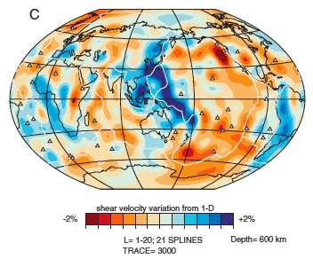
Faster velocity at 600 km of the western Pacific: cooler and deeper western slabs
Ritsema, 2003

Slide 20
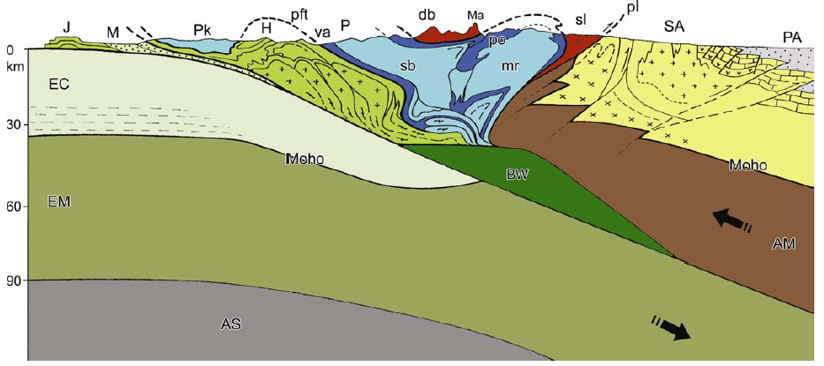
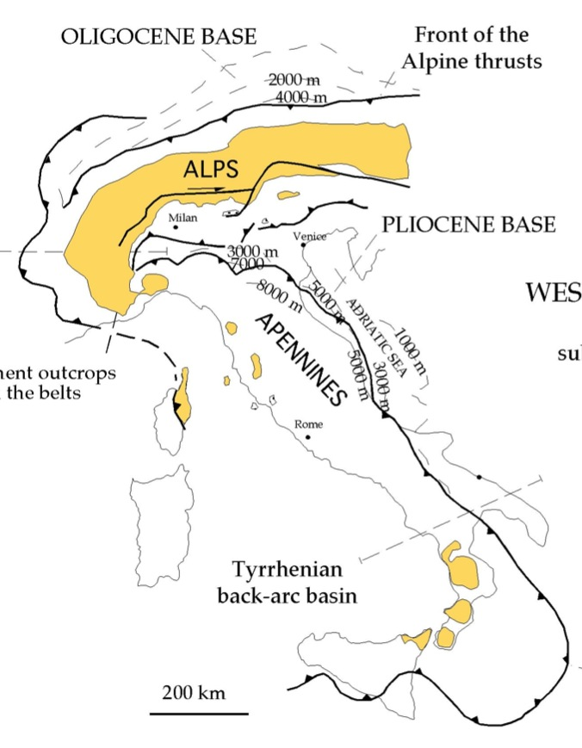
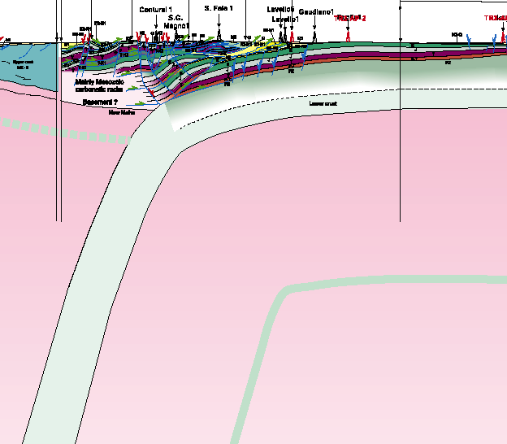
A
2 vergences
NW
0
km
30
60
90
1300°C
Dal Piaz, 1997
1 vergence
basement
B
0
km
NE
30
60
90
1300°C
Asymmetric subductions & related orogens
Scrocca et al., 2005, Tectonics

Slide 21
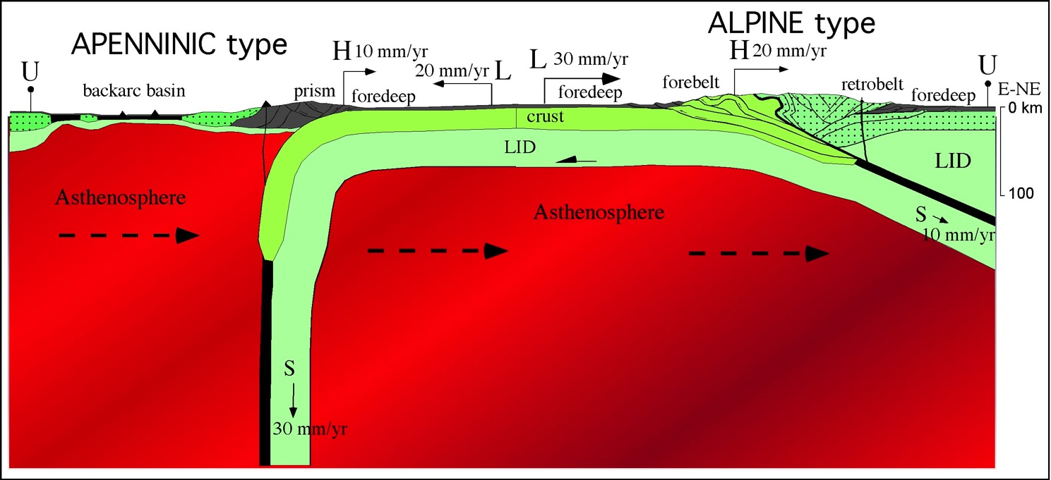
Asymmetric subductions and related orogens
heat flow
VS=VH-VL
S=H-L
convergence<subduction
convergence>subduction
Doglioni et al. 2007 ESR

Slide 22
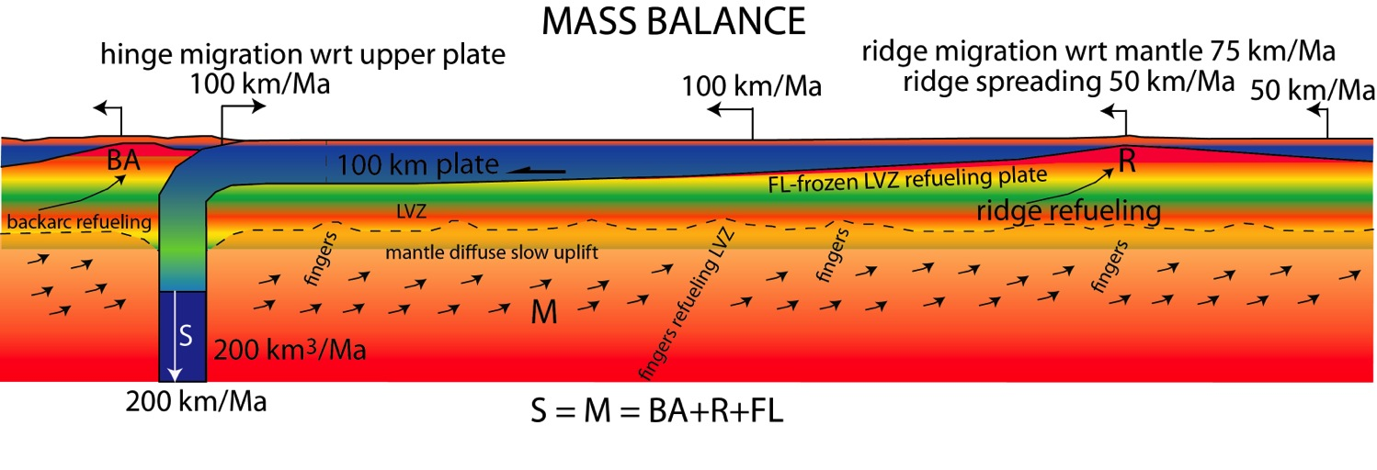
Doglioni & Anderson, 2015 GSA-AGU Volume

Slide 23
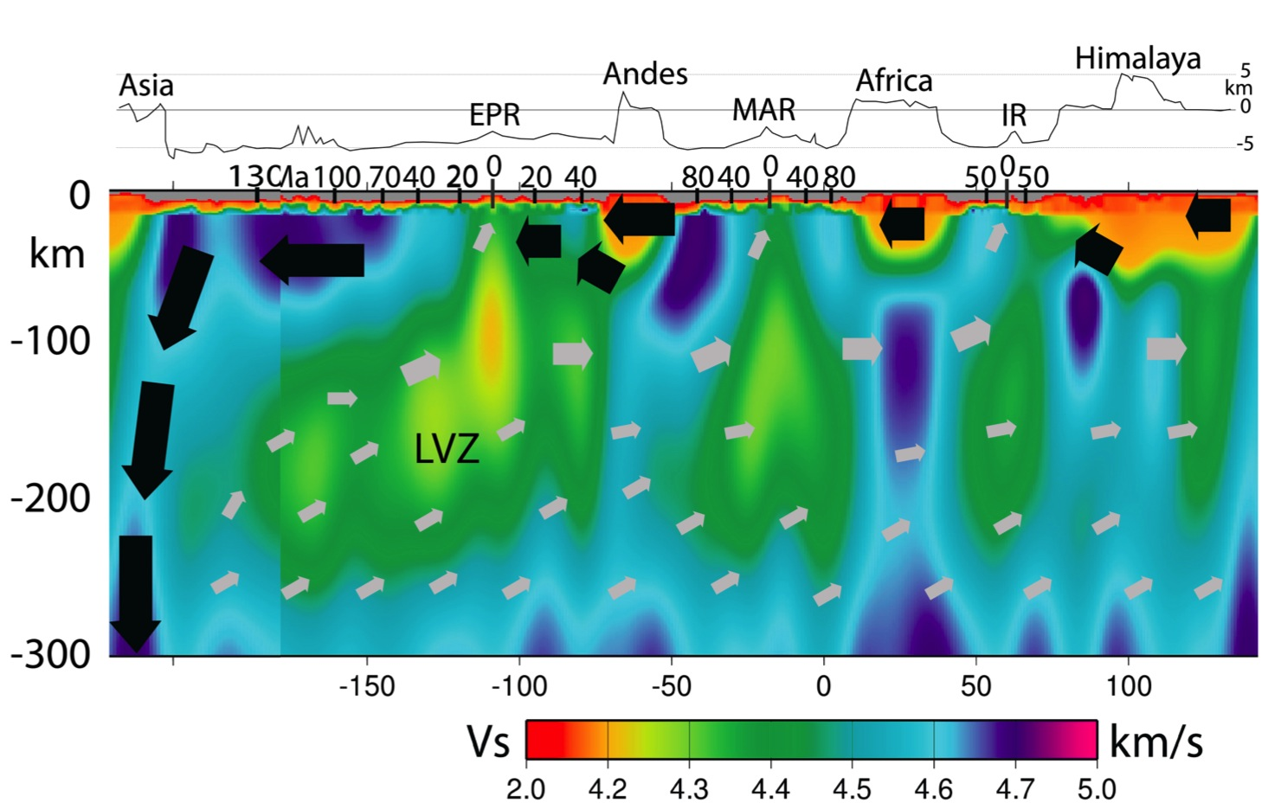
POLARIZED CONVECTION
“Westward” drift of the lithosphere
Doglioni & Anderson, 2015 GSA-AGU Volume

Slide 24
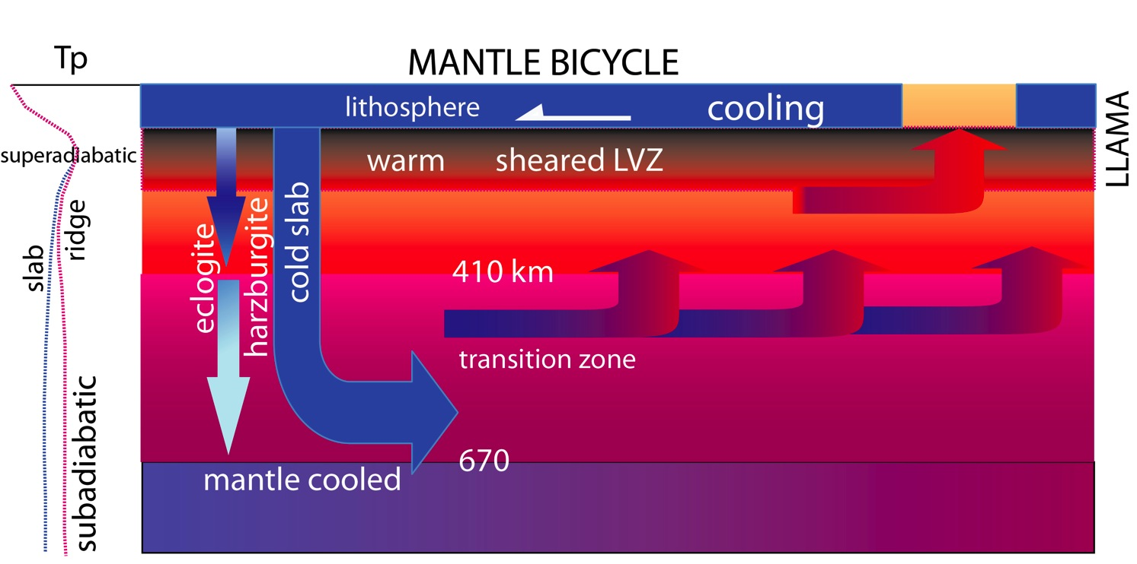
“Westerly” sheared lithosphere:
Slab pull or horizontal tidal torque?
ridge
confined descent
diffused compensating passive ascent
Doglioni & Anderson, 2015 GSA-AGU Volume

Slide 26
It is the asymmetry
that generates the phenomenon
PIERRE CURIE
Thanks to:
Eugenio Carminati, Mattia Crespi,
Françoise Chalot-Prat, Marco Cuffaro, Fabrizio Innocenti, Anatoli Levchin, Giuliano Panza & Federica Riguzzi

