Slide 1
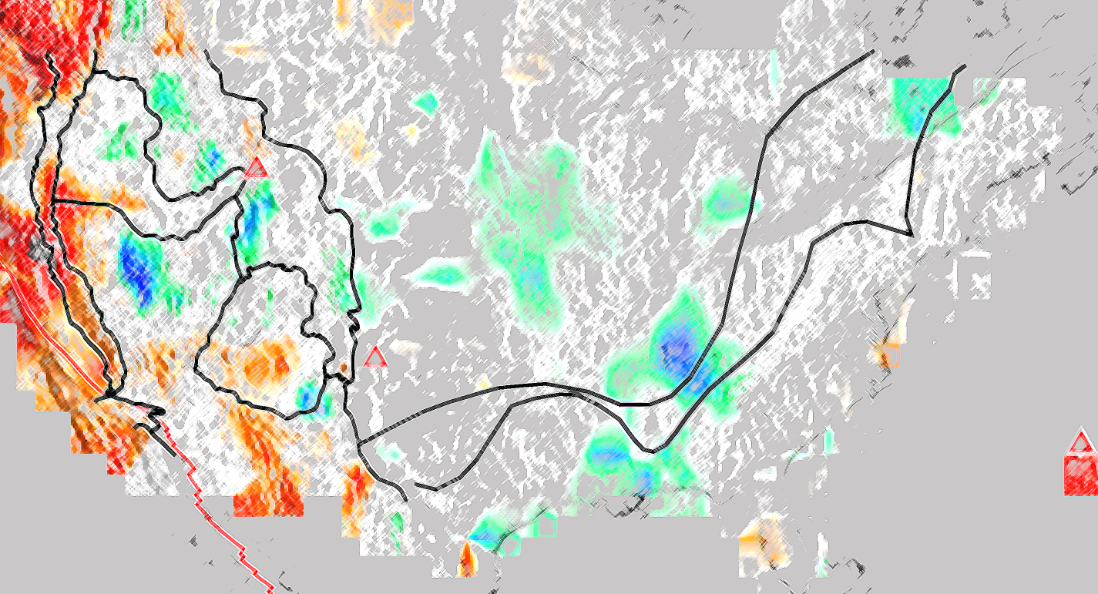
Mantle Transition Zone Discontinuities beneath the Contiguous United States
Stephen S. Gao and Kelly H. Liu sgao@mst.edu; http://www.mst.edu/~sgao
Missouri University of Science and Technology

Slide 2
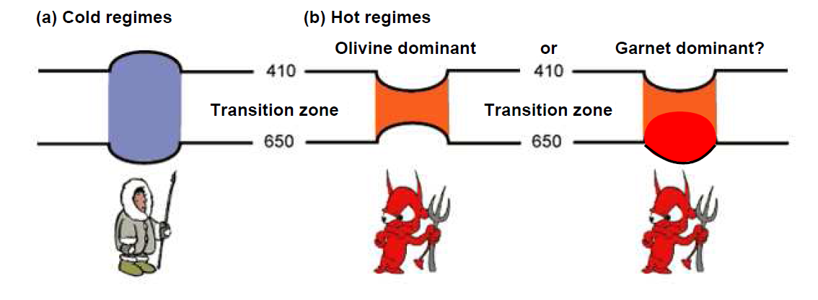
or hydration
(c) Very hot regimes
660
660
The mantle transition zone (MTZ) is the region between the 410 and 660 km discontinuities.
Variations of the depths are indicators of temperature and water content in the vicinity of the discontinuities.
The cartoon was modified from Foulger and Julian, 2004 (http://www.mantleplumes.org) and Deuss, 2007.

Slide 3
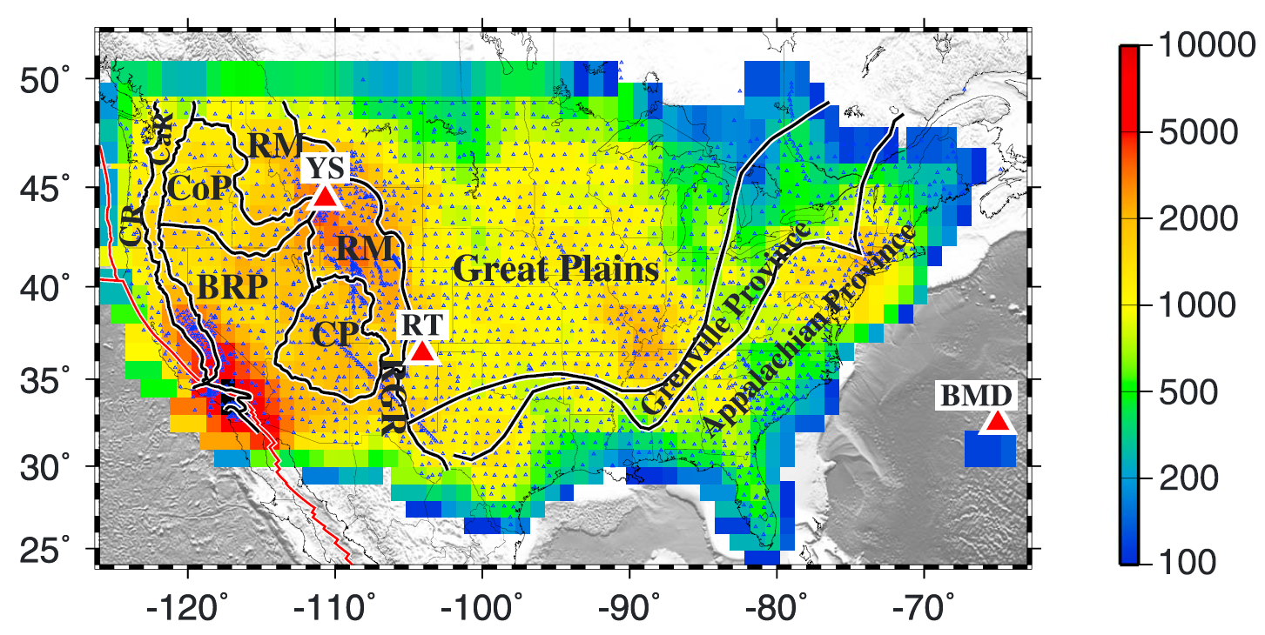
Total number of RFs used in the study: about 310,000 recorded over 25 years till late 2013
Small black triangles: 2848 broadband seismic stations used in the study
Color of image: number of P-to-S receiver functions in radius=1º circles
Large red triangles: Previously proposed hot spots (YS: Yellowstone, RT: Raton, and BMD: Bermuda)
Thick black lines outline major tectonic provinces
(After Gao and Liu, 2014a, JGR)

Slide 4
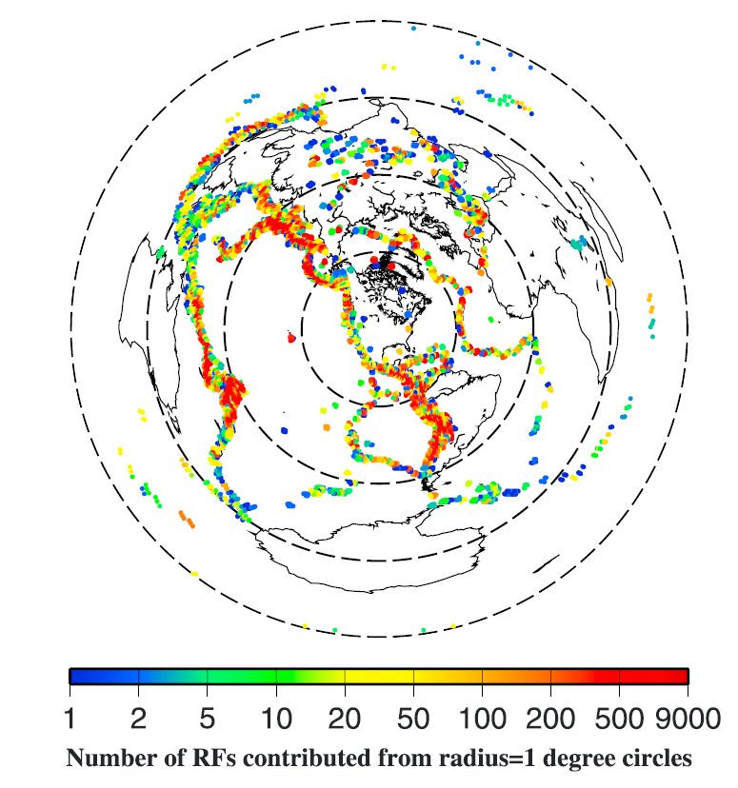
Spatial distribution of earthquake source areas.
Total number of events used in the study: 6315
Each dot represents a radius = 1 degree circular area. The distance between neighboring circular areas is 1 degree.
The color of the dot represents the number of used receiver functions originated from earthquakes in the circle.
Note the nonlinear nature of the scale bar.

Slide 5
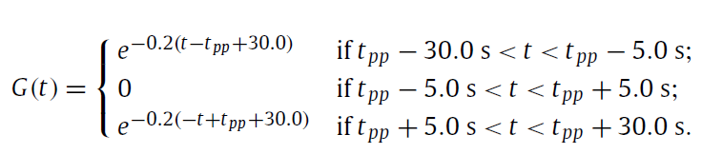
Receiver function stacking procedure
(following the approach of Gao and Liu, 2014b, EPSL)
Before the computation of the receiver functions, we reduce the degenerating effects of the strong PP arrivals by applying the following exponential function:

Slide 6
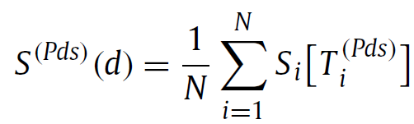
Receiver function stacking under the non-plane wave assumption
For each candidate depth (from 0 to 800 km), moveout correct and stack the RFs under the non-plane wave assumption (in which the ray-parameters of the direct P and the P-to-S converted phases are different):

Slide 7
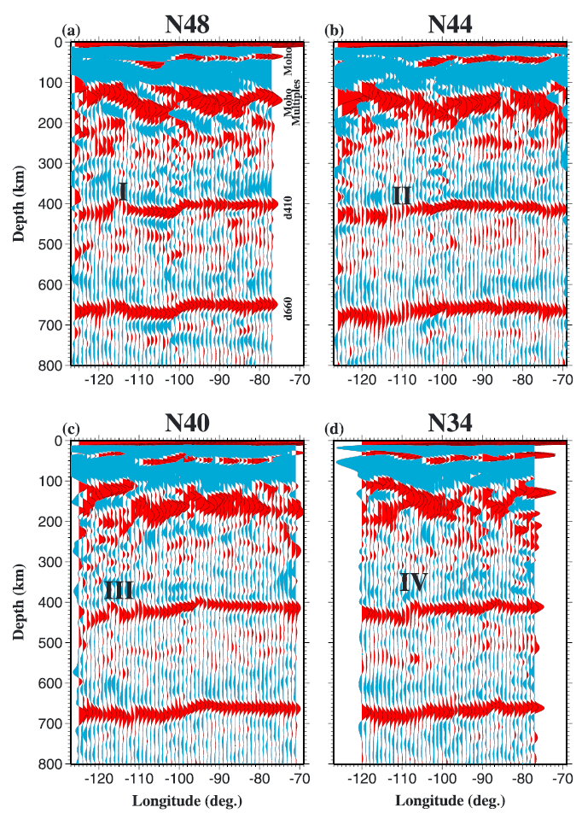
Example depth series along four E-W profiles.
Each trace is the result of stacking of RFs with piercing points (at 535 km depth) in radius=1 degree circles.
Marked features are as follows:
I: Juan de Fuca slab;
II: Yellowstone;
III: proposed lithospheric drip beneath the northern Basin and Range Province [West et al., 2009];
IV: d410 uplift beneath the southern Colorado Plateau.

Slide 8
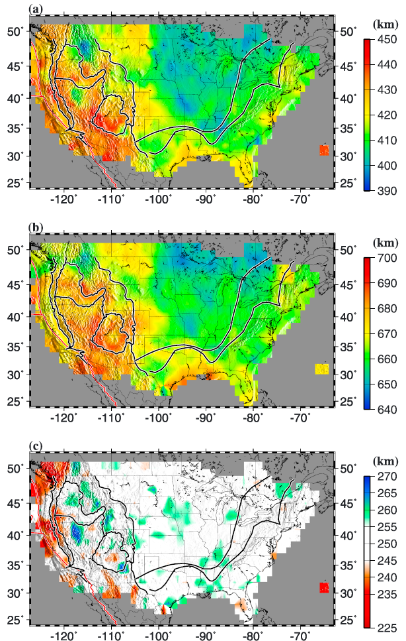
Results of RF stacking based on the 1-D IASP91 Earth model:
(a) Apparent 410 depths;
(b) Apparent 660 depths;
(c) Apparent MTZ thickness.
Note that in (c), the colored areas have a MTZ thickness that differs from the IASP91 value of 250 km by 5 km or greater.

Slide 9
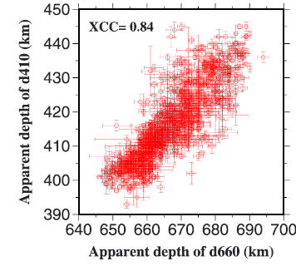
The apparent depths of the 410 are highly correlated with those of the 660, indicating that the bulk of the variations is velocity perturbations in the upper mantle.

Slide 10
or hydration
(c) Very hot regimes
660
660
660
660
Unless we accept the unlikely assumption that most of the study area has a very hot MTZ, the true depths of the 410 and 660 should be negatively correlated and not positively correlated.

Slide 11
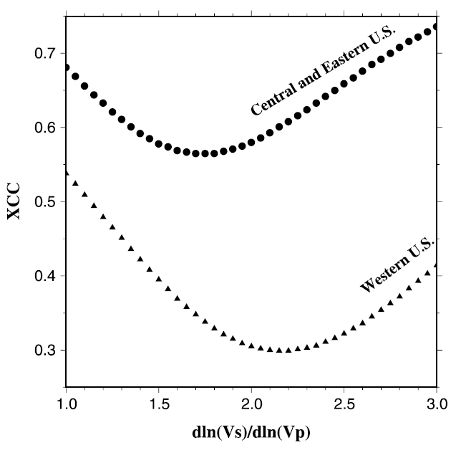
We next try to construct an S-wave model using MIT13p (Burdick et al., 2014) for depth correction.
For each candidate gamma value which is dln(Vs)∕dln(Vp)
we take the MIT13p model and derive an Vs model, and make velocity corrections to the depths. The figure shows cross-correlation coefficients between corrected 410 and 660 depths plotted against the candidate gamma values.
The optimal gamma value corresponding to the minimum XCC is 2.15 for the WUS and 1.70 for the CEUS.

Slide 12
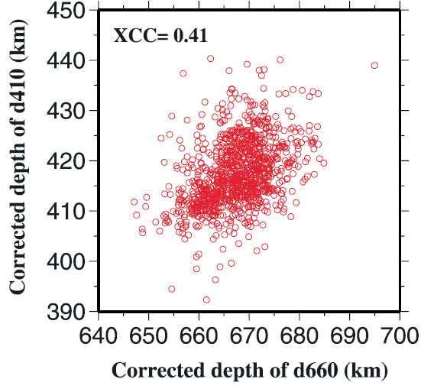
Corrected 410 depths versus corrected 660 depths, using the optimal gamma values.
Note the significant reductions of the absolute value of the XCC relative to the uncorrected situation.

Slide 13
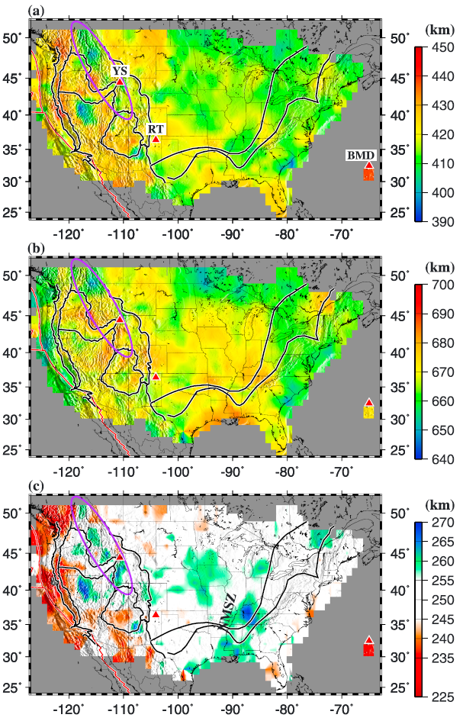
Corrected 410 and 660 depths using MITP13 and the optimal gamma values.
The triangles represent proposed hot spots, and the ellipse outlines the portion of the Juan de Fuca slab in the MTZ.
NMSZ: New Madrid Seismic Zone.

Slide 14
Main observations
Statistically, both the WUS and CEUS have a MTZ thickness that is within a few km from the global mean of 250 km: Meaning that most tectonic differences between the 2 areas are limited in the upper mantle
The MTZ adjacent to the Pacific plate is hotter than normal, due to 410 depression
The Juan de Fuca slab interacts with the MTZ beneath the Rocky Mountain Front
Cold Farallon slabs may exist in the MTZ beneath central US, consistent with previous results (e.g., Porritt et al., 2014; Sigloch, 2011; Pavlis et al., 2012)

Slide 15
Main observations
The Yellowstone and Raton areas have normal MTZ thickness: Perhaps they are upper mantle features?
The Bermuda has a depressed 410 but normal 660. Results of limited data, or a hot feature that extends to the upper MTZ?

Slide 16
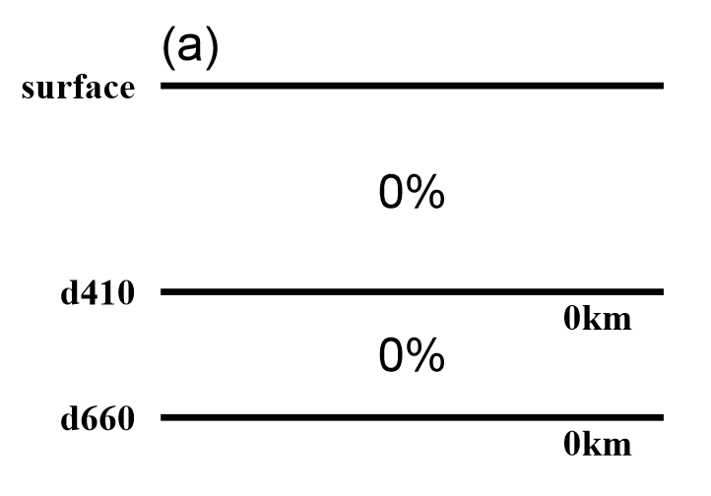
The key to resolve the plume-or-not issue using MTZ measurements:
Accurate seismic velocity models for both P- and S-waves
How to create a “perfect” mantle plume?
The true situation: Perfectly normal depths and velocities
Mohamed et al., 2014 GJI

Slide 17
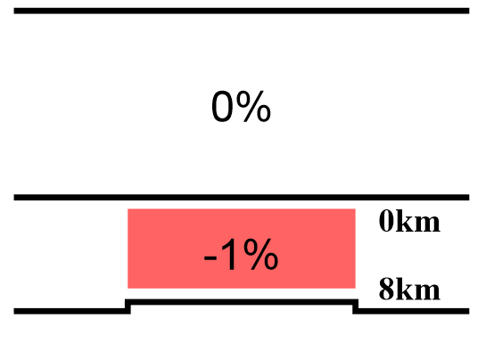
If a low velocity zone is artificially introduced in the MTZ, the 660 would uplift after velocity corrections using the wrong velocity model.

Slide 18
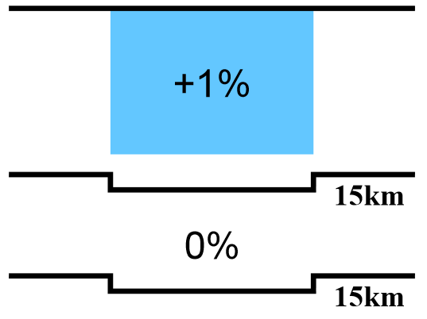
If a high velocity zone is artificially introduced in the upper mantle, both the 410 and 660 would depress after velocity corrections using the wrong velocity model.

Slide 19
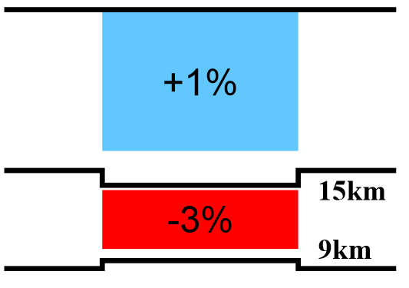
If a high velocity zone is artificially introduced in the upper mantle, AND a LVZ is artificially introduced in the MTZ, the 410 would depress and the 660 would uplift after velocity corrections using the wrong velocity model.

Slide 20
Given the limited vertical resolution of (mostly body-wave) tomography techniques, AND the need to balance the total travel-times, the above artificial velocity anomalies are quite possible …, resulting in a thinned MTZ with low velocities – A “perfect” but fake plume coming from the lower mantle!!

Slide 21
For more info
Gao, S. S., and K.H. Liu (2014a), Mantle transition zone discontinuities beneath the contiguous United States,
Journal of Geophysical Research
Gao, S.S., and K.H. Liu (2014b), Imaging mantle transition zone discontinuities using multiply reflected P-to-S conversions, Earth & Planetary Science Letters
Mohamed, A.A., S.S. Gao, A.A. Elsheikh, K.H. Liu, Y. Yu, and R.E. Fat-Helbary (2014), Seismic imaging of mantle transition zone discontinuities beneath the northern Red Sea and adjacent areas, Geophysical Journal International

