Slide 1


Geology is the key to explain igneous activity in the Mediterranean area
Michele Lustrino
Dip. Scienze della Terra, Un. di Roma La Sapienza
michele.lustrino@uniroma1.it
December 19th 2014

Slide 2
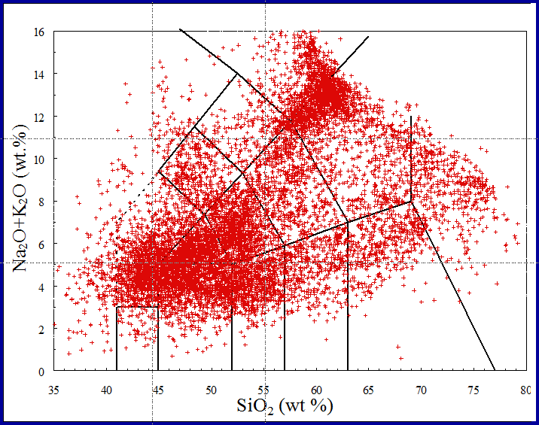
>18,000 whole-rock analyses
Lustrino and Wilson, 2007 (Earth-Sci. Rev.)
Lustrino et al., 2011 (Earth-Sci. Rev.)
Lustrino, 2011 (Geol. Mag.)
Lustrino et al., 2014 (Lithos)

Slide 4
~87 Ma
~84-79 Ma
Sodic alkaline volcanic and plutonic rocks
~73 Ma
~93 Ma
~79-64 Ma
~72 Ma
~72 Ma
Miranda et al. (2009) Cret. Res., 30, 575-586

Slide 5
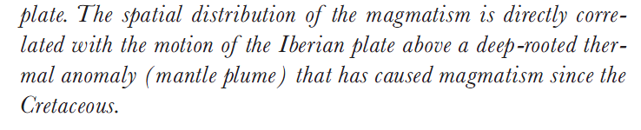
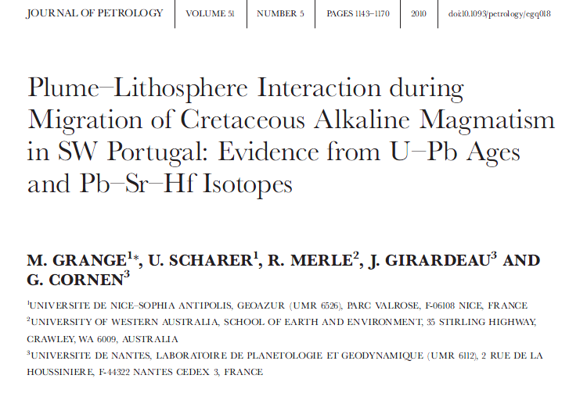
Connection between Madeira Mantle Plume and Portugal Magmatic Province
72
67
31
14
[…]
5
Geldmacher and Hoernle (2000) Earth Planet. Sci. Lett., 183, 73-92

Slide 6
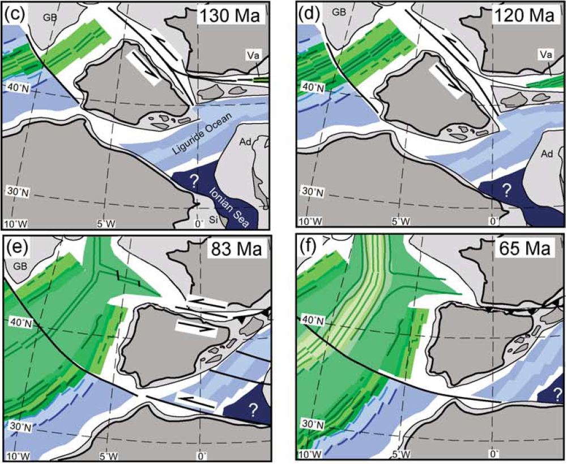
Miranda et al. (2009) Cret. Res., 30, 575-586
From: Rosenbaum et al. (2002) Tectonophysics, 359, 117-129

Slide 7
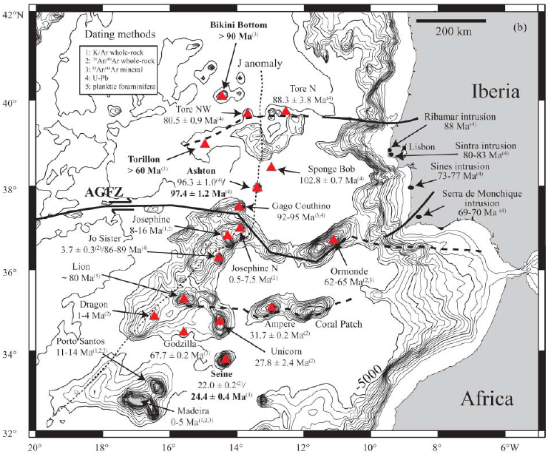
Connection between Madeira Mantle Plume and Portugal Magmatic Province
>90 Ma
~88 Ma
~80 Ma
88 Ma
No age track
83-80 Ma
>60 Ma
~103 Ma
77-73 Ma
~97 Ma
16-8 Ma
95-92 Ma
70-69 Ma
89-86; 4 Ma
~80 Ma
7.5-0.5 Ma
65-62 Ma
4-1 Ma
32 Ma
14-11 Ma
68 Ma
30-26 Ma
24-22 Ma
Merle et al. (2009) J. Geol. Soc. London, 166, 879-894
5-0 Ma

Slide 8
Chanelled Plume model
Duggen et al. (2009) Geology, 37, 283-286

Slide 9
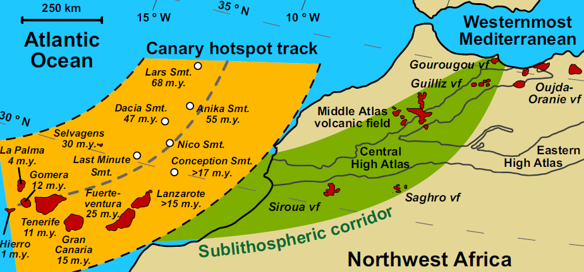
50
40
Expected age trend
Age (Ma)
30
20
10
Increasing distance from Canaries
45-35 Ma
14-5 Ma
>50 Ma
2-0 Ma
6-1 Ma
50-32 Ma
12-2 Ma
9-1 Ma
Duggen et al. (2009) Geology, 37, 283-286

Slide 10
Cenozoic igneous activity in the French Massif Central (~65-0.004 Ma)
European Cenozoic Rift System
E C R i S

Slide 11
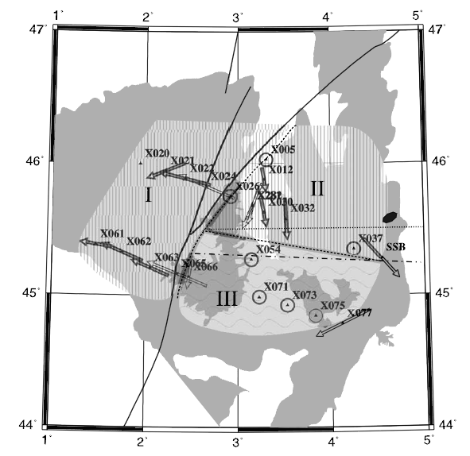
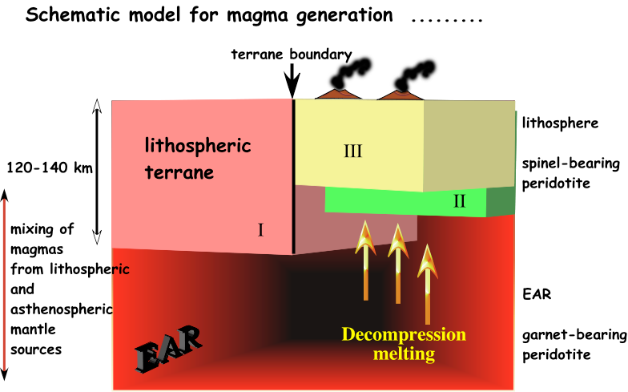
II
I
III
Babuska et al. (2002) Tectonics, 21, 10.1029/2001TC901035
M Wilson - Abstract of Penrose Plume IV Conference, Iceland, 2003 - mantleplumes.org

Slide 12
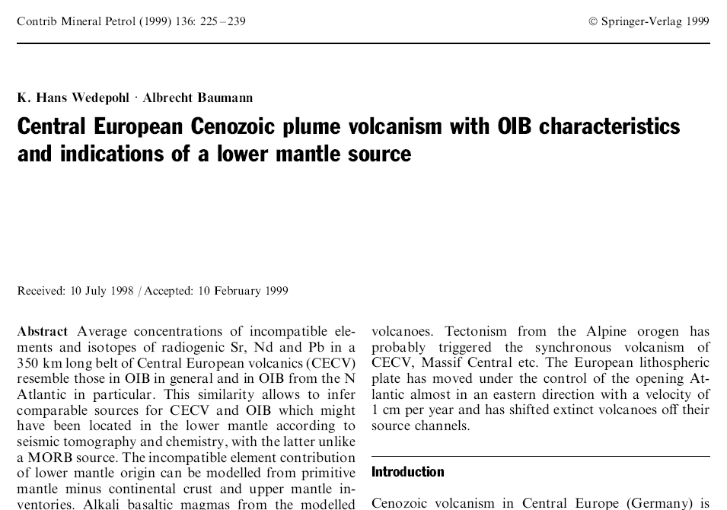

Slide 13
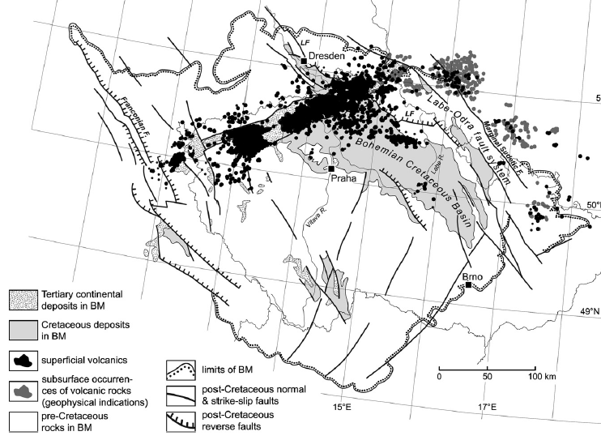
Ulrych et al., 2011 (Lithos), 123, 133-144
Eger Graben
Saxothuringian
Moldanubian

Slide 14
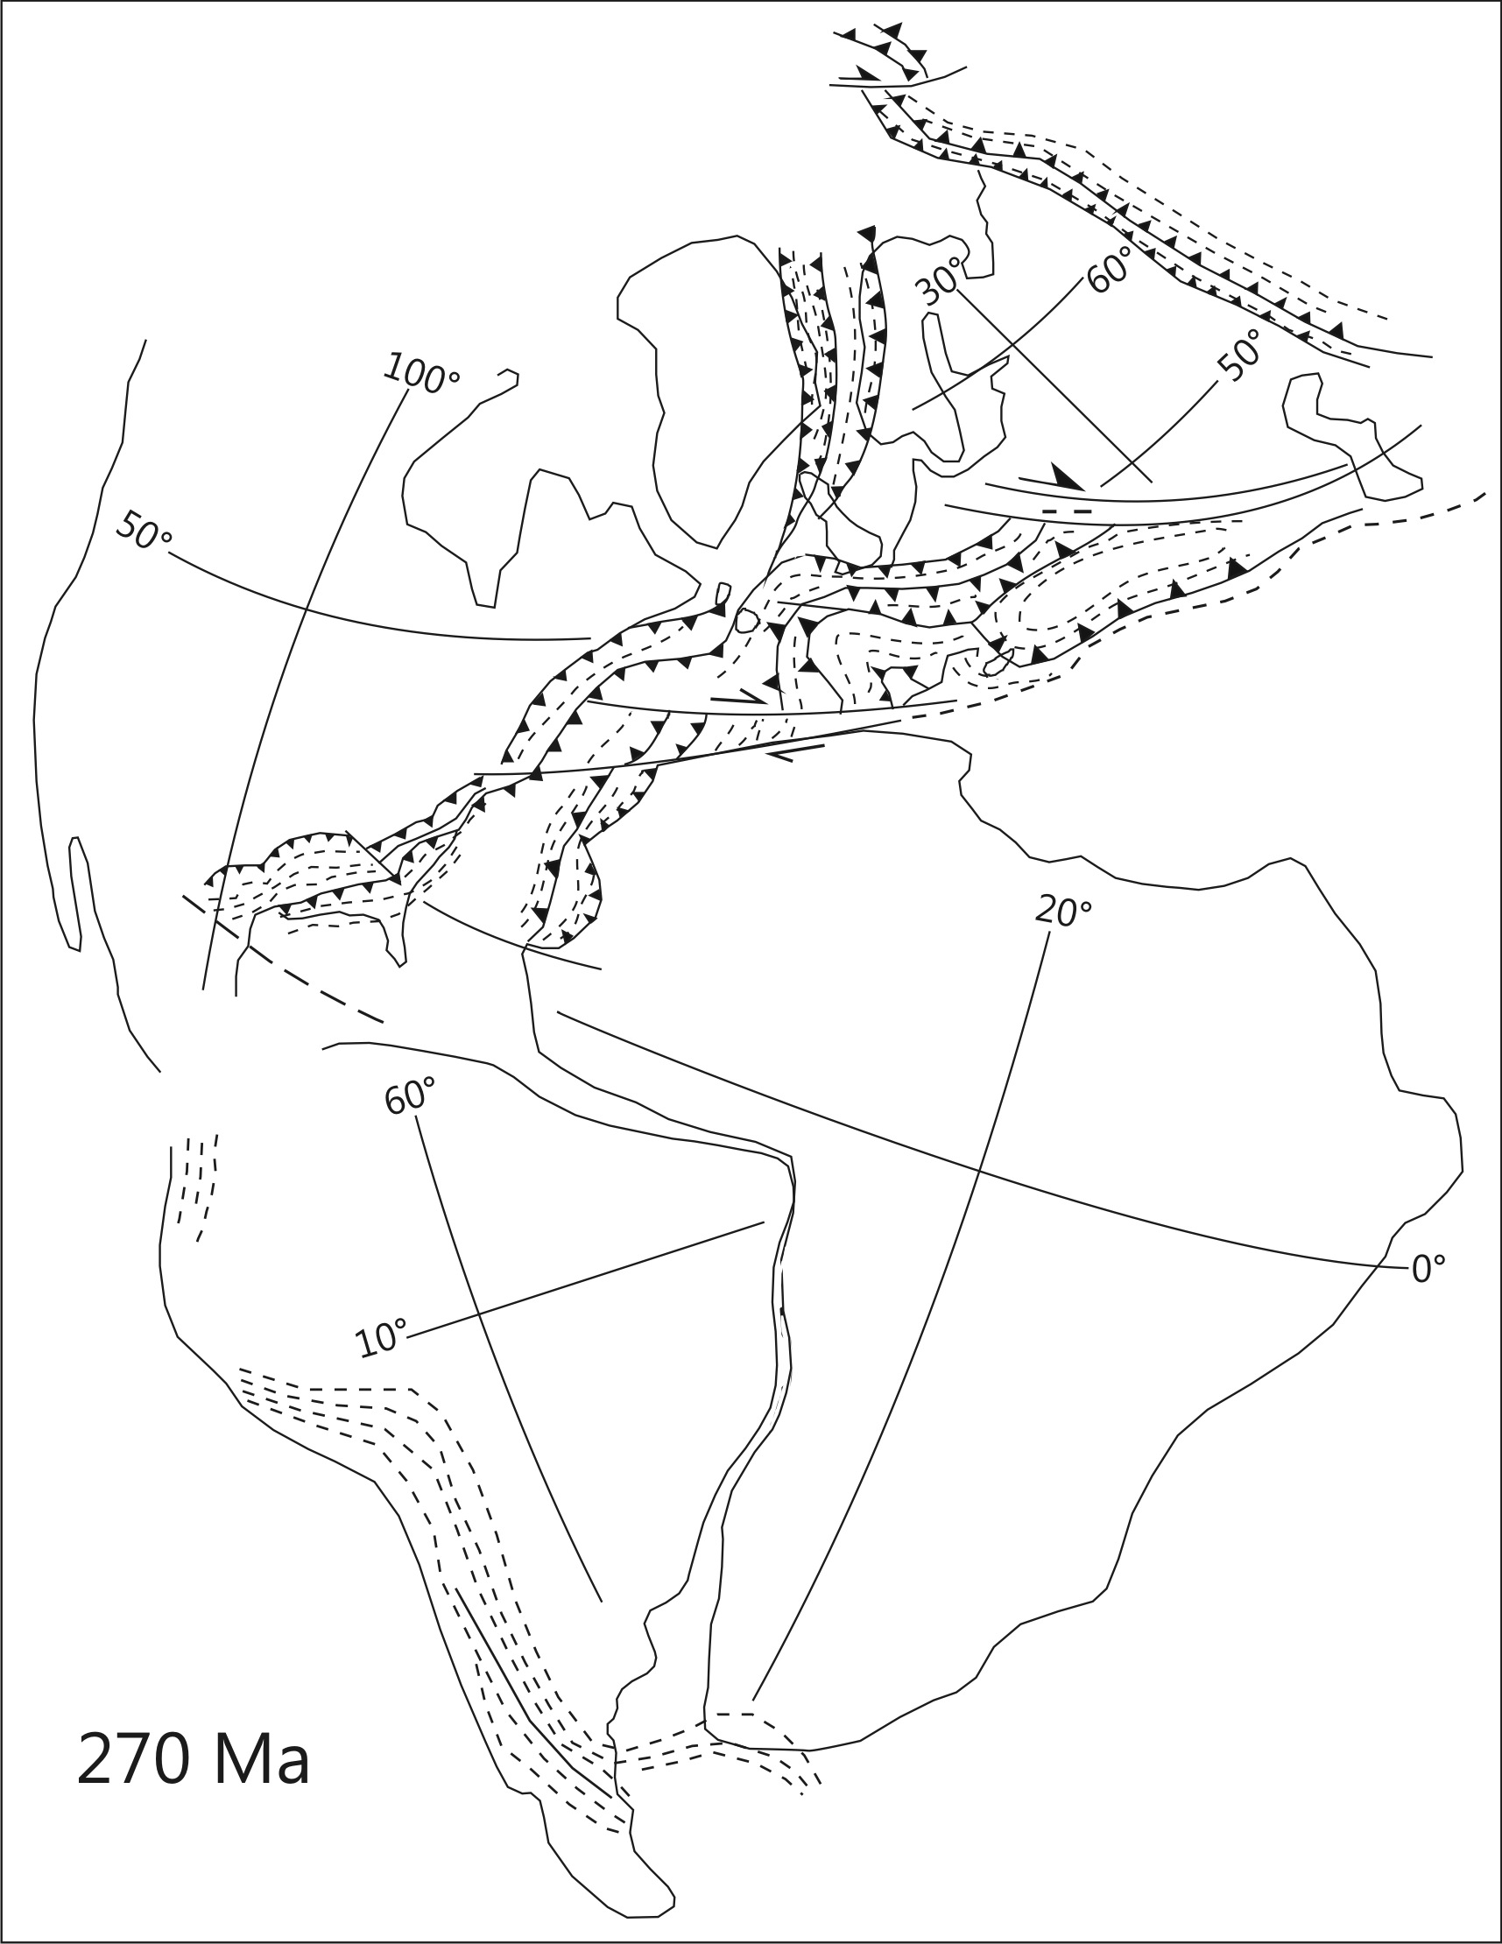
Eger Graben
Saxothuringian
Moldanubian

Slide 15
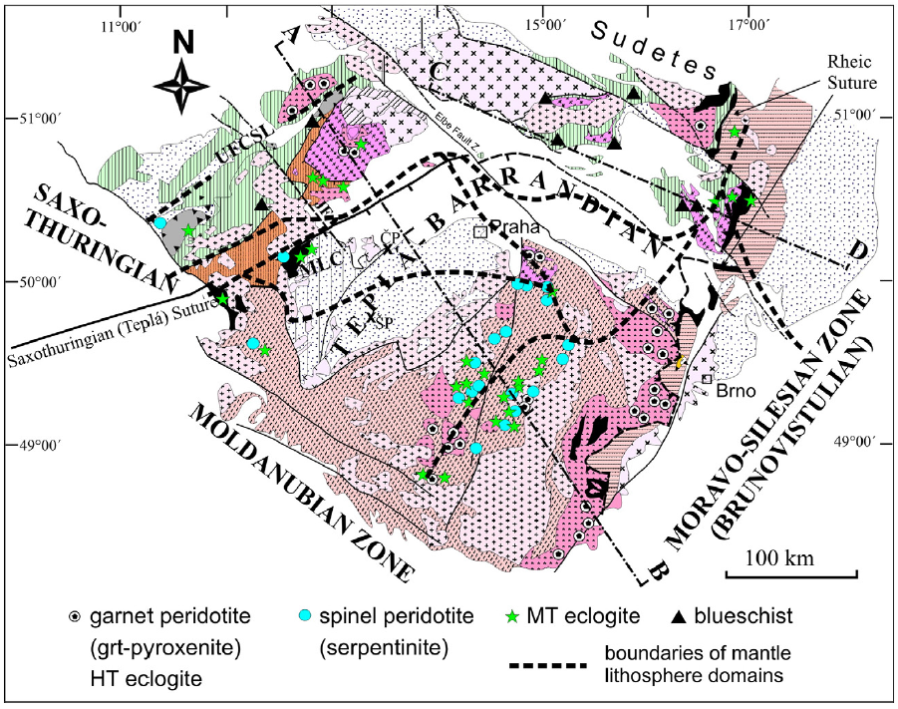
Eger Graben
Babuska and Plomerova (2013) Gondw. Res., 23, 973-987

Slide 16

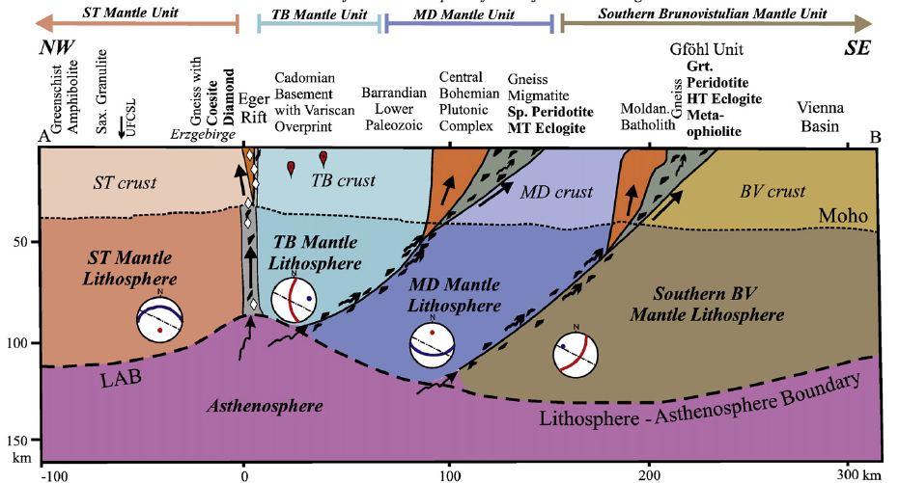
Babuska and Plomerova (2013) Gondw. Res., 23, 973-987

Slide 17
Mantle Plumes also in subduction-related settings…
Gasperini et al. (2002) J. Geophys. Res., 107, B12, 2367, doi:10.1029/2001JB000418

Slide 18
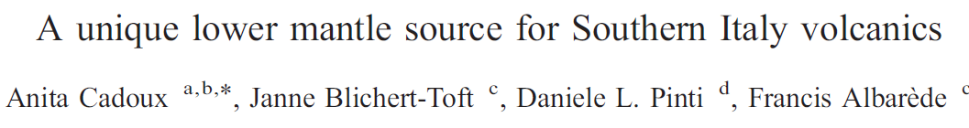
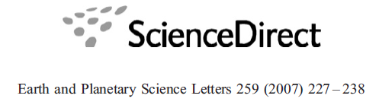
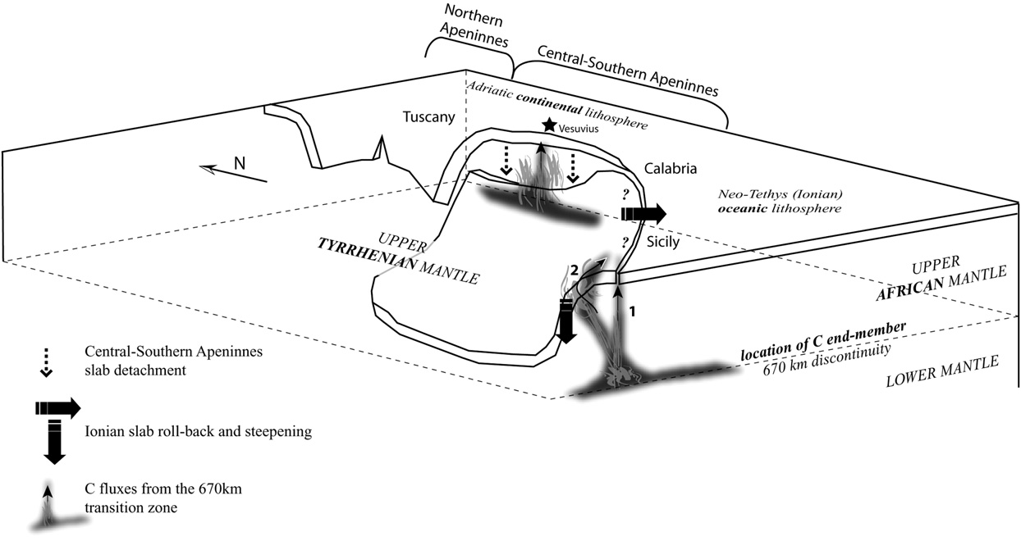
Mantle Plumes also in subduction-related settings…
Cadoux et al. (2007) Earth Planet. Sci. Lett., 259, 227-238

Slide 19
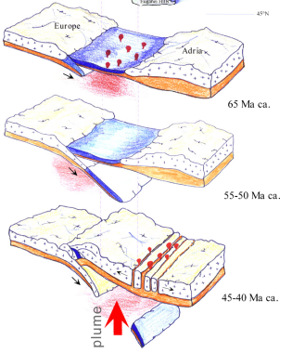
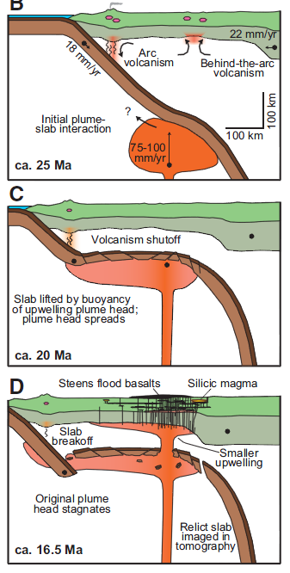
Mantle Plumes also in subduction-related settings…
Veneto Volcanic Province (N. Italy)
Veneto Volcanic Province (N. Italy)
From: Macera et al. (2008) J. Geodyn., 45, 32-48
From: Coble and Mahood (2012) Geology, 40, 655-658

Slide 20
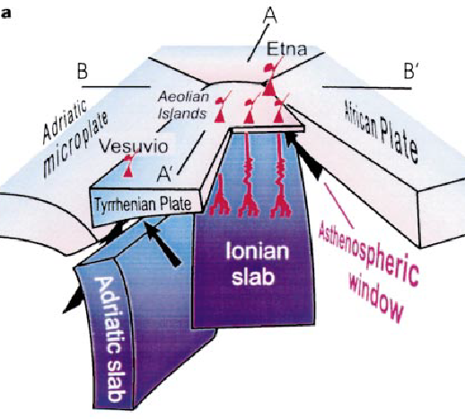
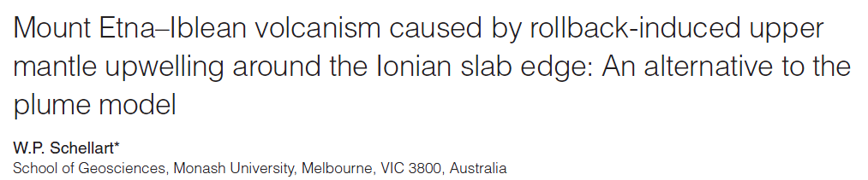
Tonarini et al. (2001) EPSL, 192, 471-483
Gvirtzman and Nur (1999) Nature, 401, 782-785
Doglioni et al. (2001)Terra Nova, 13, 25-31

Slide 21
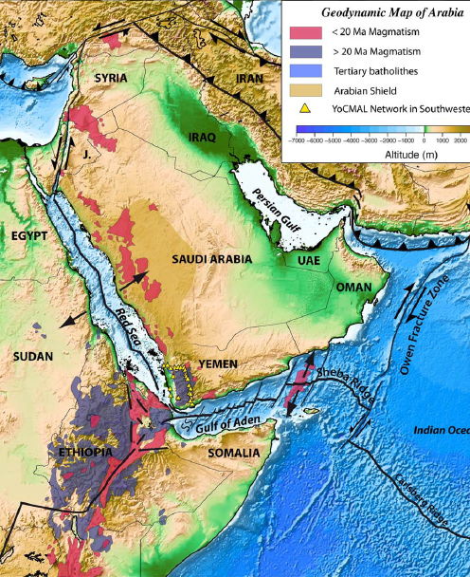
[…] The isotopic signature of the Afar plume can be traced up to the Karacadağ neovolcanic area (Faccenna et al., 2013, EPSL, 375, 254-269)
…But also: “There is no evidence for a contribution from the Afar mantle plume, as has been proposed elsewhere in northern
Arabia.”. (Ekici et al., 2014, J. Petrol., 55, 1753-1777)
Korostelev et al. (2014) G3, 15, 2850-2864.

Slide 22
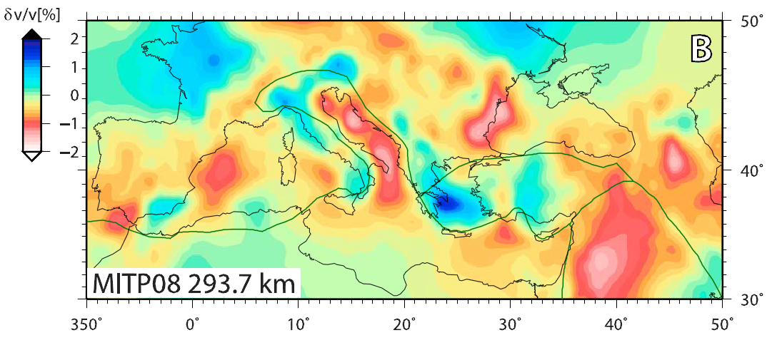
Different reference models produce different tomographic images:
No Igneous Activity
P-wave
Boschi et al. (2010) Geophys. Res. Lett., 37, doi:10.1029/2010GL045001
Red = Hot

Slide 23
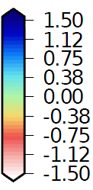
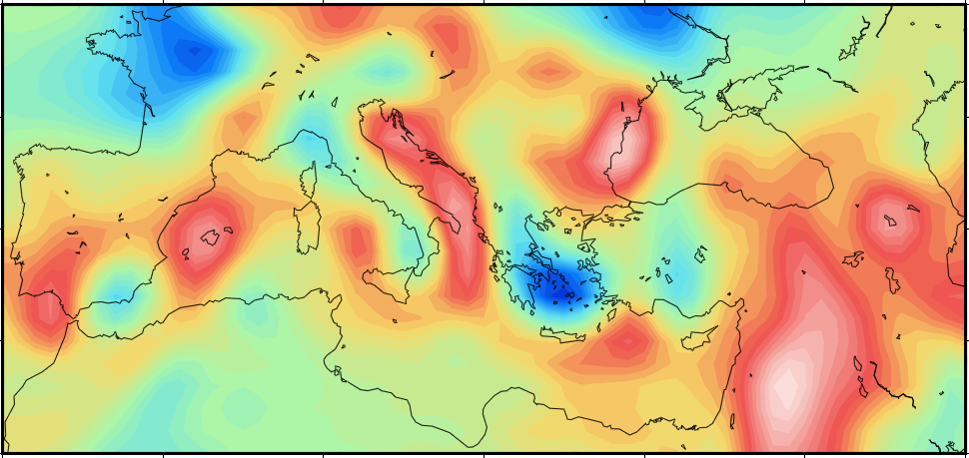
Different reference models produce different tomographic images:
P-wave
P-wave
Li et al. (2008) G3, 9, Q05018, doi:10.1029/2007GC001806
Compilation in Faccenna et al., 2014
(Rev. Geophys., 52, 283-332)

Slide 24
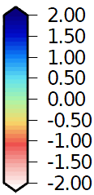
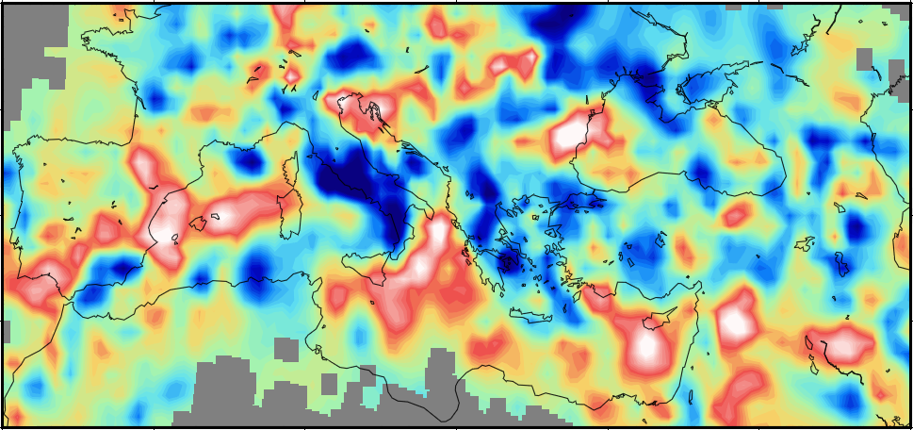
Different reference models produce different tomographic images:
P-wave
300 km
P-wave
Piromallo and Morelli (2003) J. Geophys. Res., 108, B02 165, doi:10.1029/2002JB001757
Compilation in Faccenna et al., 2014
(Rev. Geophys., 52, 283-332)

Slide 25
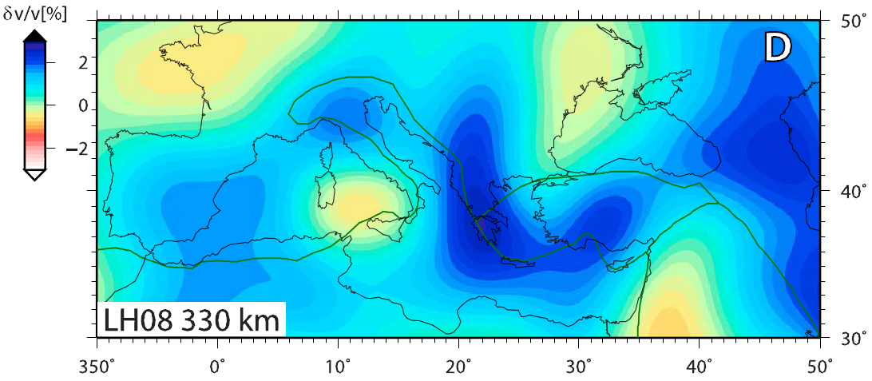
Different reference models produce different tomographic images:
P-wave
300 km
S-wave
Becker and Boschi (2002) Geochem. Geophys. Geosyst., 3, doi:10.1029/2001GC000168
Compilation in Faccenna et al., 2014
(Rev. Geophys., 52, 283-332)

Slide 26
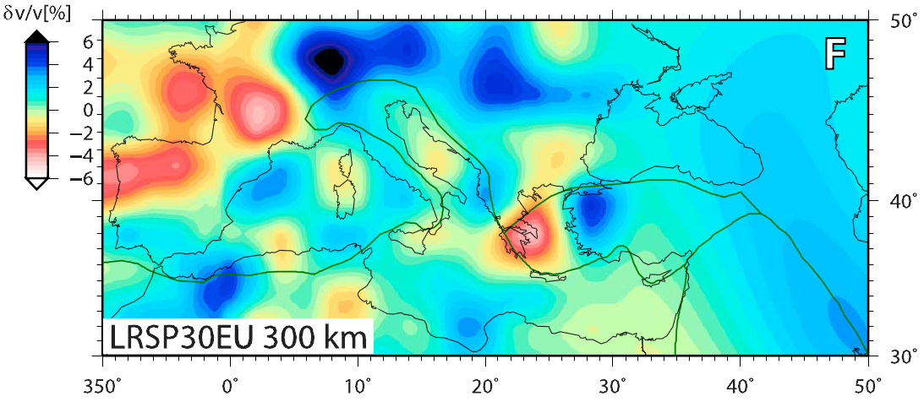
Different reference models produce different tomographic images:
S-wave
S-wave
Boschi et al. (2009) Surv. Geophys., 30, 463–501
Compilation in Faccenna et al., 2014
(Rev. Geophys., 52, 283-332)

Slide 27
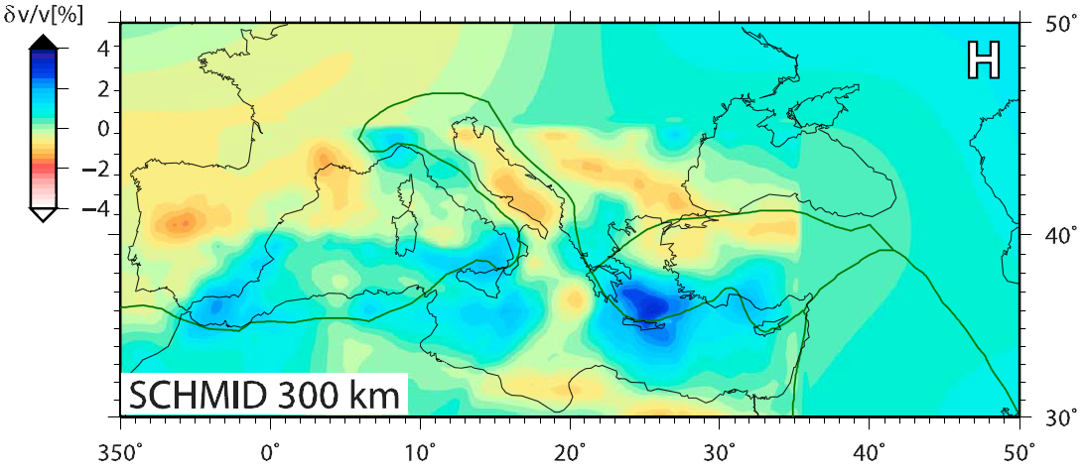
Different reference models produce different tomographic images:
S-wave
S-wave
S-wave
Schmid et al. (2008) J. Geophys. Res., 113, B03306, doi:10.1029/2005JB004193
Compilation in Faccenna et al., 2014
(Rev. Geophys., 52, 283-332)

Slide 28
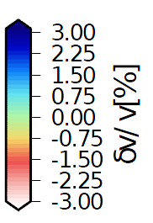
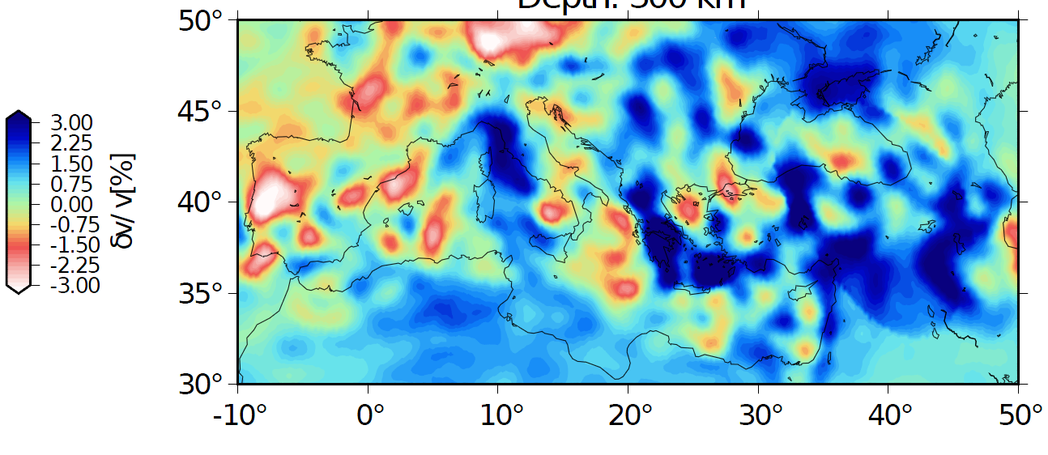
Different reference models produce different tomographic images:
300 km
S-wave
S-wave
S-wave
Zhu et al. (2012) Nat. Geosci., 5, 493–498, doi:10.1038/ngeo1501
Compilation in Faccenna et al., 2014
(Rev. Geophys., 52, 283-332)

Slide 29
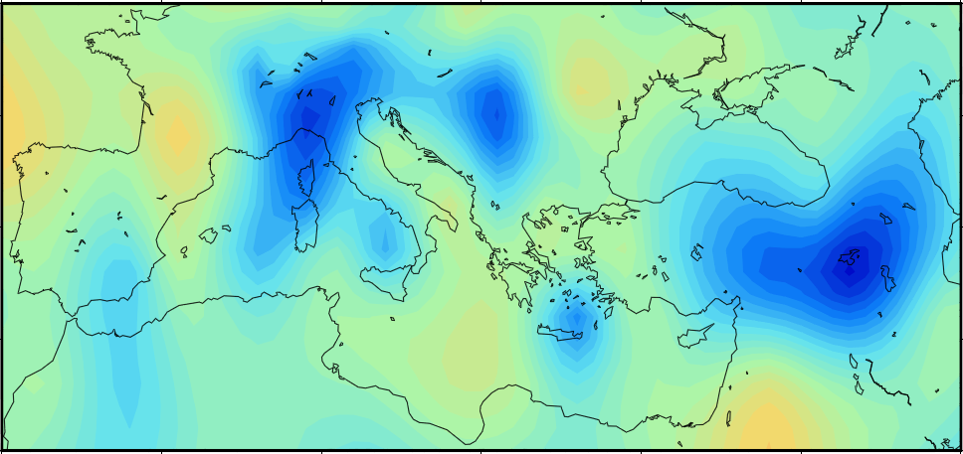
Different reference models produce different tomographic images:
S-wave
S-wave
300 km
S-wave
Auer et al. (2014) J. Geophys. Res., 119, doi:10.1002/2013JB010773
Compilation in Faccenna et al., 2014
(Rev. Geophys., 52, 283-332)

Slide 30
Surprisingly small spread of data of the bulk of the samples, considering the huge area/age/composition covered by the samples…
⁸⁷Sr/⁸⁶Sr

Slide 31
Take-away Message:
Geochemistry of igneous rocks in complex tectonic settings means nothing if not validated by geology.
The supposed deep mantle plume isotopic signature simply does not exist.
Tomography has not the power to identify deep mantle upwelling and cannot be used to measure its temperature.
Nearly all the “plume-related” magmatism is associated with important regional discontinuities.
Despite the complex tectonic setting, the “anorogenic” magma cluster in relatively narrow geochemical fields.

Slide 32
OIB Tp
MORB Tp
Adiabat
~200 km
Region B”
LLAMA
Temp
Ridge Geotherm
Midplate Geotherm
From: Anderson (2013) Austr. J. Earth Sci., 60, 657-673.
Depth
TZ

Slide 33

“Logic is as important as physics and isotopes.”
Don Anderson, 2013
Thanks for the attention (and thanks to Don)
michele.lustrino@uniroma1.it

