Slide 1

Plate tectonics initiation as a random outcome of time-dependent convection
Teresa Wong
Slava Solomatov
Theory of Earth II
AGU Fall Meeting
19 December 2014

Slide 2
Major questions on initiation of plate tectonics
Mechanism and time of initiation on the Earth (e.g., Hall et al. 2003; Stern 2004, 2007; Shirey et al. 2008)
Strength of lithosphere (e.g., Kohlstedt 1995; Hirth and Kohlstedt 1996; Bercovici et al. 2000)
  Why is it low for the Earth?
  Weakening mechanisms
Existence of plate tectonics on Venus, Mars, and Europa (e.g., Turcotte 1993, Lenardic et al. 2004, Kattenhorn and Prockter 2014)
Conditions for plate tectonics on exoplanets (e.g., O’Neill & Lenardic, 2007; Valencia & O’Connell, 2007; Korenaga, 2010; Stamenkovic & Breuer, 2014)

Slide 3
How was the question of subduction initiation studied?
Previous studies aimed to understand whether plate tectonics could happen, but they did not investigate the timing of plate tectonics initiation – When does plate tectonics start under favorable conditions?
The initial conditions and the evolution of the convection system may render the event of subduction initiation a random outcome.

Slide 4
What controls subduction initiation?
Two approaches to obtain scaling laws for subduction initiation:
Find parameters of convective system to start subduction
Fix yield stress
Find the yield stress (critical yield stress) at which subduction begins
Fix parameters of convective system

Slide 5
What controls subduction initiation?
Scaling relation for critical yield stress (Wong and Solomatov, 2015)
Critical yield stress of the lithosphere may be higher than previously predicted as a result of random initial conditions and random changes in convective cell width.

Slide 6
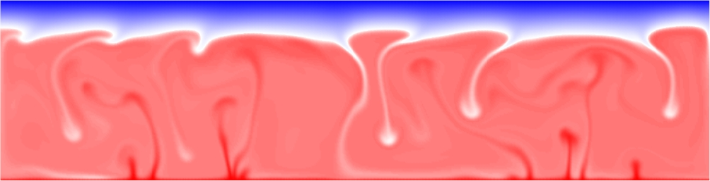
Dynamics of time-dependent convection
Changes in the dynamics of time-dependent convection are random
Cell width varies with time
Widest cell may initiate subduction

Slide 7
Dynamics of time-dependent convection
Changes in the dynamics of time-dependent convection are random
Cell width varies with time
Widest cell may initiate subduction

Slide 8
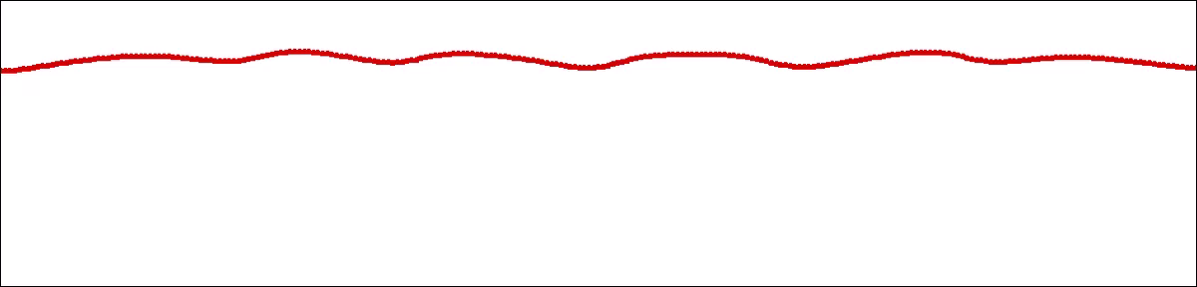
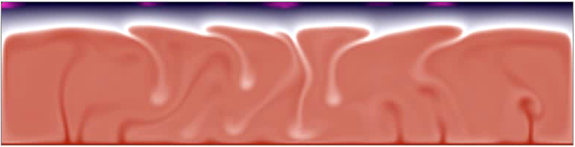
Lid thickness evolution
Variation in lid structure is slow compared to the motions in the interior

Slide 9
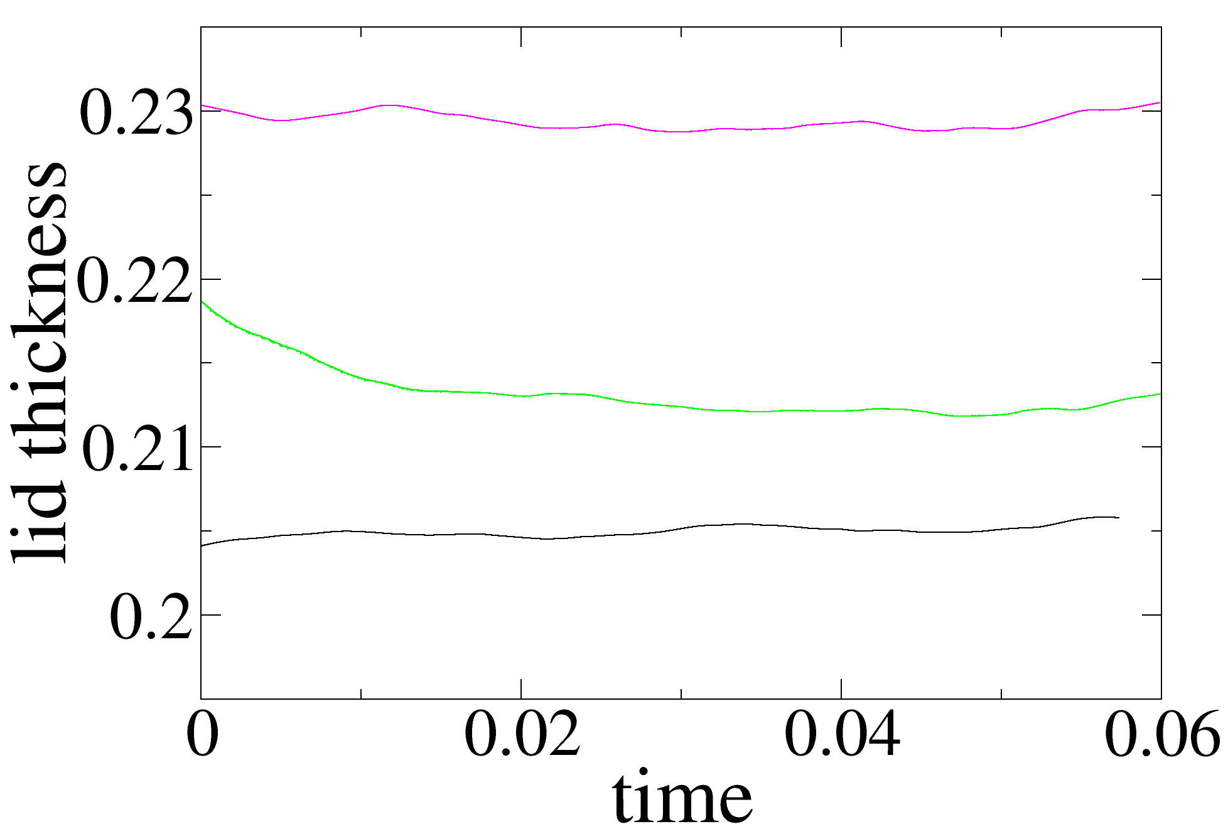
Different lid structure from different initial states
Statistically steady-state convective solutions resulting from different initial conditions are slightly different.
For example, average lid thickness is slightly different among the solutions.

Slide 10
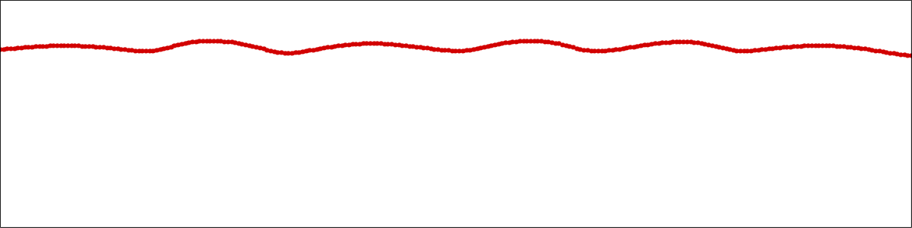
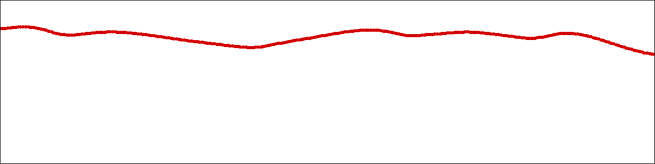
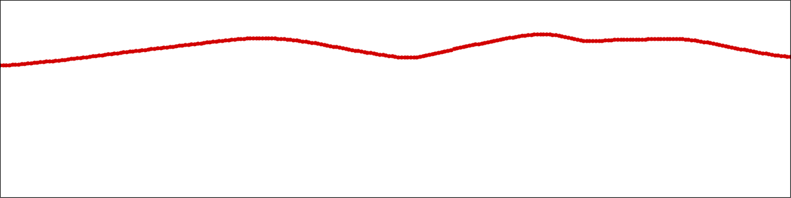
Subduction initiation – a random outcome
Random initial conditions
The time of subduction initiation may be different for different solutions because of the difference in lid structure.
δ = 0.20
Equations of thermal convection
+
Set of parameters
δ = 0.21
δ = 0.23

Slide 11
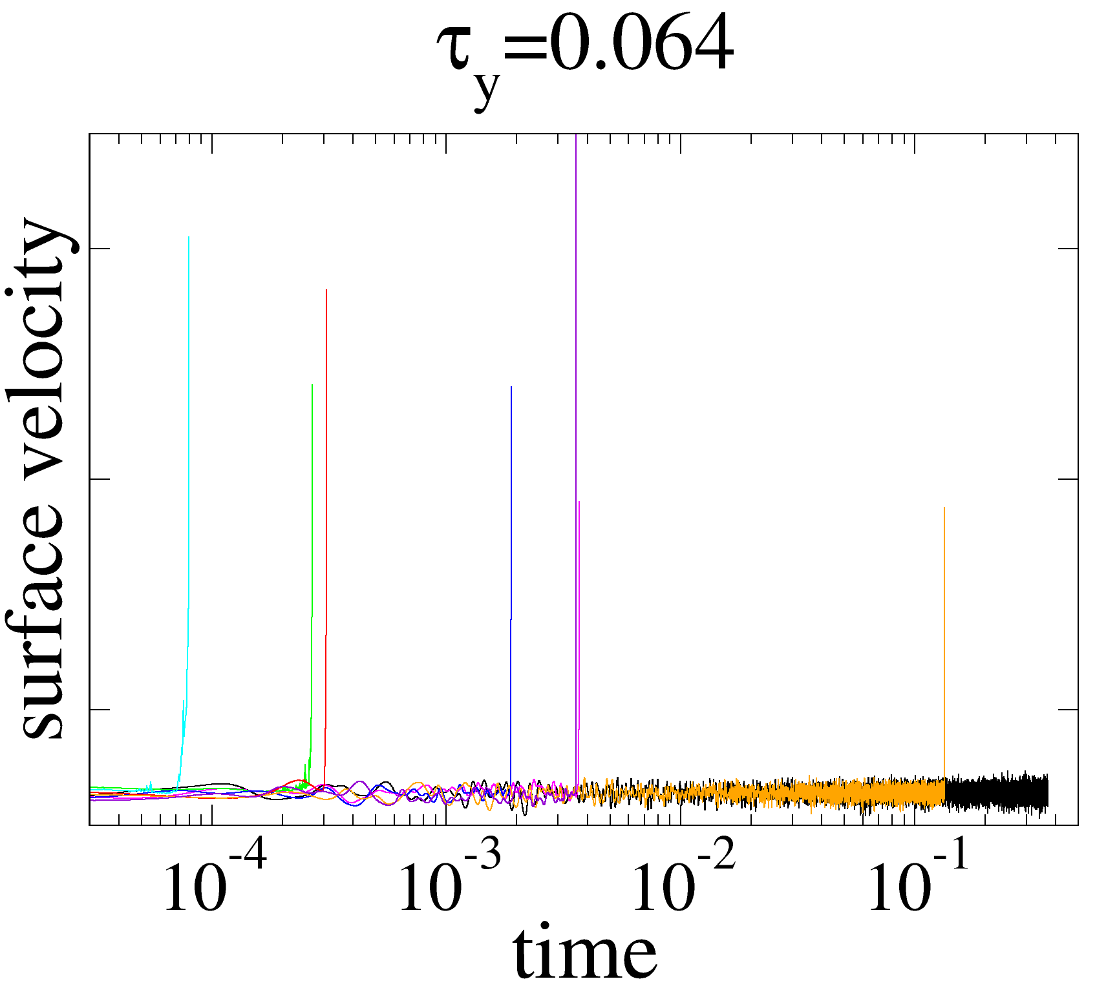
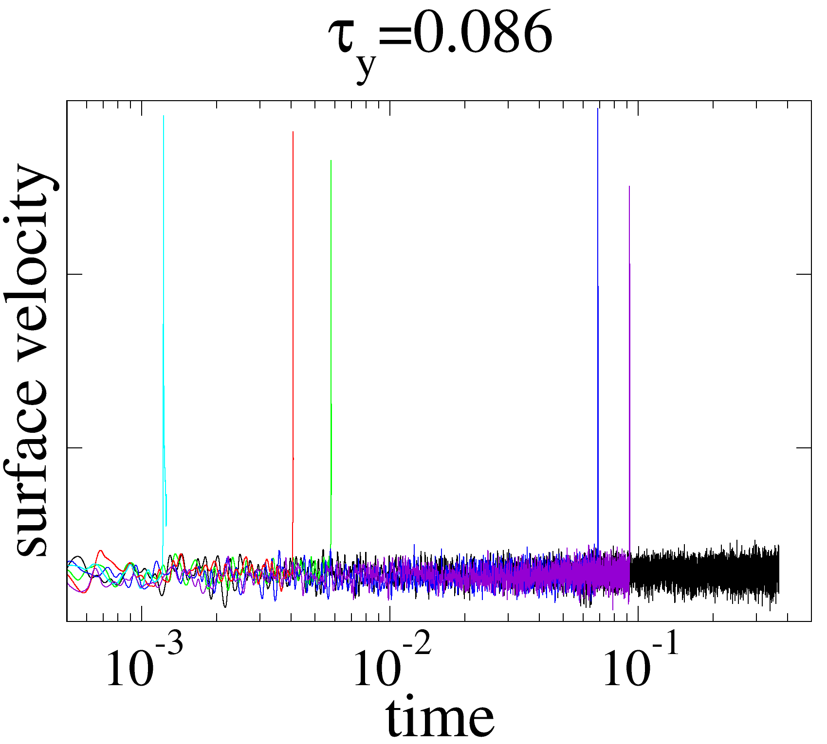
Time of subduction initiation
Ra = 3×10⁸, η = exp(-18.4T)

Slide 12
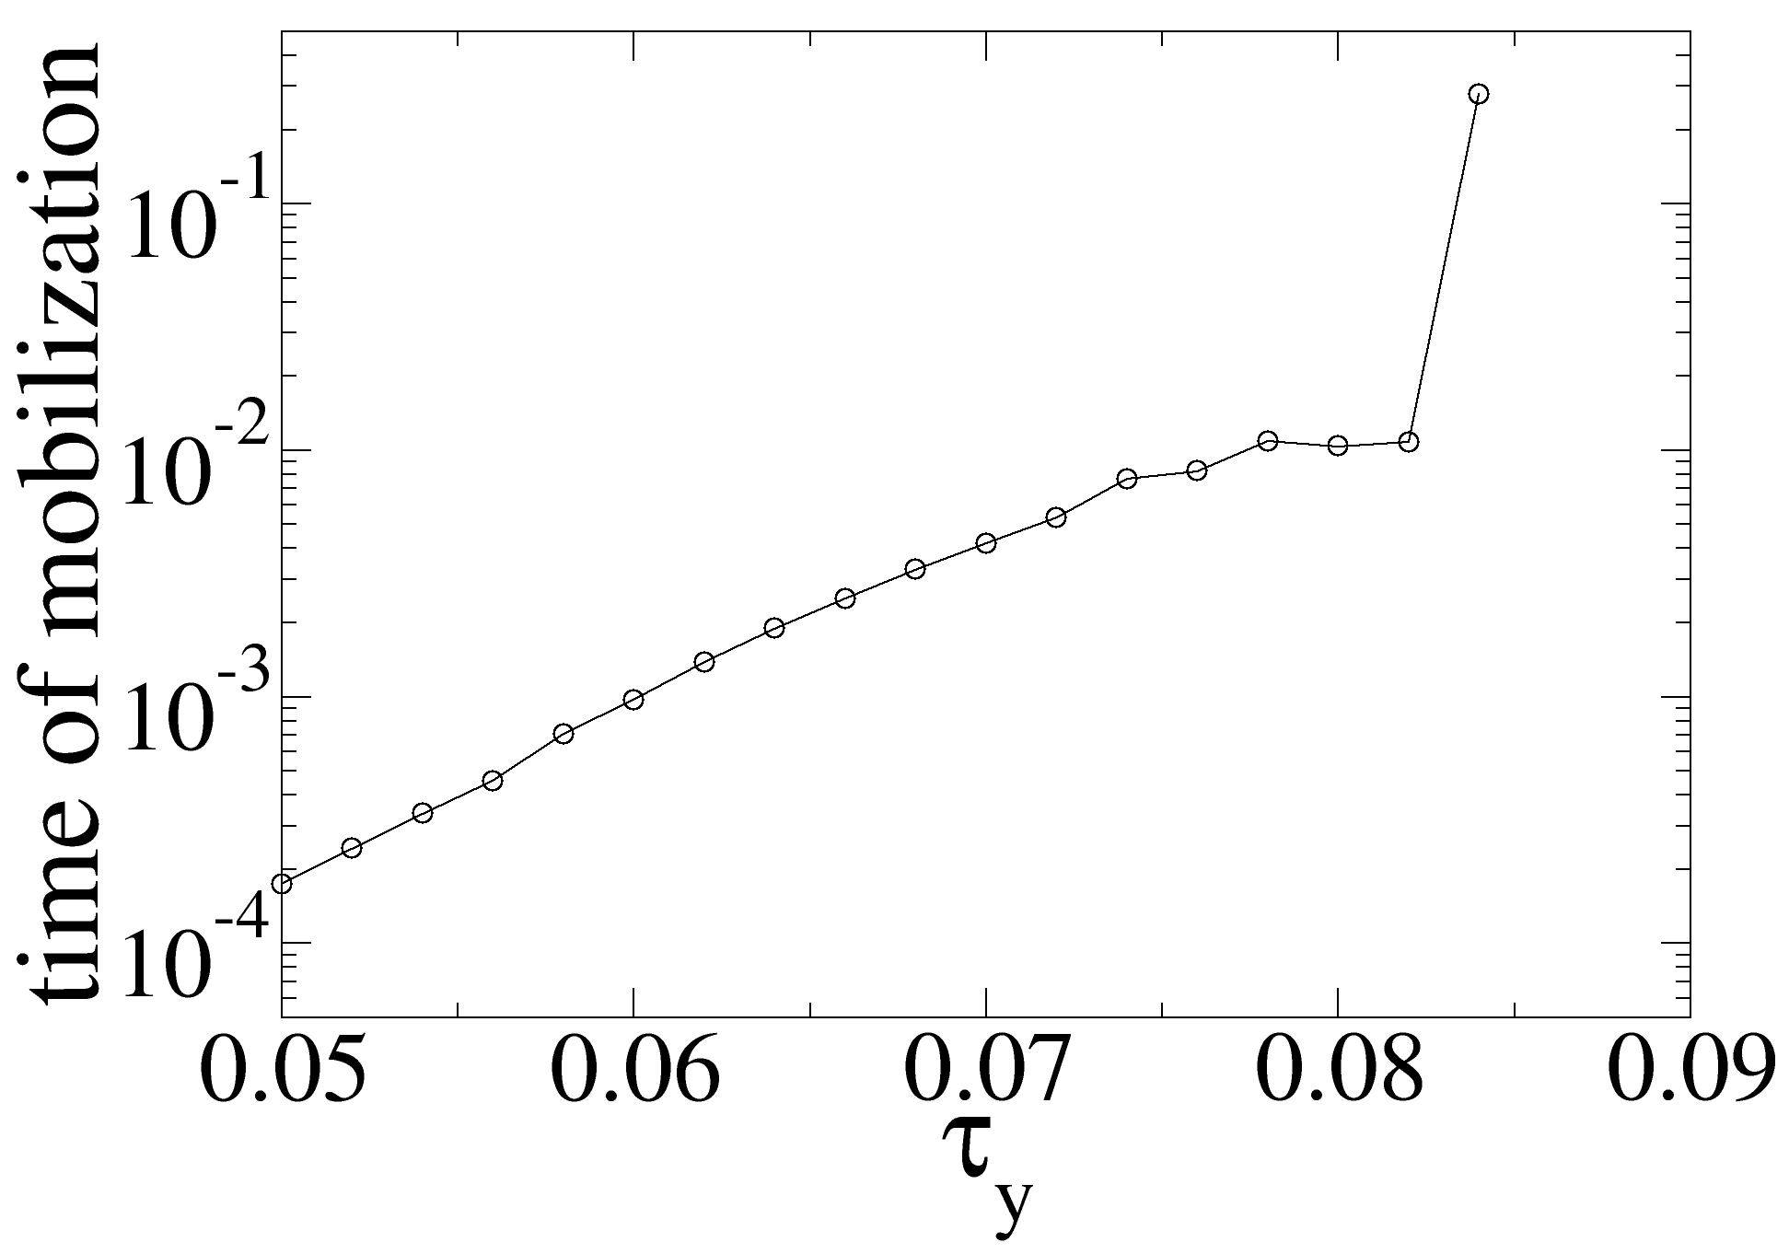
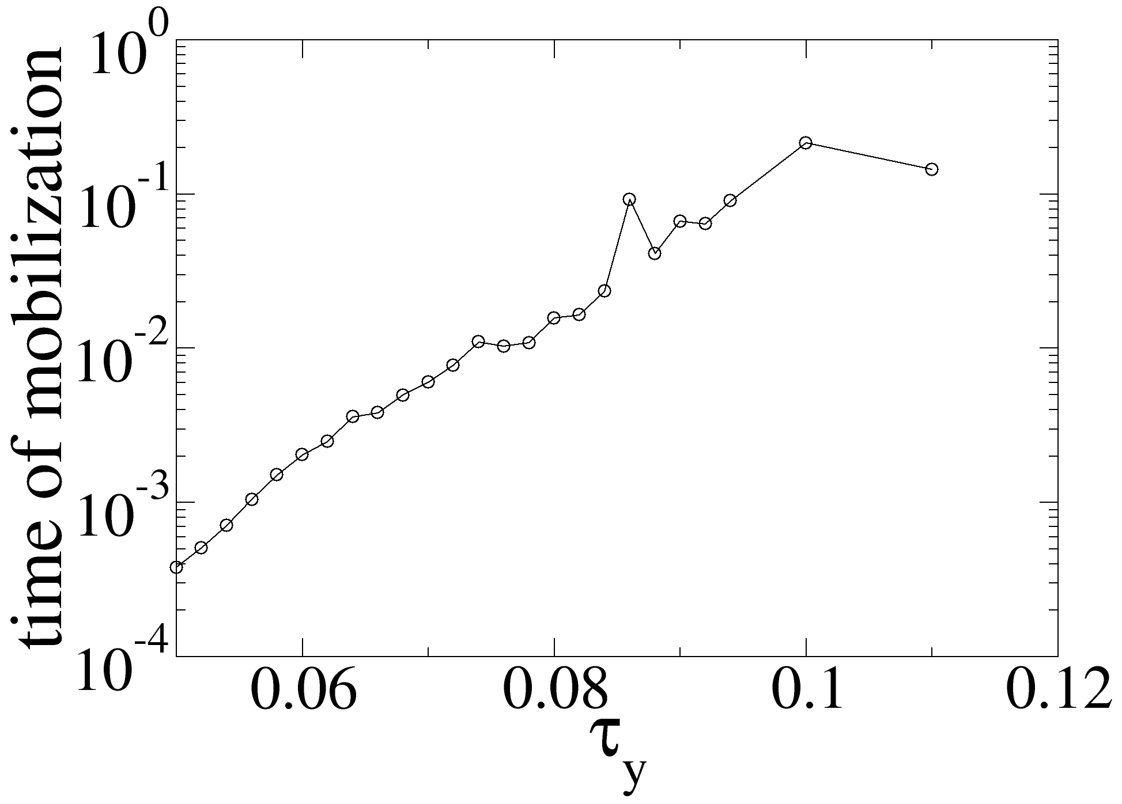
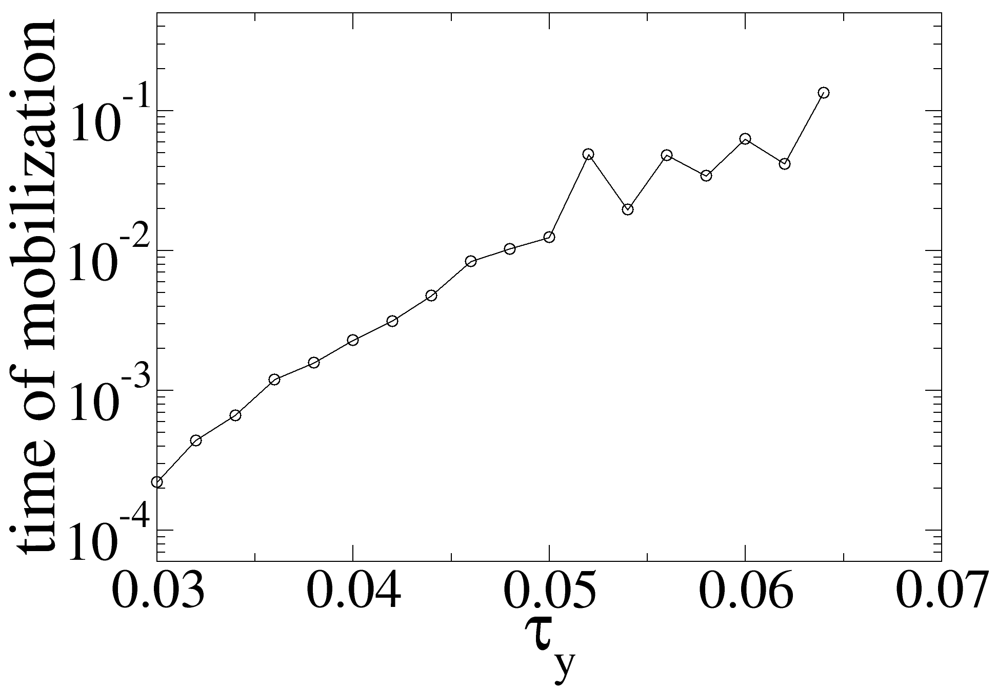
Time of subduction initiation
Ra = 3×10⁸
η = exp(-18.4T)
Different statistically steady-state solutions (i.e., lid structure)

Slide 13
Time of subduction initiation
Ra = 3×10⁸
η = exp(-18.4T)
Different statistically steady-state solutions (i.e., lid structure)

Slide 14
Time of subduction initiation
Simulations are not long enough yet to determine at which yield stress the time of mobilization would be infinite (i.e., no subduction)

Slide 15
Time of subduction initiation
Some preliminary classification of timing of subduction:
Immediate subduction – lithospheric failure occurs on the order of the timescale of cold plume detachment
Subduction after a finite period (~ 0.01 – 0.5 dimensionless time)
No subduction (at least within the simulation time)

Slide 16
Conclusions
An important question is how long does it take for plate tectonics to start under favorable conditions.
The timing of plate tectonics initiation might be a random outcome of mantle convection, controlled by initial conditions and cell evolution.
For a planet that has vigorous convection, plate tectonics may emerge either early, late or never in planetary history depending on the its early state and evolution.

