Slide 1

Are Mantle Plumes Real?
Durham Workshop on Realism & the Earth Sciences, 15-16 January, 2018
Gillian R. Foulger
Dept. Earth Sciences
Durham University
… with invaluable guidance from Thomas Rossetter

Slide 2
Question
Are mantle plumes unobservable entities?
In future, will they cease to be believed to exist?
Will they be the next phlogiston, aether, caloric, geosyncline…?

Slide 3
Reasons for doubting the reality of plumes – 1
Theory predictions are rarely confirmed.
This is generally met by arguing:
  There has been insufficient research;
  The evidence has been destroyed;
  “The” plume is too small to be resolved (the teacup orbiting the Sun argument);
  This is a different variety of plume (there are now more plume-variants than there are proposed plumes).

Slide 4
Reasons for doubting the reality of plumes – 2
Unscientific arguments are common, e.g.,
  “Most people believe in plumes”;
  “No observation could ever convince me plumes don’t exist”;
  “There must be a plume here because there is evidence for it”;
  “It is terrible to question plumes because Jason is my friend”;
  There are no alternatives;
  Confirmed predictions of other theories are explained as coincidences.

Slide 5
Reasons for doubting the reality of plumes – 3
After almost 50 years of study scientists still do not agree
  what the definition of a plume is;
  whether or not they exist; and
  (amongst believers) how many there are.
Retreat to using vague language, e.g., “hot spot”.

Slide 6
Tale of Two Theories

Slide 7
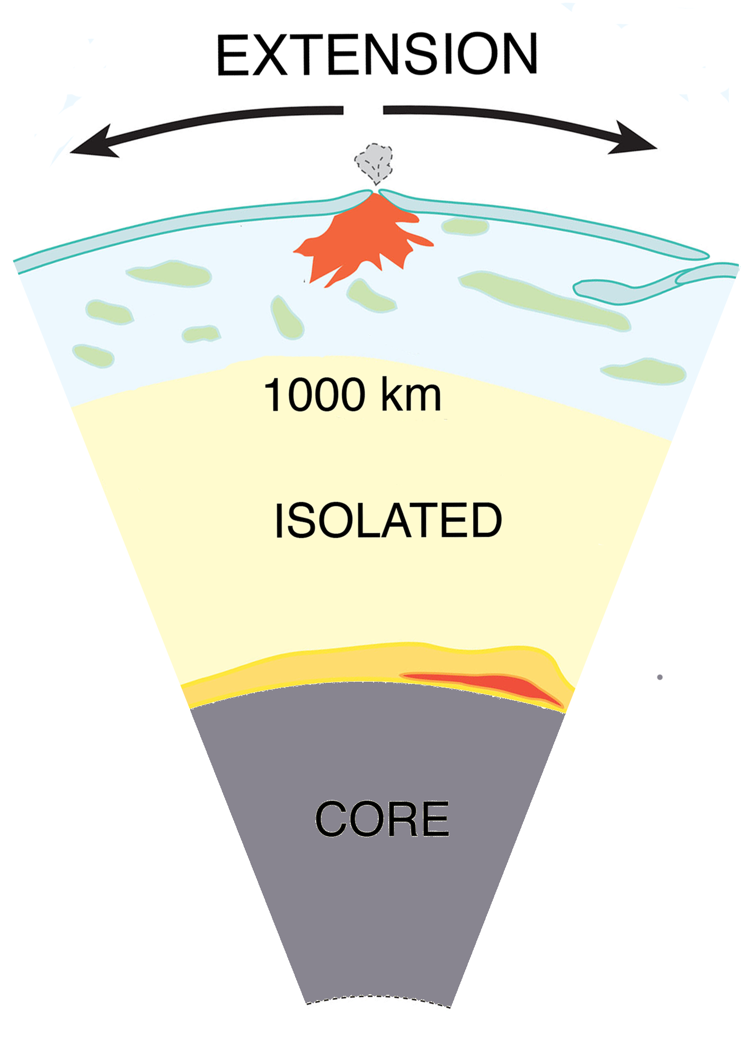
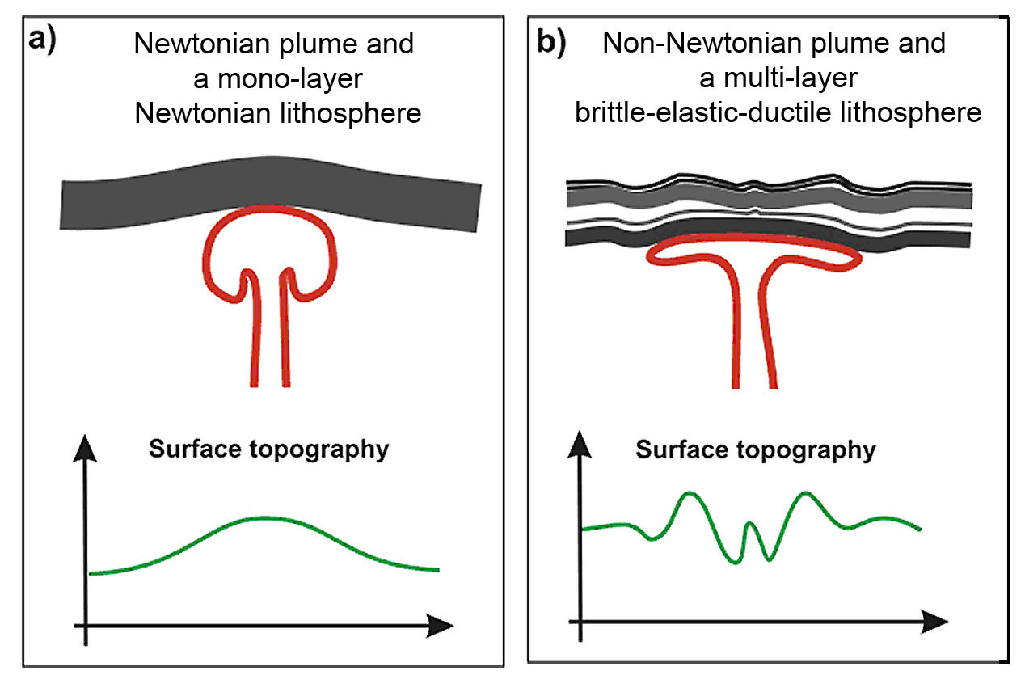
Plates vs. Plumes

Slide 8


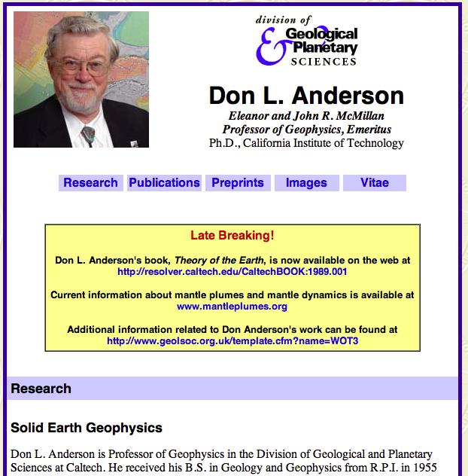

Nat. Medal of
Science
2003
Nat. Medal of
Science
1988
Notes:
National Medal of Science

Slide 9
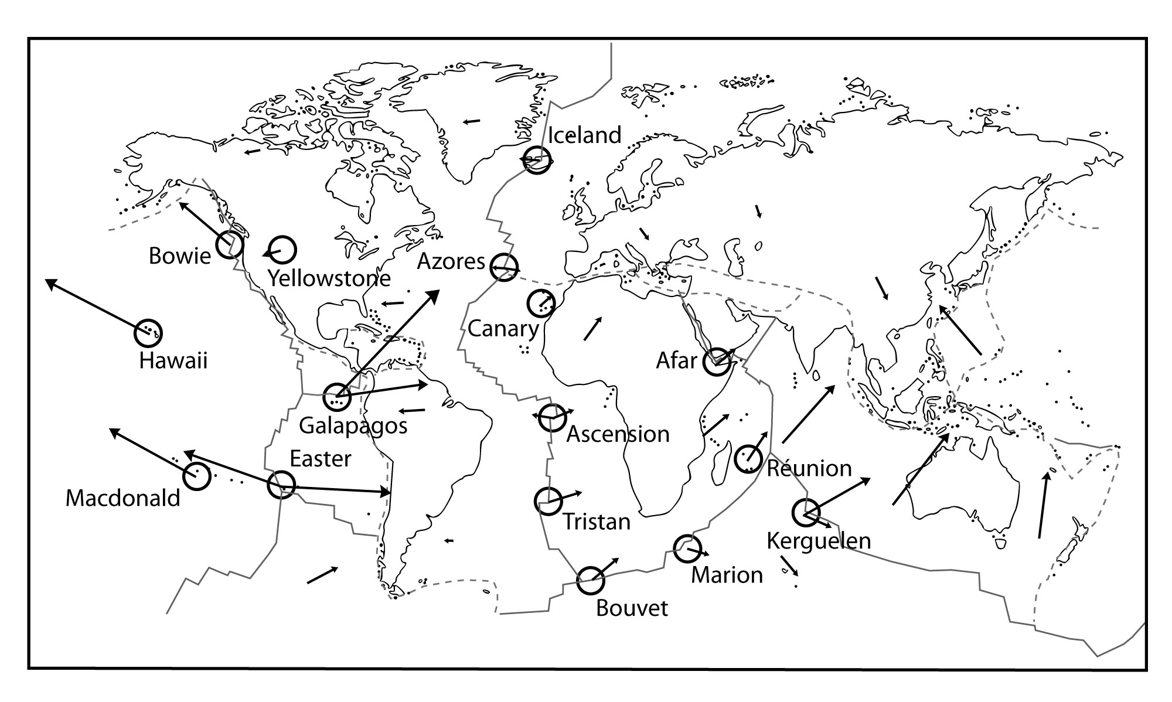
Morgan (1971)
The Plume Hypothesis
Notes:
Morgan went further. In addition to excess volcanism, plumes were supposed to also explain:
fixity & chains

Slide 10
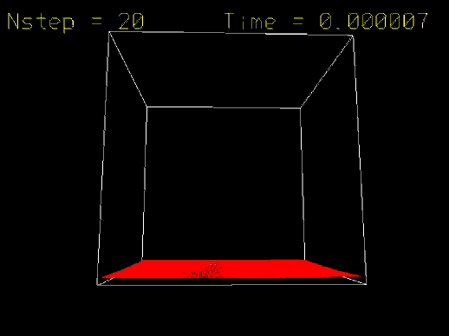

Slide 11
Five Main Predictions of the Modern Plume Hypothesis

Slide 12
1. Precursory surface uplift
Burov (2005)

Slide 13
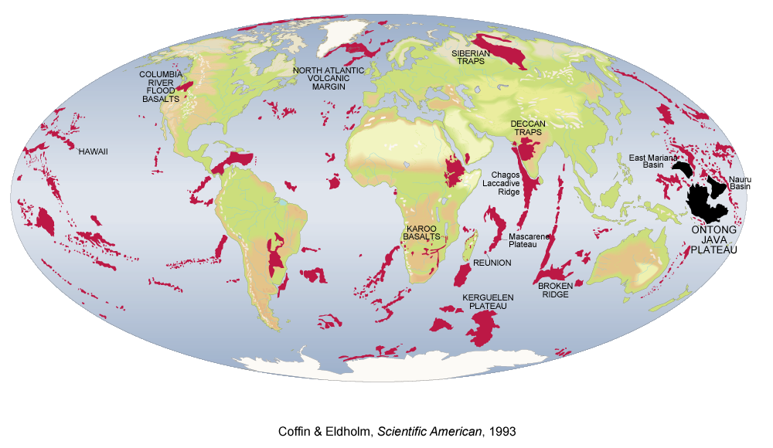
2. Followed by a “plume head” flood basalt eruption
Coffin & Eldholm (1993)

Slide 14
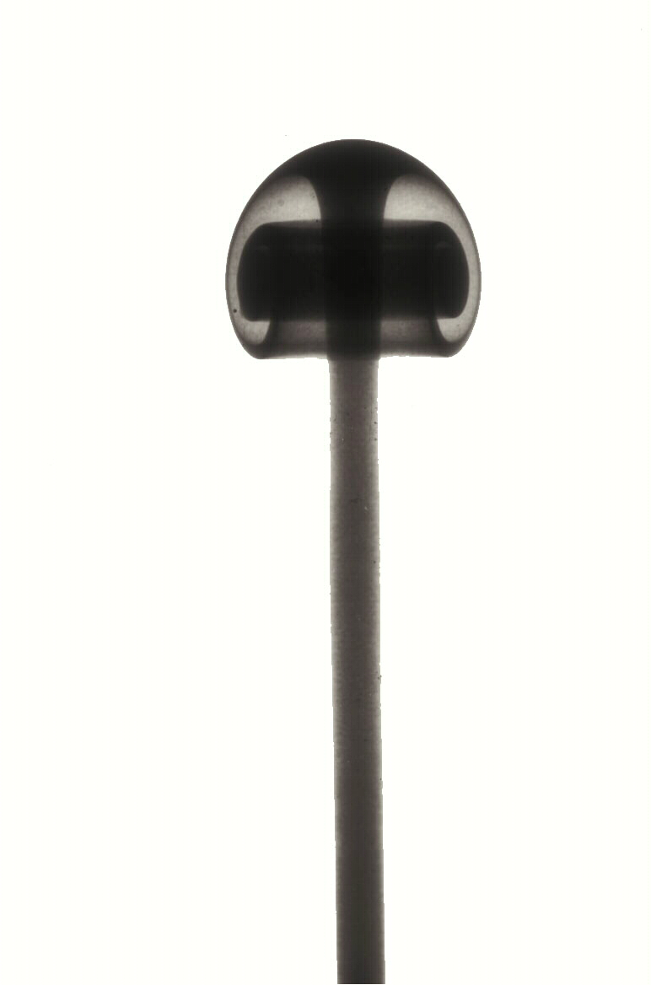
3. Plume “tail” to the core-mantle boundary
Campbell (2005)

Slide 15
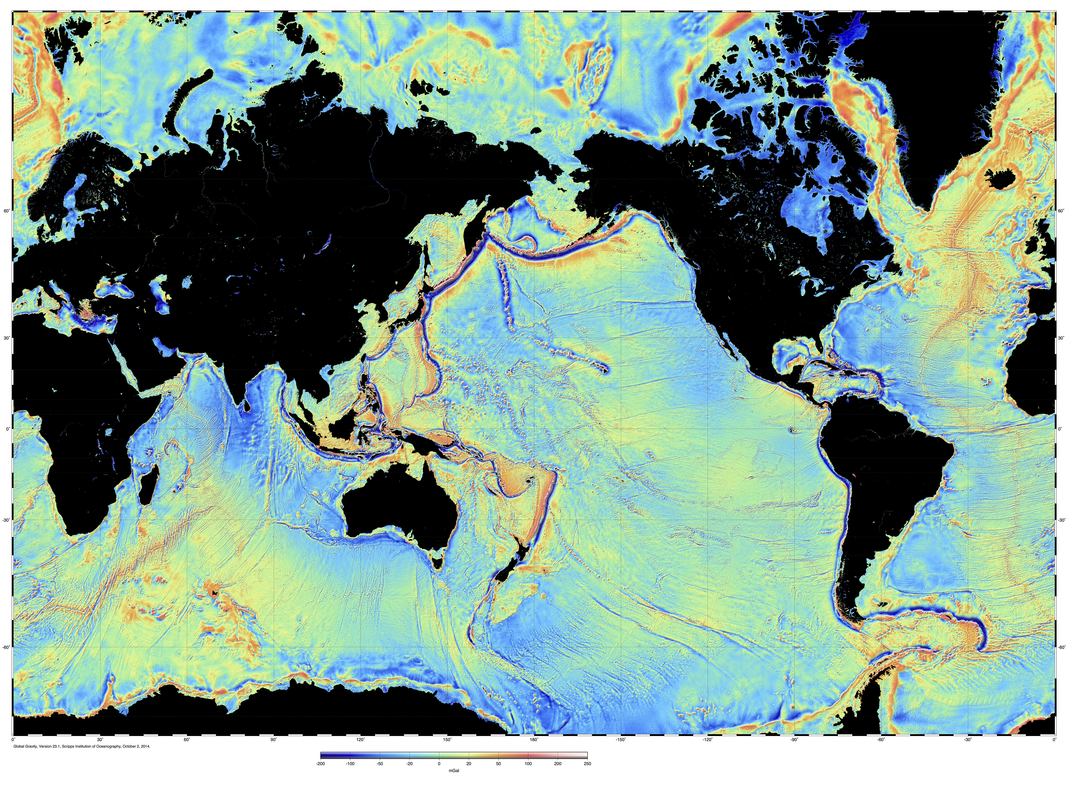
4. Fixed relative to one another, resulting in time-progressive volcanic chains
Hawaii

Slide 16


5. High magma source temperatures

Slide 17
The Failed Predictions of the Plume Hypothesis

Slide 18
1. Precursory surface uplift
Burov (2005)

Slide 19

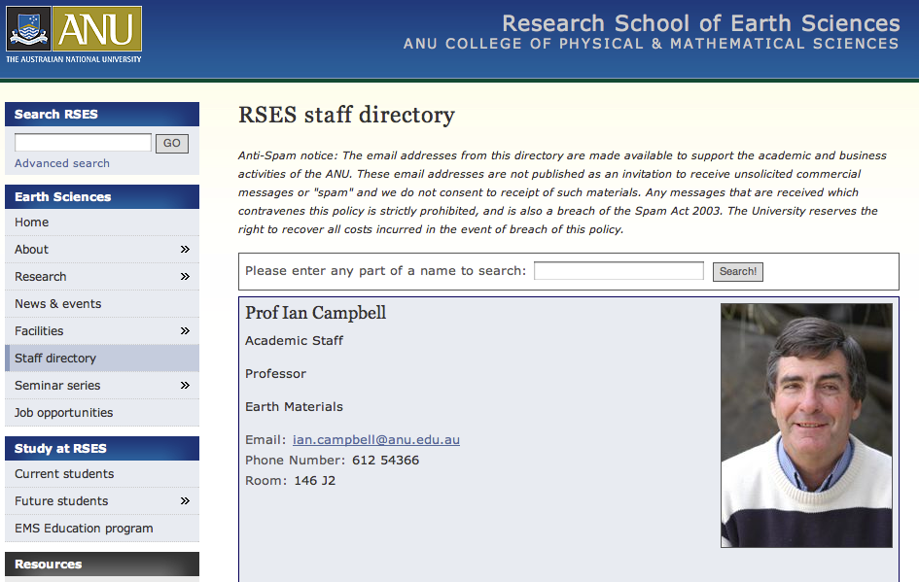

Slide 20
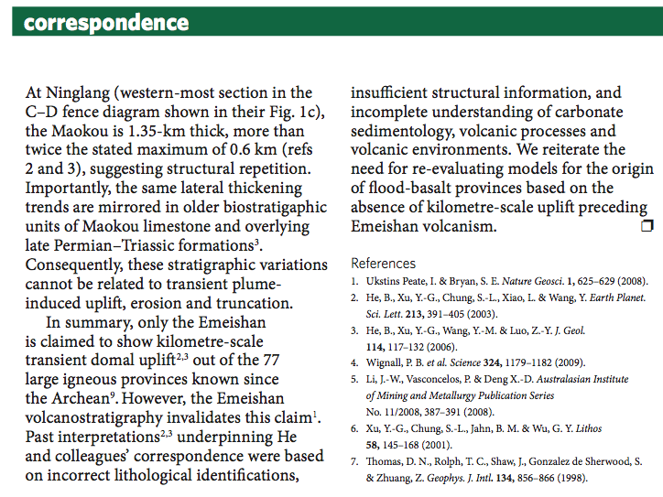
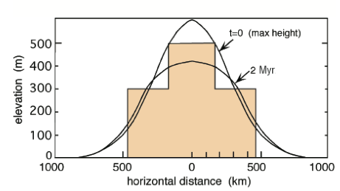
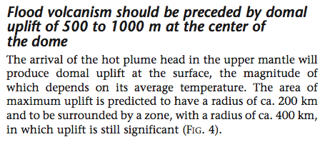
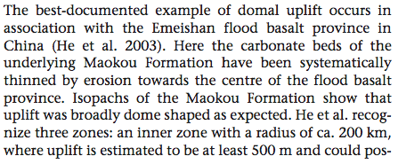
?
Ukstins-Peate & Bryan,
Nature Geoscience, 2009
Campbell,
Elements, 2005

Slide 21
2. Followed by a “plume head” flood basalt eruption
Coffin & Eldholm (1993)

Slide 22
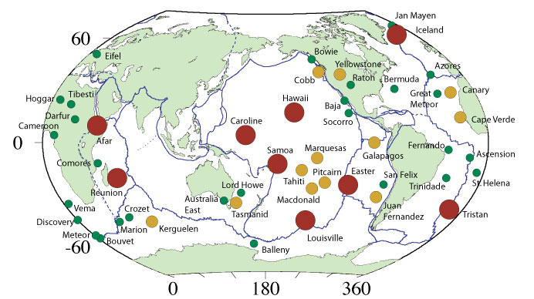
Recent list of 49 “hot spots”
From: Courtillot, V., A. Davaillie, J. Besse, and J. Stock (2003), Three distinct types of hotspots in the Earth's mantle, Earth planet. Sci. Lett., 205, 295-308.

Slide 23
Those without “plume-head” flood basalts
From: Courtillot, V., A. Davaillie, J. Besse, and J. Stock (2003), Three distinct types of hotspots in the Earth's mantle, Earth planet. Sci. Lett., 205, 295-308.

Slide 24
3. Plume “tail” to the core-mantle boundary
Campbell (2005)

Slide 25
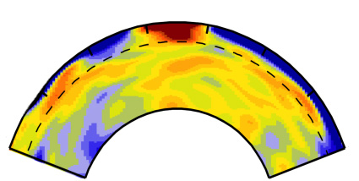
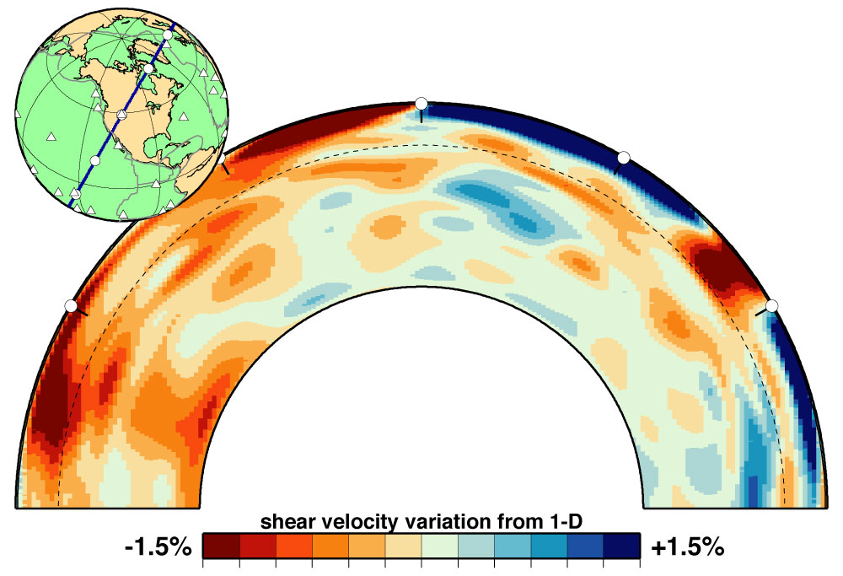
Seismic cross sections through Earth
Iceland
Yellowstone
Ritsema et al. (1999)

Slide 26
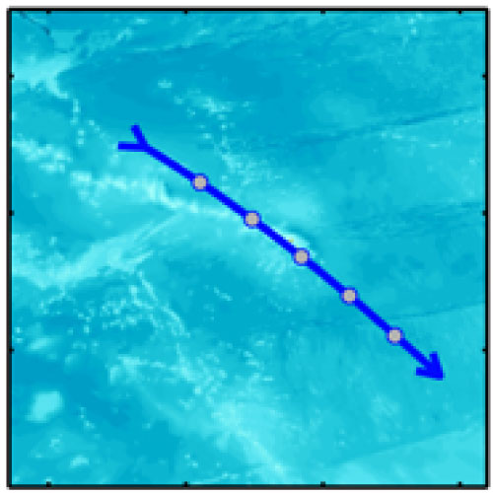
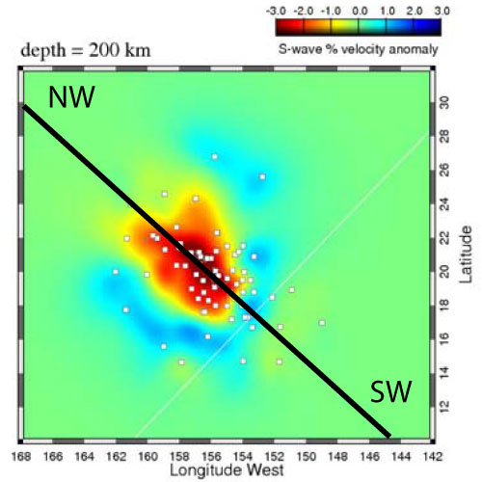
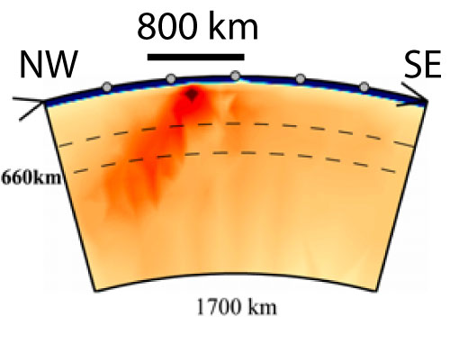
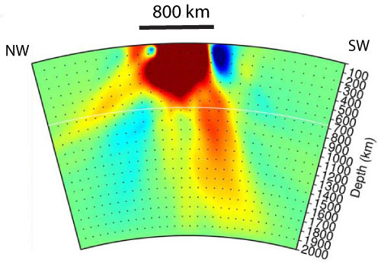
Hawaii
Li et al. (2008)
Wolfe et al. (2009)

Slide 27
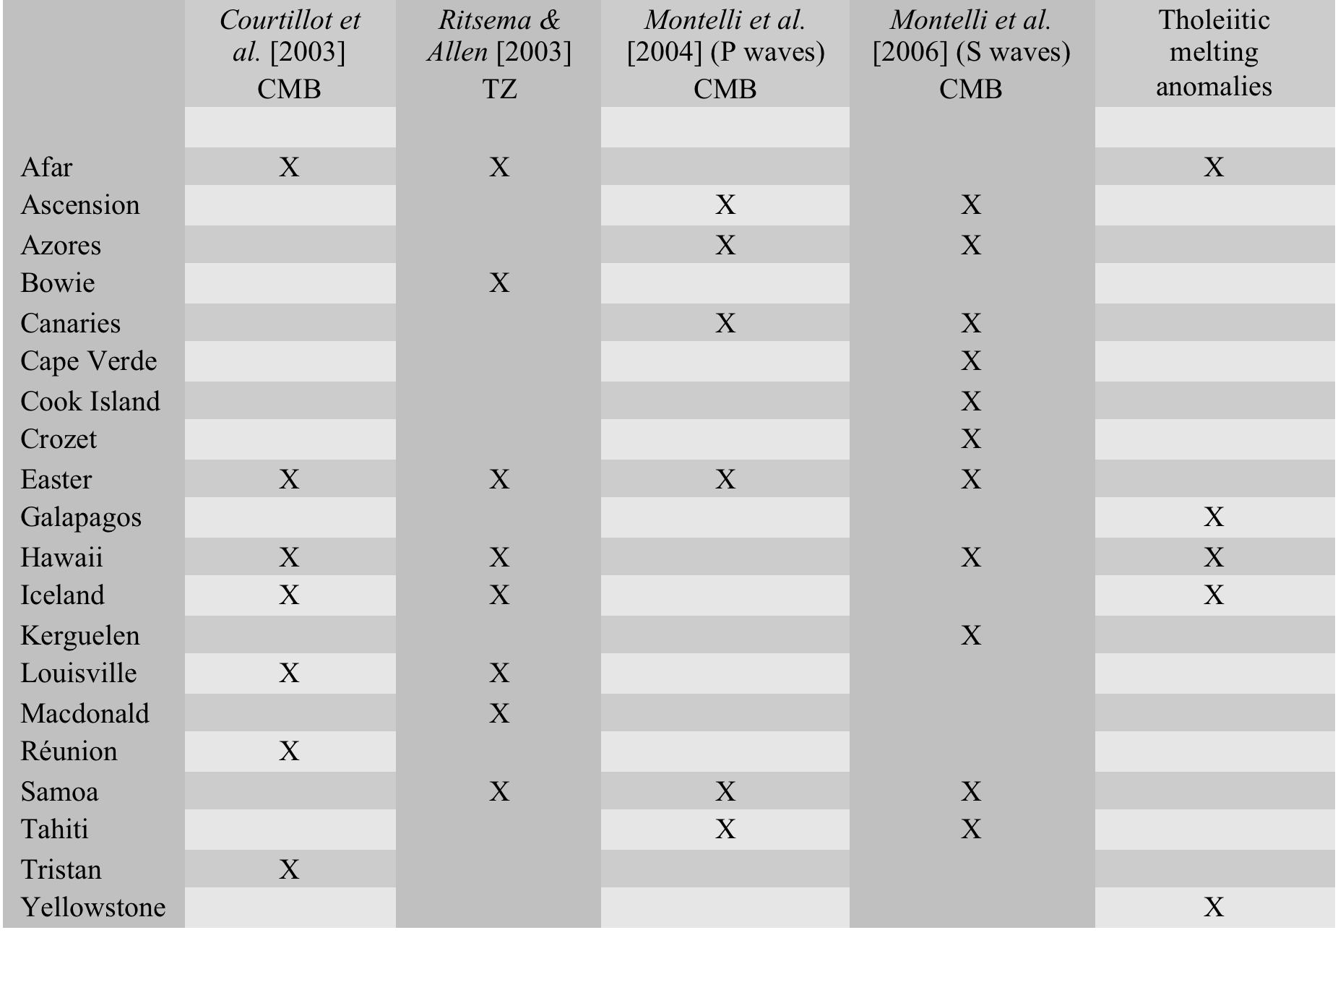

Slide 28
Seismology
Seismology cannot distinguish composition, phase & temperature
A seismic image is not a geological image
There are many problems in seismology, and insufficient skepticism
“Geologists tell us plumes exist so it is our duty to find them”

Slide 29
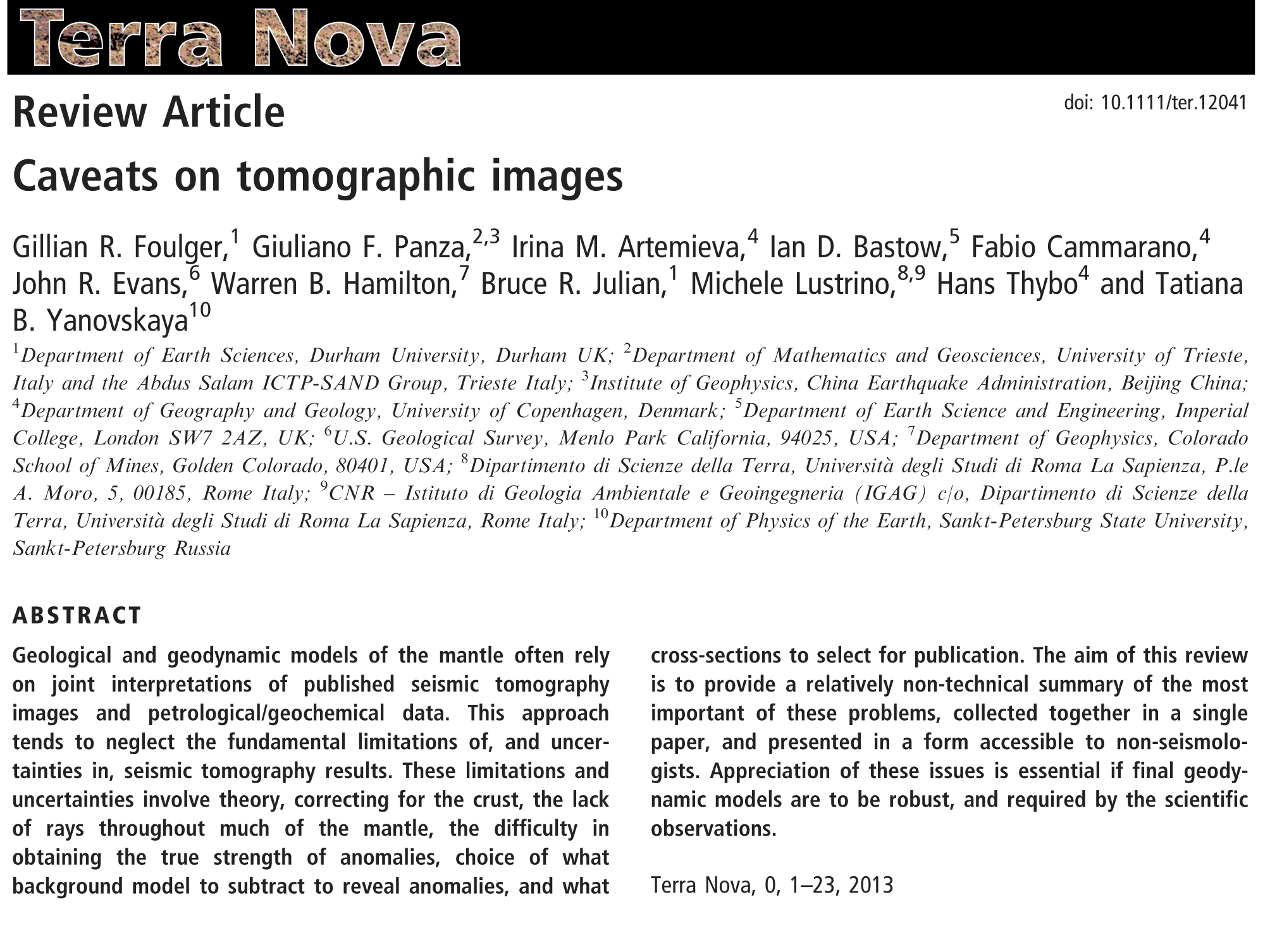

Slide 30
4. Fixed relative to one another, resulting in time-progressive volcanic chains
Hawaii

Slide 31
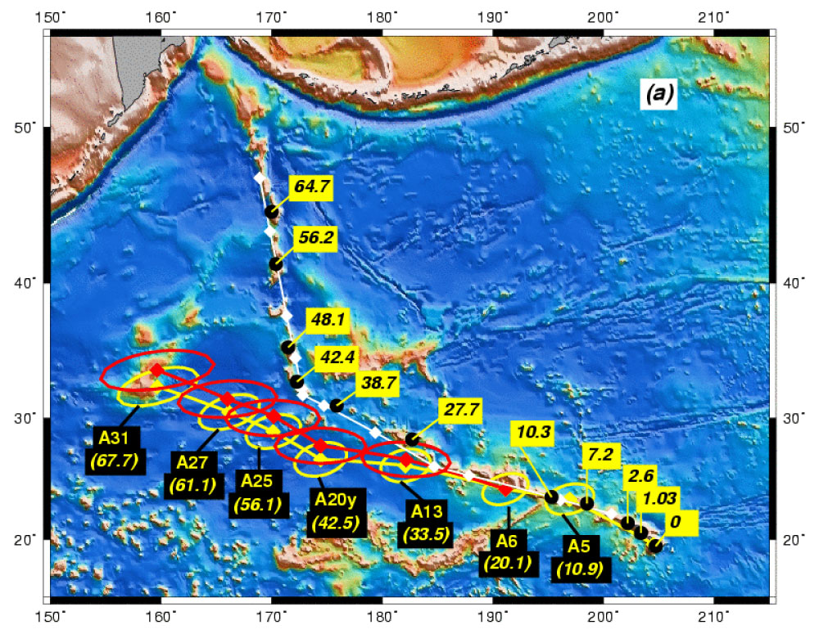
Raymond et al. (2000)

Slide 32
But…
Morgan knew this when he first proposed plumes …

Slide 33
Examples of Flawed Science

Slide 34
Geochemical tracers of the core-mantle boundary – Example A
Morgan (1971) predicts plume material different composition from “normal” magmas
Schilling (1973): Icelandic magmas have different composition
Example of a successful prediction!

Slide 35
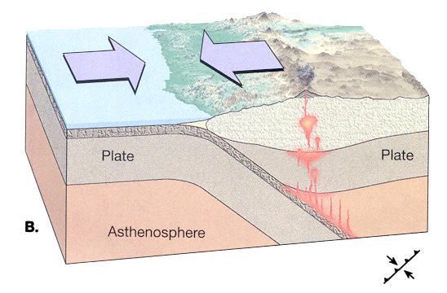
Geochemical tracers of the core-mantle boundary – Example A
Hofmann & White (1982): the difference in composition results from re-melted crust
Explained by postulating crust subducted to core-mantle boundary and returned in plumes!

Slide 36
Geochemical tracers of the core-mantle boundary – Example B
Unusual, high ³He/⁴He ratios found at Hawaii
Because thought to be a plume under Hawaii, interpreted as a core-mantle-boundary tracer
Subsequently, if high ³He/⁴He ratios found, assumed to indicate a new plume

Slide 37
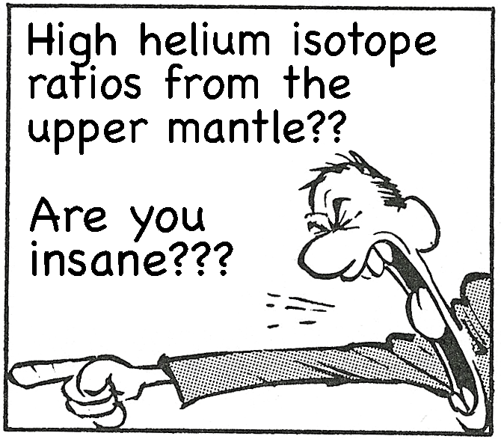
Geochemical tracers of the core-mantle boundary – Example B
Geochemistry cannot tell depth of origin of magmas
…but not everyone
accepts this …

Slide 38
Endless plume variants
Lateral flow of plume material
Tabular plumes
Pulsing plumes
High ³He/⁴He plumes
Low ³He/⁴He plumes
Headless plumes
Tailless plumes

Slide 39
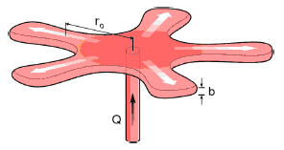
Currently Over 70 Plume Variants
Thermal (1); Fossil (2); Channelled (3); Toroidal (4); Tabular (5); Depleted Residual (6); Finger-like (7); Recycled (8); Edge (9); Cold (10); Cacto- (11); Super (12); Asthenospheric (13); Dying (14); Not very energetic (15); Spaghetti (16); Baby (17); Head-free (18); Splash (19); Pulsating (20); Subduction fluid-fluxed Refractory (21); Hydrogen (22); Heterogeneous (23); Flattened Onion (24); Subduction-driving (25); Subduction-triggered (26); Washboard (27); Bent-shaped (28); Failing (29); Delamination-triggering (30); Concentrically-zoned (31); Mushroom (32); Laminar (33); Advected (34); Extinct (35); Bilateral (36); Bifurcated (37); Geriatric (38); Primary and Secondary (39); Accreted (40); Diverted (41); Deformed (42); Golden (43); Veined (44); Hidden (45); Weak (46); Pulsing (47); Young (48); Blob-like (49); Cavity (50); Starting (51); Passive (52); Stealth (53); Tilted (54); Asymmetric (55); Mega (56); Mini (57); Not-hot (58); Killer (59); Deflected (60); Stripy (61) ; Diamondiferous (62) ; Transient (63) ; Dehydrating (64); Doughnut (65); Rear (66); Side (67); Volatile-bearing (68); Incipient (69) ; Migrating (70).
A radial viscous fingering plume, published 2017

Slide 40
Comparison with geosynclines
Mio-geosyncline
Eu-geosyncline
Ortho-geosyncline
Primary geosyncline
Zeugo-geosyncline
Para-geosyncline
Exo-geosyncline
Taphro-geosyncline
Paralia-geosyncline
Notes:
Geosyncline is a term still occasionally used for a subsiding linear trough that was caused by the accumulation of sedimentary rock strata deposited in a basin and subsequently compressed, deformed, and uplifted into a mountain range, with attendant volcanism and plutonism.

Slide 41
www.mantleplumes.org

Slide 42
Question
Is Earth Science science?
The success rate of plume predictions low (e.g., 35% for flood basalts)–how does this compare with other failed hypotheses?
Are Plumes (and geosynclines) akin to a Linnaean classification system?
Is there a residual mind-think that geology is merely a descriptive science?
Might this be why plume theorists don’t see persistent predictive failures as problematic?

Slide 43

That’s all folks
Notes:
Mechanisms: Rifting decompression melting
Generic: Thermal/Sedimentary evidence
Localities: Hawaii/What the hell is Hawaii?
And if you think you might forget the URL, we are selling mantleplumes.org coffee mugs at cost price - £2.50

