Slide 1
Twinkle Twinkle Hot Afar Oh We Wonder What You Are
By Alex Hornby, Ross Findlay, Adam Lewis, Libby Rose, David Redpath, Megan Roberts, Emma Reynolds.

Slide 2
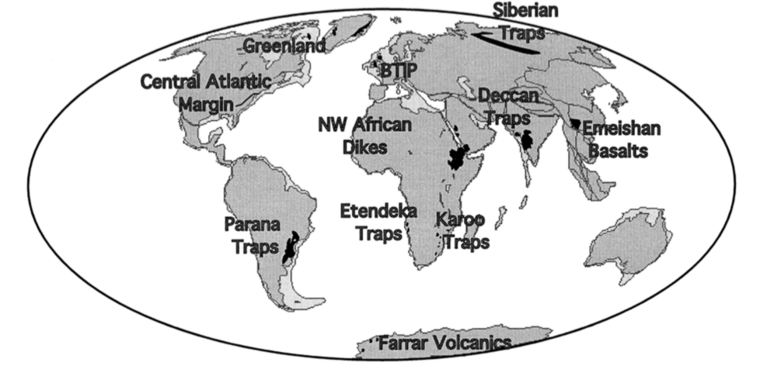
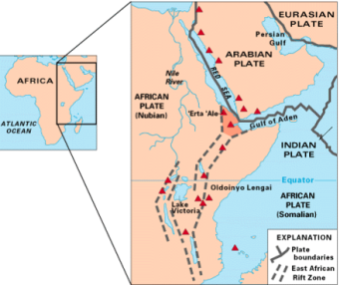
Afar, Ethiopia
Afar is at a triple tectonic junction.
The Afar region is at a constructive plate margin.
This region is mainly made up from basaltic lava.
Notes:
Afar is at a triple tectonic junction between the African spreading ridge, Arabian and Somalia plates.
This region is mainly made up from basaltic lava which also make up part of the Large igneous province in the East African Rift Zone.

Slide 3
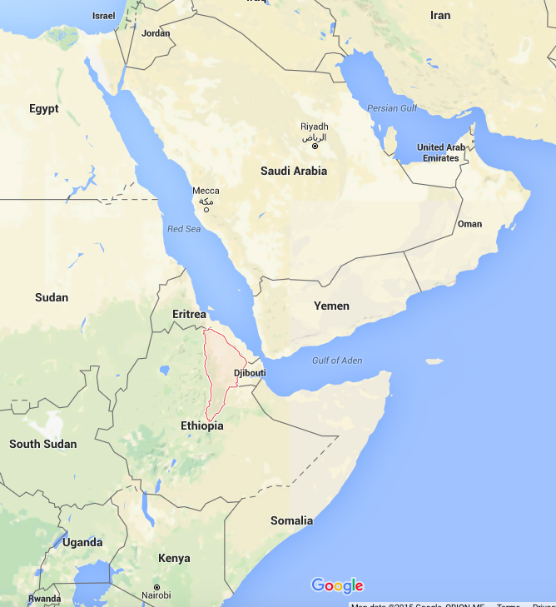
Time History
500,000 km² of flood basalts occurred 31-28 Ma (prior to the opening of the Red Sea and Gulf of Aden).
Red Sea and Gulf of Aden spreading:
30-15Ma stage one of rifting between Arabia and Africa creating the Red Sea.
10km rifting 20Ma Main period of extension.
15Ma failing rifts.
5Ma stage two of rifting between Arabia and Africa creating the Gulf of Aden.
Notes:
645km movement of the African plate for the last 30 million years, since the beginning of the Yemen Traps. 2.15cm/year
The Yemen Traps is about 660km long. 30Ma = 30000000yr
This is not conclusive to either the plume or plate theory. 2.15*30000000=64500000cm
In west of the Afar triangle, magma generation during the continental rifting was increasingly dominated by shallow decompression melting of the asthenosphere, which disproves the plume theory we will come back to this later. The composition of this material may be controlled by preferential channeling of the plume material.

Slide 4
Mantle Structure
Three main plume theories.
African Superplume
2-3 Medium Plumes
Many Small Plumes
Notes:
Over view of plume theories:
1) As seen, the seismic section best fits the Superplume hypothesis. There is an obvious low velocity zone that propagates down to the core mantle boundary and surfaces around the Ethiopian, Kenya region of East Africa.
2) There could however be 2 or 3 smaller plumes under Kenya, Afar and possibly Arabia. The southern plume could explain the volcanism in Afar 45Ma and current volcanism in Kenya. And the northern plume for the volcanism in Afar since 30Ma, it is suggested that the northern plume is dying and only the shallow part of the tail is left, this fits in with current reduction in volcanism (most of the volcanoes last erupted in the Holocene)
3) High-resolution body waves down to 400 km depth reveals multiple low-velocity zones, some suggestion that these are small 100-200 km diameter upwelling’s.
Problems with theories:
The proposed ~60° dip from vertical of the superplume is too much of an angle to be dynamically stable.
The fact that there is a low velocity zone beneath Afar currently suggests that if there is a plume with a long tail, which discounts this theory.
There are some uncertainties with this model like how the multiple small plumbs are fed, is it by a superplume at depth?

Slide 5
Mantle Structure
Notes:
Is it likely that you would be able to get these small convection cells between these two plumes that are so much closer together than other proposed plumes around the world. However we did not find any papers that have found this out.

Slide 6
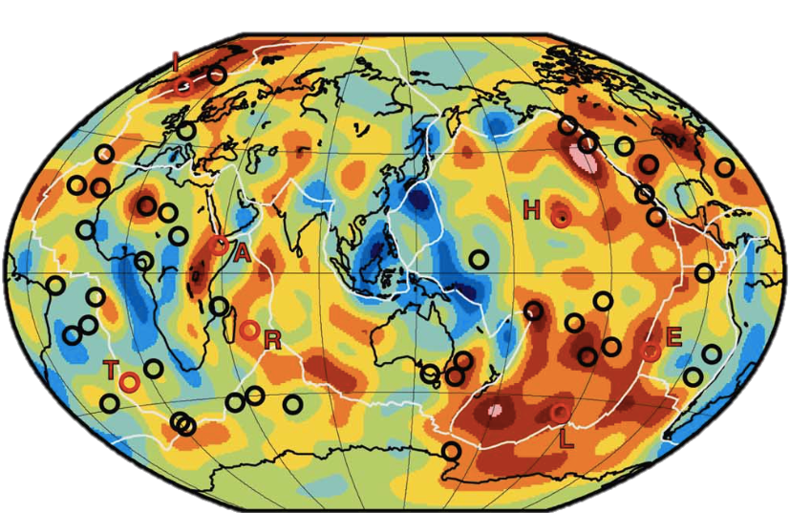
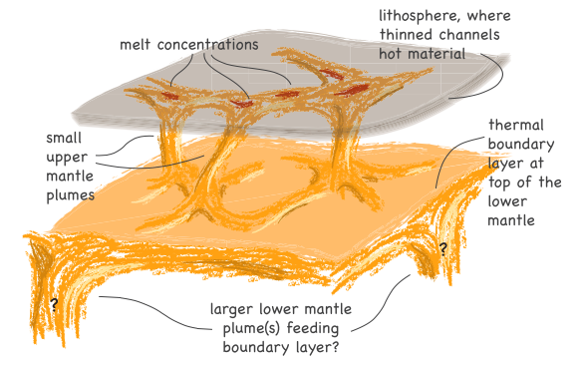
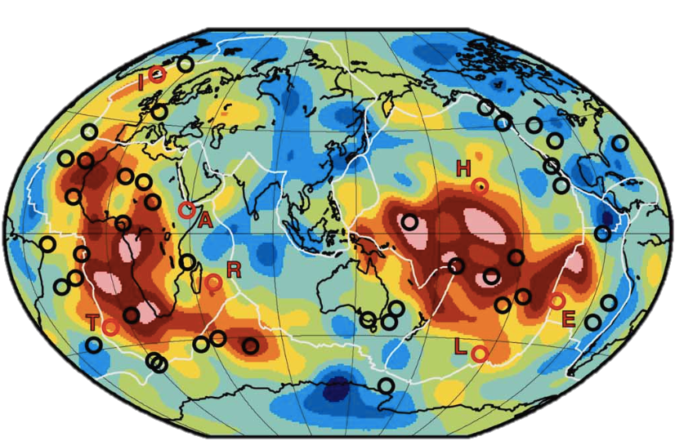
Mantle Structure
500km (2%)
2850km (2%)
Notes:
Plumes vary in temperature from 100-300°C, Afar is at the low end around 100°C so you would expect P-wave velocity anomalies of 0.4-0.8% at the top of the lower mantle and 2-6% in the upper 100 km, this is such a small percentage change and is unlikely to be measured with the resolution that is available to us today.

Slide 7
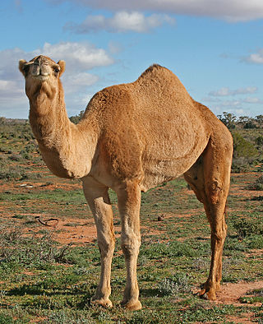
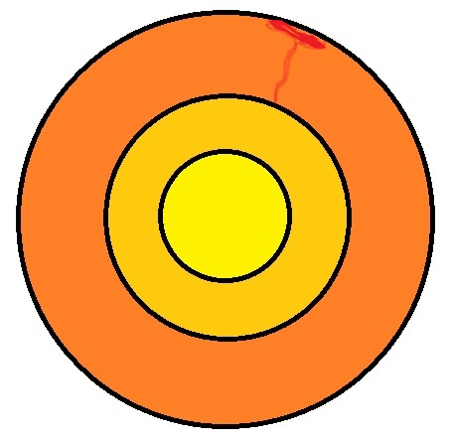
Geochemistry
Plume??
3He degassed at surface. More concentrated in the depths of the Earth where it cannot escape
Notes:
In this part of the presentation I will be attempting to give some geochemical evidence to think around both the plume and plate theories.
Afar is an exceptional place to study helium isotopes as it presents a place where rifting is occurring in both continental and oceanic crust. Mantle material is very heterogeneous beneath afar
First we will look at Helium isotopes. As we know, the Earth’s bulk amount of 3 helium was sequestered into the Earth around the big bang. Since then it has slowly been degassing close to the atmosphere. Helium ratios at the surface are thus expected to be quite low. Helium at hotspots are high. It is shown by Marty et al that the helium isotopes are indeed anomalously high around the afar “hot spot”. Supports plume theory. MORB is assosciated with R/Ra of 8+-1. Afar shows +15
Pt/Re/Os
Rogers et al show us that there is not a significant contribution of osmium from the core mantle boundary.
Schersten et al analyse kimberlite pipes from south Africa, which shows no significant tungsten negatives.
In conclusion, I believe the current knowledgebase surrounding afar is subject to much research but little agreement within the literature. I think we need to consider that afar is based near a rifting continent. Africa is a considerable portion of cratonic lithosphere which is thus very old. Helium may have been lurking down there unchanged for a while.

Slide 8
Geochemistry
Os is more compatible than Pt and Re. Thus Pt and Re become concentrated in the liquid outer core. Decay resulted in “superchondritic” outer core.
Tungsten (W) is highly lithophile and was also segregated into the Earths core.
No plume??
Notes:
ded In this part of the presentation I will be attempting to give some geochemical evidence to think around both the plume and plate theories.
Afar is an exceptional place to study helium isotopes as it presents a place where rifting is occurring in both continental and oceanic crust. Mantle material is very heterogeneous beneath afar
First we will look at Helium isotopes. As we know, the Earth’s bulk amount of 3 helium was sequestered into the Earth around the big bang. Since then it has slowly been degassing close to the atmosphere. Helium ratios at the surface are thus expected to be quite low. Helium at hotspots are high. It is shown by Marty et al that the helium isotopes are indeed anomalously high around the afar “hot spot”. Supports plume theory. MORB is assosciated with R/Ra of 8+-1. Afar shows +15
Pt/Re/Os
Rogers et al show us that there is not a significant contribution of osmium from the core mantle boundary.
Schersten et al analyse kimberlite pipes from south Africa, which shows no significant tungsten negatives.
In conclusion, I believe the current knowledgebase surrounding afar is subject to much research but little agreement within the literature. I think we need to consider that afar is based near a rifting continent. Africa is a considerable portion of cratonic lithosphere which is thus very old. Helium may have been lurking down there unchanged for a while.

Slide 9
Conclusions
Overall, Afar leans towards plate theory.
Do rifting events fit with magmatic volume?
Can you get small convection cells?
Geochemistry reflects old cratonic lithosphere.
Does Afar relate to other “Hot spots” Geochemically?
Notes:
Overall there are many arguments for either side of the debate but after looking at a few of the papers it is our view that Afar follows the Plate Hypothesis more than the Plume Hypothesis.
Current knowledge base concerning Afar is subject to much research but little agreement.
Initial rifting occurred 30Ma which is also when the igneous bodies occurred. This rifting event was likely to small to account for the LIP.
However intrusions do coincide with rifting.

Slide 10
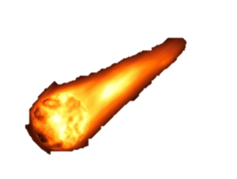
v
The Late Veneer?
Mantle reservoirs? Crustal recycling?
FOZO? HIMU?

Slide 11
References
He, Ar, Sr, Nd and Pb isotopes in volcanic rocks from Afar: Evidence for a primitive mantle component and constraints on magmatic sources, Bernard Marty, 1993
On causal links between flood basalts and continental breakup, Vincent Courtillot, 1998
The elusive mantle plume, Jeroen Ritsema, 2002
Three distinct types of hotspots in the Earth’s mantle, Vincent Courtillot, 2002
Derivation of Large Igneous Provinces of the past 200 million years from long-term heterogeneities in the deep mantle, Kevin Burke, 2004
Mantle plumes from top to bottom, Norman H. Sleep, 2006
Recent rift-related volcanism in Afar, Ethiopia, David J. Ferguson, 2010
Multiple mantle upwellings in the transition zone beneath the northern East-African Rift system from relative P-wave travel-time tomography, Chiara Civiero, 2015
Tungsten isotope evidence that mantle plumes contain no contribution from the Earth’s core, Schersten et al, 2003
The Tungsten isotopic composition of the Earth’s mantle before the terminal bombardment, Matthias Willbold, Tim Elliott & Stephen Moorbath, 2011.

