Slide 1
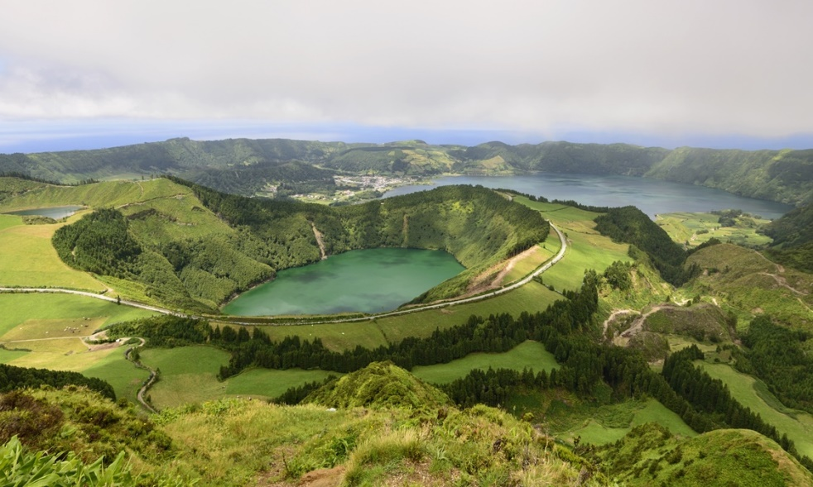
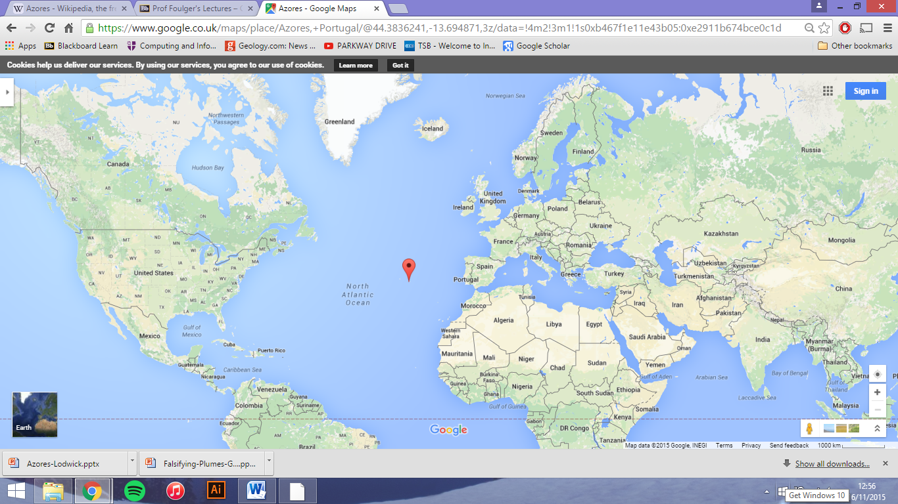
Azores
Christian Garvey, James King and Charlie Mason. (Simon Crosbie, Andrew Knott, George Lodwick, Ben Taylor, Jonathon Taylor)

Slide 2
Time history of volcanism
The Azores was onset with a flood basalt eruption, creating a 600Km wide plateau.
The Azores shows intermittent volcanism; sharing 28 volcanic eruptions since 1439.
First human observation described an eruption that occurred between two volcanic centres with isotopic compositions. (Queiroz et al, 1995).

Slide 3
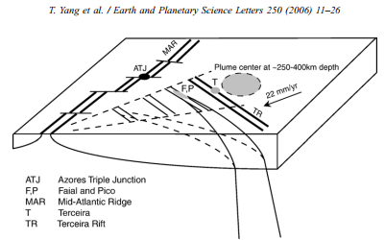
Anomalous and time progressive volcanism
Anomalous volcanism is any volcanism that is not associated with a plate boundary.
In the case of the Azores this is heavily disputed. Due to the argument of contribution to magmatism from plates vs plumes (or a mixture).
The Diagram above shows the direction of absolute motion of the African and Eurasian plates near the Azores relative to a hotspot reference frame.
This is time progressive volcanism. Although it is a small chain it is clearly visible.

Slide 4
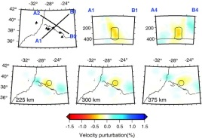
Falsifying Plumes- Tomography
Ting Yang (2006)
-Low-V anomaly in uppermost 200km of mantle- elongated along NW-SE orientation of the islands.
-Anomaly continues and merges with another anomaly to NE which extends from 250km to the top of the transition zone.
-Proposes that plume is sheared to SE as it rises through the upper mantle.
Issues
Tomographic Resolution
-Noise associated with Vs
-Seismic velocity perturbations are assumed
to represent temperature.
-No nucleation point of the proposed
plume is observed.
Figure 1: Vp structure of the mantle beneath the Azores from teleseismic tomography

Slide 5
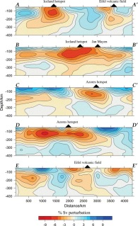
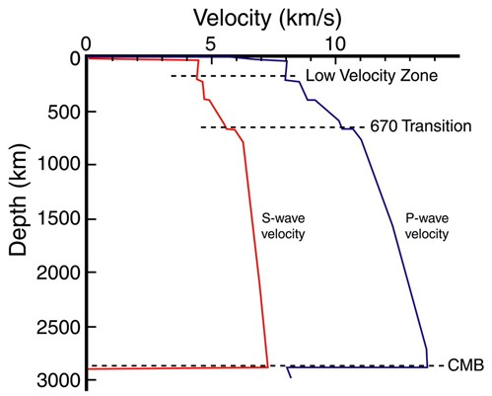
Falsifying Plumes- Tomography (cont.)
[Pilidou 2005]
Strong evidence that underlain by low-v upper mantle,
attributes to a lateral spreading of plume head.
Anomaly above 200km: 4-7% slower Vs
Issues
No evidence of any plume-like features.
TJ - expect significant passive upwelling of
asthenophere?
-May explain ponding of low-V in shallow
mantle
Vertical cross-sections:
-CC’ trend West – East
-DD’ trends SW – NE
Low-V anomaly is expected
LVZ well known to be at around 200km.
Assuming 1% p/m, Vs reduced by 3-10%.

Slide 6
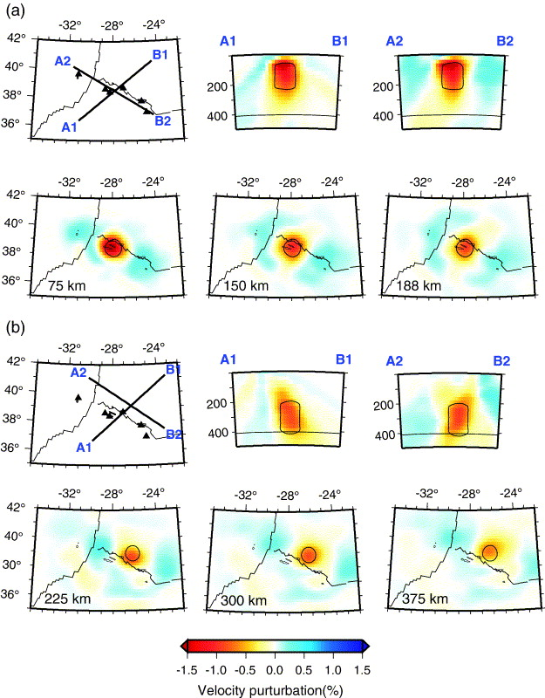
Mantle Structure Evidence
a low-velocity vertical cylinder with a diameter of 125 km at a depth range of 75–225 km beneath the center of the Azores Plateau
a vertical cylinder with a diameter of 100 km centered northeast of Terceira from 225 km to 412 km depth.
It is infered that this columnar low-velocity body marks the locus of the Azores plume and that this plume is sheared southwestward as it rises through the uppermost mantle.
A plume is inferred because the anomaly is a shallow(<200km), low-velocity, near vertical, cylindrical body, all features and consistant with that of a mantle plume, and therefore can be used as evidence against plate theory.

Slide 7
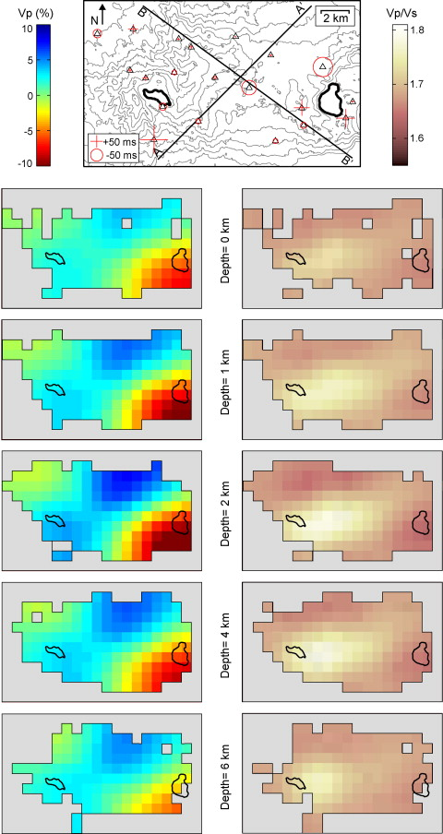
Mantle Structure Evidence
We can observe that the overall positions of the model contrasts do not strongly vary with depth.
The main anomalies stand in their positions, slightly changing in intensity.
This means that whatever mechanisms produce the velocity variations, they extend all the way down to the depth resolved by the inversion
These results provide seismic evidence for a model of plume-ridge interaction detected to the southwest in the shallow mantle by asthenospheric flow and plate motion and contributes hot mantle material and excess melt to the MAR south of the Azores.
This evidence for plume - ridge interaction can therefore be used to disprove the plate tectonic theory.

Slide 8
Geochemistry
Meitrich et al 2014 found that the Azores magmas could be generated by decompression melting, through extensional plate tectonics, of an H₂0 enriched source – without the need for plume theory.
Suggesting it may be a ‘wetspot’ rather than a hotspot.
However, geochemistry of the azores rocks have large spatial variations and thus are not conclusive evidence either way.
Beier et al. (2007) [and Elliott et al. (2007)] concluded that the mantle source is unlikely to be enriched by sediments [High Sr + Pb & low Nd + Hf] or subcontinental lithospheric mantle [low 176Hf/177Hf].
The isotope and trace element ratios suggest involvement of a basaltic melt, possibly by melt metasomatism – except this fails to reproduce the trace element signature.
Alternatively, recycled oceanic crust can explain both the trace element and isotope signature – pointing towards plume theory.
Primitive upper mantle (McDonough and Sun, 1995) normalised average compositions of Sete Cidades, Agua de Pau, Nordeste, HIMU (Willbold and Stracke, 2005) and ratio between the Nordeste average and Sete Cidades average compositions

Slide 9
What are the temperature conditions of the mantle at Azores?
Pico Island is in the Azores area
A study was conducted by Métrich et al. (2014) to find out the temperature of the mantle beneath Pico Island.
The results show that the potential temperatures are 1466-1477°C for the mantle beneath Pico Island.
This is hotter than you would expect which supports mantle plumes.
However, in order for these results to be relevant the same method of estimating has to be conducted at an MOR to see if the temperature is lower at the MOR.

Slide 10
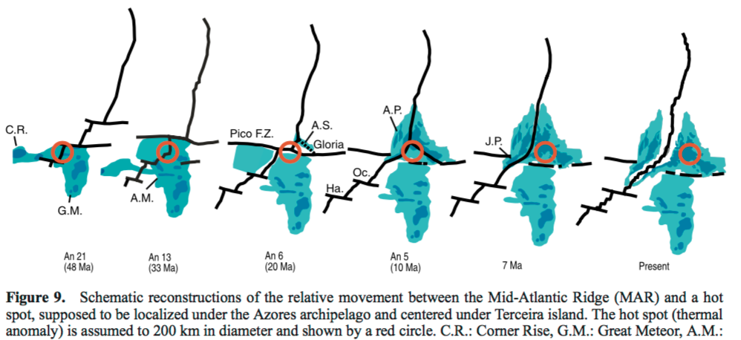
Is there a spatial relationship between the Azores hotspot and Surface extension features? (Falsifying plumes)
Schematic reconstructions of the relative movement between the Mid-Atlantic Ridge (MAR) and a hot spot, supposed to be localized under the Azores archipelago and centered under Terceira island. The hot spot (thermal anomaly) is assumed to 200 km in diameter and shown by a red circle.
It appear there was a clear spatial relationship between the Mid Atlantic ridge and Azores hotspot, the when the MAR melting zone shifted away from the 200-km plume thermal anomaly.
The sharp interruption of the volcanic construction, associated with the rifting episode, suggests that the abundant melt production requires the interaction of the two melting zones.
Therefore there was a spatial relationship but only when two melting zones were combine with abundant melt production not just attributed to the 200km plume itself. suggesting a quasi continuous MAR – Azores hot spot interaction since 85 – 90 Ma.
Is there a spatial relationship between the Azores hotspot and lower mantle structure?
Lot’s of work has been done on this relationship and that of the upper mantle. However, the spatial relationship between the Azores hotspot and lower mantle needs more work.

Slide 11
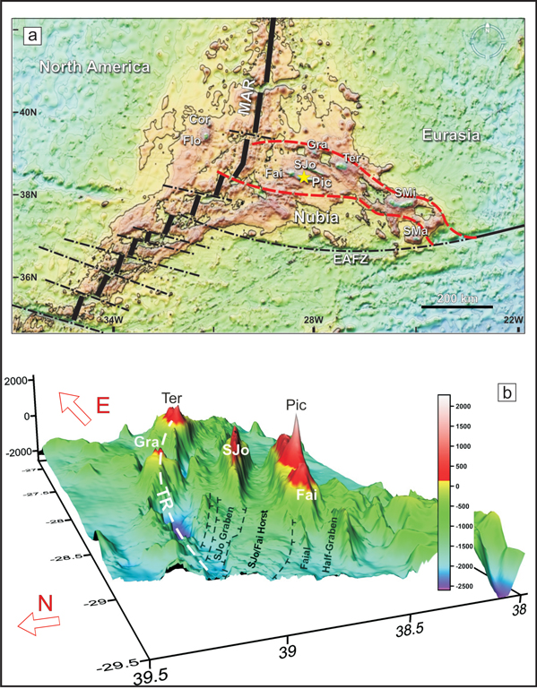
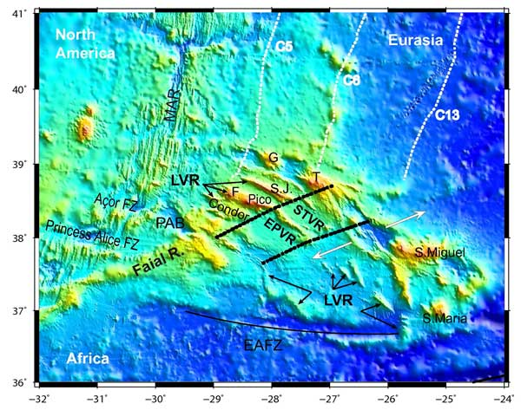
Falsifying the plume hypothesis…
The Azores is located on a tectonic triple-junction.
Tectonic rifting results in passive upwelling of magma.
A plume is not required to explain magmatism here.
Figure from Métrich et al 2014
Figure from Neves et al 2013

Slide 12
Conclusions
Not enough evidence to support a plume hypothesis
Unable to falsify plate theory
Further research that can be done: Better resolution surveys into the deeper mantle. Common misconception that seismic wave speed is representative of temperature.

