Slide 1
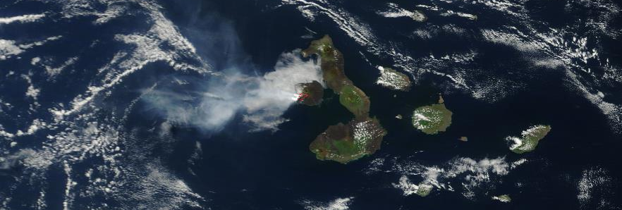
The Galapagos Hotspot: A plate vs plume controversy
By M. Bywater, H.Fell, H.Salisbury, V.Burnell, T.Bailey, D.Gibson, O. Katz, and P.Bara-Laskowski. J. Chapman helped too, I suppose.

Slide 2
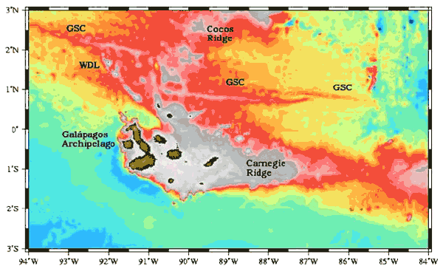
Introduction
Situated in the Pacific Ocean, roughly 600 miles off the west coast of Ecuador.
The Galapagos Spreading Centre (GSC) is between the Nazca and Cocos plates.
An issue of debate as to whether the Islands were created by Mantle Plumes or from the proximal spreading ridge.
Fig. 2. Map from Geist and Harpp (2003)
Notes:
There are five key features of the Galapagos archipelago: GSC (the main spreading centre of the area, and boundary between Nazca plate and Cocos plate), the WDL (northern islands formed by high heat flow (plume) and deviatoric stress (plate), the Carnegie Ridge (thought to be the hotspot trace in the area), Cocos Ridge (trace of excess crust from the hotspot) and the isles of Fernandina and Santa Isabella in the west (where there is more volcanic activity, hence where the hotspot is likely to be right now).

Slide 3
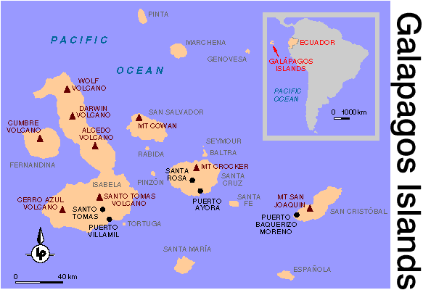


Disproving the Plume: Time Progression and Isotopic Variations
Volcanism is not strictly time progressive in the direction of plate motion.
Most of the volcanoes still active, regardless of location within island chain.
Galapagos lavas have a wider range of isotope compositions than is the norm. (Harpp and Geist, 1998)
Central-most islands have composition similar to MORBs.
Notes:
Note lack of a clear island chain; much of San Cristobal traced to similar eruption date as that seen on Fernandina.
Potential alternate hypothesis of separate mantle plumes formed from a central column.
Isotope ratio shows most recently erupted volcano has similar isotope ratios to those seen on the Cocos Ridge.

Slide 4
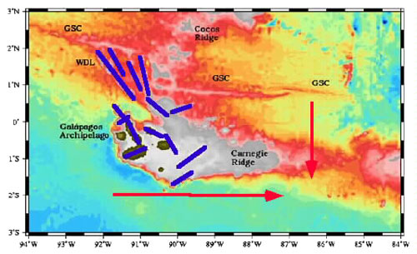
Disproving the Plume: Morphology
There are volcanoes along hotspot traces that are significantly younger than the area of ridge they occur on (e.g. Cocos Island).
If this were a plume in a fixed position, these should not appear; the plate should have moved past, leaving these areas relatively cool.
Doesn’t have the typical morphology of a mantle plume structure; no dome shape.
Fig. 6: There seem to be two separate directions of volcano alignment, neither of which are derived from directions of plate motion or spreading.
Notes:
This suggests that the initial heat source that formed the ridge (assumed to be a hotspot) is still active in that area.
Cocos Island lies on an area of the Cocos Ridge thought to be 12-16Ma, however volcanism on the Cocos Islands has been dated at 2Ma. (P. Castilo et al)

Slide 5
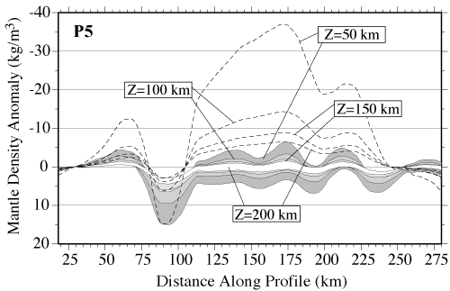
Disproving the Plume: Seismology and Temperature
Typically, isolated gravity highs are found over other hot spots, but none are seen in the Galapagos.
Although seismic evidence of plumes in the upper mantle is accumulating3, narrow plume conduits in the deep mantle have yet to be detected. (Helmsberger et al 1998)
The magmas over the hotspot are not actually hot enough, being 50-100 degrees cooler than Hawaii.
(Although this could be due to loss of heat in the thicker upper lithosphere.)
Notes:
The magma over the hotpsot is actually 50-100 degrees cooler than that seen at the typical Hawaiian hotspot.
Thicker crust has significant impact on the seismic gravity anomaly.
Rising magma responsible for usual density anomalies.

Slide 6
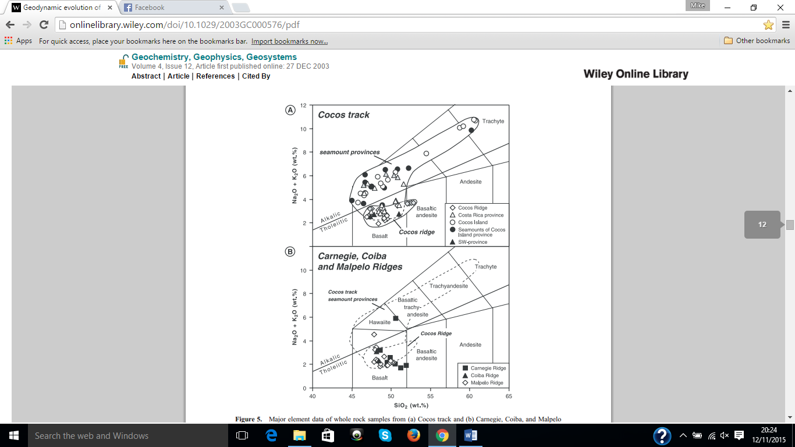
Disproving tectonics: Geochemistry
Magmatic ³He/⁴He values reach up to 26 times higher than atm concentrations at Fernandina, which is the most active volcano, and on the edge of plate motion = likely a plume centred beneath this island.
Samples collected from seamounts along the Cocos and Carnegie ridges show basalt compositions ranging from alkali to tholeiitic.
These values are close to OIB values, as opposed to MORB being exclusively tholeiitic, and so suggests a plume interaction along these potential hotspot tracks. (Kurz and Geist, 1999)

Slide 7
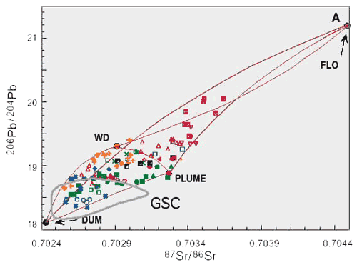
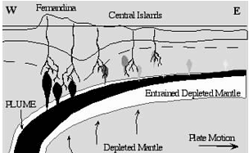
Disproving tectonics:
Isotope Variation
Large range of isotopes present due to heterogeneous mixing of plume magma, and less so due to near-surface depletion.
Horseshoe pattern of plume magma in north, south and west believed to come from toroidal mechanisms.
Is actually more likely due to a “bent” magma plume via sub-surface currents. (Griffiths, 1989).
Fig. 7: Current models of Galapagos isotope and “bent plume” hypothesis (Harpp and White, 2001)

Slide 8
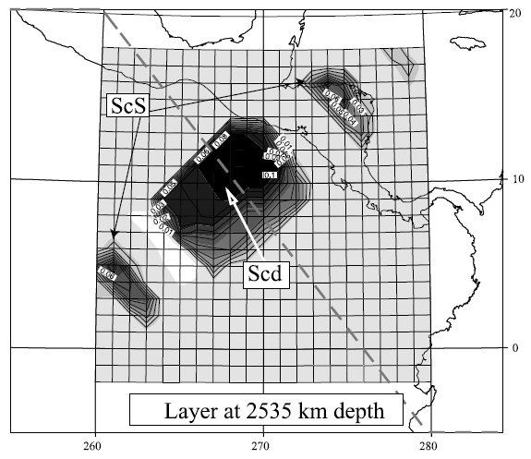
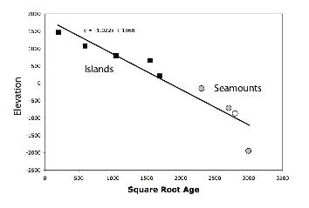
Disproving tectonics: Seamounts and Seismology
Seismic imaging of core-mantle boundary under Cocos plate shows a 100-km vertical step occurring in an otherwise flat D" shear velocity discontinuity (Thomas et al., 2004, Hutko et al., 2006, Kito et al., 2007)
S-wave arrival time tomography indicates a steeply- dipping, sharply-bounded slow zone (anomalies of about -2% relative to PREM) extending to at least 400 km depth.
Seamount data shows a (generally) quadratic relationship in comparison of age to elevation along the Cocos Ridge, suggesting plate movement over a fixed hotspot.
Fig 9: Seismic survey showing deep shear velocity discontinuity (Thomas et al)
Fig 10: Seamount and island data.

Slide 9
Conclusions
There is widespread evidence to back up both hypotheses, which is open to multiple interpretations.
Many features aren’t possible without a deep mantle source.
However, proximity to the GSC clearly influences composition of magma and island’s morphology.
Suggested work
  Find further seismic data for greater depths in order to chart depth of discontinuity to C-M boundary.
  Isotopic data from individual volcanoes can be used to create better plume models.
  Investigate potential “dual plume” theory.

