Slide 1
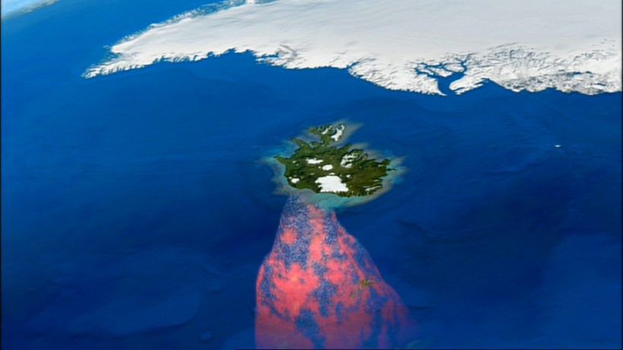
ICELAND’S PLUME
and the existential crisis
By Olivia Adams, Isabel Ashman, Robyn Brailey, Heather Martin, Ryan Northam, Emma Ownsworth, Hannah Rogers, Yannick Withoos, Jackie Woodburn

Slide 2
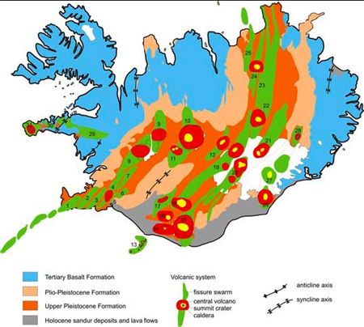
Introduction to Iceland
Located on the Mid-Atlantic Ridge
Eruption of material for 55-60Myr
Major composition is basaltic suite of rocks
Oldest rocks at the surface are 16Ma
Most active in the south west region
Recent eruptions:
  Eyjafjallajökull 2010
  Grímsvötn 2004, 2011
Source: soest.hawaii.edu/HIGP/Faculty/hey/rr2007/icelandgeo.html

Slide 3
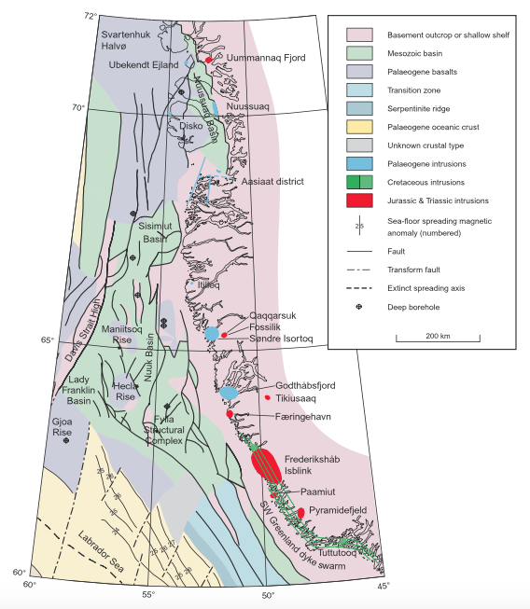
Precursors and Onset of Activity
Plume: uplift → subsidence → volcanism
1.3km uplift in W Greenland
Not able to be calculated in E Greenland
Sediments only not enough evidence
Plate: rifting of North Atlantic
Cretaceous intrusions
Subducted Iapetus slab
Larson et. al (2009)
Notes:
Plumes
Sedimentary evidence in Greenland seems to match plume model from Campbell and Griffiths (1990), suggesting uplift followed by subsidence and then volcanism
Changes in continental drainage patterns: incision, followed by very rapid sediment and volcanism.
1.3km of uplift in W Greenland, not able to be calculated in E Greenland due to lack of stratigraphic markers, but offshore evidence for uplift is found here but has not been correlated → still lack of evidence for symmetrical uplift of Greenland which would be expected for a plume
Uplift occurred 5 m.y. before volcanism, although model suggests it should be 10-20 m.y., plume would have had to rise through upper mantle very quickly
After initial volcanism, flood basalts were erupted related to rifting and sea-floor spreading → shows rifting occurred anyway, did it really need a plume to start?
Sediments alone cannot show if prevolcanic faulting was due to plume or rifting, high subsidence rate (700m in 2 m.y.) suggests plume is more likely than rifting.
Plates
Cretaceous intrusions in W Greenland provide evidence of volcanism and stress fields much before initial rifting and suggesting plume rising during the Palaeocene
Uplift in W Greenland may be due to just rifting, especially since there is a lack of evidence for uplift in E Greenland, it may not have happened there. Plume not necessarily required.
More melt production under Iceland due to subducted eclogitized Iapetus slab - unsure as to whether mechanism is sufficient to provide enough heat for the amount of melt required to create the thickness of Iceland crust. Steep dip of subducted slab would be required.
As not main theory, as yet little research into disproving plate hypothesis ie. presence of Iapetus slab

Slide 4
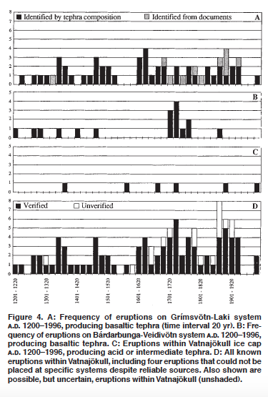
Time History of Volcanism
Plume:
Large flood basalt eruptions are present but we are unsure whether volcanism onsets this
Plate:
Intermittent volcanism
Persistent widespread volcanism - little evidence associated with a migrating point source
Anomalous melting
Notes:
1V 1. Volcanism is intermittent, 205 eruptive events have been identified in historical time. There has been an apparent stepwise increase in eruption frequency observed over the last 1100 years (Thordarson & Larsen). About 80% of the eruptions take place in the EVZ where the 4 most active volcanic systems are located.
2. 2. There are lots of basalt eruptions on Iceland, but we are unsure whether volcanism onsets with this – synthesis for further work? Volcanism started with the opening of the North Atlantic Ocean which causes basalt to rise up to form the landmass but not sure whether it would actually be a flood basalt, more likely just lots of eruptions that built over time until Iceland rose above the surface.
3. 3. Iceland is not associated with a time progressive chain – tectonic history includes multiple sporadic volcanism events. The history of Iceland cannot be realistically explained in terms of a simple model of a migrating point source. The size and direction of a time progressive trach that should have occurred assuming that there was a plume has been calculated and there is no evidence at all in any of the predicted regions for a time progressive tract. Observations are instead consistent with flood volcanism associated with continental break up.

Slide 5
Chemical and Temperature Anomalies
Predictions of the Plume Hypothesis
Thermal Anomaly of 200-300℃
High surface heat flow
Radial pattern of temperature
Picrite glass
Rapid subsidence
Deflection of 410km discontinuity
Deep-mantle and CMB tracers
Subduction to CMB
Predictions of the Plate Hypothesis
No thermal anomaly required
Melt volume controlled by source fusibility
No radial temperature pattern
Normal subsidence rates
Mantle heterogeneity
Shallow subduction depth
No lower mantle tracers
Notes:
First we’ll introduce the observations we would expect to see at the surface according to each hypothesis. The plume theory requires a positive thermal anomaly for the rising diapir of melt to actually rise through the mantle. Therefore we would expect to see the surface expressions of a high temperature anomaly in the mantle that are given in this list. The plate hypothesis doesn’t require a temperature anomaly as it is a result of passive volcanism. Geochemically, using the plume hypothesis we would expect to see deep mantle geochemical tracers whereas in the plate model only upper mantle sources would contribute to the melt.

Slide 6
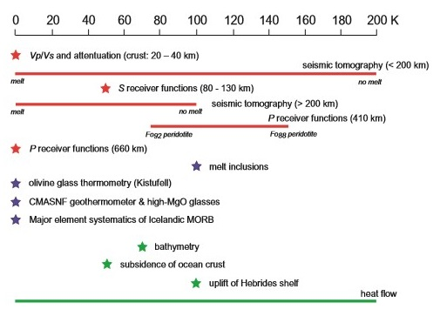
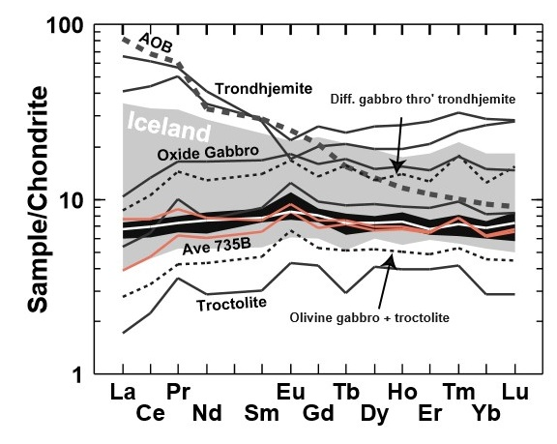
Chemical and Temperature Anomalies
Source: Foulger, Natland and Anderson; 2005
Source: Foulger,J.H.Natlands and D.L.Anderson
Notes:
As has been suggested before, Greenland has been proposed as the location of the plume head eruption and shows high temperature picrite cumulates. The olivines in Greenland show high Mg and Chromium which limits the lower temperature of crystallisation at 1450C which supports the hypothesis of high temperatures. However the picrites are cumulates and not glasses so may not represent a direct sample of the melt. There is rapid subsidence in the oceanic crust around Iceland which suggests a hotter than normal asthenosphere where the crust formed. The oceanic crust in Iceland is very thick at 40km which could suggest high temperature of formation or could be related to the proposed subducted Iapetus crust. The shallow ocean bathymetry in the northern Atlantic around Iceland also suggests a positive thermal anomaly in the upper asthenosphere. The lavas in Iceland show very strong 3He/4He ratios which have been argued to be the strongest evidence of a plume originating at the CMB but alternative theories can explain this such as the preservation of U and Th poor mantle which formed part of the source material. As shown on the graph, basalts in Iceland have a wide range of compositions which suggests a heterogeneous mantle source which contradicts the plume theory which calls for a relatively homogeneous source and mantle. In our opinion, the use of temperature and geochemistry has not disproved either hypothesis.

Slide 7
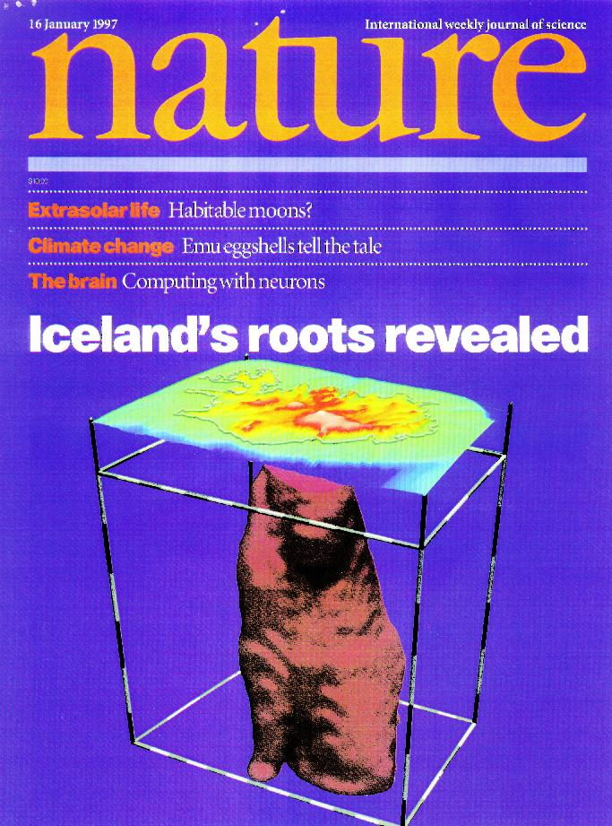
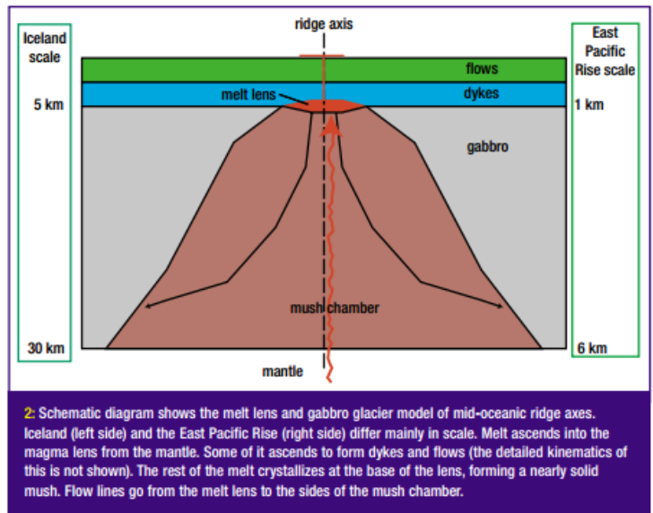
Expected seismology...
… for plates:
… for plumes:
LVZ in central Iceland
Lower-mantle derived plume was expected
Sleep et al. (2003)
Nature, 385. (1997)
Notes:
plates pic from: http://www.mantleplumes.org/WebDocuments/A-G-Stein-DLA-Sleep-Foulger.pdf
Plumes proposed to have ~200ºC temperature difference to surrounding rock.
Each 100K variation should reduce Vp & Vs by about 1% and 1.7% respectively.
Effect is weaker in lower mantle.
Talking:
*connecting part to previous slide* -- May be a direct method to view mantle through tomography but must also consider composition, density and melt.
Plate theory - no obvious anomalous seismicity because passive volcanism. If there is anything it will be exclusively shallow. This expected structure is shown in the left hand diagram; it’s a model that only extends to shallow depths and suggests that the difference between the magma chamber and the surrounding mantle should not be a large anomaly. However, the plate model does believe the mantle is non-homogenous which may be reflected in seismic tomographic data.
Plume theory - It’s commonly believed that the source of iceland is a plume: nature journal front cover 1997. Shows near surface tomography with large central low velocity zone and elaboarated hypothesis to accommodate hot thermal diaper fuels volcanism. - this highlights fundamental problem because didn’t consider other things that the plume would imply. It’s theorised that a plume should tomographically show a large low velocity plume head in the upper mantle although the plume tail may be difficult to resolve so it cannot be assumed this would appear on a model.

Slide 8
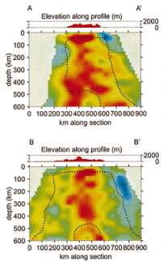
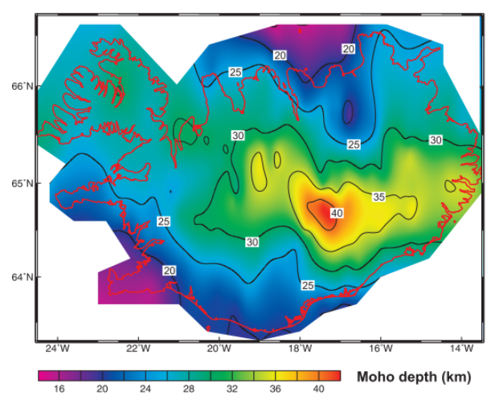
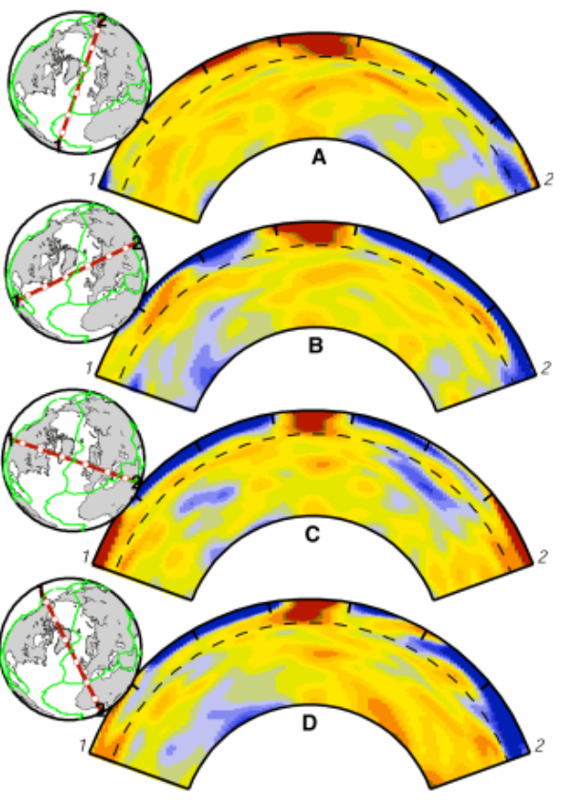
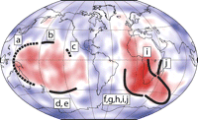
Observed anomalies
(Darbyshire, 2000)
(Ritsema, 1999)
(Garnero, 2007)
(Foulger, 2000)
Notes:
http://www.earth.lsa.umich.edu/~jritsema/Reprints/ritsema_etal_science1999.pdf
http://community.dur.ac.uk/g.r.foulger/Offprints/transzone.pdf
http://gizmo.geotop.uqam.ca/darbyshireF/Darbyshire_et_al_EPSL_2000.pdf
http://specialpapers.gsapubs.org.ezphost.dur.ac.uk/content/430/79.full
Tomography A-D - shows vertical cross sections at different angles through Iceland and has been used to suggets a plume especially D showing it is not a straight plume and might have migrated slightly but this is is inconclusive. Using a very similar dataset crossing Iceland from N to S (A to A’) and at approximately 45 degrees from SW to NE in B to B’. These might initally seem to show a plume but as you will notice the depth of this plot is only to 600km and not whole mantle. These datasets were used to calculate convection and internal heating which indicate a tabular and not a cylindirical anomaly which is not great enough to indicate a plume from the core-mantle boundary. Instead these authors concluded that the anomaly arose from the transition zone and no deeper. The alternative hypotheses could be clarified with greater resolution but as noone has been able to image accurately beneath the 650km with no resolution issues then this
Depth to Moho - The Moho marks the base of the crust and therefore the beginning of the more fluid mantle. Comparing this to the bathymetric height of Iceland compared to theoretical models of bathymetry calculated using just basaltic crust (as expected from the MOR) then we find that Iceland is sitting 3km lower than expected above sea level → this points to a submerged continental plate
LLSVP - it is thought that LLSVPs might be a cause of mantle plumes and these super piles might be a cause of hot material. However, Deschamps and Tackley and later Zhang went on to prove through numerical models and thermochemical calculations that these LLSVPs are more likely to be due to a density difference rather than a temperature difference. Nevertheless, some still believe that these LLSVPs might be a cause of mantle plumes particularly near the edges. As of yet there are not yet no universally defined boundaries to these features and therefore Iceland may or may not lie near the edge of one of these provinces and therefore this be a contributing factor → need to remember this is just a theory and no conclusive evidence

Slide 9
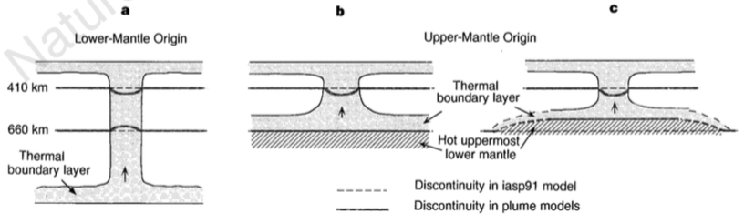
Three different plume models adapted to fit discontinuities around the transition zone (Shen Y. et al, 1998)
Notes:
multiple studies have found the transition zone below Iceland to be 20km thinner than the average Earth, showing excellent repeatability.
This thinning could be the result of many things, as shown by the multiple models here, but it is generally indicative of a hot and narrow plume *originating from the lower mantle*

Slide 10
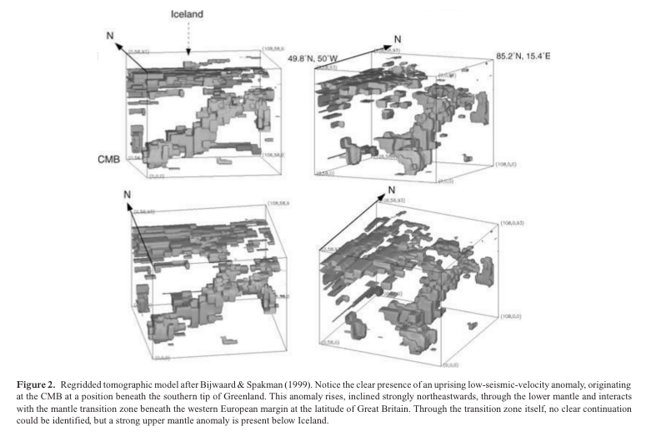
Observed anomalies at the core-mantle boundary (CMB)
Notes:
This tomography data shows a low velocity structure from the core-mantle boundary to the upper mantle. In this model the plume has a strong eastward inclination however the study has very little repeatability that we found.
Other studies only manage to image the low velocity structure down to 400km
So it is still unclear whether any proposed plume originates from the lower mantle or from a convective instability at the 660 discontinuity; but either way goes towards disproving the plate model.
HOWEVER there is widespread repeatability (repeatability to an extent not found in plume models) proposing that the Iceland low-velocity zone extends down to the mantle transition zone and no deeper which would move to falsify the plume theory.
Plume-theorists claim that these studies were based on the data recorded by a local seismic network and so have no resolution beyond the transition zone
However plume-theorists still are unable to agree on what any proposed plume would look like so the plume theory is on weak ground as there is little repeatability.

Slide 11
Thanks
for
listening!
Notes:
So, to finish, as a group we’ve come to the incredibly controversial conclusion that there is not enough evidence in any one discipline to falsify either hypothesis. A way to work around this is to work across disciplines. For example a better way to find time-progressive chains of volcanoes would be to try and identify them using seismic tomography. Similarly it is worth noting the limitations of disciplines; seismology as we use it now has too weak a resolution to be able to create a conclusive model from it. Lastly, further research into the Iapetus Slab would be incredibly useful and work towards supporting the plate theory and support chemical evidence that is found.

Slide 12
References
C. Stein, S. Stein, D. Anderson, N. Sleep and G. Foulger, 2003, Discussion: mantle plumes, Astronomy & Geophysics, Vol 44 Issue 1 pp 1.08-1.10
Dam. G, M. Larsen, M. Sonderholm; 1998; Sedimentary Response to Mantle Plumes: Implications from Paleocene Onshore Successions, West and East Greenland; Geology; Vol 25; pp 207-210
Dapeng, Zhao, 2001, Seismic Structure and Origin of Hotspots and Mantle Plumes, Earth and Planetary Science Letters, Vol 192(3), pp 251-265
F. Darbyshire, R. White, K. Priestly, 2000, Structure of the crust and uppermost mantle of Iceland from a combined seismic and gravity study
E. J. Garnero, T. Lay, A. McNamara, 2007, Implications of lower-mantle structural heterogeneity for the existence and nature of whole-mantle plumes
G.R. Foulger, D.G. Anderson, 2001, Is Iceland underlain by a plume in the lower mantle? Seismology and helium isotopes, Geophysics, Volume 145, F1-F5
G. R. Foulger et al., 2000, The seismic anomaly beneath Iceland extends down to the transition zone and no deeper
Gillian R. Foulger, James H. Natland, Don L. Anderson, 2005, Genesis of the Iceland Melt Anomaly, Geological Society of America, Special Paper 388
G.R.Foulger, J.H.Natlands, D.L.Anderson, Iceland is fertile:The geochemistry of icelandic lavas indicates extensive melting of subducted Iapetus crust in Caledonian suture.
J. Ritsema, H. van Heijst, J. Woodhouse, 1999, Complex Shear Wave Velocity Structure Imaged Beneath Africa and Iceland
Larson. L, et al., 2009, Tectonomagmatic events during stretching and basin formation in the Labrador Sea and the Davis Strait: evidence from age and composition of Mesozoic to Palaeogene dyke swarms in West Greenland, Journal of the Geological Society, London, Vol 166, pp 999-1012
Marquart, Gabriele, H. Schmeling, 2004, A Dynamic Model for the Iceland Plume and the North Atlantic Based on Tomography and Gravity Data, Geophysical Journal International, Vol 159(1), pp 40-52
Shen, Yang, S.C. Solomon, I. T. Bjarnason, C.J. Wolfe, 1998, Seismic Evidence for a Lower-Mantle Origin of the Iceland Plume, Nature, Vol 395, pp 62-65
Zhao, Dapeng, 2007, Seismic Images Under 60 Hotspots: Search for Mantle Plumes, Gondwana Research, Vol 12(4), pp 335-355
Zhao, Dapeng, 2001, Seismic Structure and Origin of Hotspots and Mantle Plumes, Earth and Planetary Science Letters, Vol 192(3), pp 251-265

