Slide 1
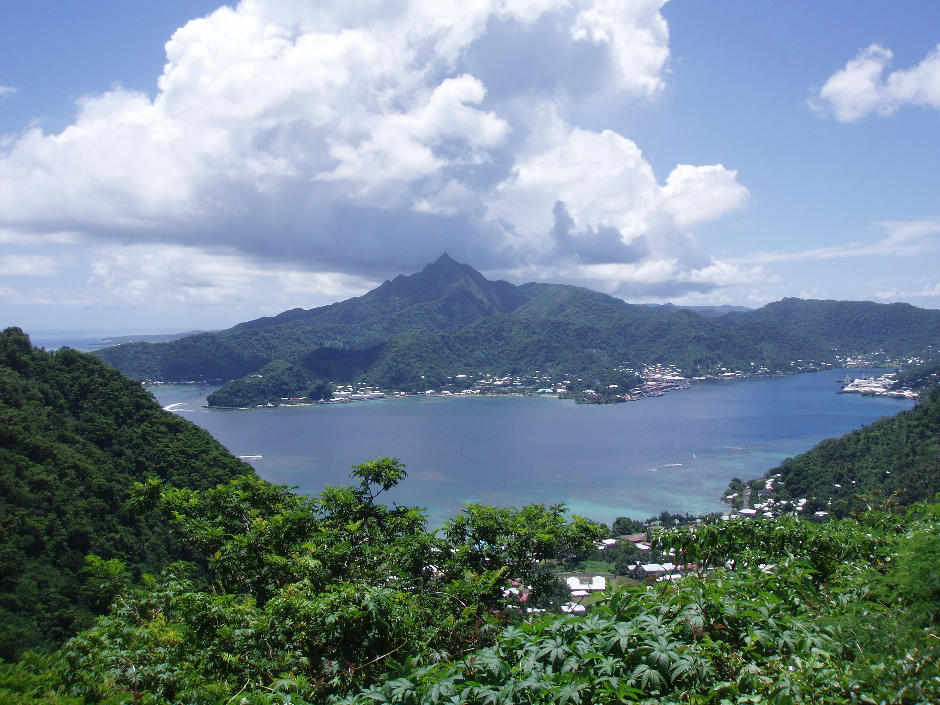
SAMOA
Henry Brett
Mario D’Acquisto
Jon Edwards
Louis Evans
Adam Goddard
Sam Graham
Josh Jones
Tom McCabe
Durham University, Department of Earth Sciences

Slide 2
Age of volcanism
Clouard & Bonneville, 2005

Slide 3
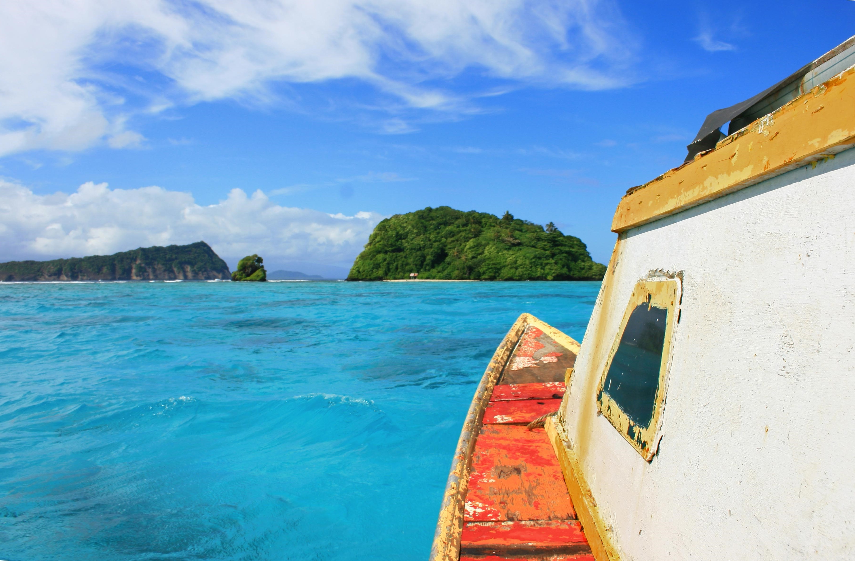
Isotope ratios
High He³/He⁴ and Ne²⁰/Ne²², similarly to Hawaii – primordial material?
Higher Sr⁸⁷/Sr⁸⁶ and ¹⁸³Nd/¹⁸⁴Nd ratios (compared to “primordial” lavas in Hawaii, Iceland and Galapagos) present in Samoa
Jackson et al. (2009).

Slide 4
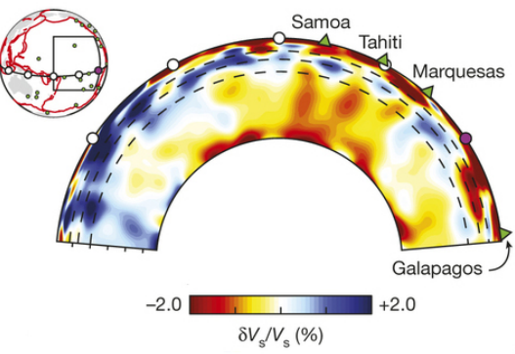
French, Scott W., and Barbara Romanowicz. (2015)

Slide 5
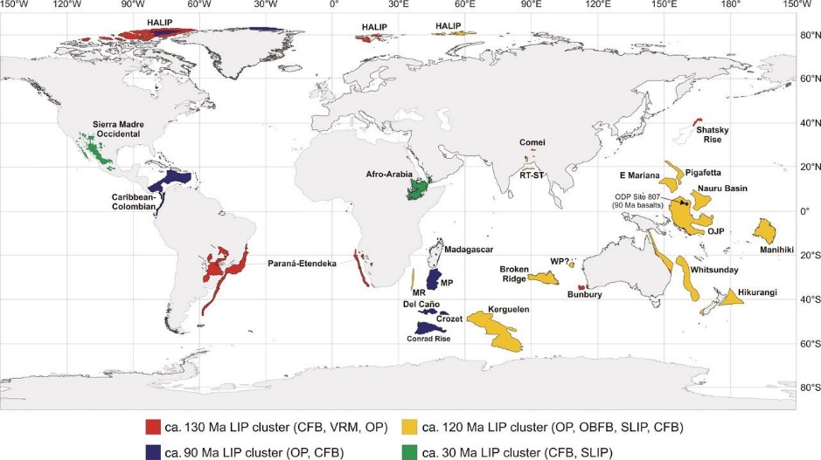
Oceanic plateaus and LIPs
No LIP identified as located at the beginning of the Samoan chain, as would be expected from a stationary plume.
Samoa
Map courtesy of the GSA Bulletin

Slide 6
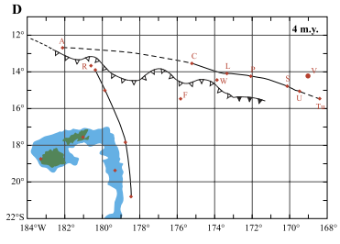
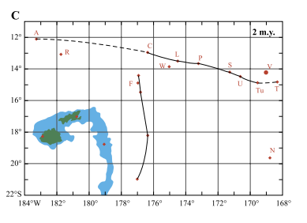
Palaeotectonics and trench proximity
Trench deemed too far from the contemporary locus of Samoan volcanism throughout geological history (Hart et al. 2004)

Slide 7
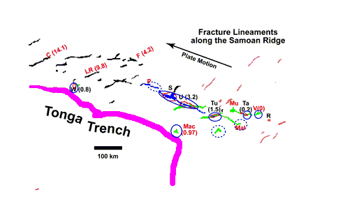
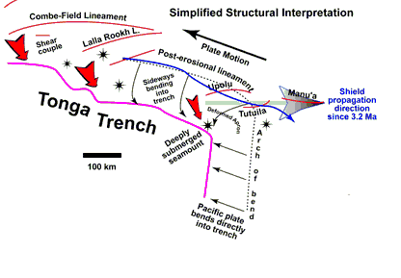
Palaeotectonics and trench proximity
Samoan chain actually consists of curving sets of linear segments; interpreted by Natland (2004) as lineaments related to stress at the bend in the trench.

Slide 8
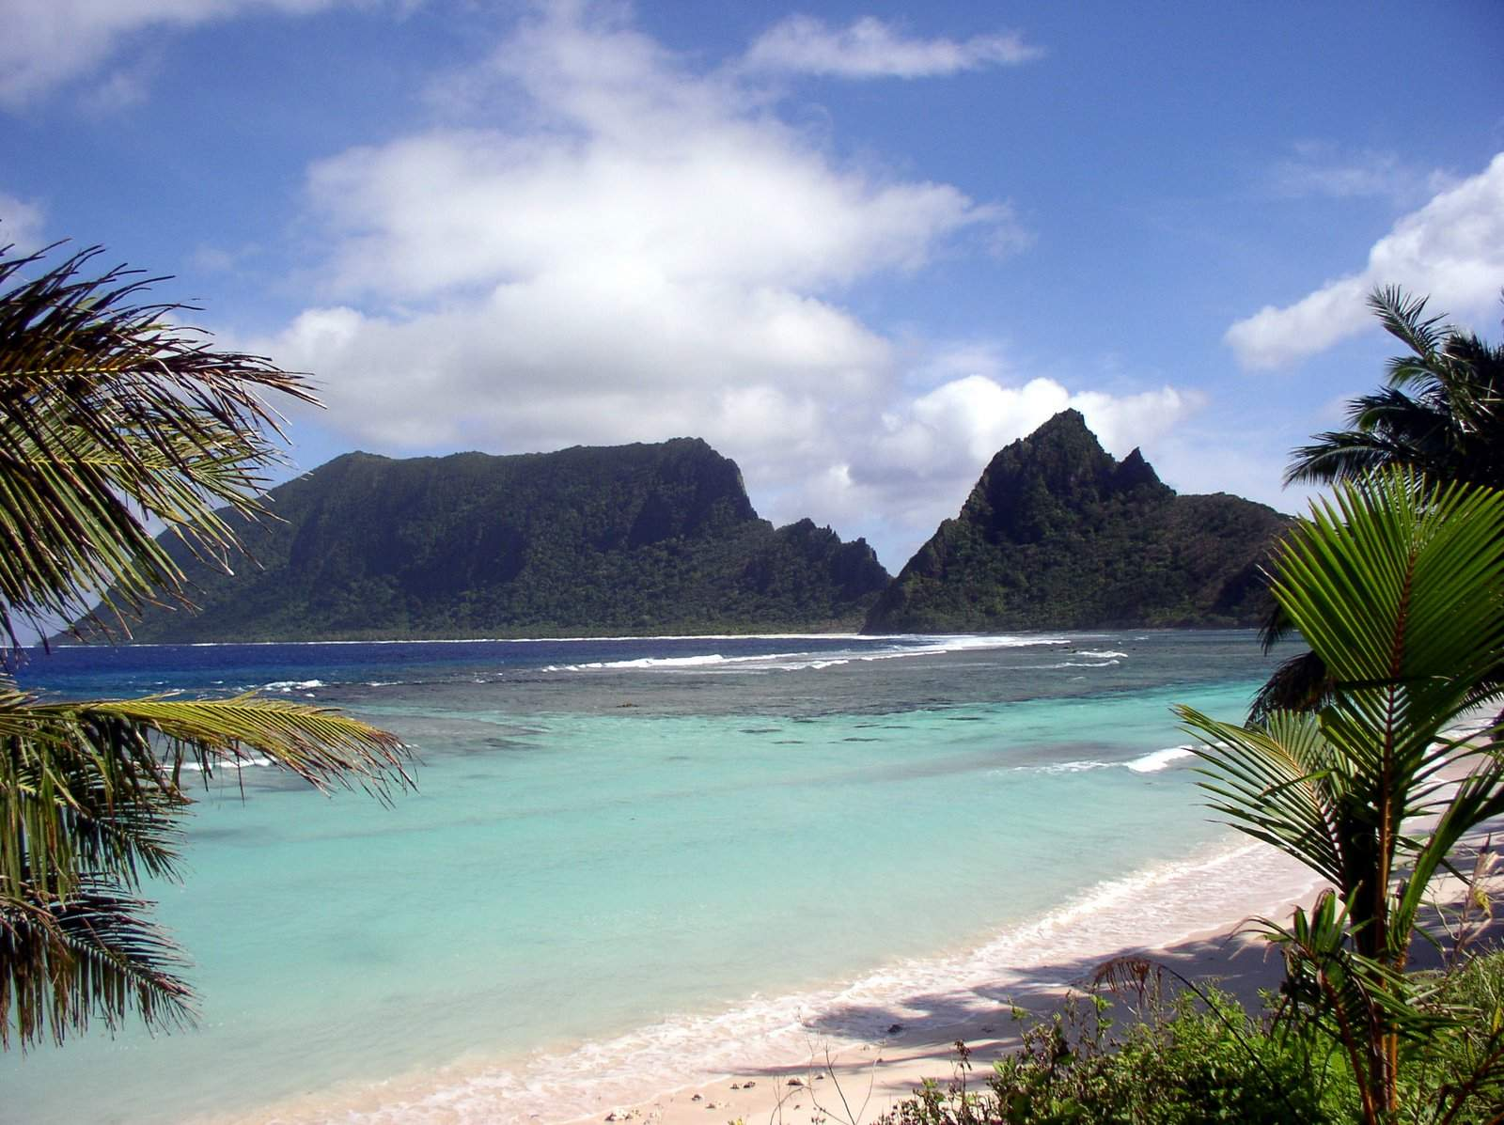
SUMMARY
Plume Hypothesis predicts a thin conduit, a Large Igneous Province, a time progression and bathymetric swell.
  No evidence for a conduit or LIP, no published work on a bathymetric swell and a debatable time progression.
Plate hypothesis predicts extension and compositional variation in upper mantle.
  Extension is observed but compositional variation is difficult to determine.

Slide 9
REFERENCES
Clouard, V. and Bonneville, A. (2005). Ages of seamounts, islands, and plateaus on the Pacific plate. GSA,
French, Scott W., and Barbara Romanowicz. "Broad plumes rooted at the base of the Earth's mantle beneath major hotspots." Nature 525.7567 (2015): 95-99.
Hart, S. R., et al. "Genesis of the Western Samoa seamount province: age, geochemical fingerprint and tectonics." Earth and Planetary Science Letters227.1 (2004): 37-56.
Helium and neon isotopes in phenocrysts from Samoan lavas: Evidence for heterogeneity in the terrestrial high ³He/⁴He mantle
James. Natland, 2003, www.mantleplumes.org/samoa.html

