Slide 1
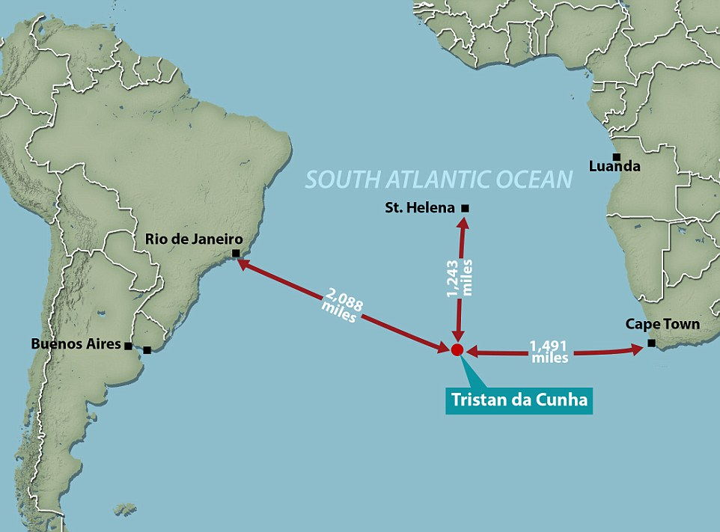
Plumes
vs
Plates
Tristan-Da-Cunha
Lee Geok Tan, Catherine Mascord,
Hawkar Mohammed, Soe Moe,
Huda Almossaeed, Waldo Serfontein

Slide 2
Plume Hypothesis
The
The hypothesis suggests:
Precursory uplift and flood basalts from the lower mantle.
Time progressive volcanic chain.
Plume tail at the core mantle boundary.
Unusually high temperature.

Slide 3
first slide:
Hotspot swells have been used to estimate the flux of material from the core–mantle boundary via plumes (i.e., buoyancy flux) and used this flux of material to estimate the amount of heat transported from the core–mantle boundary to the surface (e.g., Davies, 1988; Sleep, 1990; Hill et al., 1992). Additionally, updated swell geometry measurements may help to distinguish between hotspots associated with mantle plumes and those formed by shallower processes. Which is useful to determine precursory activity of a plume.
Results :
For Tristan and the African superswell, find in this study suggested Tristan is lack of plume head.
The swell height is range between 200-400m. which is shallower than Hawaii and Azores which are about 1500m.
Next,
Question:
A low-velocity zone in the mantle in northeastern Paraná Magmatic Province was imaged by VanDecar et al. (1995) and interpreted as a thermal anomaly corresponding to the “fossil” Tristan da Cunha plume that moved with the lithospheric plate. Considering that the lithosphere has a typical time constant of about 60 Myr for dissipating heat and consequently attenuating topography (Gallagher & Brown, 1997), it is quite improbable that heat from a plume that reached the base of the lithosphere more than 130 m.yr. ago, could still persist. It would be more acceptable an association of the low-velocity zone with a plume related to the alkaline magmatic provinces nearby, where magmatism younger than 50 m.yr. can be found. However, no geoid anomaly nor surface expression of the Tristan da Cunha thermal anomaly is recognized in this region (Molina & Ussami, 1999), except for the Iporá and Alto Paranaiba Late Cretaceous alkaline provinces (Comin-Chiaramonti et al., 1997, and references therein) further to the north.
In the light of these facts, the mantle plume/hotspot hypothesis for the origin of the alkaline lavas must be reviewed, at least regarding which plumes are most likely to have been active at the right place and right time when a specific province is considered.
With the support:
From the paper South Atlantic opening: A plume-induced breakup?
(T. Fromm 2015) saying no broad plume head existed during opening of South Atlantic.
For summary maybe?
Second slide:
J.D. fairhead et. al. Sea-floor spreading and deformation processes in the South Atlantic Ocean:Are hot spots needed?
It is proposed that the concept of “hotspot traces” for the South Atlantic is over simplistic and that a model involving the periodic release of plate stresses in the form of shear/wrench faulting may be more appropriate. Closer evaluation of the Walvis ridge and Rio Grande rise tends to support such a model. The development of the Central African rift system already testifies that major changes in plate stress configurations, seen in the fabric of the oceanic crust, have been able to develop and propagate extensive passive rift systems throughout west, central and north Africa . Lesser stress changes also register within the stratigraphic record of these basins. It is not unreasonable to conclude that stress changes within the African and South American plates will be absorbed or dissipated wherever there is an existing plate/crustal weakness; the style of deformation will depend on the orientation of such weak zones. Inspection of the satellite gravity for the South Atlantic indicates that deformation of the oceanic crust appears to be quite common and may be the controlling factor in the development of the Walvis Ridge and Rio Grande Rise aseismic ridges. The evolutionary model that we propose for these ridges is a periodic response to periodic changes and release of intra-oceanic plate stress. This has resulted in wrench and shear movement and deformation along these features (Figure 12) instead of mantle plume.
Further research or idea:
Third slide:
From the paper South Atlantic opening: A plume-induced breakup?
(T. Fromm 2015) same as first slide.
Explanation of the diagram:
Seafloor-spreading was delayed across the southern-to-central segments of the South Atlantic. The Brazil-Angola margins of the central segment are extremely extended, suggesting a much longer rift phase before breakup. Rift propagation was delayed, possibly due to the presence of more rigid Gondwana-core basement. The concept of rift-propagation barriers, suggested to enhance the supply of melt from decompressional melting the other side of the structural discontinuity, (see Argentina page; Franke et al., 2007), is thus is in accordance with the locations of the Etendeka and Paraná flood basalts. However, in order to explain the long-lived, post-rifting volcanism of the Walvis Ridge and Rio Grande Rise, it would be necessary to assume that this extension-induced hot spot continued to develop with time, perhaps growing downwards from its originial, shallow form. It may have progressively incorporated melt from the lower lithosphere, and perhaps also the asthenosphere, and fed the time-progressive volcanism. Nevertheless, the hot spot was not the origin of volcanic rifting, nor the along-margin intrusive and extrusive magmatism, and the SDRs.
suggested Tristan da Cunha model hot spots did not generate triple junctions (positions where rift could not propagate straight forward as proposed by Burke & Dewey (1973)) but hot spots may have developed where rift-propagation was hindered.
Through his findings, the absence of a large plume head signature can be interpreted in terms of (1) the non-development of a head during plume ascent, or (2) the preexistence of a hotspot before the time of breakup.
In conclusion, we do not find traces of large- scale intrusions within the continental crust at the junction with the Walvis Ridge, which would indicate important plume head–lithosphere interaction during South Atlantic breakup. It therefore seems unlikely that the arrival of the Tristan plume head initiated the opening of the South Atlantic Ocean.
Falsifying the Plume Hypothesis – Time Progressive Volcanism
Notes:
first slide:
Hotspot swells have been used to estimate the flux of material from the core–mantle boundary via plumes (i.e., buoyancy flux) and used this flux of material to estimate the amount of heat transported from the core–mantle boundary to the surface (e.g., Davies, 1988; Sleep, 1990; Hill et al., 1992). Additionally, updated swell geometry measurements may help to distinguish between hotspots associated with mantle plumes and those formed by shallower processes. Which is useful to determine precursory activity of a plume.
Results :
For Tristan and the African superswell, find in this study suggested Tristan is lack of plume head.
The swell height is range between 200-400m. which is shallower than Hawaii and Azores which are about 1500m.
Next,
Question:
A low-velocity zone in the mantle in northeastern Paraná Magmatic Province was imaged by VanDecar et al. (1995) and interpreted as a thermal anomaly corresponding to the “fossil” Tristan da Cunha plume that moved with the lithospheric plate. Considering that the lithosphere has a typical time constant of about 60 Myr for dissipating heat and consequently attenuating topography (Gallagher & Brown, 1997), it is quite improbable that heat from a plume that reached the base of the lithosphere more than 130 m.yr. ago, could still persist. It would be more acceptable an association of the low-velocity zone with a plume related to the alkaline magmatic provinces nearby, where magmatism younger than 50 m.yr. can be found. However, no geoid anomaly nor surface expression of the Tristan da Cunha thermal anomaly is recognized in this region (Molina & Ussami, 1999), except for the Iporá and Alto Paranaiba Late Cretaceous alkaline provinces (Comin-Chiaramonti et al., 1997, and references therein) further to the north.
In the light of these facts, the mantle plume/hotspot hypothesis for the origin of the alkaline lavas must be reviewed, at least regarding which plumes are most likely to have been active at the right place and right time when a specific province is considered.
With the support:
From the paper South Atlantic opening: A plume-induced breakup?
(T. Fromm 2015) saying no broad plume head existed during opening of South Atlantic.
For summary maybe?

Slide 4
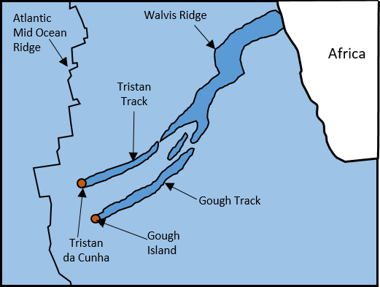
Falsifying the Plume Hypothesis – Time Progressive Volcanism
Issues with Tristan's “time progressive” volcanic chain:
The validity of the ages quoted for the chain is questionable because clean unaltered samples were not used.
The chain follows a series of pre-existing linear NE-SW trending lithospheric structures (linear zones) shown by density variations in the deep mantle tomography.
Another indictor of plume volcanism is precursory flood basalts, Tristan
does have flood basalts, the Etendeka
& Parana Basalts, however:
The flood basalts originated in the upper
mantle, rather than the lower mantle.
The transition from magma poor rifting to
volcanic activity is very sharp, rather than
gradual as would be expected in a plume
dominated system.
Notes:
Evidence against:
Many papers hold that Tristan da Cunha does have an apparently time progressive volcanic chain like Hawaii, BUT:
O’connor and Duncan (1990) have questioned the validity of the ages often quoted for the chain because clean unaltered samples from the chain were not used – as such the age readings are likely to be incorrect.
Also Bailey and Foulger (20??) suggests the volcanic chain follows a pre-existing lithospheric structure (shown in the geology and density variations in the deep mantle tomography), and may mark its NW boundary. The chain follows (and is likely part of/caused by) a series of pre-existing linear NE-SW trending lithospheric structures (linear zones) which are shown in the geology and by density variations in the deep mantle tomography.
There is also the question as to how a single plume system can split into two to produce the Tristan and Gough chains.
As such the chain may not be the product of a plume head migrating across the Atlantic.
Another indictor of plume volcanism is precursory flood basalts before the development of the volcanic chain, Tristan does have flood basalts, the Etendeka & Parana Basalts, which are typically associated with the initiation of plume volcanism, however:
There is some evidence that rifting preceded and continued to occur during the eruption of the flood basalts.
The flood basalts originated in the upper mantle, rather than the lower mantle as would be expected for plume associated flood basalts
Additionally the transition from magma poor tectonic to volcanic rifting is very sharp, in a plume dominated system this transition is expected to be gradual. Additionally the seismic anomaly is confined to the upper mantle – not deep enough for a plume.
Franke 2012

Slide 5
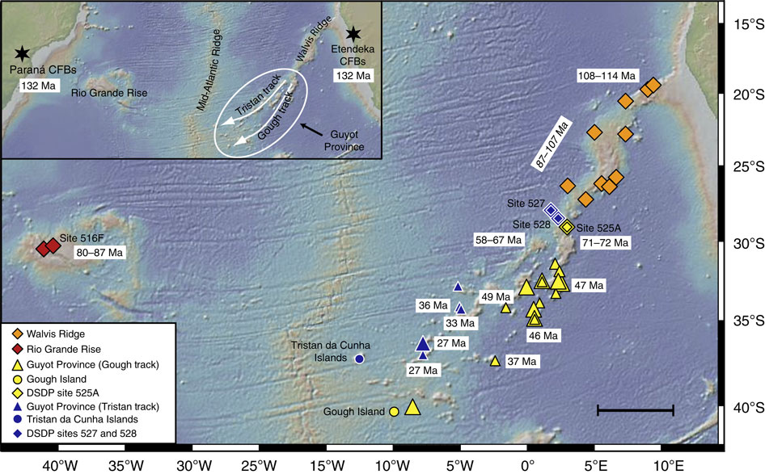
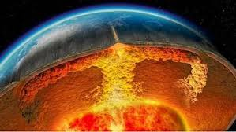
Falsifying the Plume Hypothesis – Geochemistry
Low He³/He⁴ signature at Tristan da Cunha may indicate the presence of some recycled material in their mantle source
A 2D seismic survey of the Argentina and Uruguay shows that the volumes of melts decreases towards The Tristan da Cunha.
The incompatible trace element ratios and isotopic compositions of the PCFB tholeiites showing that this plume did not play a Substantial Role in the PCFB origin.
Osmium isotope data provides no evidence for the involvement of Tristan da Cunha plumes in the origin of the PCFB
How in this model can granites be explained?
Why should the rift start in the south at About 48°S when the plume was centered at about 30°S?

Slide 6
Falsifying the Plume Hypothesis – Geochemistry
Why does the conjugate Rio Grande Rise on the South American plate, exhibits a different morphology compared to the Walvis Ridge ?
Why should the South Atlantic plumes track the mid-oceanic ridge when the hotspot reference frame is independent of plate tectonics?
The transition from magma-poor to magma-rich rifting takes place within ~ 10 kilometers.
The mantle plume model is unsatisfactory for explaining CFB in the south Africa and America

Slide 7
Plate Hypothesis
The
The hypothesis suggests:
Magmatism driven by shallow processes.
Lithospheric stress determine location.
Mantle fusibility determine magma volume.

Slide 8
Falsifying the Plate Hypothesis – Lithospheric Extension
Volcanism Associated with Lithosphere Extension.
Amount and rate of magmatism (Parana Flood Basalt).
Depends on fusibility of the source beneath and availability of pre-existing melt.
An estimated average volume of 3 km3 of lava erupts onto the seafloor annually along the mid-ocean ridge (MOR), a volume equivalent to ~ 60-70% of the annual global volcanic budget.
Location | Volume (Km³) | Duration (m.y.) | Rate (Km³yr¯¹)
Terceira, Azores | 5.46 | 0.023 | 2.4 x 10¯⁴
Sao Miguel, Azores | 4.5 | 0.005 | 9 x 10¯⁴
Mid-ocean ridge, volcanism per 400km average length of ridge | ??? | ??? | ~2.4 x 10¯²
Kilauea, Hawaii | 3.3 | 1.85 x 10¯⁴ | 1.7 x 10¯²
Mauna Kea, Hawaii | 24,800 | 0.3 | 8.3 x 10¯²
Iceland | 20,000 | 1.0 | 2 x 10¯²
Mid-ocean ridge, intrusive + extrusive per 400 km average length of ridge. | ??? | ??? | ~1.6 x 10¯¹

Slide 9
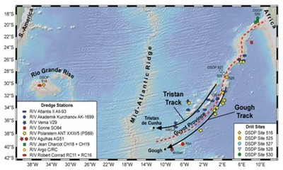
Falsifying the Plate Hypothesis – Time Progressive Volcanism
Further studies:
Geophysical data of the region around Tristan
Marine electromagnetic
Active and passive seismic
Gravity data
Crustal structure
Temperature anomalies
Partial melt anomalies
Notes:
Time progressive:
the seamounts formed only at the edge of the swell, where the oceanic crust was spreading apart. However, ⁴⁰Ar/³⁹Ar isotopic data of lava samples erupted at several hotspot trails across the Atlantic swell.in combination with the structure and age of the sea floor, and find that the trails formed synchronously, in a pattern consistent with movement of the African Plate over plumes rising from the edge of the Africa Low Shear Wave Velocity Province. the age of Walvis Ridge basement increases linearly with increasing distance from Tristan da Cunha (Figure 4), thus linking recent hot spot volcanism on Tristan da Cunha, via the Walvis Ridge, to its 120-130 Ma expression on the Namibian coast, the Etendeka continental flood basalt field. The distribution of available Rio Grande Rise basement and fossil ages, in conjunction with present estimates of the narrow age-range of the Parana flood basalts, is compatible with age-progressive volcanism linking the northeastern shoulder of the Rio Grande Rise (-75 to 84 Ma) to 120-130 Ma continental flood basalt volcanism
Lithospheric extension
Based on the results of seismic reflection profiling, Austin and Uchupi [1982] have suggested that the South Atlantic began to open in the form of a northward propagating rift. The oldest seafloor spreading anomaly identified in the South Atlantic at the latitude of Capetown is M11 (133 Ma), while the oldest anomaly recognized off of the Namibian coast is M4 (126 Ma) [Cande et al., 1989]. As the Etendeka and Parana flood basalts appear to have erupted at about the same time that the northward- propagating South Atlantic rift reached the latitude of Namibia, a close association may have existed between hot spot volcanism and continental rifting. However, due to uncertainty in locating the continent-ocean boundary [e.g. Rabinowitz, 1976, 1978; Scrutton, 1978], it is presently difficult to determine whether or not, on reconstruction of the African and South American plates to a prerifting configuration, overlapping or misfit exists at the latitude of the Walvis Ridge-Rio Grande Rise. The existence such an overlap would suggest that crustal stretching of occurred in response to doming of the continental lithosphere by the upwelling plume, so supporting a relationship hot spot volcanism.

Slide 10
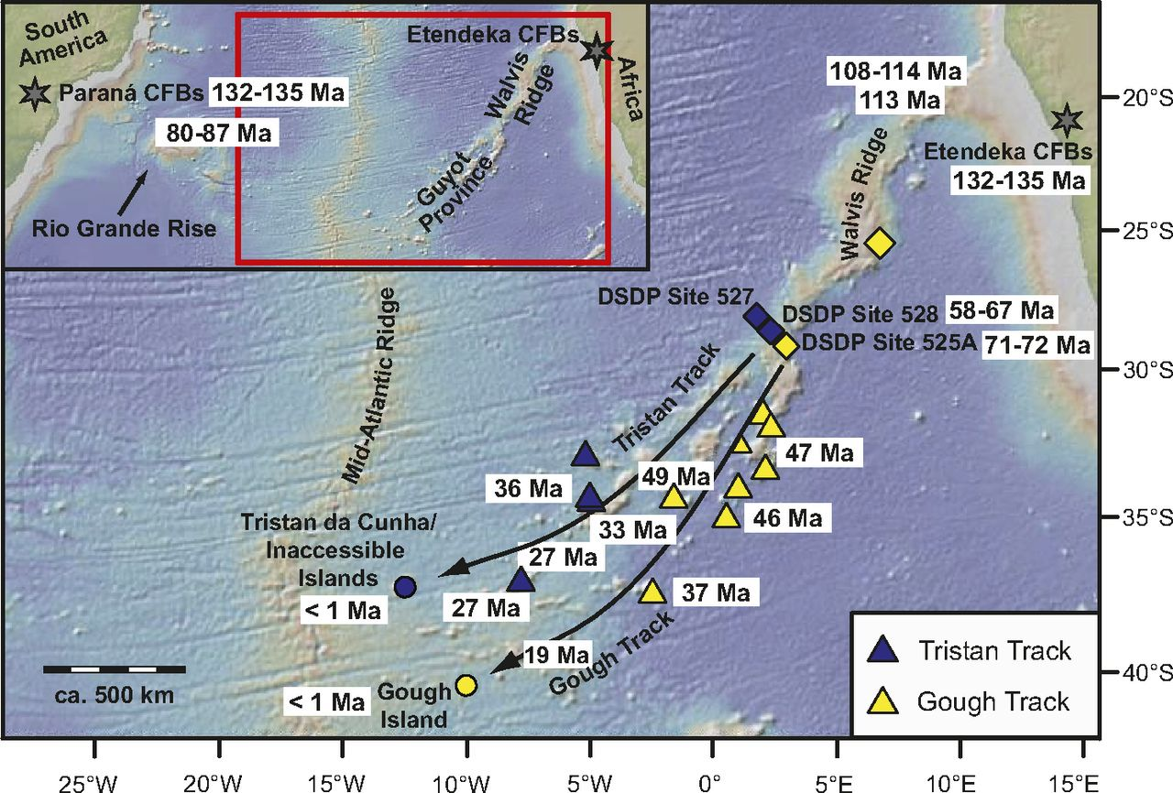
Falsifying the Plate Hypothesis – Geochemistry
Chemical zonation of Tristan/Gough “track”.
Notes:
ZONATION ~ 70Ma Vanaf eerste bladsy!
Bilateral, asymmetric zonation with two distinct mantle source components (As would expect with plume)
GOUGH (S) elevated ²⁰⁷Pb/²⁰⁴Pb and ²⁰⁸Pb/²⁰⁴Pb at a given ²⁰⁶Pb/²⁰⁴Pb
low ¹⁴³Nd/¹⁴⁴Nd and ¹⁷⁶Hf/¹⁷⁷Hf
2. Tristan (N) more depleted source
X4 longer than Pacific zoned tracks.
BUT
he origins of the enriched isotopic
GRAFIEK To characterize the mantle sources involved in PCFB genesis and account for the chemical and isotopic observations, the involvement of asthenospheric mantle and two enriched mantle sources (EM-I and EM-II) are required. The asthenospheric component was enriched by fluids and/or magmas related to Neoproterozoic subduction.
isotopic signatures of Walvis Ridge and Rio Grande basalts may be explained by the remelting of detached continental lithospheric mantle left behind during the continental break-up processes
EM-I similar to either an ancient, recycled lower continental crustal component , or a metasomatized SCLM(sub-continental lithospheric mantle) component
EM-II ultimately derives from the upper continental crust probably through the subduction and recycling of pelagic sediments or metasomatized (i.e., fluid/melt infiltration) oceanic lithosphere.
GRANITE In this context, could the granite found in the Rio Grande Rise be a piece of continental crust–a microcontinent broken off during South Atlantic opening

Slide 11
Future Work
Enhanced resolution of the existing satellite gravity → Mantle Tomography Improved
There is not sufficient isotopic data for the west side of the hotspot which makes it difficult to proof there is time progressive tracking (Rio Grande rise)
Notes:
Our ability to repick the altimeter radar waveforms to a higher degree of accuracy
improve satellite data processing methodology using the geoid (or sea surface) to gravity
rather than the traditional method of sea slopes to gravity
has resulted in significant improvement in the data resolution that is able to resolve reliable isotropic signals down to 10 km wavelengths (or 5 km at half wavelength) in equatorial areas.

Slide 12
Questions

Slide 13
References –
O’connor, J.M. & Duncan, R.A. (1990) Evolution of the Walvis Ridge-Rio Grande rise hot spot system: implications for African and South American plate motions over plumes. Journal of Geophysical Research 95 (11) 475-502
Bailey, K. & Foulger, G., (20??) Tristan volcano complex: oceanic end-point of a major African lineament. Available at:http://www.mantleplumes.org/Penrose/PenPDFAbstracts/Bailey_Ken_abs.pdf
Franke D., (2012) No major control by hot-spot-related mantle processes on the evolution of the Laptev Sea, the South China Sea, and the southern South Atlantic. Available at http://www.mantleplumes.org/RiftHotspotControl.html
Júnior, Eduardo RV Rocha, et al. "The Headless Tristan da Cunha Mantle Plume.”
Franke, D., Hinz, K., Ladage, S., Neben, S., Schnabel, M., & Schreckenberger, B. (2010). Shallow Magma Sources During Continental Rifting and Breakup of the South Atlantic. Available at: h ttp://www. mantleplumes. org/Argentina. html.
(J. Crisp, Rates of magma emplacement and volcanic output, J. Volcanol. Geotherm. Res. 20, 177-211, 1984.)
http://ir.library.oregonstate.edu/xmlui/handle/1957/17329
Rohde, J., Hoernle, K., Hauff, F., Werner, R., O’Connor, J., Class, C., ... & Jokat, W. (2013). 70 Ma chemical zonation of the Tristan-Gough hotspot track. Geology, 41(3), 335-338.
O'Connor, J. M., & Jokat, W. (2015). Age distribution of Ocean Drill sites across the Central Walvis Ridge indicates plate boundary control of plume volcanism in the South Atlantic. Earth and Planetary Science Letters, 424, 179-190.
Fairhead, J. D., & Wilson, M. (2004). Sea-floor spreading and deformation processes in the South Atlantic ocean: Are hot spots needed. MantlePlume. org, University of Durham, UK Available from http://www. mantleplumes. org/SAtlantic. html.
Júnior, E. R. R., Marques, L. S., Machado, F. B., & Nardy, A. J. The Headless Tristan da Cunha Mantle Plume.

