Slide 1
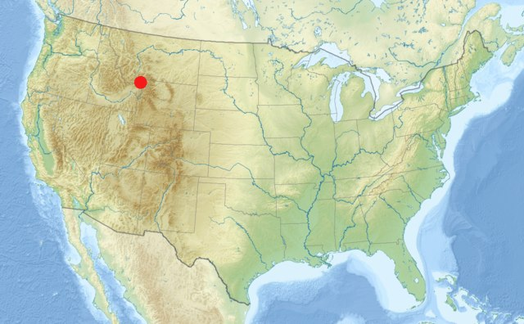
Yellowstone: Plate vs Plume
E. Cullen; C. Johnston; M. MacKenzie; A. Millar-Durrant; K. Pal; F. Rea and G. Thomas.

Slide 2
Time History Volcanism
Reference:
https://community.dur.ac.uk/g.r.foulger/Offprints/Yellowstone.pdf

Slide 3
Precursory
Plume = Uplift previous and during magmatism
Plate = Subsidence and magmatism
Figure 2.
References : P. R. Hooper, V. E. Camp, S. P. Reidel, M. E. Ross. The Origin of the Columbia River Flood Basalt Province: Plume versus Nonplume Models
V. E. Camp, P. R. Hooper, 1981, Geologic studies of the Columbia Plateau: Part I. Late Cenozoic evolution of the southeast part of the Columbia River Basalt Province, Geological Society of America Bulletin, Part 1, v. 92, p. 659-668 (figure 1)
Figure 2 Gillian’s Lecture notes
Figure 1.
Notes:
The cross-section is from the SE section of the Columbia River basalts. It shows that each successive Grande Rhonde lava unit pinches out further to the west than the one previous. What this indicates is a continuous westward tilting during extrusion.
Magma erupting from vents did not have enough fluid pressure to overcome the higher plateau and so only minor eruptions would occur at the higher topography. At lower elevations vents could easily overcome the pressure and so erupt more easily.
There is also evidence of uplift in the northeast where a continuous northward dipping paleoslope developed during the main eruptive phase of the Columbia River basalts. This means that uplift continued during flood basalt eruptions- uplift also consistent with paleobotanical altitude estimates.
If Plate theory was the dominating mechanism occurring under Yellowstone it would be expected that, for the volume of magma present ponding must have taken place. This ponding may have caused uplift beforehand just like a plume. However, once erupted, subsidence would begin. This is not the case in Yellowstone. And so it seems the Plume theory is more like in the case of uplift.

Slide 4
Chemical and Temperature Anomlies
References:
http://www.livescience.com/32127-how-hot-is-the-yellowstone-hotspot.html
http://www.livescience.com/29034-yellowstone-mantle-plume-experiment.html
Matthew J Fouch
2012 Geological Society of America
The yellowsotne Hotspot:Plume or not?
Geodynamics of the Yellowstone hotspot and mantle plume: Seismic and GPS imaging, kinematics, and mantle flow
Robert B. Smith^{a, ,} , Michael Jordan^{a, f}, Bernhard Steinberger^{b}, Christine M. Puskasª, Jamie Farrellª,Gregory P. Waite^{a, c}, Stephan Husen^{a, d}, Wu-Lung Chang^{a, g}, Richard O'Connell^{e}
Journal of Volcanology and Geothermal Research
Volume 188, Issues 1–3, 20 November 2009, Pages 26–56
The Yellowstone magmatic system from the mantle plume to the upper crust
Hsin-Hua Huang, Fan-Chi Lin, Brandon Schmandt, Jamie Farrell, Robert B. Smith and Victor C. Tsai
Science 15 May 2015: 773-776.Published online 23 April 2015

Slide 5
Mantle Structure
Reference:
Upper Mantle Origin of the Yellowstone Hotspot. R. Christiansen; G. Foulger and J. Evans. 2002. Geological Society of America Bulletin. pp 1245-1256.

Slide 6
Further Research
Unable to prove or disprove the plume theory.
Need to conduct high resolution tomographic studies of the entire mantle to locate any plume geometries.

