Slide 1
THE AZORES
CHRISTIAN, JACK, FRASER, BEN, JAMES M & JAM W

Slide 2
BACKGROUND
Located in the North Atlantic the Azores is an autonomous region of Portugal, 850 miles to the west.
The Azores lie at a triple junction between the Eurasian, North American and African Plate.
The Archipelago is also bisected by the mid Atlantic ridge (the solid black line running N-S in figure 1)
The islands are of varying compositions getting progressively older towards the East.
Figure 1: A Bathometric image showing the location of the Azores plateau at the transtentional junction between the Eurasia, North American and African plates. (Metrich et al. 2014)

Slide 3
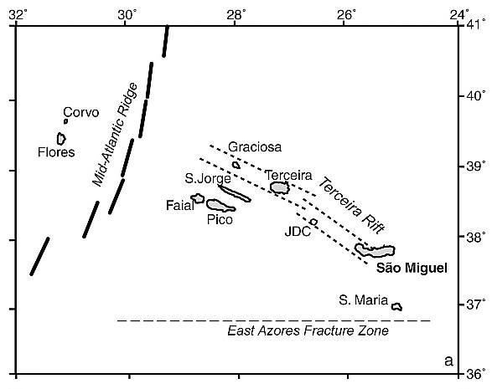
TIME HISTORY OF VOLCANISM
28 eruptions in last 600 years.
The Azores may be an example of time progressive volcanism
However there is little evidence for time progression of volcanism of the Azores, such as a trail of seamounts - e.g. as seen at Hawaii - and therefore there is no evidence for relative movement of the volcanic centers across time.
‘Plume’ hypotheses here would be expected to cause a hotspot, which would move across the surface during plate movement (which is not observed).
(Hasse. M, (2003)) A map showing the potential time progressive chain within the Azores Archipelago
Notes:
Evidence for this is also on the island of Sao Miguel, where the oldest volcanic rocks are located on the NE of the island, and the youngest in the W
Shows possible movement direction of eruption center from E to W
This is the largest and most active volcanic island in the Azores, with 5 eruptions in the last 500 years and many more in the last 5000.
The first recorded eruption was described as between two volcanic centres with isotropic materials (Guest J.E. et al, 1999).
Models show the division of a volcanic center of Sao Miguel into two, but this only ranges back to 5000 years ago and is not a fair representation of long-term patterns.
No indication of linear lateral movement.

Slide 4
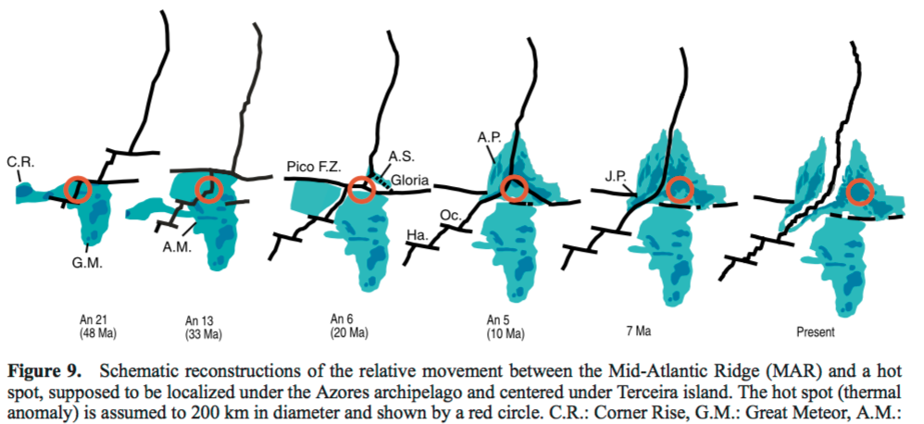
SURFACE FEATURES
The Azores are located at a tectonic triple junction
A possible mechanism for the increased Volcanism in the area due to the passive upwelling of magma.
Volcanism is at a maximum during periods of interaction between the proposed hotspot and MAR
Volcanic construction ceased as the hotspot moved about 150–200 km east of the MAR between 7Ma and 10Ma
Suggests that both heating mechanisms are required to produce melt
The motion of the plates in the Azores region, with respect to the hot spot, is poorly constrained.
Sketch showing the movement between the MAR and the proposed Azores hotspot roughly 200km in diameter (red circle)
Notes:
It is estimated that the Azores hot spot is located centered under the Central Group of islands, on the boundary of the Africa and Eurasia plates.
The present-day motion of the MAR relative to the Azores hot spot, since 5 Ma, is estimated to have a Northerly direction and a velocity varying between 22 and 33 km/Myr [Gripp and Gordon, 2002].
More work needs to be done to properly constrain.

Slide 5
MANTLE TOMOGROPHY
The transition zone occurs between 410-660km depth.
Defined by the change from Olivine to Wadsleyite and from Ringwoodite to Perovskite
Mantle transition zone above hotspots is known to be thinner than the global average due to upwelling hot material
A low velocity anomaly beneath the Azores that reaches approximately 300 km into the mantle is present.
Suggests the archipelago is underlain by an area of low velocity upper mantle, consistent with a spreading plume head
Topography maps of 410 km and 660 km discontinuities and mantle transition zone thickness. Deeper reflectors are indicated by red colours, shallower reflectors by blue colors
Notes:
The zone at 410km represents the phase transition from Olivine to Wadsleyite and is exothermic
The zone at 660km is due to the phase transition from Ringwoodite to Perovskite and is endothermic
Montelli et al. (2006) and Zhao (2007)find prominent low velocity zones beneath Azores, Cape Verdes and Canaries, stretching down to at least 700 km depth. A high resolution tomographic study of the Azores hotspot (Yang et al., 2006), detects a low velocity anomaly reaching to at least the top of the transition zone, while a surface wave tomography study (Silveira et al., 2006) finds a broad low velocity anomaly beneath the Azores that reaches only approximately 300 km into the mantle. Furthermore the study by Silveira et al. (2010) indicates a ‘normal’ transition zone thickness of 250 km a few hundred kilometres away from the Azores plateau.
A recent study by Silveira et al. (2010) revealed that transition zone thickness does not vary from the standard value in a large region of the Northern Atlantic outside the Azores plateau, whilst Lawrence and Shearer (2006) and Gu and Dziewonski (2002) reported a narrow transition zone in the same region.
Disproves the idea of regional plate hypothesis as the

Slide 6
SEISMIC DISCONTINUITIES
S wave velocity is 4% to 7% slower with respect to PREM at 75–150 km depth (Pilidou 2005)
Anomaly extends from 25°N to 45°N along the ridge axis
When compared with other anomaly's such as Iceland the Azores anomaly is elongated further along the ridge, is shallower and decays more rapidly with depth.
No Low – V area in the deeper mantle as expected with a plume
Suggests this is not the primary mechanism
Vertical cross sections beneath the Azores indicating the lateral extent of the ‘hotspot’ and lack of evidence for a plume tale

Slide 7
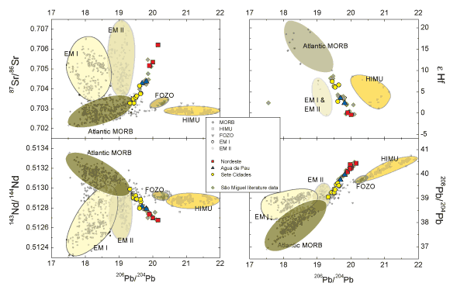
‘WETSPOT’ OR ‘HOTSPOT’
Azores mantle contains a higher proportion of volatiles and H2O towards the East.
Magmas generated by decompressional melting of H2O- enriched mantle, without need for elevated temperature. (Metrich, 2014)
Disproving the Plume theory
Temperatures recorded below Pico island are 1466-1477˚C, roughly 120˚C above expected.
Possibly disproving Plate theory
This increased temperature may not be anomalous, as little data from the MAR.
From West (yellow) to East (red) shows a movement away from MORB at the mid-atlantic ridge towards melts that are more enriched. (Beier. C, 2007)

Slide 8
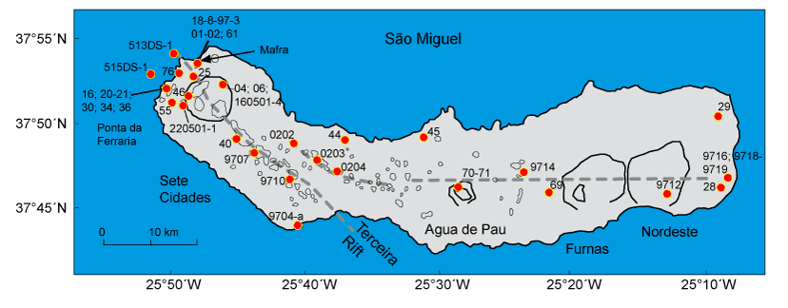
GEOCHEMICAL VARIATIONS
W
Gradual Increase in the relative enrichment in some incompatible elements
E
Enriched in Sr, Ba, Ti relative to the Nordeste lavas
Enriched in Cs, Rb, Th, U and Pb
Generally enriched compared to the Sete Cidades
Data here less supportive of a mantle plume as suggestive of a more depleted source
Perhaps supportive of a plume in this region

Slide 9
GEOCHEMICAL VARIATION CAUSE
The change from light-RE enriched to light-RE depleted cannot be accounted for by variable extents of partial melting of a single mantle source and subsequent fractional crystallization during magma ascent. (Schilling 1975)
Suggest two distinct mantle sources, and an intermediate zone of mixing.
Increasing chemical variability of the basalts towards the Azores is probably caused by correspondingly larger extent of fractional crystallization at shallow depth, and/or greater variability in the extent of partial melting, apparently subsequent to and superimposed on the mixing of the two mantle sources.
Chondrite normalised REE at varying latitudes across the Azores showing the decreased enrichment in REE and the evidence for multiple sources.
Notes:
Makes the Plume hypothesis less likely as this would mean only one source

Slide 10
SUMMARY
Majority of the evidence disproves the plume hypothesis.
While Geochemical, Seismic and Surface features suggest that it is the more likely option there is still too little data to actually prove the plate theory
’Hotspot’ – Ridge interaction
To further improve our understanding higher resolution seismic surveys beneath the Azores would allow us to determine the nature and mechanism of the observed magmatism beneath the islands

Slide 11
REFERENCES
Merrich N, Zanon V, Creon L, Hildenbrand A, Moreira M, Marquez F. 2014, Water beneath the Azores: Mantle Melting in a transtentional ge.dynamic setting
3 + 2 Volcanoes: São Miguel Island, Azores". VOLCANO HOTSPOT. N.p., 2016. Web. 27 Oct. 2016.
Haase, Karsten M. and Christoph Beier. "Tectonic Control Of Ocean Island Basalt Sources On São Miguel, Azores?". Geophysical Research Letters 30.16 (2003): n. pag. Web.
Guest, J.E et al. "Volcanic Geology Of Furnas Volcano, São Miguel, Azores". Journal of Volcanology and Geothermal Research 92.1-2 (1999): 1-29. Web.

