Slide 1
Galápagos
Claire Hudson, Charlie Donald, Alex Perry, Erica Martin, Anna Whitford

Slide 2
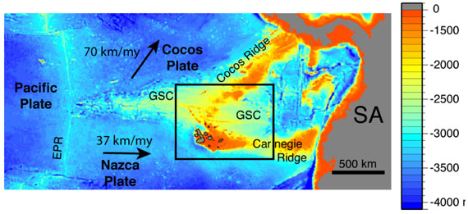
Introduction
Located in Pacific Ocean
1000km W of Ecuador coast
Cover area of 7880km2 (~10x less than Scotland)
21 islands
Located over the Galápagos Triple Junction - where Cocos, Nazca and Pacific plates meet
Location of the Galápagos, showing EPR (East Pacific Rise) and GSC (Galápagos Spreading Ridge)
Image from Harpp et al., 2003
Notes:
CLAIRE map shows bathymetry, Ecuador under ‘SA’

Slide 3
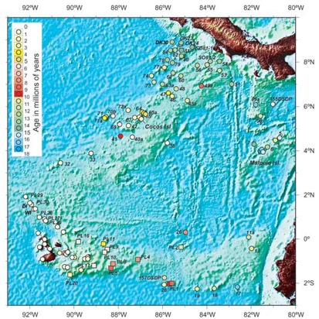
Disproving the Plume Hypothesis
Correlation of sample ages on the Western side of the Galápagos
Volcanism has not produced narrow, time-progressive lines of seamounts
5Myr main period of volcanism
They become active at different times e.g. Isabela is the most active at present
John M. O’Connor, Peter Stoffers, Jan. R. Wijbrans & Tim J.Worthington
Notes:
CHARLIE- would expect time-progressive lines if there was stationary plume under moving plate-should be in a line, random ages suggests. No age progression across islands
5Myr volcanism, seen by main dots being white-yellow
Isabella bottom left, top right is Panama

Slide 4
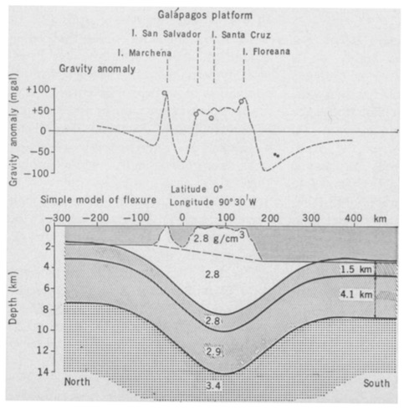
Disproving the Plume Hypothesis: Gravity
E-W trending residual negative anomaly is seen across the Galápagos
Historical studies: due to a low-density region beneath the islands i.e. a hotspot
More recent hypotheses:
Block of low-density continental crust below the islands
Thermal expansion related to a plum may lower the density
Weight of volcanic ‘pile’ caused downwarping
Free Air Anomaly over the Galápagos
J.E Case et al., 1974
Notes:
ALEX
Can’t 100% attribute these to a plume

Slide 5
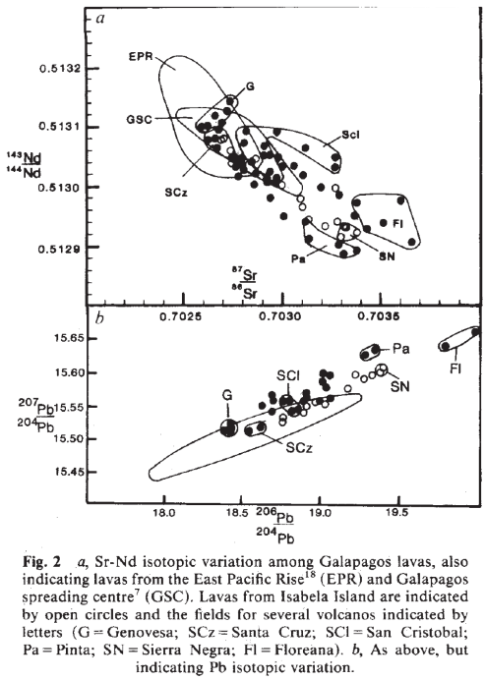
Disproving the Plume Hypothesis:
Low mantle temperatures
Seismic structure of thickest crustal segments not explained by a hot homogeneous mantle upwelling.
Subducted oceanic crust
Isotope Variation
Notes:
ANNA
Thickened crustal segments are due to upwelling of normal temperature but fertile mantle.
Recycling of subducting oceanic crust would explain observed geochemical patterns in the island magma chains without the need for anomalously high mantle temp.’s.
In addition the Galapagos lavas have a wider range of isotopes composition than normal.

Slide 6
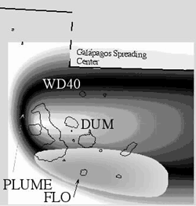
Disproving the Plate Hypothesis:
Geochemistry
Sr, Nd & Pb
2 way mixing of heterogeneous plume source and the depleted asthenosphere - material risen from depth
Plume magma endmembers Wd, FLO
Peridotite is the dominant source lithology
Tholeiitic Basalts
High 3He/4He Ratio
(Geist & Harpp)
(Harpp & White 2001)
Notes:
ERICA

Slide 7
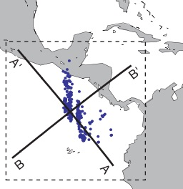
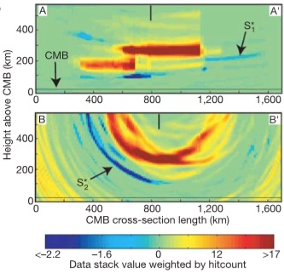
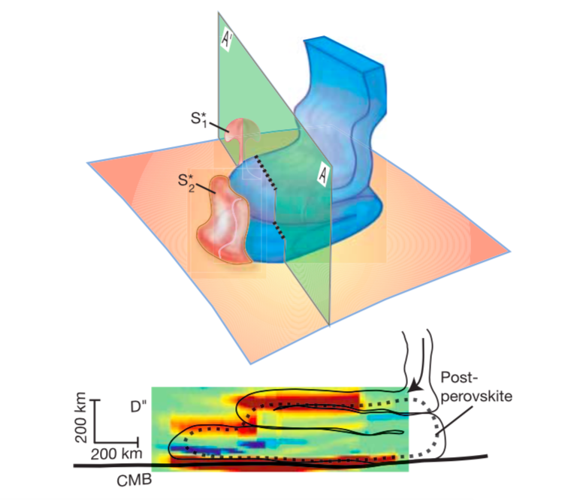
Disproving the Plate Hypothesis
Jump in perovskite - post perovskite boundary by up to 100km would require a temperature change of 700K over 100km laterally - not likely
-> a folded subducted plate?
Plate creates small boundary-layer instabilities = prompting upwelling of partial melt (S1 / S2)
Blue line represents subducting slab.
D” discontinuity seen seen in red. Cross-section line shown on RHS.
Notes:
ALEX
Slabs can retain strong temperature gradients, and buckle + spread out as they approach the core-mantle boundary.
Slab material descending upon the CMB, prompting upwelling instabilities of partial melt with strong velocity reductions. A lateral gradient of composition, perhaps of iron or aluminium content, could augment any thermal effects on the depth of the phase boundary.
Diagram on RHS shows how this subducting plate affects the CMB. Also suggests that there could potentially be a second low velocity structure i.e. a second plume resulting from this

Slide 8
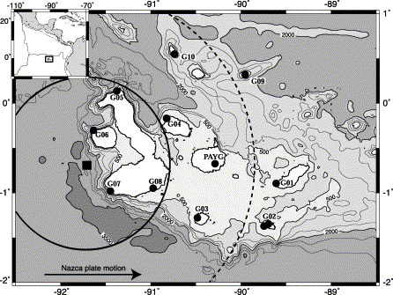
Disproving the Plate Hypothesis: Geophysical
Seismic
Anomalously thin transition zone below the Galápagos islands over an area of 100km in radius (40km SW of centre of the island Fernandina)
•18+/-8km change in thickness
•This anomaly is consistent with excess temperature of 130+/-60 K (similar to Iceland/Society hotspots)
Anomalously thin transition zone beneath the Galápagos hotspot, E. Hooft
Radius of thin transition zone shown by black circle. Contours represent bathymetry.
Notes:
CLAIRE
NOTE UPLIFT AROUND ISABELA (active volcano) - 4 miles lifted over 15 feet -> suggests magma enters the lithosphere through a fissure and then solidifies and is uplifted due to isostasy

Slide 9
Conclusions
Most data leads to support of the PLUME HYPOTHESIS, although most evidence is rarely confirmed with confidence.
Inconsistencies can be mostly explained by the proximity of the volcanic activity and the Galapagos Spreading Centre.
In some cases features of each hypothesis are not exclusive.
Further work required:
Higher quality element and isotope data sets
More/better seismic data to constrain LVZs, and possible dual plume?
More data out there!
Impact hypothesis?
Notes:
ERICA

