Slide 1
Hawaii
Plates vs Plumes

Slide 2
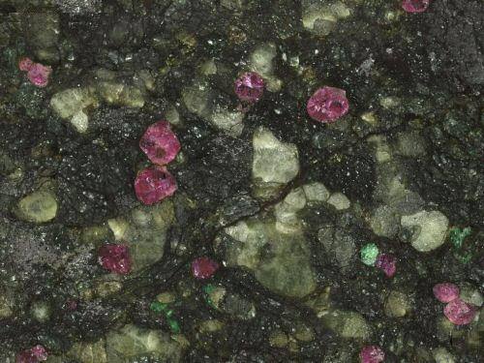
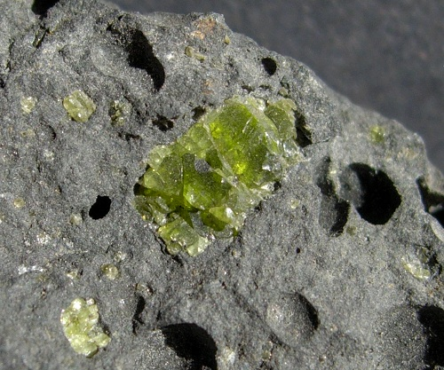
Plume Temperature Anomalies
Lherzolite with garnet and olivine porphyroblasts, taken from Google Images search
Picrite, or olivine basalt showing olivine porphyroblasts taken from Google Images search

Slide 3
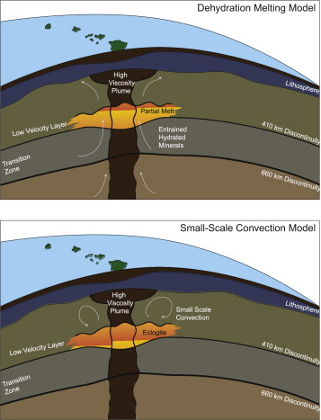
Seismic Anomaly
Taken from lecture slides
Matthew Huckfeldt, Anna M. Courtier, Garrett M. Leahy, Implications for the origin of Hawaiian volcanism from a converted wave analysis of the mantle transition zone. Earth and Planetary Science Letters, Volume 373, 1 July 2013, Pages 194–204.

Slide 4
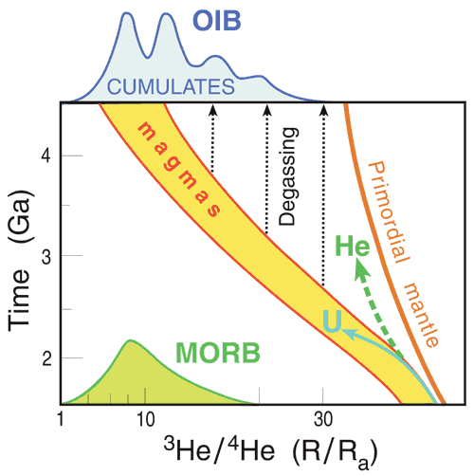
Diagram shows variation in R/Ra values for Helium in over time, note the large variations in values for MORB and OIB
Taken from http://www.mantleplumes.org/HeliumFundamentals.html

Slide 5
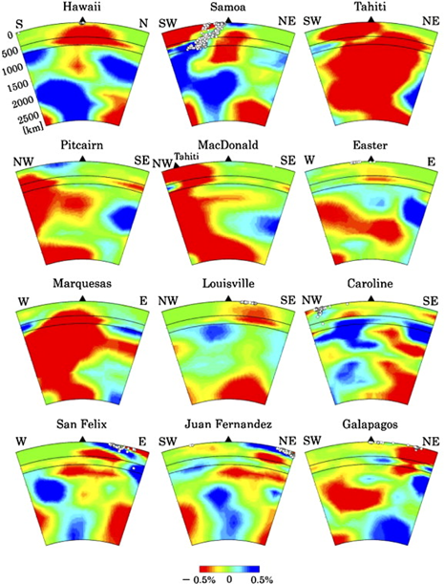
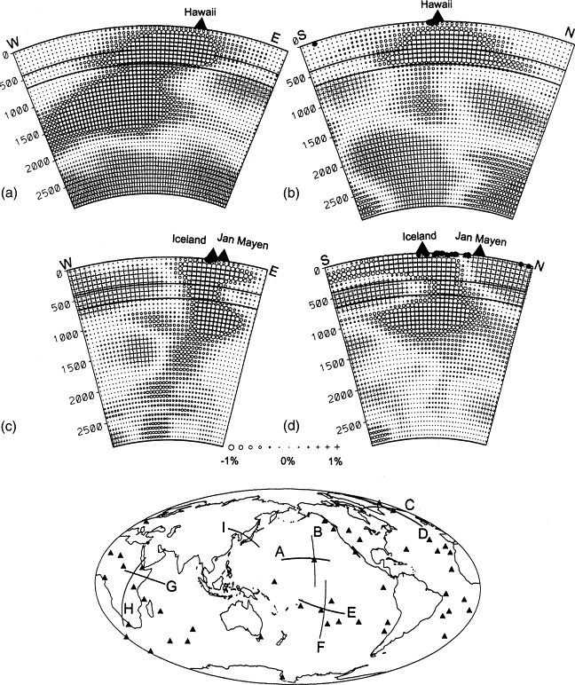
D. Zhao (November 2007). "Seismic images under 60 hotspots: Search for mantle plumes". Gondwana Research. Elsevier. 12 (4): 335–355.
Zhao, D (2004). "Global tomographic images of mantle plumes and subducting slabs: insight into deep Earth dynamics". Physics of the Earth and Planetary Interiors. 146.

Slide 6
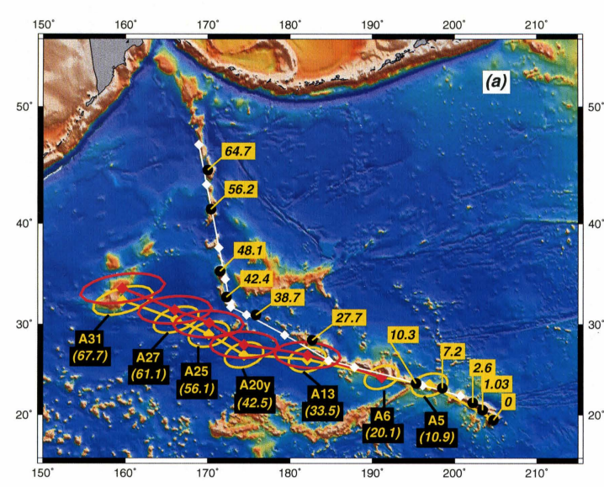
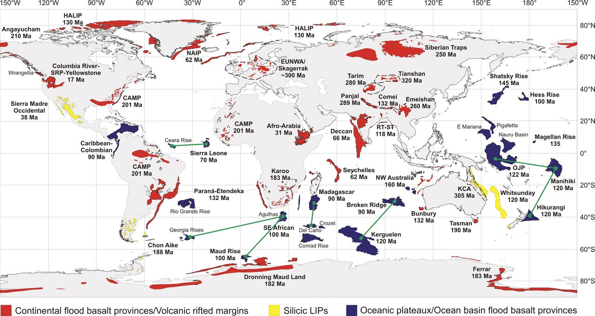
???
Red: Continental flood basalt provinces/Volcanic rifted margins
Yellow: Silicic LIPs
Blue: Oceanic plateaux/Ocean basin flood basalt provinces
From Bryan and Ernst (2008)
Yellow Track: Theoretical positions of seamounts and volcanoes along the Hawaiian-Emperor chain, from reconstructions of plate motion assuming a fixed hotspot location relative the Indo-Atlantic hotspot reference frame.
Red Track: The same, including east-west Antarctic motion.
From Raymond et al. (2000)

Slide 7
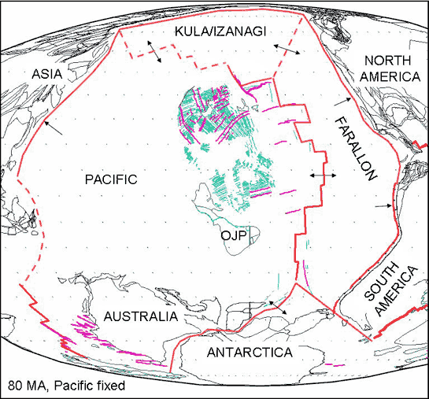
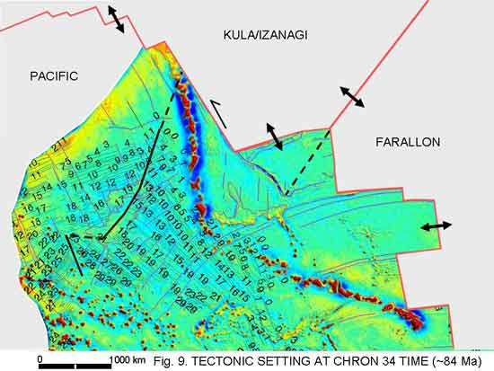
A reconstruction of Plate tectonics 80 Ma. Red lines are boundaries, dashed where inferred.
Green lines are magnetic lineations.
Plate reconstruction of the North Pacific 84 Ma, with a free air gravity map of the Hawaiian-Emperor seamount chain imposed on it.

Slide 8
Conclusions

