Slide 1
Iceland: Plate or Plume?
Nurtasha Ahmad Johar, Chris Kelly, Tara Love, Julia May, Luke Mingaye, Josh Scott

Slide 2
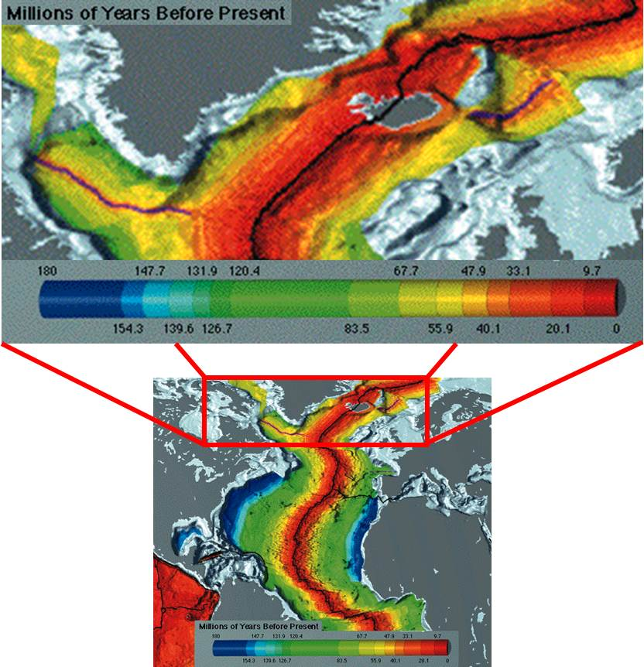
Background information
Landmass of 103,000km²
Iceland formed on a pre-existing spreading ridge which formed the Atlantic during and after the breakup of Pangaea.
Iceland itself only formed in the last 25Ma or so.
The area has show intermittent rather than continuous volcanism.
There is no time-progressive chain, and the thicknesses of oceanic crust close to the ridge (v-shaped basement ridges or “chevron ridge”)show it has not been continuously active.^{[Hey]}
Volcanism began with a flood basalt event, forming the North Atlantic Igneous Province.
5km³/century magmatic output
Image adapted from original NOAA poster

Slide 3
Falsifying The Plume Hypothesis

Slide 4
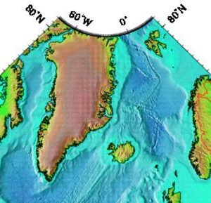
Falsifying Plumes: General
High melt volume could be caused by incorporation of volatiles or recycled crustal material. At least part of the Icelandic microplate could be continental crust.^{[Foulger]}
Greenland’s picrites often cited as flood basalts from opening or evidence of plume.
Volume suggests the opening would have been hottest at the beginning. Plumes would expect lower temperature material from the top of the plume head, and then high temperature at the plume stem.^{[Tegner, et} ^{al]}
http://oceancurrents.rsmas.miami.edu/atlantic/east-iceland_2.html

Slide 5
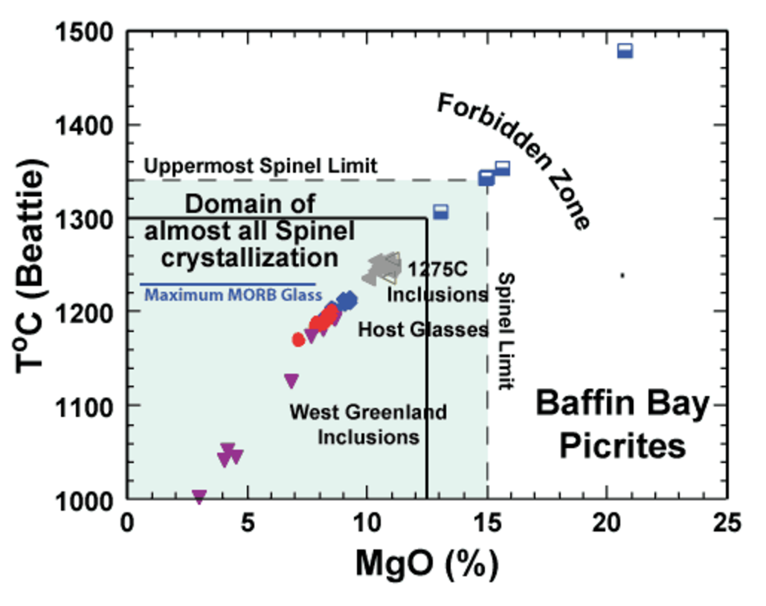
Falsifying Plumes: Geochemistry
Baffin Bay (Greenland) Spinels indicate T no higher than 1340°C^{[Natland]}.
High Fo could be from archaen mantle rocks^{[Bernstein et} ^{al]}…
…but if a plume, it would have to rise through crust somehow without recording/entraining younger material.
T estimates vary from 50 to 200°C ^{[Foulger]}
Maybe not enough for a thermally buoyant plume
High He ratios are present?
Natland, Eruptive Temperatures of the Paleogene Picrites of West Greenland and Baffin Bay

Slide 6
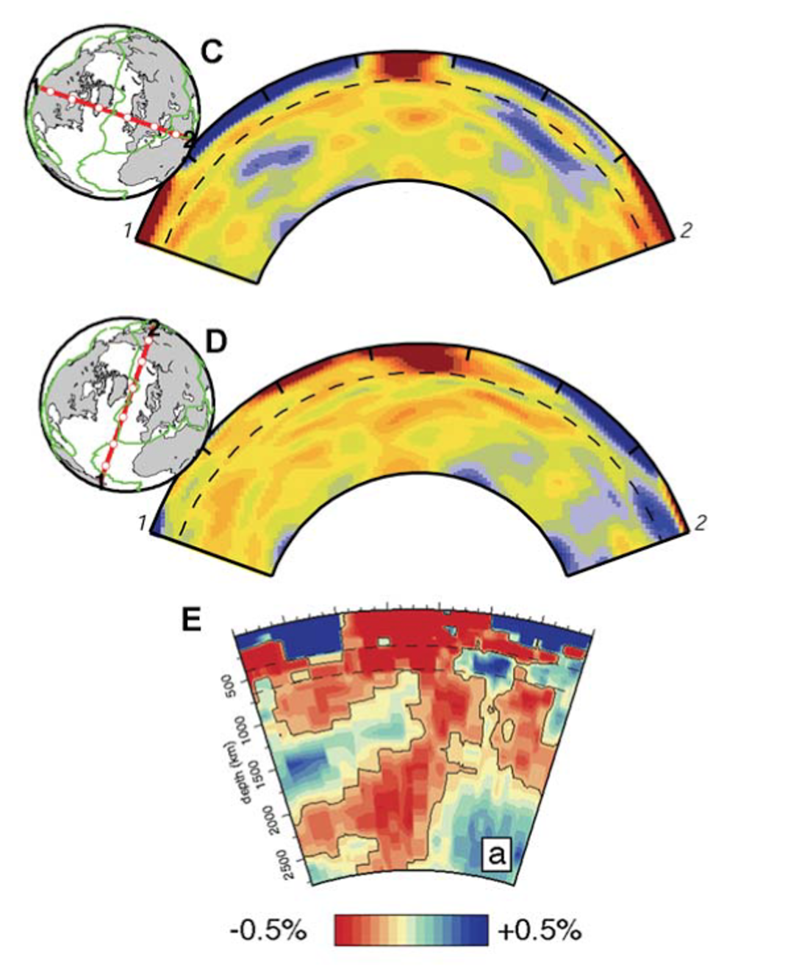
Falsifying plumes: Seismic & structural
Low velocity seismic anomaly reaches down to 660km phase transition.
Plume tail not visible, may be too narrow to be measured, but there’s no evidence of it.
“Tomography provides little support for a plume…
“but suggests that the Iceland hotspot is fed by an upwelling, most of which is confined to the upper mantle.”^{[Foulger & Pearson]}
Nowhere near any LLSVPs.
Foulger, Plates, Plumes and Paradigms

Slide 7
Falsifying the plate hypothesis

Slide 8
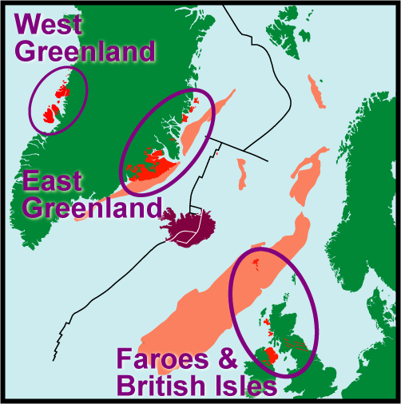
Falsifying Plates: General
Anomalously high melt volumes in Iceland and Greenland
The North Atlantic Igneous Province (NAIP) could be the flood basalt?
But does it predate the ridge?
<10 million km^3 igneous rock over 2-3 millions years.
Influence of a plume on igneous activity when the overlying lithosphere is stretched and rifted?^{[White&Mckenzie]}
Thermal anomaly marking source?
Extent of NAIP
http://myweb.uiowa.edu/dpeate/dwp-eg2000.htm

Slide 9
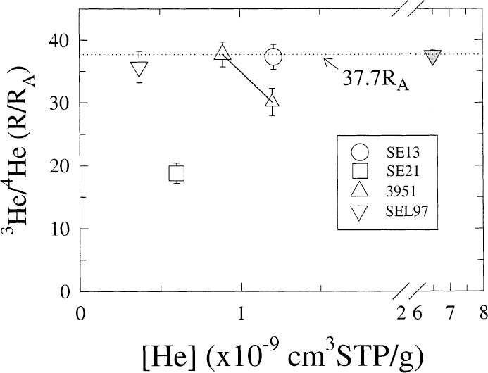
Falsifying Plates: Geochemistry
High Cr₂O₃ in Greenland picrites would need 30% extraneous source for material
Cr suggest T_{cryst} <1160-1467°C
³He/⁴He at Selardalur is <37.7 Ra^{[Hilton et al, 1999]}
Also high He in Baffin Island 14.4-49.5 Ra
FOZO/PHIM/‘C’ incoporation? Fifth mantle component with high He.
Hilton, Extreme ³He/⁴He ratios in northwest Iceland: constraining the common component in mantle plumes

Slide 10
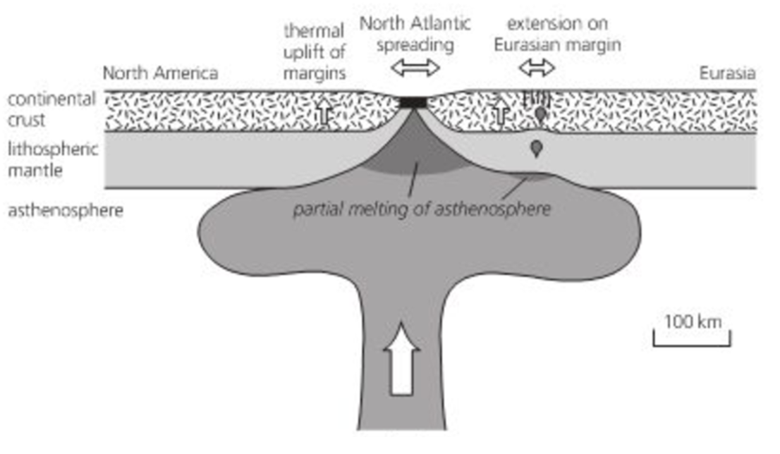
Falsifying Plates: Geophysics & Structural
Regional uplift of UK, Greenland and Western Norway, >2000km² area.
Underplating low density material from plume?
Sedimentation in North Sea
Could be from plume?
But precusory? Or from ridge?
localized patch of material with “ultra-low seismic wave speed” at the CMB
…hot, partially molten source region of the Iceland mantle plume?^{[Helmberger, et al]}
Plume tail would be too narrow to show on tomography.
Woodcock & Strachan, Geological History of Britain and Ireland

Slide 11
Summary
Chemistry suggests <50-200°C temperature anomaly. Perhaps not enough for a plume?
Chemistry suggests incorporation of crustal material (microplate? Or subducted crust from Iapetan subduction?)
Low velocity zone down to 660km. No clear evidence below that depth.
Incorporation of He rich mantle component?
Some sort of upwelling, but upper mantle only?
Regional uplift of huge area, but not precisely dated. Before flood basalts? Coincident? Afterward? Could be caused by plume, or spreading ridge itself opening there at the time.
Not time-progressive trail.
Can’t conclude either hypothesis. Most data is ambiguous, directly conflicting or could be interpreted either way.

Slide 12
Questions

