Slide 1
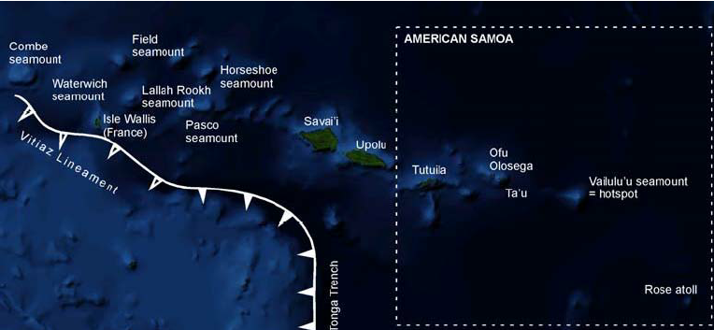
Samoa
Figure 1. Satellite image map of the islands/ seamounts associated with the Samoan volcanic chain [Birkland et.al 2009].
Eastern Province Subaerials and Seamounts
?
Western Samoa seamount province (WESAM)
Post-erosional (PE) volcanic province
Which hypothesis, plate tectonics or deep mantle plume can explain the formation of the Samoan volcanic chain in the South-West Pacific?
Alistair Bingham, Alex Jenkins, Alfie Leach, Daniel Van Helden, Henry Hoult, Jack Stead and Nick Rothwell.
Notes:
Samoa and the surrounding waters are composed of a complex relationship of volcanic islands and seamounts located ~1,500 km South of the equator on the Western Pacific Ocean.
The two largest islands Savai'i and Upolu make up the independent country of Samoa, whereas the eastern islands and seamounts belong to American Samoa, unincorporated territories of the USA.
Throughout this presentation, we divide the seamounts as well as the subaerial islands of Samoa/American Samoa into the “Western Samoan volcanic province” (WESAM), the post-erosional volcanism (PE) the Eastern volcanic province based on geographic distribution.

Slide 2
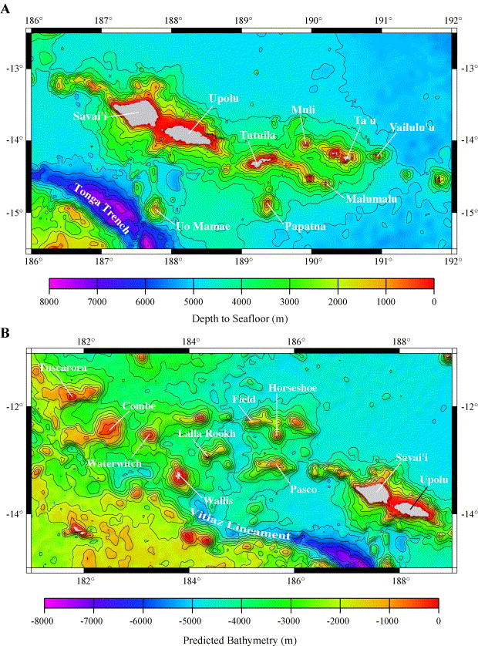
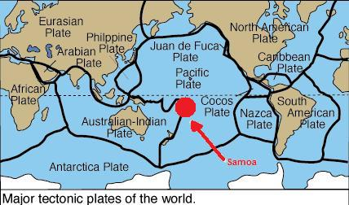
Geographical position
Samoa’s subaerial islands and submarine seamounts are situated on the Eastern edge of the Pacific Plate.
The Tonga Trench is the site of a subduction zone and on average has plate convergences with the Australian-Indian plate of 15 cm/year [Londsdale, 1986].
The Lau back-arc basin on the Australian-Indian plate has the fastest spreading of 17cm/year. [Chang, S-J, 2016].
Figure 1: Location of the Samoan islands on Earth [Dynamic Earth 2009].
Figures 2a-b: Location maps for the Western Samoa (WESAM) seamount relative to the subaerial islands and submarine volcanoes of Eastern Samoa. The Vitaz Lineament is a continuation of the northern termination of the Tonga Trench.
Notes:
The NE part of the Tonga Trench is located 150km South of Savai’i island, 174°W and 15°S , where the Pacific Plate is subducting beneath the Indian-Australian Plate
This point is referred to as the NE terminus (NET) at which point the trench bends around, turns West, and continues into the Vitiaz Lineament [Wright et al. 2000]. From (Govers and Wortel, 2005) this is a stepped transform fault plate boundary that runs along the southern part of the WESAM, at the location of the Vitaz lineament. Here interactions of the trench and transform fault may be placing stress on localized portions of the Pacific Plate, a condition that likely has been exaggerated by the ultrafast 17 cm per year roll back of the down going Pacific Plate [Ruellan et al. 2003]. This complex setting has allowed some scientists to interpret the Samoan chain as unique, which we will explain.

Slide 3
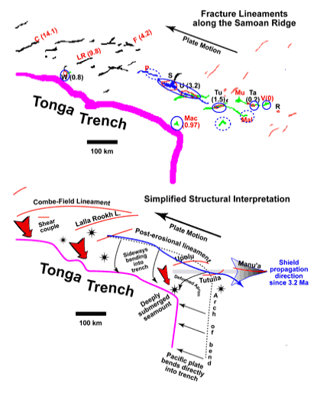
Evidence to Disprove the deep MANTLE plume theory
Extensional Features
Post erosional rift system
Plate bends laterally towards subduction zone
Rifts form orthogonal to tensional stress
Orientation varies due to drag along transform fault
Pacific plate subducting underneath the India -Australian plate but there is a stepped transform fault plate boundary that runs underneath the west islands.
Ultra-fast slab roll-back (17mm/year) exaggerates the extension. [Age systematics of two young en echelon Samoan volcanic trails, A.P Koppers et al, 2011]
Figure 3a) Crest lines of volcanic ridges in the region, ages are given in parentheses from [Duncan, (1985) and Natland & Turner (1985)].
Figure 3c) Simplified structural interpretation showing trends of Samoan fracture lineaments in relation to the vector of plate motion.
Notes:
The NET is located currently ∼300 km from the Vailulu'u potential hot spot location. Therefore, the interaction of the nearby Tongan trench may now be related to the volcanism occurring along the entire length of the Samoan chain in the last 2 Ma, instead of a progressive Easterly movement of shield volcanism as seen in similar scenarios in Hawaii.
Figure 3a) Crest lines of volcanic ridges in the region, ages are given in parentheses from [Duncan, (1985) and Natland & Turner (1985)]. Circled locations have had Quaternary-Historic volcanism. Islands and banks are C = Combe Bank; F = Field Bank; LR = Lalla Rookh Bank; W = Wallis Islands; P = Pasco Bank; S = Savai`i Island; U = Upolu Island; T = Tutuila Island; Ta = Ta`u Island; Mac = Machias Seamount; MU = Muli Seamount; Mal = Malumalu Seamount; V = Vailulu`u.
Figure 3b) Simplified structural interpretation showing trends of Samoan fracture lineaments in relation to the vector of plate motion.
There is a transition from straightforward subduction along the northerly trending portion of the Tonga Trench to lateral plate bending and likely shear coupling on the Pacific Plate along the westerly trending transform portion of the trench. [Natland, 2016].
Geodetic reconstructions of this northern terminus may have left the Vitiaz Lineament in its wake due to the tear in the Pacific Plate.
Stars are isolated volcanic islands/seamounts.

Slide 4
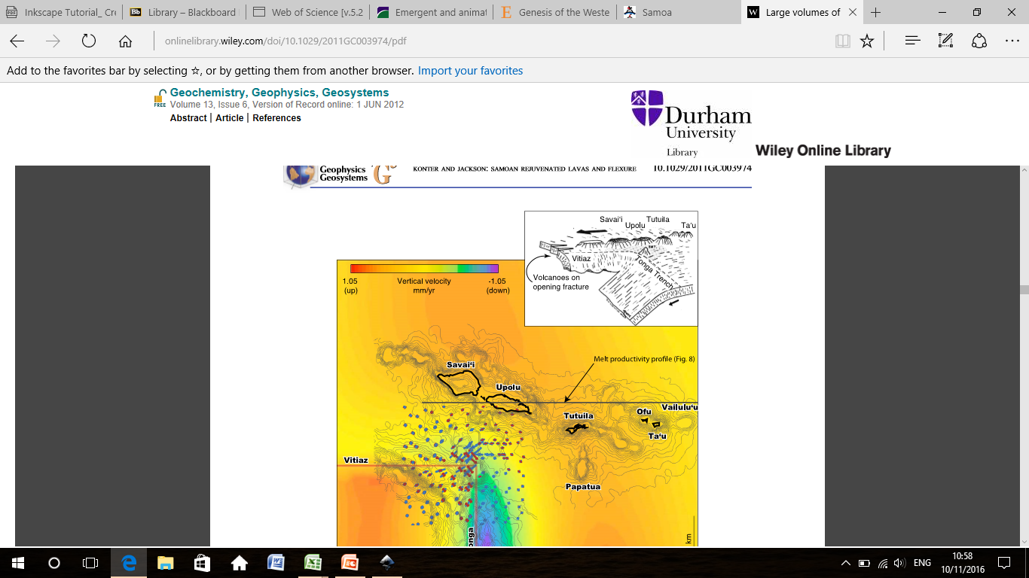
Evidence to disprove the deep MANTLE plume theory
Subsidence, uplift and precursory events:
There is no evidence of doming, although evidence for precursory uplift may have been destroyed by the rapid subduction at the Tonga trench (Natland, 2003).
The magmatism can be explained by plate flexure which has been observed and measured (Konter & Jackson, 2012).
Up thrusting produces decompression melts which escapes through the fractures created by extension along the Vitiaz lineament.
Lave originated from multiple sites along the chain in post-erosional magmas (younger volcanism).
Figure 4: Inset from (Natland, 1980), fractures from the strain produced by the NET curvature may induce enriched shallow magmas to break the surface during the post-erosional volcanism.
Notes:
Rapid subsidence of the inferred Samoan island chain (approaching the subduction zone - trench) is occurring making the exact age of onset difficult to interpret. Subaerial materials were dredged near the summit of the Machias seamount, which now is nearly 1 km deep, having subsided that far in < 1 Myr. (Natland, 2003).
Plate flexure induced melts of alkalic basanites, alkali basalts and nephelinites which have formed as a result of up thrusting of up to 1 km of the Pacific crust lithosphere. This up thrust has produced decompression melts beneath the Samoan islands and hence the active volcanism seen today. This flexure is a result of the rapid subduction within the Tonga trench and the tear that exists along the Vitiaz lineament.
This theory would support the plate tectonics theory due to melt being produced by decompression through plate uplift.
Post-erosional volcanism is varied and sporadic compared to the older WESAM basalts/basanites that occur along a lineament NE-SW. Hundreds of small volcanic cones mark the trace of the Samoan post-erosional rift zone across the islands of Savai`i, Upolu and it extends under water to Tutuila [Natland, 1980.] These rifts are only 1-2 km wide, but nearly 200 km long.
The principal feature of these post-erosional eruptions, the lava didn’t originate from a central conduit system or secondary rift supplied by the central conduit unlike Kilauea in Hawaii [Fiske & Jackson, 1972]. Instead, eruptions individually erupted from single vents and widely scattered with 43 cones over 84km.

Slide 5
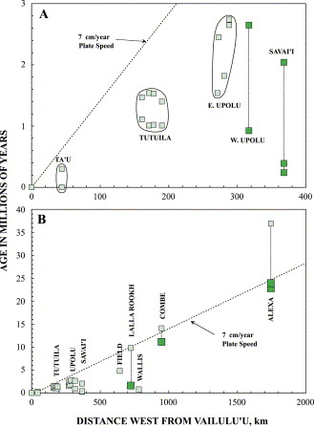
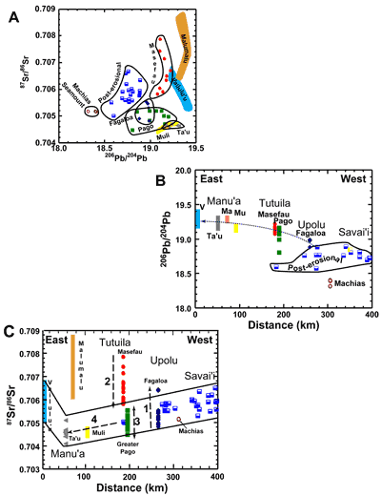
Evidence to disprove the DEEP MANTLE plume theory
The Geochemistry:
B
K-Ar, ⁴⁰Ar/³⁹Ar plateau and total fusion ages produced for a range of Samoan subaerial and submerged volcanism.
Ages show anomalies even though the general trend of the ages decreases from WNW to ESE.
Placement of a deep plume at the curving corner of the Tonga Trench must be down to complete chance (Courtillot et al. 2003).
EMII isotopic signature (extreme end-member of the OIB), materials must have once been at the Earth’s surface.
A
Figure 5:
A) 87Sr/86Sr vs 206Pb/204Pb plot for the WESAM, post-erosional and Eastern province samples.
B) 87Sr/86Sr vs distance from Vailulu’u seamount, temporal changes for the subaerial volcanism indicated by the black arrows.
Age-Distance relationship from the submerged Vailulu’u seamount,
Age–Distance relationships for dredge basalts from the WESAM Seamount province.
Notes:
Figure A:
Samoan “shield” alkali basalts through to trachyte lavas from the subaerial Samoan islands. Ta'u, Tutuila and Eastern Upolu data (small lightly shaded squares) are K–Ar ages, from McDougall, 1987 and Brocher, 1985.
Post-erosional lavas of Western Upolu and Savai‘i consisted of alkali basalts, basanites and nephelinites (large darkly shaded squares) are ^{40/39}Ar plateau ages from Workman et al. 2004. The older “shield” lavas on these islands are mostly covered and hinder the collection of data to help a continuation of a working mantle plume model younging to the SW as the data jumps over a long time period.
Figure B:
Small lightly shaded squares are ^{40/39}Ar total fusion ages, from Duncan; large darkly shaded squares are ^{40/39}Ar “plateau” ages. The dashed line is for the 7 cm/year local Pacific plate velocity.
The general trend is that the sampled ages decrease from WNW to ESE towards Vailulu’u seamount.
However, evidence of eruptions on Western Upolu (<1 Ma) as well as 1.6 Ma old Lalla Rookh and highly under saturated basanites from the same dredge’s used have resulted in an interpretation of volcanic rejuvenation in these areas. Furthermore, on Savai’i, eruptions of the shield volcano Motavanu in 1905 and 1911 suggests that the mantle plume model of a moving plate ENE over a fixed hot-spot is unsupported. This is due to the anomalous recent volcanic activity away from the potential current deep mantle plume location over Vailulu’u.
These rejuvenations of volcanic activity could be related to interaction of the Eastward migration of the Tong Trench corner (which is currently South of Savai’i) and migrating rapidly Eastwards.
Many post erosional and shield basalts have 87Sr/86Sr > 0.705, extreme examples of the EMII end-member with highly radiogenic Sr ratios, relative unradiogenic Nd and intermediate Pb isotope compositions.
Upolu (3.2-1.4 Ma): increasing in ⁸⁷Sr/⁸⁶Sr through time, from shield building to post-shield alkalic volcanism, 2) Tutuila Masefau (1.53-1.29 Ma): max ⁸⁷Sr/⁸⁶ at the beginning, reducing through time, until the eruption of 3) Greater Pago volcanic series (1.29-1.0 Ma), which was abruptly lower in ⁸⁷Sr/⁸⁶Sr. East of Tutuila, lavas of 4) Muli and Ta`u volcanoes of the Manu`a lineament have ⁸⁷Sr/⁸⁶Sr as low or lower than lavas of Tutuila, decreasing further Eastwards.
These variations in distinct isotopic compositions over time of the “Shield” lavas and rejuvenated “post-erosional” lavas implies different source materials and not a single deep enriched plume from the core-mantle boundary.
The Machias seamount, an isolated edifice South of Savai’i has radiogenic 206Pb/204Pb ratio considerably lower, this may be due to its subsiding character at the curving corner of the Tonga Trench.
The EMII end-member has been interpreted by scientists as originating from the surface before subduction back into the mantle. Materials at the Earth’s surface before subduction consists of feldspar and clay minerals. If the plume (featuring these isotopic characteristics) rose from the C-M boundary, it must represent material that has cycled entirely through the mantle and back up again.
However, these materials would have been originally hydrous and even if shallow subduction squeezed out the H2O (Dixen et al. 2002), the sedimentary components will never be denser than the minerals of the mantle peridotite and therefore wouldn’t sink to the C-M boundary. Also feldspars and clay minerals melt at lower temperatures so would melt before reaching the C-M boundary.

Slide 6
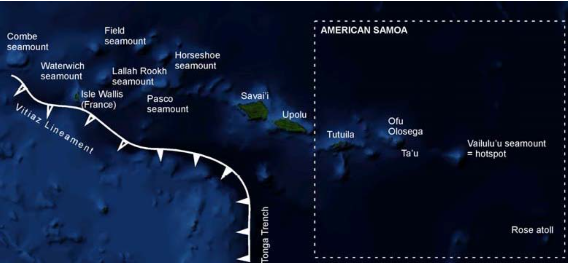
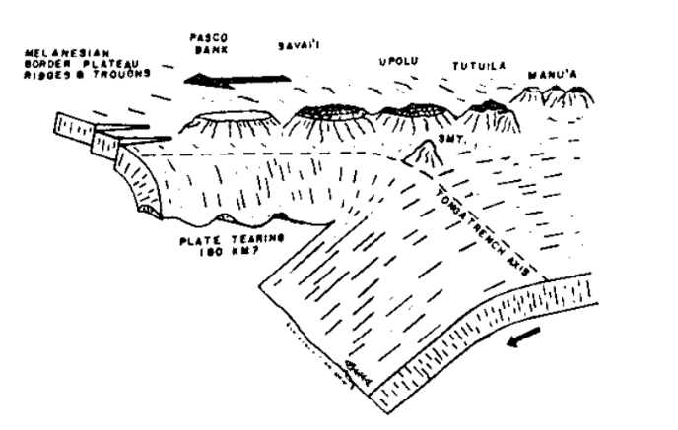
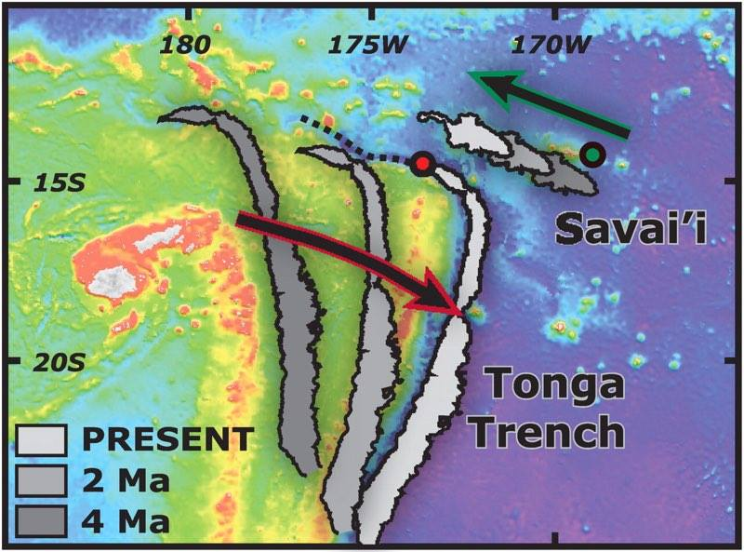
Evidence to disprove the plate tectonic theory
Post-erosional lineaments
PLATE MOTION
Figure 7:
Interpretive diagram of the Tonga Trench and Savai’i progression in the last 4 Ma.
TONGA TRENCH
Sideways bending into trench
Shield propagation direction since 3.2 Ma
Figure 6: This Diagram was adapted from:
Natland, J.H., 1980. The progression of volcanism in the Samoan linear volcanic chain. Am. J. Sci, 280, pp.709-735.
Birkeland, C., Craig, P., Fenner, D., Smith, L., Kiene, W.E. and Riegl, B.M., 2008. Geologic setting and ecological functioning of coral reefs in American Samoa. In Coral Reefs of the USA (pp. 741-765). Springer Netherlands.
Natland, J.H., 2003. The Samoan Chain: a shallow lithospheric fracture system. See http://www. mantleplumes. org/Samoa. html.
Notes:
The plate motions at the Samoan region cause a complexity and unique setting.
The back-arc spreading of Lau basin West of the Tonga trench along with the very fast plate movement of the Pacific plate Eastwards subducting underneath the Indo-Australian plate has over the past 40 Ma allowed the Tonga Trench and the Vitiaz Lineament to be tectonically near enough to potential the volcanic characteristics seen on the volcanic chain.
However, due to the fast 7.1 cm per year Pacific Plate motion toward the WNW and the ultrafast rollback of the Pacific Plate along the Tonga Trench toward the east, this tectonic situation was drastically different over the last 15 Ma [Ruellan et al. 2003].
Therefore the proposed location of the Vailulu’u hot spot will have been much further away from the plate boundary and similar to the location observed at Hawaii in present day.
For example, around 4 Ma, the location of the North-Eastern Terminus was at least five times further away (∼1,500 km) from the predicted location of the Samoa hot spot [Koppers et al. 2008]. This makes Samoa a truly intraplate hot spot and reduces the potential effects of plate tectonic boundary stresses on the formation of the older Samoan volcanoes in the WESAM province.

Slide 7
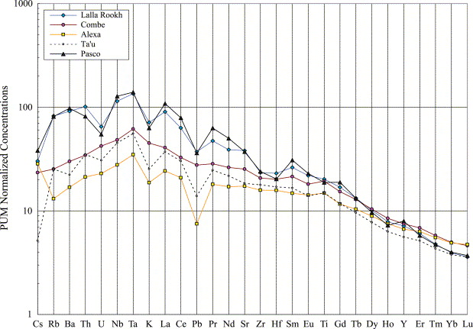
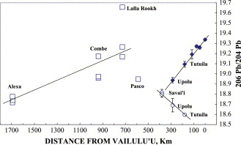
Evidence to disprove the plate tectonic theory
Figure 8: Spidergram of trace element variations normalised to primitive mantle for WESAM basalts and Eastern Province Ta’u basalt.
The Geochemistry:
Basalts dredged from 4 submarine WESAM’s (Pasco, Lalla Rookh, Combe and Alexa seamounts) have Sr, Nd and Pb isotopic signatures consistent with derivation from the Samoan deep mantle plume.
Isotopic similarities in the early WESAM basalt seamount dredges and the older Eastern province lavas.
Trace elemental variations across all samples along the chain.
Perpendicular linear relationships with the younger
Post-Erosional volcanism on Savai'i, Upolu and Tutuila.
Pasco Bank in the isotopic ratio field lies between the
two variations, could be an intermittent period.
Figure 7: 206Pb/204Pb vs distance from Vailulu’u diagram for Samoan basalts as a function of distance from Vailulu'u volcano (Hart et al. 2004)
Notes:
It is clear from the earlier diagram that the age progression of the WESAM basalts and the Eastern Province volcanism was younging ESE towards the potential present day Vailulu’u seamount.
Figure 7: The WESAM basalts are shown as hollow squares. The “Shield” basalts from the Eastern Province are shown as solid diamonds. The open circles are for post-erosional basalts from Savai'i, Upolu and Tutuila.
The Eastern Province shield basalts form a very regular increasing ²⁰⁶Pb/²⁰⁴Pb trend with distance (younging) to the east and compare similarly with the older WESAM seamounts.
The Post-erosional basalts vary considerably to the WESAM and Eastern Province isotopic signatures.
Pasco-Bank is in line with the Post-Erosional basalts of Tutuila, Upolu and Savai’i, therefore representing either a brief interlude or “resetting” of the younging direction with increasing 206Pb/204Pb Eastward, or possibly a start of the Post-Erosional trend shown in the lavas of Savai’i, Upolu and Tutuila.
From further research by (Hart et al. 2004), in Pb isotope space, Pasco was transitional between the shield and Post-Erosional fields. The expected age of ∼8 Ma for Pasco is also the time when the Samoa plume may have changed its “drift” direction from produced reconstructions, and this could drive a different “sampling mix” from what is clearly an isotopically heterogeneous plume.
Figure 8) The trace element spider grams (Normalized to the Primitive Mantle) for the average data from the WESAM basalts of Lalla Rookh, Combe and Alexa are compared with the average Ta’u Island basalt. Ta’u from the Eastern Province is used as it has similar Sr and Nd signatures like the WESAM seamounts.
The negative anomalies of U, K and Pb are typical of almost all OIB and typically derived from deep mantle plumes and not IAB from subducting plates, the lack of U depletion at Combe and Alexa may represent the addition of U during seawater interaction [Hart, S.R. et al.]. Since these elements are all mobile during alteration, there must be some caution when interpreting.

Slide 8
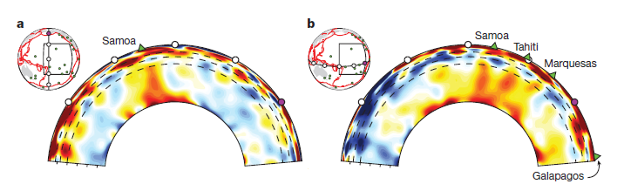

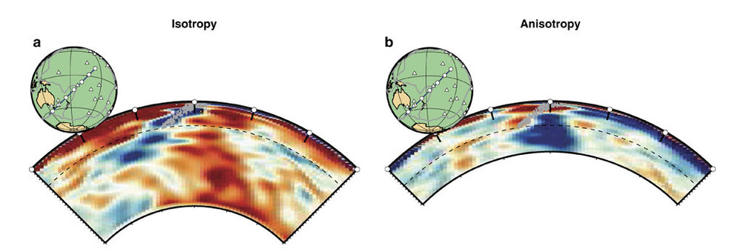
Evidence to disprove the plate tectonic theory
Seismic Tomography
Plume detected beneath Samoa
Rooted in a wide (500-800km) ULVZ at the CMB
Detected using information contained within seismic waveforms
Broad, quasi-vertical conduit – not a typical plume
Deflected at transition zone
Geodynamic Modelling
[Chang S.J et al. (2016)] carried out geodynamic modelling using a relatively large plume
Supported seismological observations
Consistent with data from previous studies
Figures 9a-b: Seismic velocity signal diagrams for the crust to the lower mantle in the Samoan arc region.

Slide 9
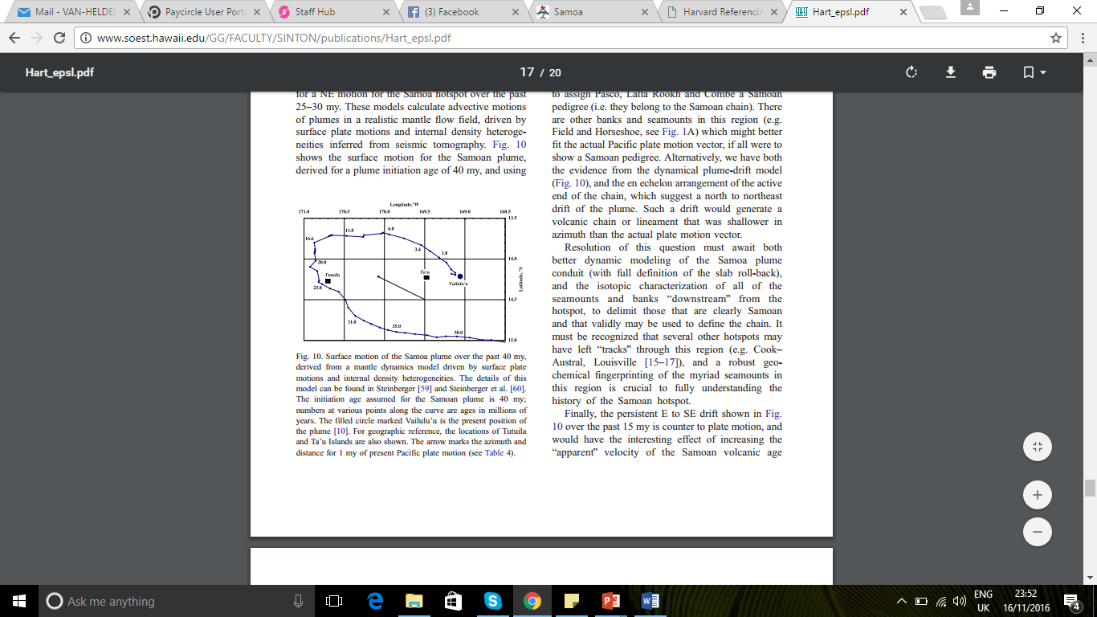
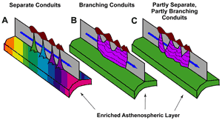
CONCLUSION
During the recent (Quaternary) period, the advancement of the Tonga Trench may have caused plate tectonics to take a role in the anomalous data plots along the Samoan chain.
Figure 10a) Age progression diagram compared to longitude/latitude of the Samoan lavas.
Figure 10b) Possible mechanism for laterally enriched asthenosphere to erupt along the entire Samoan chain in the Quaternary.
In conclusion we are still unsure whether it is just one model that can explain the phenomenon of the Samoan region.
However, possibly both an initial deep mantle plume which may continue today produced the early volcanic regions.
Notes:
The dating of the Eastern Province lavas and the WESAM dredges with data of modelled plate tectonic movement in this region suggests a potential U-turn shape of deep mantle plume around 16 Ma.
Early shield basalt volcanism began around 40 Ma, which was followed by a Samoan rejuvenation on the larger islands of Savai’i, Upolu and Tutuila away from the possible hot spot location of Vailulu’u seamount in the ESE in the Eastern Province.
As well as that, there is no observed change in isotopic composition with time and distance for the post-erosional volcanic rift zones. Unlike those traced for the older lavas produced by the deep mantle plume mechanism.
This suggests a different potential mechanism than a deep mantle plume progression ESE in the recent ~4 Ma to produce volcanism laterally along the Samoan volcanic chain.
A Chemically Heterogeneous Source Layer beneath the Lithosphere
Since the quaternary, there are great distances over the exposures of distinct lavas derived from the EMII end-member of subducted material. This suggests that the uppermost asthenosphere enriched laterally along the chain. The most simplistic approach would be that beneath the Samoan region , the asthenosphere hosts an enriched layer of mantle material and when deep fractures (caused by the lithospheric stretching, bending from the plate tectonics at the NE Terminus) reaches the lithosphere/asthenosphere margin, the enriched lavas erupt in multiple locations. The variation in isotopic and elemental properties may be caused by what the melt encounters at the varying fracture locations.
It is still possible for the mantle plume to be continuing beneath the present day Vailulu’u, however the placement of a deep plume at the corner of curved region of the Tonga Trench and away from a plate margin would be down to chance with still limited data.
Alternative models from [Natland, (2016)] suggests the disturbances triggered by trench rollback on the underlying mantle wedge may cause thermal/convective disturbance and with the subduction/back arc/transform zone complexity at the Tonga trench corner, it may initiate diaper-like uprise of mantle material beneath the ESE region of Samoa below Vailulu’u and other Eastern Province associates.
In conclusion we are still unsure whether it is just one model that can explain the phenomenon of the Samoan region, however, possibly both an initial deep mantle plume which may continue today produced the early volcanic regions and during the recent (Quaternary) period, the advancement of the Tonga Trench may have caused plate tectonics to take a role in the anomalous data plots along the Samoan chain.

Slide 10
References
Brocher, T.M. (1985). Investigations of the Northern Melanesian Borderland. Circum-Pacific Council for Energy and Mineral Resources Earth Science Series, 3, pp. 67 -75,139–172.
Dynamic Earth. (2009). Samoa Tsunami and Earthquake 2009. [ONLINE] Available at: https://earthpbl.wordpress.com/samoan-earthquake-2009/. [Accessed 10 November 2016].
French, S. & Romanowicz, B. Broad plumes rooted at the base of Earth’s mantle beneath major hotspots. Nature 525, 95-99 (2015)
Hart, S.R, Coetzee, M, Workman, R.K, Blusztain, Johnson, K.T.M, Steinberger, B, Hawkinse, J.W. 2004. Genesis of the Western Samoa seamount province: age, geochemical fingerprint and tectonics. Earth and Planetary Science Letter, 227, 1-2, 37-56
McDougall, I. (1987). Age and evolution of the volcanoes of Tutuila, American Samoa. Pacific Science, 39, pp. 311-320.
Natland, J.H. The Samoan Chain: A Shallow Lithospheric Fracture System. MantlePlumes.org, Summary Paper (2003)
Chang, S.J, Ferreira, A.M.G., & Faccenda, M. (2016). Upper- and mid-mantle interaction between the Samoan plume and the Tonga - Kermadec slabs. Nature communications 7
Workman, R.K, Hart, S.R, Jackson. M, Regelous. M, Farley. K, Blusztajn. Kurz, J.M, Staudigel. H. (2004). Recycled Metasomatized Lithosphere as the Origin of the Enriched Mantle II (EM2) End-member: evidence from the Samoan Volcanic Chain. Geochem. Geophys. Geosyst, 5.
Wright, D. J., S. H. Bloomer, C. J. MacLeod, B. Taylor, and A. M. Goodliffe (2000), Bathymetry of the Tonga Trench and fore arc: A map series, Mar. Geophys. Res., 21(5), 489–512,
Govers, R., and M. J. R. Wortel (2005), Lithosphere tearing at STEP faults: Response to edges of subduction zones, Earth Planet. Sci. Lett., 236(1–2), 505–523,
Ruellan, E., J. Delteil, I. Wright, and T. Matsumoto(2003), From rifting to active spreading in the Lau Basin–Havre Trough back arc system (SW Pacific): Locking/unlocking induced by seamount chain subduction, Geochem. Geophys. Geosyst., 4(5), 8909,
Natland, J. 2016. The Samoan Chain: A Shallow Lithospheric Fracture System. [ONLINE] Available at: http://www.mantleplumes.org/Samoa.html. [Accessed 15 November 2016].
Koppers, A. A. P., J. A. Russell, M. Jackson, J. Konter, H. Staudigel, and S. R. Hart (2008), Samoa reinstated as a primary hotspot trail, Geology, 36(6), 435–438,

