Slide 1
Yellowstone – Plume or Plate?
Alastair Davies, Thomas Jones, Stephen Secker, George Aldiss, Bob Elliott & Josh Grattage

Slide 2
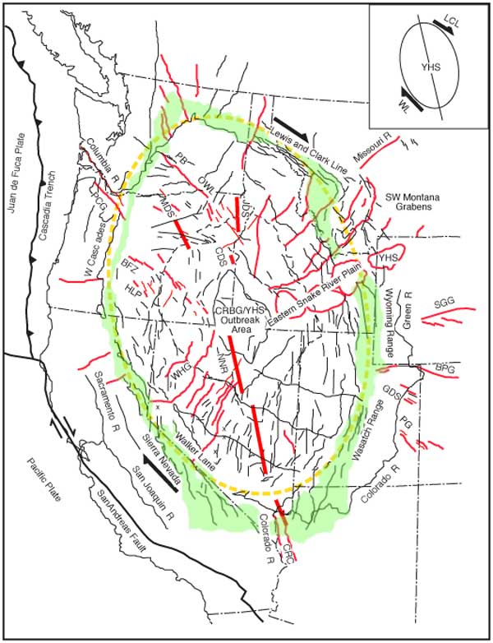
Background Geology
Middle and Late Miocene structural features of the western USA that define the great elliptical structure (red dashed line) centered on the outbreak area of the CRBG/YHS (central area). Green–uplifted rim. Heavy red lines–mafic dike swarms. Medium red lines–radial faults and Clark line (LCL) and the Walker lane (WL). Shear couple widens the ellipse.
Fig. 2. Map of western United States showing the track of the Yellowstone hotspot. Extent of 17–14-Ma flood basalts, dikes, and rhyolites indicates a process we consider driven by the Yellowstone mantle plume head.

Slide 3
Background Geology
The Yellowstone Snake River Plain (“YSRP”) may appear at first sight to be a time-progressive chain of volcanism over 16Ma, along the Hawai’i model
But the chain has to be viewed in the context of (inter alia)
  a region-wide geological reorganisation, which included elements of extension (such as Basin and Range and Cascades subduction zone roll-back), and dextral shear
  The Columbia River Basalts (“CRB”) which erupted 234Km³ of lava in 1.6Ma, starting in 17 Ma
Is the regional ellipse shape evidence of extension, or of a plume head?
Can either plume or plate theory explain the speed of eruption of the CRB (neither offers a ready explanation)?
Does the CRB have to be connected to the YSRP, or could they be separate?

Slide 4
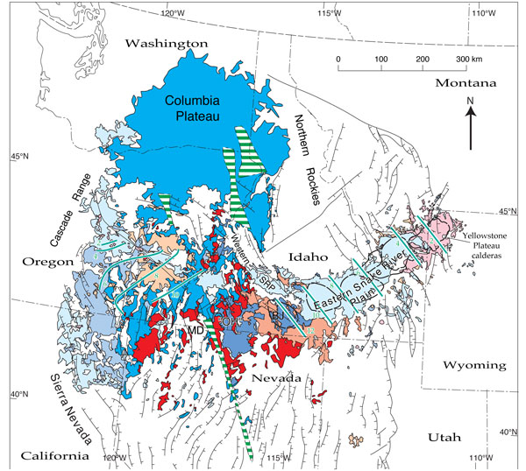
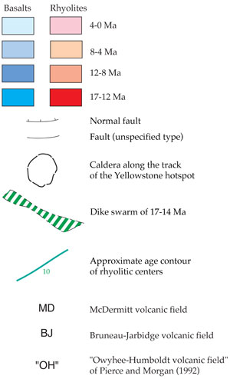
Time History
Numerical Models show flood basalts erupted too fast for arriving plume head.
Potentially lithospheric subsidence prior to flood basalt eruption, plume predicts uplift.
Flood basalts erupt along linear fissure, not a point source
Two diverging silicic volcanic trails

Slide 5
Chemical Evidence
Figure 6: Helium-isotopic ratios. Black dots are proportional in area to the maximum ³He/⁴He observed locally for the hydrothermal activity. Dashed line shows Yellowstone caldera. CH, Crater Hills; GGB, Gibbon Geyser Basin; MV, Mud Volcano; SGB, Shoshone Geyser Basin.

Slide 6
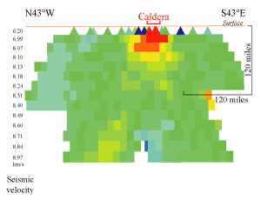
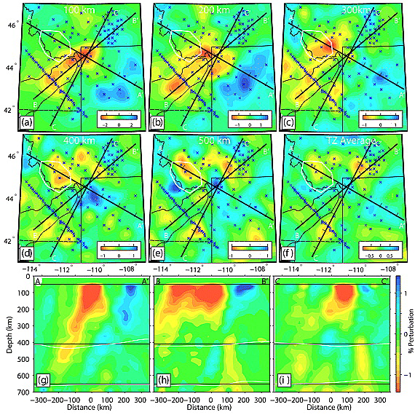
Structural Evidence
Cross section through a teleseismic tomography model of Yellowstone. Red is slow, green is fast.
Notes:
The strongest argument in favour of the plume model is the time-progressive trail of silicic volcanism that stretches from McDermitt caldera at the western end of the Eastern Snake River Plain (ESRP) to Yellowstone itself at the eastern end
AGAINST
The Tomogrpahy shown in the cross section shows that a low-wave speed body is found beneath Yellowstone and that it does not extend deeper than 200Km. A similar structure is found beneath the ESRP. This is not what is predicted if the ESRP and flanking topographic swell represent a trailing plume head.
AND a thermal anomaly in the 410Km-660Km range would be expected to be accompanied by depression of the 410Km discontinuity and elevation of the 660Km discontinuity, BUT THESE DO NOT OCCUR.

Slide 7
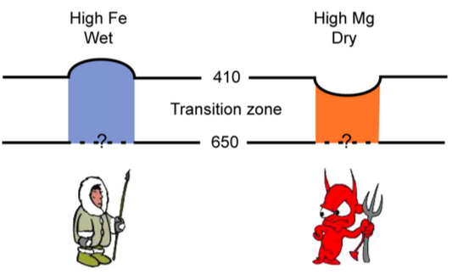
More Structural Evidence
Cartoon of transition zone reaction to thermal anomalies.
Vertical cross-section, colours indicate zones of rapid increase (red) and decrease (blue) of wave speed with depth. Black horizontal lines: nominal depths of the 410- and 660-km discontinuities.

Slide 8
Further Research
Is the CRB “ellipse” is a sign of uplift or extension? is the uplift only local?
Determine the initial U/Th content
Higher resolution seismic imagery to investigate the plume tail
References:
Christiansen, R.L., (2001), The Quaternary and Pliocene Yellowstone Plateau volcanic field of Wyoming, Idaho, and Montana, U.S. Geological Survey Professional Paper 729-G, 144 pp.
Dueker, K.G., and Sheehan, A.F., (1997), Mantle discontinuity structure from midpoint stacks of converted P to S waves across the Yellowstone hotspot track, J. geophys. Res., 102, 8313-8327
Foulger, R.F., Christiansen, R.L., and Anderson, D.L., (2015). The Yellowstone “hot spot” track results from migrating basin-range extension, The Geological Society of America Special Paper 514
Pierce, L.P., and Morgan, L.A. (2009), Is the Track of the Yellowstone hotspot driven by a deep mantle plume? – Review of volcanism, faulting, and uplift on light of new data, Journal of Volcanology and Geothermal Research 188 (2009) 1-25, doi: 10.1016/j.jvolgoeres.2009.07.009
Sears, J.W. (2009), Great Elliptical basin, western United States: Evidence for top-down control of the Yellowstone hot spot and Columbia River Basalt Group www.mantleplumes.org, accessed on 21 October 2016

