Slide 1
Temperatures in the upper 200 km of the mantle are ~200 K higher than assumed in canonical geotherms*
Don L. Anderson
Because of…
Anharmonicity, anisotropy, anelasticity
2. Non-linear conductivity (insulation)
3. Thick boundary layer (seismology)
4. Secular cooling (Lord Kelvin)
5. Radioactivity (Rutherford)
6. Seismic properties
*mantle potential temperatures at ~200 km depth are higher than at ~2800 km depth
Notes:
1. Thermodynamically consistent geotherms include considerations that are overlooked in geochemical models and in canonical models. Inclusion of physics completely changes reference mantle geotherms such as the classical McKenzie & Bickle one that is widely used to define “excess temperature” and “ambient mantle”.

Slide 2

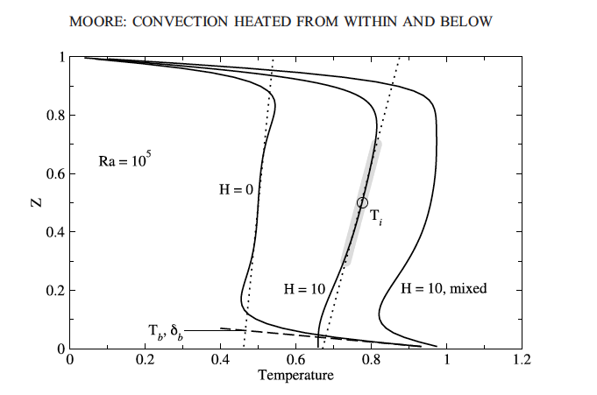
McKenzie & Bickle* ignore U,Th,K; therefore, their ‘ambient’ mantle is colder than in more realistic models.
D
E
P
T
H
Temperatures in hypothetical deep ‘Plume Generation Zones’ (PGEs)
are >300 C colder than in the surface boundary layer
PGE
*Cambridge geophysicists have now abandoned the assumptions behind their geotherm but geochemists still use it to define excess T.
Notes:
2. Straightforward classical physics shows that deep mantle temperatures are subadiabatic and much colder than assumed in geochemical reference models.

Slide 3
Internally heated & thermodynamically self-consistent geotherm derived from fluid dynamics
Schuberth et al.
D”
Depth (km)
The upper boundary layer is hotter/thicker & the lower boundary layer is colder than assumed in Canonical Geotherms such as McKenzie & Bickle (1988)
Notes:
3. Most of the mantle between boundary layers is subadiabatic & colder than generally assumed.
Deep upwellings, if they exist, are colder than shallow sources.

Slide 4
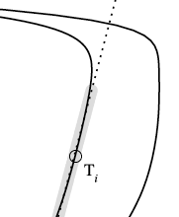
T
The recognition that mantle
potential temperatures at ~200 km
depth are higher than between
~ 400-2800 km depth is the most significant & far-reaching development in mantle petrology & geochemistry since Birch & Bullen established the non-adiabaticity of the mantle (superadiabatic thermal gradient above 200 km, subadiabatic gradient below) .
depth
High Tp in the shallow mantle is consistent with petrology (Hirschmann, Presnell)
[the BL is mainly buoyant refractory harzburgite, not fertile pyrolite]
Notes:
4. The most important overlooked piece of physics is the decrease of potential temperature with depth. It is related to internal heating and secular cooling.

Slide 5
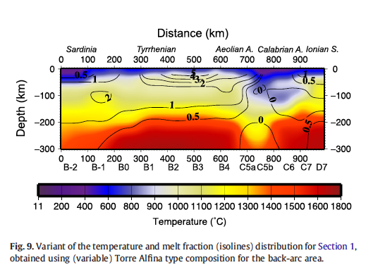
Geophysically inferred midplate & back-arc mantle temperatures are typically ~1600 C at ~200 km depth, with 1-2 % melt content*
A back-arc thermal environment
1600 C
M. Tumanian et al. / Earth-Science Reviews 114 (2012)
*this is just one example of the over-whelming geophysical evidence for Tp>1500 C in the surface boundary layer (Region B)
Notes:
5. This is just one example of over-whelming geophysical evidence for Tp>1500 C in the surface boundary layer (mantle Region B)…in non hotspot areas. High temperatures
At 200 km do not imply implausible amounts of magma. The boundary layer is relatively infertile.
M. Tumanian et al.(2012)

Slide 6
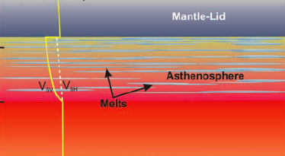
Intra-plate magmas such as Hawaiian tholeiites are derived from the low-velocity zone (LVZ) part of the sheared surface boundary layer (LLAMA). They are shear-driven not buoyancy driven.
PLATE
FOZO
Low-velocity zone
200 km
1600 C
The upper 220 km of the mantle (REGION B) is a thermal, shear & lithologic boundary layer & the source of midplate magmas.
Notes:
6. Intra-plate magmas such as Hawaiian tholeiites are derived from the low-velocity zone (LVZ) part of the sheared surface boundary layer (LLAMA)

Slide 7
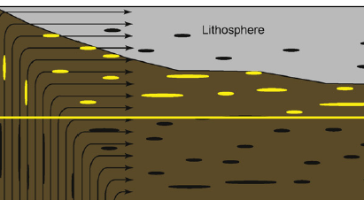
UPDATE OF CLASSICAL PHYSICS-BASED PLATE MODELS (Birch, Elsasser, Uyeda, Hager…)*
Ocean Island
LITHOSPHERE
INSULATING LID
MORB
LVZ
OIB
220 km
MORB
after Hirschmann
-200 C
-200 C
See also Doglioni et al., On the shallow origin of hotspots…: GSA Sp. Paper 388, 735-749, 2005.
*not Morgan, Schilling, Hart, DePaolo, Campbell…
Notes:
7. The amount of melt in the LVZ is too small to explain the wavespeed and the anisotropy (Hirschmann, 2010) unless the temperature is ~200 K in excess of MORB temperatures, about the same as required to explain Hawaiian tholeiites. This suggests that within-plate volcanoes are sampling ambient BL mantle, as suggested by Carlo Doglioni and others.

Slide 8
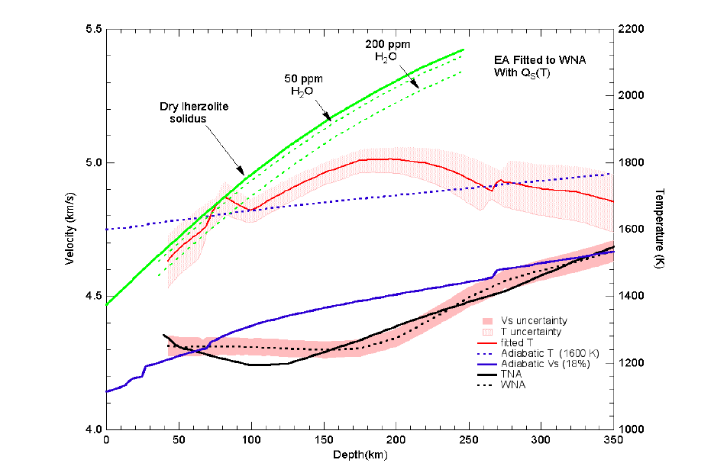
It has long been known that seismic gradients imply subadiabaticity over most of the mantle (Bullen, Birch)
Thermal bump region (OIB source)
Geotherm derived from seismic gradients
T
Canonical 1600 K adiabat
CONDUCTION REGION
SUBADIABATIC REGION
Xu
Depth
Notes:
8. Wavespeed gradients imply subadiabaticty below ~200 km. The average temperature increase inferred from seismic gradients across the upper 200 km of the mantle is ~1530 K. This causes the negative seismic wavespeed gradient and the Gutenberg low velocity zone, as has long been known but often ignored. Thermodynamic inversion of seismological data show that there is at least a 200 C decrease in temperature between 200 km and the base of the transition zone…gradients of wavespeeds exceed those predicted for adiabatic self-compression of a homogeneous mantle for depths between 200 and > 350 km depth.

Slide 9
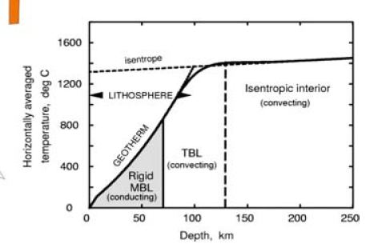
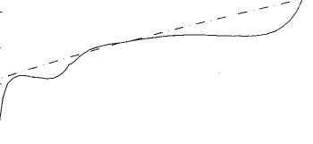
Geotherms illustrating the thermal bump and subadiabaticity
1600
1400
Midplate
bump
(& backarc)
Ridge adiabat
Boundary layer
UPPER MANTLE
T
ºC
LLAMA(shearing)
ridge
midplate
TZ
400
200
Plate (conducting)
D”
T
LOWER MANTLE
B
CMB
Depth
Depth
The highest potential temperature in the mantle is near 200 km. Tectonic processes (shear, delamination) are required to access this.
Notes:
9. Material displaced by slabs or sucked up by spreading becomes the passive upwelling source of MORB, which erupts as NMORB at places
where the boundary layer has been disrupted or dragged away. It can also rise under midplate locations but then spreads laterally unless a ridge migrates over it.

Slide 10
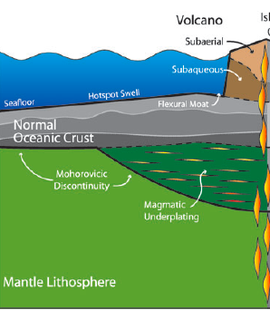
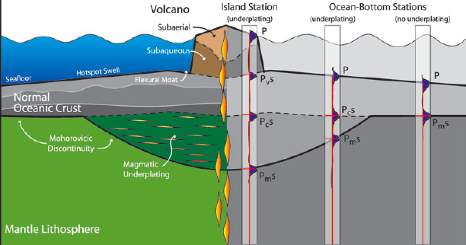
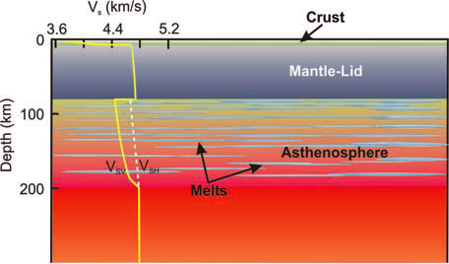
AMBIENT MIDPLATE MANTLE TEMPERATURES REACH 1600 C
MID-PLATE BOUNDARY LAYER VOLCANOES
Leahy et al.
Common Components (FOZO)
LVZ
1600 C
“hotspot” & back-arc magmas are extracted from the thermal bump region of the surface boundary layer
Kawakatsu et al
Notes:
10. “hotspot” magmas are extracted from the thermal bump region of the surface boundary layer.
This is similar to J.Tuzo Wilson’s initial explanation of Hawaii and other classic pre-plume plate tectonic models (Elsasser, Birch, Dale Jackson).

Slide 11
The upper boundary layer (BL) of the mantle is hotter than assumed in geochemistry; the deeper ‘depleted mantle’ (DM) source of MORB is ~200 K colder than ambient shallow (subplate) mantle*.
Hawaiian magmas are from ambient BL mantle; no localized or ‘excess’ temperature is required.
*all terrestrial ‘intra-plate hotspot’ magmas are derived from the surface boundary layer. MORB & near-ridge ‘hotspots’ are from the cooler TZ.
Notes:
11. The now abandoned 1988 Cambridge geotherm is the basis of the excess temperature and ambient mantle assumptions; this alone means that iconic models of geochemistry need to be revisited.

Slide 12
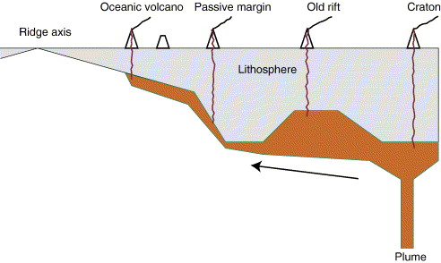
Standard Model
MORB
“ambient”
Ridge source
hot
Norman Sleep
Jason Phipps Morgan
Long-Distance Lateral flow of plume material…avoiding thin spots (ridges)
Lateral plumes
+200 C
LLAMA Boundary (thermal bump) Layer (thick plate)Model
Ridge
anisotropic
hot
-200 C
Sub-
Adiabatic
3D Passive Upwellings
Gives an oceanic plateau when a triple junction migrates overhead
See “shallow origin of hotspots…”, C. Doglioni
Ridge source
Notes:
12. Morgan and Sleep (upper panel) have recently decoupled vertical plumes from surface hotspots by invoking long distance lateral flow
of plum pudding mantle. In the plate and boundary layer models (lower panel), passive upwellings feed ridges directly or by along-ridge and lateral flow, below the boundary layer.

Slide 13
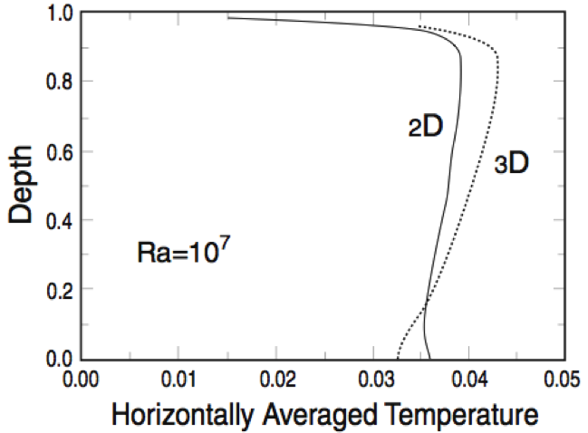
Subadiabatic gradient
(Jeanloz, Morris, Schuberth)
Effects of secular cooling, radioactivity, thermodynamics (& sphericity)
Thermal max in upper mantle exists without “plume-fed asthenosphere” or core heat
O
OIB
MORB
Melts can exist in the BL
“… most geochemists & geophysicists have taken the adiabatic concept dogmatically... Such a view impact(s)… petrology, geochemistry & mineral physics.” Matyska&Yuen(2002)
CMB
Notes:
13. Subadiabaticity is well established

Slide 14
Crust
LID
220-410
650
Lower
Mantle
Anderson, J.Petr. 2011
MORB
A
B’
B”
C’
C’’
D’
D”
Tp
OIB &
Back-arc magmas
Region B
Moho-220 km
BL
G
L
LVL
TZ
Subadiabatic geotherm
slabs
Deep Tp is colder than B
Region D”
BL
Decaying T boundary condition
No infinite energy source; no 2nd Law violations
Notes:
14. Nomenclature of the mantle & elements of a thermodynamically consistent geotherm. A schematic potential temperature (Tp) geotherm is shown. The adiabatic interior of canonical geotherms is replaced by an internally heated-slab cooled region with a subadiabatic gradient.

Slide 15
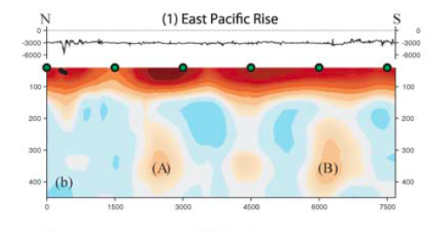
THE QUESTION NOW IS, WHERE DOES MORB COME FROM?
RIDGES HAVE DEEP FEEDERS
Some ridge segments are underlain by “feeders” that can be traced to >400 km depth, particularly with anisotropic tomography (upwelling fabric)
Only ridge-related swells have such deep roots
6:1 vertical exaggeration
Maggi et al.
Ridges cannot represent ambient midplate or back-arc mantle
Notes:
15. Some ridge segments are underlain by “feeders” that can be traced to >400 km depth, particularly with anisotropy (upwelling fabric). The feeders, with no vertical exaggeration, are dome-like.

Slide 16
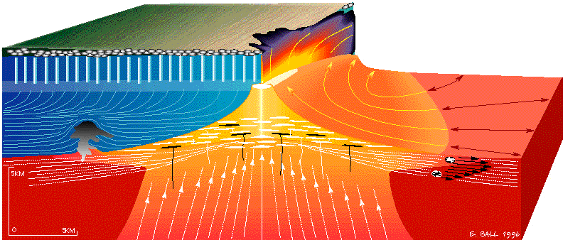
Ridge crests occur above ~2000 km broad 3D passive upwellings…’hotspots’ are secondary or satellite shear-driven upwellings
Near-ridge ‘hotspots’ sample deep & are coolish compared to midplate volcanoes
OIB
1000-2000 km
MORB
Passive upwellings are broad & sluggish, to compensate for narrow fast downwellings
Notes:
16. Passive upwellings are broad & sluggish, to compensate for rapid downwellings. They are best sampled at ridges, where there is no pre-existing boundary layer.

Slide 17
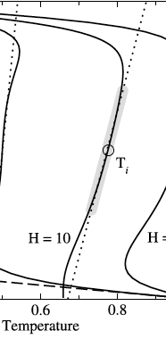
RIDGE FEEDERS
Along-ridge profile
True intra-plate hotspots do not have deep feeders
R i d g e
geotherms
TZ
Ridge adiabat
ridge
Ridge-normal profile
OIB
TZ
T
Notes:
17. Schematic model based on surface wave tomography (anisotropy & wave speeds). On-ridge and off-ridge upwellings feed ridges.The long distance lateral sub-plate flow (Sleep) applies also to the feeding of ridges by passive upwellings (Vogt). When triple junctions migrate over transition zone upwellings, plateaus such as Shatsky Rise result.

Slide 18
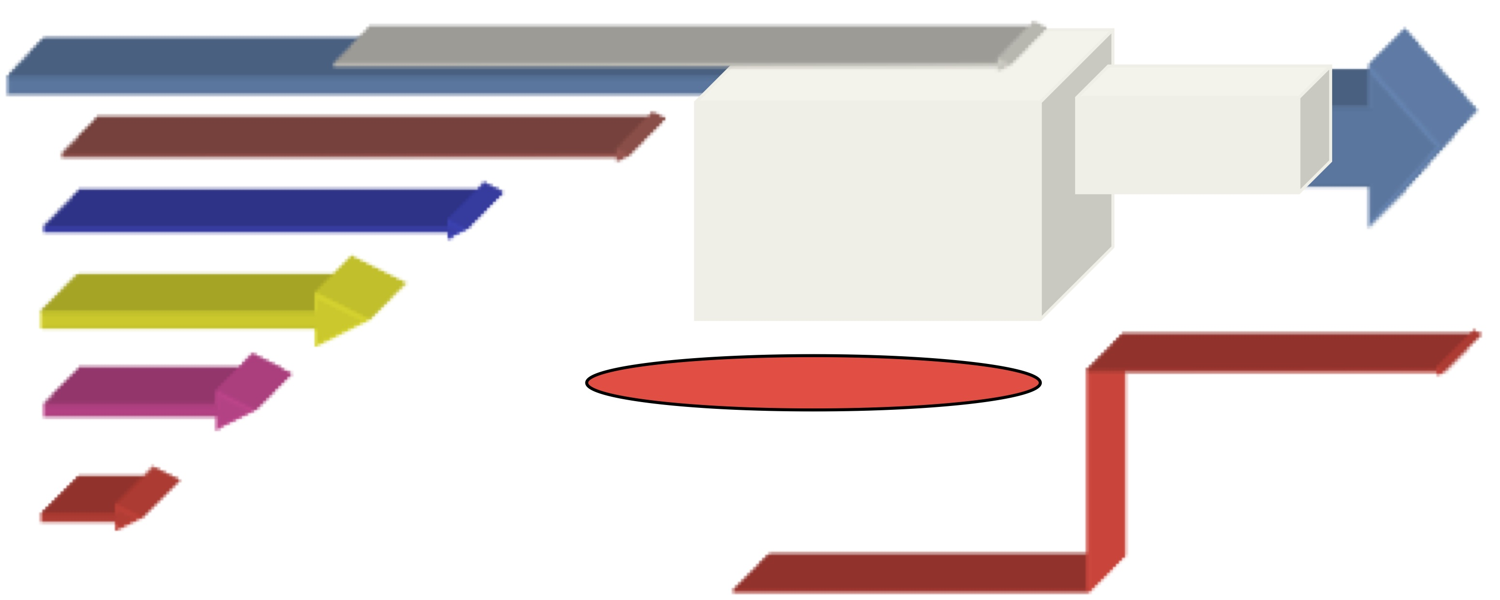
LLAMA* Shear Boundary Layer Model
*Laminated Lithologies & Aligned Melt Accumulations (Anderson, J. Petr. 2011)
teleseismic rays
S early
S late
SKS very late
west
underplate
HOT
FRACTURE ZONES & ROOTS OF SWELLS PERTURB MANTLE FLOW
Lateral variation in relative delay times are due to plate & LVZ structure & subplate anisotropy, not to deep mantle plumes
Notes:
18. A variable thickness plate moves to the left and entrains the viscous underlying mantle, which is part of the thermal boundary layer. The temperatures increases by about 10 C/km with depth. Lithospheric steps cause disruption of the shear boundary layer and allow access to the deeper hotter portions. Note that the hotter parts of the boundary layer are almost stationary relative to the surface.

Slide 19
TAKE-AWAY MESSAGE
Mantle potential temperatures at ~200 km depth are higher than between ~ 400-2800 km depth. This is the most significant & far-reaching development in mantle petrology & geochemistry since Birch & Bullen established the non-adiabaticity (subadiabatic thermal gradient) of the mantle from seismology & physics 60 years ago.
High temperatures can only be accessed where laminar flow is disturbed (delamination, FZs, convergence).
Notes:
19. take-away message

Slide 20
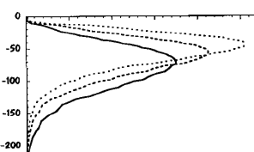


Thus, the ‘new’* Paradigm
Shear-driven magma segregation
Shear strain
Super-adiabatic boundary layer
REGION B
Hawaii source
“fixed”
300 km
Thermal max
Tp decreases with depth
Narrow downwellings
Broad passive upwellings
MORB source
TRANSITION ZONE (TZ)
600 km
600 km
(RIP)
200 Myr of oceanic crust accumulation
(* actually due to Birch, Tatsumoto, J.Tuzo Wilson)
Notes:
20. The plate tectonic cycle in a mantle that is internally heated and cooling with time. Convection is composed of narrow downwellings and broad upwellings, the precise opposite of Morgan’s & Schilling’s assumptions and subsequent geochemical models. Region B is a sheared BL with a superadiabatic thermal gradient and decreasing seismic wavespeeds. Most of the underlying mantle has a subadiabatic gradient, giving high positive wavespeed gradients. Cold upwellings, triggered by spreading and subduction, can originate in the transition region because of the subadiabatic nature of the geotherm and the cooling effect of slab trapping by the 650-km discontinuity.

Slide 21
Thank
you
EXTRA SLIDES
Notes:
21. Thank you.

Slide 22
SUMMARY
Net W-ward drift is an additional source of shear (no plate is stationary)
ridge
LID
LVZ
LLAMA
200
400
km
Mesosphere (TZ)
Cold slabs
Ridges are fed by broad 3D upwellings plus lateral flow along & toward ridges
Intraplate orogenic magmas (Deccan, Karoo, Siberia) are shear-driven from the 200 km thick shear BL (LLAMA)
Notes:
X25 (22). The transition zone feeds ridges. Cold slabs accumulate at 650 km, displacing older mantle upwards. (The geometry, enriched over depleted but fertile, is the reverse of the WOOD’s HOLE
(Schilling/Hart/Hauri/Hanan/Jackson) geochemical models). “Hotspots” are side effects of plate tectonics. Pacific plateaus are caused by triple junctions migrating over off-ridge upwellings from the transition region.

Slide 23
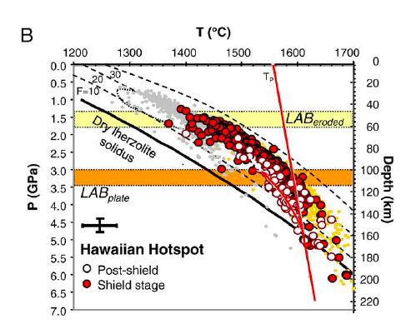
MORB
ambient
SKIP
MORB
Hawaiian magmas
LVZ
-200 C
Notes:
X17. Midplate magmas are extracted from the surface boundary layer (blue). The ridge adiabat (red) extends into the transition region below 400 km depth. MORB is extracted off of this passive cool upwelling near 60 km depth.

Slide 24
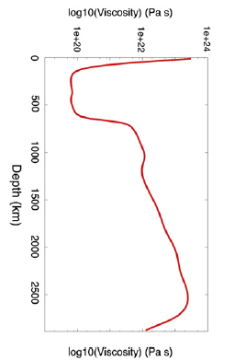
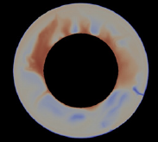
LLAMA
Lithosphere
Lid
Low-wavespeed
Anisotropic &
Melt-accumulation zones
The active layer
ASTHENOSPHERE
Temperature
Interesting region for seismology but unimportant for geochemistry
Viscosity
Notes:
EXTRA One key to mantle dynamics is the low-viscosity zone

Slide 25
Physics-based models (e.g. Birch) are paradox-free because the heatflow, helium, neon, Pb, Th, TiTaNb, FOZO, ΔNb, OIB, chondritic, mass balance, excess temperature, ambient mantle, subsidence, LAB…paradoxes & the Common Component Conundrum are all artificial results of unphysical & unnecessary assumptions in the canonical models of geochemistry & petrology.
SKIP
Notes:
X23. The Tatsumoto & physics based models of mantle evolution are paradox-free since almost all the geochemical paradoxes are the result of unnecessary and unphysical assumptions.

Slide 26
The questions are no longer “From what depth are plumes emitted?” and “Are Hawaiian magmas hotter than MORB & ambient mantle?”, but rather
“With a 200 km thick insulating boundary layer are plumes needed at all?”
“Considering the subadiabatic nature of the deep mantle geotherm (in the presence of internal heating & cold slabs) are plumes even useful for the purpose intended?”
“If the boundary layer is shear-, rather than buoyancy-driven, do we need the plume concept?”
Notes:
EXTRA

Slide 27
Magmas are delivered to the Earth’s surface not by active buoyancy-driven upwellings but by shear-induced magma segregation (Kohlsteadt, Holtzman, Doglioni, Conrad), magmafracture and passive upwellings. “Active” upwellings (plumes, jets) play little role in an isolated planet with no external sources of energy and material. This is a simple consequence of the 2nd Law of thermodynamics (Lord Kelvin)…secular cooling also implies subadiabaticity in an isolated cooling planet.
Notes:
X26. There are no significant active upwellings in the mantle

Slide 28
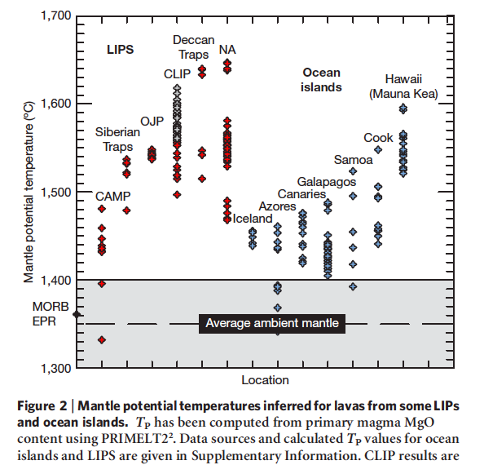
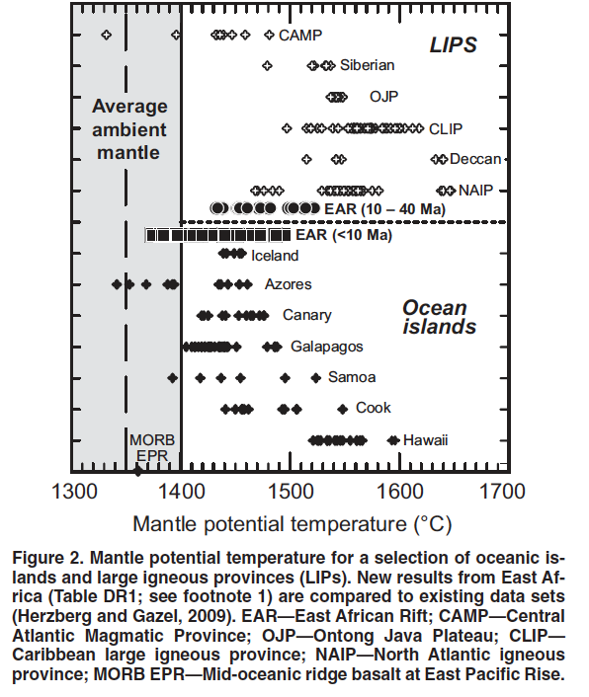
PETROLOGICALLY INFERRED
TEMPERATURES IN THE MANTLE
(Herzberg, annotated)
Mantle under large plates cannot be as cold as at mature ridges
Passive upwelling mantle (no surface boundary layer)
Typical BL temperatures inferred from seismology & mineral physics
Midplate mantle
Magma potential temperatures depend on age of plate and depth of extraction (modified from Herzberg).
Inferred T & P of midplate magmas are all in the boundary layer, which has to hotter than at mature spreading ridges
Notes:
X27. Although petrological estimates of mantle P and T show a large scatter and there is question about some of the assumptions, even the most extreme estimates of melt extraction depths fall well within the parameters of seismologically constrained boundary layers. Except for some rare inclusions in diamonds there is no evidence that any abundant rock or mineral originated or evolved any deeper than 200 km

Slide 29
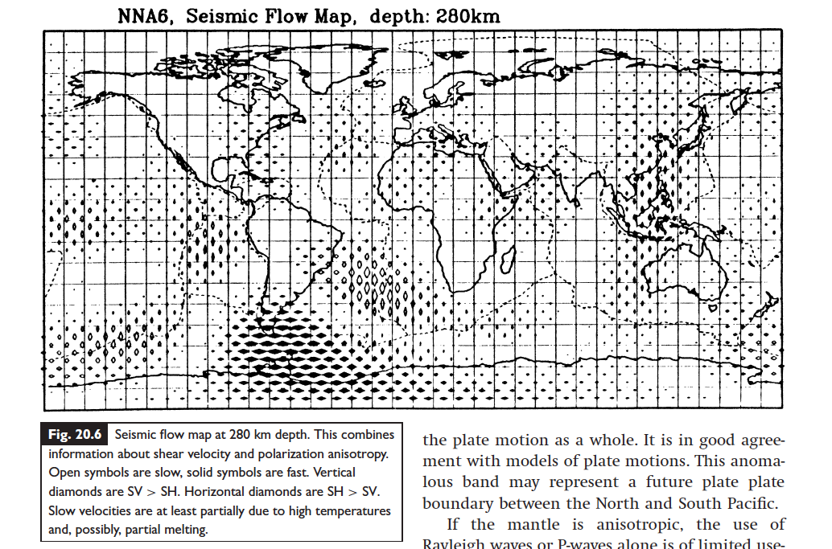
upwellings
Ridges are fed by broad passive upwellings from as deep as the transition zone (TZ). They are not active thermal plumes & are mainly apparent in anisotropic tomography.
Notes:
X28. Anisotropy below 200 km indicates that ridges are fed by deep upwellings (ANDERSON, NEWTOE, FIGURE 20.6).

Slide 30
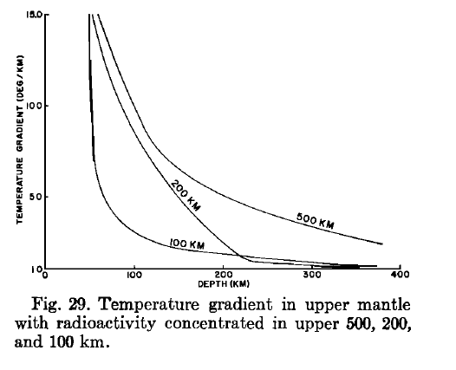
U, Th, K and other LIL are concentrated in the crust & the upper mantle boundary layer during the radial zone refining associated with accretion (Birch, Tatsumoto…). This accentuates the thermal bump.
(Lubimova, MacDonald, Ness)
Notes:
X30. Most geochemical models ignore radioactivity or the upward concentration of U, Th and K (e.g. Birch). This affects conclusions.

Slide 31
Francis Birch (1952 & his 1965 GSA Presidential Address)... The Earth started hot & differentiated, & put most of its radioactive elements toward the top…which becomes hot.
This is ignored in all standard petrology & geochemical models.
“The transition region is the key to a variety of geophysical problems…”
…including the source of mid-ocean ridge basalts.
Notes:
X31. The Earth started hot.

Slide 32
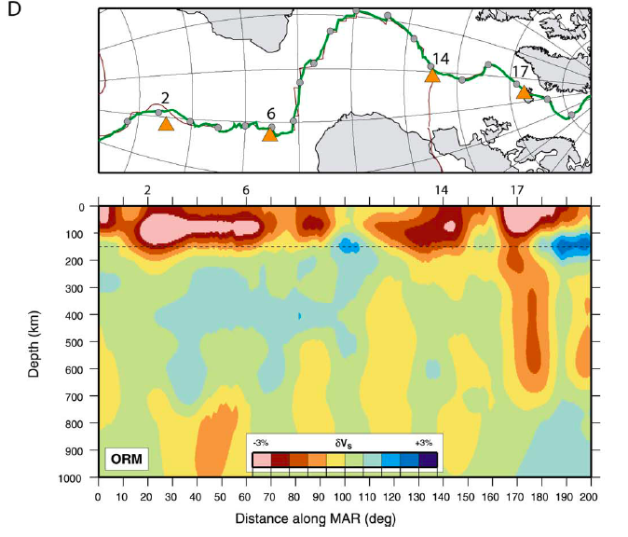
MID-ATLANTIC RIDGE (MAR)
Tp decreases with depth
Ritsema & Allen
Notes:
X34. Not only do high-velocity and low-velocity anomalies (slabs and plumes) end at 650 km, but deep features are terminated at 650 . The whole mid-Atlantic ridge seems to be fed by 3 or 4 broad near-ridge upwellings…and perhaps, by lateral flow, from off-ridge upwellings.

Slide 33
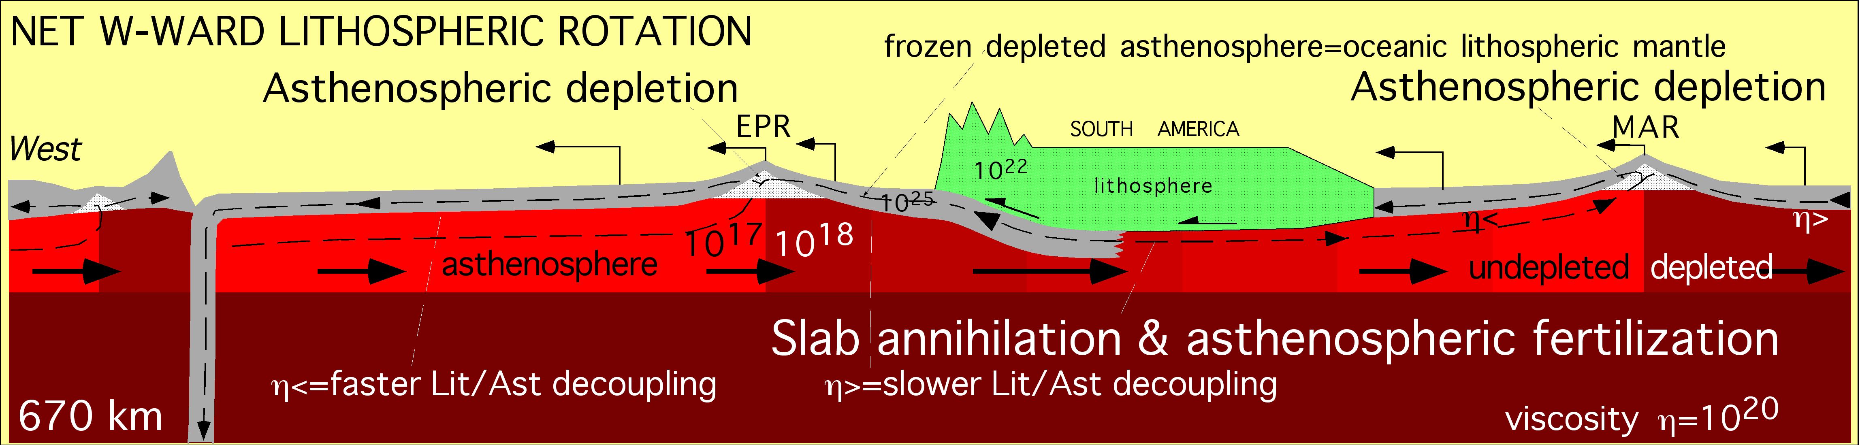
Plate motions plus net westward drift of the lid-lithosphere-plate system (LLAMA) create anisotropy & cause shear-driven melt segregation in the upper ~200-km of the mantle, a shear boundary layer
OUT
OUT
IN
Westward drift of the outer boundary layer of the mantle also shows up as a toroidal component in plate motions (which is added to plate motions in the no-net-rotation frame)
Doglioni et al. 2007 ESR
Notes:
X20. The outer ~200 km of the mantle is a shear boundary layer in which magmas can be sheared out.

Slide 34
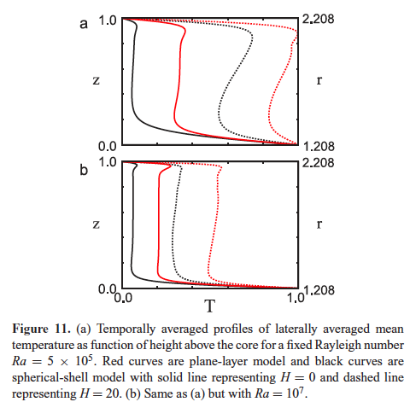
Geotherms derived from fluid- & thermo-dynamics
Region B
No U,Th,K
Thermal bump
r
With realistic parameters most of the mantle in fluid dynamic models
is subadiabatic *, in agreement with classical seismology
Earth-like parameters (U,Th,K)
Region D”
[low Rayleigh numbers, Ra, are appropriate for chemically stratified mantle (Birch)]
Unfortunately, many geochemists still assume adiabaticity & maximum upper mantle temperatures of ~1300 C
(*Jeanloz, Moore, Jarvis, Tackley, Stevenson, Butler, Sinha, Schuberth, Bunge, Lowman etc.)
Notes:
X10. A planet that is heated from within, and that is cooling with time, will have a substantial subadiabatic gradient and a thermal maximum in the upper mantle. (Bunge, Lowman AND MANY OTHERS). This is reenforced by subduction of cold slabs.

Slide 35
NETTLES AND DZIEWONSKI
What is geophysically unique about the mantle around hotspots?
Anisotropy (not local heatflow, temperature or low wave speed)
ridge
shear
Hawaii
BL
1600 C
~1300 C
wavespeed
A partially molten sheared thermal boundary layer (LLAMA)
LLAMA
laminated
Max melt
anisotropy
Notes:
X6. Hotspots are fueled from shear zones by shear-driven magma segregation.

Slide 36
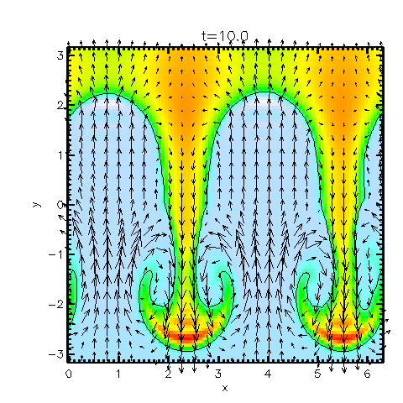
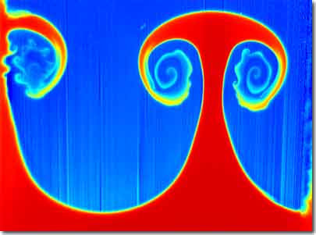
Fluid cooled from above
slabs
Broad passive upwellings
Morgan mantle plume
Heated from below

