Slide 1

Do Mantle Plumes Exist?
GSA, Annual Meeting, Phoenix, AZ, 2019
Session “Great Concepts and Controversies in Geosciences Since Steno’s Introduction of the Principles of Stratigraphy in 1669”
Gillian R. Foulger
Dept. Earth Sciences
Durham University
Thomas Rossetter
Department of Philosophy
Durham University

Slide 2




How do we do science?
Popper: Falsificationism
Quine: Confirmation holism
  Hypotheses have auxiliary hypotheses
Kuhn: Historically
  Scientists only reject auxiliary hypotheses & protect the main hypothesis
Lakatos: Methodology of scientific research programmes
  A hard core: central tenets which are immune,
  A protective belt: auxiliary hypotheses introduced to accommodate failed predictions

Slide 3
Progressive vs. degenerative
Generate predictions that fail or merely accommodate known phenomena
Generate successful predictions
Hard core: central tenets of the hypothesis
Protective belt:
auxiliary hypotheses

Slide 4
  The plume hypothesis: a degenerative research programme in the Lakatosian sense.

Slide 5
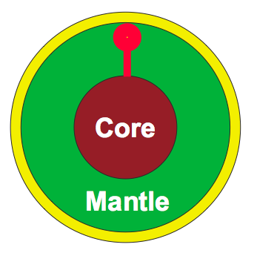
The Hard Core

Slide 6
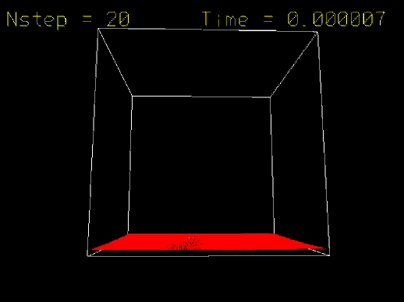

Slide 7
Five Main Predictions of the Modern Plume Hypothesis

Slide 8
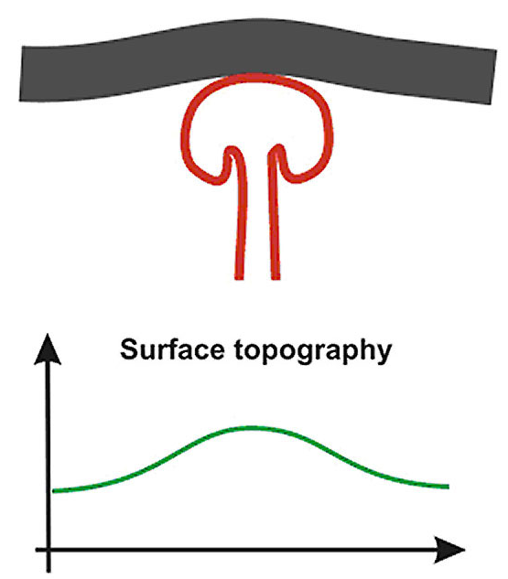
1. Precursory surface uplift
Burov (2005)

Slide 9
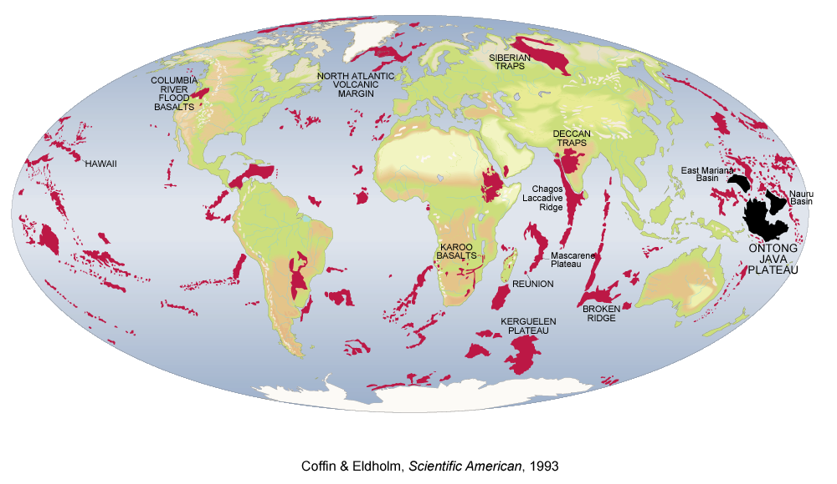
2. Followed by a “plume head” flood basalt eruption
Coffin & Eldholm (1993)

Slide 10
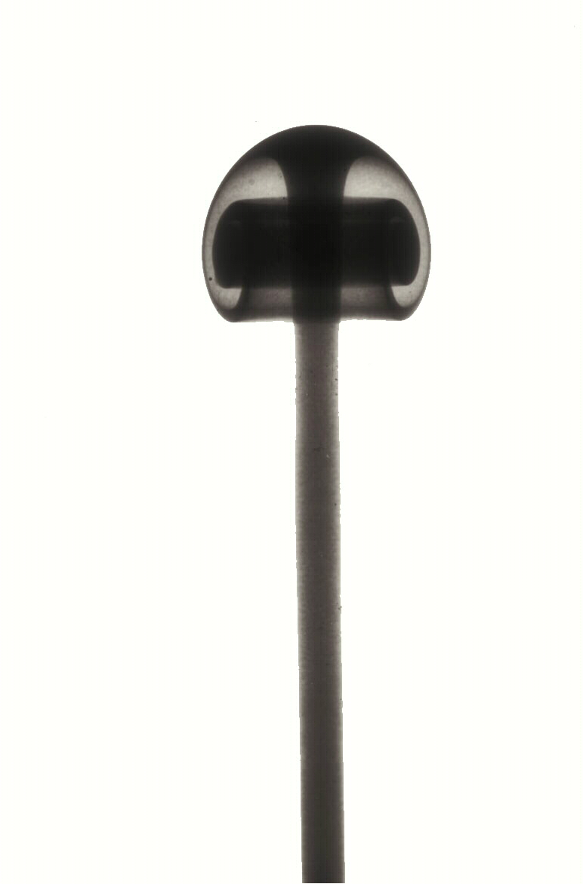
3. Plume “tail” to the core-mantle boundary
Campbell (2005)

Slide 11
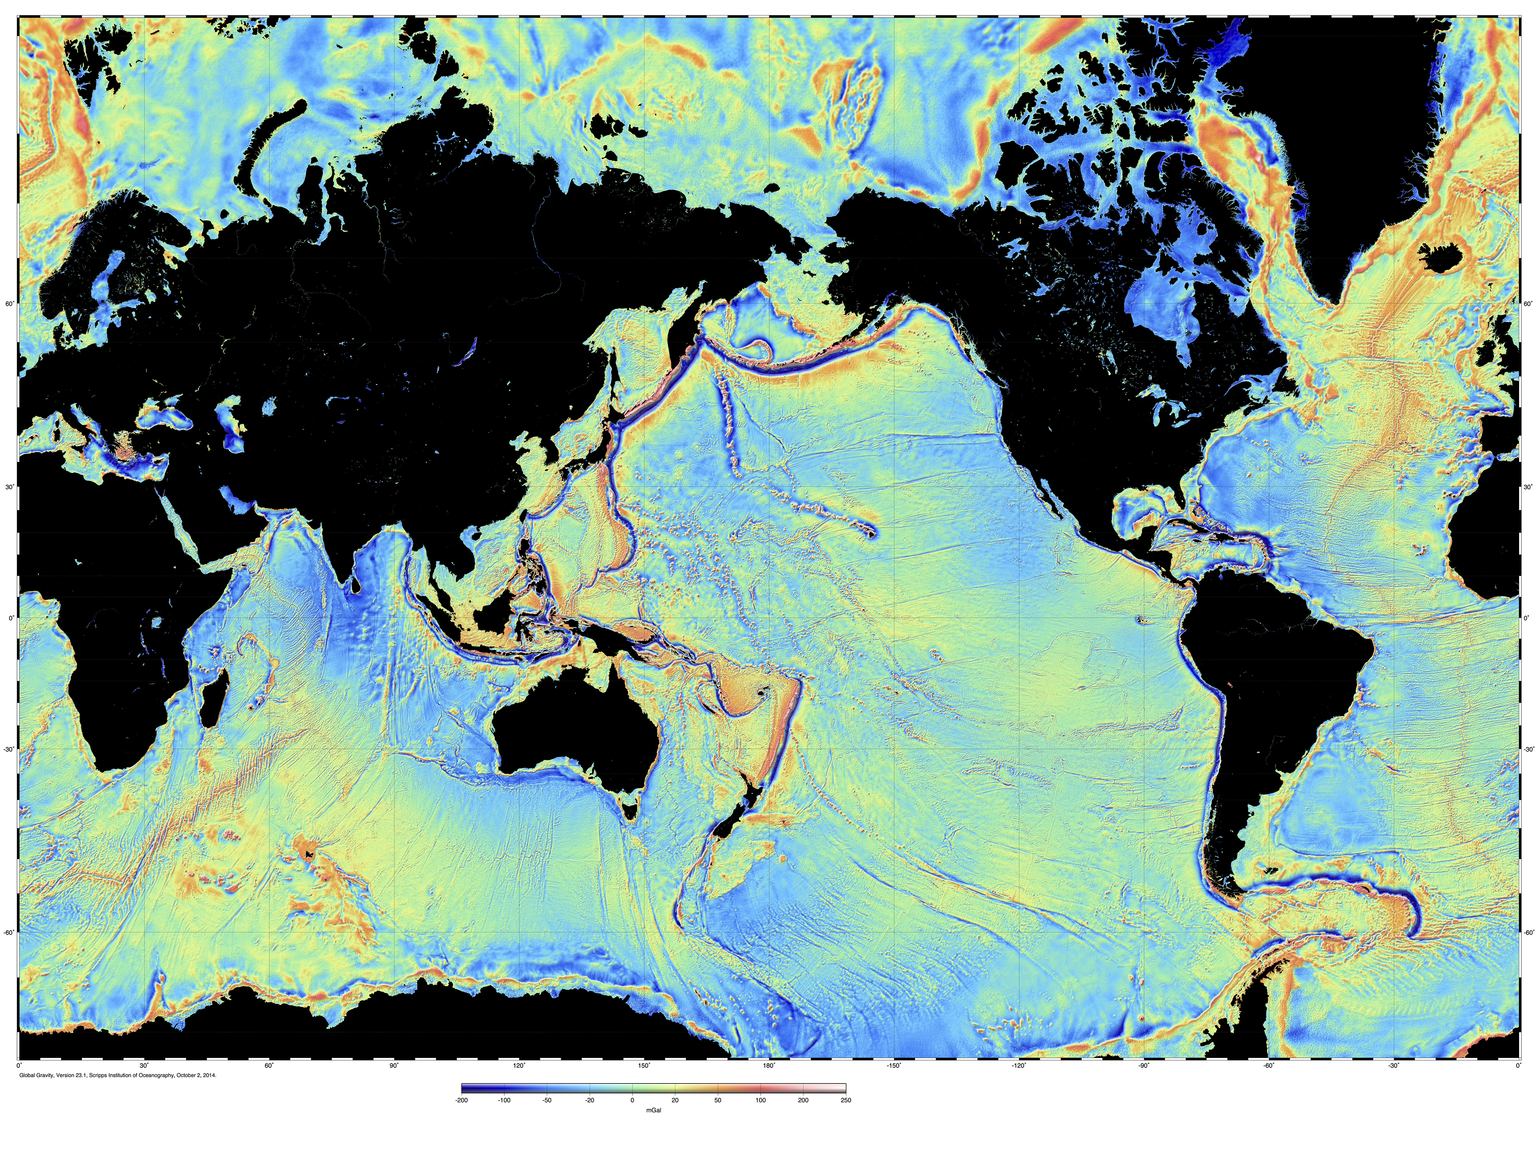
4. Fixed relative to one another, resulting in time-progressive volcanic chains
Hawaii

Slide 12


5. High magma source temperatures

Slide 13
The Failed Predictions of the Plume Hypothesis

Slide 14
1. Precursory surface uplift
Burov (2005)

Slide 15
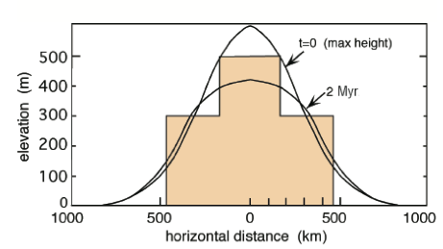
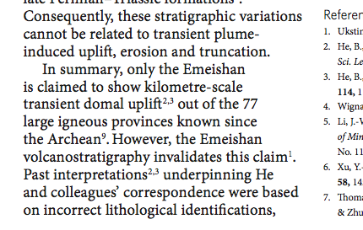
?
Ukstins-Peate & Bryan,
Nature Geoscience, 2009

Slide 16
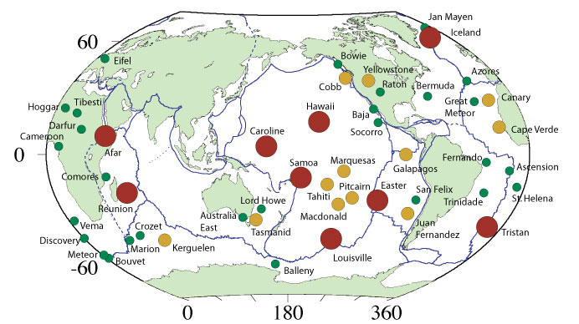
2. “Plume head” flood basalt eruption
From: Courtillot, V., A. Davaillie, J. Besse, and J. Stock (2003), Three distinct types of hotspots in the Earth's mantle, Earth planet. Sci. Lett., 205, 295-308.

Slide 17
Those without “plume-head” flood basalts
From: Courtillot, V., A. Davaillie, J. Besse, and J. Stock (2003), Three distinct types of hotspots in the Earth's mantle, Earth planet. Sci. Lett., 205, 295-308.

Slide 18
3. Plume “tail” to the core-mantle boundary
Campbell (2005)

Slide 19
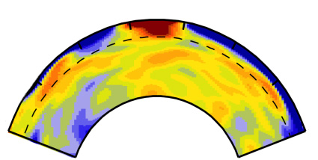
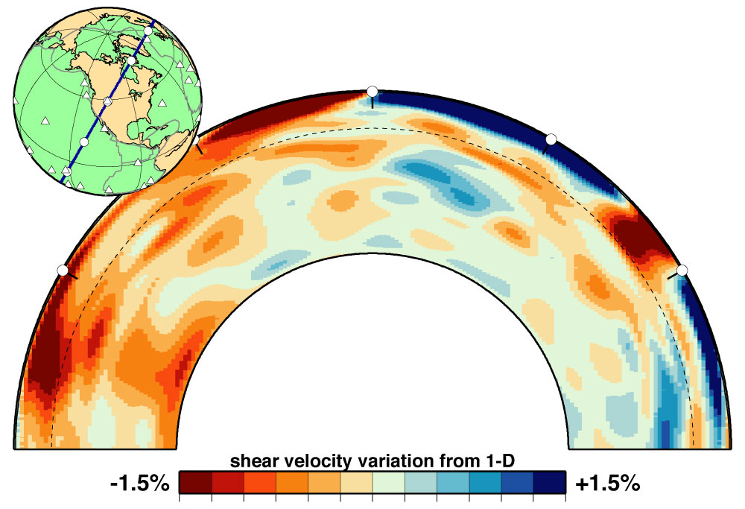
Seismic cross sections through Earth
Iceland
Yellowstone
Ritsema et al. (1999)

Slide 20
4. Fixed relative to one another, resulting in time-progressive volcanic chains
Hawaii

Slide 21
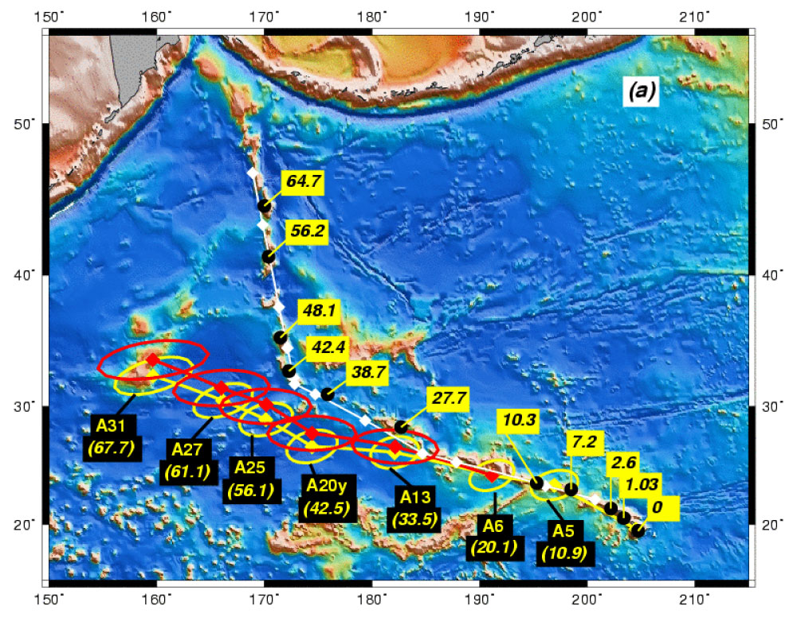
Raymond et al. (2000)

Slide 22
Lakatosian protective belt
Flood basalt
Plume tail
Uplift
Time-progressive track
High temperature

Slide 23
Lakatosian protective belt
Flood basalt
Plume tail
Uplift
Time-progressive track
High temperature
Complex structure causes distortions
Entrainment of cold mantle can mask high temperatures
Lateral flow can displace volcanism
“Mantle wind” can deflect plumes
Plume roots can be shallow

Slide 24
Lakatosian protective belt
Flood basalt
Plume tail
Uplift
Time-progressive track
High temperature
Lateral flow can displace volcanism
“Upside-down drainage”
Eroded away
“Headless plume”
Distant, unconnected flood basalt
Multiple plumes
Multiple-headed plume
Pulsing plume
Plume head has been subducted
…and if all else fails…
Simply ignore the problem

Slide 25
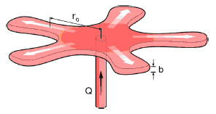
Currently Over 70 Plume Variants
85
Thermal (1); Fossil (2); Channelled (3); Toroidal (4); Tabular (5); Depleted Residual (6); Finger-like (7); Recycled (8); Edge (9); Cold (10); Cacto- (11); Super (12); Asthenospheric (13); Dying (14); Not very energetic (15); Spaghetti (16); Baby (17); Head-free (18); Splash (19); Pulsating (20); Subduction fluid-fluxed Refractory (21); Hydrogen (22); Heterogeneous (23); Flattened Onion (24); Subduction-driving (25); Subduction-triggered (26); Washboard (27); Bent-shaped (28); Failing (29); Delamination-triggering (30); Concentrically-zoned (31); Mushroom (32); Laminar (33); Advected (34); Extinct (35); Bilateral (36); Bifurcated (37); Geriatric (38); Primary and Secondary (39); Accreted (40); Diverted (41); Deformed (42); Golden (43); Veined (44); Hidden (45); Weak (46); Pulsing (47); Young (48); Blob-like (49); Cavity (50); Starting (51); Passive (52); Stealth (53); Tilted (54); Asymmetric (55); Mega (56); Mini (57); Not-hot (58); Killer (59); Deflected (60); Stripy (61); Diamondiferous (62); Transient (63; Dehydrating (64); Doughnut (65); Rear (66); Side (67); Volatile-bearing (68); Incipient (69); Migrating (70).
A radial viscous fingering plume, published 2017

Slide 26
www.mantleplumes.org

Slide 27

That’s all folks
Notes:
Mechanisms: Rifting decompression melting
Generic: Thermal/Sedimentary evidence
Localities: Hawaii/What the hell is Hawaii?
And if you think you might forget the URL, we are selling mantleplumes.org coffee mugs at cost price - £2.50

