Slide 1
Plates vs. Plumes: A Geological Controversy
Gillian R. Foulger
Durham University, U.K.

Slide 2
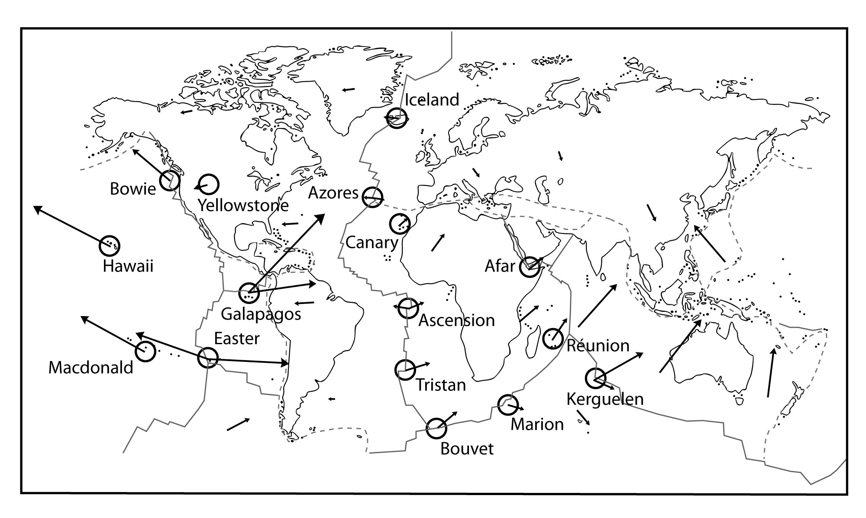
Morgan (1971)
The Plume Hypothesis
Notes:
Morgan went further. In addition to excess volcanism, plumes were supposed to also explain:
fixity & chains

Slide 3
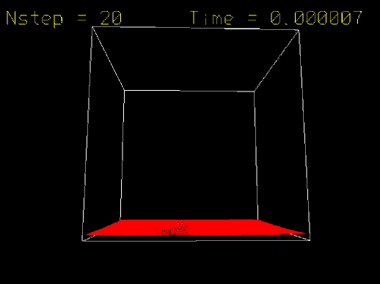

Slide 4
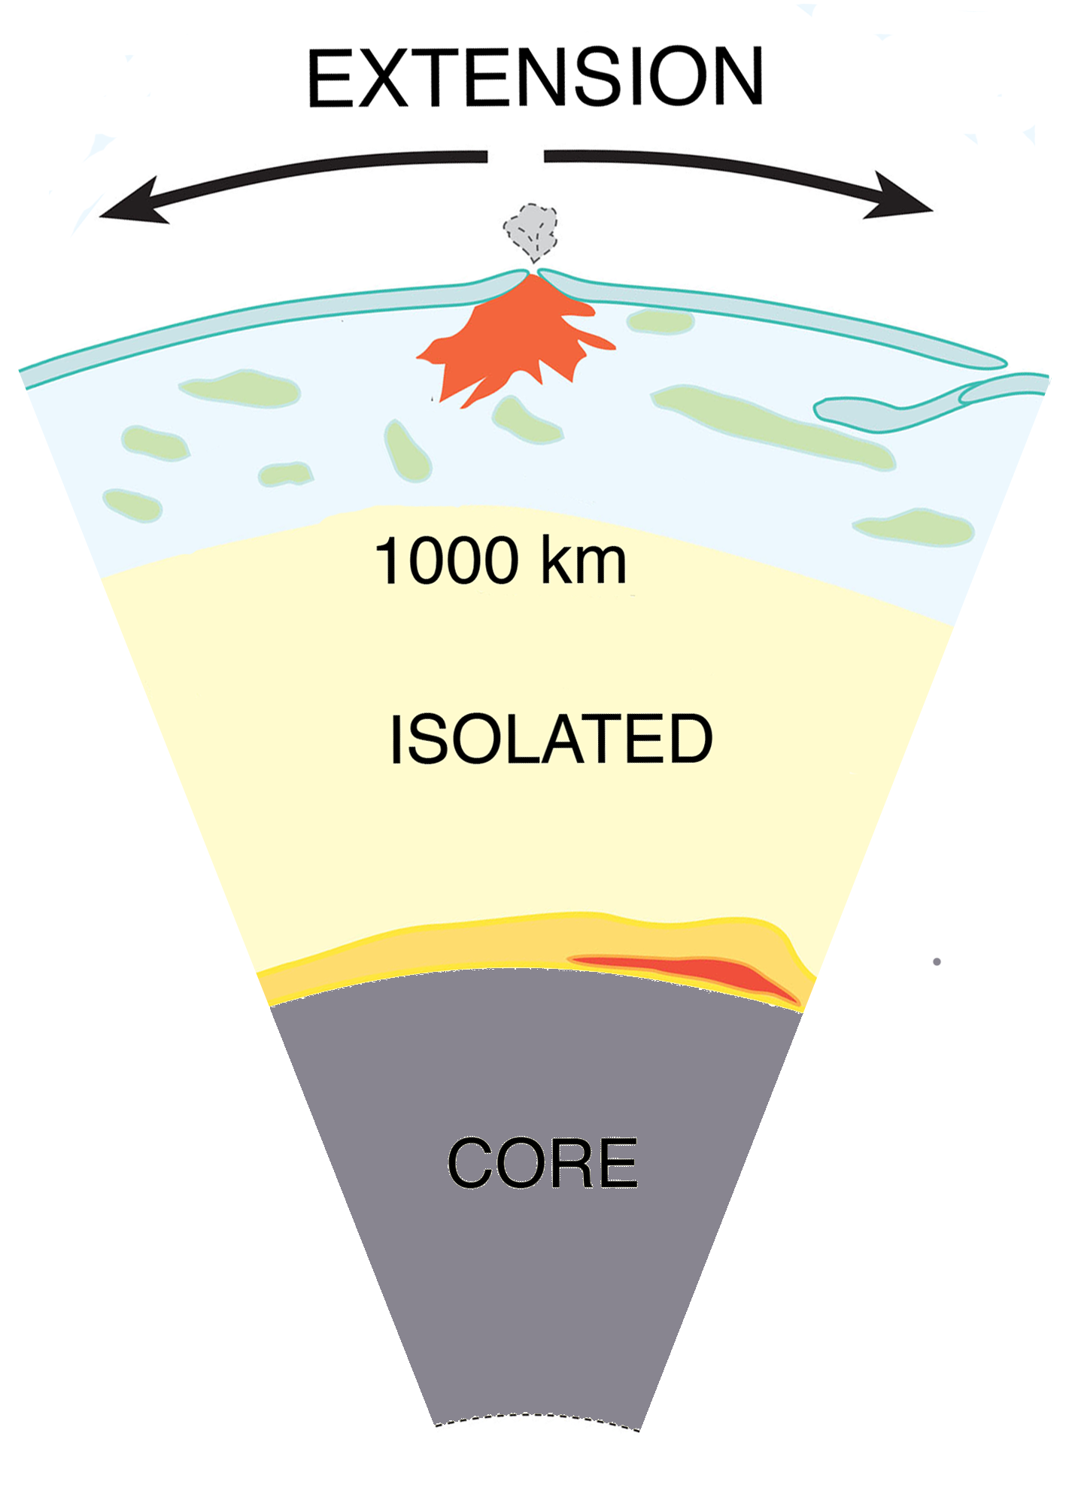
The Plate hypothesis

Slide 5
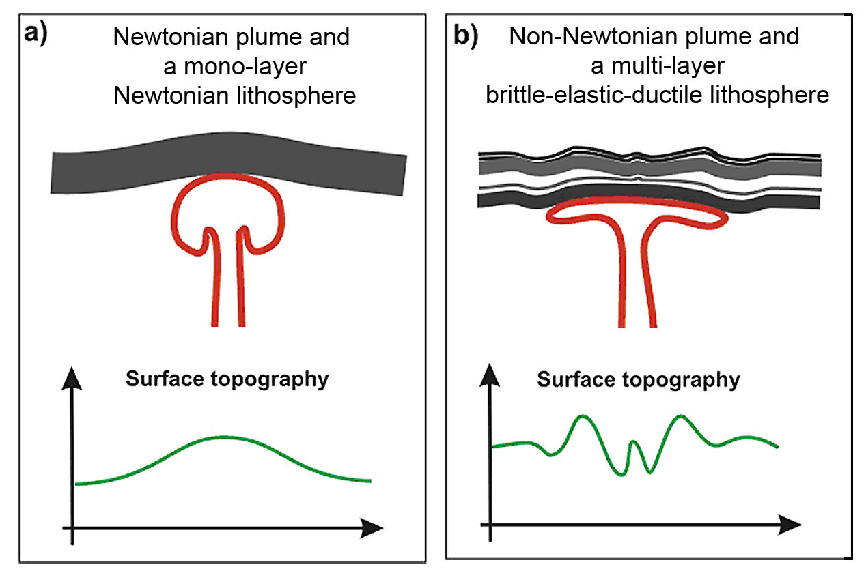
Top Down vs. Bottom Up

Slide 6
Predictions of the Plume Hypothesis

Slide 7
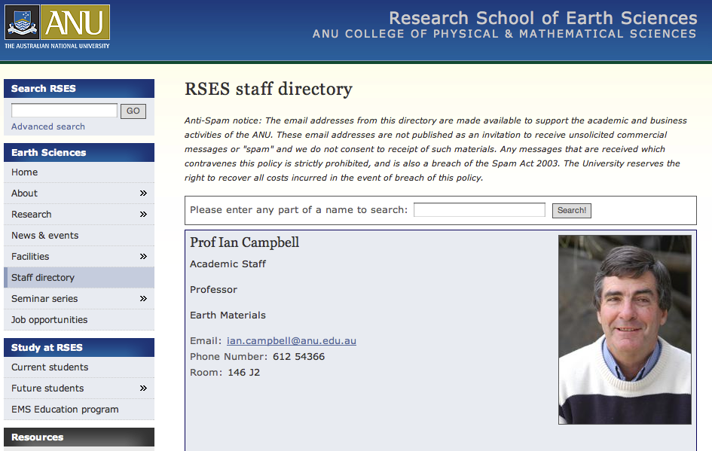

Slide 8
1. Precursory uplift
Burov (2005)

Slide 9
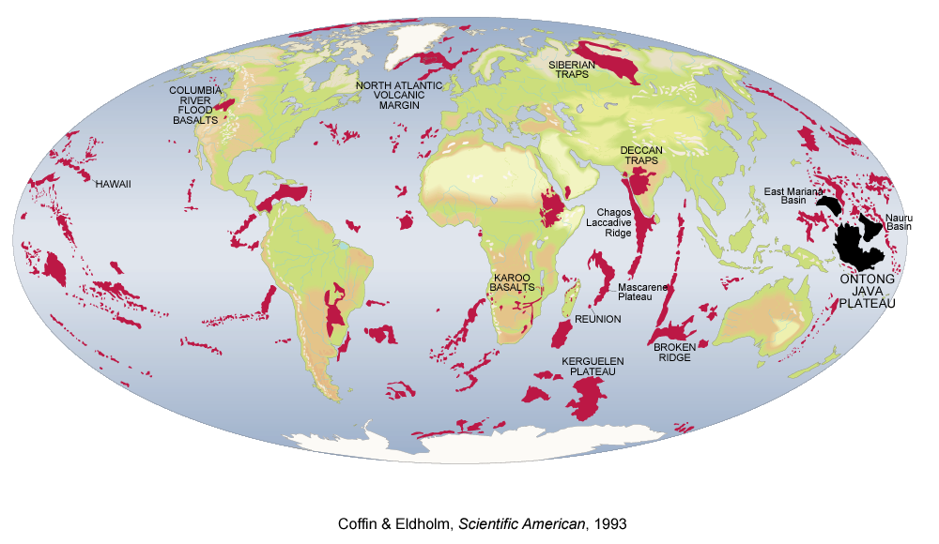
2. Flood basalt eruption
Coffin & Eldholm (1993)

Slide 10
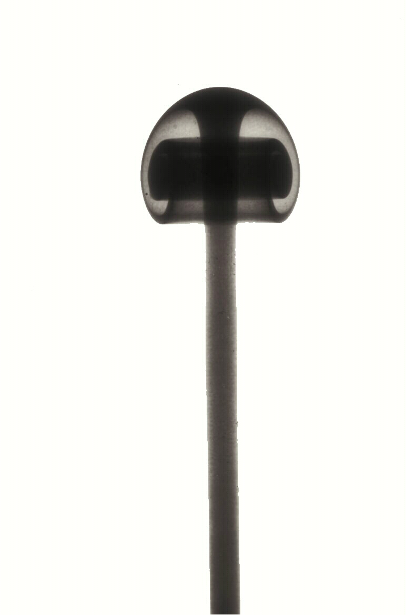
3. Plume “tail” to the core-mantle boundary
Campbell (2005)

Slide 11
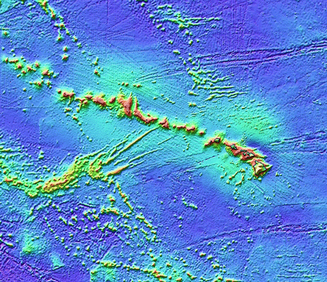
4. Time-progressive chain
Hawaii

Slide 12


5. High temperature

Slide 13
Predictions of the Plate Hypothesis

Slide 14
1. Lithospheric extension
2. Source fusibility
3. Shallow mantle source

Slide 15
Plume predictions are not confirmed

Slide 16
Precursory uplift

Slide 17
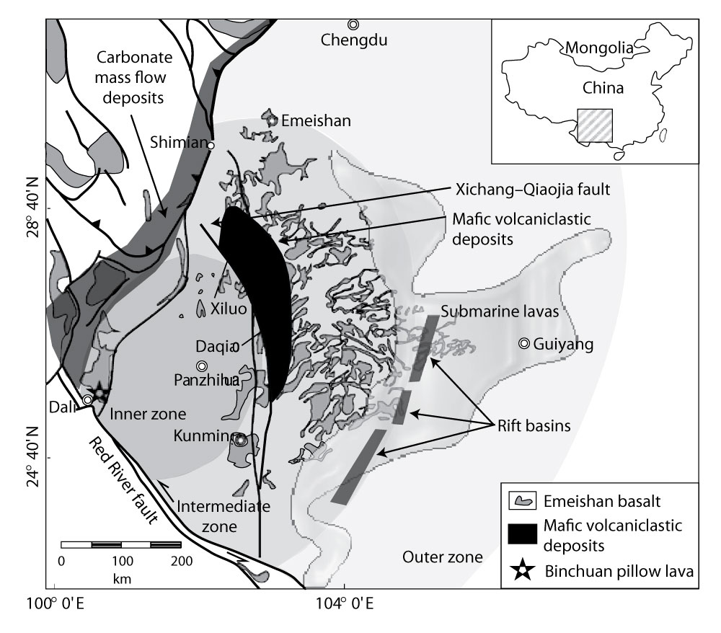
Emeishan basalts, China – 260 Ma

Slide 18


Slide 19
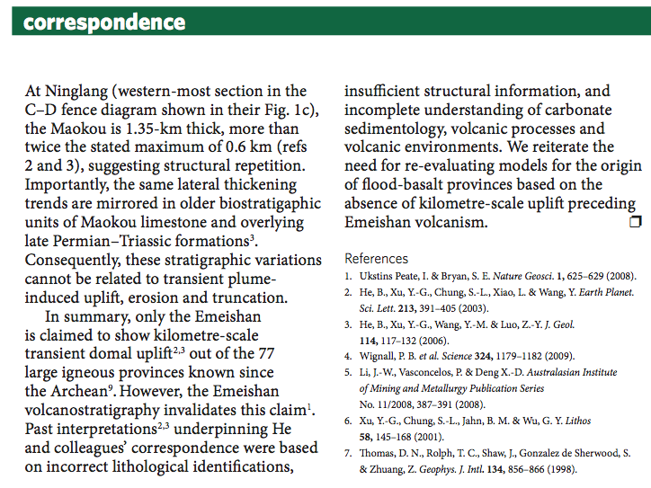
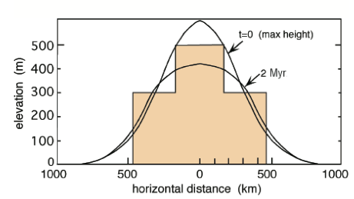
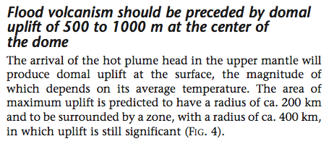
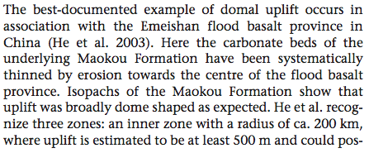
?
Ukstins-Peate & Bryan,
Nature Geoscience, 2009
Campbell,
Elements, 2005

Slide 20
Time-progressive volcanic chains

Slide 21
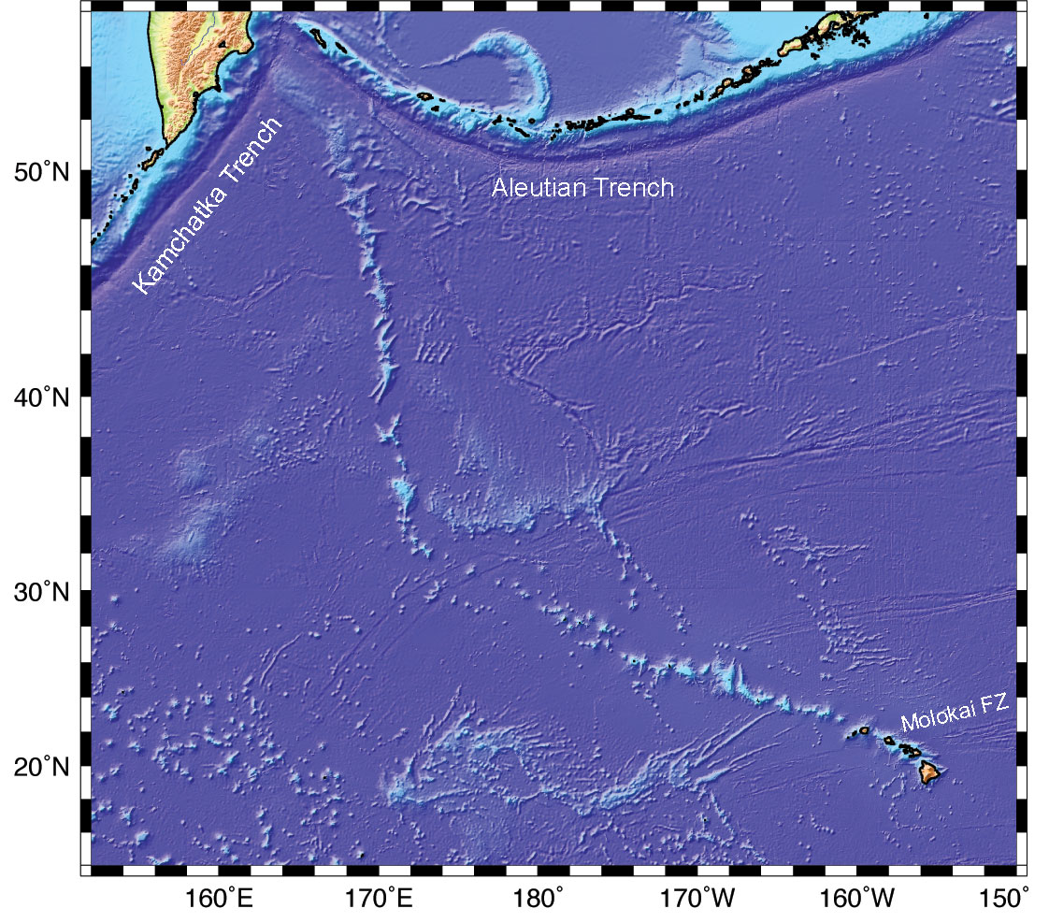
Hawaii
80 Ma
50 Ma
0 Ma

Slide 22
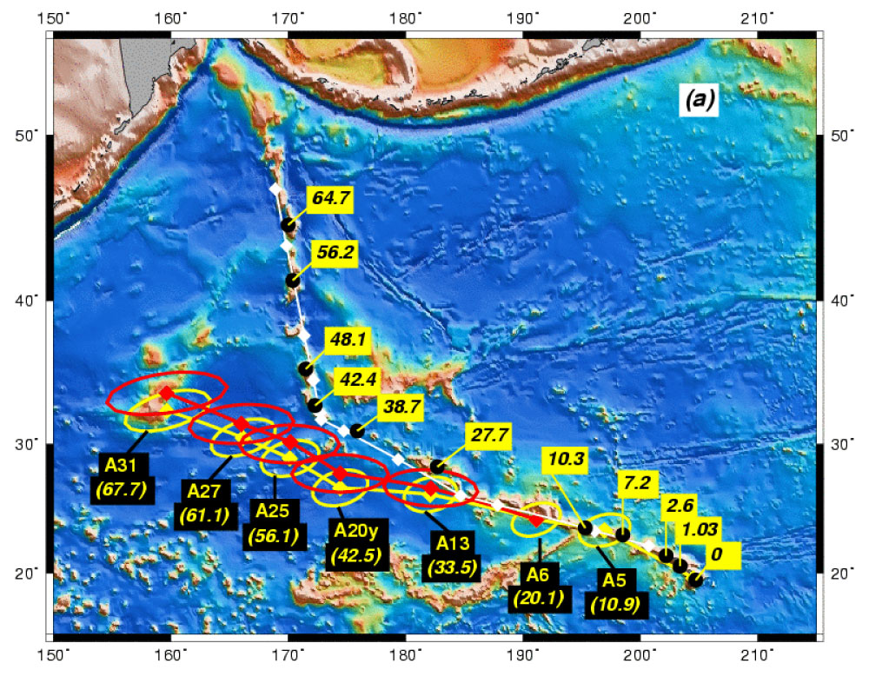

Slide 23
Seismology – looking for plume tails

Slide 24


Seismic imaging is a can of worms
Hmm… Is this a multi-headed plume?

Slide 25
Bruce map

Slide 26
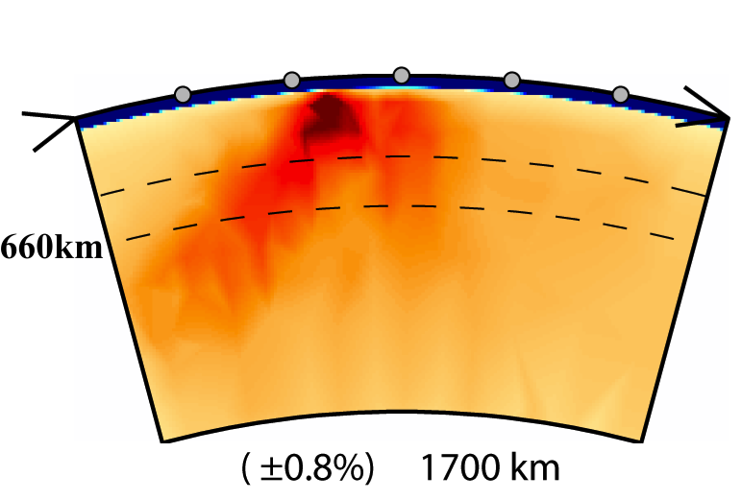
Hawaii: Tomography
NW SE
NW SE
Li et al. (2008)
Wolfe et al. (2009)

Slide 27
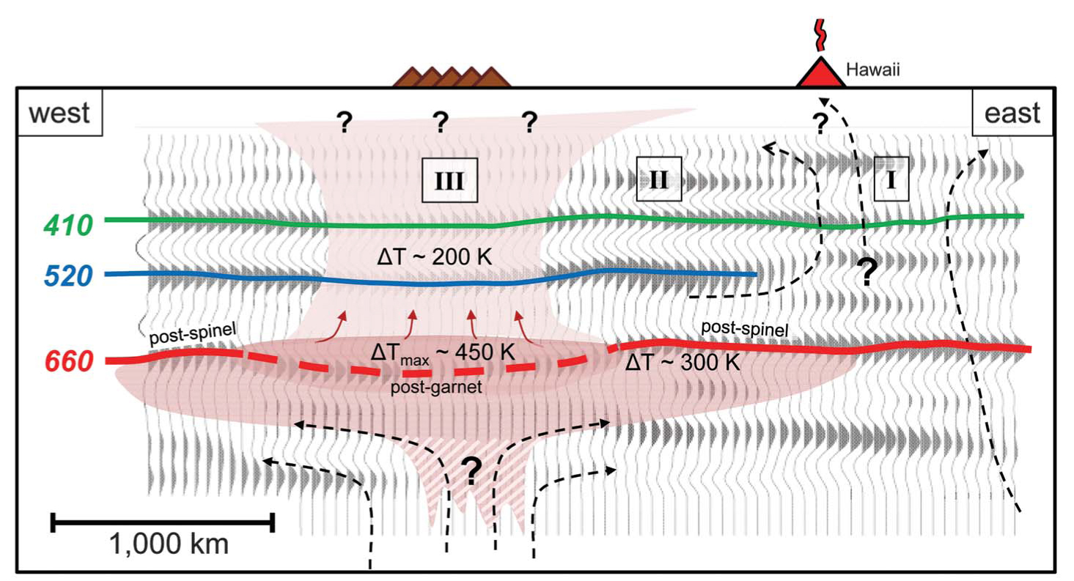
Hawaii: Receiver functions
2000 km
W
E
Cao et al. (2011)

Slide 29
No-one can agree on how many plumes there are, or where they are

Slide 30
Many “hot spot” lists

Slide 31
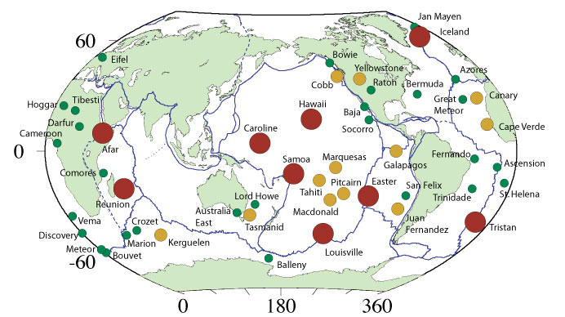
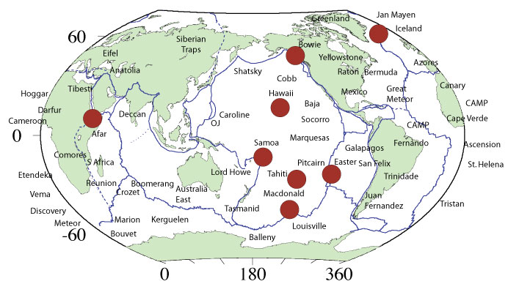
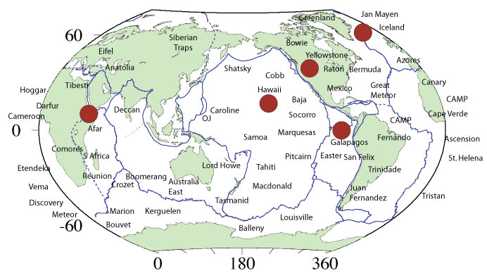
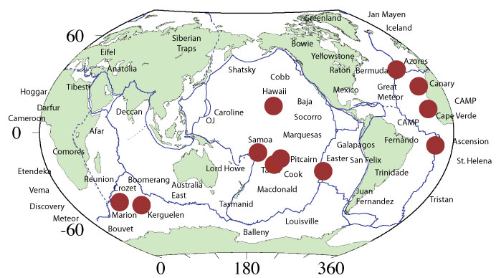
Courtillot et al. (2003)
Ritsema & Allen (2003)
Tholeiitic provinces
Montelli et al. (2006)

Slide 32
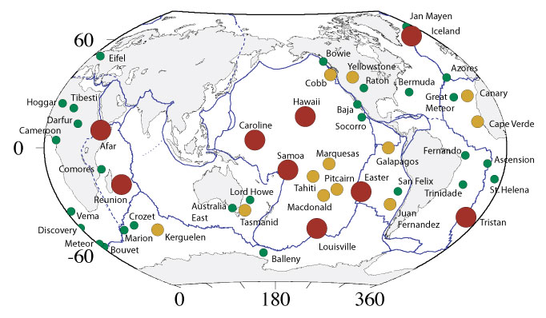
None fit all the predictions
Flood basalt & volcanic chain: only 3/49!

Slide 33
Endless plume variants
Lateral flow of plume material
Tabular plumes
Pulsing plumes
High ³He/⁴He plumes
Low ³He/⁴He plumes
Headless plumes
Tailless plumes

Slide 34
Comparison with geosynclines
Mio-geosyncline
Eu-geosyncline
Ortho-geosyncline
Primary geosyncline
Zeugo-geosyncline
Para-geosyncline
Exo-geosyncline
Taphro-geosyncline
Paralia-geosyncline
Notes:
Geosyncline is a term still occasionally used for a subsiding linear trough that was caused by the accumulation of sedimentary rock strata deposited in a basin and subsequently compressed, deformed, and uplifted into a mountain range, with attendant volcanism and plutonism.

Slide 35
This is not scientific

Slide 36
What about the Plate hypothesis?

Slide 37
The Plate hypothesis involves diverse processes

Slide 38
This immediately fits the observations

Slide 39
Examples

Slide 40
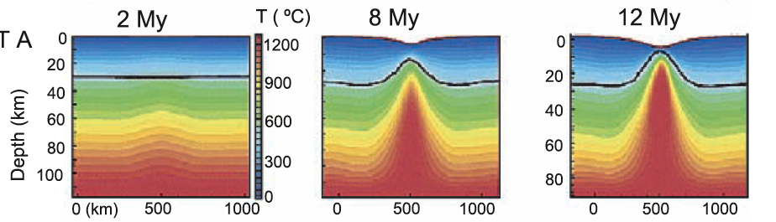
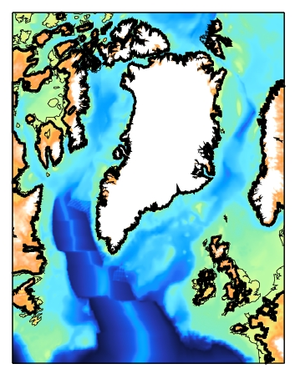
Continental breakup
Van Wijk et al. (2001); Jones (2005)

Slide 41
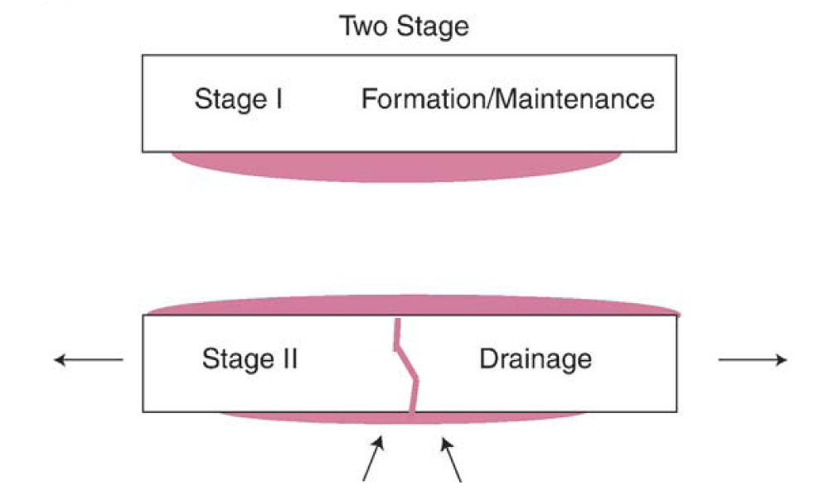
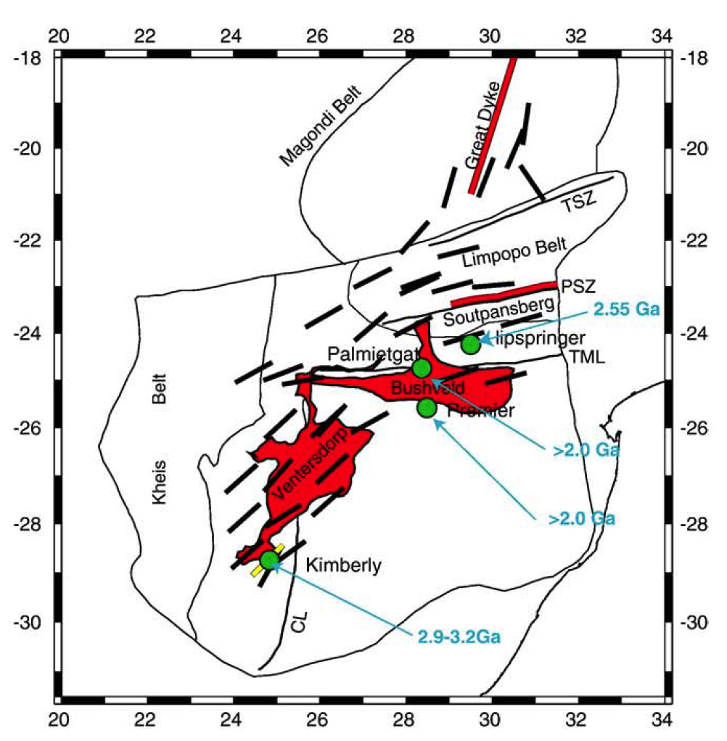
Melt ponding & draining is required
Southern Africa
Silver et al. (2006)

Slide 42
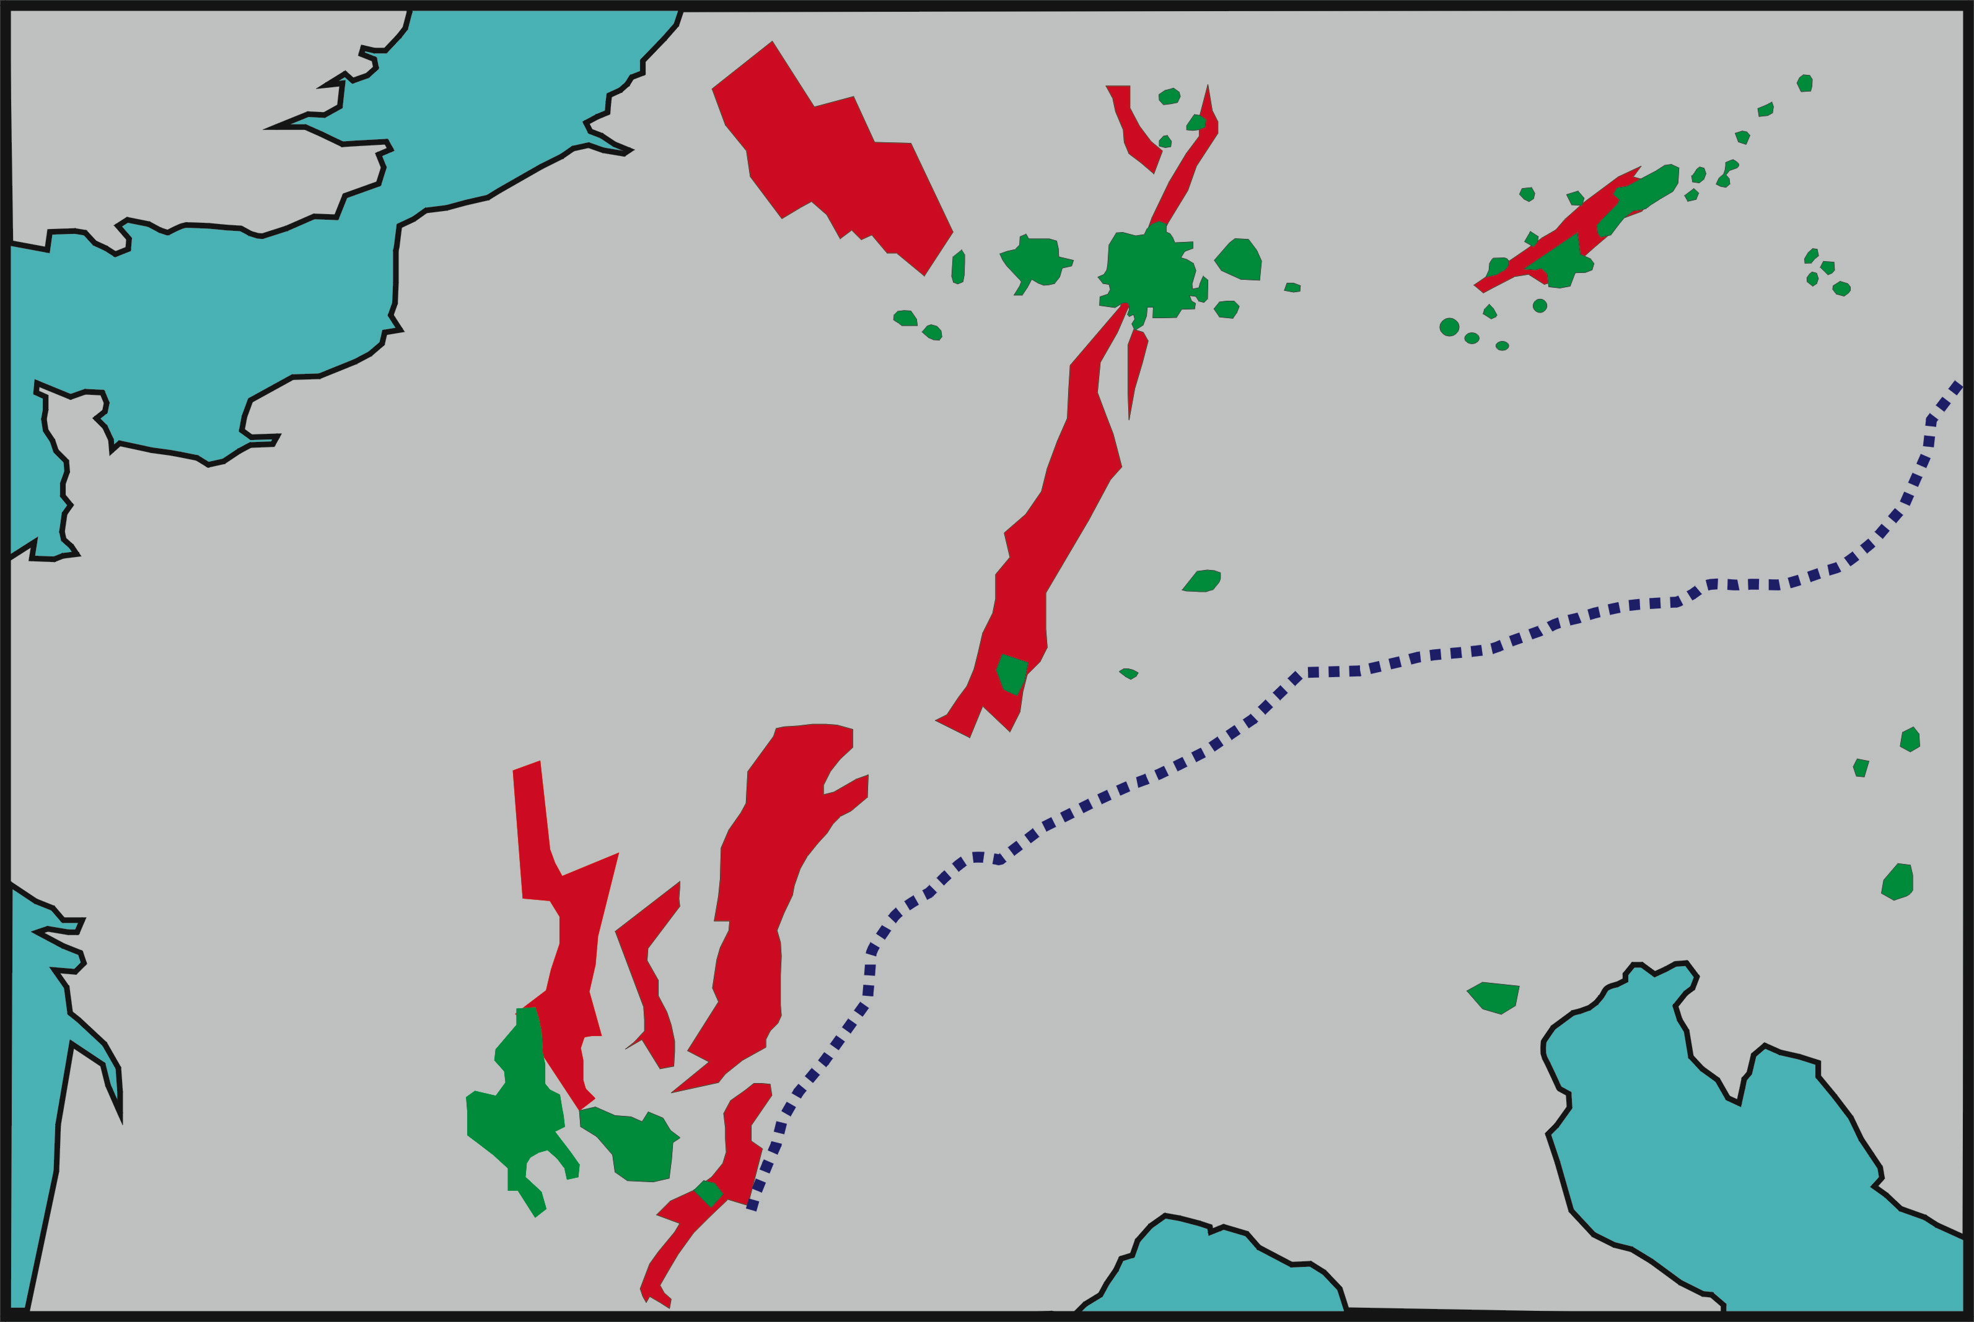
European Intraplate Volcanism
Tamar Graben?

Slide 44
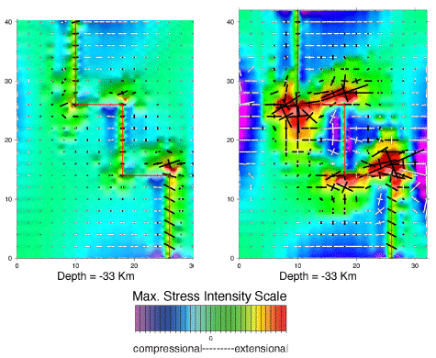
Extensional stress at plate boundary junctions
Beutel (2005)

Slide 45
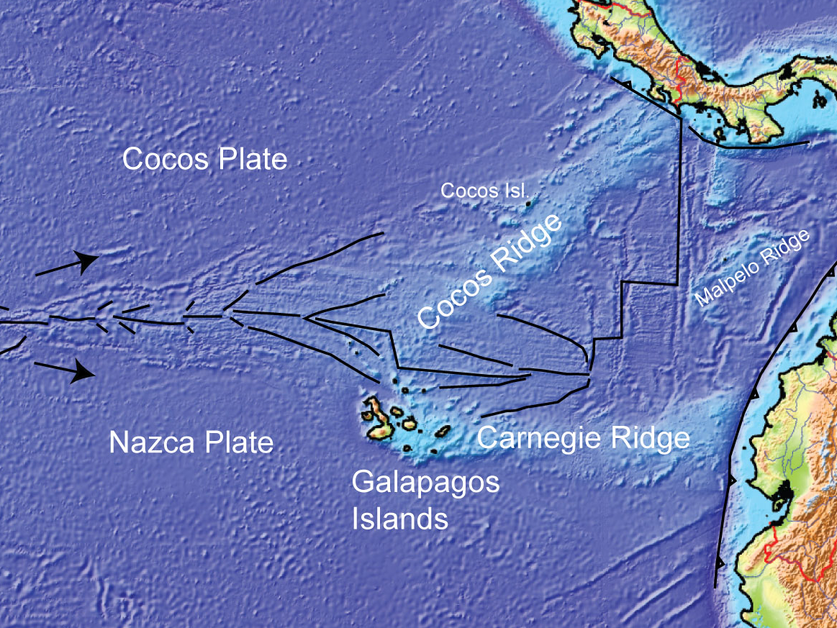

Slide 46
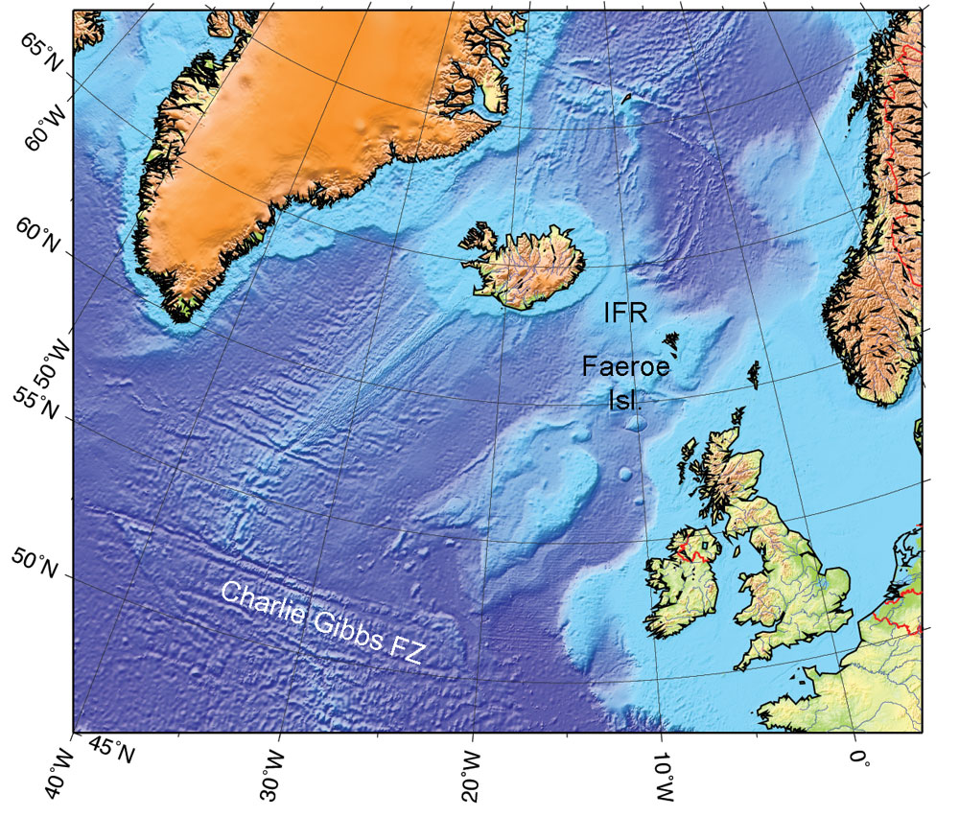

Slide 47
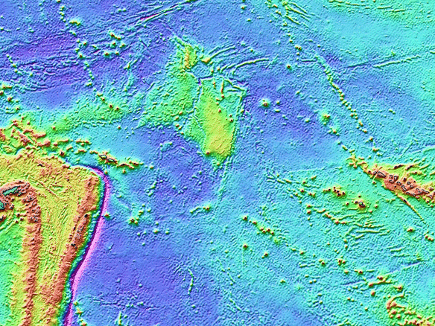
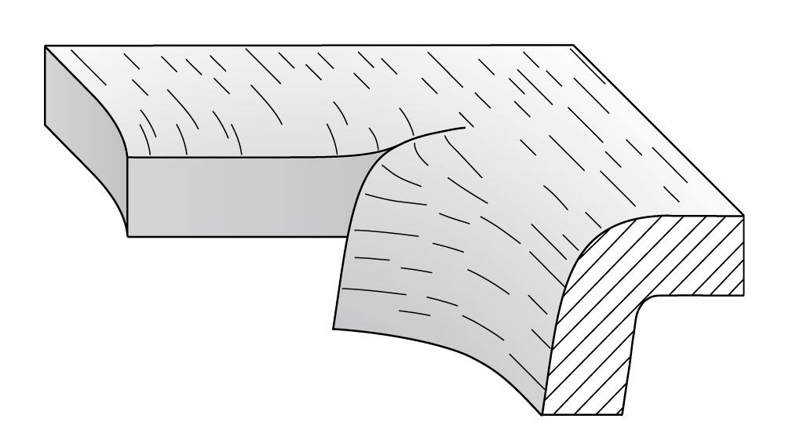
Slab tearing at Samoa
Samoa

Slide 49
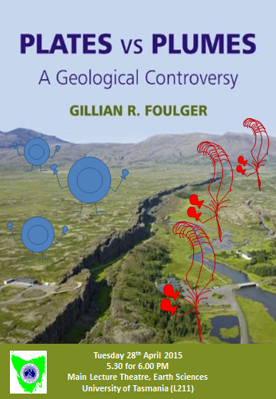
A comment on boxing matches…

Slide 50
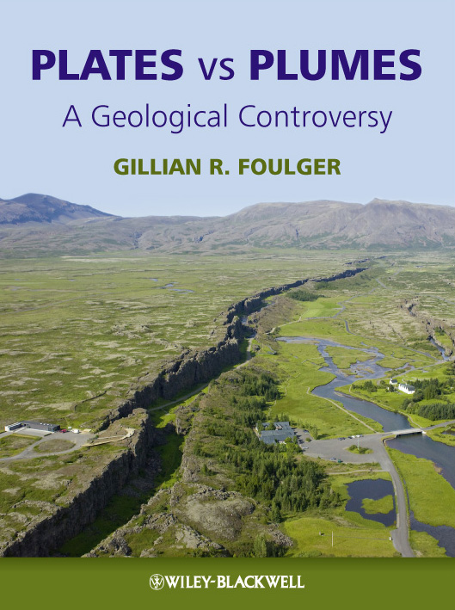
That’s all folks
Notes:
Mechanisms: Rifting decompression melting
Generic: Thermal/Sedimentary evidence
Localities: Hawaii/What the hell is Hawaii?
And if you think you might forget the URL, we are selling mantleplumes.org coffee mugs at cost price - £2.50

