Slide 1
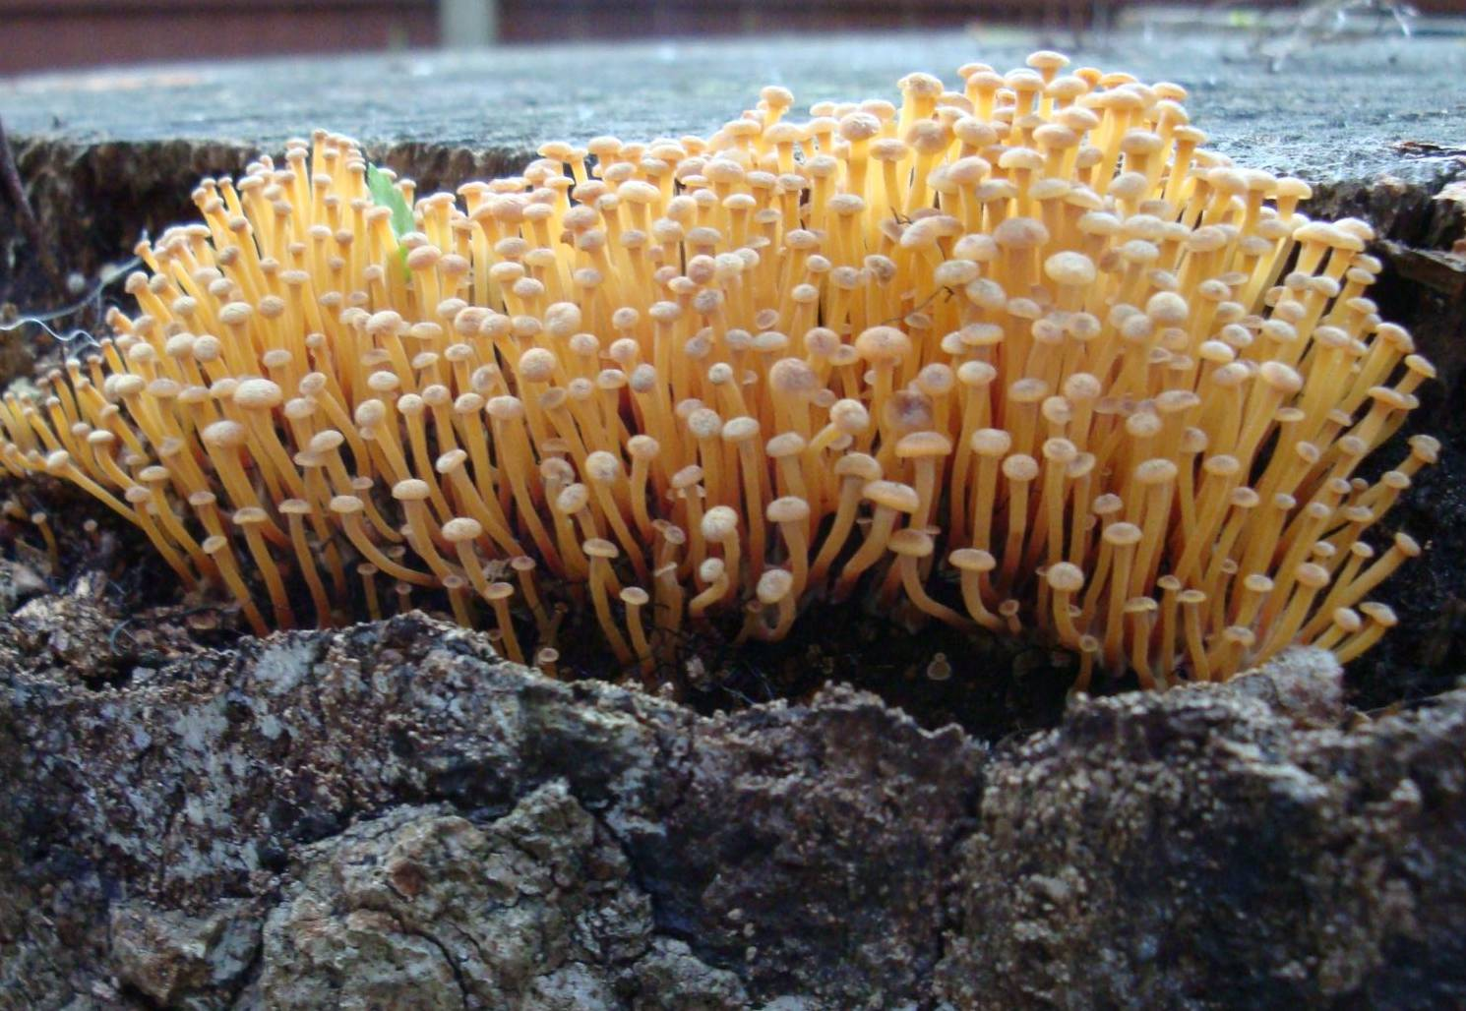


Unsuccessful mantle plume hunting within and around the Mediterranean
Michele Lustrino
Dipartimento di Scienze della Terra,
Università degli Studi di Roma La Sapienza
michele.lustrino@uniroma1.it
Durham,
February 28th 2013

Slide 2
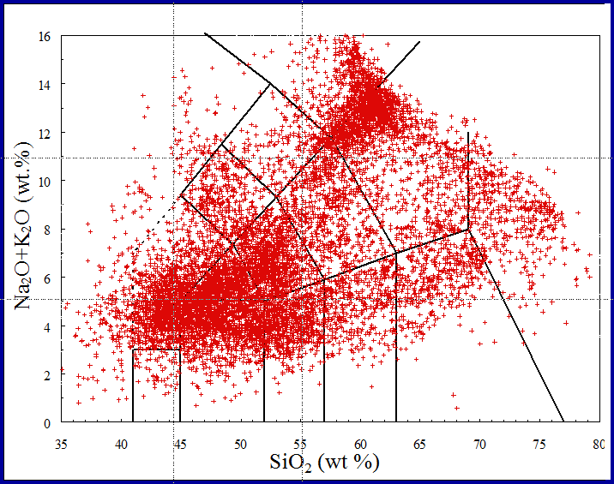
~16,000 whole-rock analyses
What?
Lustrino and Wilson, 2007 (Earth-Sci. Rev.)
Lustrino et al., 2011 (Earth-Sci. Rev.)

Slide 3
What?
In more detail:
What? Where?
“Orogenic” Rocks
“Anorogenic” Rocks

Slide 4
What?
What? Where?

Slide 5
~87 Ma
~84-79 Ma
Sodic alkaline volcanic and plutonic rocks
~73 Ma
~93 Ma
~79-64 Ma
~72 Ma
~72 Ma
Miranda et al. (2009) Cret. Res., 30, 575-586

Slide 6
Miranda et al. (2009) Cret. Res., 30, 575-586

Slide 7
Connection between Madeira Mantle Plume and Portugal Magmatic Province
Plate Movement
Geldmacher and Hoernle (2000) Earth Planet. Sci. Lett., 183, 73-92.

Slide 8
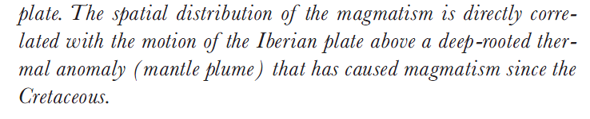
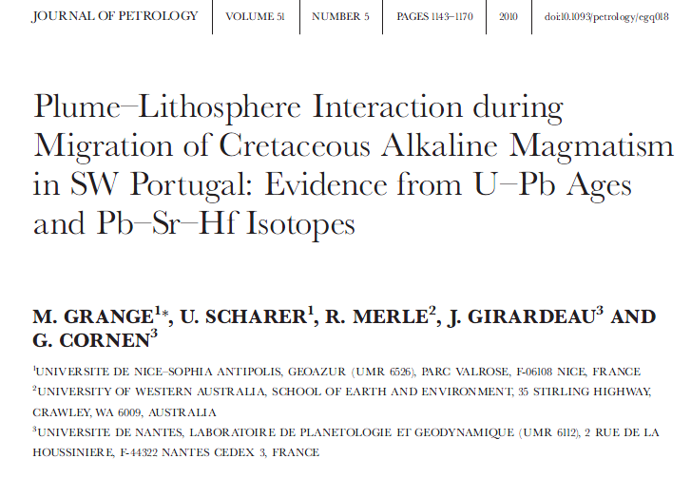
Connection between Madeira Mantle Plume and Portugal Magmatic Province
72
67
31
14
[…]
5
Geldmacher and Hoernle (2000) Earth Planet. Sci. Lett., 183, 73-92

Slide 9
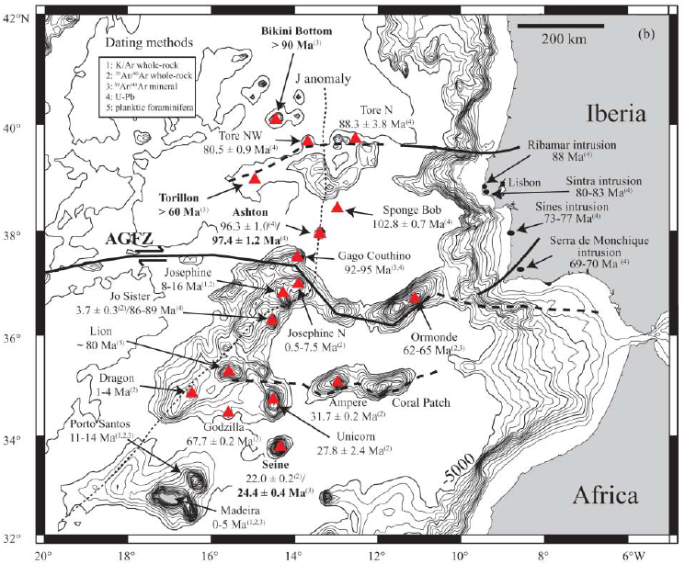
Connection between Madeira Mantle Plume and Portugal Magmatic Province
>90 Ma
~88 Ma
~80 Ma
88 Ma
No age track
83-80 Ma
>60 Ma
~103 Ma
77-73 Ma
~97 Ma
16-8 Ma
95-92 Ma
70-69 Ma
89-86; 4 Ma
~80 Ma
7.5-0.5 Ma
65-62 Ma
4-1 Ma
32 Ma
14-11 Ma
68 Ma
30-26 Ma
24-22 Ma
Merle et al. (2009) J. Geol. Soc. London, 166, 879-894
5-0 Ma

Slide 10
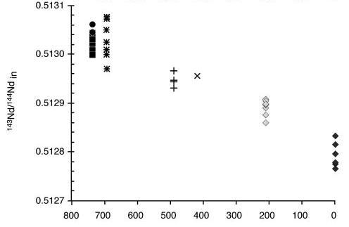
Connection between Madeira Mantle Plume and Portugal Magmatic Province
Increasing interaction of plume with continental lithosphere.
Depleted MORB Mantle Field
Hypothetycal Mantle Plume “signal”
¹⁴³Nd/¹⁴⁴Nd
Distance from the continent
Geldmacher and Hoernle (2000) Earth Planet. Sci. Lett., 183, 73-92.

Slide 11
Chanelled Plume model
Duggen et al. (2009) Geology, 37, 283-286

Slide 12
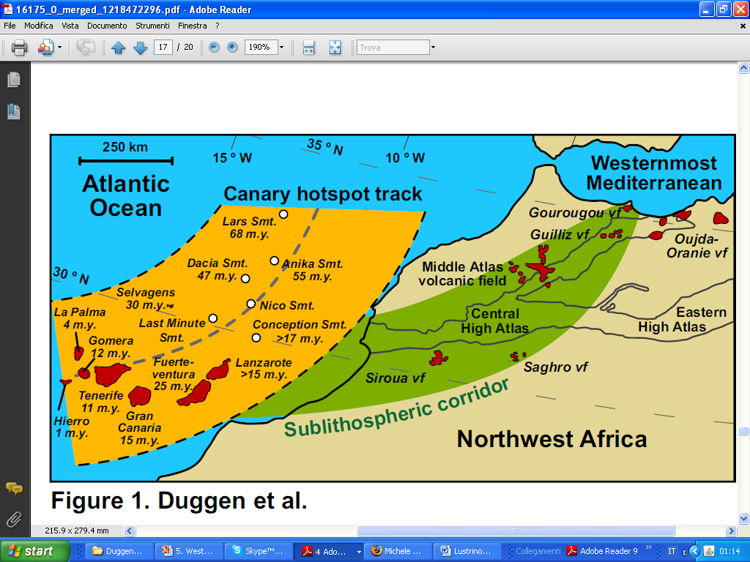
Chanelled Plume model
A single mantle source proposed on the basis of isotopic similarities among different volcanic rocks.
In this case about 1500 km separates Canaries from N Morocco lavas.
Duggen et al. (2009) Geology, 37, 283-286

Slide 13
Chanelled Plume model
A single mantle source proposed on the basis of isotopic similarities among different volcanic rocks.
In this case about 1500 km separates Canaries from N Morocco lavas.
Duggen et al. (2009) Geology, 37, 283-286

Slide 14
Chanelled Plume model
A single mantle source proposed on the basis of isotopic similarities among different volcanic rocks.
In this case about 1500 km separates Canaries from N Morocco lavas.
Duggen et al. (2009) Geology, 37, 283-286

Slide 15
50
40
Expected age trend
Age (Ma)
30
20
10
Increasing distance from Canaries
45-35 Ma
14-5 Ma
>50 Ma
2-0 Ma
6-1 Ma
50-32 Ma
12-2 Ma
9-1 Ma
Duggen et al. (2009) Geology, 37, 283-286

Slide 16
Cenozoic igneous activity in the French Massif Central (~65-0.004 Ma)
European Cenozoic Rift System
E C R i S

Slide 17
Much of the Cenozoic igneous activity of France is located on an uplifted area
Here Hercynian metamorphic and igneous rocks crop out
The lithospheric structure of the Hercynian basement is very complex

Slide 18
The Massif Central is divided by a major NNE-SSW trending Late Hercynian strike-slip fault system (Sillon Houlier).
Babuska et al. (2002) Tectonics, 21, 10.1029/2001TC901035
Notes:
SH = Sillon Houlier, Late Hercynian strike-slip fault).
This tectonic line divides the Hercynian Massif Central into two main parts. The western block is 100-140 km-thick. The eastern block is divided into two sectors. Sector II has the same thickness of Sector I, but sector III is much thinner (60-80 km) and has been weakened being the suture zone of the Hercynian Orogenesis.

Slide 19
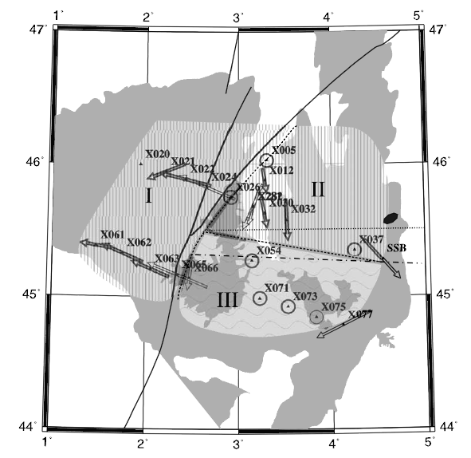
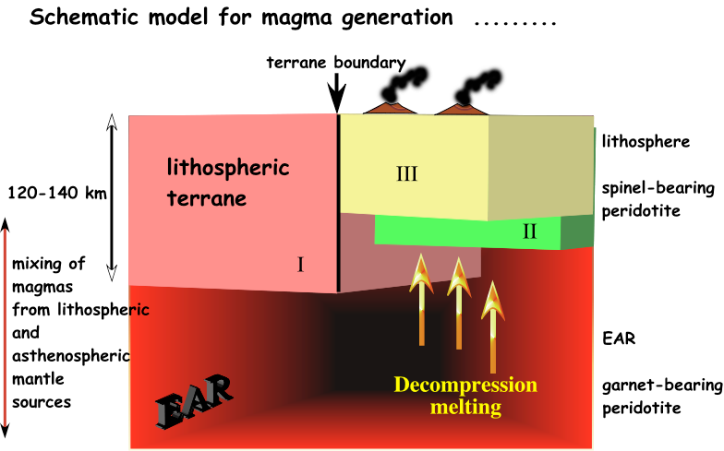
II
I
III
Babuska et al. (2002) Tectonics, 21, 10.1029/2001TC901035
M Wilson - Abstract of Penrose Plume IV Conference, Iceland, 2003 - mantleplumes.org

Slide 20
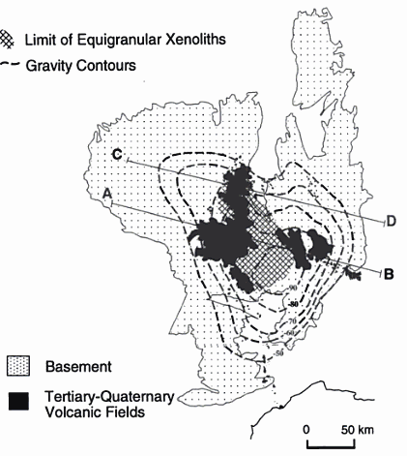
Why a mantle plume?
1) Petrography of mantle xenoliths (equigranular in the center of the Massif and increasingly sheared on the outer border).
Wilson and Patterson (2001) Geol. Soc. Am. Spec. Paper, 352, 37-58
Granet et al. (2005) Earth Planet. Sci. Lett., 136, 281-296

Slide 21
Why a mantle plume?
2) Seismic Tomography (e.g., see sections A-B and C-D in the next slide).
Wilson and Patterson (2001) Geol. Soc. Am. Spec. Paper, 352, 37-58
Granet et al. (2005) Earth Planet. Sci. Lett., 136, 281-296

Slide 22
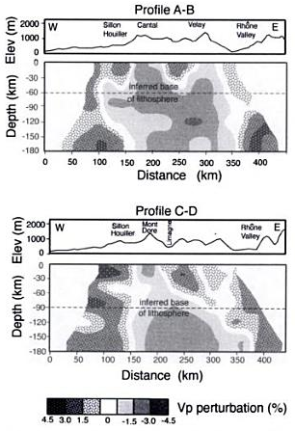
Why a mantle plume?

Slide 23
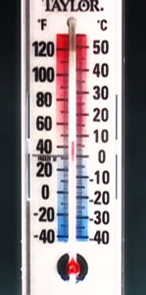
Why a mantle plume?
The presence of an hot spot (mantle with a Tp ~200 °C hotter than average mantle) has been proposed on the basis of a teleseismic tomographic study).
X
PLUME
X
NO PLUME

Slide 24
In this case the red columnar volume centered beneath the French Massif Central is strong down to 250 km but can be observed down to >1000 km.
This feature has been interpreted as an evidence of a deeply anchored mantle plume (thermal anomaly).
Why a mantle plume?
-2
-1
0
+1
+2
Piromallo and Morelli (2003) J. Geophys. Res., 108, doi:10.1029/2002JB001757
P velocity variation (%)

Slide 25
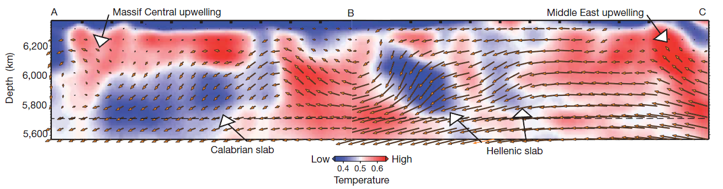
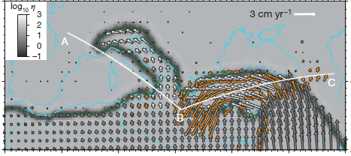
>400 km thick
Faccenna and Becker (2010) Nature, 465, 602-605
[…] assuming that velocity anomalies are simply related to temperature. (Faccenna and Becker, 2011)
But: […] Seismic velocities depend not only on temperature and pressure, but compositional variations may contribute significantly in the upper mantle (Giacomuzzi et al., 2012, EPSL, 335-336, 105-120)

Slide 26
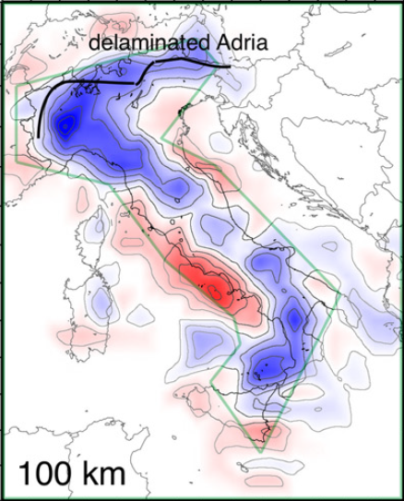
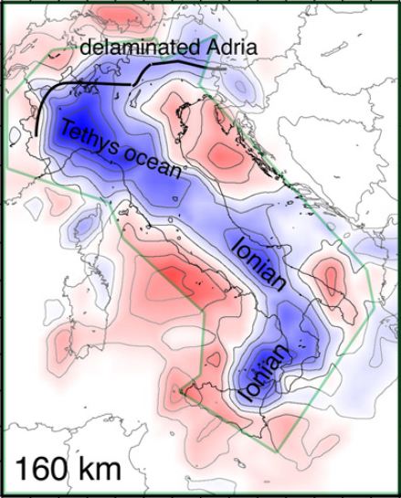
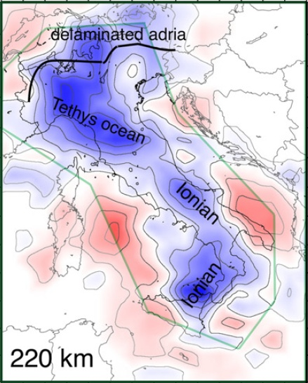
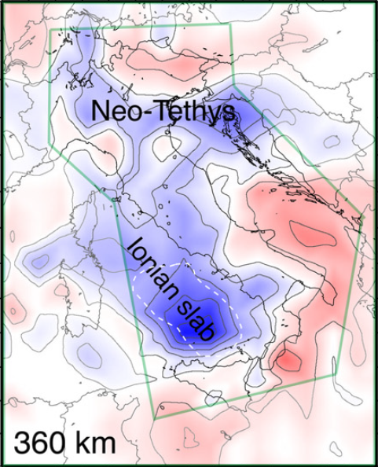
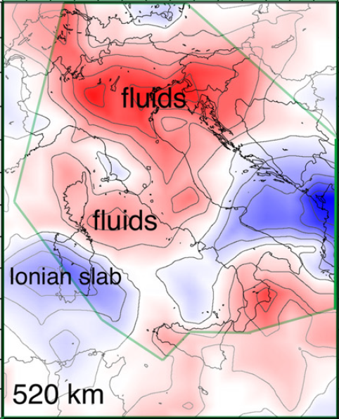
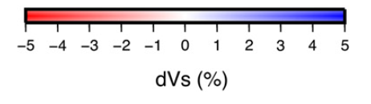
Red and Blue: more compositional rather than temperature constraints
Giacomuzzi et al., 2012, EPSL, 335-336, 105-120)

Slide 27
Why a mantle plume?
3) Cenozoic uplift on a large area more or less centered where the igneous activity is more abundant.
Ziegler and Dezes, 2007 (Glob. Planet. Change)

Slide 28
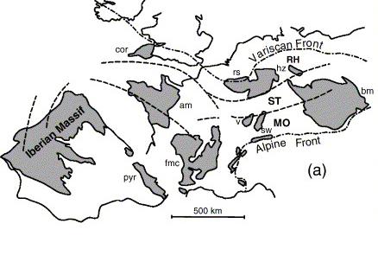
Hercynian (Variscan) Massifs
Why a mantle plume?
3) Cenozoic uplift on a large area more or less centered where the igneous activity is more abundant.
With Cenozoic “plume” activity
Without Cenozoic “plume” activity

Slide 29
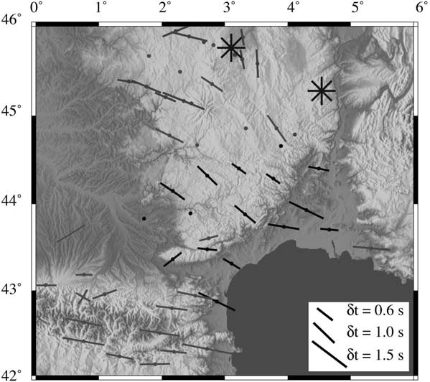
Why a mantle plume?
4) Seismic anisotropies.
Barruol and Granet (2002) Earth Planet. Sci. Lett., 202, 31-47

Slide 30
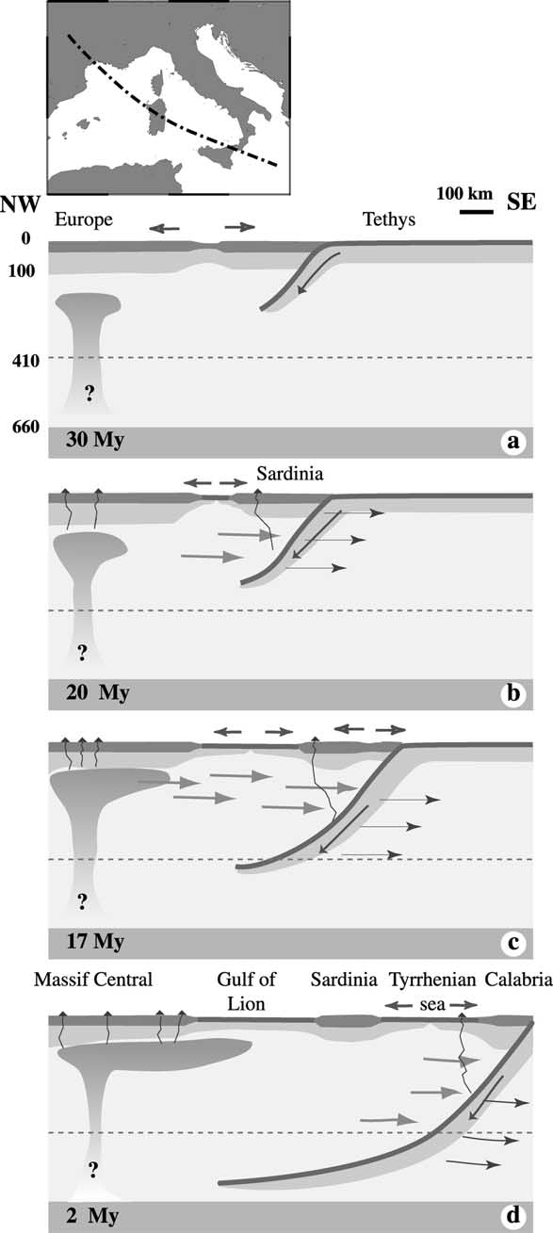
Why a mantle plume?
?
Very deep bathymetry
4) Seismic anisotropies.
?
Barruol and Granet (2002) Earth Planet. Sci. Lett., 202, 31-47

Slide 31
Why a mantle plume?
5) Geochemical similarities among different Cenozoic anorogenic igneous rocks emplaced in the Alpine foreland.
Typical bell-shaped pattern peaking at Nb-Ta and with high HFSE-LILE ratios

Slide 32
Up to 0.712!
Why a mantle plume?
5) Geochemical similarities among different Cenozoic anorogenic igneous rocks emplaced in the Alpine foreland.
Large isotopic variation: mixing of partial melts of asthenospheric (EAR-like) with enriched lithospheric mantle sources, combined with both upper and lower crustal contamination.

Slide 33
How to explain the igneous activity and the development of continental rifting in the Alpine foreland:
A sort of “Splash Plume”
North
South
North
South
L. Michon (2000) PhD Thesis

Slide 34

North
South
North
South
L. Michon (2000) PhD Thesis

Slide 35
Igneous activity from Early Eocene (~45 Ma) to Holocene (~0.01 Ma).
Upper Palatinate
29-19

Slide 36
P wave velocity anomalies (Ref. model AK135)
The scale varies for each panel, such that X = 2% in (A), 1% in (B), and 0.5% in (C) and (D).
Goes et al. (1999) Science, 286, 1928-1931

Slide 37
Goes et al. (1999) Science, 286, 1928-1931

Slide 38
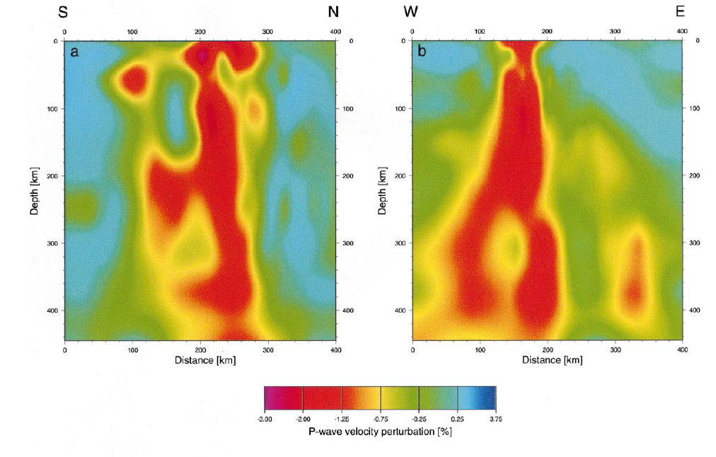
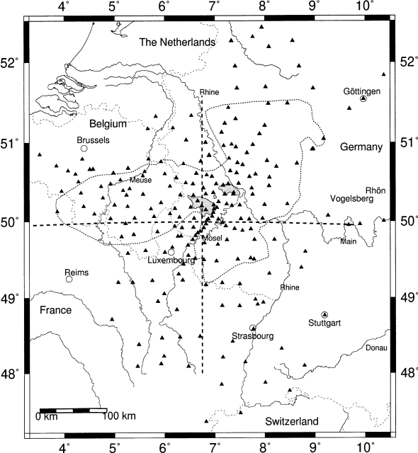
0
0
100
100
200
200
300
300
400
400
-2
-0.75
+0.25
-3
-1.25
-0.25
+3.75
Ritter et al. (2001) EPSL, 186, 7-14

Slide 39
Interestingly, another tomographic study did not evidence the presence of any deep anomaly beneath the Eifel area.
Piromallo and Morelli (2003) J. Geophys. Res., 108, doi:10.1029/2002JB001757
-2
-1
0
+1
+2
P velocity variation (%)

Slide 40
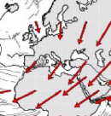
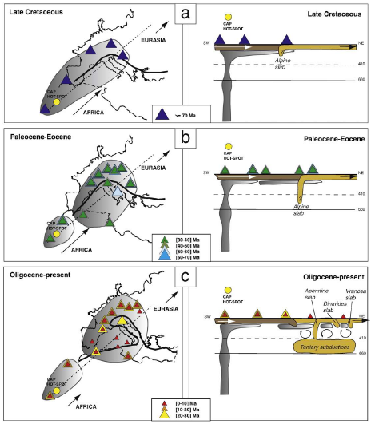
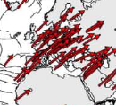
An age-progressive hot spot track (60-0.01 Ma) is lacking.
Late Cretaceous
Paleogene
Crespi et al., 2007 (Geophys. J. Int.)
Oligocene-Present
Dietmar Muller et al., 2008, (Geochem. Geophys. Geosyst.)
Altamimi et al., 2007 (J. Geophys. Res.)
Piromallo et al., 2008 (EPSL)

Slide 41
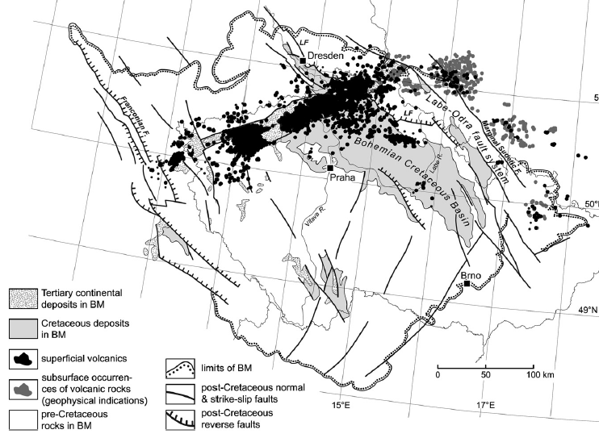
1. Pre-rift (Late Cretaceous to Mid Eocene, 79–49 Ma)
2. Syn-rift (Mid Eocene to Mid Miocene, 42–16 Ma)
3. Late-rift (16–0.26 Ma)
Ohře Rift Graben
Saxothuringian
Moldanubian
Ulrych et al., 2011 (Lithos), 123, 133-144

Slide 42
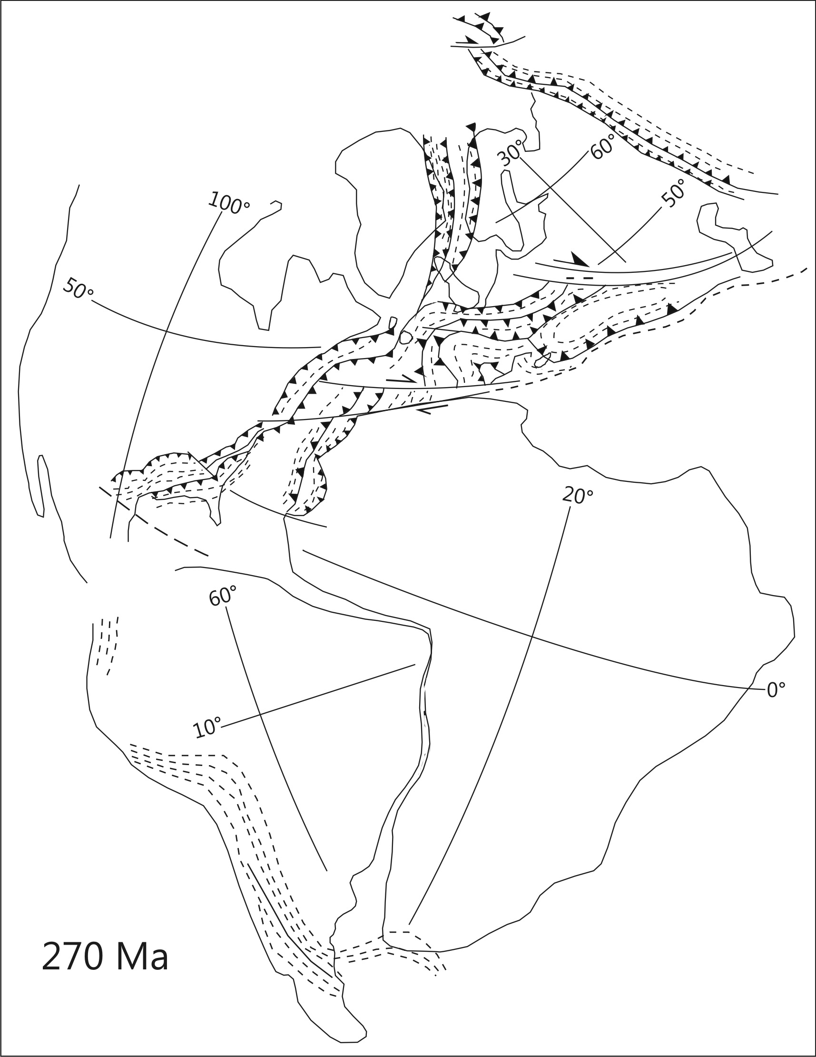
Ohře Rift Graben
Saxothuringian
Moldanubian

Slide 43
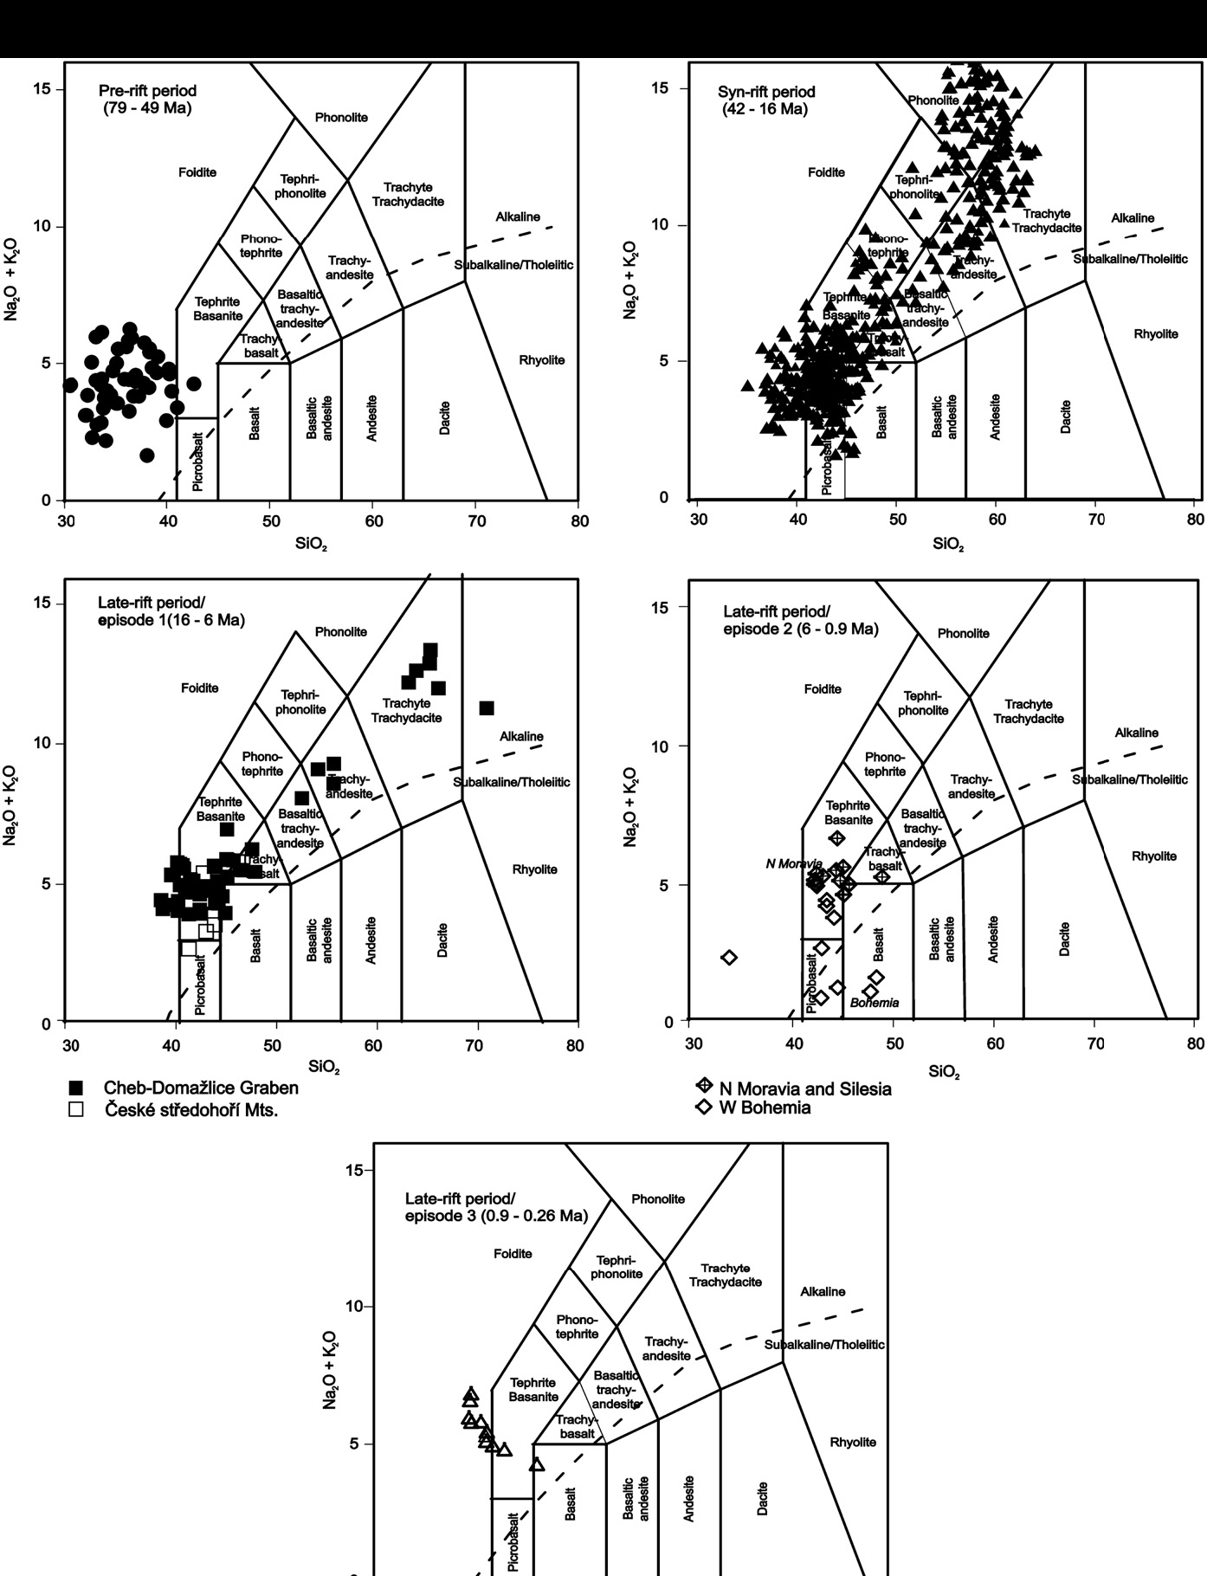
Pre-Rift
(79-49 Ma)
Syn-Rift
(42-16 Ma)
Late-Rift
(16-6 Ma)
Late-Rift
(6-0.9 Ma)
About 97% of the Ohre Rift volcanic rocks have been emplaced during the Syn-Rift Stage
Late-Rift
(0.9-0.28 Ma)
Ulrych et al., 2011 (Lithos), 123, 133-144

Slide 44
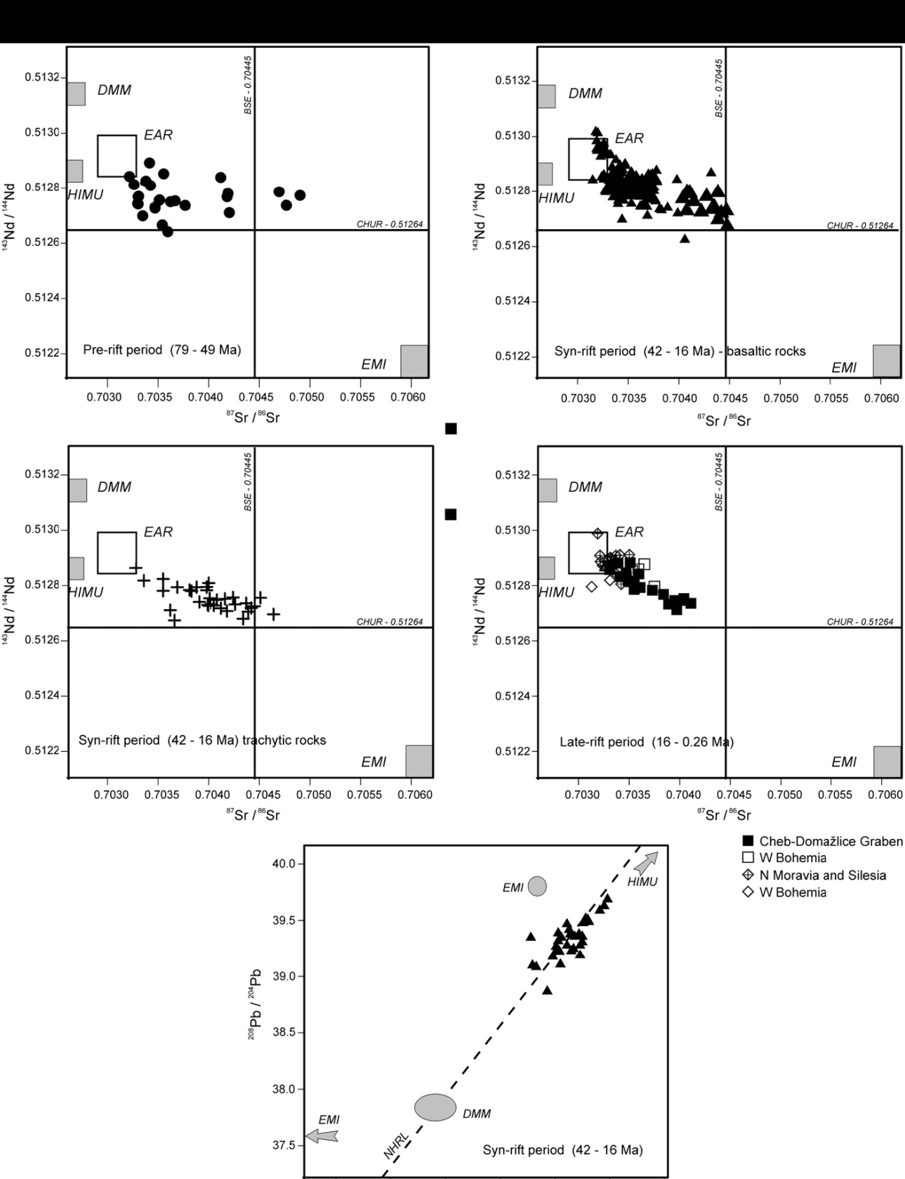
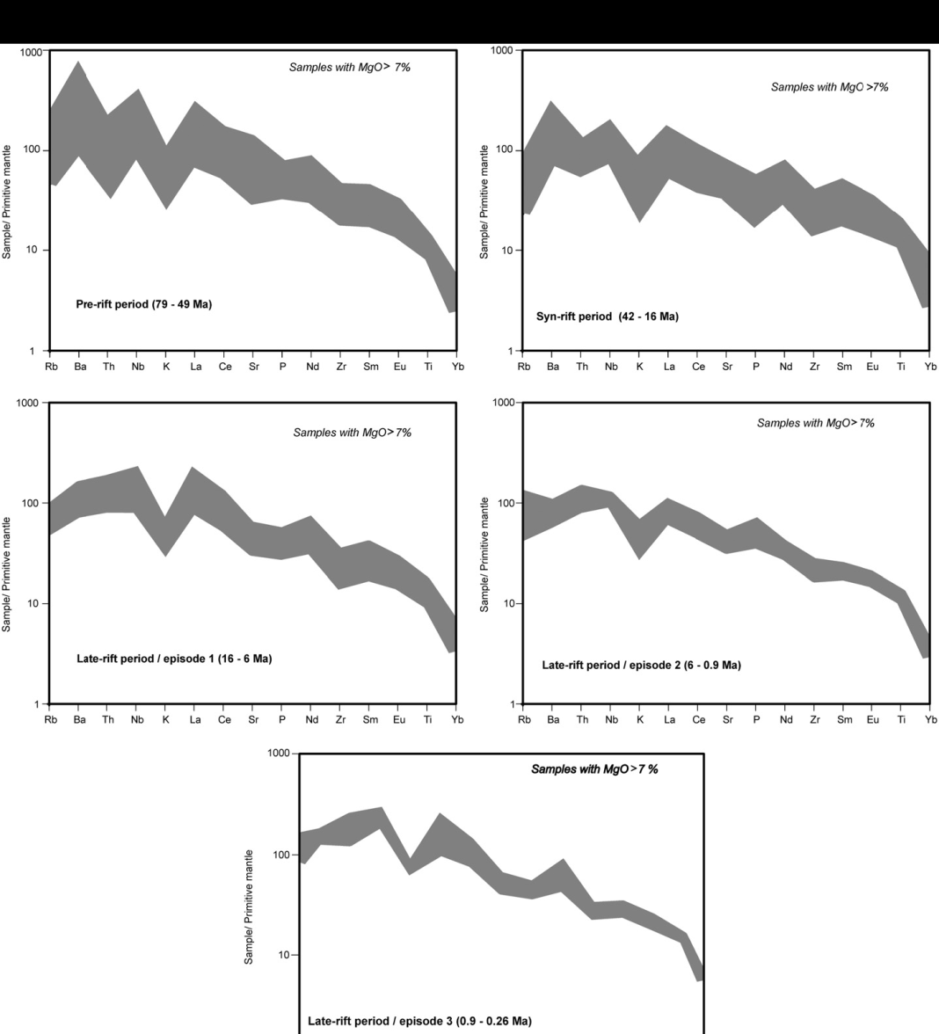
Pre-Rift
(79-49 Ma)
Syn-Rift (42-16 Ma) basaltic rocks
Pre-Rift
(79-49 Ma)
Syn-Rift
(42-16 Ma)
Syn-Rift (42-16 Ma) trachytic rocks
Late-Rift
(16-6 Ma)
Late-Rift (16-6 Ma)
Ulrych et al., 2011 (Lithos), 123, 133-144
Syn-Rift
(42-16 Ma)
Late-Rift
(0.9-0.26 Ma)

Slide 45
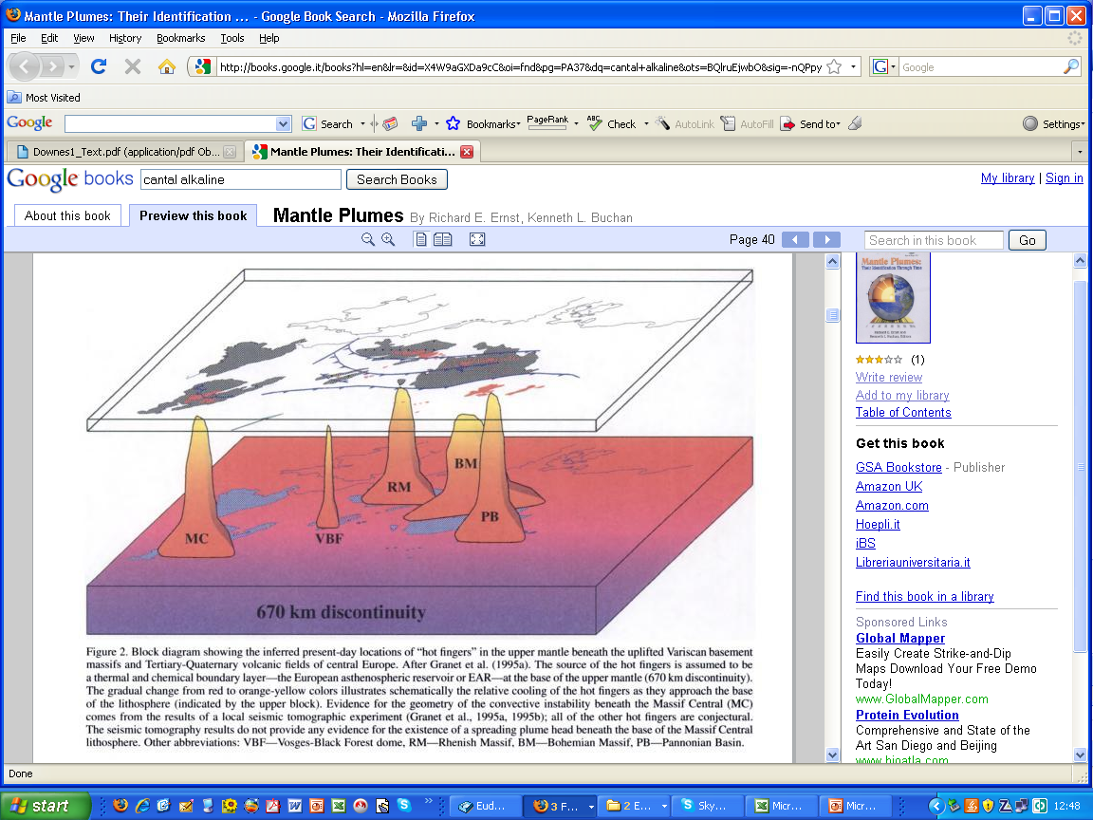
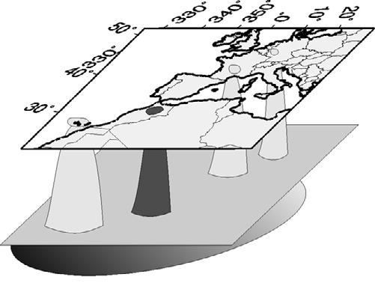
In general Central Europe is considered the place where small mantle plumes reach the surface
Eifel
Canaries
Massif Central
Wilson and Patterson (2001) Geol. Soc. Am. Spec. Paper, 352, 37-58
Atlas
Zeyen et al. (2005) Tectonics, 24, TC2001, doi:10.1029/2004TC001639
Four different Mantle Plumes

Slide 46
A far far away origin for the western-central Europe mantle plumes...
Oyarzun et al. (1997) Geology, 25, 727-730

Slide 47
A far far away origin for the western-central Europe mantle plumes...
Canary Is. (~70-0 Ma)
Massif Central (~62-0 Ma)
Bohemian Massif (~80-0 Ma)
Cape Verde Is. (~20-7 Ma)
Calatrava (~9-1 Ma)
Oyarzun et al. (1997) Geology, 25, 727-730

Slide 48
A far far away origin for the western-central Europe mantle plumes...
No age-track!
Plume Channeling
Piromallo et al. (2008) EPSL, 268, 15-27
Oyarzun et al. (1997) Geology, 25, 727-730

Slide 49
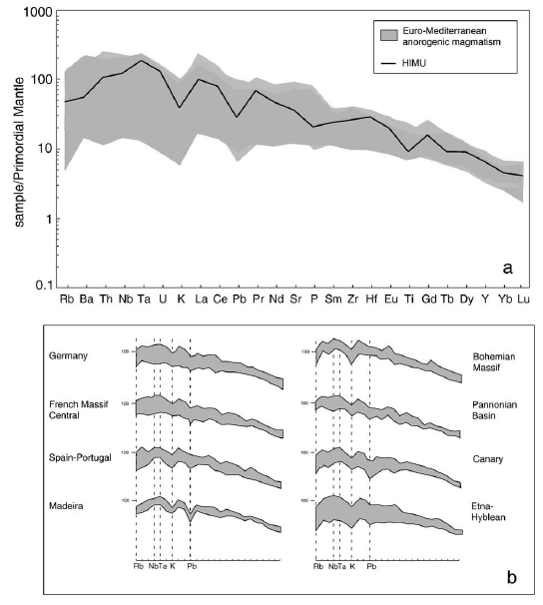
Euro-Mediterranean anorogenic magmatism
Average HIMU-OIB
Incompatible trace element “similarity”
Why a Mantle plume? → Common mantle source, inferred on the basis of “geochemical similarities” of the igneous rocks from different districts.
Piromallo et al. (2008) Earth Planet. Sci. Lett., 268, 15-27
Bohemian M.
Germany
France
Pannonian Bas.
Iberia
Canaries
Madeira
Etna- Hybean Mts.

Slide 50
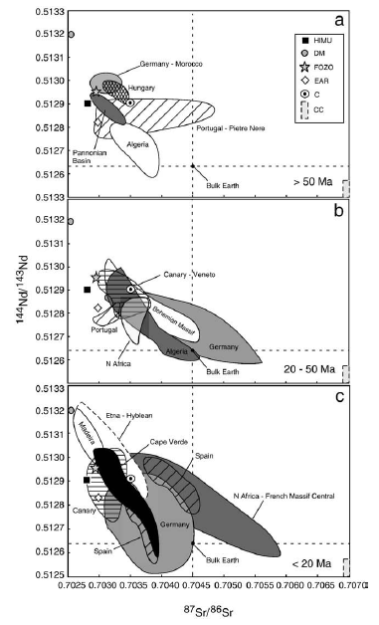
Sr-Nd isotopic “similarity”
Also Sr-Nd isotope similarity has been interpreted as derivation from a similar physical mantle source.
¹⁴³Nd/¹⁴⁴Nd
Piromallo et al. (2008) EPSL, 268, 15-27.
I.e., geochemical concepts have been translated into physical volumes.
⁸⁷Sr/⁸⁶Sr

Slide 51
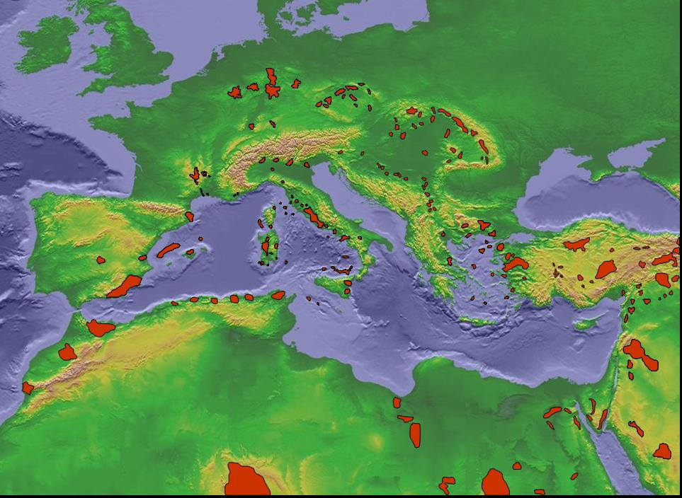
1000
Area covered:
More than 3000 km-long
Canary Islands
Bohemian Massif
Pannonian Basin
France
Germany
Spain
100
Sample/Primitive Mantle
10
1
Rb
Th
Nb
K
Ce
Pr
P
Sm
Hf
Ti
Tb
Y
Er
Yb
Cs
Ba
U
Ta
La
Pb
Sr
Nd
Zr
Eu
Gd
Dy
Ho
Tm
Lu

Slide 52
1000
St. Helena basalts: Typical HIMU-OIBs
France
Germany
Spain
100
St. Helena
Sample/Primitive Mantle
Ba/Nb
10
1
Rb
Th
Nb
K
Ce
Pr
P
Sm
Hf
Ti
Tb
Y
Er
Yb
Cs
Ba
U
Ta
La
Pb
Sr
Nd
Zr
Eu
Gd
Dy
Ho
Tm
Lu

Slide 53
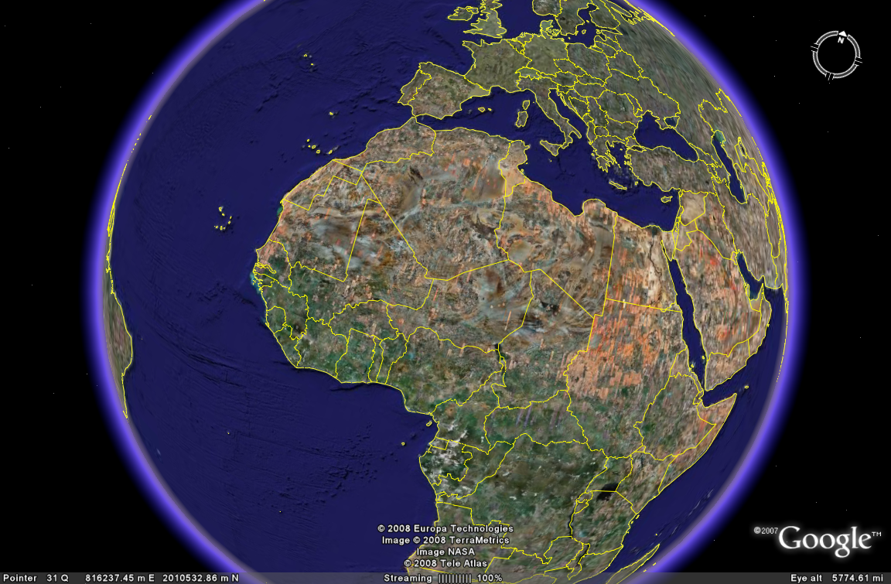
A single mantle plume for St. Helena and Germany or Bohemian massif basalts?
Bohemian Massif
St. Helena Island

Slide 54
Mantle Plumes also in subduction-related settings…
Gasperini et al. (2002) J. Geophys. Res., 107, B12, 2367, doi:10.1029/2001JB000418

Slide 55
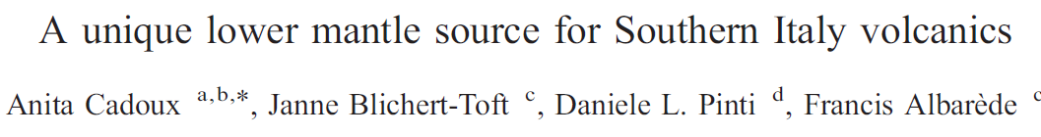

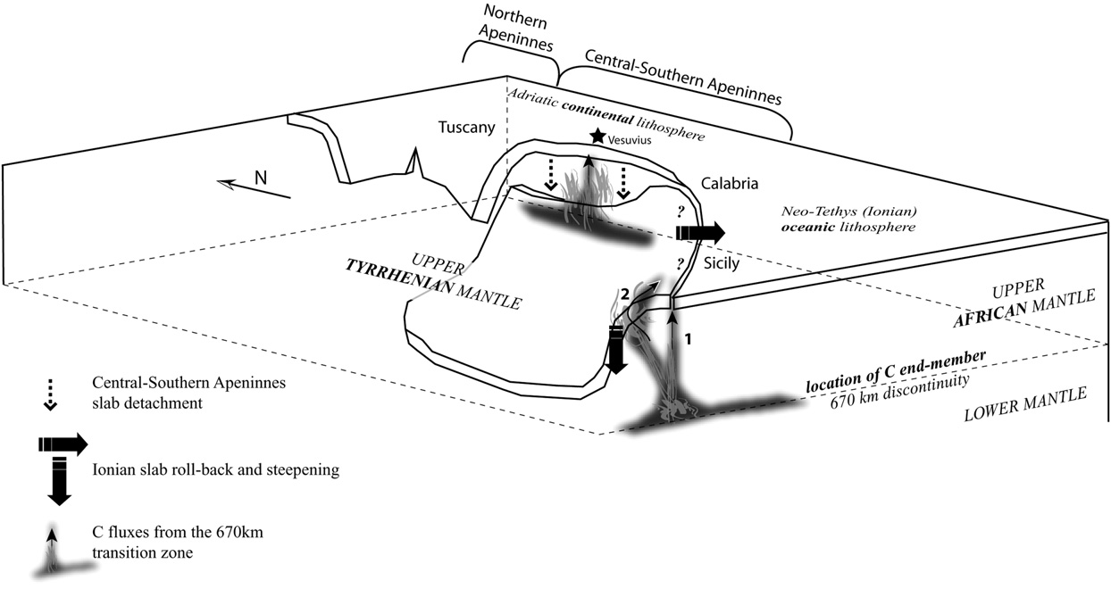
Cadoux et al. (2007) Earth Planet. Sci. Lett., 259, 227-238

Slide 56
A Mantle Plume also beneath Italy
Alpine Corsica W-directed tectonic transport
Alps back-thrusts
Central Europe
Graben System
Alpine Belt
100
Trace of the Alpine Tethys subduction (pre-Eocene)
410
670
km
30 Ma
500 km
Lavecchia and Creati (2006) Ann. Geophys., 49, 373-387

Slide 57
A Mantle Plume also beneath Italy
Ligurian-Provençal
Basin
Sardinia
France
100
Eastward pushing Mantle Plume
410
670
16 Ma
km
Lavecchia and Creati (2006) Ann. Geophys., 49, 373-387
500 km

Slide 58
A Mantle Plume also beneath Italy
Next slide
Ligurian-Provençal
Basin
Tyrrhenian
France
Sardinia
Calabria
Present
Lavecchia and Creati (2006) Ann. Geophys., 49, 373-387
500 km

Slide 59
A Mantle Plume also beneath Italy
Ligurian-Provençal
Basin
Tyrrhenian
France
Sardinia
Calabria
Chiarabba et al. (2008) Earth Planet. Sci. Lett.268, 408-423
Present
500 km

Slide 60
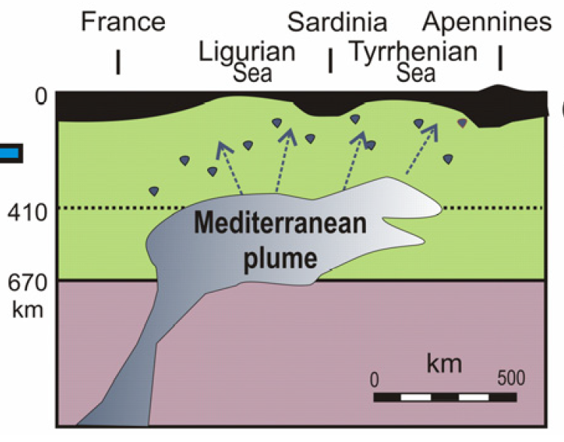
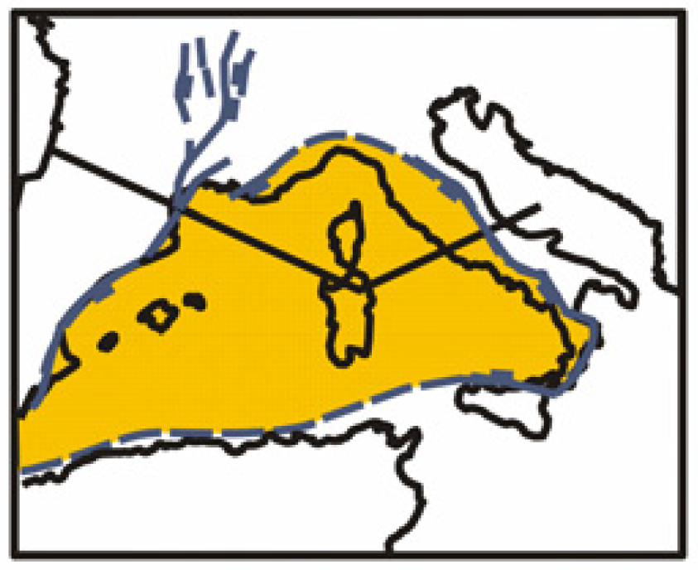
A Mantle Plume also beneath Italy
?
?
?
Ligurian-Provençal
Basin
Tyrrhenian
Bell et al. (2012) J. South Am. Earth Sci., in press
France
Sardinia
Calabria
Present day
IMPORTANT: No traces of fossil or active subduction.
Present
500 km

Slide 61
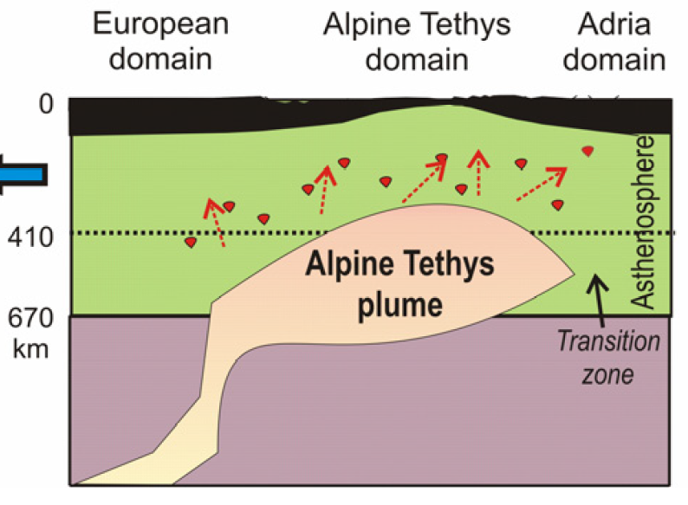
A Mantle Plume also beneath Italy
Bell et al. (2012) J. South Am. Earth Sci., in press
Present day
A mantle plume also in Late Jurassic!
Late Jurassic

Slide 62
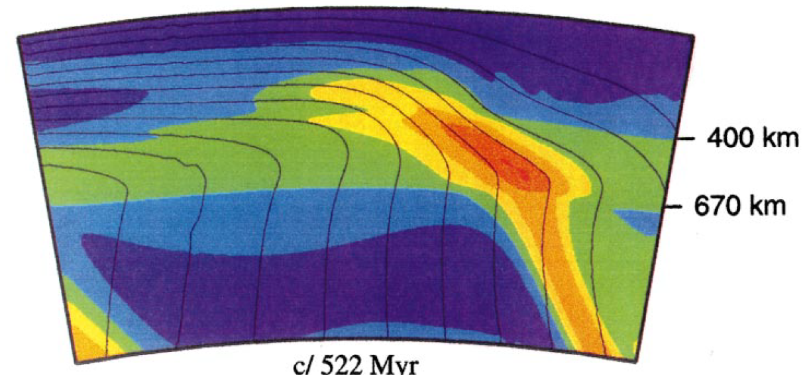
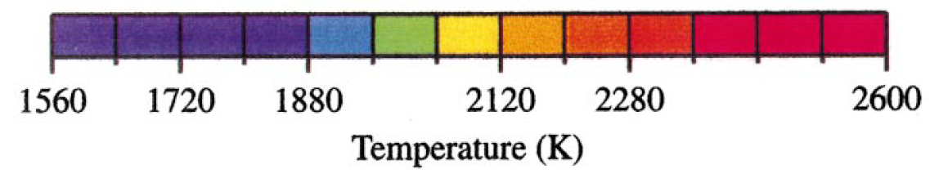
A Mantle Plume also beneath Italy
~1850 °C
Bell et al. (2012) J. South Am. Earth Sci., in press
Present day
410 km
660 km
From: Brunet and Yuen (2000) Earth Planet. Sci. Lett., 178, 13-27

Slide 63
A Mantle Plume also beneath Italy
Ligurian-Provençal
Basin
Tyrrhenian
Bell et al. (2012) J. South Am. Earth Sci., in press
France
Sardinia
Calabria
Present day
Constraints for a mantle plume?
Present
500 km

Slide 64
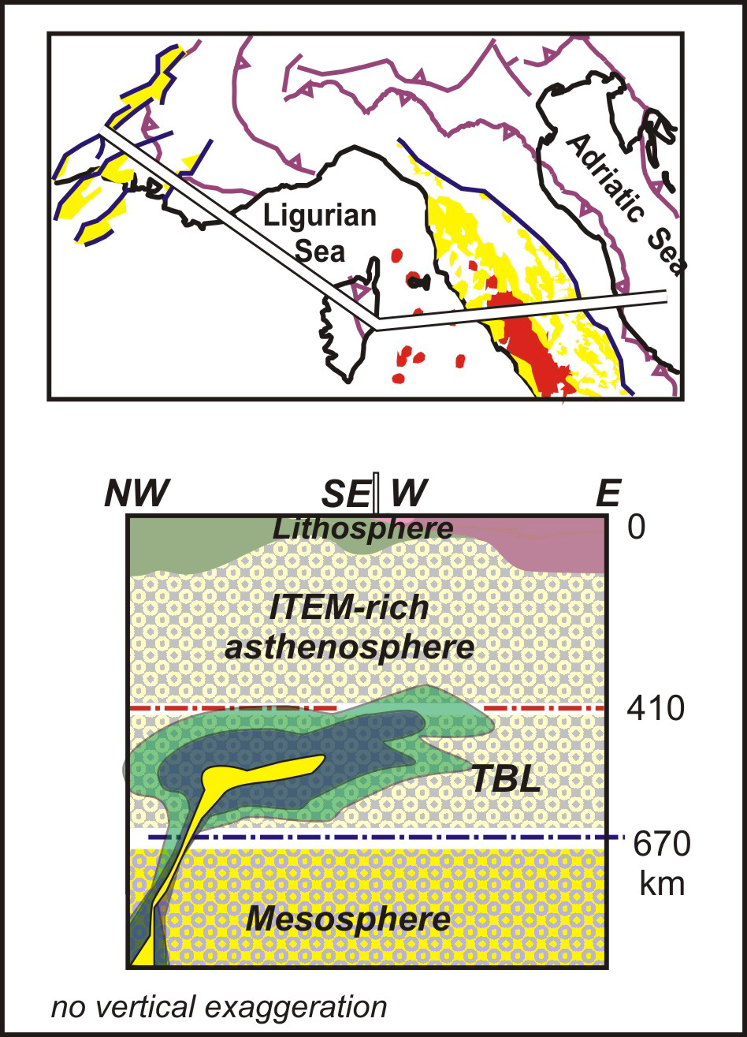
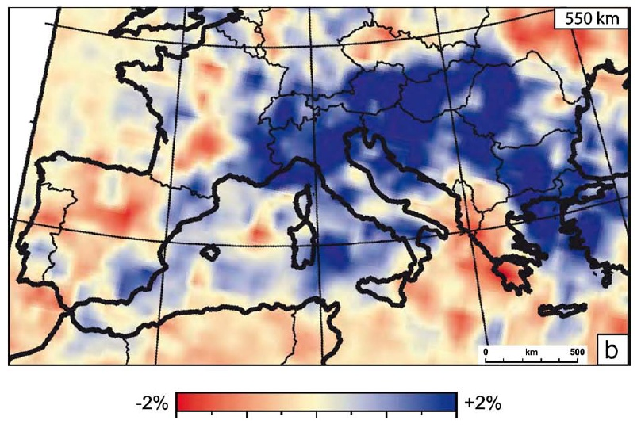
Piromallo and Morelli (2003) J. Geophys. Res., 108, 2065, doi:10.1029/2002JB001757
Lavecchia and Bell (2012) Updates in Volcanology, F. Stoppa (Ed.)
Presence of a zone with fast Vp anomalies at 550 km depth?
…Traces of a volatile-poor trapped plume head
Wadsleyite (β olivine)

Slide 65
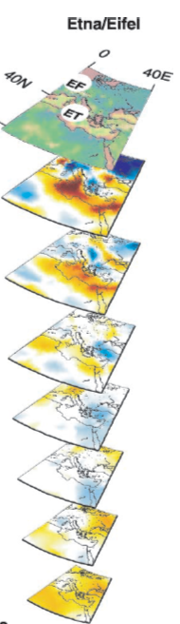
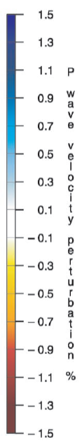



Montelli et al. (2004) Science, 303, 338-343
Spakman and Wortel (2004) Transmed, 31-52
[…] Negative (positive) wave speed anomalies likely represent predominantly higher (lower) temperatures than average. Temperature anomalies can be as large as 10%-20%. [Spakman and Wortel, 2004]

Slide 66


Tonarini et al. (2001) EPSL, 192, 471-483
Gvirtzman and Nur (1999) Nature, 401, 782-785
Doglioni et al. (2001)Terra Nova, 13, 25-31

Slide 67




Not only “local”, but also “regional” Mantle Plumes
Hoernle et al. (1995) Nature, 374, 34-39
…?
Next Slide
S=H-L

Slide 68

In the area where the highest Vp negative anomalies have been found, no igneous activity is recorded during the last 300 Myrs.

Slide 69

Not only “local”, but also “regional” Mantle Plumes
Isotopic “evidence” of a common source.
Origin of these isotopic vectors?
LVC
Low Velocity Component
Interaction with “non-plume” material (typically lithosphere)
Hoernle et al. (1995) Nature, 374, 34-39.

Slide 70
Not only “local”, but also “regional” Mantle Plumes
Bohemian Massif rocks
LVC
S=H-L
Low Velocity Component
From: Hoernle et al. (1995) Nature, 374, 34-39.

Slide 71

Boschi et al. (2010) Geophys. Res. Lett., 37, doi:10.1029/2010GL045001

Slide 72

Becker and Boschi (2002) Geochem. Geophys. Geosyst., 3, doi:10.1029/2001GC000168

Slide 73

Boschi et al. (2009) Surv. Geophys., 30, 463–501

Slide 74

Schmid et al. (2008) J. Geophys. Res., 113, B03306, doi:10.1029/2005JB004193

Slide 75


Workel and Spakman (2000) Science, 290, 1910-1917
P-wave anomaly
-2.5%
+2.5%

Slide 76
Just very few geochemical comments on the “anorogenic” igneous rock of the Circum-Mediterranean area:
From: Lustrino and Wilson (2007) Earth-Sci. Rev., 81, 1-65

Slide 77
Surprisingly small spread of data of the bulk of the samples, considering the huge area/age/composition covered by the samples…
⁸⁷Sr/⁸⁶Sr

Slide 79

“Anorogenic”
“Orogenic”
Again, relatively small spread of data of the bulk of the samples.
K₂O+Na₂O
SiO₂

Slide 80
From: Lustrino (2011) Geol. Mag., 148, 304-316

Slide 81
From: Lustrino (2011) Geol. Mag., 148, 304-316

Slide 82
Message to take away:
Geochemistry of igneous rocks in complex tectonic settings means nothing if not validated by geology.
The supposed deep mantle plume isotopic message cannot be easily distinguished from DMM.
Tomography has not the power to identify deep mantle upwelling and cannot be used to infer the temperature.
Geochemical and tomographic plume models do not take into account the geology and geodynamic evolution.
- Some (many) “plume-related” melts are compatible with volatile-rich sources, not anhydrous pyrolitic mantle.
Nearly all the “plume-related” magmatism is associated with important regional discontinuities.
Despite the complex tectonic setting, the “anorogenic” magma cluster in relatively narrow geochemical fields.

Slide 83
Thanks for the attention and the invitation
michele.lustrino@uniroma1.it
(send me an e-mail to have a copy of this presentation)
Durham,
February 28th 2013

