Slide 1

The Plate vs. Plume controversy:
Why has it not been resolved?”
Meiji University, Tokyo
26th May, 2018
Gillian R. Foulger
Dept. Earth Sciences
Durham University

Slide 2
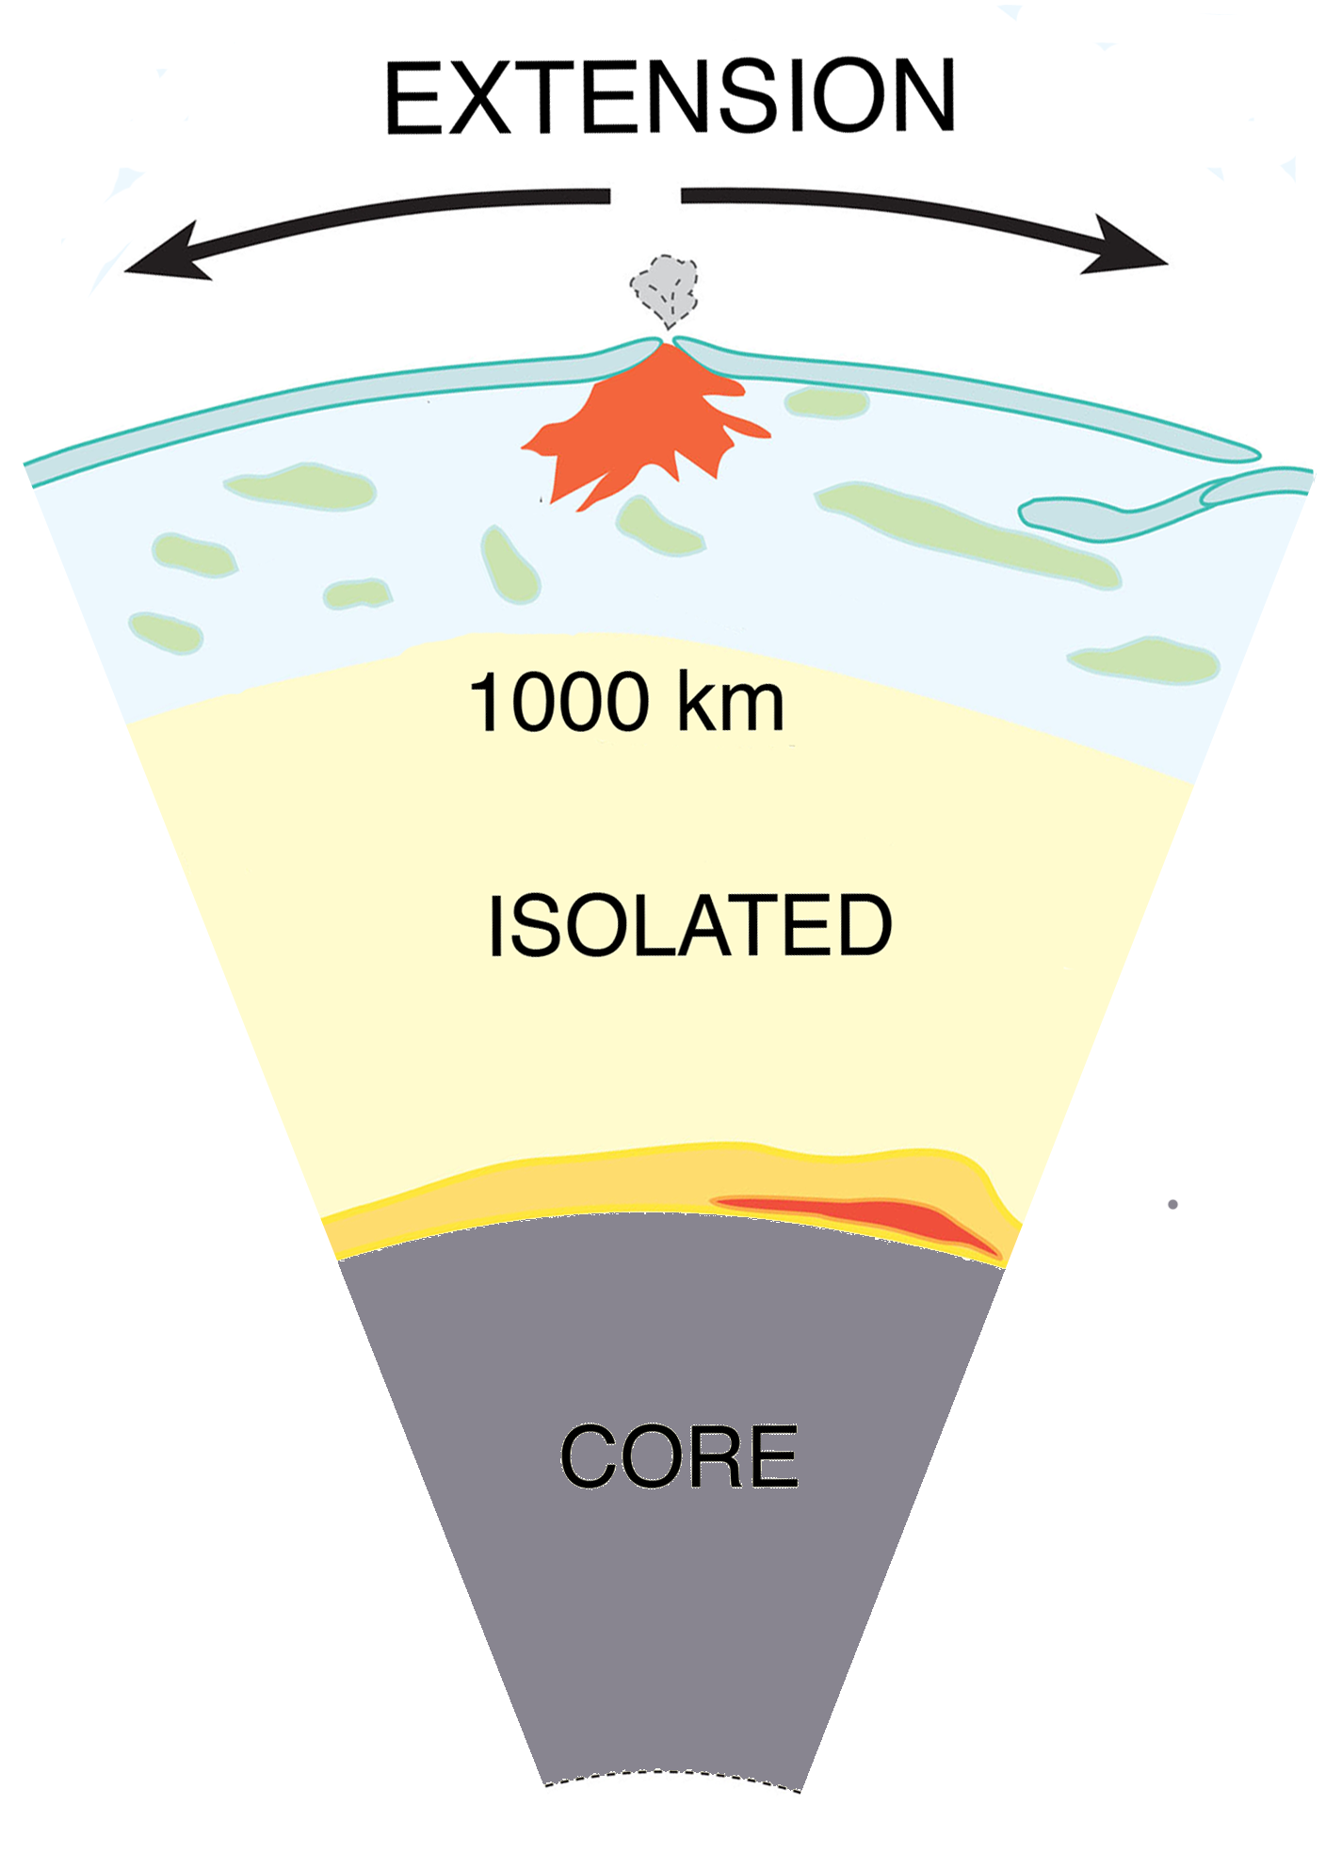
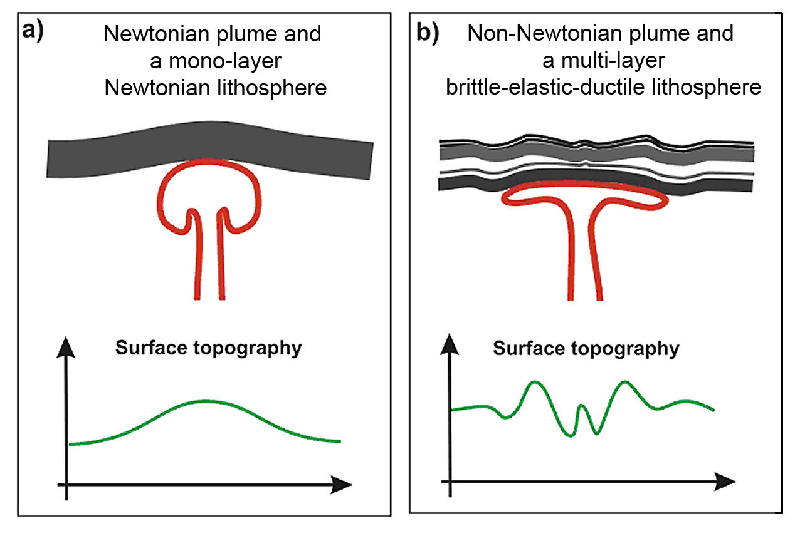

Plates or Plumes?

Slide 3
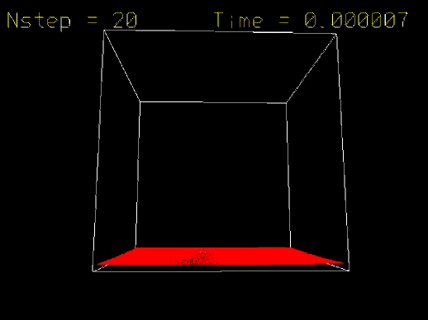

Slide 4
Five Main Predictions of the Modern Plume Hypothesis

Slide 5
1. Precursory surface uplift
Burov (2005)

Slide 6
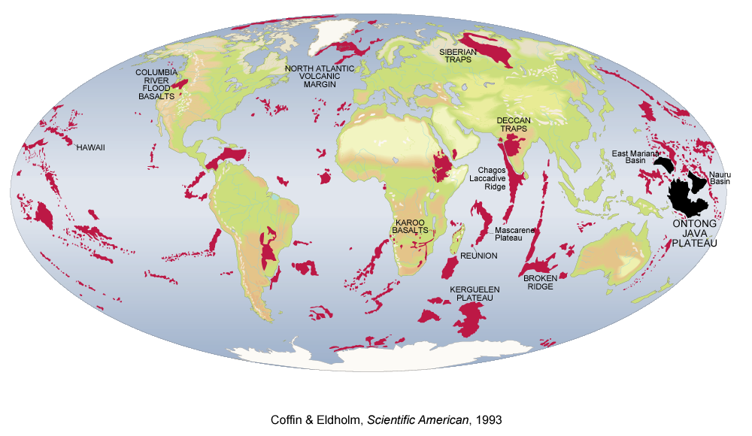
2. Followed by a “plume head” flood basalt eruption
Coffin & Eldholm (1993)

Slide 7
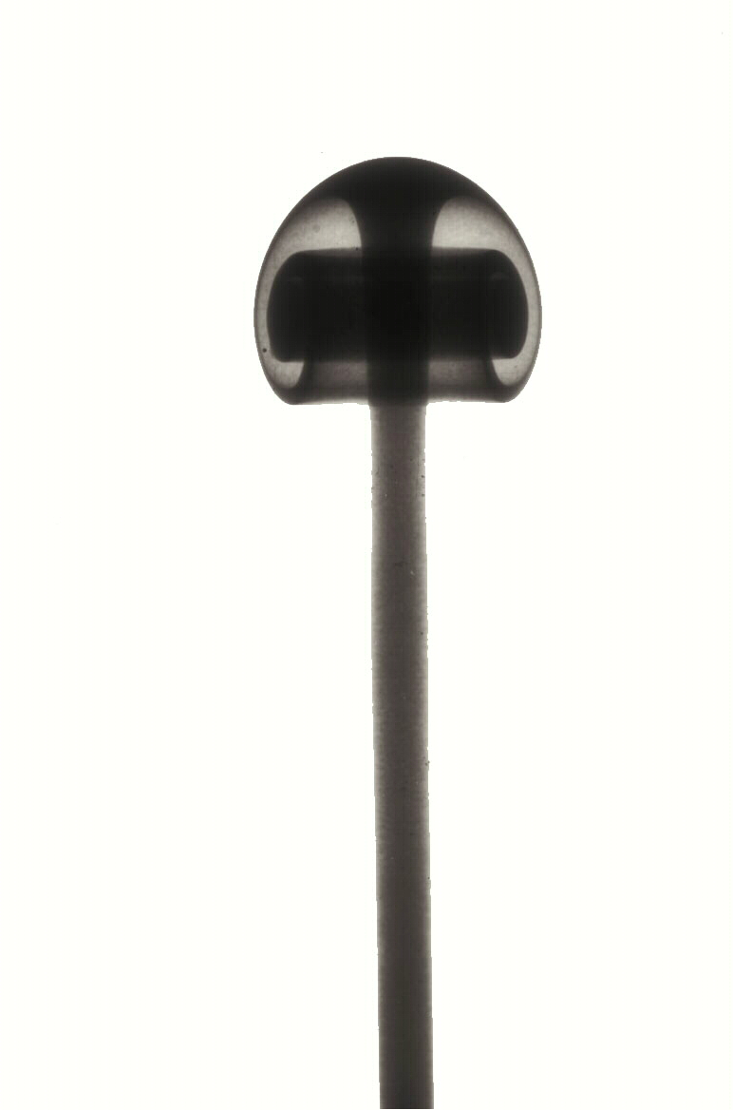
3. Plume “tail” to the core-mantle boundary
Campbell (2005)

Slide 8
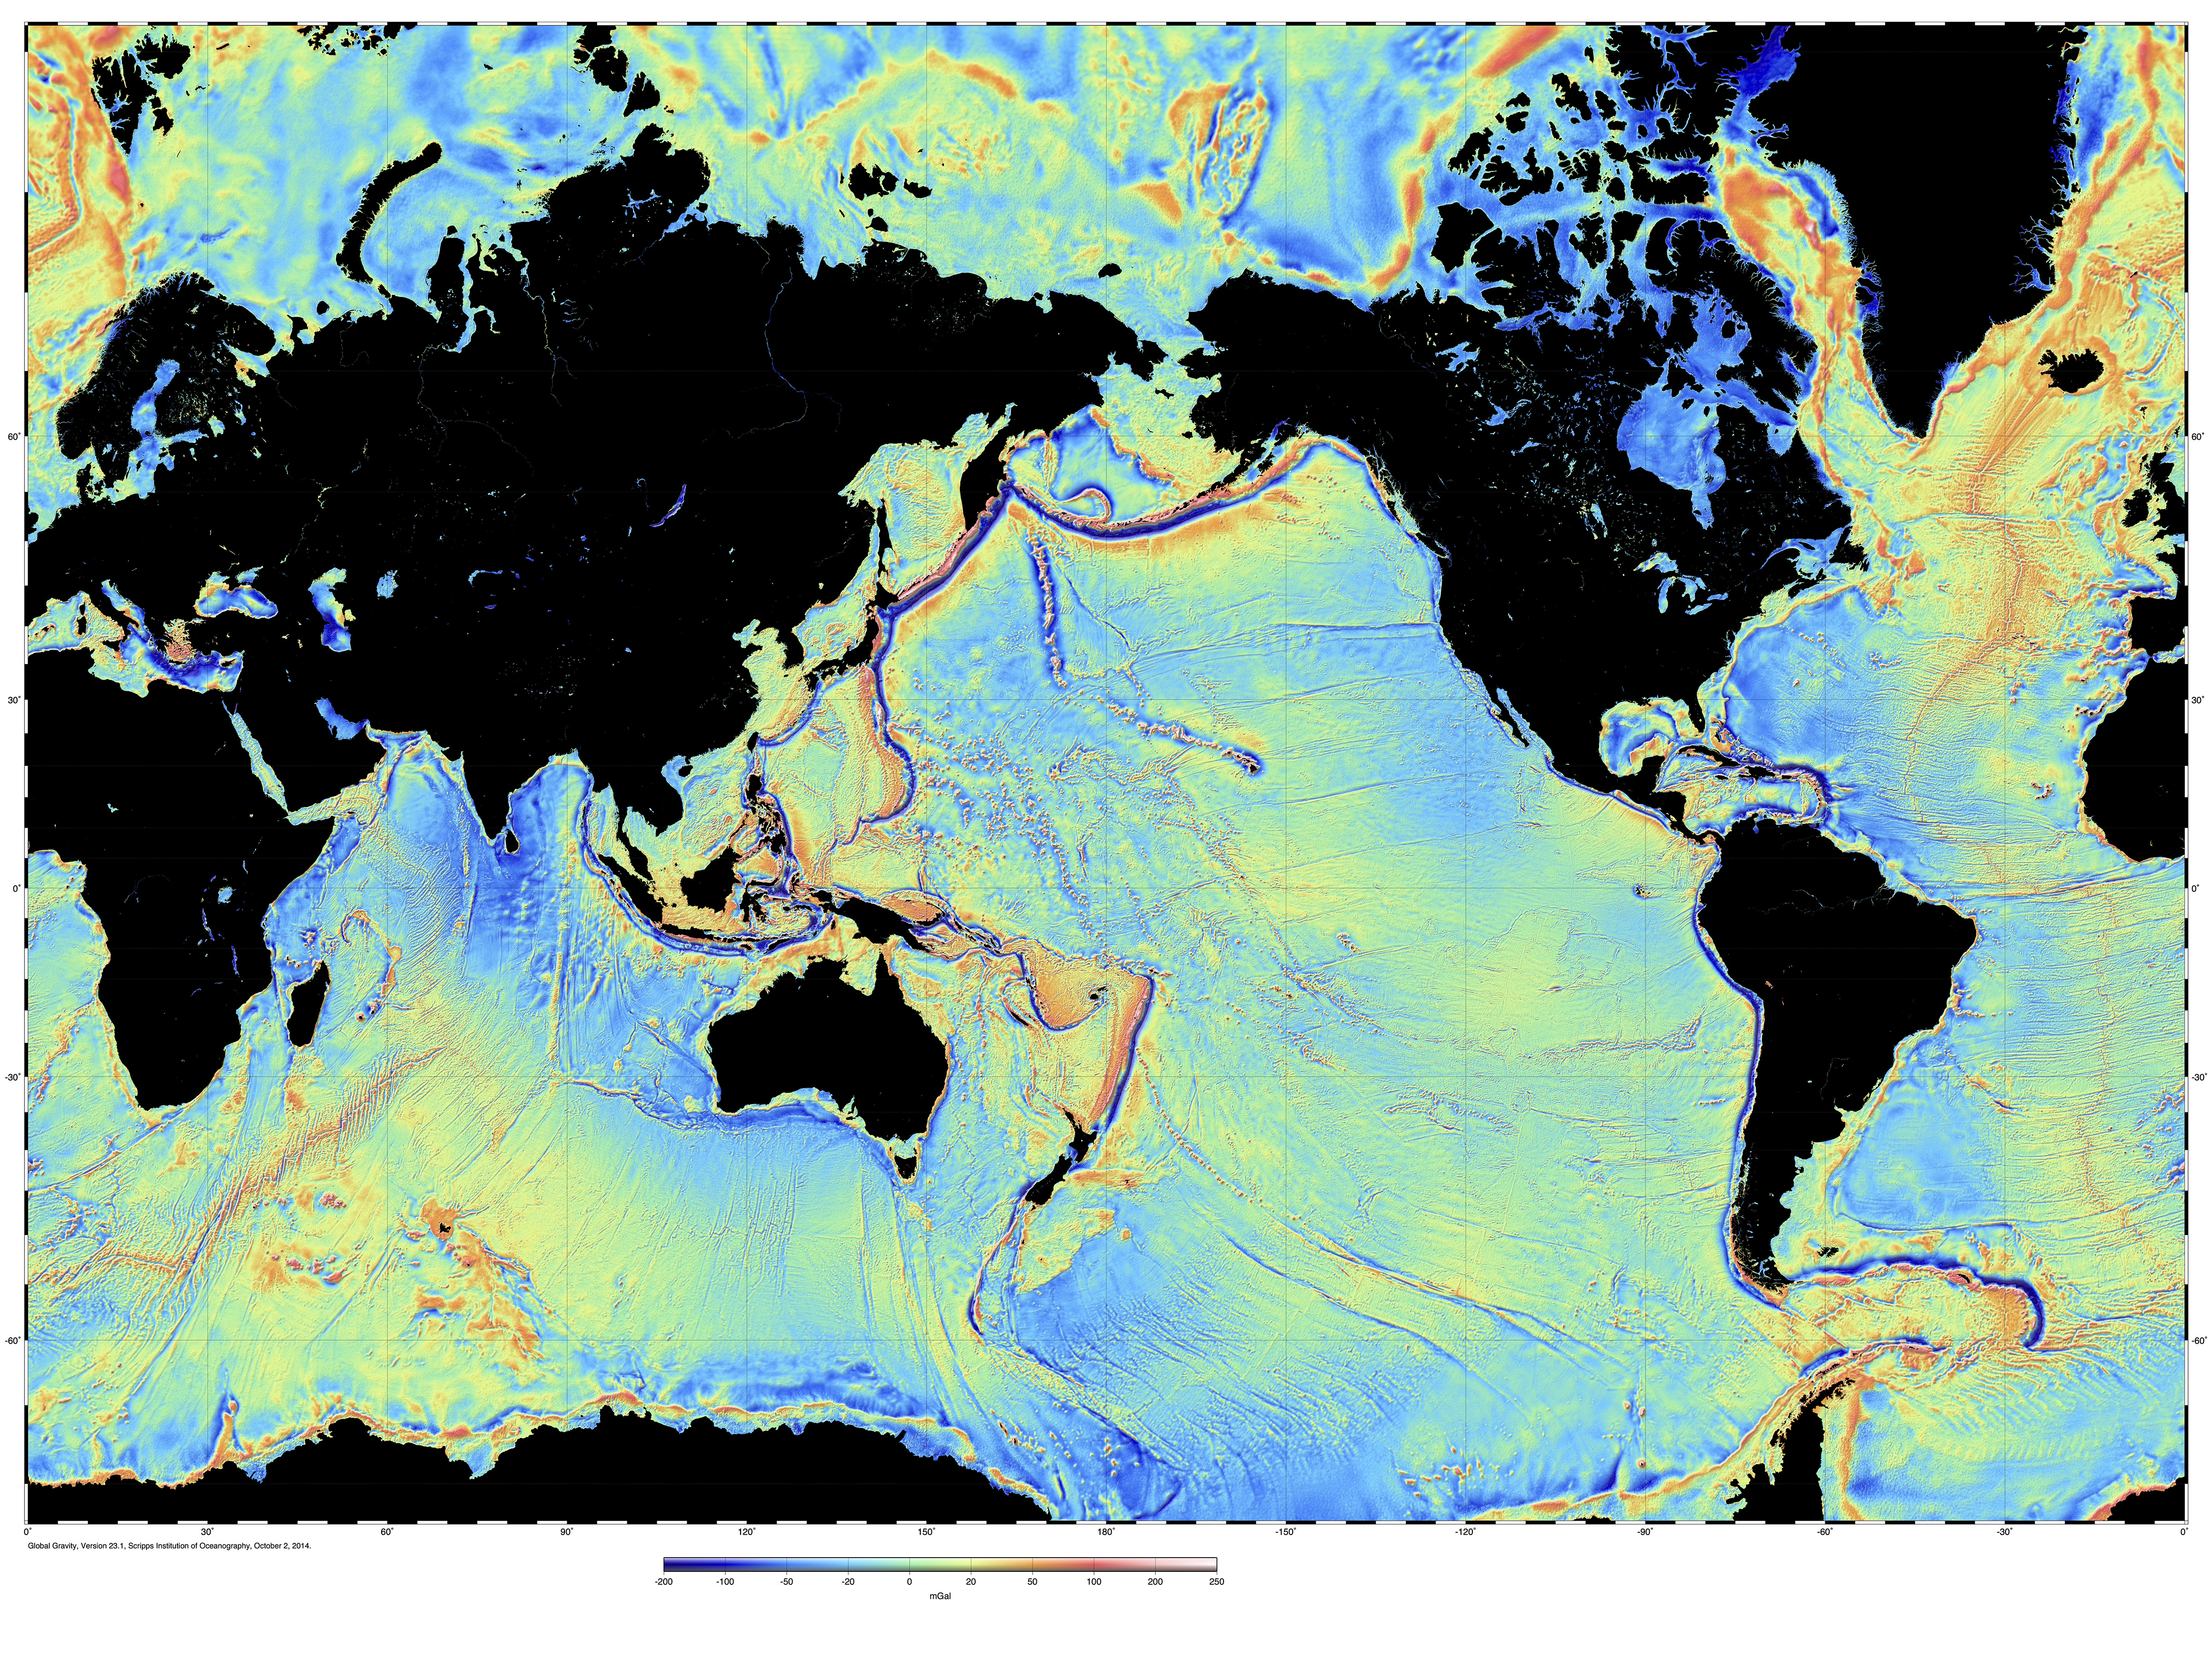
4. Fixed relative to one another, resulting in time-progressive volcanic chains
Hawaii

Slide 9


5. High magma source temperatures

Slide 10
These Predictions Fail

Slide 11
1. Precursory surface uplift
Burov (2005)

Slide 12
Flood basalts
Coffin & Eldholm (1993)

Slide 15
2. Followed by a “plume head” flood basalt eruption
Coffin & Eldholm (1993)

Slide 16
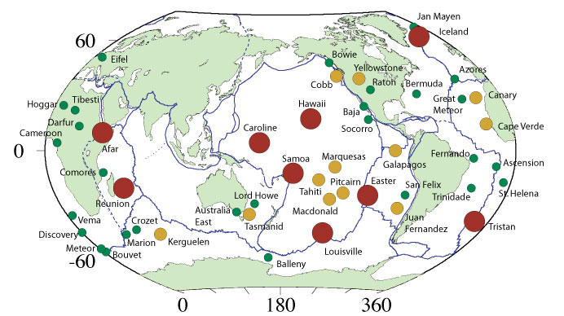
Recent list of 49 “hot spots”
From: Courtillot, V., A. Davaillie, J. Besse, and J. Stock (2003), Three distinct types of hotspots in the Earth's mantle, Earth planet. Sci. Lett., 205, 295-308.

Slide 17
Those with “plume-head” flood basalts
From: Courtillot, V., A. Davaillie, J. Besse, and J. Stock (2003), Three distinct types of hotspots in the Earth's mantle, Earth planet. Sci. Lett., 205, 295-308.

Slide 18
3. Plume “tail” to the core-mantle boundary
Campbell (2005)

Slide 19
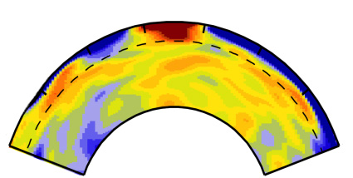
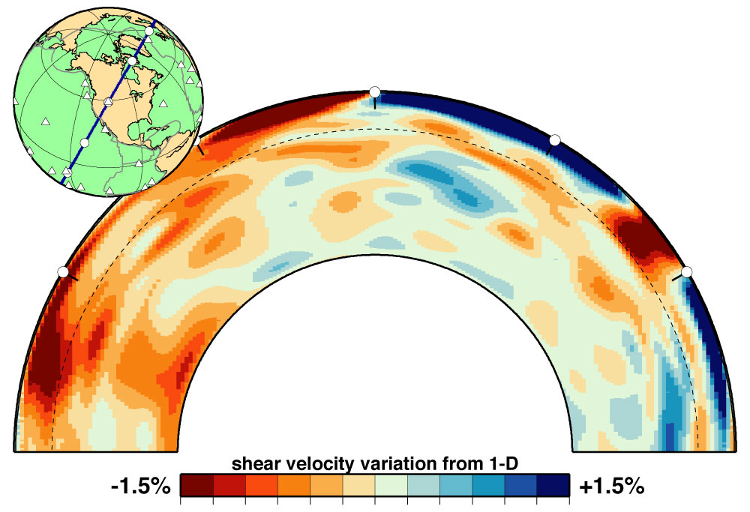
Seismic cross sections through Earth
Iceland
Yellowstone
Ritsema et al. (1999)

Slide 20
4. Fixed relative to one another, resulting in time-progressive volcanic chains
Hawaii

Slide 21
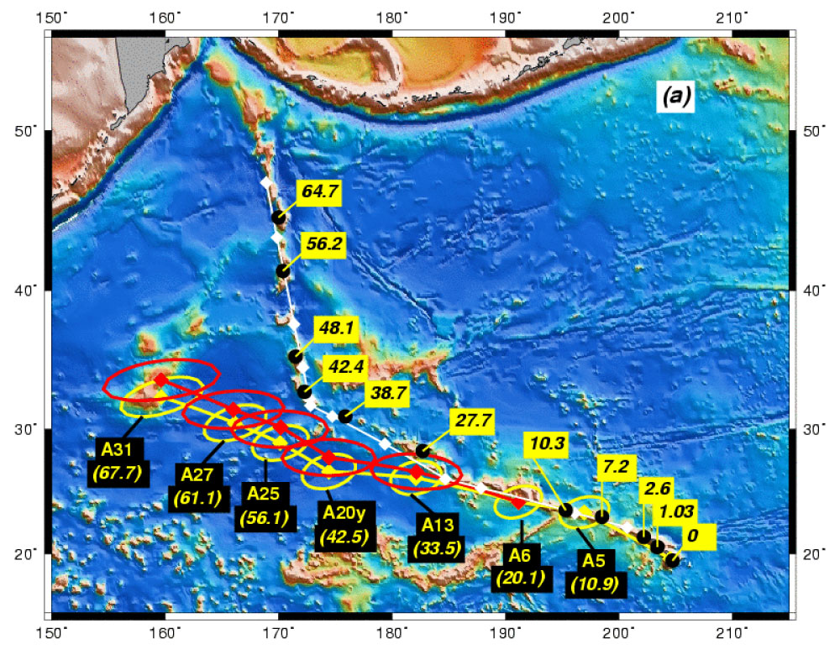
Raymond et al. (2000)

Slide 22
5. High magma source temperatures

Slide 23
“Hot spots” with picrite glass
From: Courtillot, V., A. Davaillie, J. Besse, and J. Stock (2003), Three distinct types of hotspots in the Earth's mantle, Earth planet. Sci. Lett., 205, 295-308.

Slide 24
The Plate Hypothesis
Predictions

Slide 25
1. Volcanism associated with lithosphere extension

Slide 26
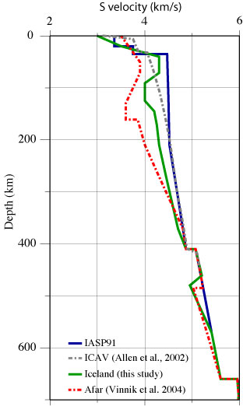
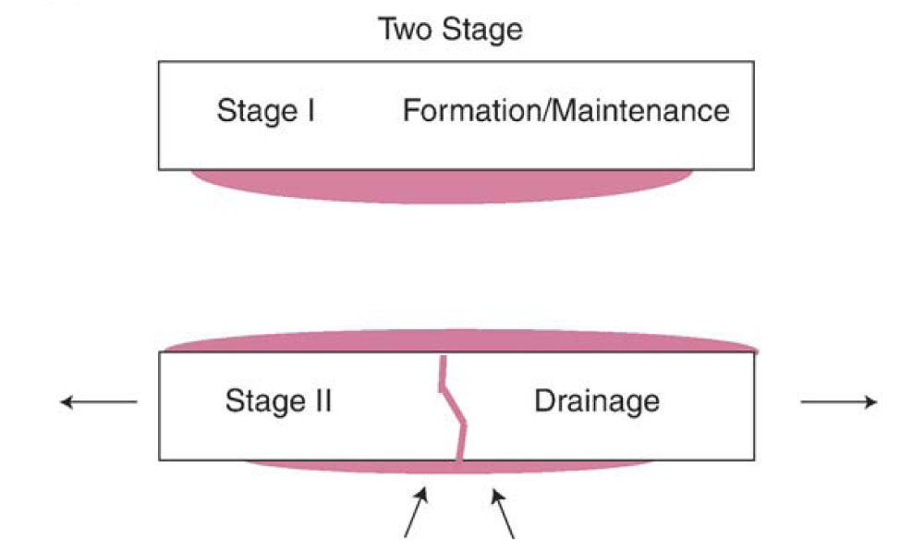
2. Melt exists in the mantle

Slide 27


2. …and solid material near its melting point
Melt anomaly source
MORB source
melting point varies

Slide 28
Plate: Precursory surface uplift
✗
Burov (2005)

Slide 29
Plate: flood basalt eruption
If enough melt available
Coffin & Eldholm (1993)

Slide 30
Plate: “tail” to the core-mantle boundary
✗
Campbell (2005)

Slide 31
Plate: Time-progressive volcanism
Space/Time distribution follows extension
Hawaii

Slide 32

Plate: High magma source temperatures
✗

Slide 33
So why isn’t the controversy resolved?
The Plume model is very flexible

Slide 34
Definition of a “plume”
fossil plume (Rotolo et al., 2006)
dying plume (Davaille & Vatteville, 2005)
recycled plume head (Gasperini et al., 2000)
tabular plume (Hoernle et al., 1995)
finger-like plume (Cadoux et al., 2007)
baby plume (Ritter, 2006)
channelled plume (Oyarzun et al, 1997)
toroidal plume (Mahoney et al., 1992)
head-free plume (Ritter, 2006)
cold plume (Hanguita & Hernan, 2000)
depleted residual plume (Danyushevsky et al., 1995)
pulsating plume (Krienitz et al., 2007)
subduction fluid-fluxed refractory plume (Falloon et al., 2007)

Slide 35
So why isn’t the controversy resolved?
The Plume model is very flexible
We are using the wrong methods
  Seismology
  Geochemistry

Slide 36
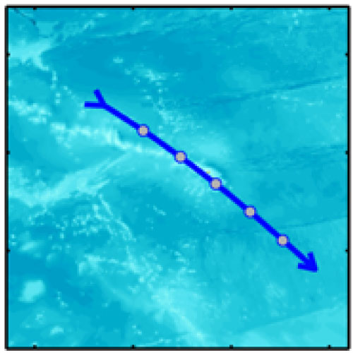
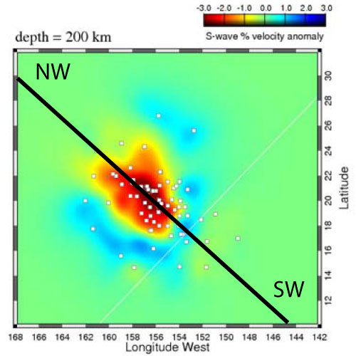
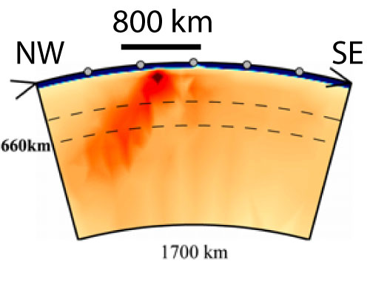
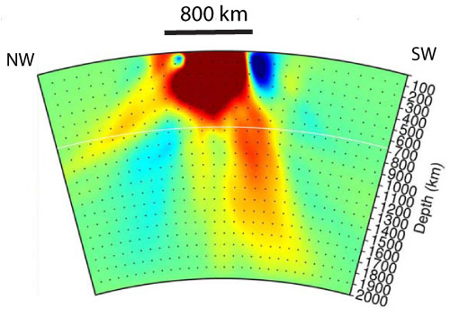
Hawaii
Li et al. (2008)
Wolfe et al. (2009)

Slide 37
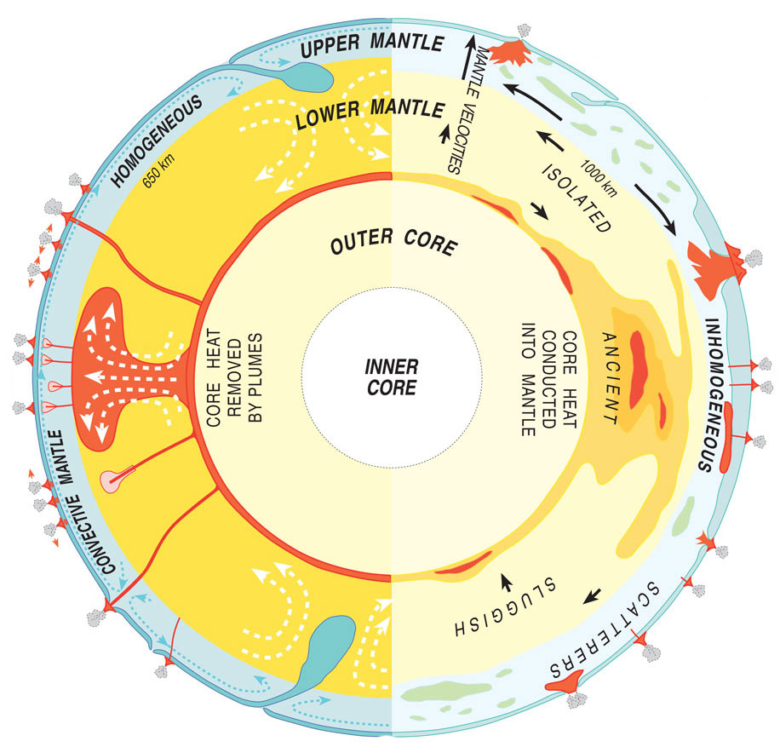
Geochemistry
Geochemistry cannot distinguish depth!

Slide 38
The role of seismology & geochemistry
Test whether data are consistent with hypotheses
These methods cannot “prove” Plate or Plume

Slide 39
Need to look for:
Extension
  Structural geology
  Volcanic dykes
  Geodesy (GPS, strainmeters, etc)
  Vertical motions – subsidence
  Numerical deformation modelling

Slide 40
So why isn’t the controversy resolved?
The Plume model is very flexible
We are using the wrong methods
  Seismology
  Geochemistry
We are too specialist

Slide 41


We know plumes exist because GEOCHEMISTS see them
We know plumes exist because SEISMOLOGISTS see them
SEISMOLOGIST
GEOCHEMIST

Slide 42
So why isn’t the controversy resolved?
The Plume model is very flexible
We are using the wrong methods
  Seismology
  Geochemistry
We are too specialist:
  Prof. Geochemist: “We know plumes exist because seismologists see them”
  Prof. Seismologist: “We know plumes exist because geochemists see them”
We are too lazy:
  It is easy to swim with the current and hard to swim upstream.

Slide 43
Notes:
Mechanisms: Rifting decompression melting
Generic: Thermal/Sedimentary evidence
Localities: Hawaii/What the hell is Hawaii?
And if you think you might forget the URL, we are selling mantleplumes.org coffee mugs at cost price - £2.50

Slide 44

159 years later
1859

Slide 45

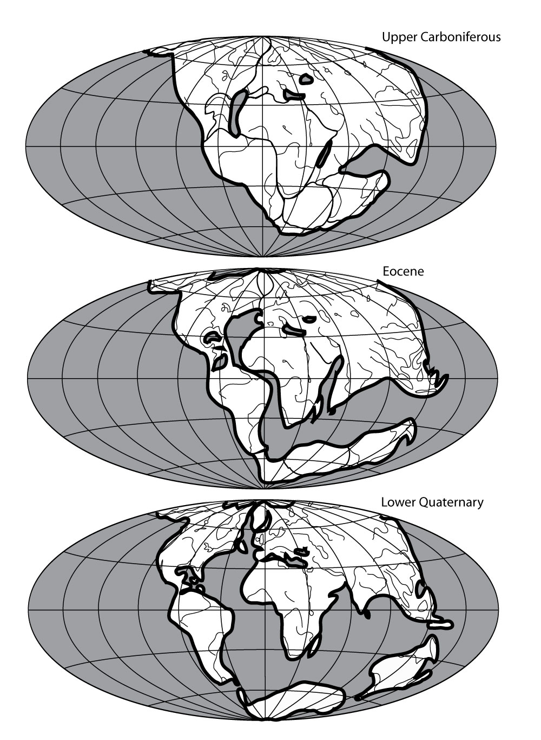
1915

Slide 46
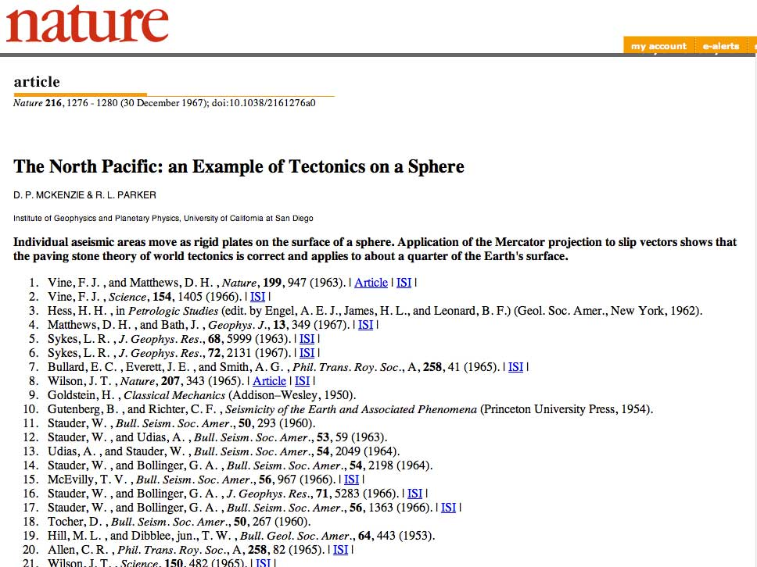
52 years later

Slide 47
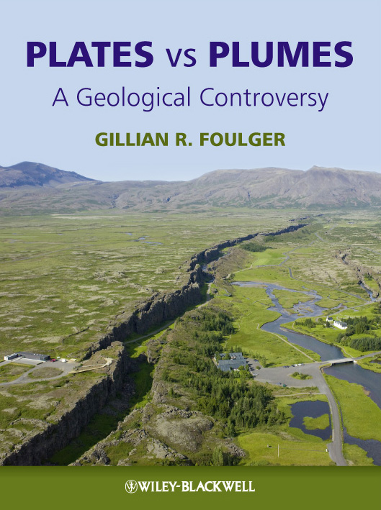
That’s all folks

Slide 48
That’s all folks
Notes:
Mechanisms: Rifting decompression melting
Generic: Thermal/Sedimentary evidence
Localities: Hawaii/What the hell is Hawaii?
And if you think you might forget the URL, we are selling mantleplumes.org coffee mugs at cost price - £2.50

Slide 49


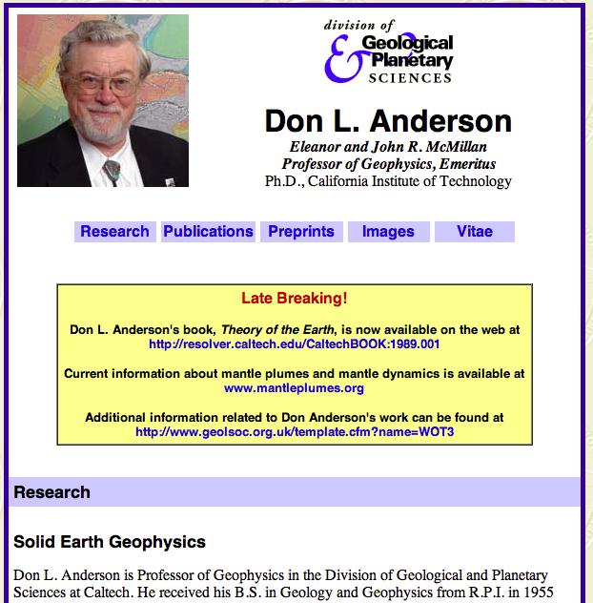

Nat. Medal of
Science
2003
Nat. Medal of
Science
1988
Notes:
National Medal of Science

Slide 50
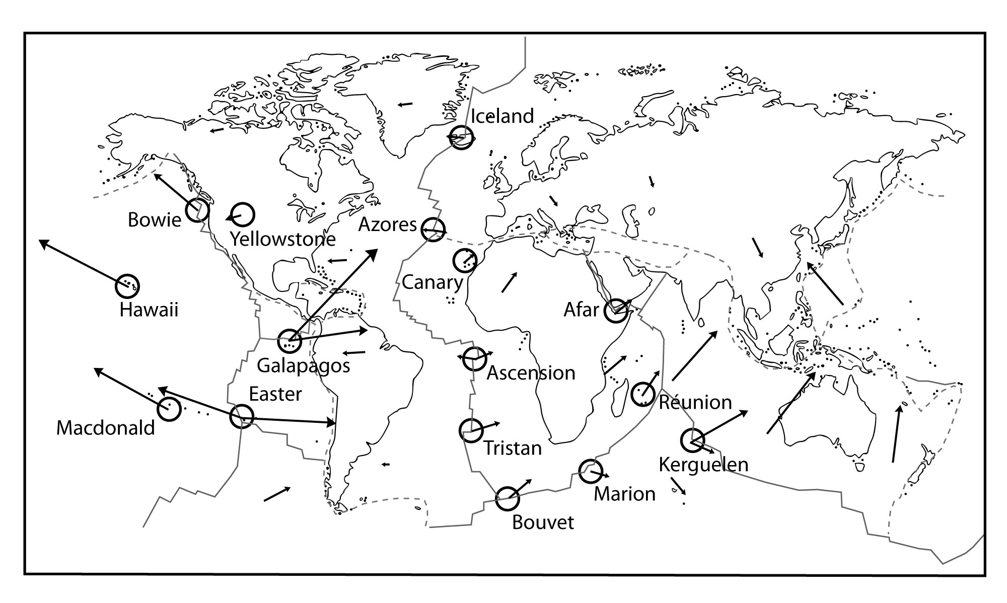
Morgan (1971)
The Plume Hypothesis
Notes:
Morgan went further. In addition to excess volcanism, plumes were supposed to also explain:
fixity & chains

Slide 51
Picrite glass is an indicator of high temperature

Slide 52
Predictions of the Plate hypothesis

Slide 53
Plate: High magma source temperatures
✗

Slide 54
“Plates vs. Plumes Controversy”
??? years later

Slide 55
Comparison with geosynclines
Mio-geosyncline
Eu-geosyncline
Ortho-geosyncline
Primary geosyncline
Zeugo-geosyncline
Para-geosyncline
Exo-geosyncline
Taphro-geosyncline
Paralia-geosyncline
Notes:
Geosyncline is a term still occasionally used for a subsiding linear trough that was caused by the accumulation of sedimentary rock strata deposited in a basin and subsequently compressed, deformed, and uplifted into a mountain range, with attendant volcanism and plutonism.

Slide 56
Question
Are mantle plumes unobservable entities?
In future, will they cease to be believed to exist?
Will they be the next phlogiston, aether, caloric, geosyncline…?

Slide 57
Reasons for doubting the reality of plumes – 1
Theory predictions are rarely confirmed.
This is generally met by arguing:
  There has been insufficient research;
  The evidence has been destroyed;
  “The” plume is too small to be resolved (the teacup orbiting the Sun argument);
  This is a different variety of plume (there are now more plume-variants than there are proposed plumes).

Slide 58
Reasons for doubting the reality of plumes – 2
Unscientific arguments are common, e.g.,
  “Most people believe in plumes”;
  “No observation could ever convince me plumes don’t exist”;
  “There must be a plume here because there is evidence for it”;
  “It is terrible to question plumes because Jason is my friend”;
  There are no alternatives;
  Confirmed predictions of other theories are explained as coincidences.

Slide 59
Reasons for doubting the reality of plumes – 3
After almost 50 years of study scientists still do not agree
  what the definition of a plume is;
  whether or not they exist; and
  (amongst believers) how many there are.
Retreat to using vague language, e.g., “hot spot”.

Slide 60
Tale of Two Theories

Slide 61
Plates vs. Plumes

Slide 62

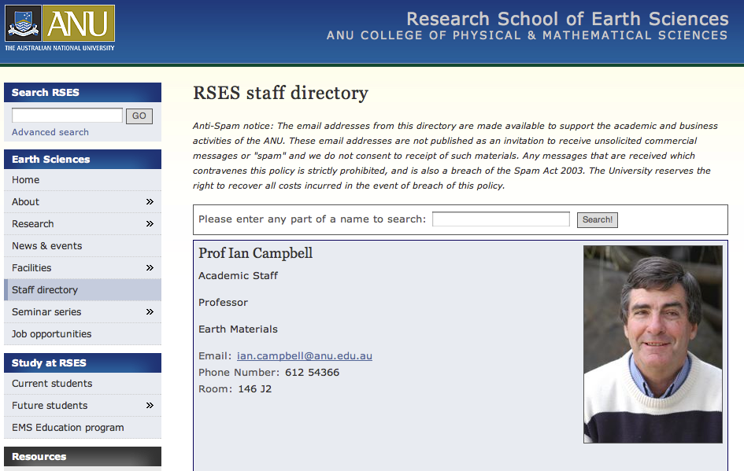

Slide 63
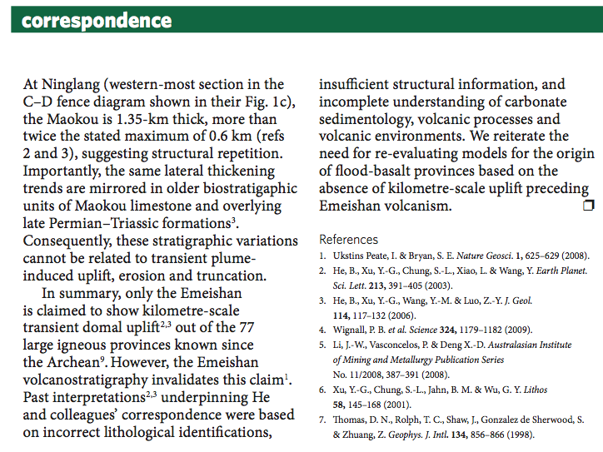
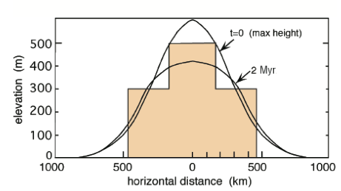
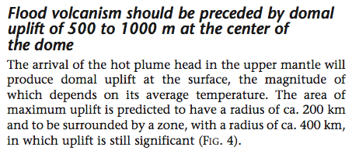
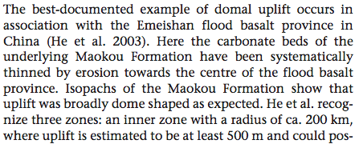
?
Ukstins-Peate & Bryan,
Nature Geoscience, 2009
Campbell,
Elements, 2005

Slide 64
2. Followed by a “plume head” flood basalt eruption
Coffin & Eldholm (1993)

Slide 65
3. Plume “tail” to the core-mantle boundary
Campbell (2005)

Slide 66
Seismic cross sections through Earth
Iceland
Yellowstone
Ritsema et al. (1999)

Slide 67
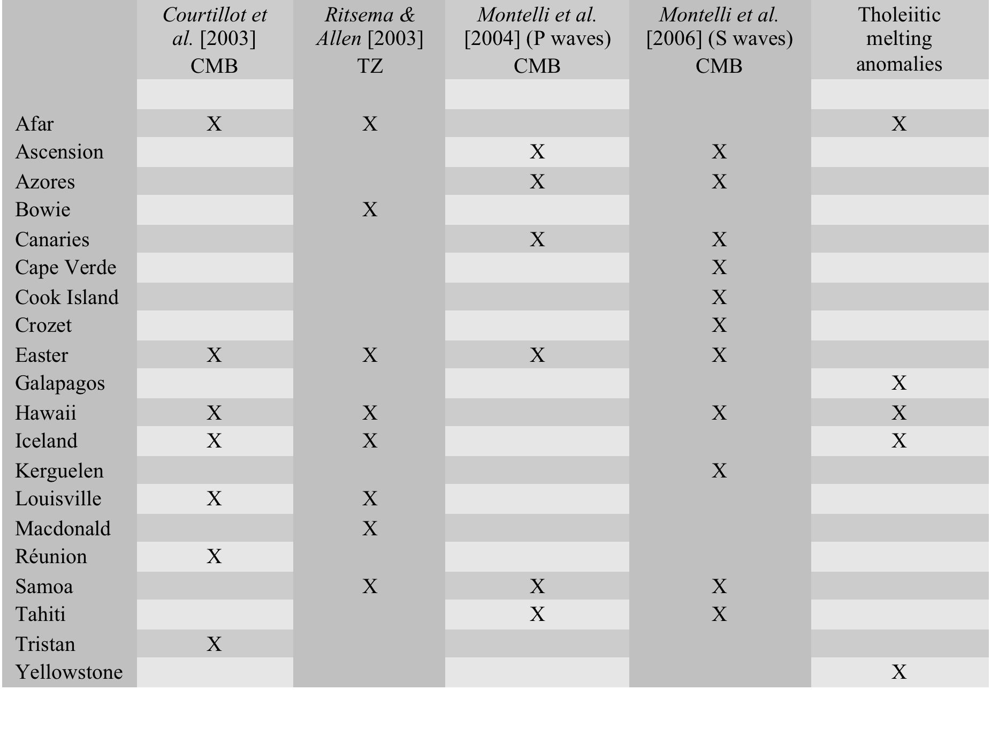

Slide 68
Seismology
Seismology cannot distinguish composition, phase & temperature
A seismic image is not a geological image
There are many problems in seismology, and insufficient skepticism
“Geologists tell us plumes exist so it is our duty to find them”

Slide 69
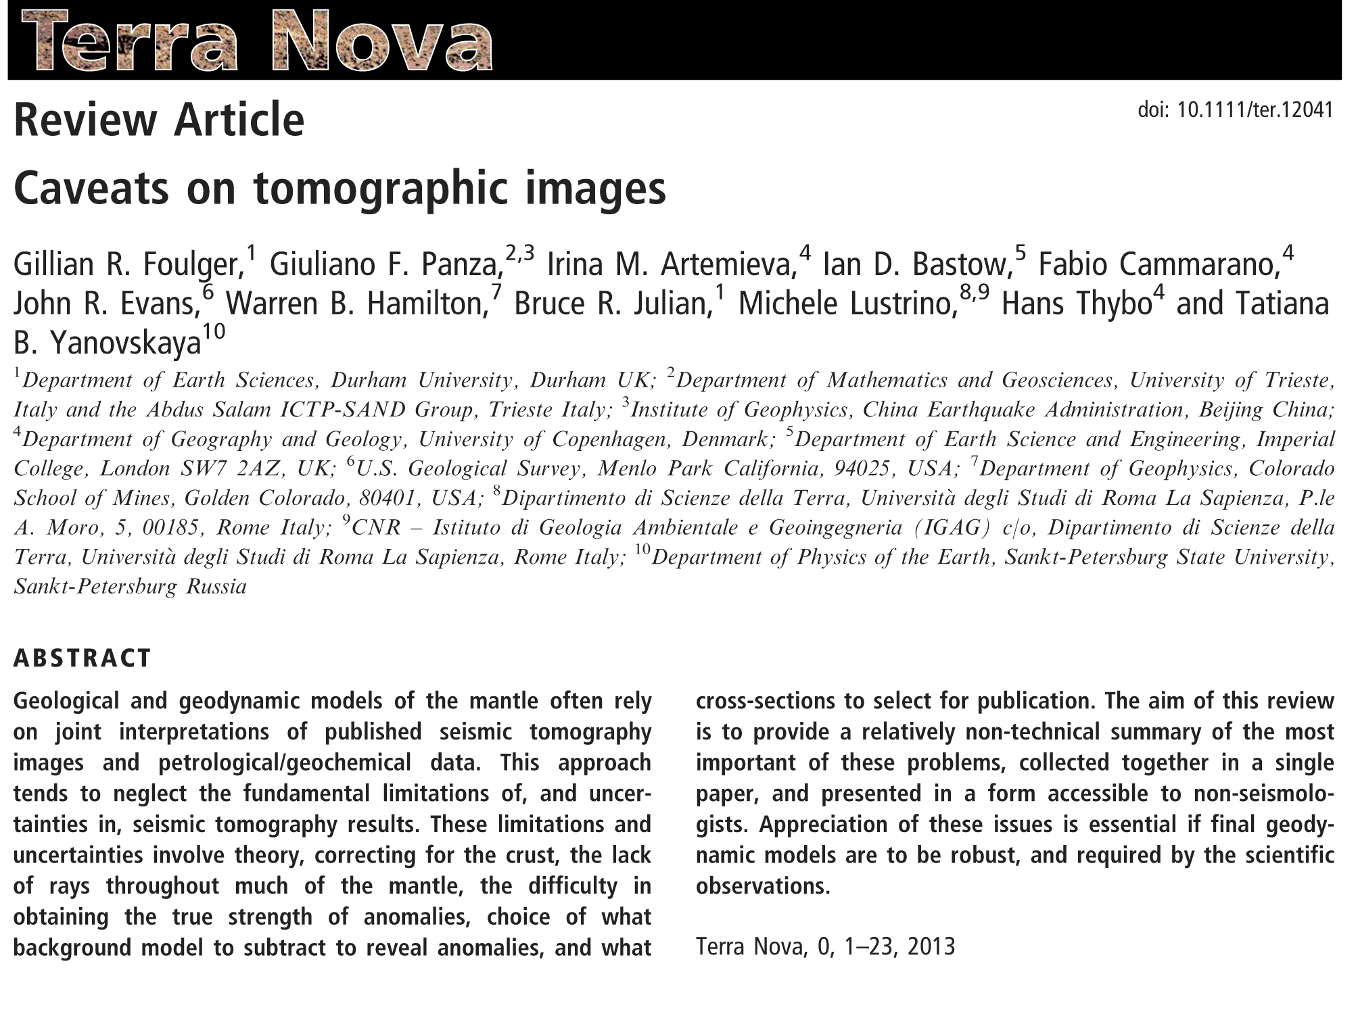

Slide 70
But…
Morgan knew this when he first proposed plumes …

Slide 71
Examples of Flawed Science

Slide 72
Geochemical tracers of the core-mantle boundary – Example A
Morgan (1971) predicts plume material different composition from “normal” magmas
Schilling (1973): Icelandic magmas have different composition
Example of a successful prediction!

Slide 73
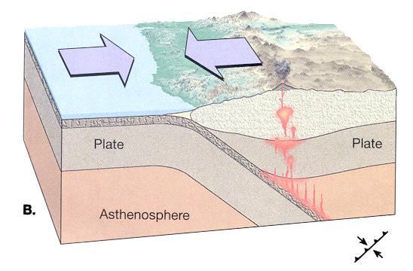
Geochemical tracers of the core-mantle boundary – Example A
Hofmann & White (1982): the difference in composition results from re-melted crust
Explained by postulating crust subducted to core-mantle boundary and returned in plumes!

Slide 74
Geochemical tracers of the core-mantle boundary – Example B
Unusual, high ³He/⁴He ratios found at Hawaii
Because thought to be a plume under Hawaii, interpreted as a core-mantle-boundary tracer
Subsequently, if high ³He/⁴He ratios found, assumed to indicate a new plume

Slide 75
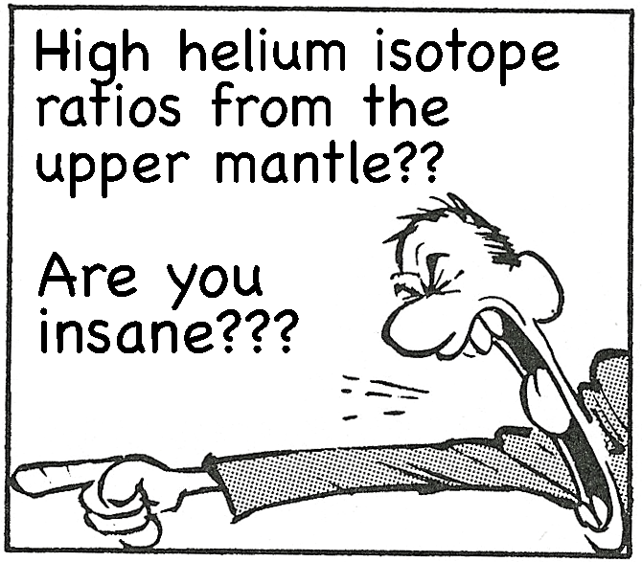
Geochemical tracers of the core-mantle boundary – Example B
Geochemistry cannot tell depth of origin of magmas
…but not everyone
accepts this …

Slide 76
Endless plume variants
Lateral flow of plume material
Tabular plumes
Pulsing plumes
High ³He/⁴He plumes
Low ³He/⁴He plumes
Headless plumes
Tailless plumes

Slide 77
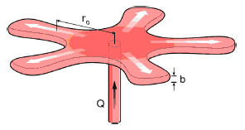
Currently Over 70 Plume Variants
Thermal (1); Fossil (2); Channelled (3); Toroidal (4); Tabular (5); Depleted Residual (6); Finger-like (7); Recycled (8); Edge (9); Cold (10); Cacto- (11); Super (12); Asthenospheric (13); Dying (14); Not very energetic (15); Spaghetti (16); Baby (17); Head-free (18); Splash (19); Pulsating (20); Subduction fluid-fluxed Refractory (21); Hydrogen (22); Heterogeneous (23); Flattened Onion (24); Subduction-driving (25); Subduction-triggered (26); Washboard (27); Bent-shaped (28); Failing (29); Delamination-triggering (30); Concentrically-zoned (31); Mushroom (32); Laminar (33); Advected (34); Extinct (35); Bilateral (36); Bifurcated (37); Geriatric (38); Primary and Secondary (39); Accreted (40); Diverted (41); Deformed (42); Golden (43); Veined (44); Hidden (45); Weak (46); Pulsing (47); Young (48); Blob-like (49); Cavity (50); Starting (51); Passive (52); Stealth (53); Tilted (54); Asymmetric (55); Mega (56); Mini (57); Not-hot (58); Killer (59); Deflected (60); Stripy (61) ; Diamondiferous (62) ; Transient (63) ; Dehydrating (64); Doughnut (65); Rear (66); Side (67); Volatile-bearing (68); Incipient (69) ; Migrating (70).
A radial viscous fingering plume, published 2017

Slide 78
Comparison with geosynclines
Mio-geosyncline
Eu-geosyncline
Ortho-geosyncline
Primary geosyncline
Zeugo-geosyncline
Para-geosyncline
Exo-geosyncline
Taphro-geosyncline
Paralia-geosyncline
Notes:
Geosyncline is a term still occasionally used for a subsiding linear trough that was caused by the accumulation of sedimentary rock strata deposited in a basin and subsequently compressed, deformed, and uplifted into a mountain range, with attendant volcanism and plutonism.

Slide 79
www.mantleplumes.org

Slide 80
Question
Is Earth Science science?
The success rate of plume predictions low (e.g., 35% for flood basalts)–how does this compare with other failed hypotheses?
Are Plumes (and geosynclines) akin to a Linnaean classification system?
Is there a residual mind-think that geology is merely a descriptive science?
Might this be why plume theorists don’t see persistent predictive failures as problematic?

Slide 81
Relationship between models & data and ultimate priority of empirical observation.
In my view, observations must ultimately trump models
…but observations are only as good as the observer…

Slide 82
Scientific method
What is Science &
How is it Different from a Belief System

Slide 83
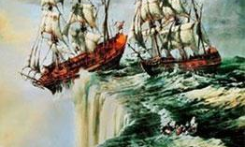
Example: Flat-Earth theory
Consistent
require
Disprove
Observation 1: Ships sail and never return.
Consistent with flat-Earth hypothesis.
Does not require it.
… an uncommon approach in Earth Science

Slide 84
www.mantleplumes.org

Slide 85
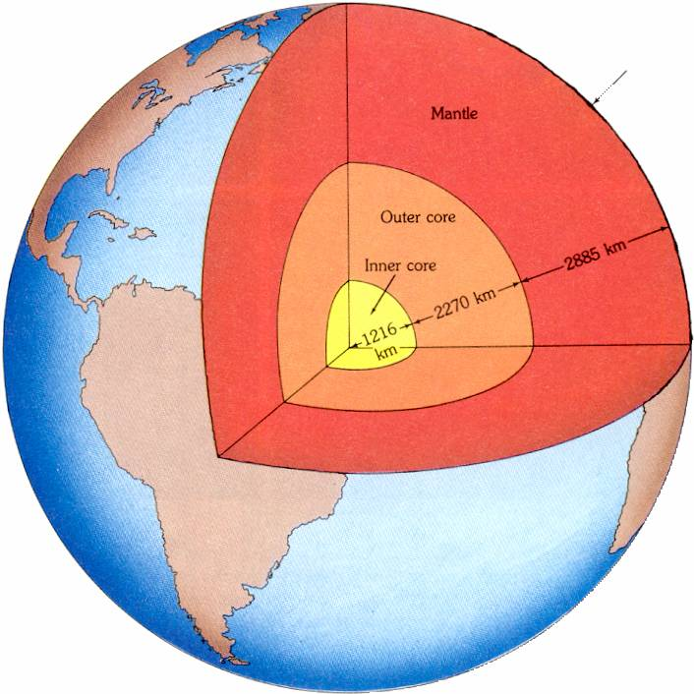
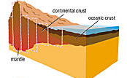
Chemical theory of Earth

Slide 86
Reasons for doubting the reality of plumes – 4
“Well, there are some unexplained mysteries, but geosynclines still explain things best”

Slide 87
5. High source temperatures

Slide 88
The temperature of the mantle at depths of 10’s, 100’s or 1,000’s of km depth is exceedingly difficult to measure

Slide 89
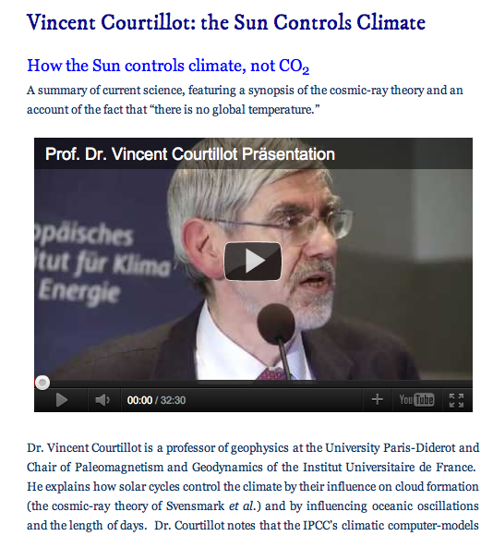
But do we need to measure it?
‘Hotspots are, by definition, hot.’
– Courtillot [2003], p. 299

Slide 90
Additional points
Plume hypothesis depends on many assumptions that are challenged, e.g.,
  “normal” mantle is below the melting point
  melting anomalies are due to localized high temperature, not low melting point
  regions of extension will not be volcanic unless the local temperature is anomalously high
  high temperatures require importation of heat from the core-mantle boundary in the form of narrow jets
  the upper mantle is vigorously stirred by plate-tectonic-related convection and is homogeneous

Slide 91
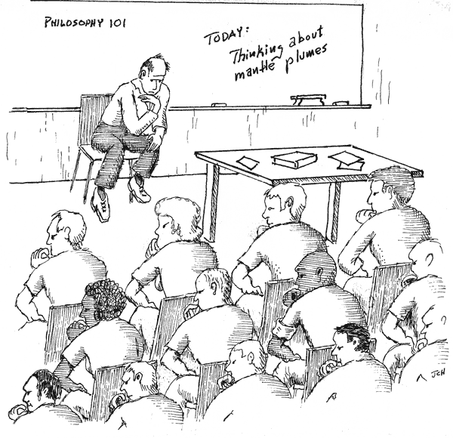
Food for thought

Slide 92


Slide 93


Slide 94
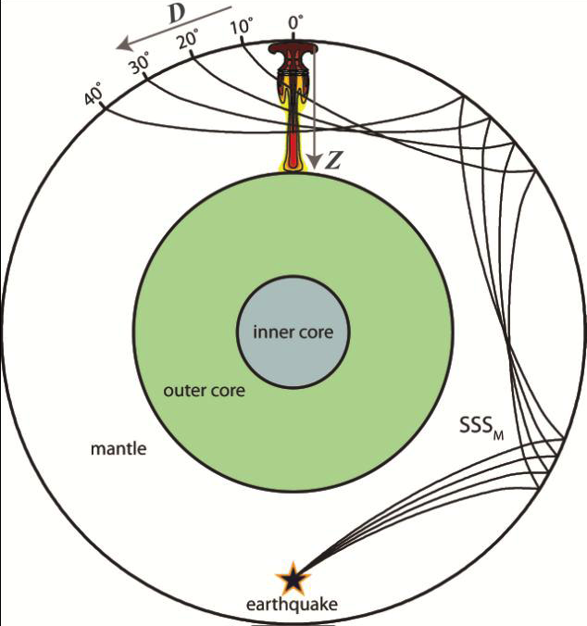

Slide 95
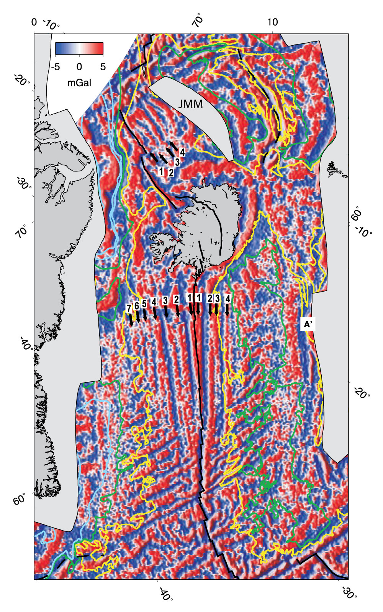
The “chevron ridges”

Slide 96
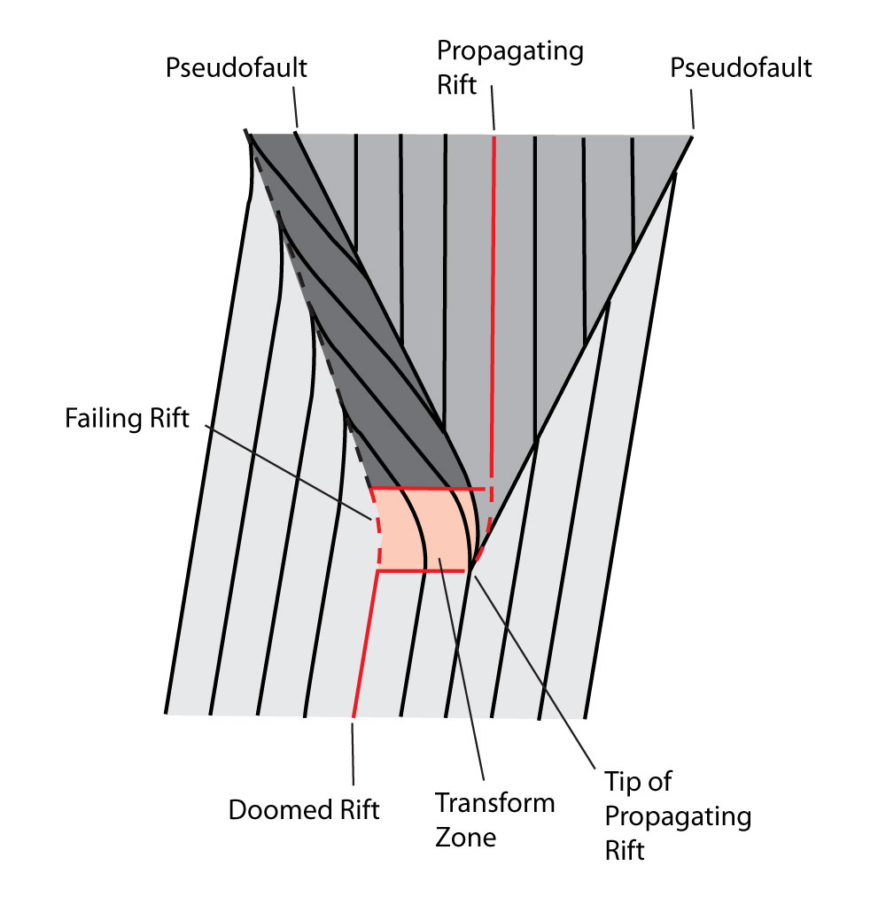
Propagating ridges

Slide 97
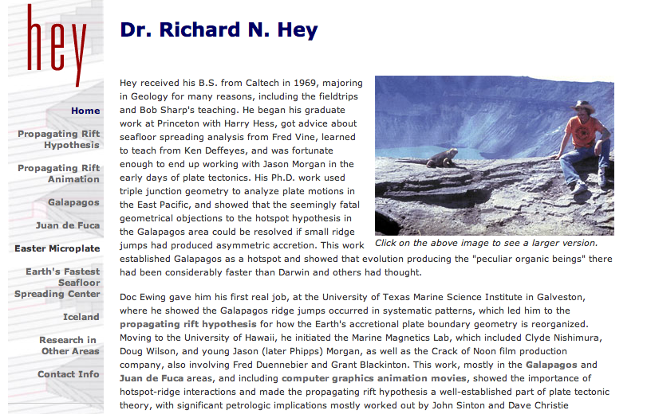
Check out: http://www.mantleplumes.org/Disclosure.html

Slide 98
http://www.soest.hawaii.edu/HIGP/Faculty/hey/movie.html

Slide 99
Is it wider on the western flank?
Competing models:
Propagating ridges? Plume?

Slide 100
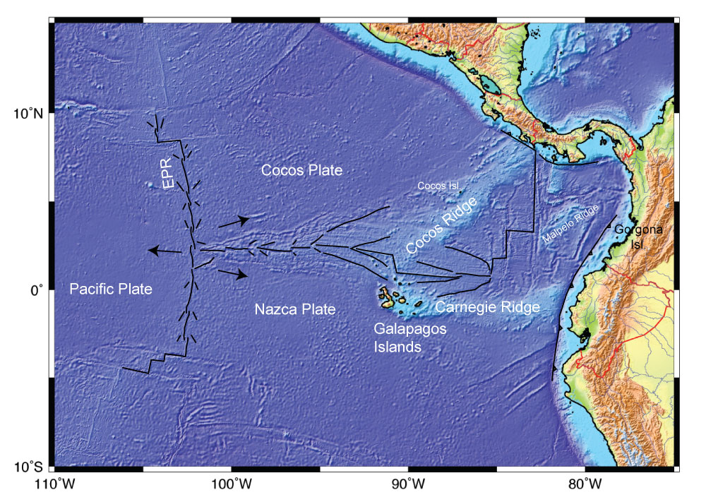
The home of propagating ridges

Slide 101
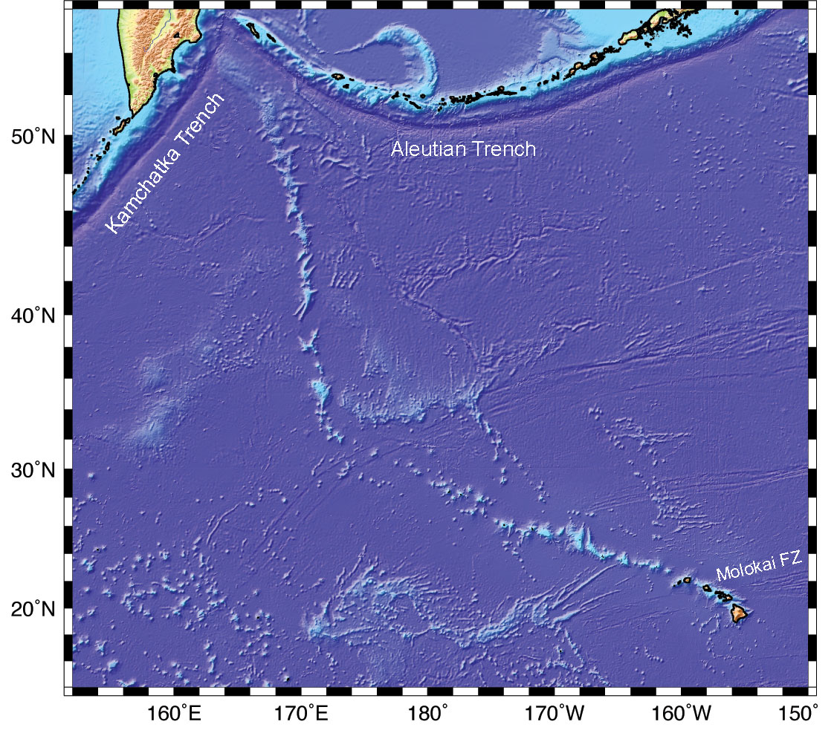
Hawaii
80 Ma
50 Ma
0 Ma

Slide 102
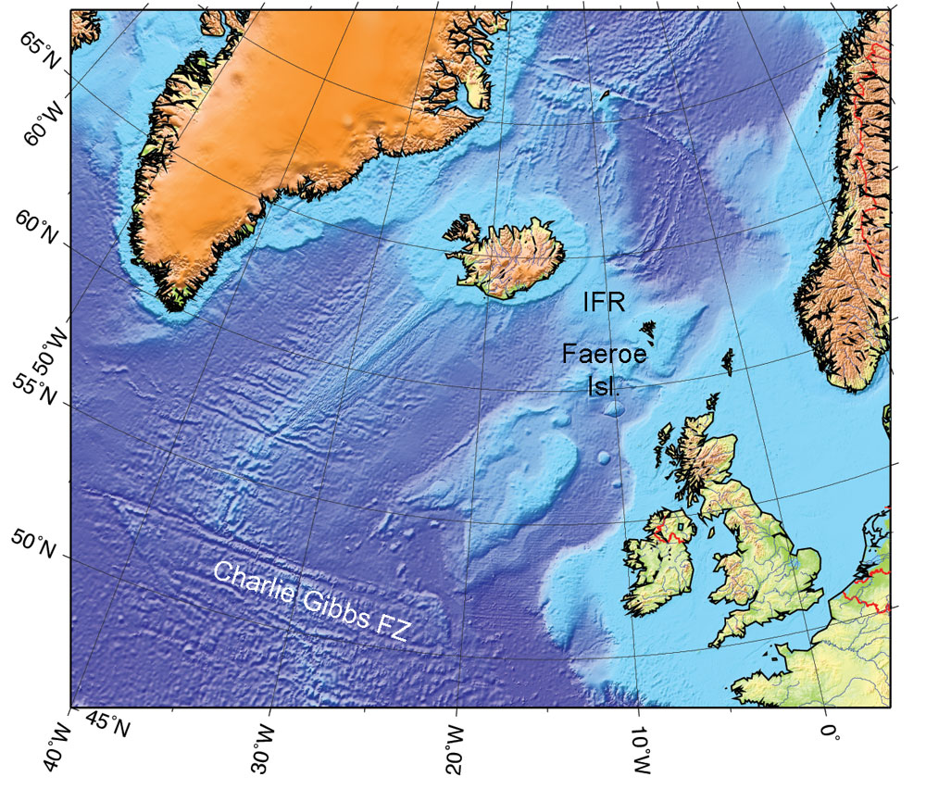

Slide 103
Teleseismic Tomography
Evans & Achauer (1993)

Slide 104
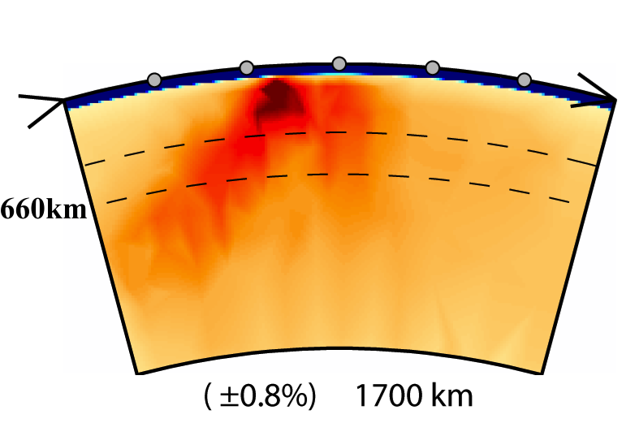
Hawaii: Tomography
NW SE
NW SE
Li et al. (2008)
Wolfe et al. (2009)

Slide 105
Poor repeatability of plume location

Slide 106
The Plate hypothesis

Slide 107
Successful predictions

Slide 108
Back-arc extension
Christiansen et al. (2002)

Slide 109
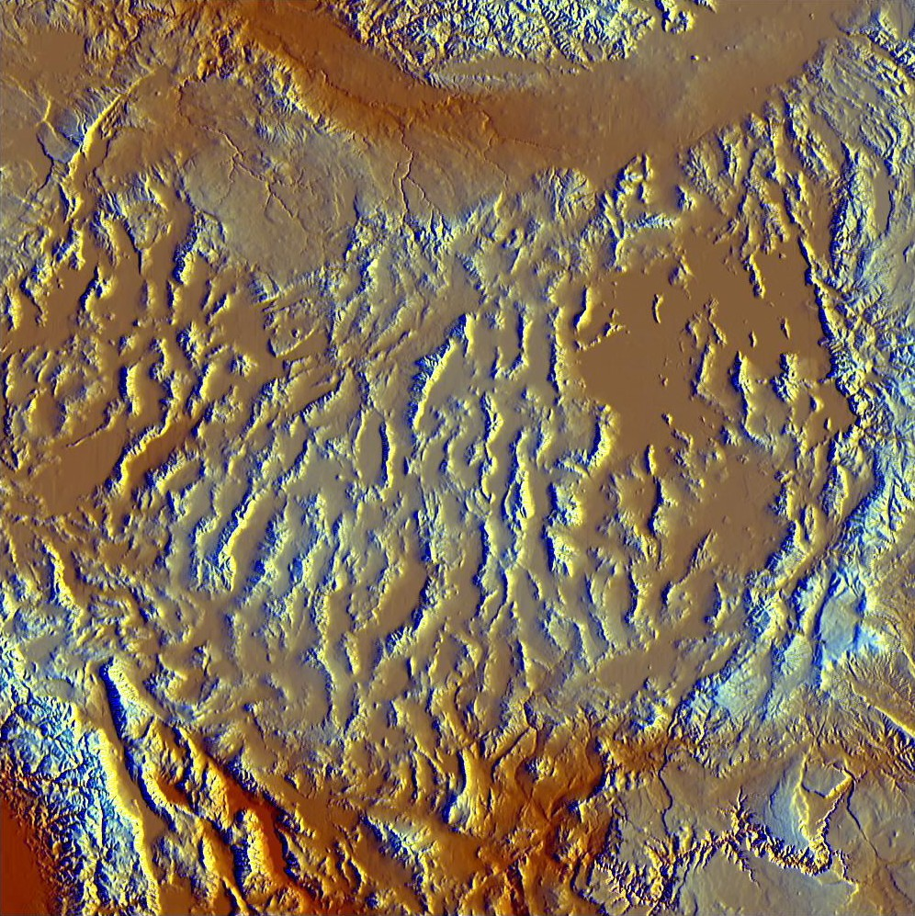
Distributed continental extension

Slide 110
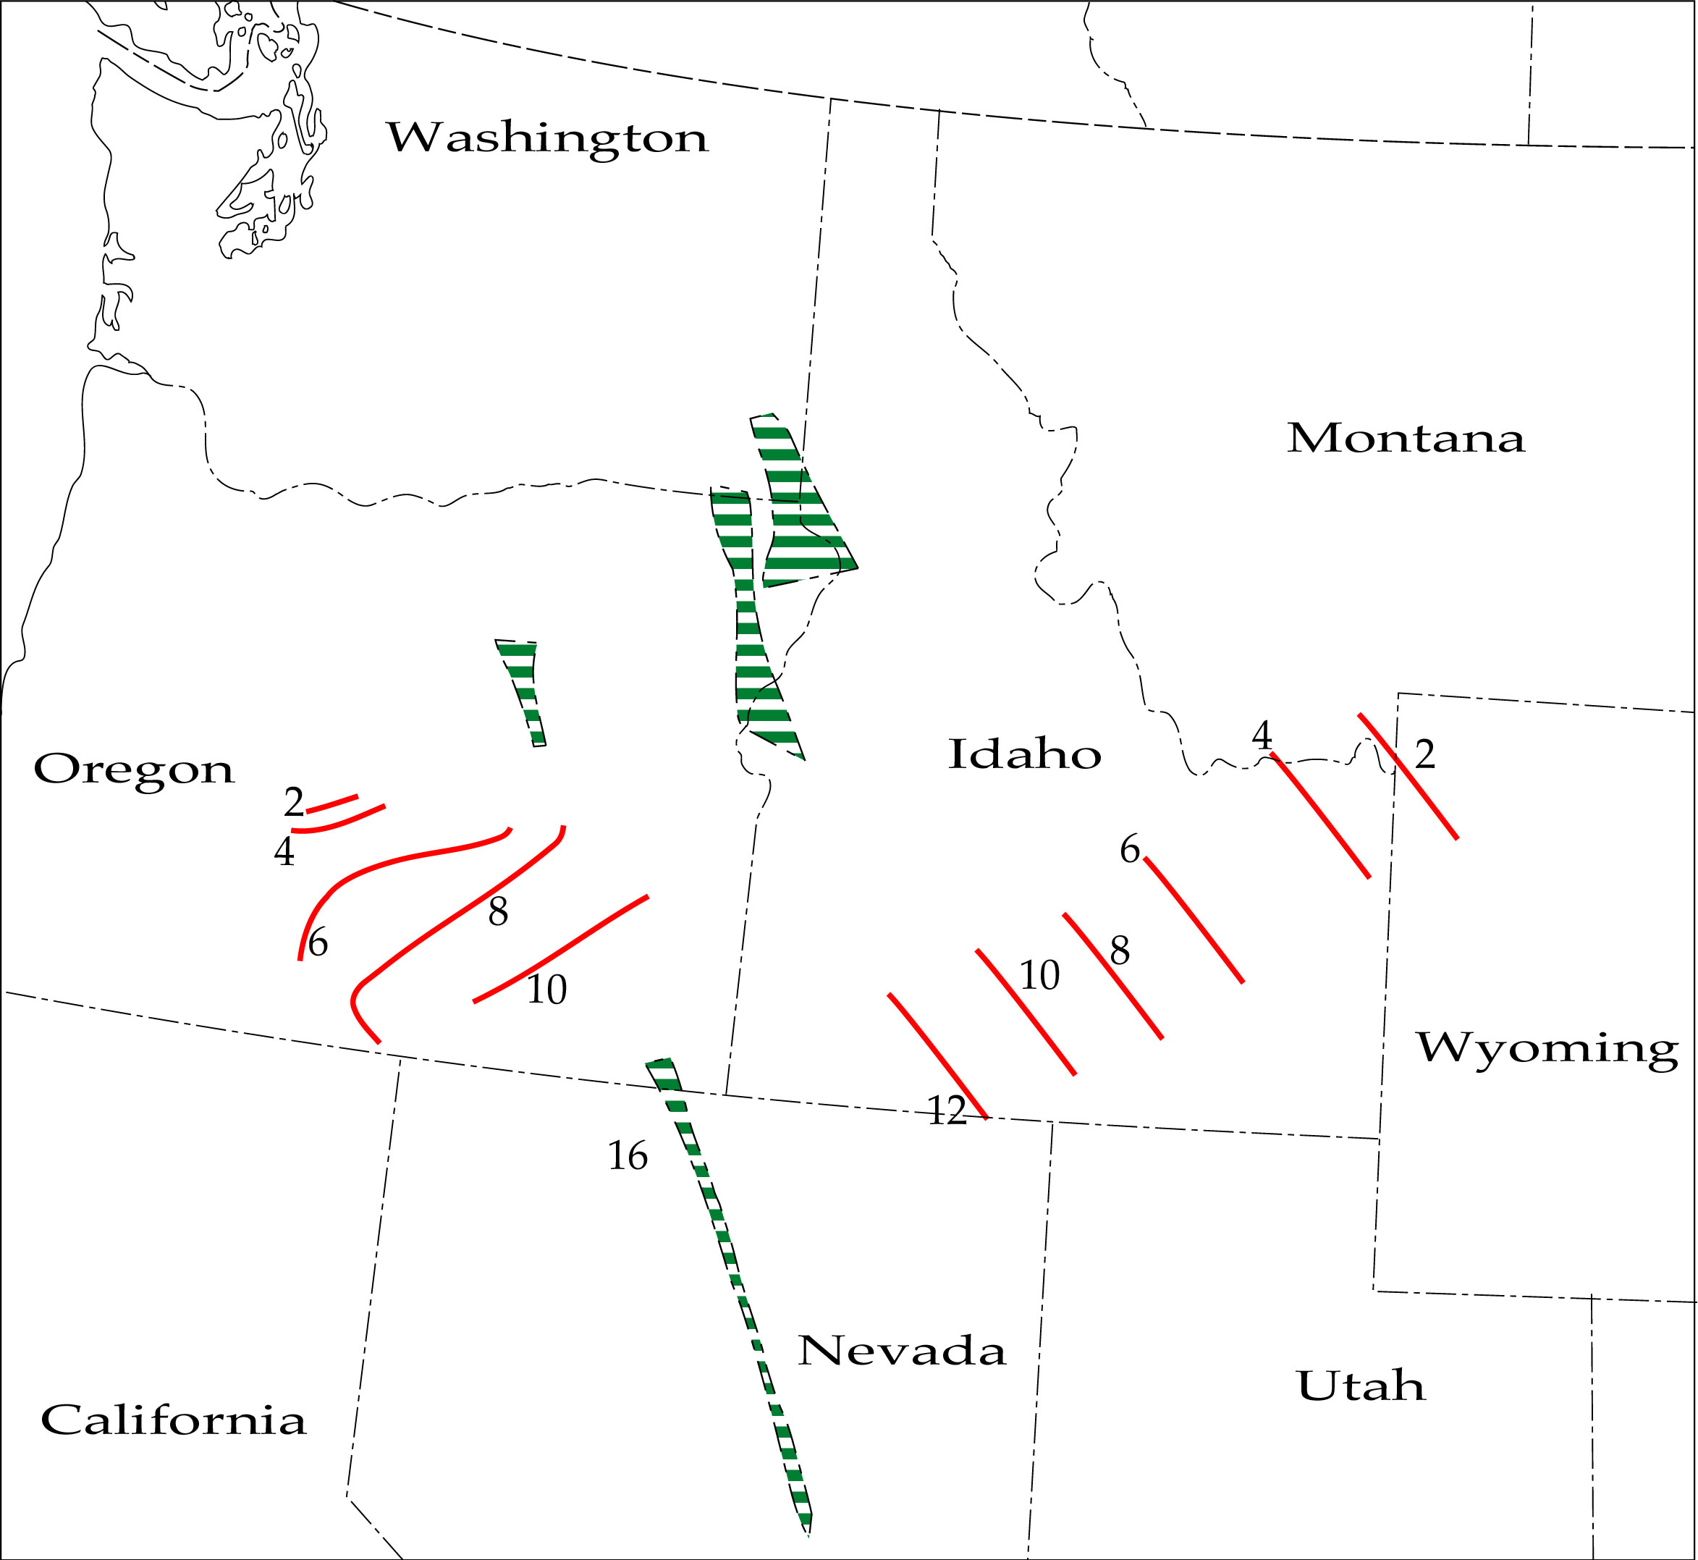
Reverse time-progressive volcanic trail (“Newberry trend”)
Christiansen et al. (2002)
Notes:
Art’s comments: A lot of uncertainty about the role of shallow hydrothermal circulation, and how it is modelled is a matter of discretion. General heat flow field complicated by the hydrothermal activity. Difficult to project into the mantle.

Slide 111
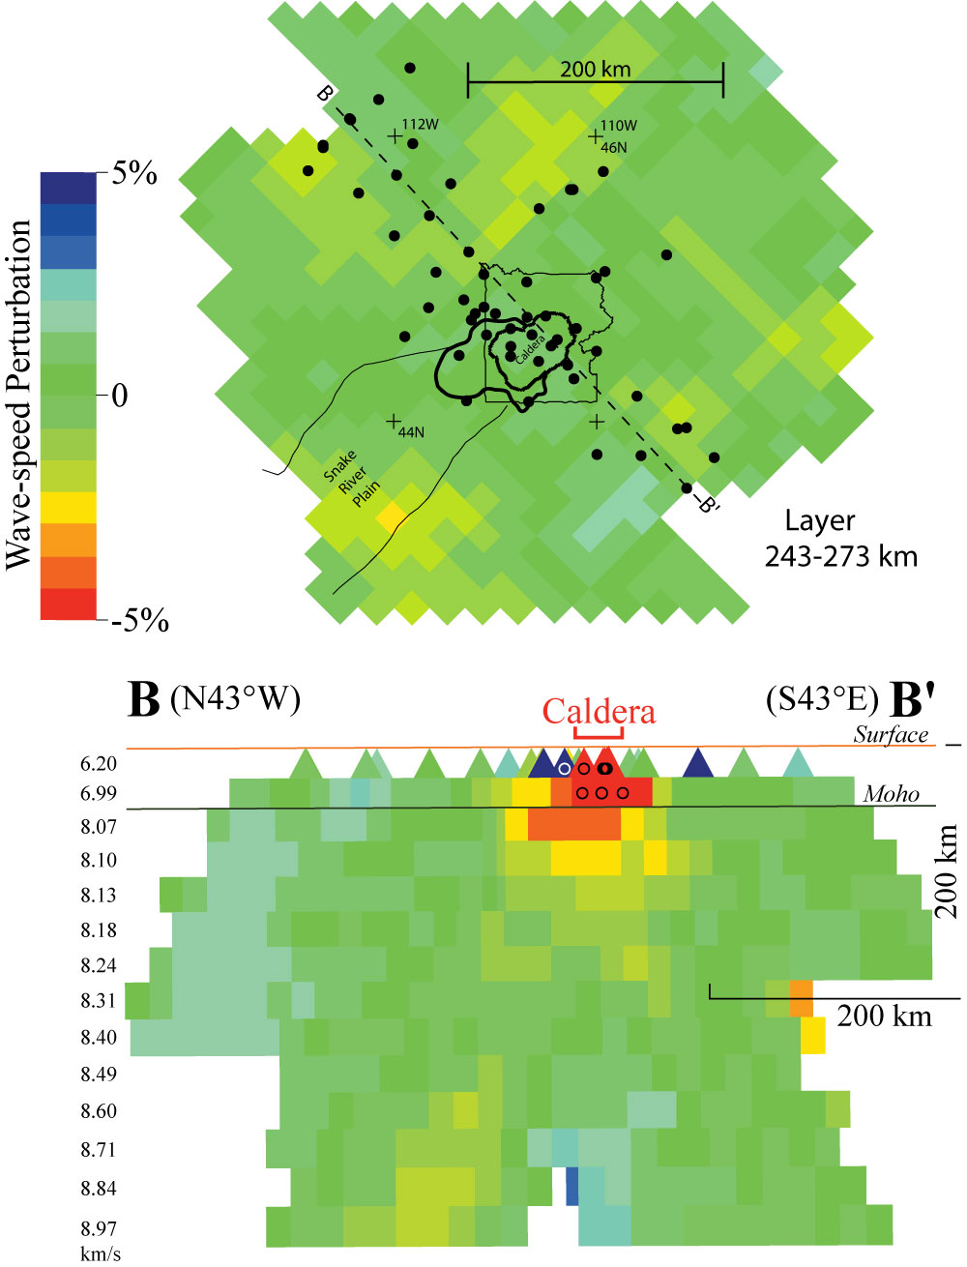
Yellowstone: Teleseismic tomography
Christiansen et al. 2002

Slide 112
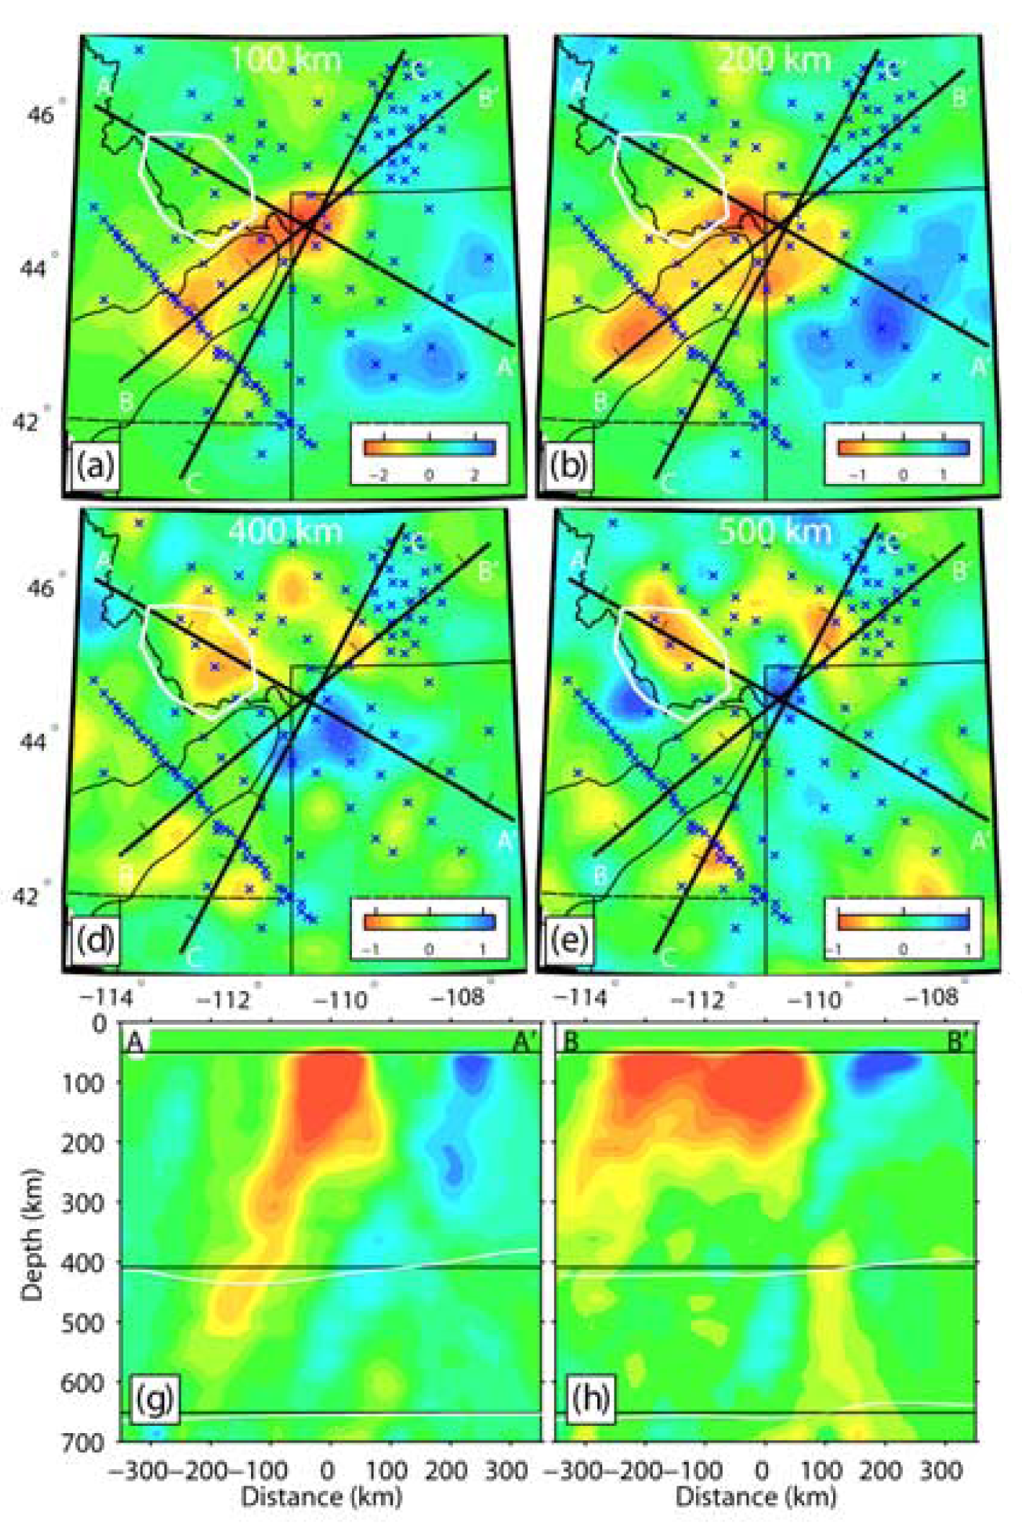
Yellowstone:
Teleseismic tomography
Yuan & Dueker (2005)

Slide 113
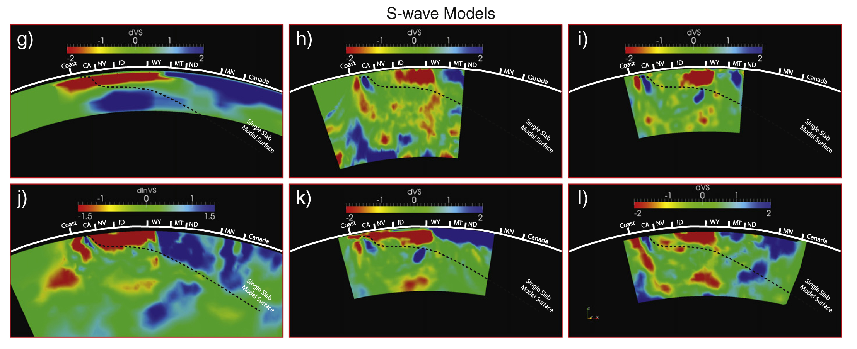
Tomography X-section along Eastern Snake River Plain - Yellowstone
Pavlis et al. (2012)

Slide 114
But what about the time-progressive volcanism?
Christiansen et al. (2002)

Slide 115

Yellowstone Heise Picabo
After Anders (1994)
Notes:
Migration of high fault displacements on large range-bounding normal faults in the vicinity of the ESRP-Y (after Anders, 1994). The rate of migration of high fault activity is 2.02 - 2.37 km/Ma, similar to the migration rate of large caldera-forming volcanism from 10 to 2 Ma.

Slide 116
Foulger et al. (2015)

Slide 117
Craters of the Moon National Monument

Slide 118

Lakagigur, Iceland

Slide 119

Iceland

Slide 120
Foulger et al. (2015)

Slide 121

Iceland: Fissure eruption

Slide 122
The Galapagos

Slide 123


Slide 125

The chevron ridges
Foulger (2010)
Jones et al. (2002)

Slide 126
The chevron ridges
Foulger (2010)
http://www.mantleplumes.org/Disclosure.html
Jones et al. (2002)
Foulger (2010)

Slide 128
Predictions of the Plate hypothesis

Slide 129
1. Volcanism associated with lithosphere extension

Slide 130

2. Space/Time distribution follows extension
Notes:
For more animations: http://www.navdat.org/animations/index.cfm

Slide 131

4. Normal temperatures

Slide 132
5. Melt exists in the mantle

Slide 133
Two views of the mantle
Melt anomaly source
MORB source
MORB
source
~200˚C hotter than surrounding mantle
Melt anomaly
source
melting point varies

Slide 134

Eruptives contain “fertile” (i.e. low-melting-point) recycled material

Slide 136
No-one can agree on how many plumes there are, or where they are

Slide 137



Courtillot et al. (2003)
Ritsema & Allen (2003)
Tholeiitic provinces
Montelli et al. (2006)

Slide 138

Extensional stress at plate boundary junctions
Beutel (2005)

Slide 139

Fig. 5.24

Slide 140

Late Cenozoic volcanic centers
St. George volcanic zone
Valles volcanic zone
Burdick et al. (2014)
Notes:
Map showing the distribution, composition, and age of Late Cenozoic volcanic centers in the Western United States" by R. G. Luedke and R. L. Smith. It is USGS Miscellaneous Geologic Investigations Map I-1523.

Slide 141

Late Cenozoic volcanic centers
St. George volcanic zone
Valles volcanic zone
Burdick et al. (2014)
Burdick et al. (2014)
Notes:
Map showing the distribution, composition, and age of Late Cenozoic volcanic centers in the Western United States" by R. G. Luedke and R. L. Smith. It is USGS Miscellaneous Geologic Investigations Map I-1523.

Slide 142
Yellowstone
Ritsema et al. (1999)

Slide 143

Variation of melting point with composition

Slide 144

Variation of melting point with volatiles

Slide 146
Propagating ridges

Slide 148

~ 10% of a slowly spreading plate boundary
Parsons et al. (1998)

Slide 149
The chevron ridges
Foulger (2010)
Jones et al. (2002)

Slide 150
2. Space/Time distribution follows extension
Notes:
For more animations: http://www.navdat.org/animations/index.cfm

Slide 151
3. Shallow-mantle structure
Ritsema et al. (1999)

Slide 152
4. Normal temperatures

Slide 153
Two views of the mantle
Melt anomaly source
MORB source
MORB
source
~200˚C hotter than surrounding mantle
Melt anomaly
source
melting point varies

Slide 154
Eruptives contain “fertile” (i.e. low-melting-point) recycled material

Slide 155
Plates or Plumes?

Slide 156
Five Predictions of the Plate Hypothesis

Slide 157
Five Predictions of the Plate Hypothesis
1.

Slide 158
2. Lithosphere extension
Basin & Range Province, USA

Slide 159


Composition
3. Volume Related to Fusibility
Pyrolite
Eclogite
Volatiles
Cordery et al. (1997)

Slide 160
4. Shallow-mantle structure
Iceland
Yellowstone
Ritsema et al. (1999)

Slide 161
5. Space/Time distribution follows extension
Basin & Range Province
65 Ma - present
Notes:
For more animations: http://www.navdat.org/animations/index.cfm

Slide 162
Melt in mantle NOT sufficient
Extension is required
✖
✔
Notes:
It is a common misunderstanding that the mere existence of melt in the mantle is sufficient to explain surface eruptions–that the lithosphere is passive and melt in the mantle can pass through it unimpeded as light passes through a glass window. This is not the Plate hypothesis, which predicts that lithospheric extension is required for melt to escape to the surface.

