Slide 1

Seismic Tomography
Challenges and New Approaches
Bruce Julian, Gillian Foulger

Slide 2
Types of Tomography
Teleseismic, “ACH” (Aki, Christoffersson & Husebye, 1976)
Local-Earthquake, “LET” (Aki & Lee, 1976;Thurber, 1983…)
Whole-mantle (or Earth): Similar to local-earthquake
…

Slide 3
Teleseismic Ray Paths
Steep in
upper mantle
P & PKP
Julian & Anderson, 1968

Slide 4
Teleseismic Tomography
Cannot measure absolute wave speeds
Insensitive to vertical variations
Evans & Achauer (1993)

Slide 5
Smearing along rays
Eken et al. (2008)

Slide 6
Smearing along rays
Eken et al. (2008)

Slide 7
Example: Spurious Low Wave-speed Zone
“Data” computed from this
lead to this model (!!)
Foulger et al. (2013) after Ian Bastow

Slide 8
Example: Spurious Low-Wavespeed Zone
And the inferred shapes of the high-wavespeed zones are wrong!
Foulger et al. (2013) after Ian Bastow

Slide 9
Why the spurious low wave-speeds?
Numerical damping: Minimize mean-
square departure of V from a reference model.
Therefore the mean change in V is zero.

Slide 10
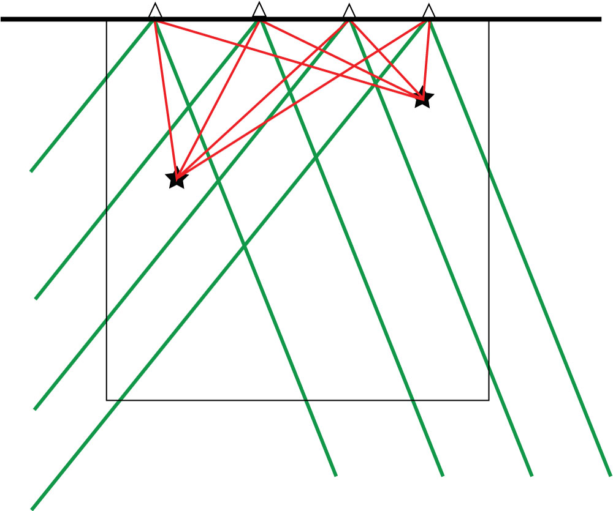
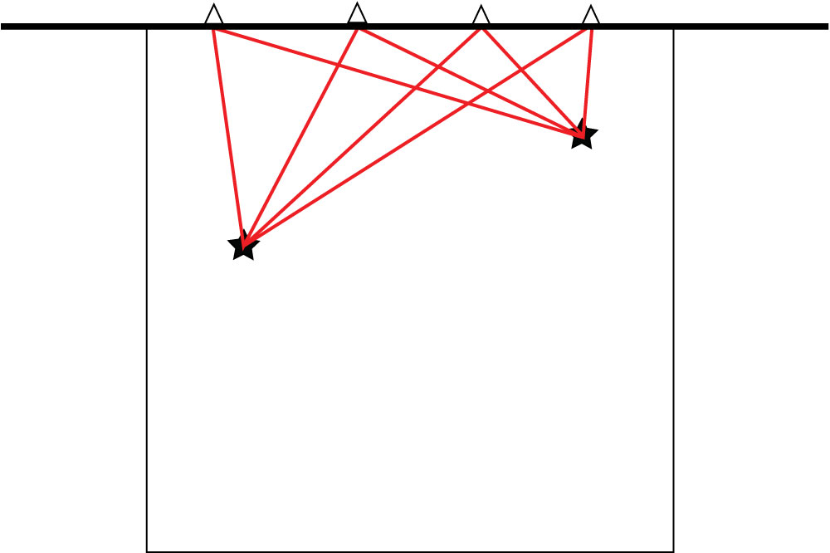
Local vs. Distant Events
Local events sample shallow structure only.
Distant events sample deeper structure.

Slide 11
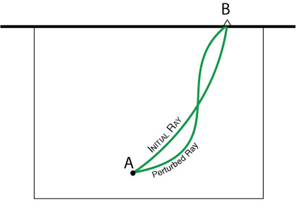
Local Event
Must solve for change in wave speed,
Forward problem:
(Fermat)
Notes:
When inverting local-event arrival times, the locations and origin times of the events must be included as unknowns and solved for. The theoretical first-order dependence of the arrival times on the origin parameters is relatively simple.

Slide 12
Local Event
and solve for earthquake locations & times.
Forward problem:
Notes:
When inverting local-event arrival times, the locations and origin times of the events must be included as unknowns and solved for. The theoretical first-order dependence of the arrival times on the origin parameters is relatively simple.

Slide 13
Wait! Don’t we also need to solve for event locations & times in teleseismic tomography?
YES
Bad News: This is seldom or never done.
Good News: It is not difficult to do.
We solve for the direction and time of each
incoming wave front (3 parameters/event).

Slide 14
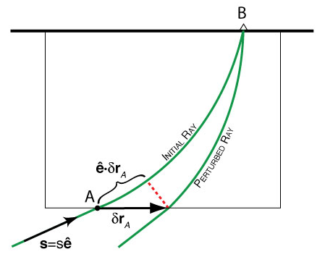
Distant Event
Incident Plane Wave:
Arrival time at B:
Perturbed Wave:
Notes:
When inverting distant-event arrival times, the orientations and times of the incident waves must be included as unknowns and solved for. The theoretical first-order change in the arrival time at B turns out to equal the change in the arrival time at the unperturbed entry point A. This fact needs to be incorporated into the “ACH” method of teleseismic tomography (Aki et al., 1976) to account for biasing effects of the structure outside the study volume, although heretofore this first-order effect has been ignored.

Slide 15
If we change the direction and/or time of the incoming wave, the change in the arrival time at the seismometer (B) is the same (to first order) as the change in the arrival time at the original entry point (A) at the bottom of the local structure!

Slide 16
General Difficulties with Seismic Tomography
Inadequate ray coverage

Slide 18
Inhomogeneous Ray Coverage
Figure provided by Jeroen Ritsema and published in Hamilton (2011).
Notes:
Figure 7: S and SS raypaths sampling the mid-mantle. Much of Earth's interior is effectively unsampled, and much else is sampled primarily by sub-parallel rays rather than by the diversely crossing rays required for good tomographic imaging. The so-called deeply subducted “Farallon slab” (Grand et al., 1997) beneath the Caribbean and eastern United States is particularly non-uniformly sampled. Published tomographic images of this region vary greatly (Figure 11). (Figure provided by Jeroen Ritsema and published in Hamilton, 2011).

Slide 19
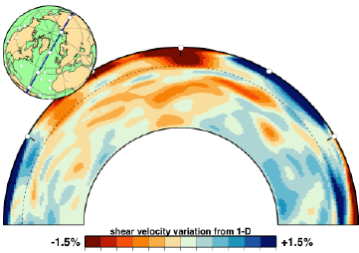
Whole-Mantle Tomography
Model S20RTS (Ritsema et al., 1999, 2004)
Section along MAR through Iceland
Resolution best in upper mantle (surface waves).
Limited by ray distribution, esp. in lower mantle.
Artifacts

Slide 20
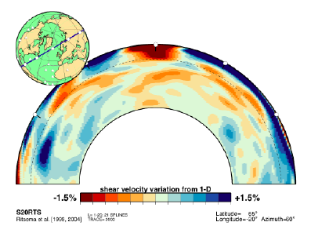

Slide 21
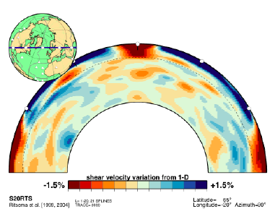

Slide 22
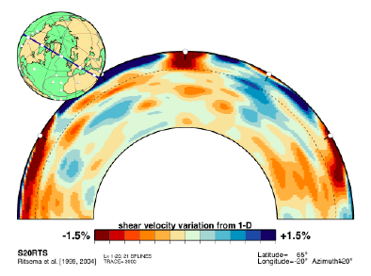

Slide 23
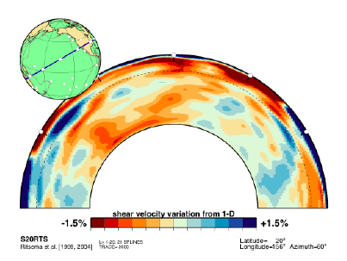
Hawaii

Slide 24
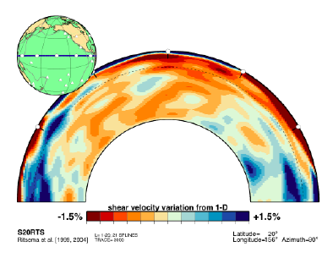

Slide 25
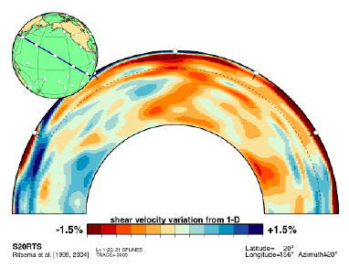

Slide 26
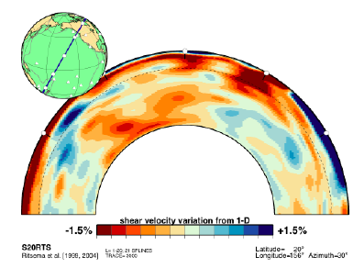

Slide 27
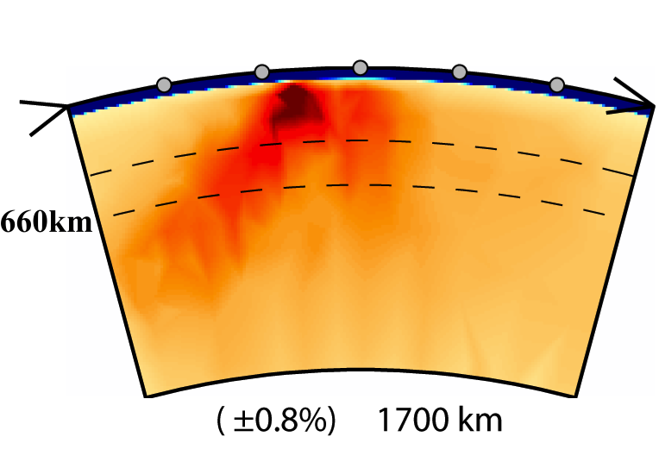
Inhomogeneous Ray Coverage
NW SE
NW SE
Li et al. (2008)
Wolfe et al. (2009)

Slide 28
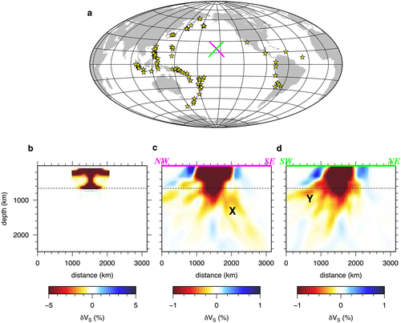
Evaluating the Resolution of Deep Mantle Plumes in Teleseismic Traveltime Tomography
Evaluating the Resolution of Deep Mantle Plumes in Teleseismic Traveltime Tomography, Volume: 123, Issue: 1, Pages: 384-400, First published: 23 November 2017, DOI: (10.1002/2017JB014730)
Maguire et al. (2018)
Notes:
Smearing test for the PLUME experiment (i.e., configuration B). S and SKS traveltimes are jointly inverted using FF. (a) Earthquake distribution used in the inversion, as well as the locations of cross sections through recovered model. (b) Input plume structure, which is the upper mantle expression of R1c (i.e., R1c where the plume tail has been artificially removed). (c) NW‐SE cross section through the recovered model. The feature labeled “X” illustrates smearing oriented steeply to the SE due to the prevailing incoming ray direction of South American events. (d) SW‐NE cross section through recovered model. The feature labeled “Y” reflects smearing to the SW owing to the prevalence of South Pacific events.
IF THIS IMAGE HAS BEEN PROVIDED BY OR IS OWNED BY A THIRD PARTY, AS INDICATED IN THE CAPTION LINE, THEN FURTHER PERMISSION MAY BE NEEDED BEFORE ANY FURTHER USE. PLEASE CONTACT WILEY'S PERMISSIONS DEPARTMENT ON PERMISSIONS@WILEY.COM OR USE THE RIGHTSLINK SERVICE BY CLICKING ON THE 'REQUEST PERMISSIONS' LINK ACCOMPANYING THIS ARTICLE. WILEY OR AUTHOR OWNED IMAGES MAY BE USED FOR NON-COMMERCIAL PURPOSES, SUBJECT TO PROPER CITATION OF THE ARTICLE, AUTHOR, AND PUBLISHER.

Slide 29
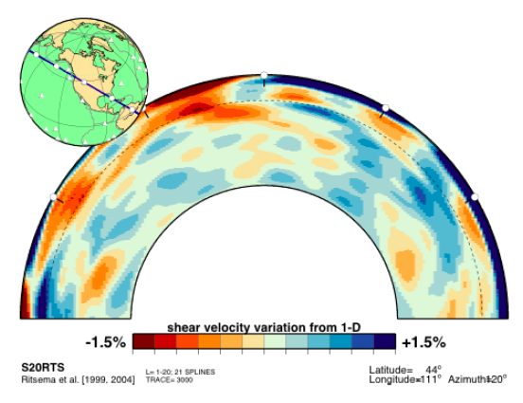
Yellowstone

Slide 30
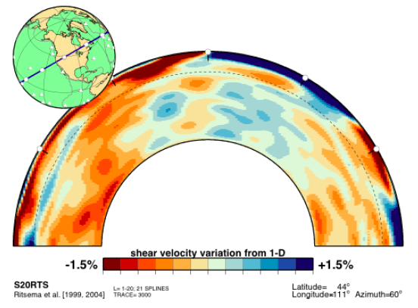
Yellowstone

Slide 31
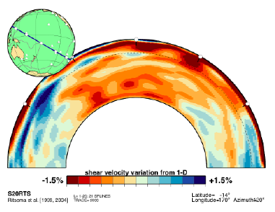

Slide 32
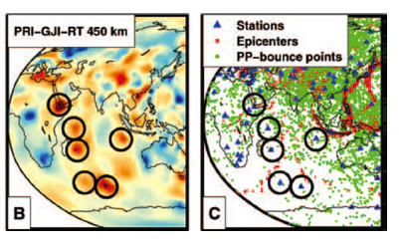
Example: “Plumes” in Whole-Mantle Models
Model: Montelli et al. (2004; 2006); Figures: Van der Hilst & V. de Hoop (2005)

Slide 33
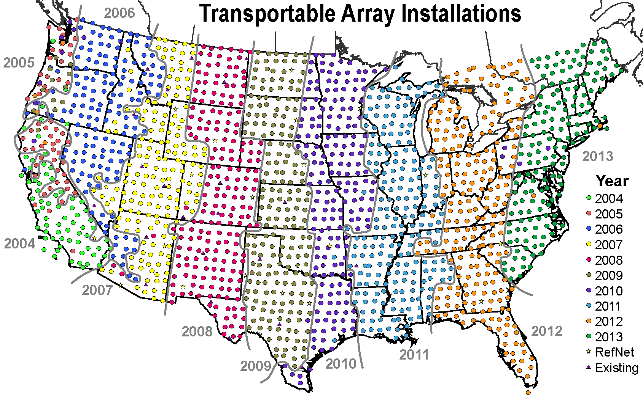
Seek Better Ray Coverage?

Slide 34
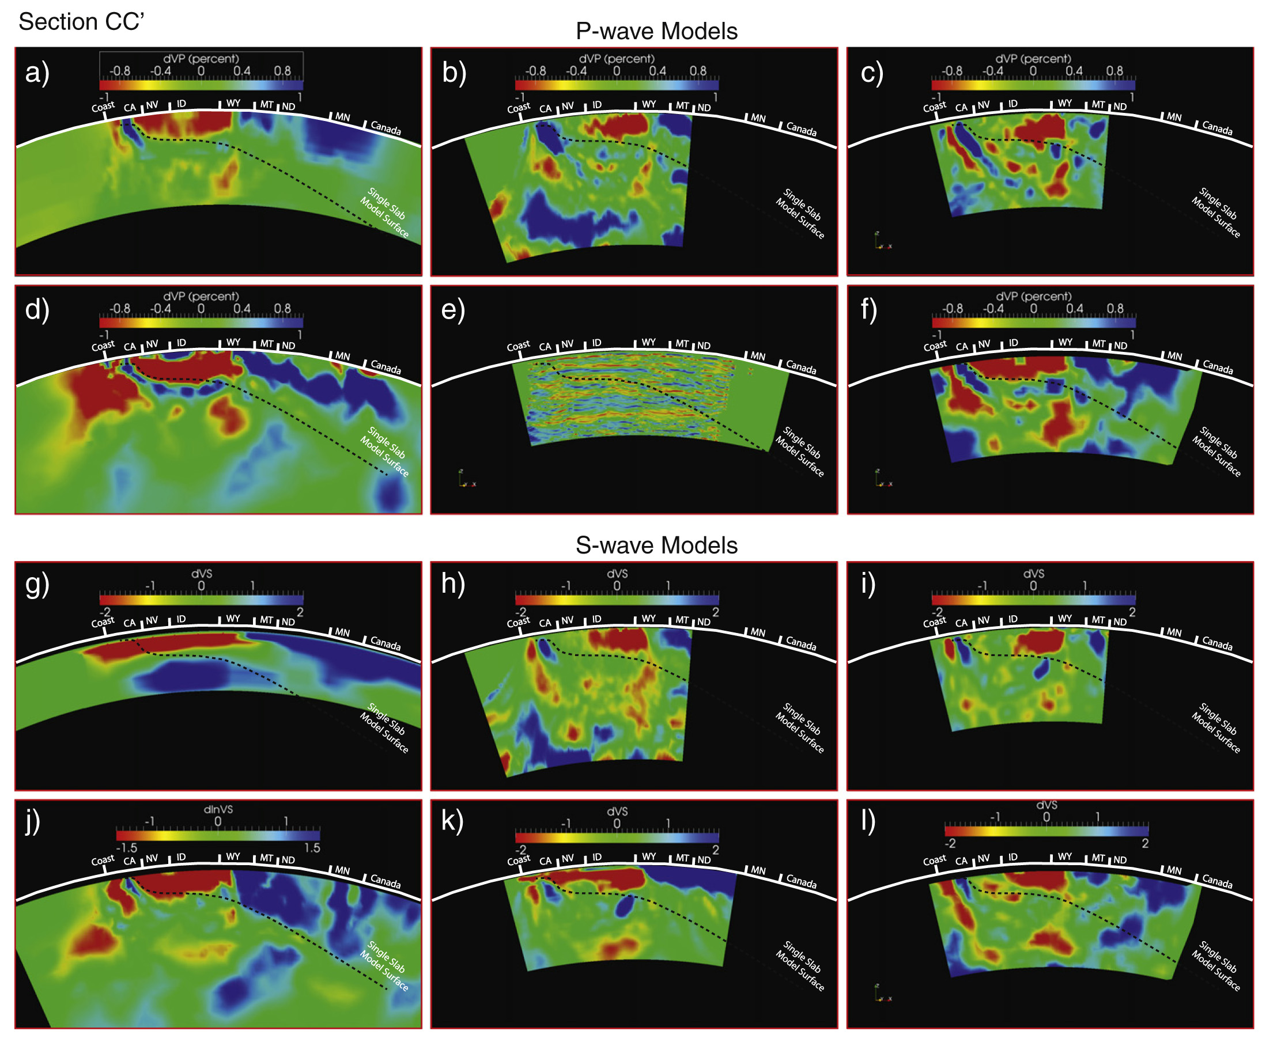
Sections Across Northern US
Cape Mendocino to Canada-Minnesota border
(Pavlis, 2012)

Slide 35
General Difficulties with Seismic Tomography
Inadequate ray coverage
Displaying the results

Slide 36
Displaying the Results
Bijwaard & Spakman (1999)

Slide 37
General Difficulties with Seismic Tomography
Inadequate ray coverage
Displaying the results
Finite-frequency wave-propagation effects

Slide 38
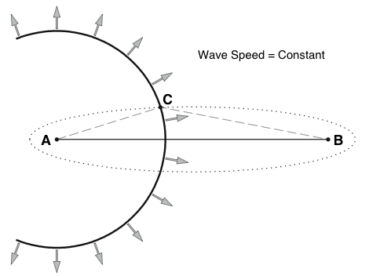
Finite-Frequency Tomography
Travel time “feels” Fresnel zone, of width (“Banana”).
Sensitivity = 0 on ray! (“Doughnut”).

Slide 39
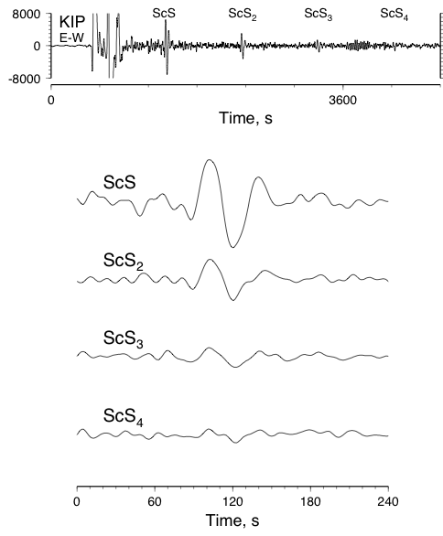
Multiple ScS Core Reflections
Hawaii earthquake of 1973 April 26, recorded on Oahu (Best et al., 1974)
Relative times indicate high wave speeds and low attenuation.

Slide 40
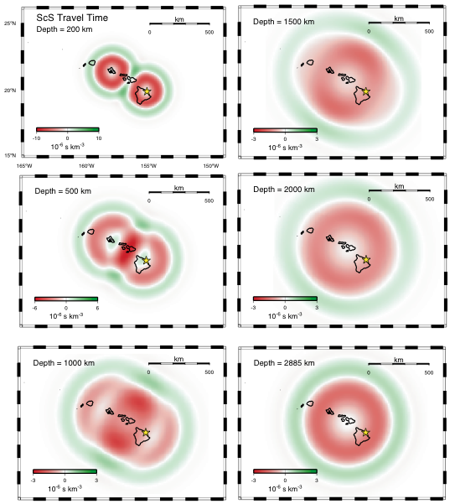
Hawaii: ScS Sensitivity Kernel
Using “Banana-Doughnut” theory of Dahlen et al. (2000)

Slide 41
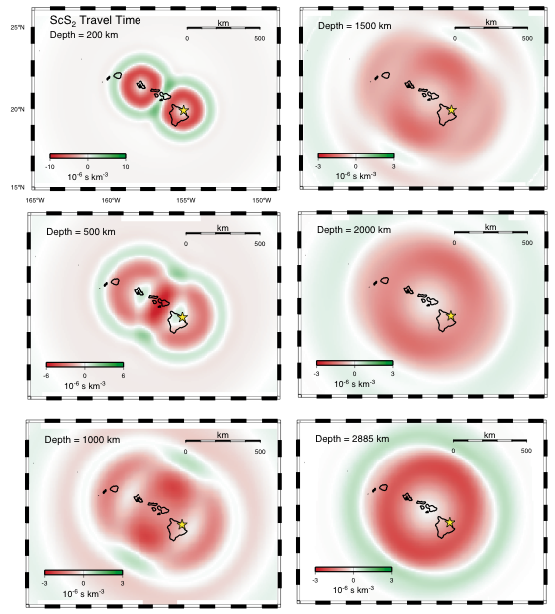
ScS₂ Sensitivity Kernel
Similar to ScS kernel in upper mantle.

Slide 42
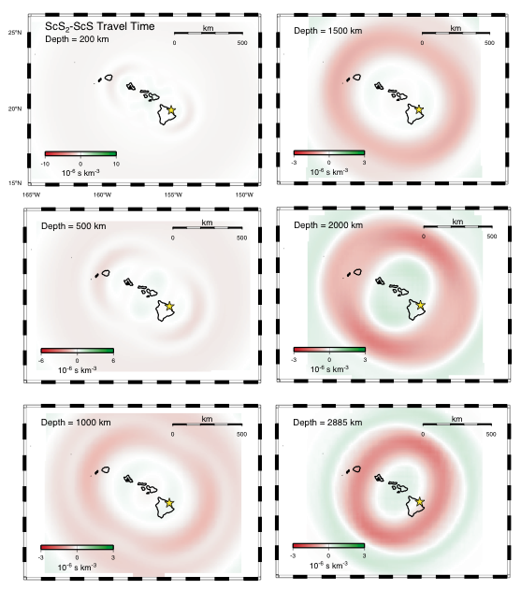
ScS₂-ScS Sensitivity Kernel
Almost zero small-scale sensitivity in upper mantle

Slide 43
Use a better wave-propagation theory?
Ray Theory
“Banana-Doughnut” Theory
Van der Hilst & V. de Hoop (2005)

Slide 44
The Way Forward
  Publish seismic models on web, with errors
Integrate seismology & geochemistry where each has power:
  e.g., LVZ = depth where volatiles lower the solidus of minerals
  Suggests melt present

Slide 45
Test Hypotheses, Don’t Seek “Models”.
(Nature, 2006)

Slide 47
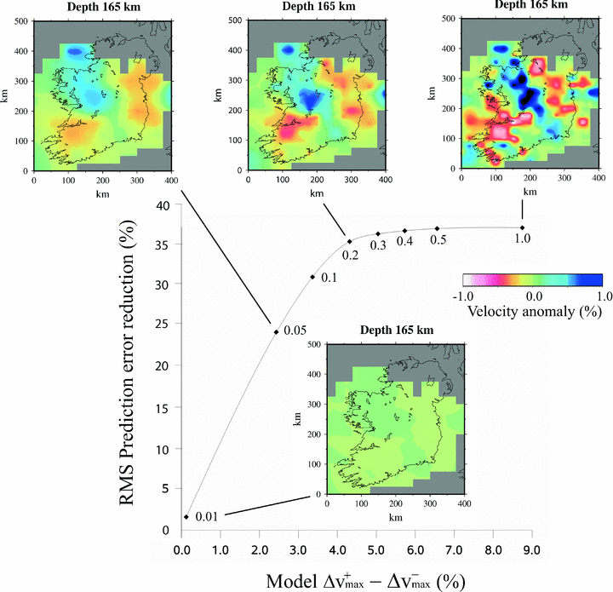
O’Donnell et al. (2011)
Notes:
Figure 5: Trade-off curve showing the balance between model roughness (quantified by the difference between the extremal positive and negative wave speed contrasts) and root mean square prediction error reduction (%). The curve is labeled with wave speed model parameter standard deviations. Each point represents a model solution corresponding to the indicated model parameter standard deviations (from O'Donnell et al., 2011).

Slide 48
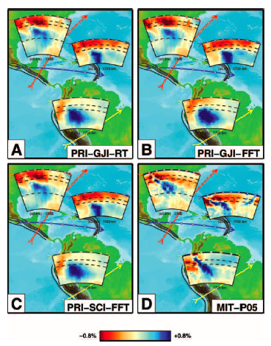
Different Methods, Same Data
Ray Theory and Finite-Freq. Theory give similar results, which lack subducted slabs.
MIT inversion of same data shows more detail, has slabs.
Van der Hilst & de Hoop, GJI 2005

Slide 50
Don’t Seek “Models”
Test Hypotheses

Slide 51
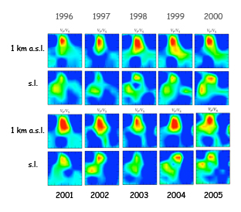
Example: Coso Geothermal Area, California
2001 2002 2003 2004 2005

Slide 52
Are these changes real?
Changes in tomographic models are expected even if the Earth doesn’t change, because of:
• Differences in ray coverage
• Observational errors

Slide 53
Computer Program tomo4d
Analyzes two epochs of data.
Inverts for structural change required by the data.

Slide 54
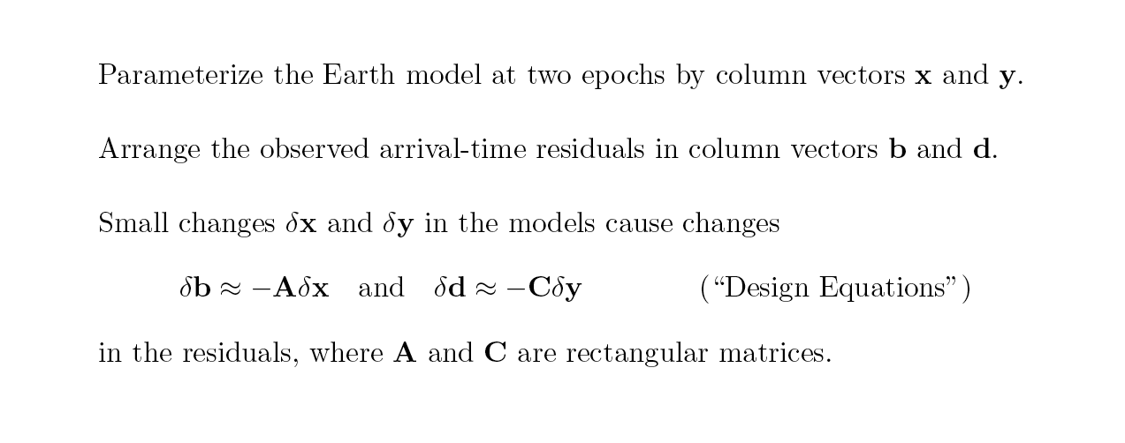
Two-Epoch Problem
Parameterize the Earth model at two epochs by column vectors x and y.
Arrange the observed arrival-time residuals in column vectors b and d.
Small changes δx and δy in the models cause changes:
In the residuals, where A and C are rectangular matrices

Slide 56
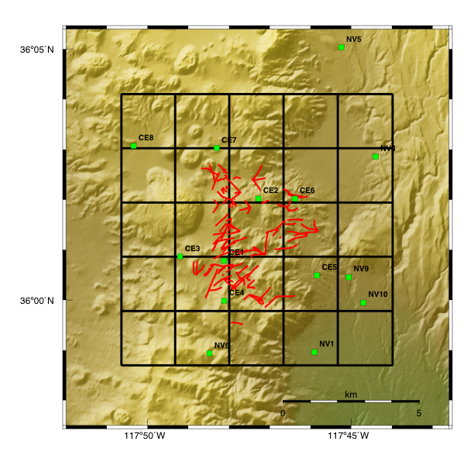
The Coso Geothermal Area
Tomography grid:
2 x 2 km horizontal
1 km vertical
Navy seismometers
Geothermal wells

Slide 57
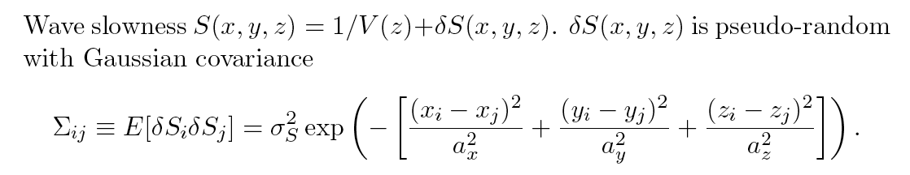
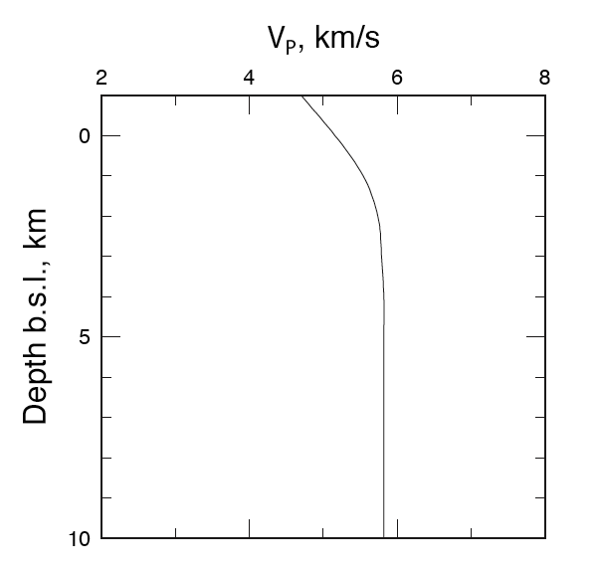
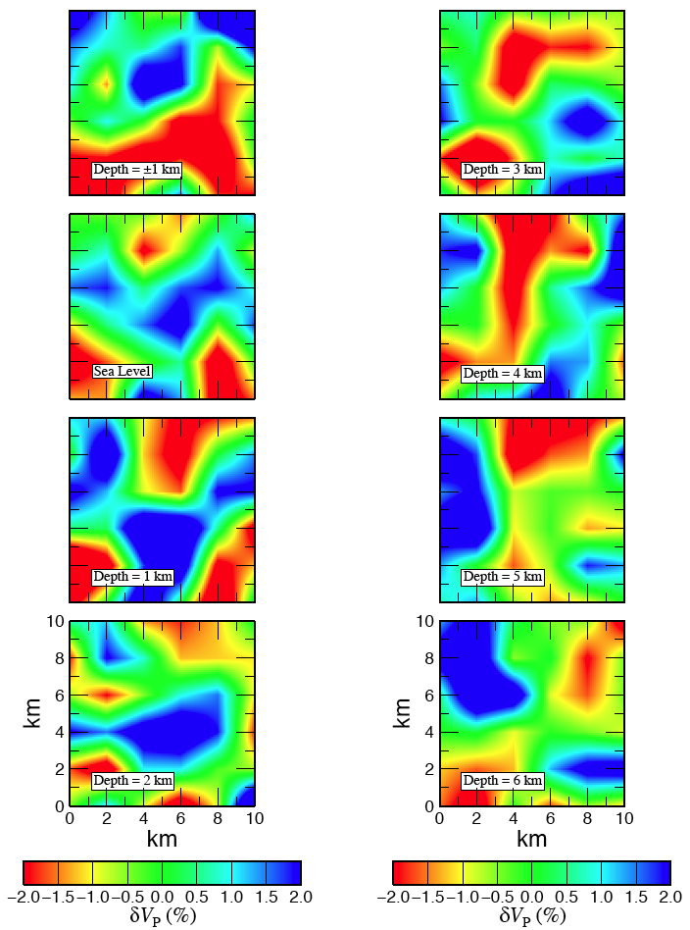
Tests with Synthetic Data

Slide 58
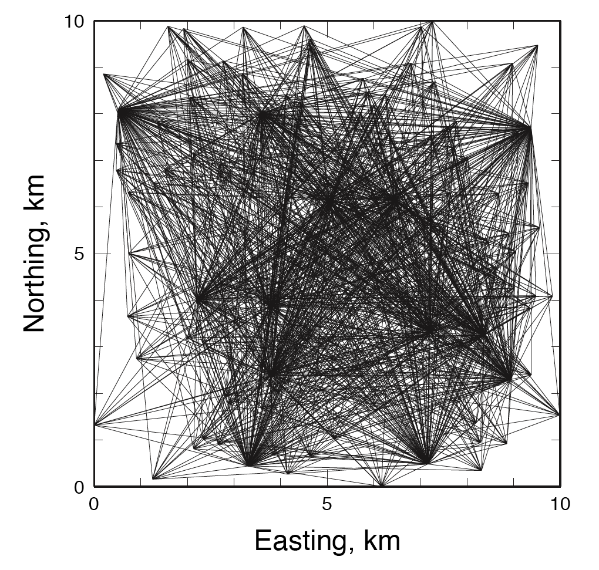
Synthetic Case:
Uniform Earthquake Distribution
100 earthquakes in 10-km cube
13 seismometers, located as at Coso

Slide 59
Independent Inversions: Spurious Temporal Variations
Julian & Foulger, 2010

Slide 60
tomo4d Inversion: No True Temporal Variations
Julian & Foulger, 2010

Slide 61
True Temporal Variations: Independent inversions

Slide 62
True Temporal Variations: tomo4d Inversion

Slide 63
Imperfect Retrieval of True Structure

Slide 64
Coso Results
Structural changes: V_{P}
Depth
-1 km
0 km

Slide 65
Coso Results
Structural changes: V_{S}
Depth
-1 km
0 km

Slide 66
Coso Results
Structural changes: V_{P}/V_{S}
Depth
-1 km
0 km
Notes:
\

Slide 67
Conclusions
Earth is not well sampled by observed seismic rays.
Derived structures are smeared along rays.
Many inferred structures are really ray bundles.
Teleseismic tomography omits effect of event location. Many studies need to be repeated.
Would be better to test hypotheses than to seek “models”. Example: Time-dependent tomography.

Slide 68
Spurious Temporal Variations

Slide 69
No True Temporal Variations

Slide 70
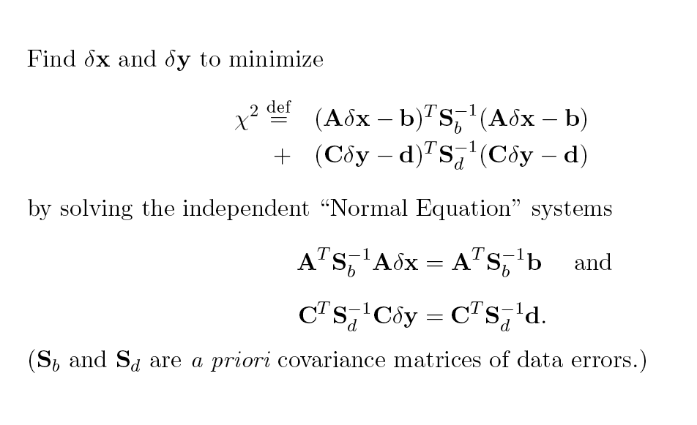
Conventional Least-Squares Method

Slide 71
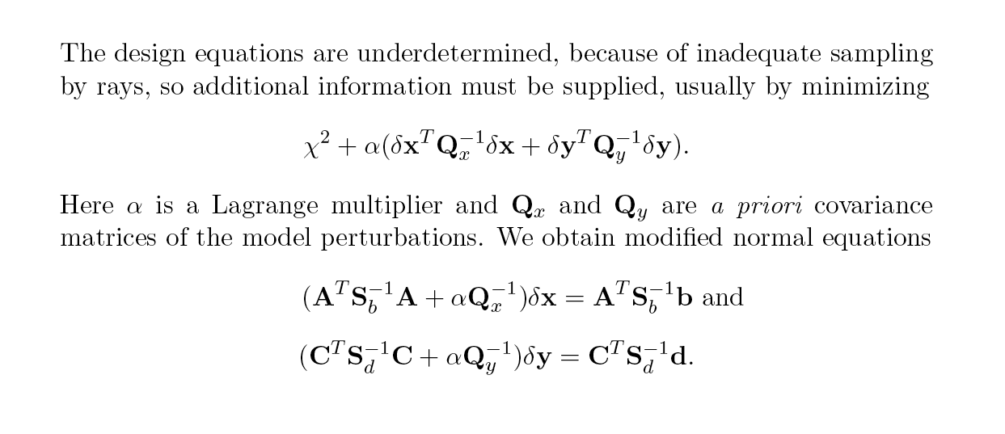
Regularization

Slide 72
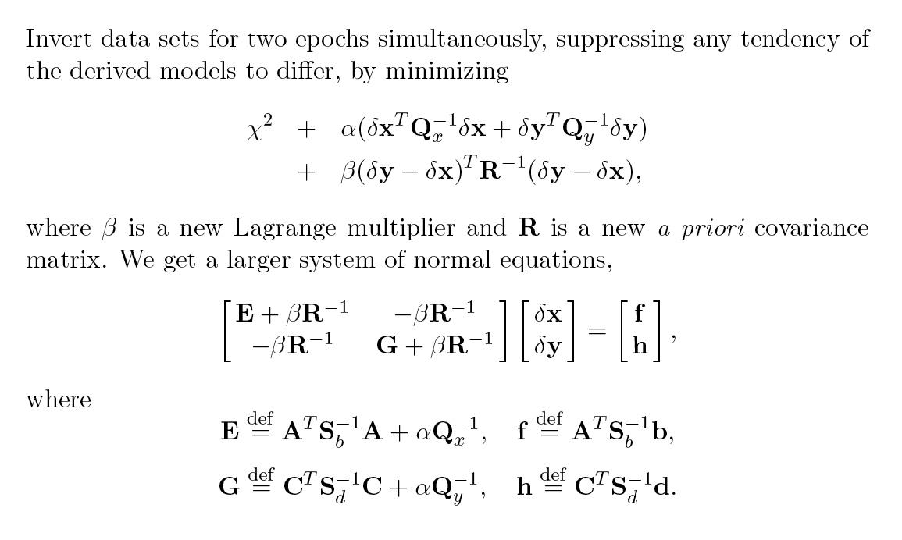
Differential Least-Squares Method

Slide 73
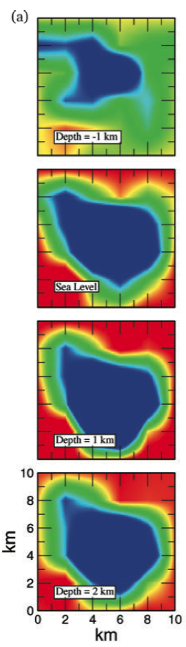
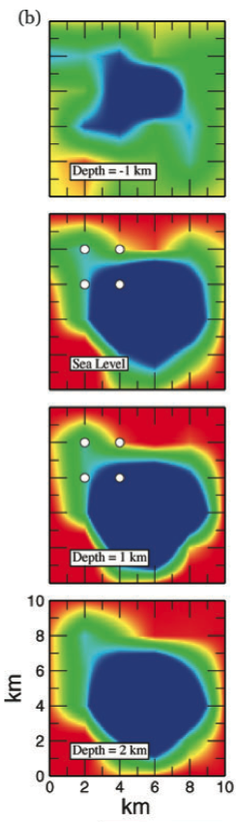
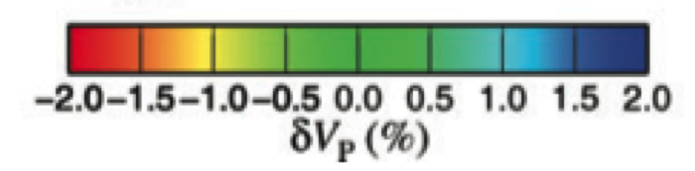
tomo4d
MEQs
set 1 set 2
…but detects true temporal variations
  Theoretical Data Test

Slide 74
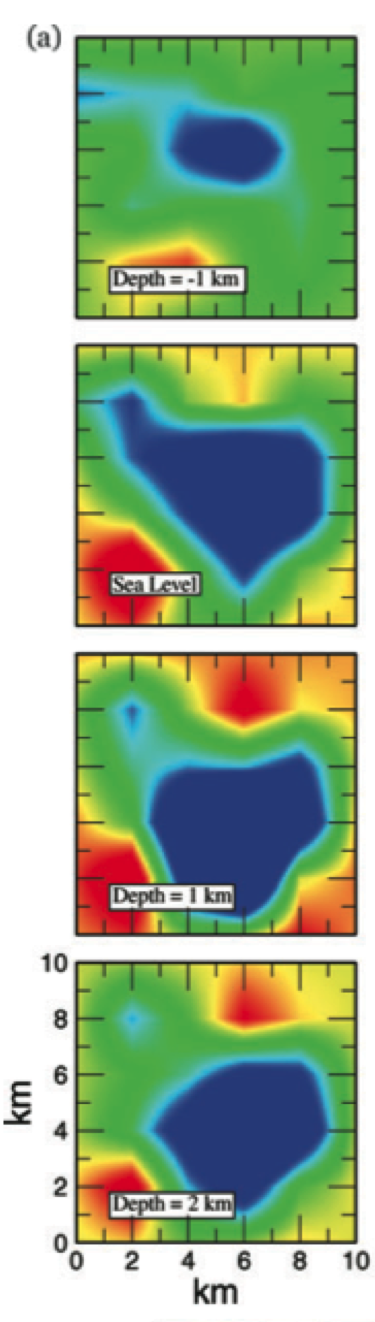
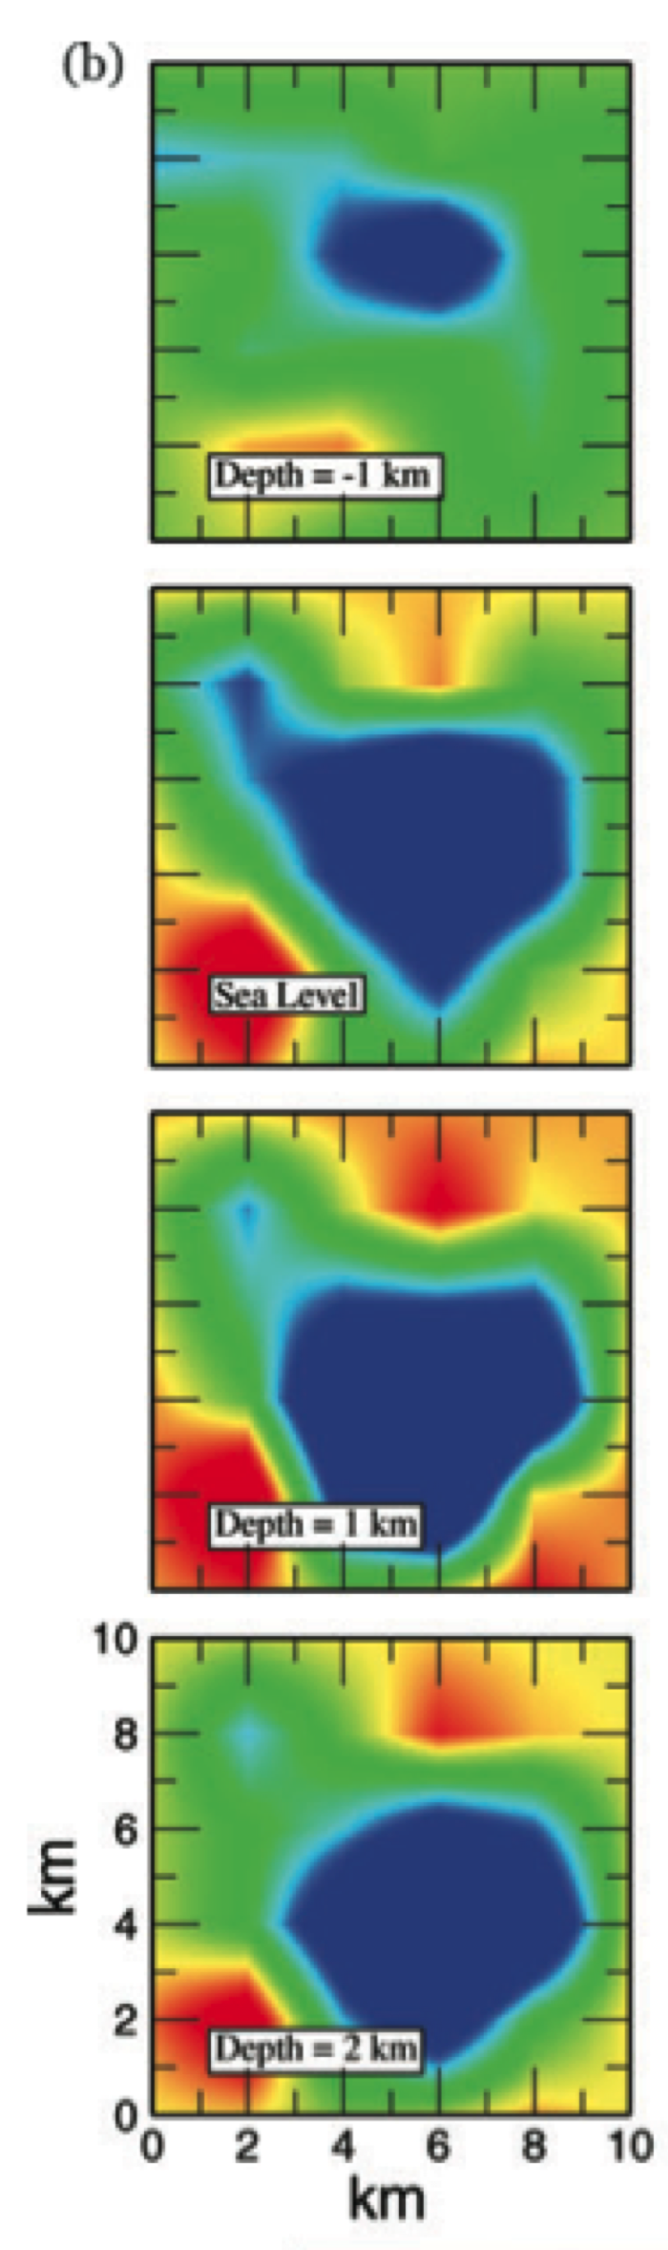
tomo4d
MEQs
set 1 set 2
  Theoretical Data Test
Same structure
  Suppresses erroneous structural changes not required by the data

Slide 75
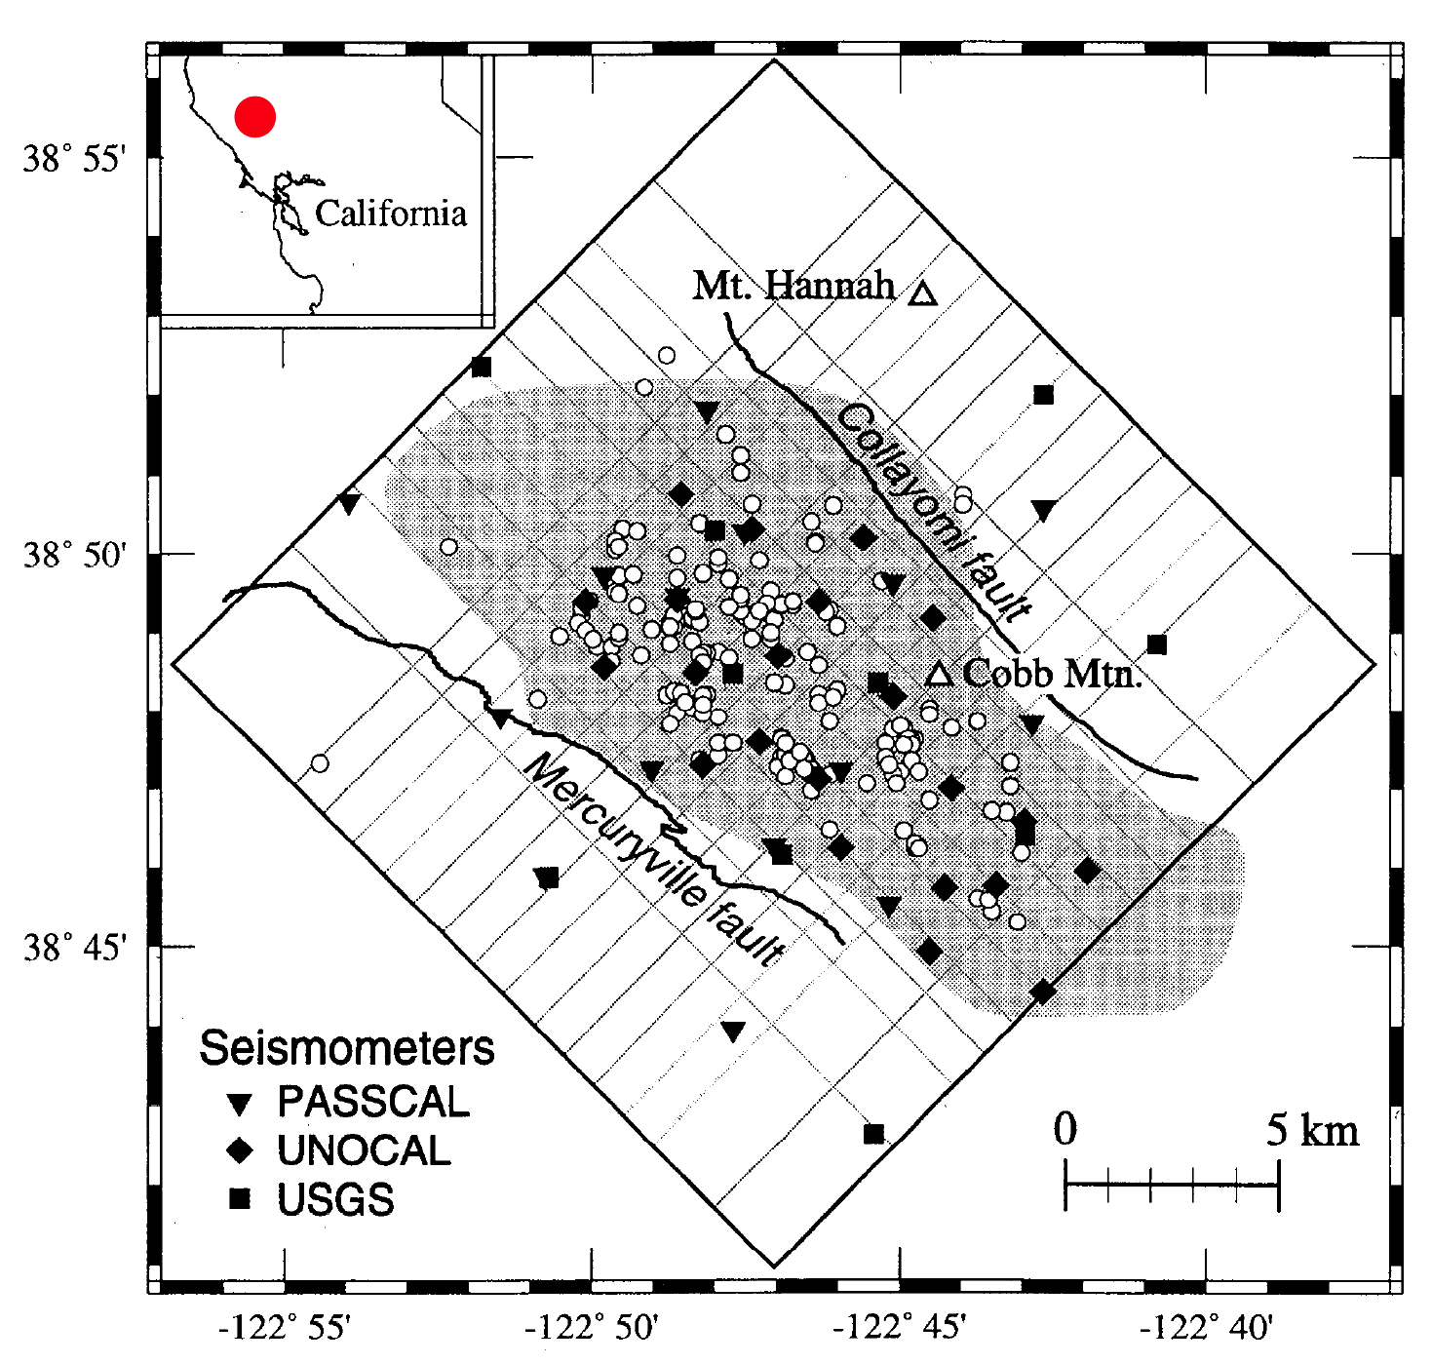
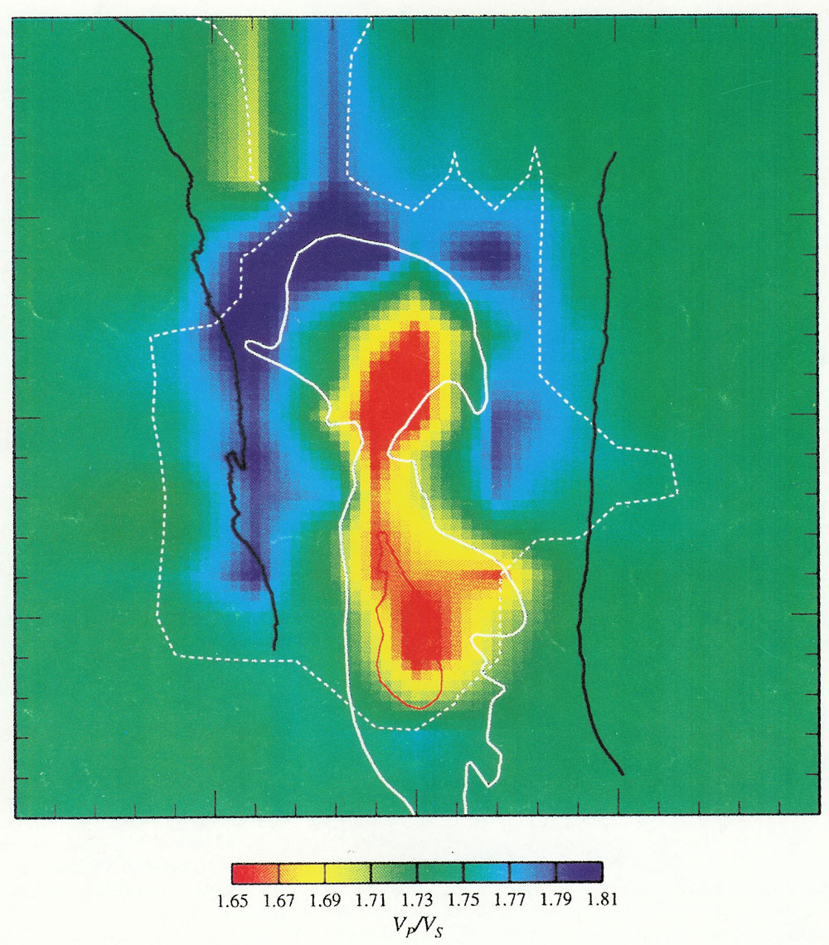
Image of Geothermal Reservoir
The Geysers, California

Slide 76
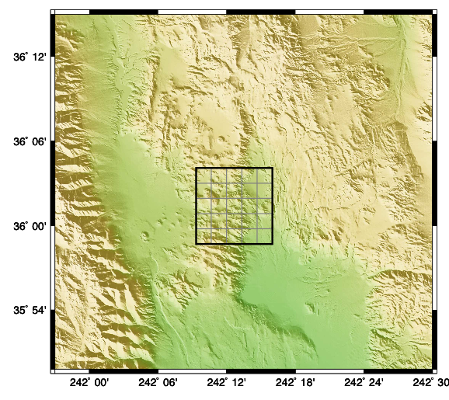
SW Basin & Range Province

Slide 77
Application: Coso Geothermal Area
Data processing
  Few 100 MEQs for each year
  Best 10 in each cube
  Arrival times hand-measured

Slide 78
Application: Coso Geothermal Area
Data 1996, 2006, 2007, 2008, 2010 and 2012

Slide 79
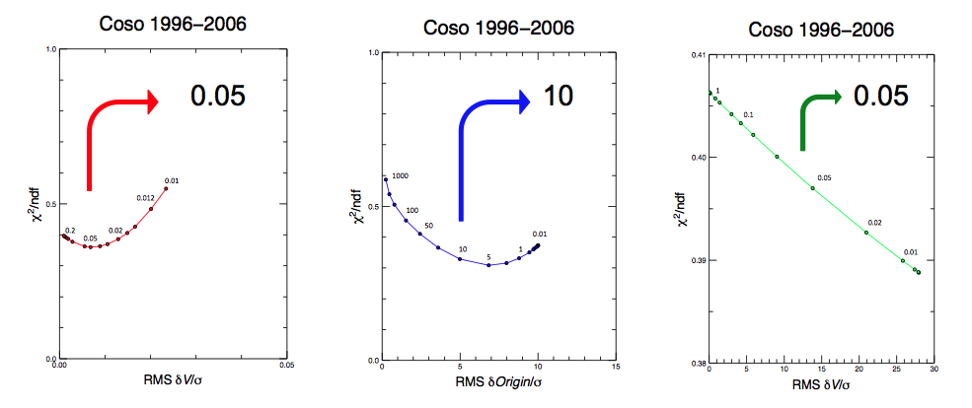
Application: Coso Geothermal Area
Data processing
  Damping parameters
Wave speed
Event origin
Temporal change
Trade-off damping curves

Slide 80
Results
P
S
P
S
-1 km
Ray density
Best-sampled
area - the main
geothermal field
sea level
1 km
2 km

Slide 81
Results
2007
2012
Improvement in data residuals
  Final RMS residual
  0.04 s (P)
  0.07 s (S)

Slide 82
Results
Structural changes: V_{P}
Depth
-1 km
0 km

Slide 83
Results
Structural changes: V_{S}
Depth
-1 km
0 km

Slide 84
Results
Structural changes: V_{P}/V_{S}
Depth
-1 km
0 km
Notes:
\

Slide 85
Results
Structural changes (2006-2012)
-1 km
0 km
_{ΔVp}
_{ΔVs}
_{ΔVp/Vs}

Slide 86
Future work
Process data from 2013 – present:
  Contribute to ongoing management of Coso field
Process data 1996 – 2005:
  Can trace historic evolution
  Can assist planning for new reservoirs

Slide 87
Future work
Calibrate against production/injection data to develop quantitative tool
Integrate with other data e.g.
  surface deformation data (InSAR)
  geology
  reservoir modelling

Slide 88
Conclusions
tomo4d: can rigorously determine weak seismic structural changes
Application to the Coso geothermal field remarkably successful:
  SW & NE fields responding differently to production

Slide 89
Can this be correct?
(It seems suspiciously simple.)
Test: Compare with exact solution, e.g. for a layer over a half-space.

Slide 90
ACH Tomography is Not Correct

Slide 93
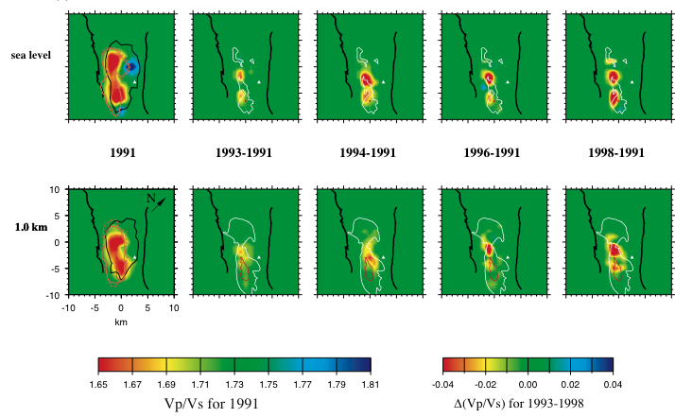
Temporal Variations of Wave Speeds
Example: The Geysers, California

Slide 94
Teleseismic Tomography
Structure outside the study volume cannot be ignored
Evans & Achauer (1993)

