Slide 1
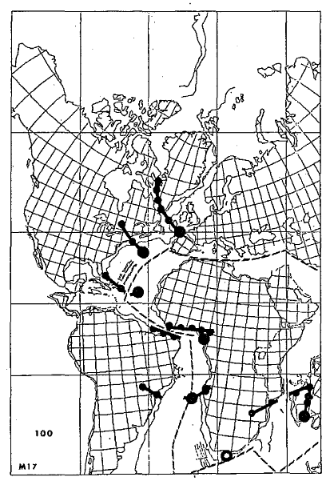
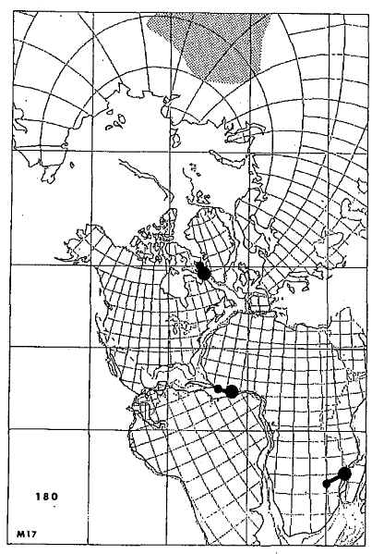
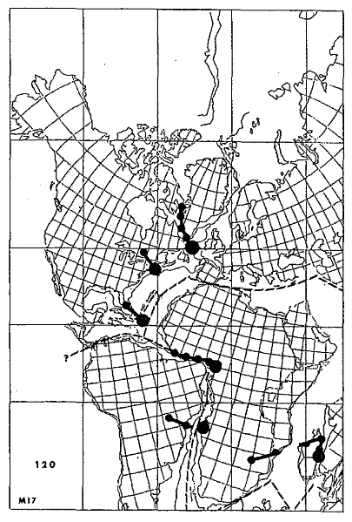
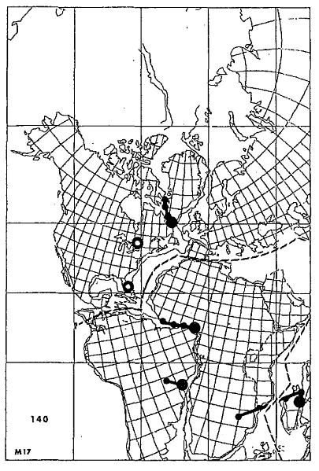
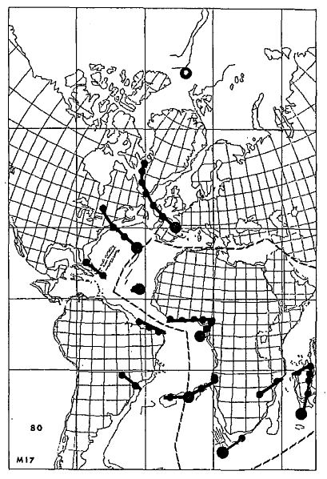
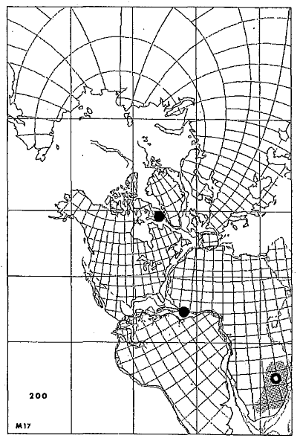
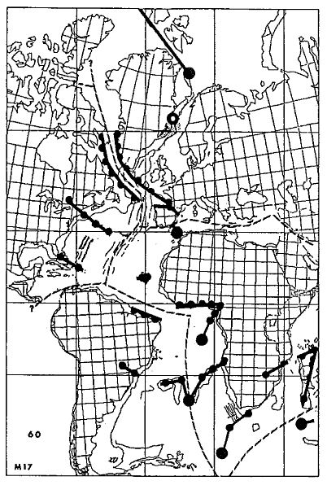
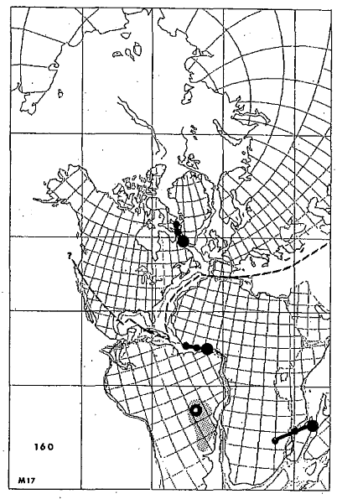
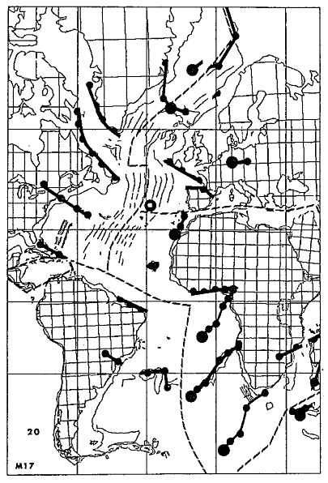
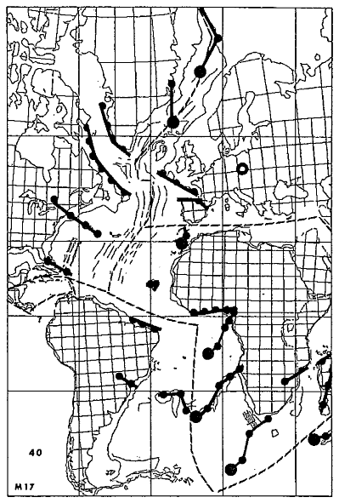
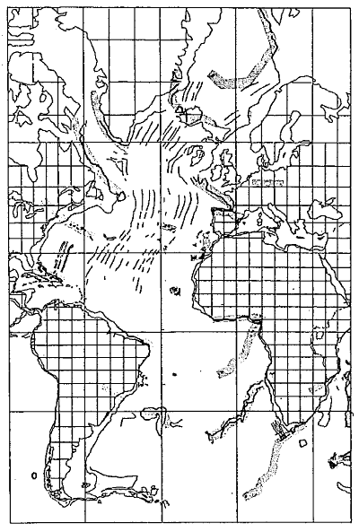
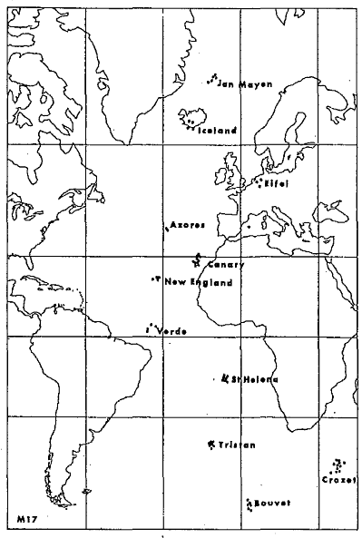
Jan Mayen
Iceland
Eifel
Azores
Canary
New England
Verde
St. Helena
Tristan
Crozet
200 Ma
Bouvet
180 Ma
160 Ma
140 Ma
120 Ma
100 Ma
80 Ma
60 Ma
40 Ma
20 Ma
0 Ma
Morgan (1981) In: Emiliani (Ed) The Sea, Vol. 7, 443-487 J. Wiley & Sons

Slide 2
No evidence of volcanism along this hypothetical track
Canary
St Helena
The Crozet hot-spot is considered the source of Karroo CFB (peaking @ 180 Ma)
Crozet
200 Ma
Morgan (1981) In: Emiliani (Ed) The Sea, Vol. 7, 443-487 J. Wiley & Sons

Slide 3
180 Ma
Morgan (1981) In: Emiliani (Ed) The Sea, Vol. 7, 443-487 J. Wiley & Sons

Slide 4
Igneous activity starts around 134 Ma
Tristan
160 Ma
Morgan (1981) In: Emiliani (Ed) The Sea, Vol. 7, 443-487 J. Wiley & Sons

Slide 5
The igneous activity in the Eifel area ranges from ~65 to ~0.01 Ma in the same area
New England
(Cape) Verde
140 Ma
Morgan (1981) In: Emiliani (Ed) The Sea, Vol. 7, 443-487 J. Wiley & Sons

Slide 6
120 Ma
Morgan (1981) In: Emiliani (Ed) The Sea, Vol. 7, 443-487 J. Wiley & Sons

Slide 7
Bouvet
100 Ma
Morgan (1981) In: Emiliani (Ed) The Sea, Vol. 7, 443-487 J. Wiley & Sons

Slide 8
The Siberian Traps (~200 Ma) are considered the first expression of the Jan Mayen hot-spot
Jan Mayen
80 Ma
Morgan (1981) In: Emiliani (Ed) The Sea, Vol. 7, 443-487 J. Wiley & Sons

Slide 9
Iceland
Afar
Quoted in the article, but not reported in the figures
60 Ma
Morgan (1981) In: Emiliani (Ed) The Sea, Vol. 7, 443-487 J. Wiley & Sons

Slide 10
Eifel
The igneous activity in the Eifel area ranges from ~65 to ~0.01 Ma in the same area
40 Ma
Morgan (1981) In: Emiliani (Ed) The Sea, Vol. 7, 443-487 J. Wiley & Sons

Slide 11
Azores are located along a major dextral strike-slip fault (Azores-Gibraltar Fracture Zone)
Azores
No existence of hot-spot track along the Cameroon Line
20 Ma
Morgan (1981) In: Emiliani (Ed) The Sea, Vol. 7, 443-487 J. Wiley & Sons

Slide 12
0 Ma
Morgan (1981) In: Emiliani (Ed) The Sea, Vol. 7, 443-487 J. Wiley & Sons

Slide 13
Jan Mayen
Iceland
Eifel
Azores
Canary
New England
Verde
St. Helena
Tristan
Crozet
Bouvet
Morgan (1981) In: Emiliani (Ed) The Sea, Vol. 7, 443-487 J. Wiley & Sons

