Slide 1
The North Atlantic: Exceptional, or the Rule?
Gillian R. Foulger
Durham University

Slide 2
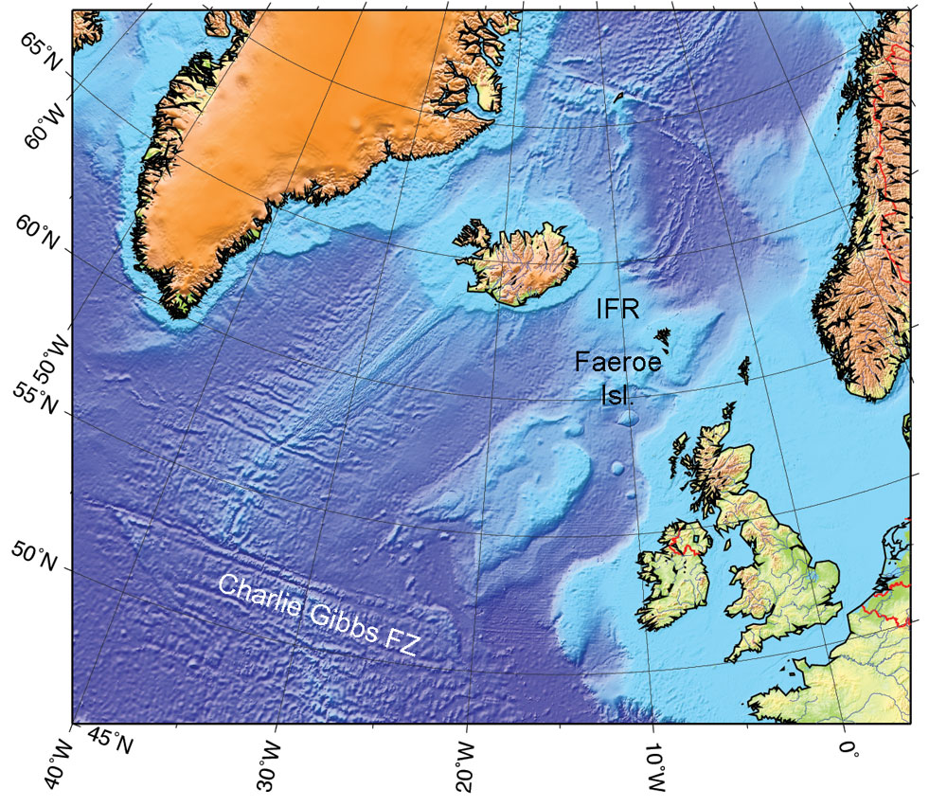

Slide 3
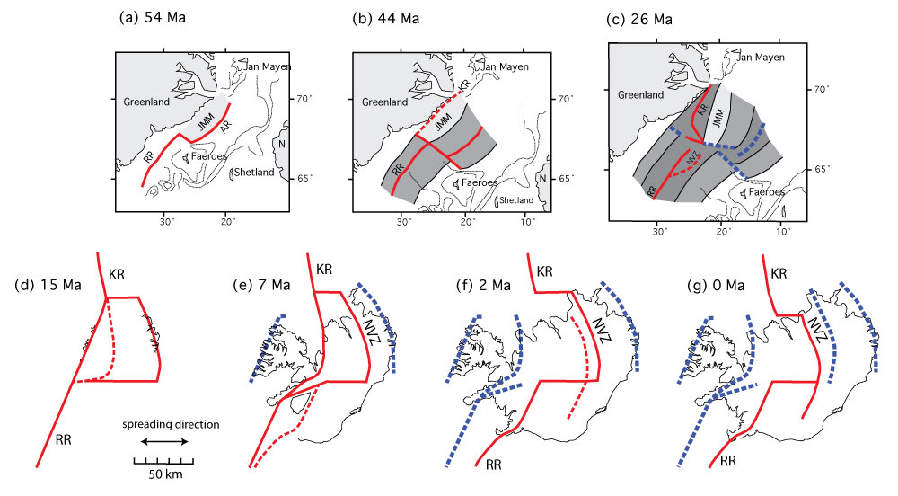
Foulger (2010)
Foulger (2010)

Slide 4
Foulger (2010)
Foulger (2010)

Slide 5
Foulger (2010)
Foulger (2010)

Slide 6
Foulger (2010)
Foulger (2010)

Slide 7
Foulger (2010)
Foulger (2010)

Slide 8
Foulger (2010)
Foulger (2010)

Slide 9
Foulger (2010)
Foulger (2010)

Slide 10
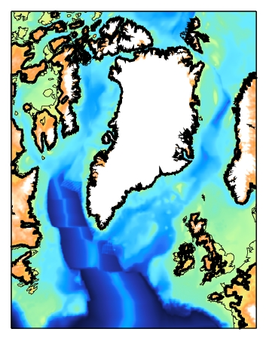
Foulger (2010)
DISKO
FAROES &
E GREENLAND
ODP
158
61 - 59 Ma
BRITISH
PROVINCE

Slide 11
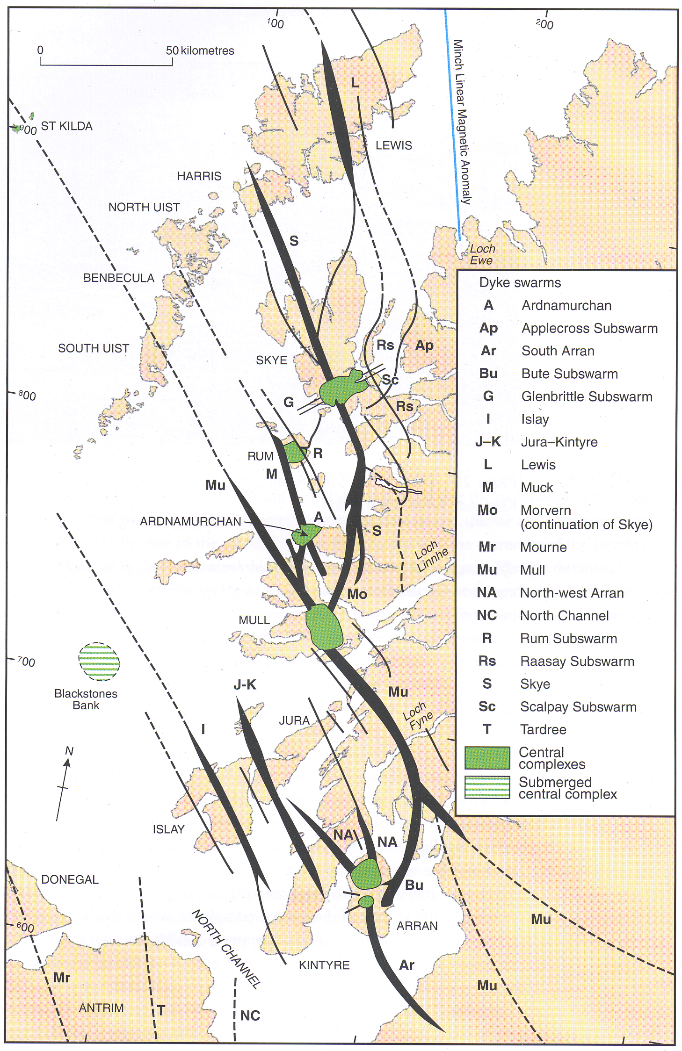
Foulger (2010)
DISKO
FAROES &
E GREENLAND
ODP
158
BRITISH
PROVINCE
~ 54 Ma

Slide 12
Question:
Are the volcanics related to a plume or lithospheric breakup?

Slide 13
Foulger (2010)
Foulger (2010)

Slide 14
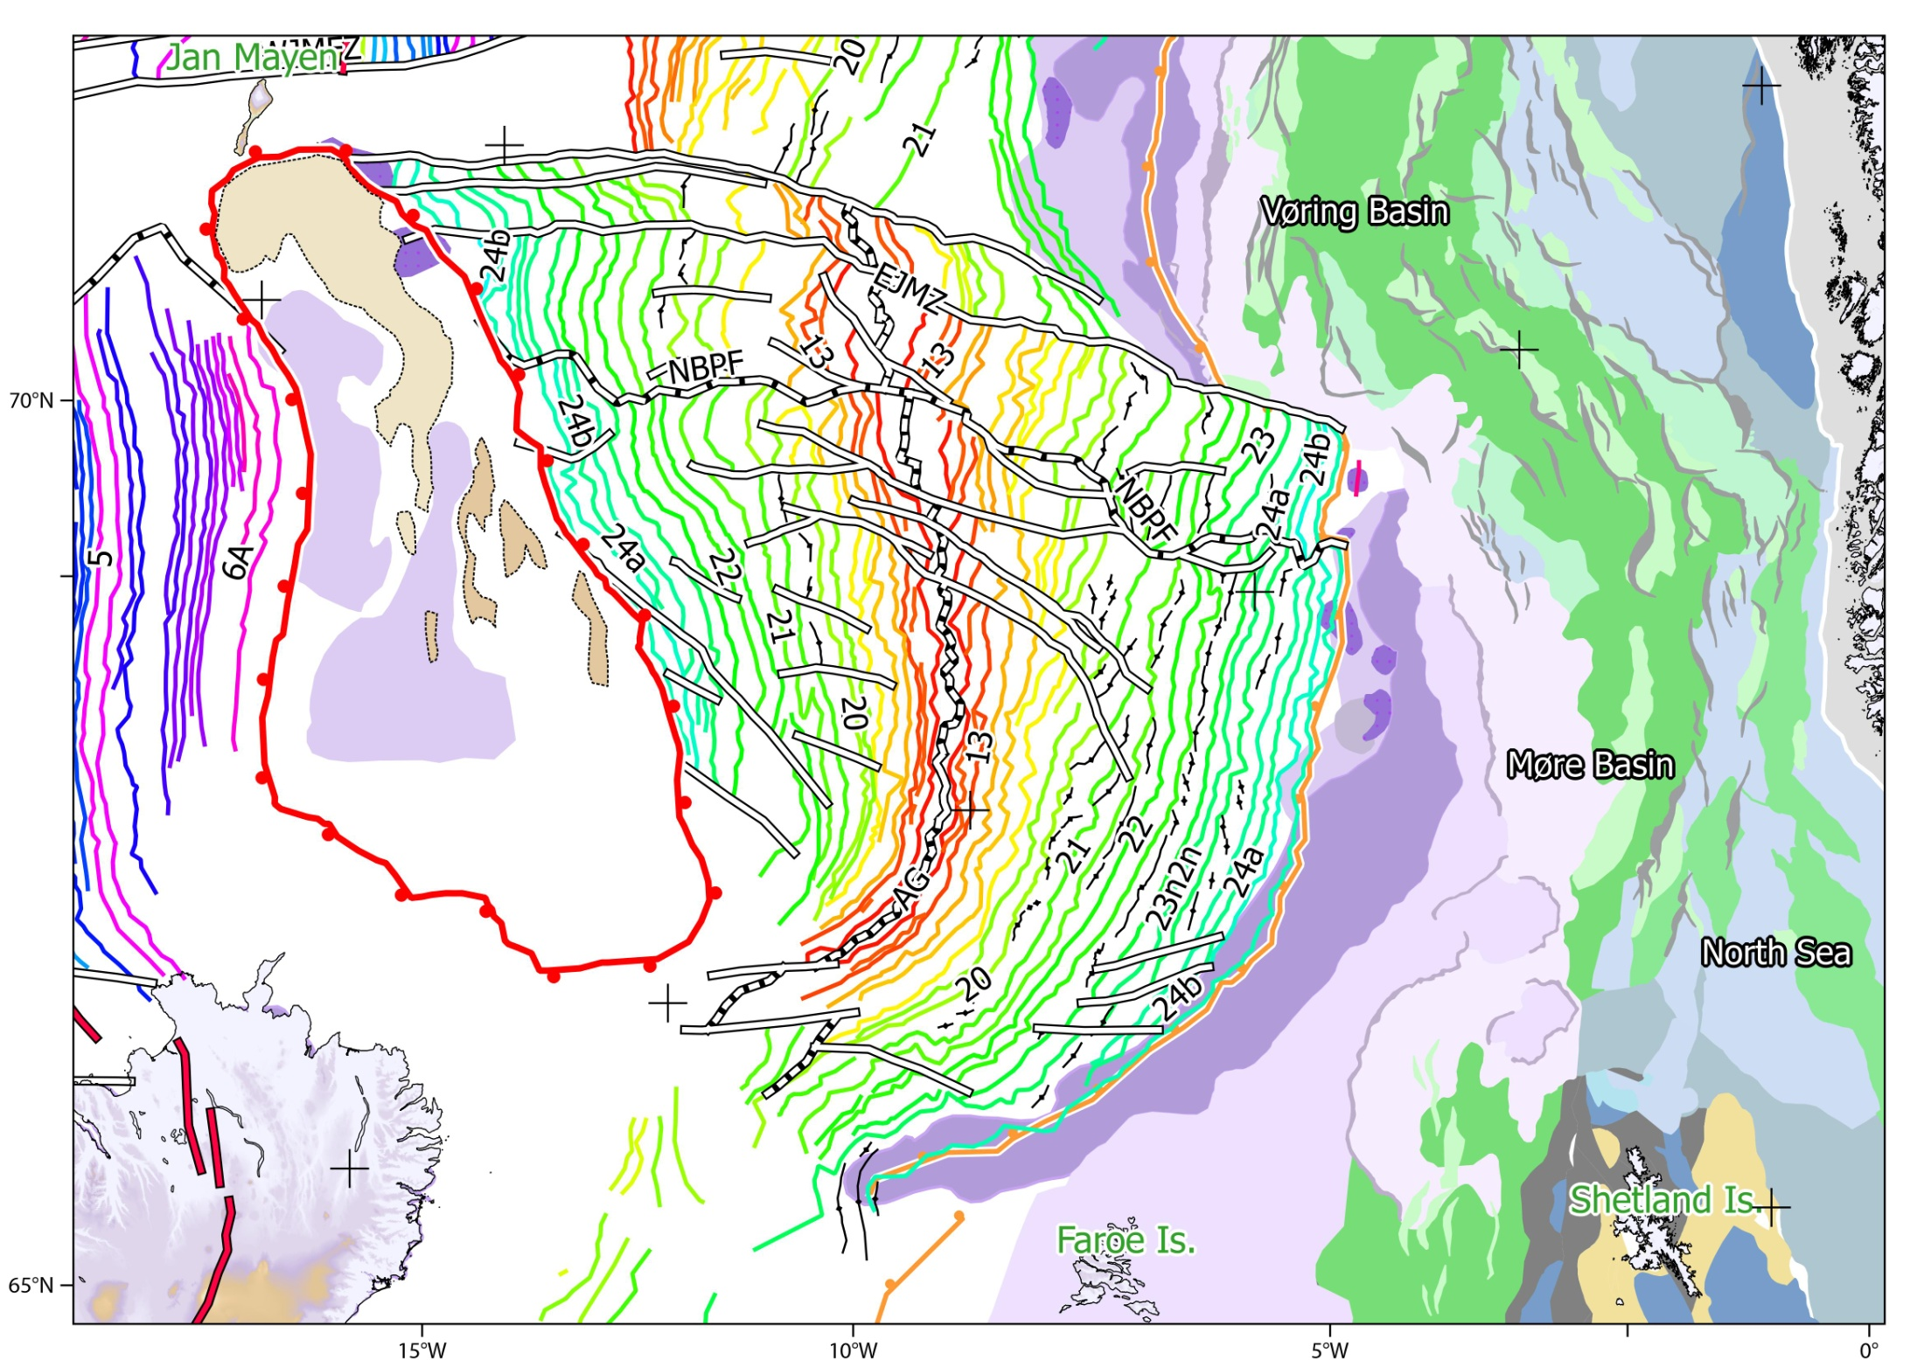
Foulger (2010)
Gernigon (2014)

Slide 15
Questions:
What is the south Jan Mayen Microcontient?
Foulger (2010)
Gernigon (2014)

Slide 16
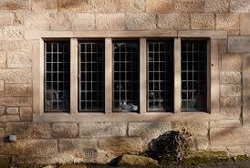
Questions:
What is the south Jan Mayen Microcontient?
Foulger (2010)
Mullions
Gernigon (2014)

Slide 17
Questions:
What is the south Jan Mayen Microcontient?
What is the western Iceland-Faroe Ridge?
Foulger (2010)
Gernigon (2014)

Slide 18
Questions:
What is the south Jan Mayen Microcontient?
What is the western Iceland-Faroe Ridge?
Does it extend beneath Iceland?
Foulger (2010)
Gernigon (2014)

Slide 19
Foulger (2010)
Foulger (2010)

Slide 20
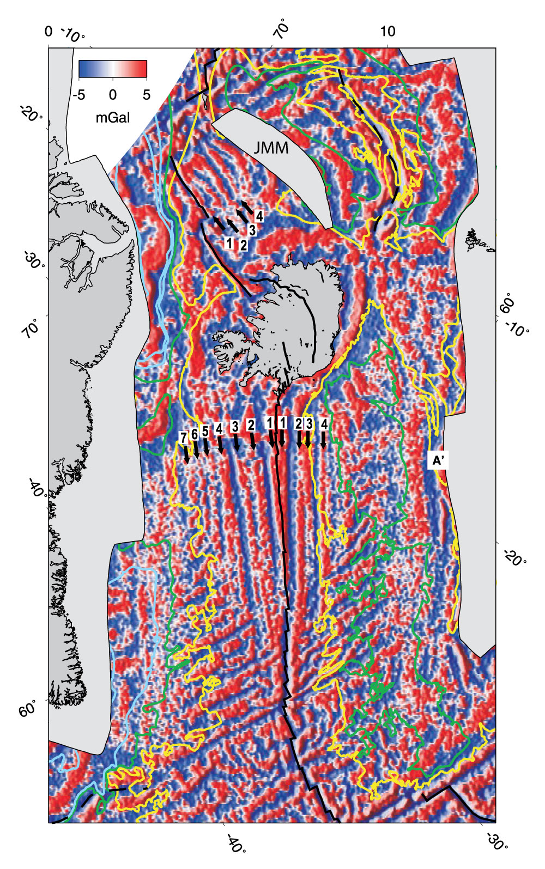
Foulger (2010)
Jones et al. (2002)

Slide 21
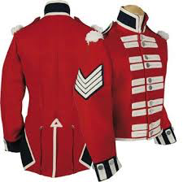
The chevron ridges
Foulger (2010)
Jones et al. (2002)
Foulger (2010)

Slide 22
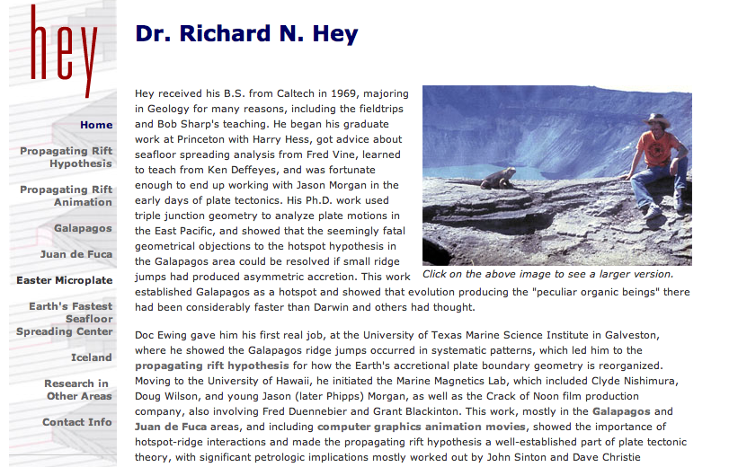

Slide 23
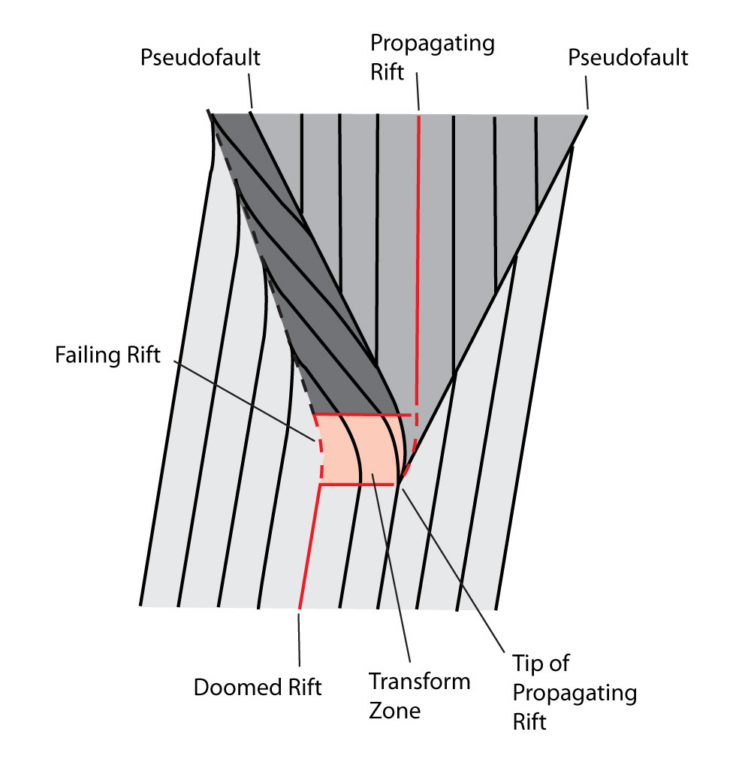
Propagating ridges

Slide 24
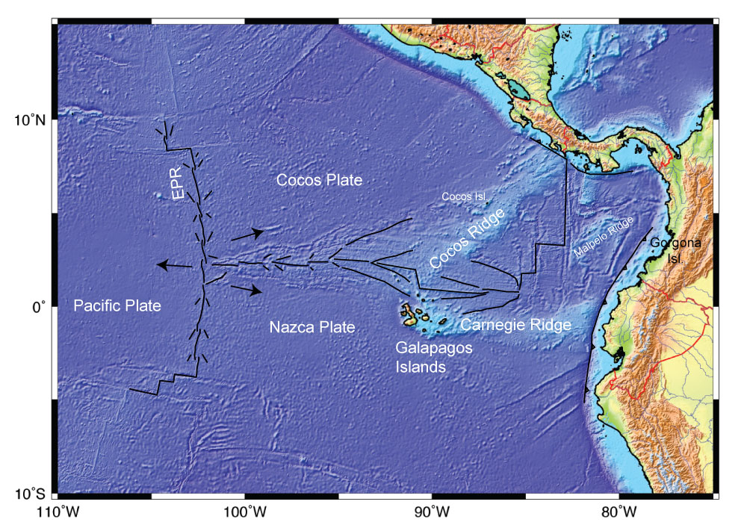
The Galapagos

Slide 25
http://www.soest.hawaii.edu/HIGP/Faculty/hey/movie.html

Slide 26
2007: Reykjanes Ridge research cruise
led by Martinez, Höskuldsson & Hey

Slide 27
The chevron ridges
Foulger (2010)
Jones et al. (2002)

Slide 28
The chevron ridges
Foulger (2010)
Jones et al. (2002)

Slide 29
The chevron ridges
Foulger (2010)
http://www.mantleplumes.org/Disclosure.html
Jones et al. (2002)
Foulger (2010)

Slide 30
The chevron ridges
Questions:
Thicker or thinner crust at tips?
Foulger (2010)
http://www.mantleplumes.org/Disclosure.html
Jones et al. (2002)
Foulger (2010)

Slide 31
The chevron ridges
Questions:
Thicker or thinner crust at tips?
Why?
Foulger (2010)
http://www.mantleplumes.org/Disclosure.html
Jones et al. (2002)
Foulger (2010)

Slide 32
The chevron ridges
Questions:
Thicker or thinner crust at tips?
Why?
Link to larger-scale rift propagation?
Foulger (2010)
http://www.mantleplumes.org/Disclosure.html
Jones et al. (2002)
Foulger (2010)

Slide 33
The chevron ridges
Questions:
Thicker or thinner crust at tips?
Why?
Link to larger-scale rift propagation?
Does it happen elsewhere?
Foulger (2010)
http://www.mantleplumes.org/Disclosure.html
Jones et al. (2002)
Foulger (2010)

Slide 34
The Galapagos

Slide 35
Lets go to Iceland

Slide 36
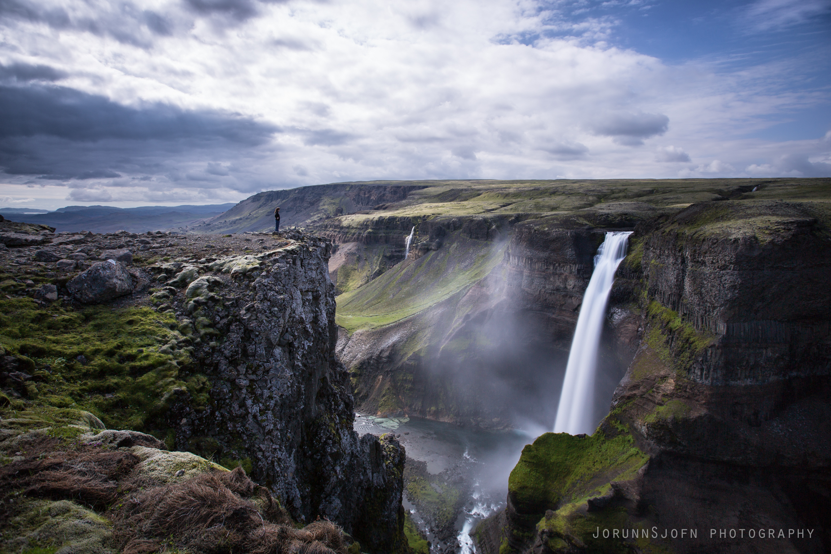

Slide 37
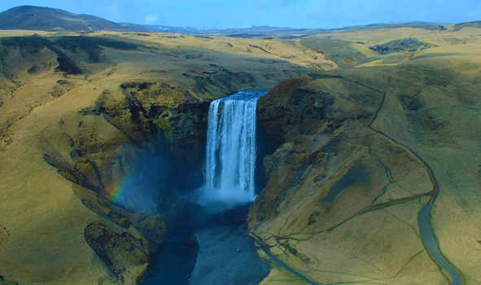

Slide 38
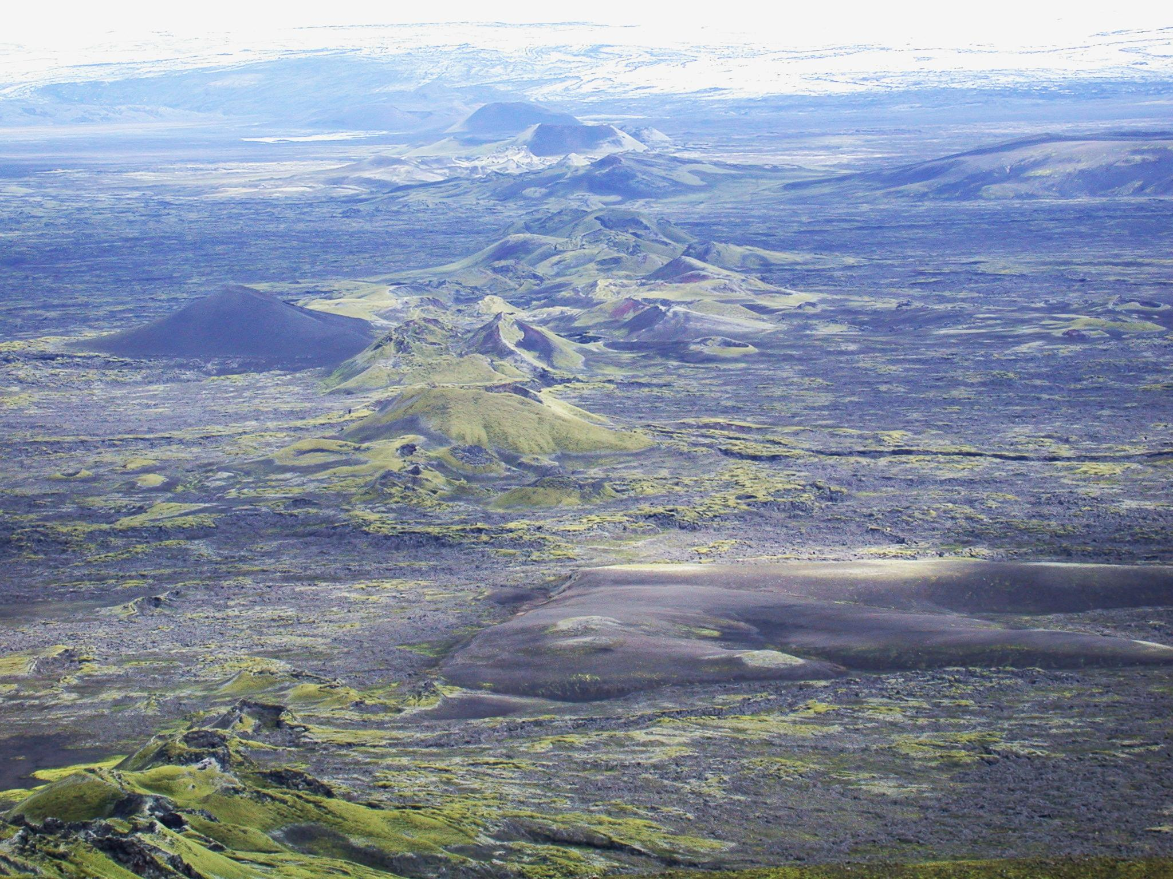
Laki 1783-1784
Notes:
Exceptionally well documented: MMS weather logs, scientific publications, official government reports – news paper articles as
well as personal diaries. Sources can be compared and their reliability is easily assessed.
Eruption history
Sulfur release and atmospheric loading
Transport of plumes and dispersal of aerosols
Impact on climate (Environmental impact on poster)
Sulfur release by other Icelandic flood lava eruptions

Slide 39
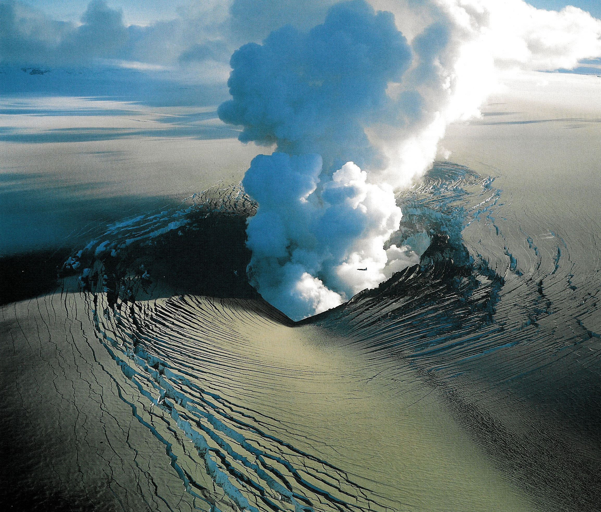
Grimsvötn eruption, 1996
Gjalp 1996

Slide 41
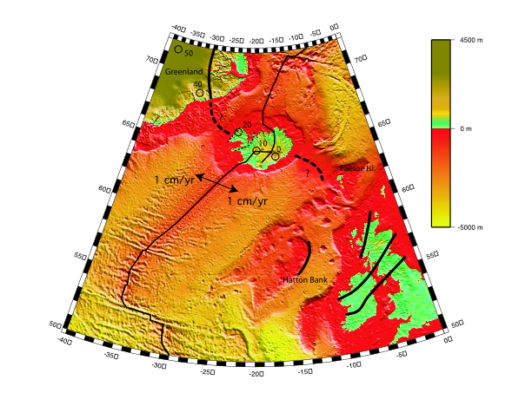

Slide 42
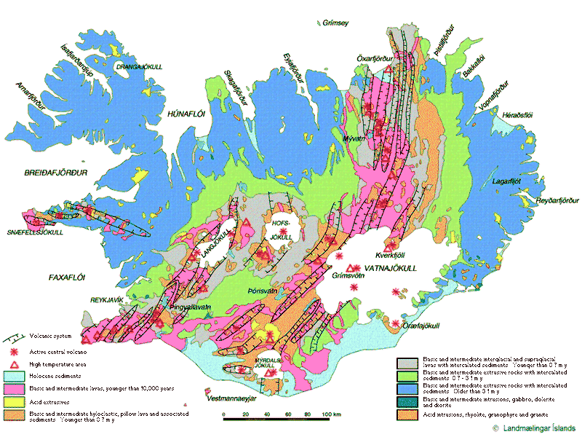

Slide 43
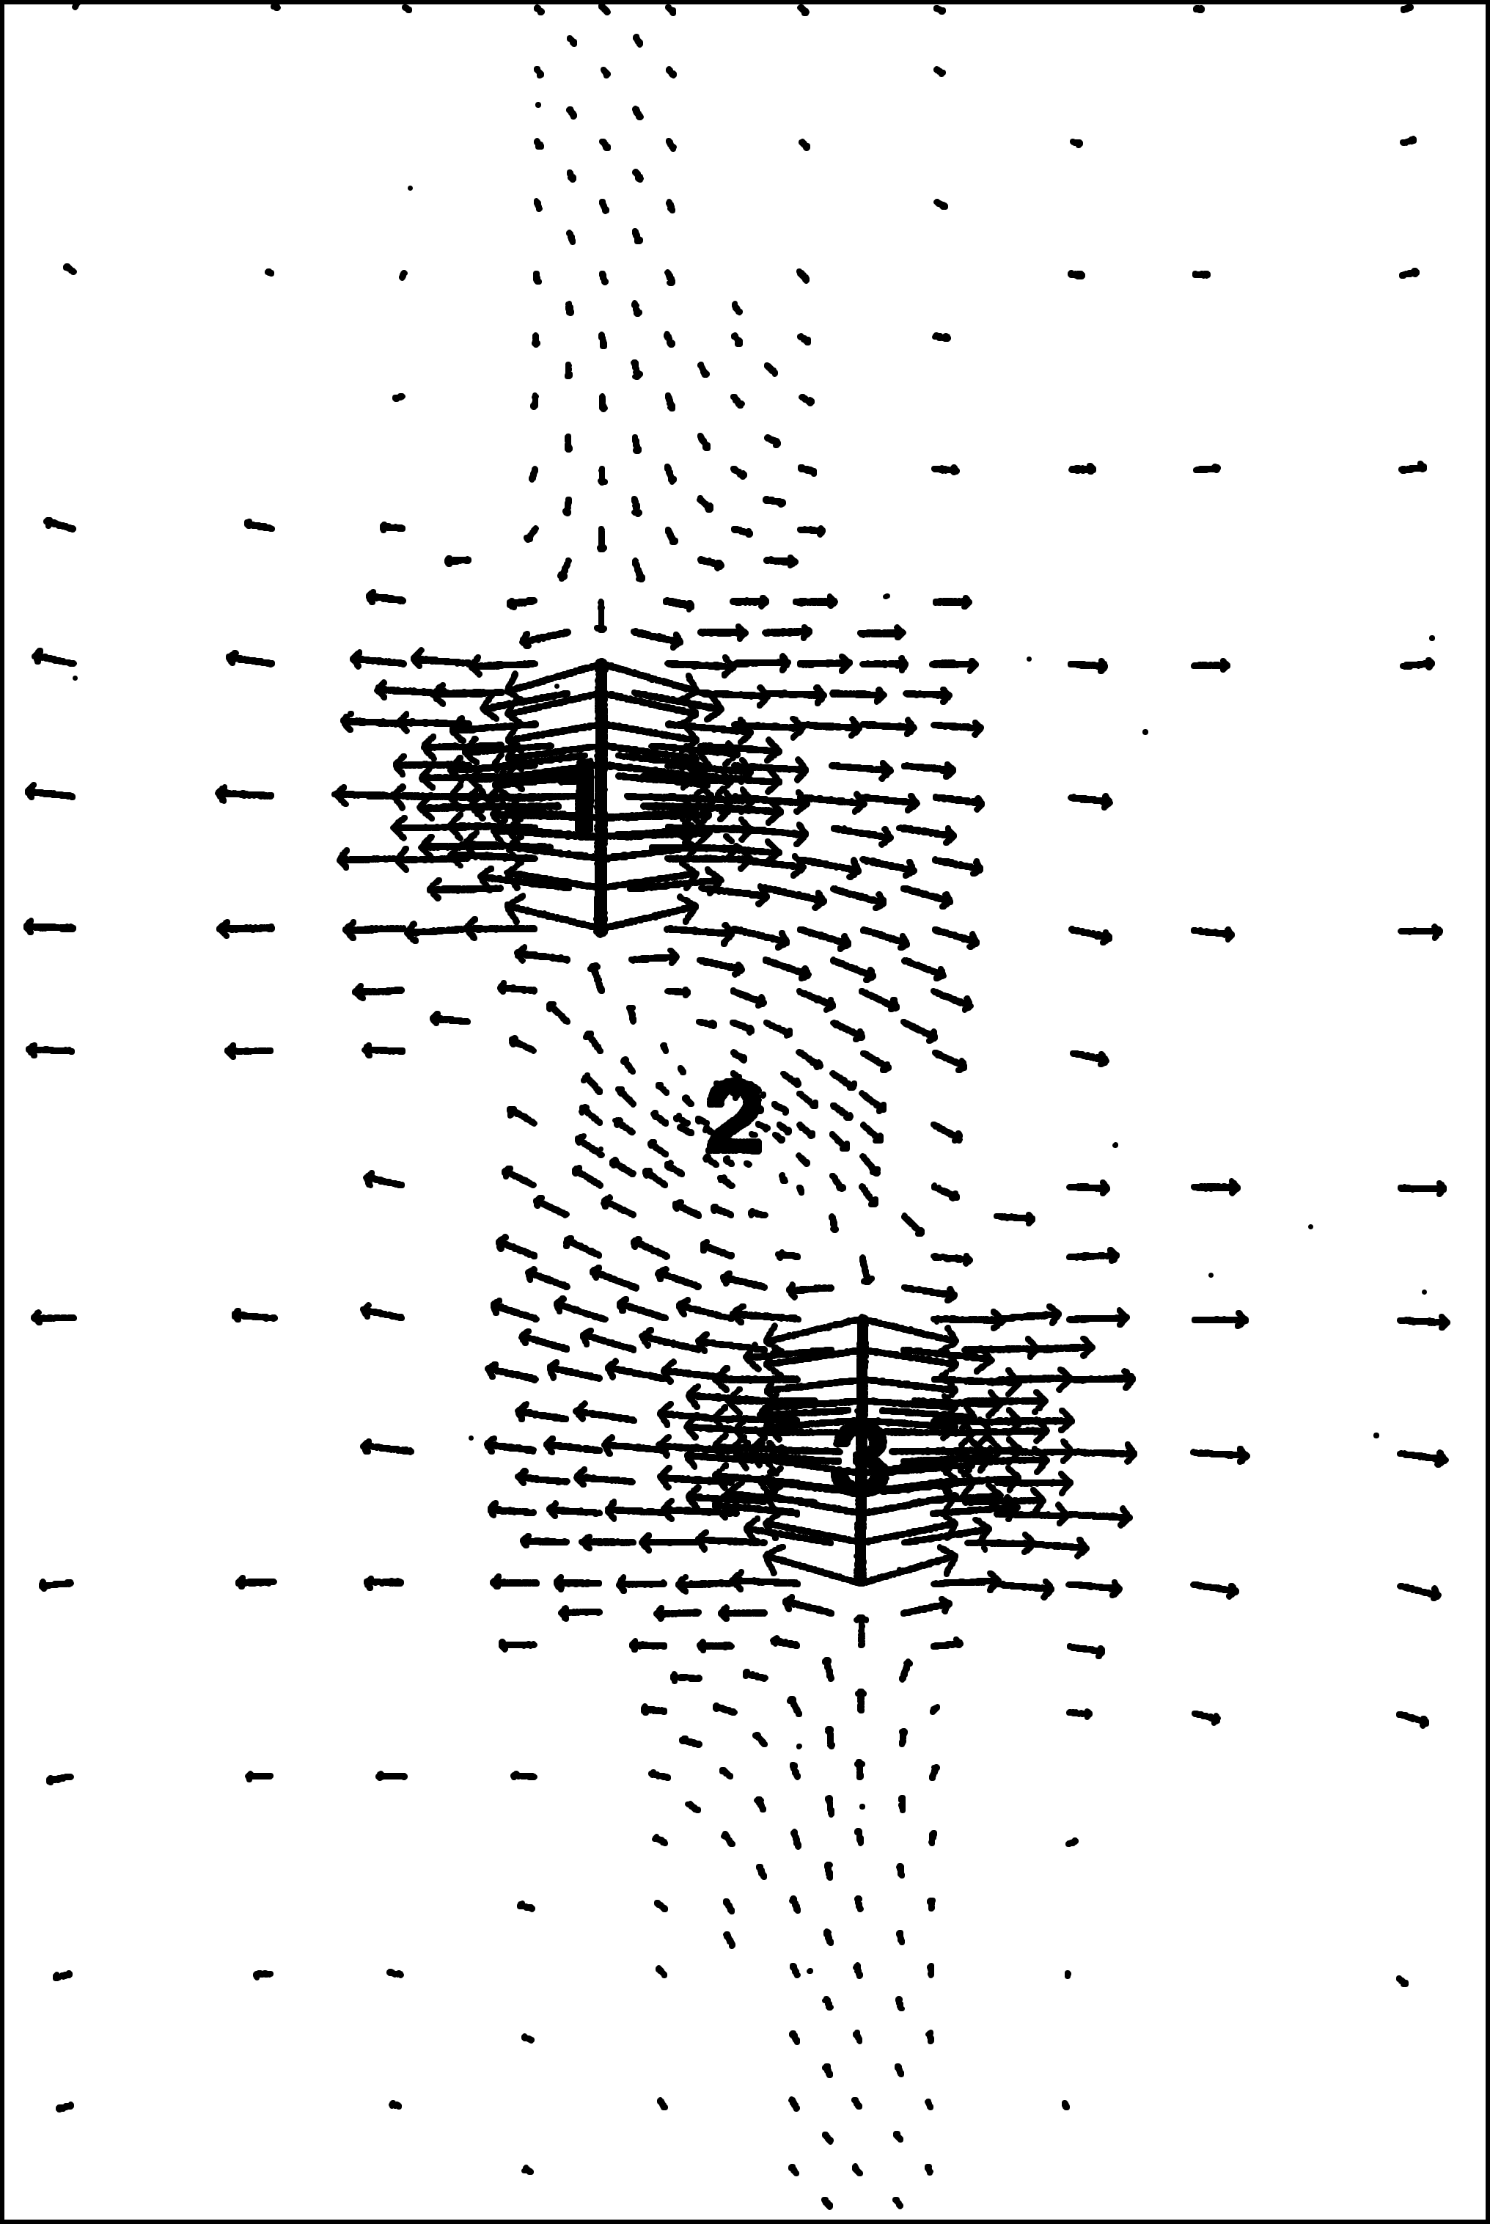
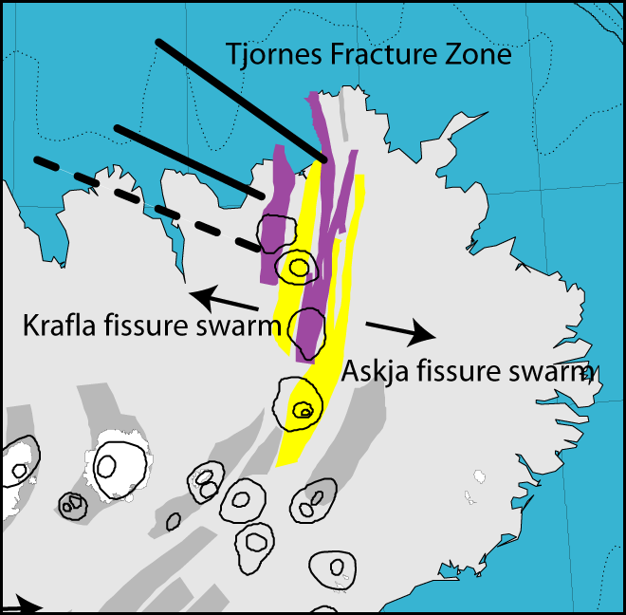

Slide 44
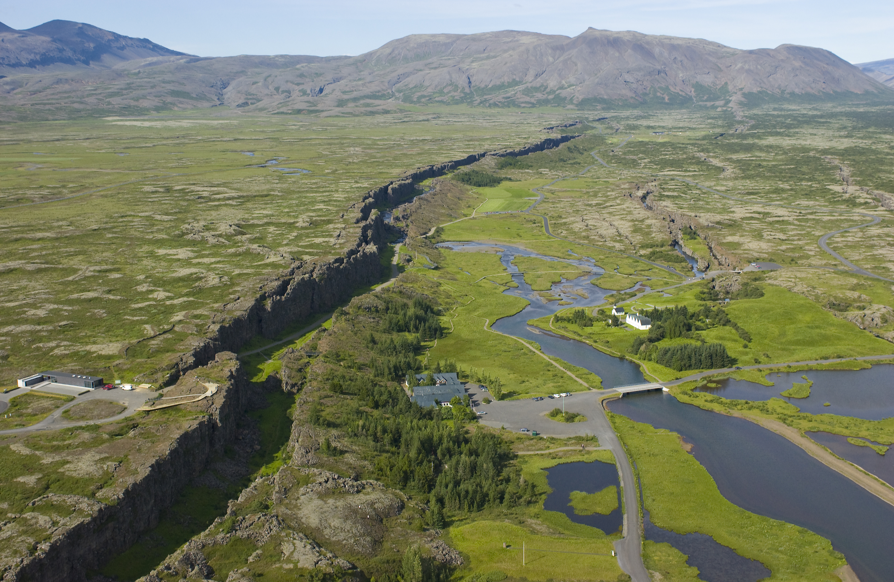

Slide 45
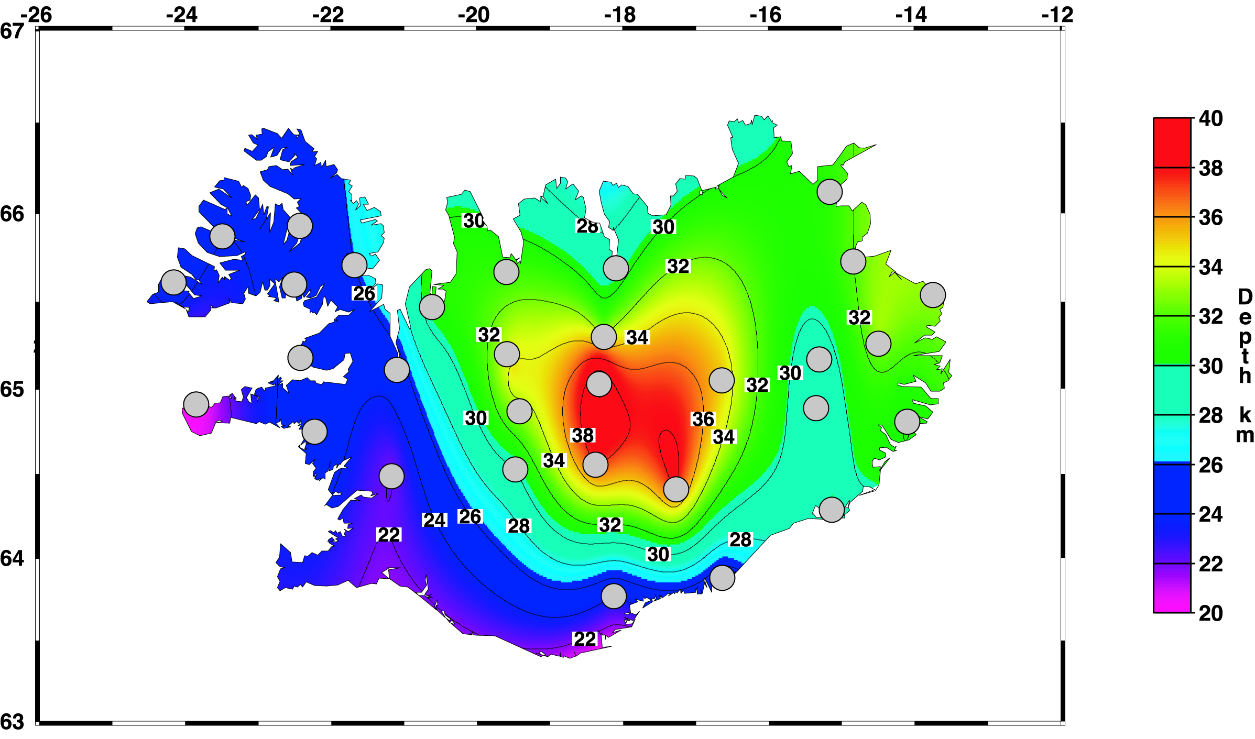
Foulger et al. (2003)

Slide 46
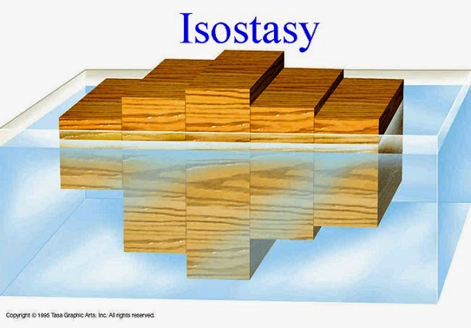

Slide 47
4 km

Slide 48
4 km
1 km

Slide 49
Question:
What is the lower Icelandic crust made of?
?

Slide 50
Holmes (1929)

Slide 51

End
Dedicated to
Evelyn Lárusdóttir Yates Foulger

